Slide 1
Analysis of Social and Information Networks
Chapter 20 – The Small World Phenomenon

Slide 2
Social Distance with Reddit Links
Reddit links can be compared by the number of commentators they have in common:
  The more users two links have in common, the “closer” they are to each other in terms of content or relevancy
Distance defined:
  The number of shared unique comment authors between links

Slide 3
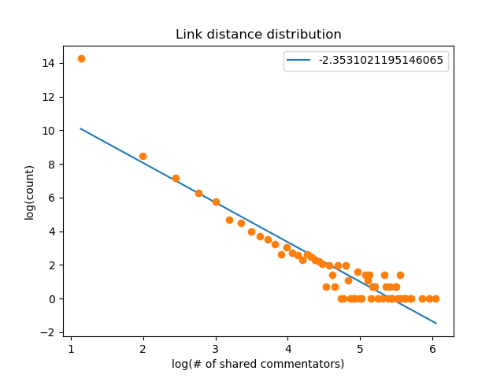
Distance Distribution
Log-log plot of histogram of distance and counts
  Does not have p close to -1
  Not efficient
But:
  Artificial measurement of distance
  Does not represent social interaction between people

