Slide 1
Analysis of Social and Information Networks
Chapter 1 and 2 – Overview and Graphs

Slide 2
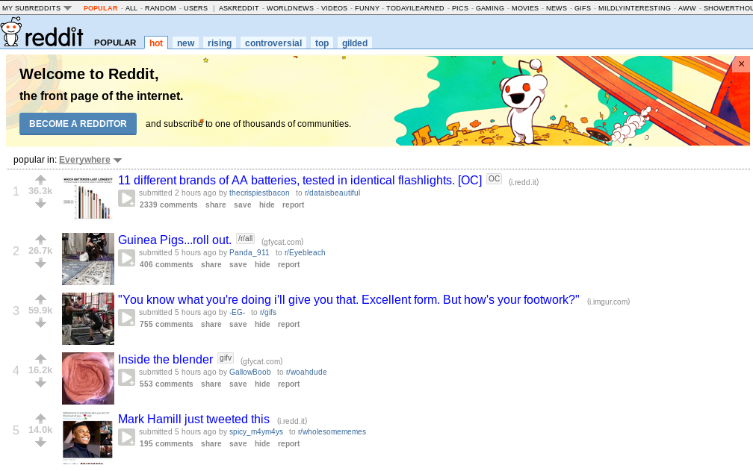
Reddit.com: the frontpage of the Internet

Slide 3
Reddit.com: the frontpage of the Internet
Reddit is a website where users can share links to images, blogs, videos, GIFs, etc. and comment on these links
Every signed user can vote on content:
  The more upvotes a link/comment has, the higher up it is displayed
  Downvoted content is pushed further down on the webpage
A user-moderated hub for news, hobbies, communities, questions,…
https://www.youtube.com/watch?v=tlI022aUWQQ

Slide 4

Subreddits
Subreddits are a smaller community contained in the reddit website
Usually oriented towards one specific topic of interest
  r/asoiaf
  r/TodayILearned
  r/gaming
  r/DungeonsAndDragons
  r/DataIsBeautiful
  r/Gephi

Slide 5
The Reddit Comment Database
Complete dataset of reddit comments, divided by month, since October 2007
  Author name
  Body of comment
  Score
  Thread
  Subreddit
  Timestamp
  ...

Slide 6
The Subreddit Graph
Nodes represent a subreddit, with attributes:
  Number of comments
  Number of unique comment authors
Edges connect subreddits:
  Undirected connection
  Edge weight corresponds to the number of shared authors between the communities
Comment processing was done with Python
Graph analysis was done with Gephi

Slide 7
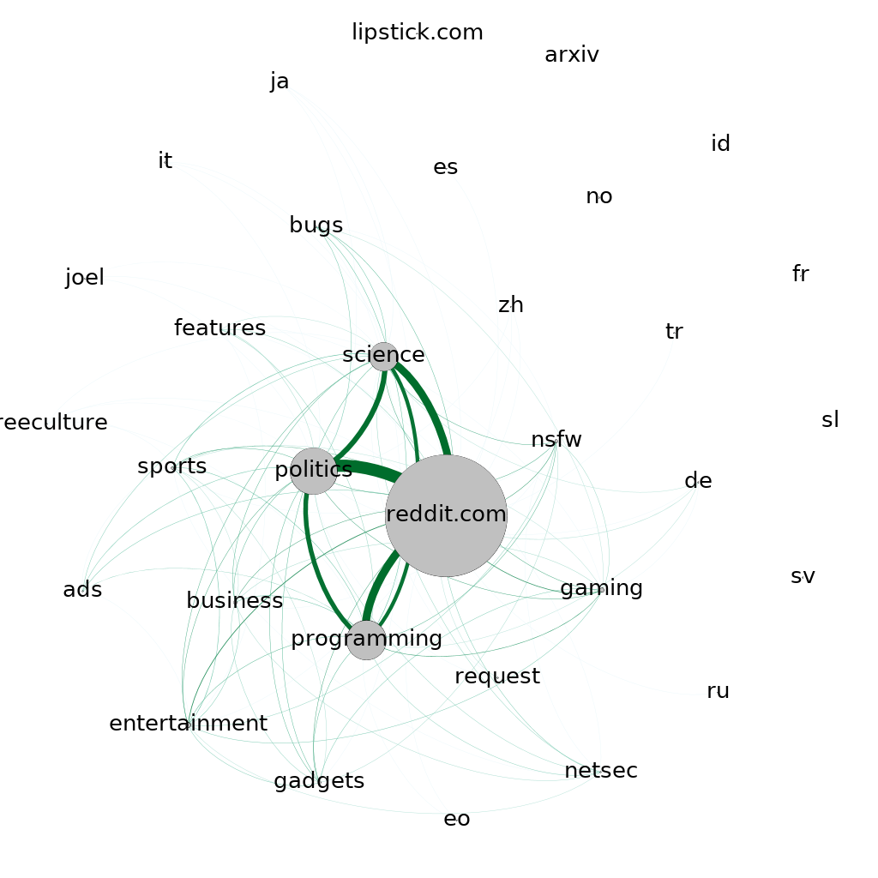
Subreddit Graph for October 2007
32 subreddits
104 connections
The main page of reddit was a separate subreddit back then. Today it’s a collection of links from all subreddits.

Slide 8
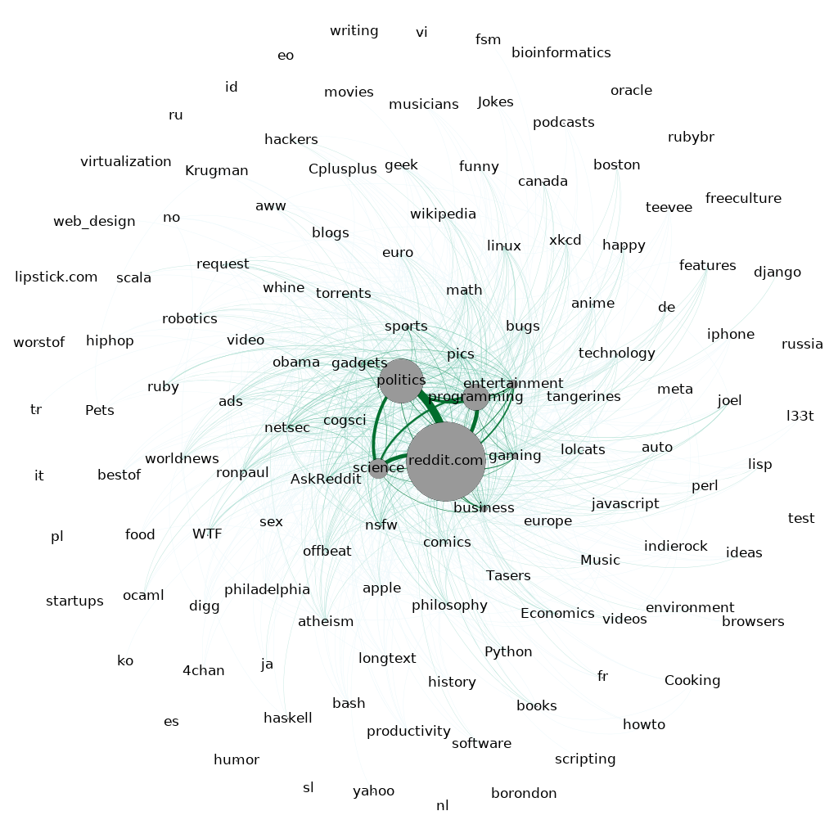
Subreddit Graph for January 2008
126 subreddits
856 connections
Boom of subreddits, but still 4 central:
  Reddit.com
  Politics
  Science
  Programming

Slide 9
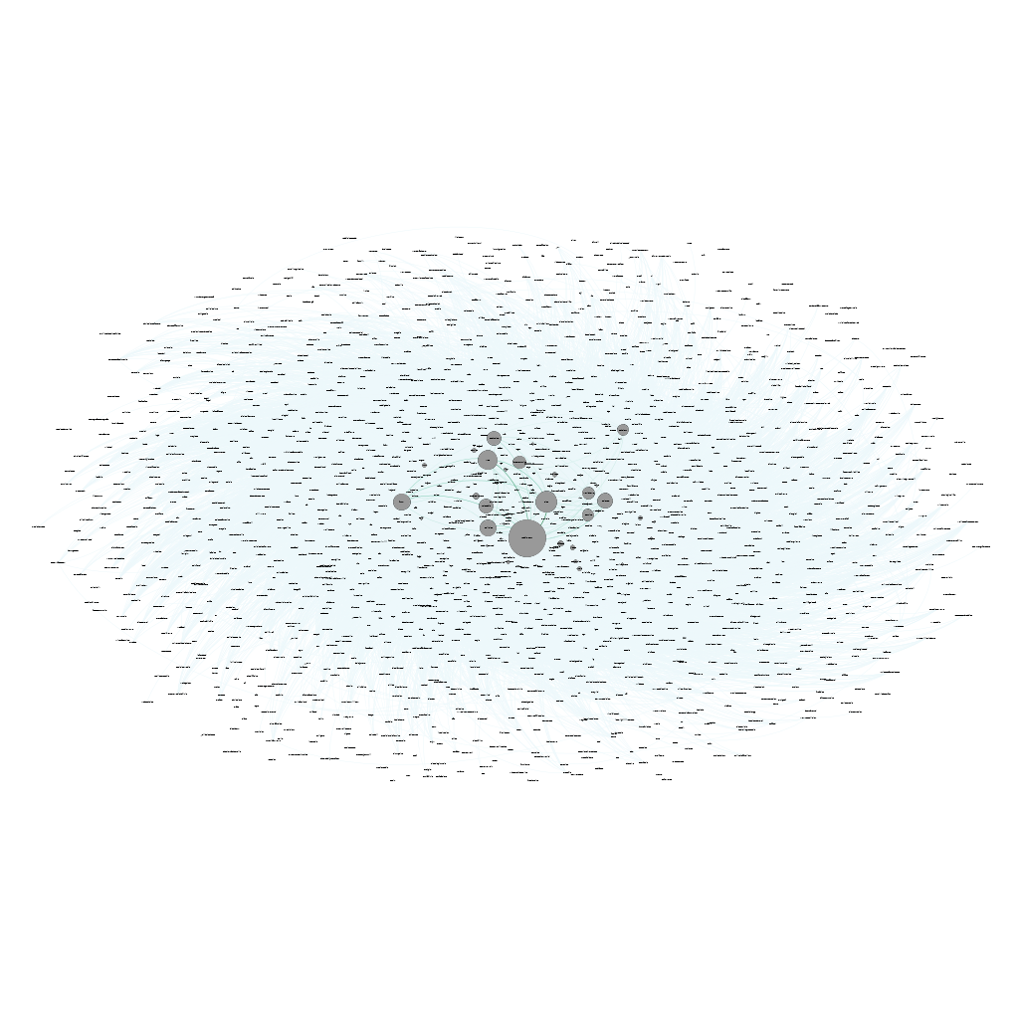
Subreddit Graph for July 2009
1686 subreddits
60733 connections
A dozen subreddits start to gain more popularity

Slide 10
Analysis of Social and Information Networks
Chapter 3 – Strong and Weak Ties

Slide 11
Clustering Coefficient Over Time
Users tend to gravitate towards the bigger subs
  Lots of shared users between all subreddits
  Isolated subreddits are usually very small
  High number of connections between nodes
  High Clustering Coefficient
  ≈ 85%

Slide 12
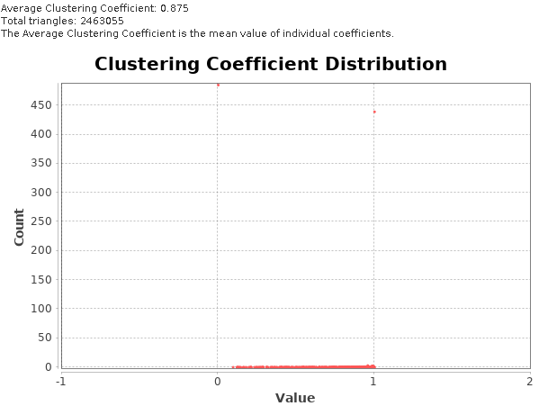
Clustering Coefficient Over Time

Slide 13
Clustering Coefficient Over Time
Small increase overall of the Clustering Coeff.
  All subs tend to be connected, considering it just takes one shared author to establish a connection
  Low number of local and global bridges
  Increase in coeff. can be due to growing subs with more diverse commentators: higher participation in a large number of subs will increase the number of connections between all
Triadic closure usually exists:
  If 3 subs share one author, all of them will be connected
More interesting to analyze the evolution of shared authors between specific subs
  “Diadic Reinforcement”: subs that are connected will tend to increase the weights between them

Slide 14
Diadic Reinforcement Between Subs
Connected subs become increasingly more connected

Slide 15
Diadic Reinforcement Between Subs
It’s hard to say if there is a real effect of Triadic Closure happening
  A connection to another sub probably doesn’t affect its users to actively engage in the other, unlike with friend networks
  Since these are the 4 most popular subs at the time, it’s more likely that more users visit and interact with them, since they are growing in popularity
The increasing popularity of the site brings new users to all the subs, increasing their connections

Slide 16
Analysis of Social and Information Networks
Chapter 4 - Networks in Their Surrounding Contexts

Slide 17
Homophily and Reddit
Reddit.com presents itself as a main hub for a plethora of topics, interests and information
The comment authors are anonymous: no information is known about them other than their username
However, the concept of a subreddit puts in homophily in motion:
  The creation of specific communities for specific topics will bring together users who share interest in these topics
  Subreddits create more uniform user distributions in them
  Still very diverse: the Internet is a very large place, with users from everywhere and with every possible interest

Slide 18
Selection and Social Influence
Subreddits are a perfect example of user Selection
  A user can select which subreddits it wants to visit and subscribe to, thus creating a personalized social environment surrounded by users with similar tastes and interests
But Social Influence also plays a big roll on Reddit
  Reddit Hive Mind Thinking: overall, users tend to like and hate the same things
  Scoring system only benefits popular opinions, which in turn get more popular; provides direct feedback of the popularity of a personal opinion
  “Circlejerking”: A group discussion or activity between like-minded individuals that validates mutual biases or goals in a non-confrontational environment.

Slide 19
Affiliation in Subreddits
We can consider a graph of comment authors affiliated with the subreddits they post on
kn0thing
r/Drawing
GallowBoob
Unidan
r/ciclejerk
Spez
r/BirdsWithArms
AWildSketchAppears

Slide 20
Closures in the Subreddit Context
Triadic Closure:
  Unlikely to happen, since user interaction tends to be random, with no specific bias for selected authors
Focal Closure
  If two users are affiliated with a specific subreddit then the probability of interaction between then increases.
  This considering said interaction is intra-sub; inter-sub there is most likely no influence
Memebership Closure:
  Unlikely, a interaction with a certain user will not create a tendency for it to visit an affiliated subreddit
  Unless said interaction is in a affiliated sub, in that case the closure is automatic

Slide 21
Analysis of Social and Information Networks
Chapter 5 – Positive and Negative Relations

Slide 22
Relations in Reddit
Users can mainly interact in two ways:
  Comment on a link
  Respond to a user comment on a link
Reddit’s scoring system provides insight to a comment/link content:
  Upvoted comments/posts tend to present common and accepted opinions by the community
  Downvoted comments/posts pose unpopular opinions or irrelevant content for the discussion (e.g. spam)

Slide 23
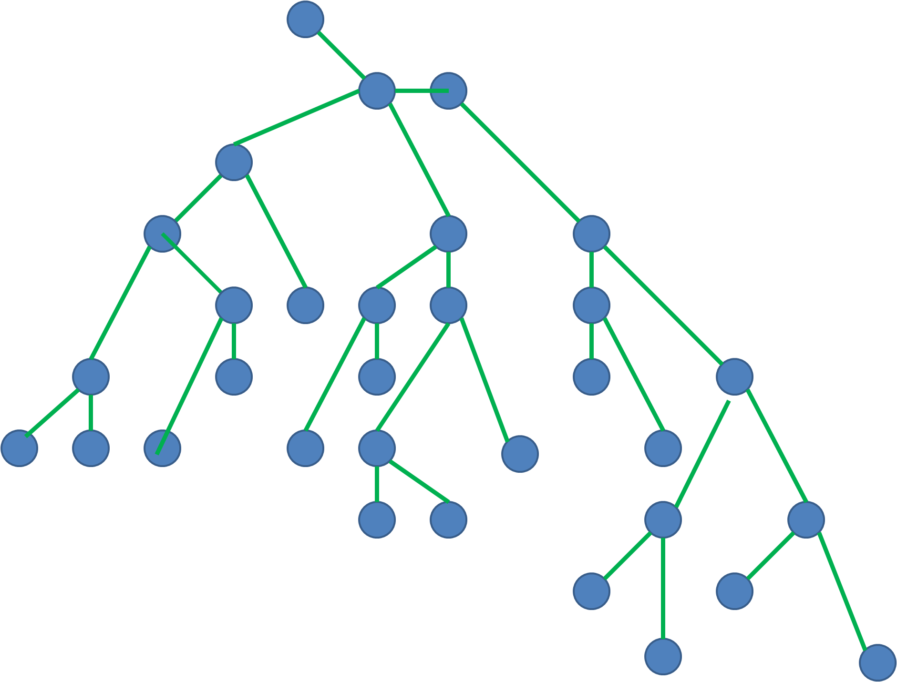
Graphs of Comments
Consider that a comment is a response to a post or another comment
  Creates graph trees of responses
  One comment can only respond to another comment, but one comment can originate several responses
  No Triangles
Post

Slide 24
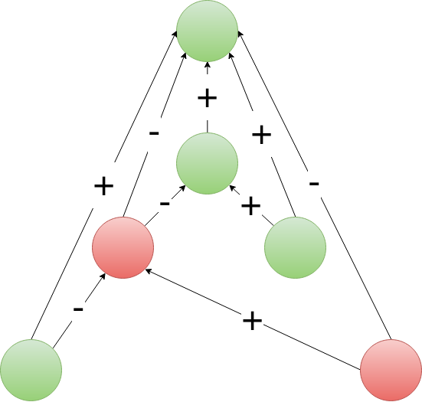
Graphs of Comments: Another Approach
Consider each comment is a response to the post AND another comment
  Generates 1 triangle per response
  Green: upvoted
  Red: downvoted
  Agreeing opinions: +
  Disagreeing opinions: -
  Balanced
Post

Slide 25
Graphs of Comments: Assumptions and Challenges
Assumptions:
  The score of a comment/link is a measure of how agreeable is its content.
  If a response has the same score as its parent, they are of the same opinion
  If a response has a symmetric score as its parent, they are in disagreement
Interesting to prove these assumptions:
  Text mining to determine sentiment and level of agreement of a comment/post
  Determine if a post/subreddit has balanced comments
  Determine opposing communities on a subreddit (e.g. r/politics before a major election)
Post

Slide 26
Analysis of Social and Information Networks
Chapter 18 - Power Laws And Rich-Get-Richer Phenomena

Slide 27
Popularity on Reddit
Number of upvotes determines popularity of content
Rich-get-richer phenomena:
  Upvoted content is shown first to any user, causing it to become more upvoted and popular
Popularity and power laws:
  Several distributions will present a power law model for popularity:
    Comments and upvotes
    Links and upvotes
    Links and number of comments

Slide 28
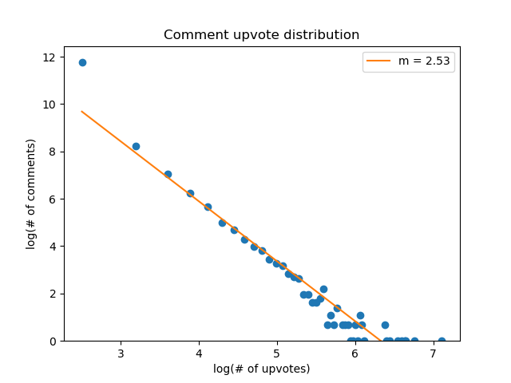
Comments and number of upvotes
Distribution of comments and respective upvotes,
calculated using a 100-bin histogram

Slide 29
Analysis of Social and Information Networks
Chapter 19 – Cascading Behavior in Networks

Slide 30
Diffusion of Opinion on Reddit
Reddit has very homophilic communities
  Subreddits are created for one topic/purpose = Isolated Clusters
  Controversial/unpopular opinions are usually downvoted: less impact on the community
Adoption/Change of opinion is very unlikely on a large subreddit
  Subreddits tend to share the same general opinion: Reddit Hive Mind, Circlejerking
  If a group of users does not feel represented in a subreddit, they create their own for that topic

Slide 31
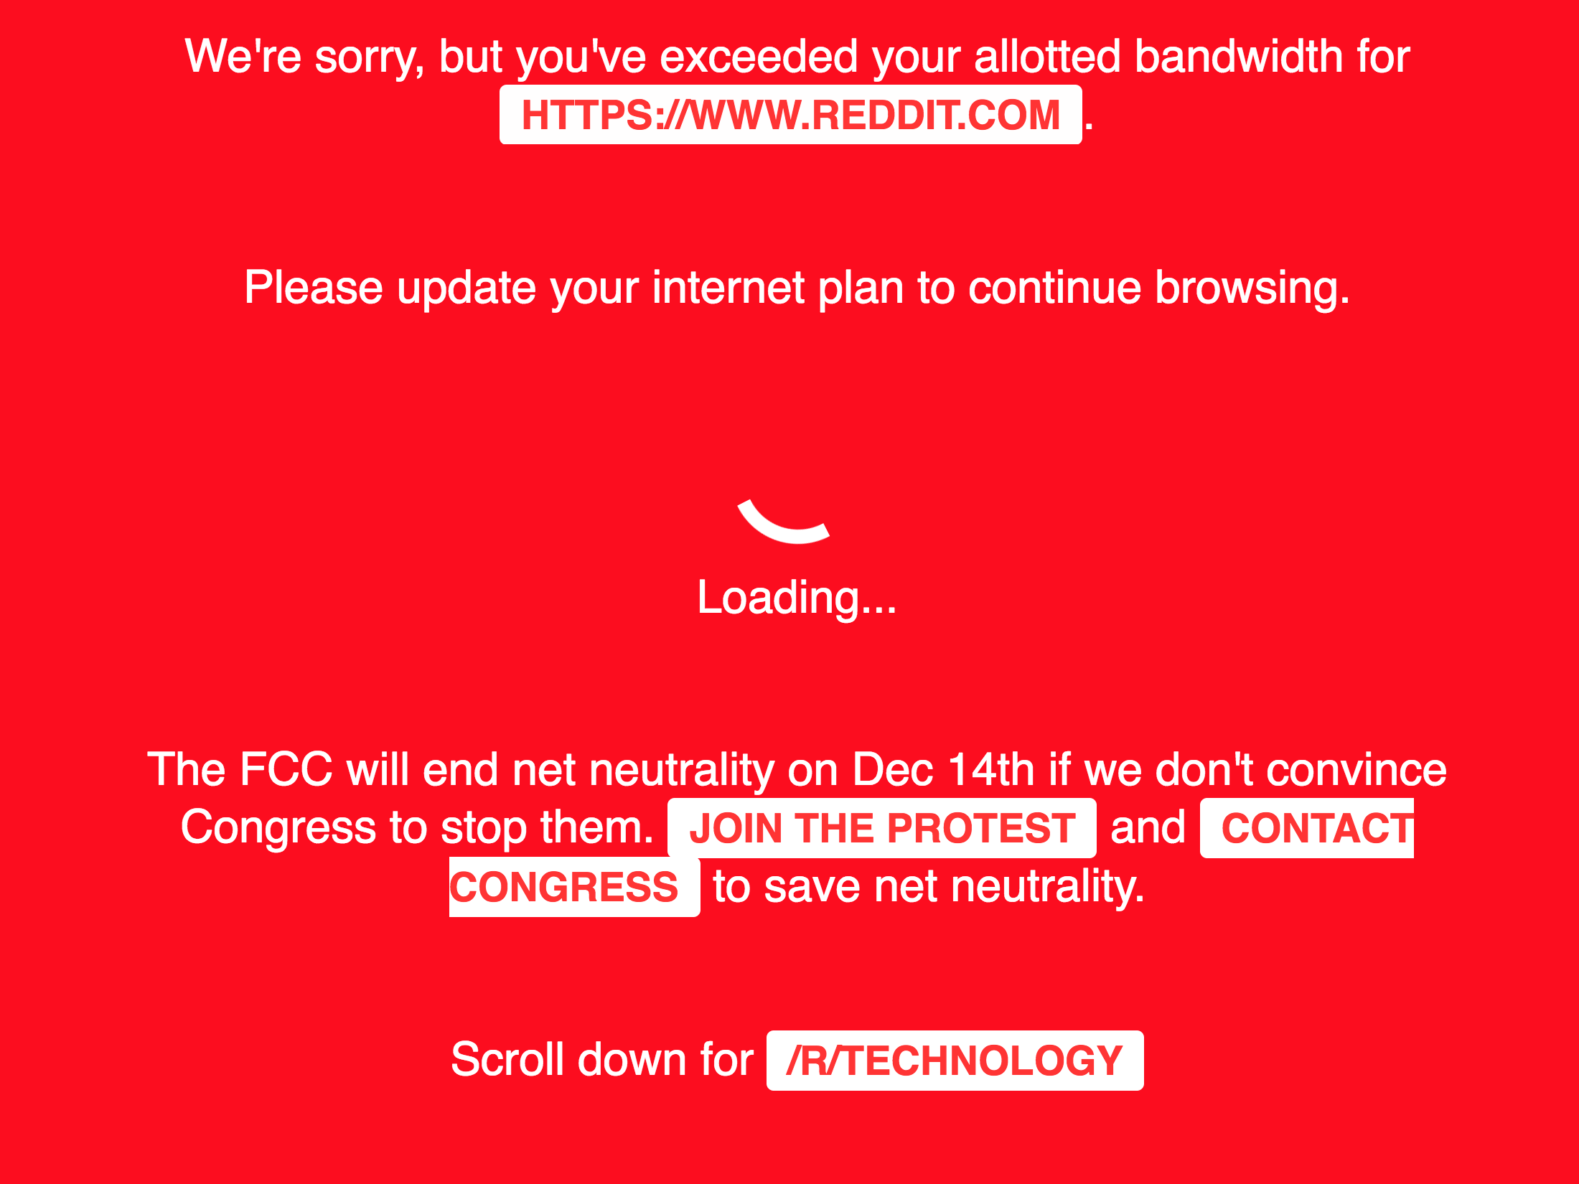
Collective Action on Reddit
The power of anonymity decreases the risk of repercussions from collective actions
  Some events unite all the subreddits with a common goal

Slide 32
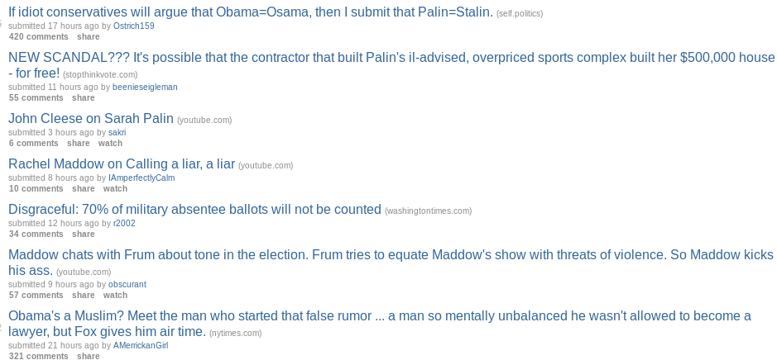
r/politics and Political Support
r/politics is a subreddit for political discussion
  Usually U.S.A. politics
On 2008, prior to the Obama vs. McCain Election:
  Most of the links and comments supported Obama
  Only a few unpopular submissions were supporting McCain

Slide 33
Analysis of Social and Information Networks
Chapter 20 – The Small World Phenomenon

Slide 34
Social Distance with Reddit Links
Reddit links can be compared by the number of commentators they have in common:
  The more users two links have in common, the “closer” they are to each other in terms of content or relevancy
Distance defined:
  The number of shared unique comment authors between links

Slide 35
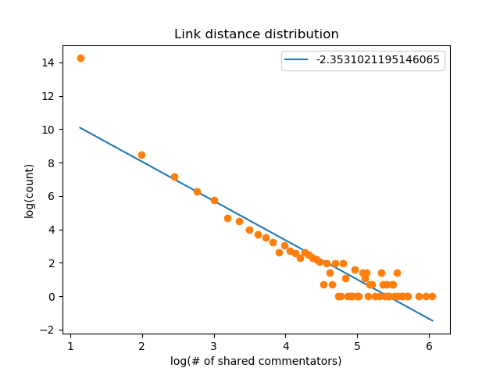
Distance Distribution
Log-log plot of histogram of distance and counts
  Does not have p close to -1
  Not efficient
But:
  Artificial measurement of distance
  Does not represent social interaction between people

