Slide 1
Analysis of Social and Information Networks
Chapter 5 – Positive and Negative Relations

Slide 2
Relations in Reddit
Users can mainly interact in two ways:
  Comment on a link
  Respond to a user comment on a link
Reddit’s scoring system provides insight to a comment/link content:
  Upvoted comments/posts tend to present common and accepted opinions by the community
  Downvoted comments/posts pose unpopular opinions or irrelevant content for the discussion (e.g. spam)

Slide 3
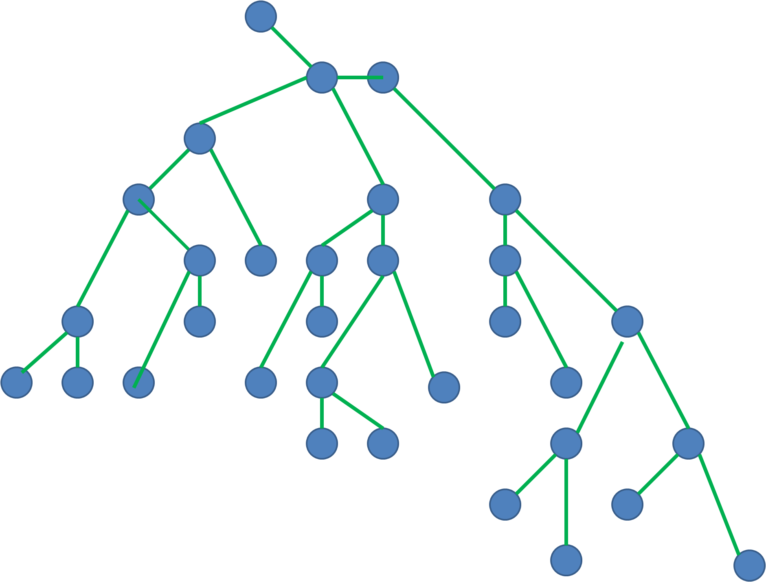
Graphs of Comments
Consider that a comment is a response to a post or another comment
  Creates graph trees of responses
  One comment can only respond to another comment, but one comment can originate several responses
  No Triangles
Post

Slide 4
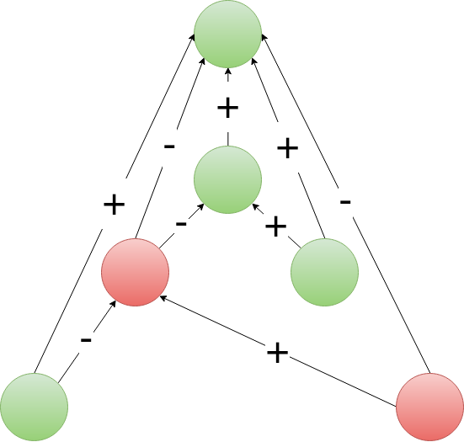
Graphs of Comments: Another Approach
Consider each comment is a response to the post AND another comment
  Generates 1 triangle per response
  Green: upvoted
  Red: downvoted
  Agreeing opinions: +
  Disagreeing opinions: -
  Balanced
Post

Slide 5
Graphs of Comments: Assumptions and Challenges
Assumptions:
  The score of a comment/link is a measure of how agreeable is its content.
  If a response has the same score as its parent, they are of the same opinion
  If a response has a symmetric score as its parent, they are in disagreement
Interesting to prove these assumptions:
  Text mining to determine sentiment and level of agreement of a comment/post
  Determine if a post/subreddit has balanced comments
  Determine opposing communities on a subreddit (e.g. r/politics before a major election)
Post

