Slide 1
Making the Chessbot
By João Bagulho

Slide 2
The Decision algorithms
“shuffle” bot
Random choice
“getnext” bot
Gets the next best move
“minmax” bot
Gets the next best move taking into consideration the users choices
“abprune” bot
Min-Max with Alpha-Beta Pruning
“abprune_v2” bot
Min-Max with Alpha-Beta Pruning, time limits and much more

Slide 3
The “getnext” bot
Purpose
Evaluate the behaviour of the heuristics function.
How does it work?
As the name implies it will get the next move evaluate it with the heuristics function and return the best scored move.

Slide 4
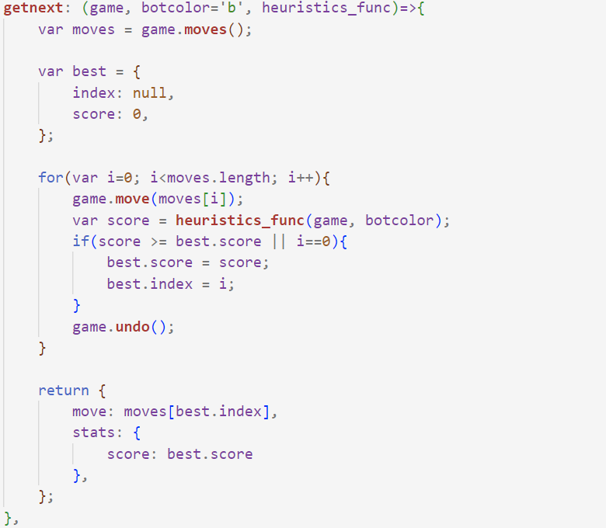
The “getnext” bot
Get all moves
For each move
Get Result Board
If (bigger than previous score) or (first move)
Store score
Store index
Return Move by Stored Index
Declaration at line 323 of the “chessbot.js” file

Slide 5
The “getnext” bot
Pros
Cons
Fast
Aggressive
Simple
Good for Heuristics testing
No prediction
Easy to Win
Annoying to play against

Slide 6
The “minmax” bot
Purpose
Find the best move, by predicting what move the player will make, using the Min-Max algorithm
How does it work?
It will have 2 modes Max-Player and Min-Player.
The Max-player will pick the move with the highest score.
The Min-Player will pick the move with the lower score.
The function will play first as Max-Player and then as Min-Player.
Then it will call upon itself increasing the depth until a limit at which will return a score

Slide 7
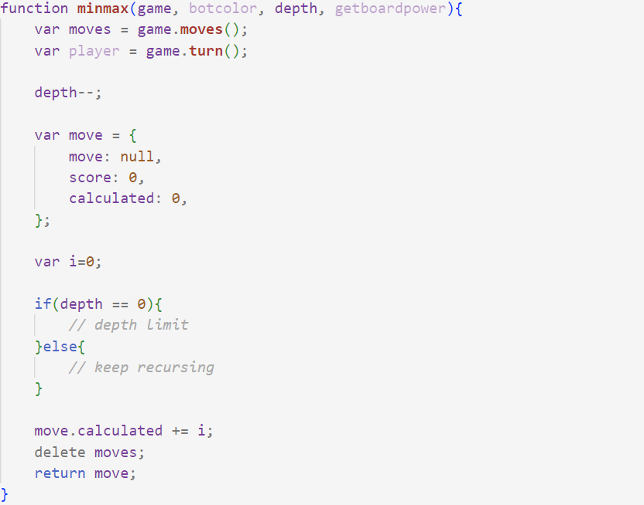
The “minmax” bot
Get all moves
Get Who is Playing
If reached depth limit then use heuristics function
If not at depth limit then use minmax function
Return best choice

Slide 8
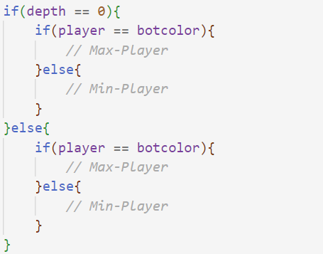
The “minmax” bot
If reached depth limit then use heuristics function
If is bot playing then pick best move
If is user playing then pick worse move
If not at depth limit then use minmax function
If is bot playing then pick best move
If is user playing then pick worse move

Slide 9
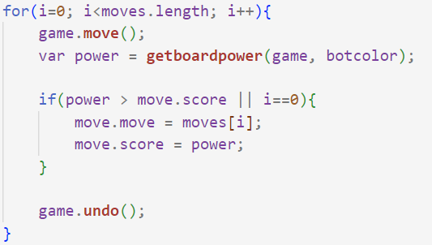
The “minmax” bot
If is bot playing then pick best move
For each move
Get Result Board
If (bigger than previous score) or (first move)
Store move
Store score

Slide 10

The “minmax” bot
If is bot playing then pick best move
For each move
Get Result Board
If (smaller than previous score) or (first move)
Store move
Store score

Slide 11
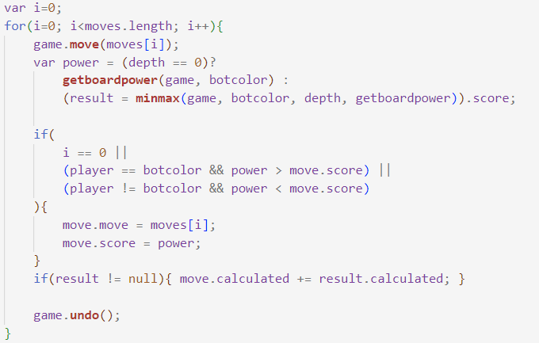
The “minmax” bot
Optimizations:
Remove the Big If condition
Merge depth limit and recursion for loops
Merge Min-Player and Max-player for loops
Final version is at line 171 of the “chessbot.js” file

Slide 12
The “minmax” bot
Pros
Cons
Better decisions
Protects it’s pieces while capturing the users pieces
It’s slow, really slow
Calculates unnecessary branches
Consumes a lot of memory
Needs a separate thread to prevent blocking the program

Slide 13
The “abprune” bot
Purpose
Find the best move, by predicting what move the player will make, using the Min-Max algorithm.
Prevent unnecessary branches.
How does it work?
It will use the Min-Max algorithm to find the best move.
It will use Alpha-Beta pruning:
Set alpha to Max-Player’s best choice
Set beta to Min-Player’s best choice
If alpha is bigger or equal to beta return best choice so far.

Slide 14
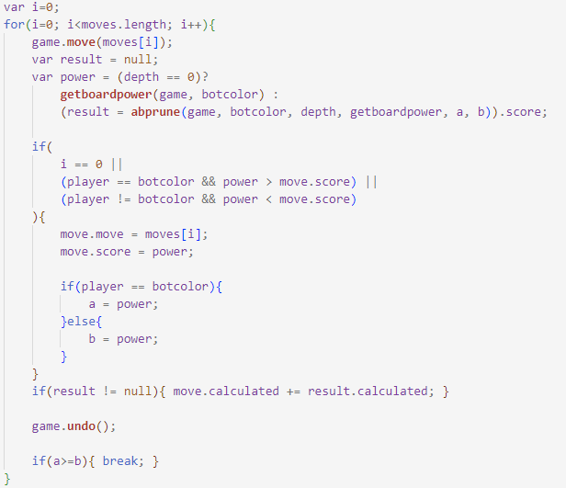
The “abprune” bot
Using the “minmax” bot code.
Set a = Max-Player’s best choice
Set b = Min-Player’s best choice
If a ≥ b return best choice so far.
Declaration at line 208 of the “chessbot.js” file

Slide 15
The “abprune” bot
Pros
Cons
Faster than Min-Max
Almost the same choice
All the pros of Min-Max
Can go deeper than Min-Max for the same amount of time
Inconsistent timings
Can still take to long to respond
Always the same choices
No accounting for leaf nodes earlier than depth limit
Checkmate can take longer than depth

Slide 16
The “abprune_v2” bot
Purpose
Find the best move, by predicting what move the player will make, using the Min-Max algorithm.
Prevent unnecessary branches.
Stop if it’s going to exceed the time limit, but go until the time limit if there is less pieces.
Prevent move repetition.
How does it work?
It will use the Min-Max algorithm to find the best move.
It will use the alpha-beta pruning to prevent unnecessary branches.
In case it exceeds the time limit just treat the remaining branches as leaf nodes.
If game is over just return the score.
It will increase the depth limit until the time limit is triggered.
Shuffle the moves.

Slide 17
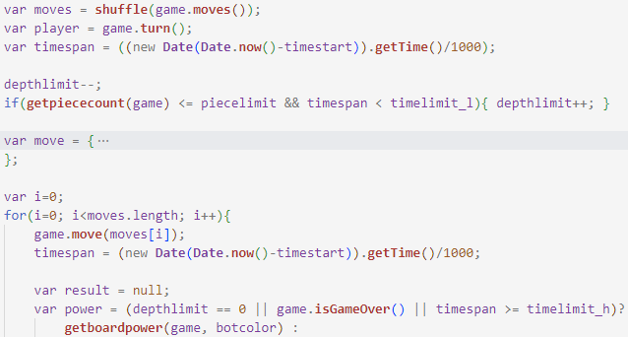
The “abprune_v2” bot
Shuffle the moves
If there are few pieces left and the timespan is bigger than the lower time limit then increase the depth limit
If game is over or the timespan is bigger than the higher time limit just return the board value
Declaration at line 254 of the “chessbot.js” file

Slide 18
The “abprune_v2” bot
Pros
Cons
Better choices
Respects time limit independently of depth
Just a bit slower
The higher time limit pruning can lead to worse choices
The depth limit, the piece limit and the Higher and lower time limits must be at balance.

Slide 19
The Evaluation Algorithms
Version 0
Adds the bot pieces values and subtracts the user pieces values
Version 1
Prefer threatening and winning
Version 2
Avoid ties
Version 3
Avoid sacrifices and take castling into consideration

Slide 20
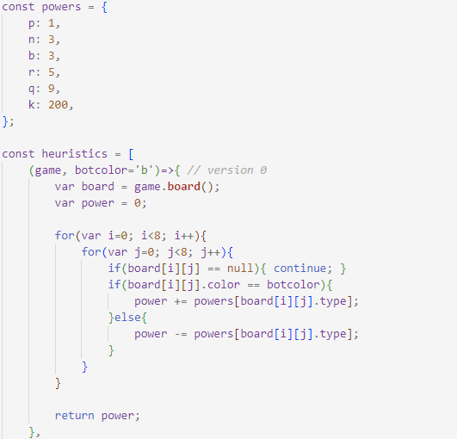
Heuristics function – Version 0
Add the bot pieces values
Subtract the user pieces values
Declaration at line 14 of the “chessbot.js” file

Slide 21
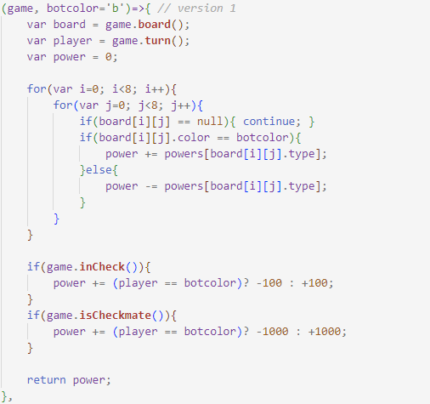
Heuristics function – Version 1
If in check:
Bot: subtract 100
User: add 100
If in Checkmate:
Bot: subtract 1000
User: add 1000
Declaration at line 31 of the “chessbot.js” file

Slide 22
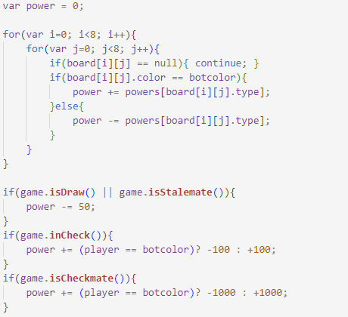
Heuristics function – Version 2
If Draw or Stalemate the remove 50 points
Declaration at line 56 of the “chessbot.js” file

Slide 23
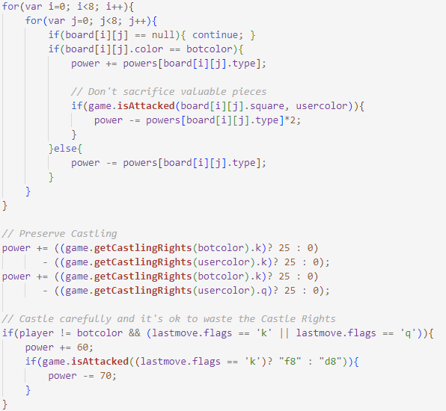
Heuristics function – Version 3
If sacrificing piece remove the value of the piece since it will be killed.
Castling rights
Bot: add 25 per each side
User: remove 25 per each side
If last bot move was castle add 60 points
If castling results in rook sacrifice then remove 70 points
Declaration at line 85 of the “chessbot.js” file

Slide 24
In Conclusion
By using the “abprune_v2” bot and the heuristics version 3
It can go 5 levels deep rarely triggers a time cut-off
When at 15 pieces it will generate branches for 10 sec and resolve in less than 150 sec or it will trigger a cut-off
The higher time limit is 150 sec
Although the choices are better it is still more likely for the game to end with a draw rather than with a winner or loser

