Slide 1
Chat Service Application
João Bernardo Castanheira Patrício

Slide 2
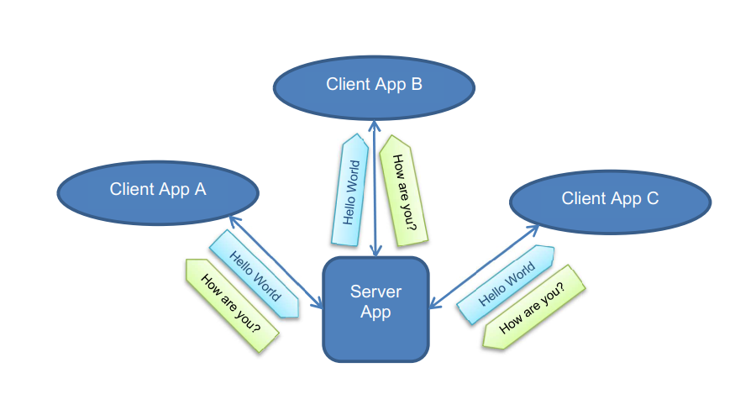
Requirements
A user can send and receive text messages;
The applications shall run on a computer/laptop;
The applications are written in C++ development language;
The client application:
connects automatically or per user input to the server application;
user can disconnect from the server application;
user can send a text message to the server;
user can write messages that are only send after a user command to the server application;
user can see the received text messages from the server application;
The server application:
shall allow the connection and disconnection of clients;
shall send all text messages to the other connected clients.

Slide 3
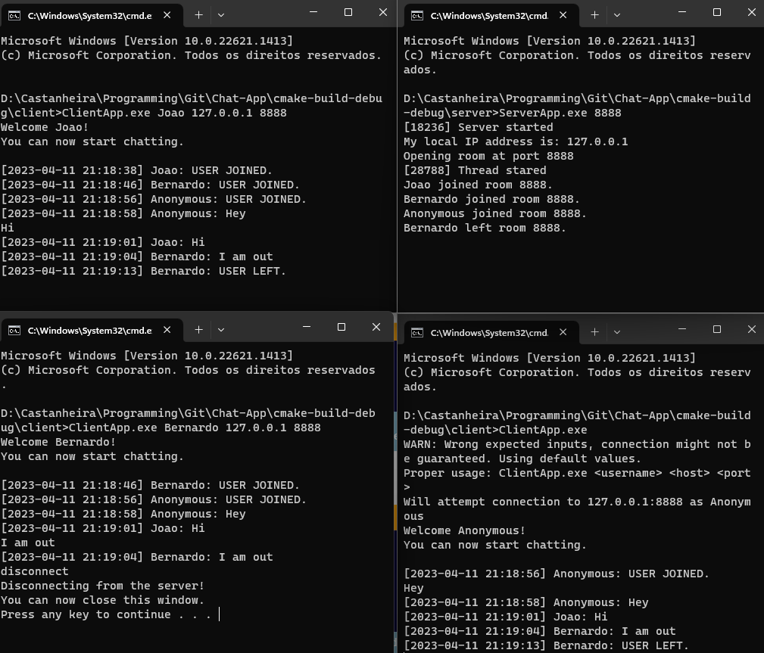
Demonstration
Run the server executable:
“ServerApp.exe 8888”
Run the client executable:
“ClientApp.exe Joao 127.0.0.1 8888”
Run the client executable:
“ClientApp.exe Bernardo 127.0.0.1 8888”
Fig.1: Example demonstration.

Slide 4
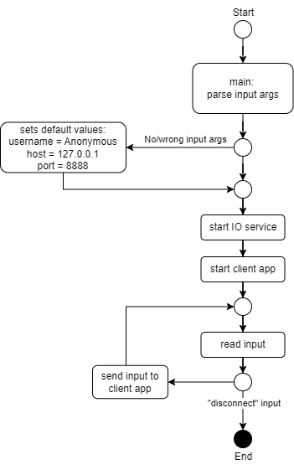
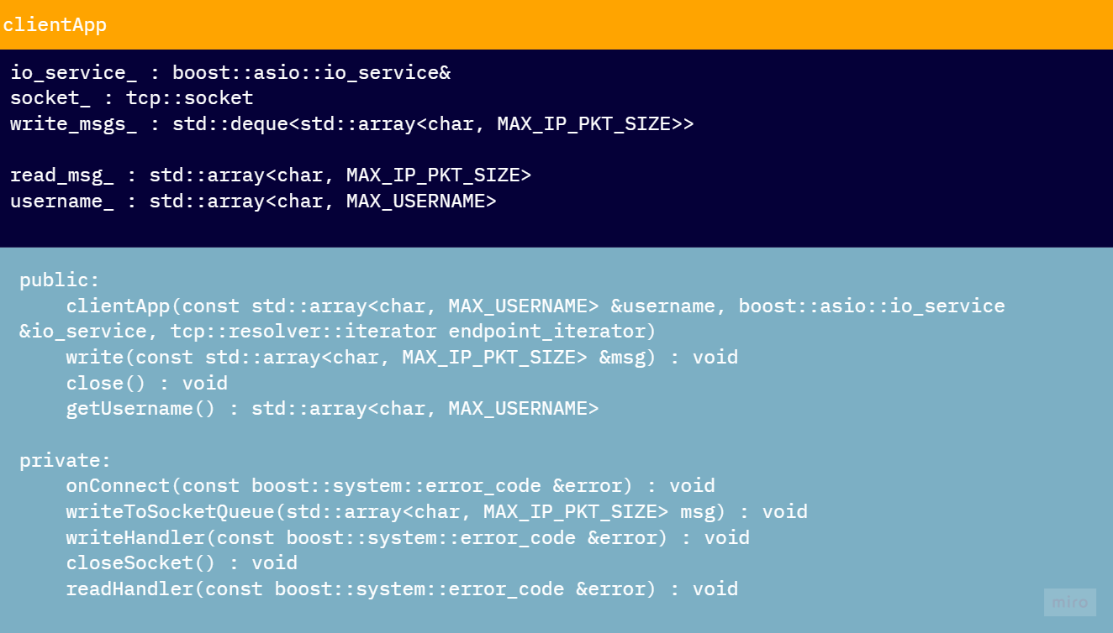
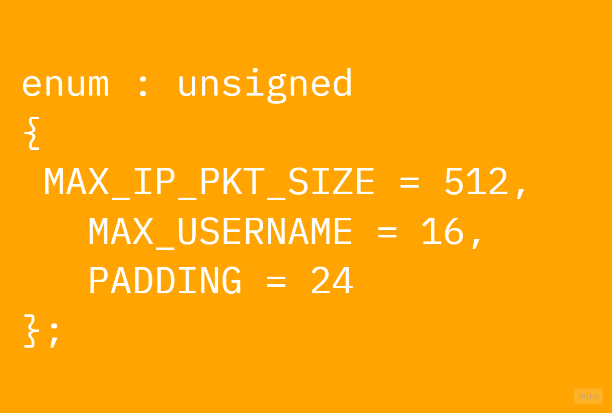
Strategy - Client
Fig.2: ClientApp main flow diagram.
Fig.3: clientApp diagram.
Notes:
I wanted to have a simple cliente application whose job was only to provide the user info, targeted server/room and then to send and receive contente from the server.

Slide 5
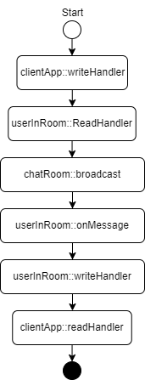
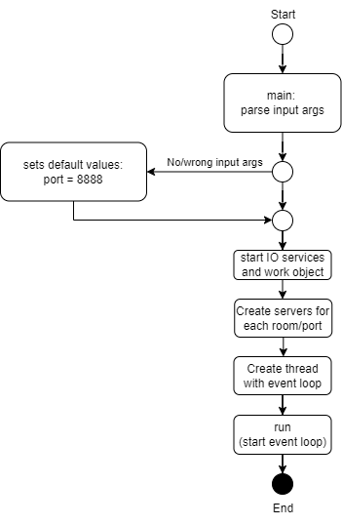
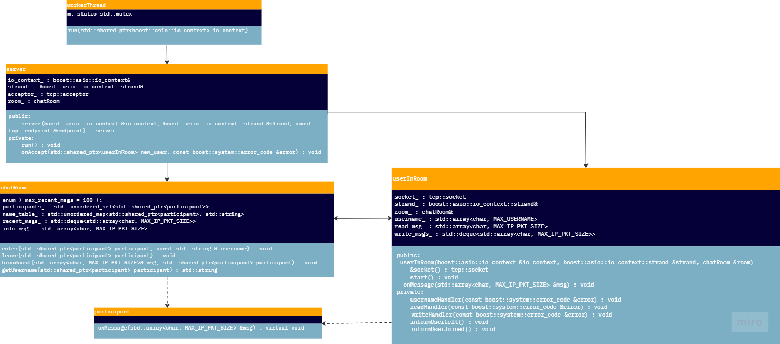
Strategy - Server
Fig.6: Message flow overview.
Fig.4: ServerApp main flow diagram.
Fig.5: ServerApp diagram.
Notes:
At the server side, I wanted to have a componente to deal with each user, a componente to deal with each room and a componente to deal with the server as a hole, this way we could keep a modular architecture and add future features at the desired locations, something I did as an exemple at the user connected/disconnected output.

Slide 6
Used technologies
The main used technology was the Boost library and its IO utilities.
Advantages:
Flexibility and modularity: easy to integrate and customize its functionality to the targeted specific needs;
Cross platform: supported on Windows and Linux;
Concurrency: supports asynchronous and multi-threading operations.
Supports, among others, TCP and IPv4;
Easy of use: since it handles complex tasks, allows users to abstract from complex details regarding IO, threading and socket communication.

Slide 7
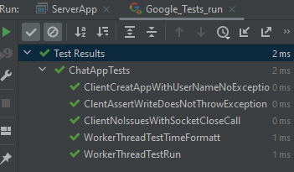
Used tools
Cmake build system;
GoogleTest;
Clion;
github;
batch scripts;
chat-gpt;
miro;
draw.io.
Fig.7: Unit tests with GoogleTest.

Slide 8
Advantages:
Easy to use;
Modular (easy to add new features);
Asynchronous;
Abstraction on the IO networking handling;
Light weight;
Supports different rooms;
Informs about connected/disconnected users.
Disadvantages:
Low security: messages are not encrypted;
No graphical interface;
Depends on Boost library.

Slide 9
References
Boost. Boost C++ Libraries (2023), from https://www.boost.org (last access on April 12, 2023);
Network programming. The Boost C++ Libraries (2015), from https://theboostcpplibraries.com/boost.asio-network-programming (last access on April 12, 2023);
Mauville Technologies. MOYF (2021), from https://github.com/mauville-technologies/MOYF (last access on April 12, 2023);
OzzadarDev. Socket Programming in C++ using Boost.Asio (2021). , from https://www.youtube.com/watch?v=DVMHEDhYEr4&list=PLKH0QdYnI6AlcsMeNTN0G8QRKum4p7QbT&index=9&ab_channel=OzzadarDev (last access on April 12, 2023);
Jia, B. Chat (2017), from https://github.com/botaojia/chat (last access on April 12, 2023);
Yuting Nig. Chat (2020), from https://dens.website/tutorials/cpp-asio/tcp-chat-server (last access on April 12, 2023);
Dens. TCP chat server (2019), from https://dens.website/tutorials/cpp-asio/tcp-chat-server (last access on April 12, 2023);
J-TAG (2021). Qt Chat Server, from https://github.com/J-TAG/qt-chat-server (last access on April 12, 2023).

