Slide 1
Chat Service Application
João Bernardo Castanheira Patrício

Slide 2
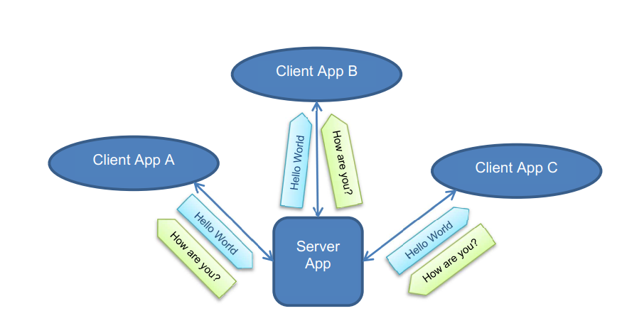
Requirements
A user can send and receive text messages;
The applications shall run on a computer/laptop;
The applications are written in C++ development language;
The client application:
connects automatically or per user input to the server application;
user can disconnect from the server application;
user can send a text message to the server;
user can write messages that are only send after a user command to the server application;
user can see the received text messages from the server application;
The server application:
shall send all text messages to the other connected clients.

Slide 3
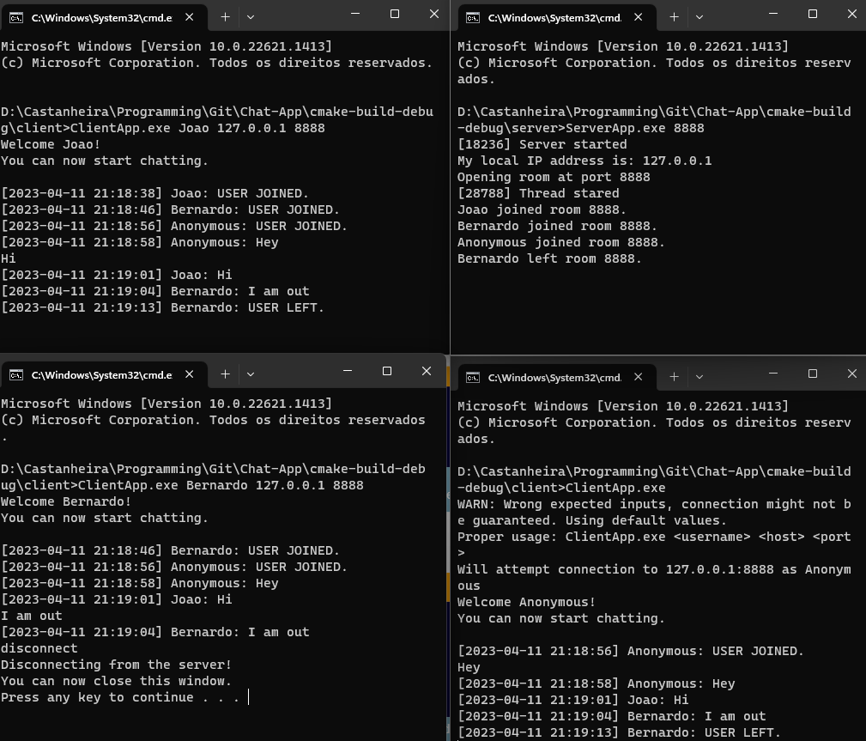
Demonstration
Run the server executable:
“ServerApp.exe 8888”
Run the client executable:
“ClientApp.exe Joao 127.0.0.1 8888”
Run the client executable:
“ClientApp.exe Bernardo 127.0.0.1 8888”

Slide 4
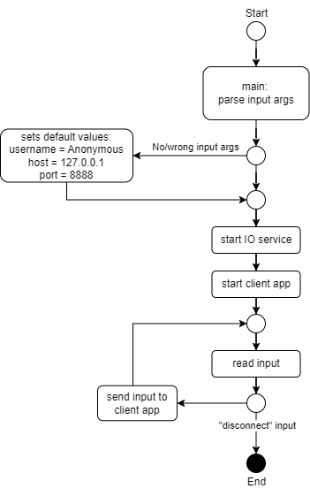
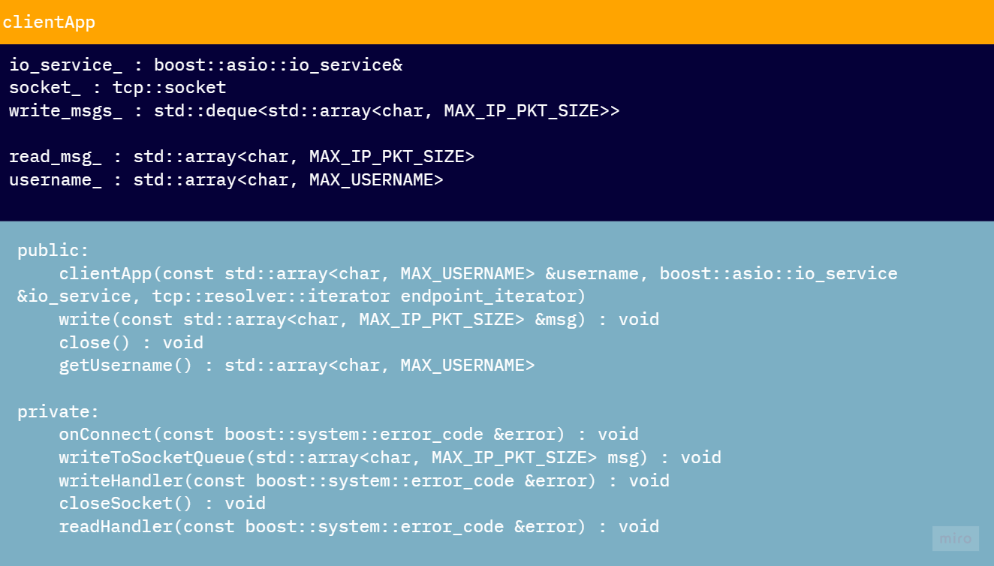
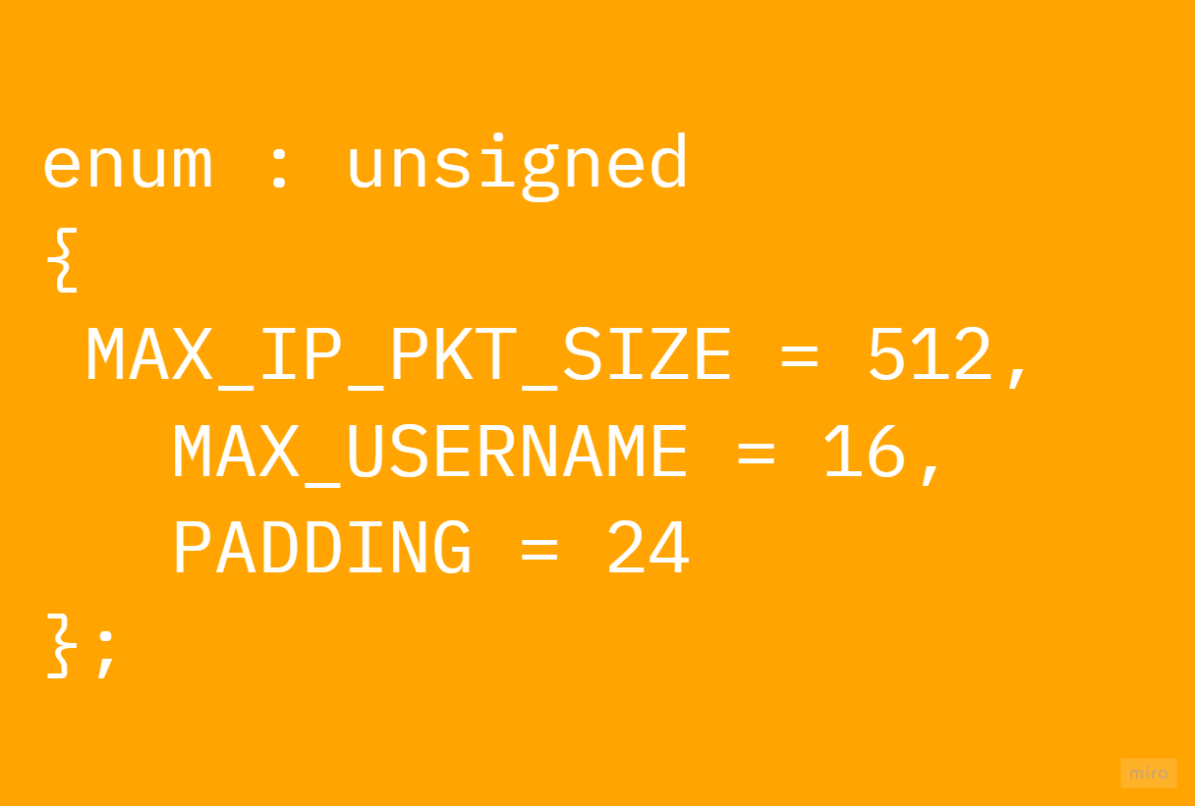
Strategy - Client
Notes:
I wanted to have a simple cliente application whose job was only to provide the user info, targeted server/room and then to send and receive contente from the server.

Slide 5
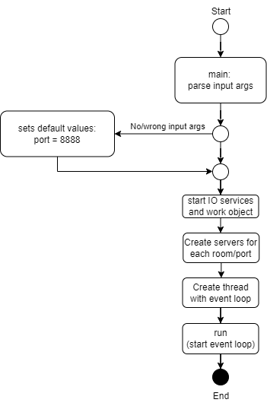
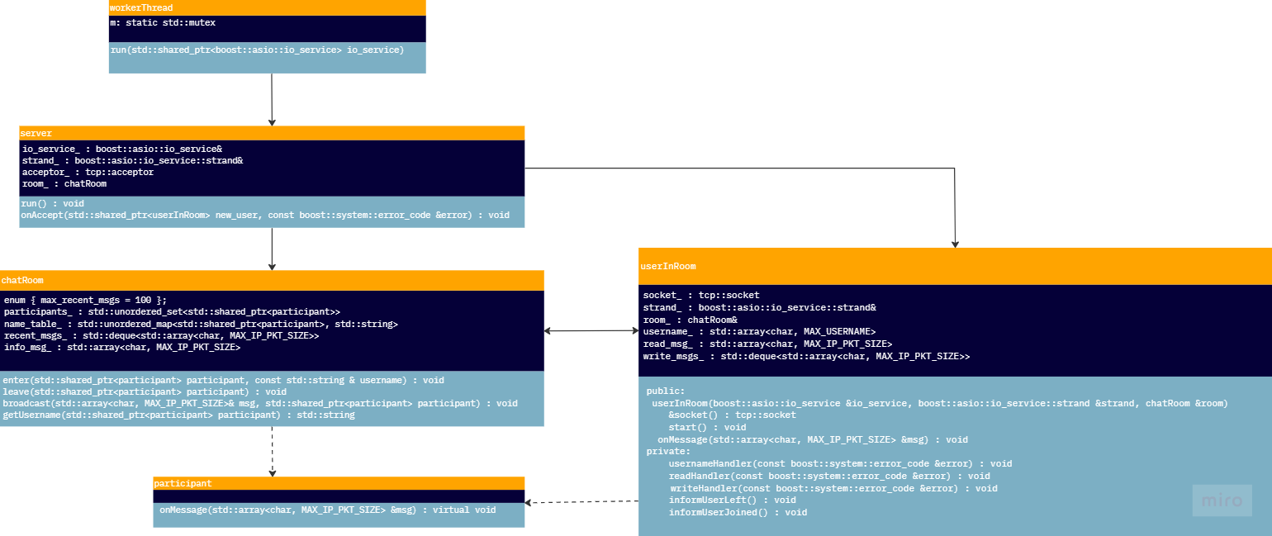
Strategy - Server
Notes:
At the server side, I wanted to have a componente to deal with each user, a componente to deal with each room and a componente to deal with the server as a hole, this way we could keep a modular architecture and add future features at the desired locations, something I did as an exemple at the user connected/disconnected output.

Slide 6
Used technologies
The main used technology was the Boost library and its IO utilities.
Advantages:
Flexibility and modularity: easy to integrate and customize its functionality to the targeted specific needs;
Cross platform: supported on Windows and Linux;
Concurrency: supports asynchronous and multi-threading operations.
Supports, among others, TCP and IPv4;
Easy of use: since it handles complex tasks, allows users to abstract from complex details regarding IO, threading and socket communication.

Slide 7
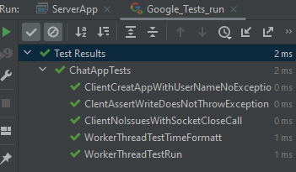
Used tools
Cmake build system
GoogleTest
Clion
github
batch scripts
chat-gpt
miro
draw.io

Slide 8
Advantages:
Easy to use
Modular (easy to add new features)
Asynchronous
Abstraction on the IO networking handling
Light weight
Supports different rooms
Informs about connected/disconnected users
Disadvantages:
Low security: messages are not encrypted
No graphical interface
Depends on Boost library

Slide 9
References
Boost (2021). Boost C++ Libraries, from https://www.boost.org (last access on April 11, 2023)
Mauville Technologies (2021). MOYF, from https://github.com/mauville-technologies/MOYF (last access on April 11, 2023)
OzzadarDev (2019). Socket Programming in C++ using Boost.Asio, from https://www.youtube.com/watch?v=DVMHEDhYEr4&list=PLKH0QdYnI6AlcsMeNTN0G8QRKum4p7QbT&index=9&ab_channel=OzzadarDev (last access on April 11, 2023)
Jia, B. (2021). Chat, 2023, from https://github.com/botaojia/chat (last access on April 11, 2023)
J-TAG (2021). Qt Chat Server, from https://github.com/J-TAG/qt-chat-server (last access on April 11, 2023)

