Slide 1
Reunião
23/10/2019

Slide 2
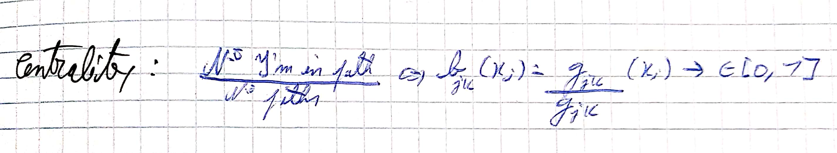
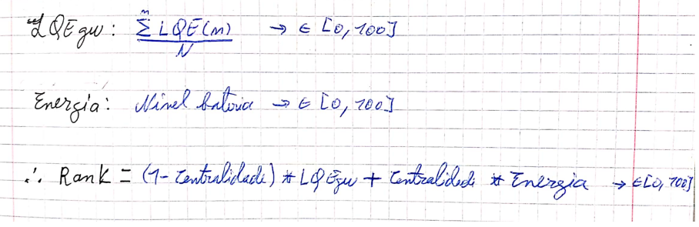
Equations:

Slide 3
Method 3:
    Escolha da GW pelo valor do rank;
Com controlo: Nova Gw tem de ter um rank 10% melhor que a anterior e confirmar 3 vezes em periodos de 5s.
Sem controlo: Elege logo a nova gateway.

Slide 4
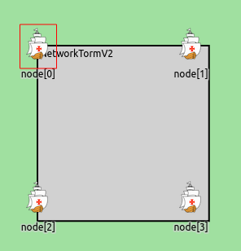
Test A
-1Msg/sec durante primeiros 100s;
-Sem movimento;
-Nós distanciados a 10m {0,1,2,3};
-Bateria inicial de 100J;
-Simulação de 200s.

Slide 5
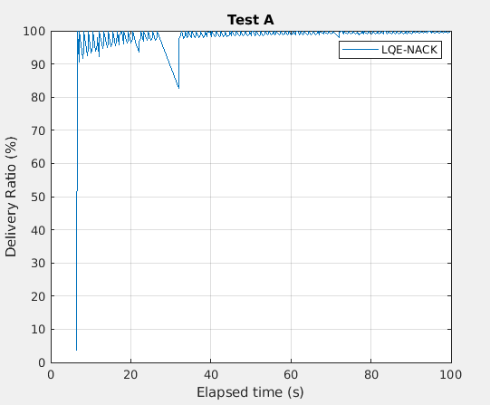
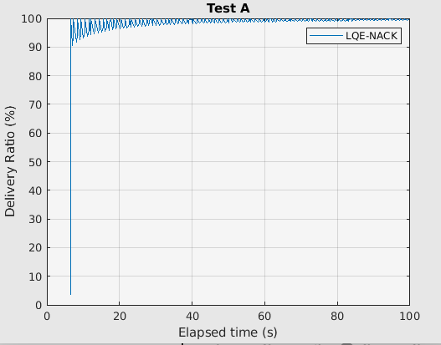
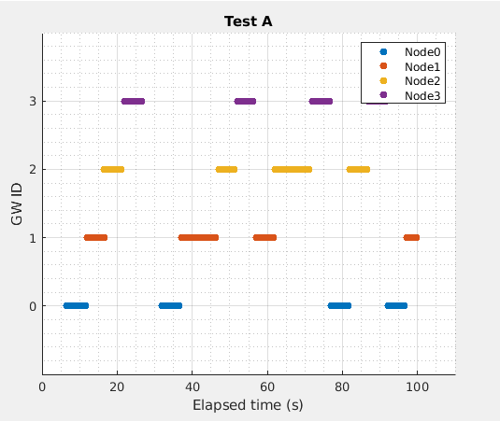
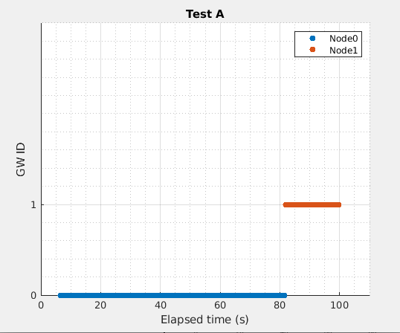
A: M3S/L
A: M3C3
100%
Overhead:9522
R.Overhead:13
Gws:4
NºHops:472
Battery at 100s (%):
0->93;
1->95;
2->95;
3->95;
Simulation events:
277355
Rank at 197s:
0->83.0
1->84.0
2->83.5
3->84.0
100%
Overhead:9288
R.Overhead:0
Gws:2
NºHops:300
Battery at 100s(%):
0->82;
1->96;
2->100;
3->100;
Simulation events:
275006
Rank at 197s:
0->77.5
1->84.5
2->86.5
3->86.5
Notes:
M3C3:
Changed gw at 82s when [0] rank=77.5 and [1]rank=86.5

Slide 6
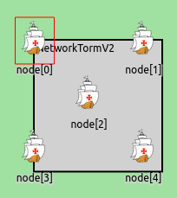
Test C
-1Msg/sec durante primeiros 100s;
-Sem movimento;
-Nós distanciados a 20m {0,1,3,4};
-Nó 2 no centro;
-Bateria inicial de 100J;
-Simulação de 200s.

Slide 7
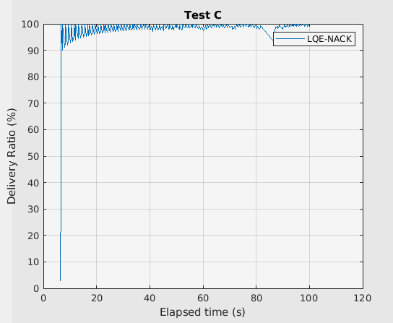
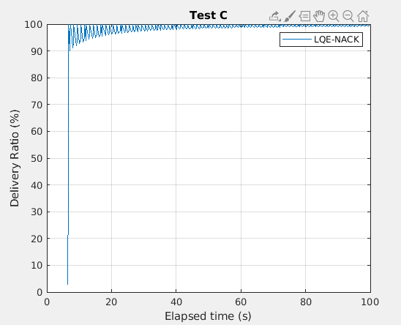
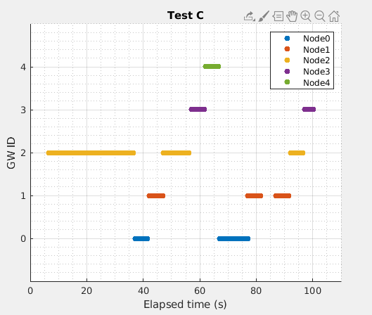
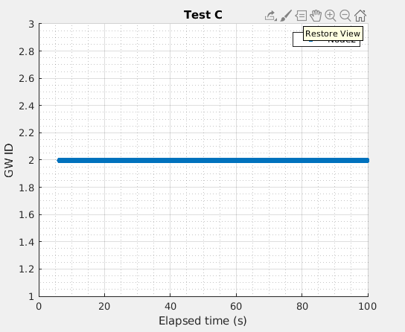
A: M3S/L
A: M3C3
100%
Overhead:12600
R.Overhead:15
Gws:5
NºHops:588
Battery at 100s (%):
0->95;
1->93;
2->83;
3->98;
4->98;
Simulation events:
358231
Rank at 197s:
0->74.0
1->73.2
2->74.6
3->74.8
4->75.2
100%
Overhead:12235
R.Overhead:0
Gws:1
NºHops:400
Battery (%):
0->100;
1->100;
2->69;
3->100;
4->100;
Simulation events:
354457
Rank at 197s:
0->76.0
1->76.0
2->68.6
3->76.0
4->76.0

Slide 8
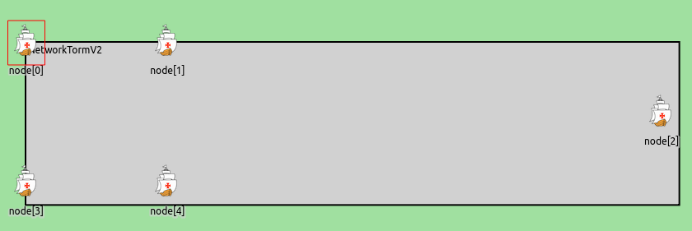
Test Cmov
-1Msg/sec durante primeiros 100s;
-Sem movimento;
-Nós distanciados a 20m {0,1,3,4};
-Nó 2 no centro;
-Bateria inicial de 100J;
-Simulação de 200s.
- O nó 2 aos 20s afasta-se para fora do cluster, parando aos 50s.
T1
T2
Notes:
20->50s

Slide 9
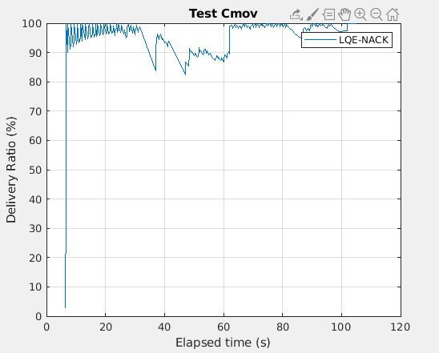
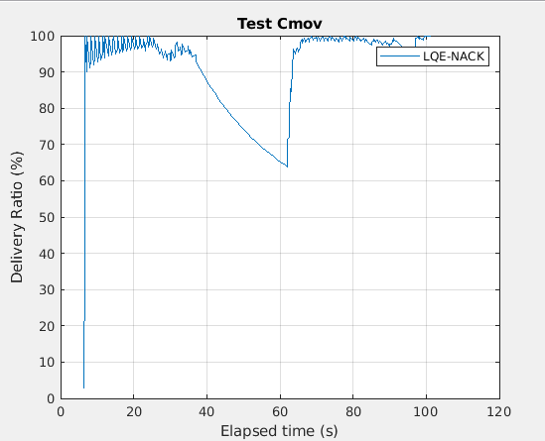
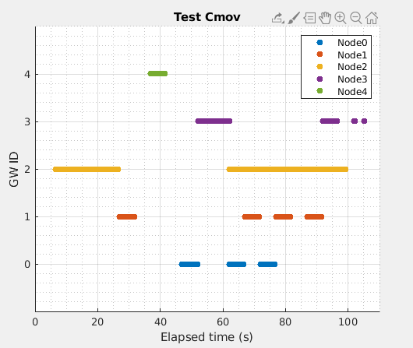
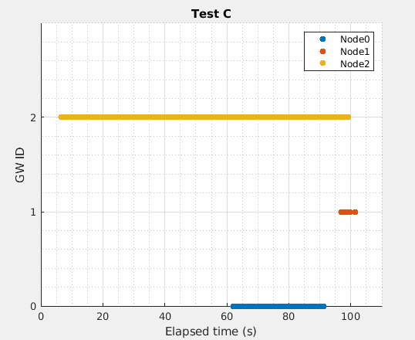
A: M3S/L
A: M3C3
100%
Overhead:7920
R.Overhead:15
Gws:5
NºHops:644
Battery at 100s (%):
0->94;
1->94;
3->96;
4->97;
Simulation events:
288997
Rank at 197s:
0->75.5
1->75.5
3->76.0
4->77.0
100%
Overhead:7543
R.Overhead:5
Gws:3
NºHops:527
Battery at 100s (%):
0->84;
1->99;
2->88;
3->100;
4->100;
Simulation events:
284937
Rank at 197s:
0->70.5
1->77.5
3->78.5
4->78.5
Notes:
M3C3:
Gw changes:
0->78.500000 | 2->0.000000 => 62.000000
1->78.500000 | 0->70.500000 => 92.000000

Slide 10
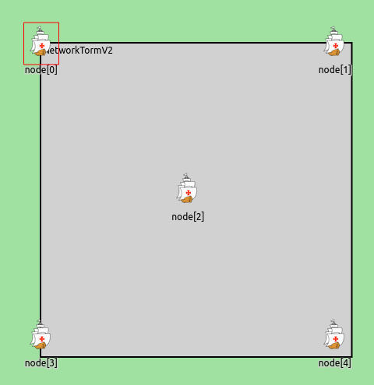
Test D
-1Msg/sec durante primeiros 100s;
-Sem movimento;
-Nós distanciados a 44m {0,1,3,4};
-Nó 2 no centro;
-Bateria inicial de 100J;
-Simulação de 200s.

Slide 11
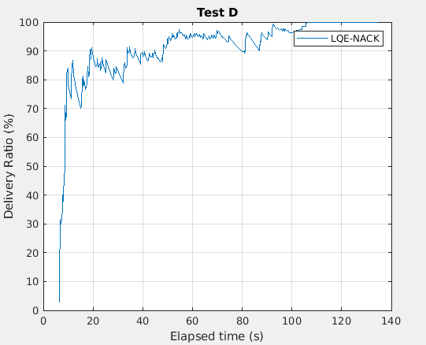
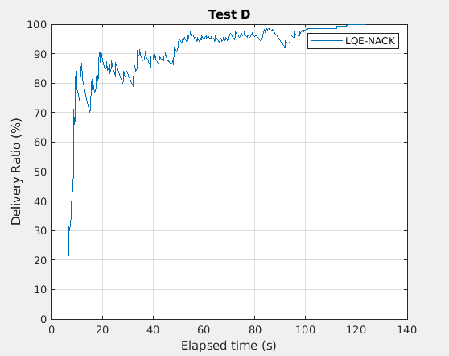
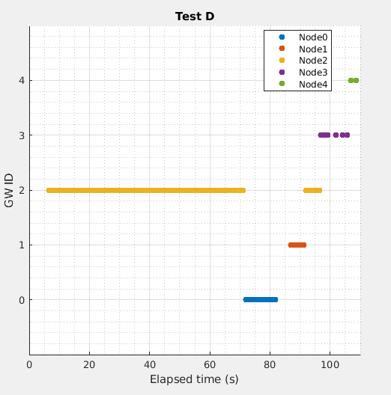
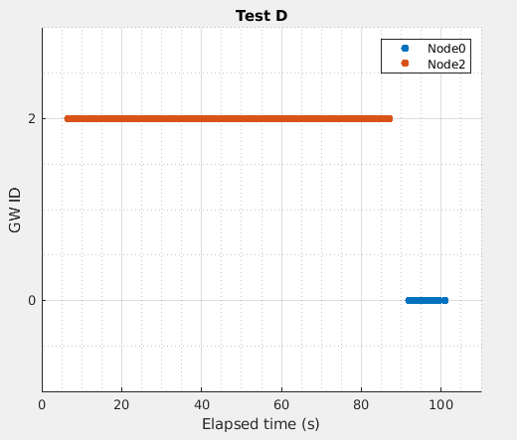
A: M1->S/L
A: M3C3
100%
Overhead:2595
R.Overhead:49
Gws:4
NºHops:542
Battery at 100s (%):
0->96;
1->95;
2->64;
3->100;
4->100;
Simulation events:
247604
Rank at 197s:
0->64.2
1->63.8
2->64.0
3->65.0
4->65.4
100%
Overhead:2623
R.Overhead:2
Gws:2
NºHops:439
Battery at 100s (%):
0->95;
1->100;
2->57;
3->100;
4->100;
Simulation events:
248223
Rank at 197s:
0->62.6
1->65.8
2->57.0
3->65.8
4->65.8
Notes:
M3C3:
Changed Gw:
0->65.800000 | 2->58.000000 => 87.000000

Slide 12
Without a control method, the simulation consumes much more hardware resources and time as it handles many more events.
Notes:
O maior overhead deve-se ao aumento de nº de hops e, consequentemente, acks

