Slide 1
Reunião
23/10/2019

Slide 2
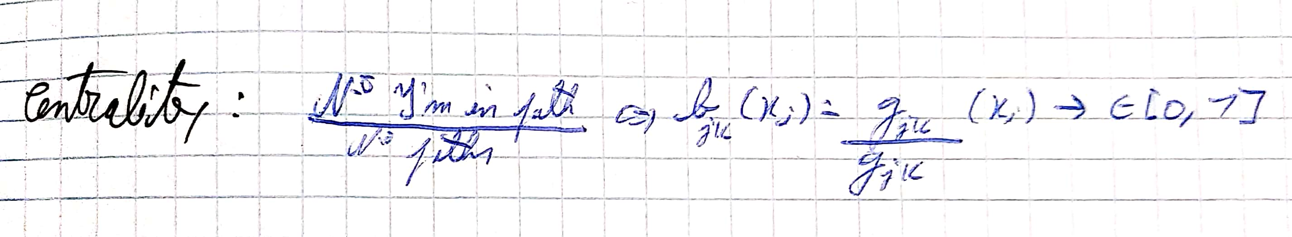
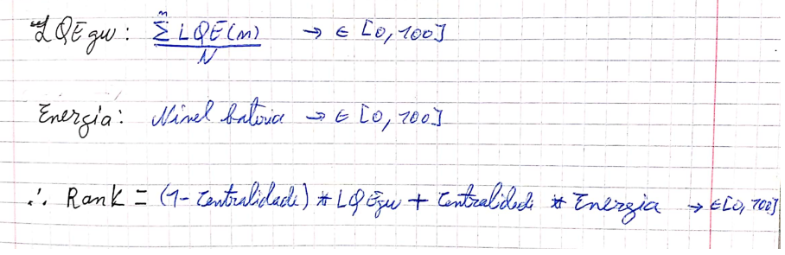
Equations:

Slide 3
Method 1:
Escolha da GW pelo valor de bateria, desempate por ser min 1% melhor, centralidade, ou por menor ID;
Com controlo: Nova Gw tem de ter um rank 10% melhor que a anterior e confirmar 3 vezes em periodos de 5s.
Sem controlo: Elege logo a nova gateway.

Slide 4
Method 3:
Escolha da GW pelo valor do rank, desempate por ser min 1% melhor, centralidade, ou por menor ID;
Com controlo: Nova Gw tem de ter um rank 10% melhor que a anterior e confirmar 3 vezes em periodos de 5s.
Sem controlo: Elege logo a nova gateway.

Slide 5
5s

Slide 6
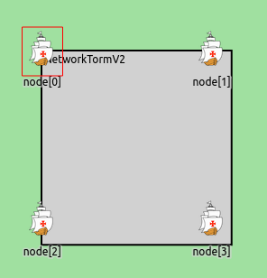
Test A
-1Msg/sec durante primeiros 100s;
-Sem movimento;
-Nós distanciados a 10m {0,1,2,3};
-Bateria inicial de 100J;
-Simulação de 200s.

Slide 7
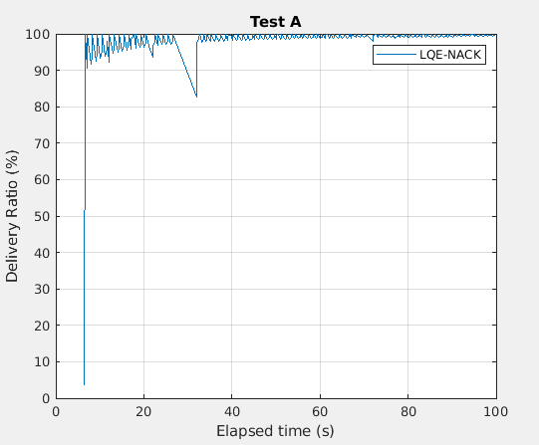
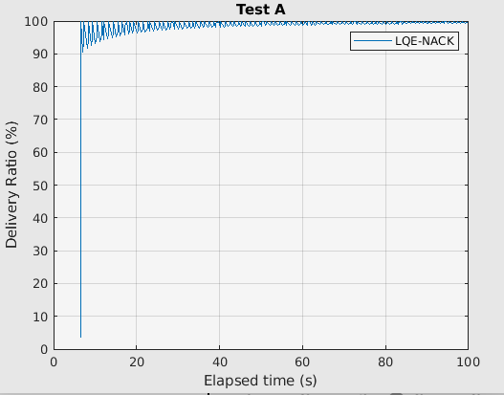
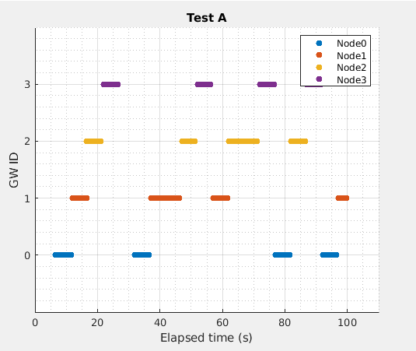
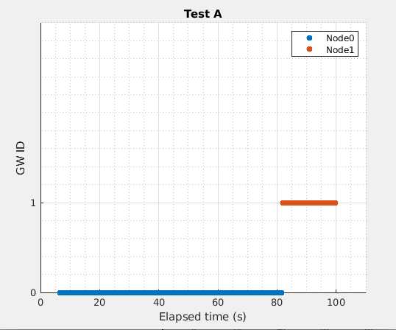
A: M3SC
A: M3C3
100%
Overhead:9522
R.Overhead:13
Gws:4
NºHops:472
Battery at 100s (%):
0->93;
1->95;
2->95;
3->95;
Simulation events:
277355
Rank at 197s:
0->83.0
1->84.0
2->83.5
3->84.0
100%
Overhead:9288
R.Overhead:0
Gws:2
NºHops:300
Battery at 100s(%):
0->82;
1->96;
2->100;
3->100;
Simulation events:
275006
Rank at 197s:
0->77.5
1->84.5
2->86.5
3->86.5
Notes:
M3C3:
Changed gw at 82s when [0] rank=77.5 and [1]rank=86.5

Slide 8
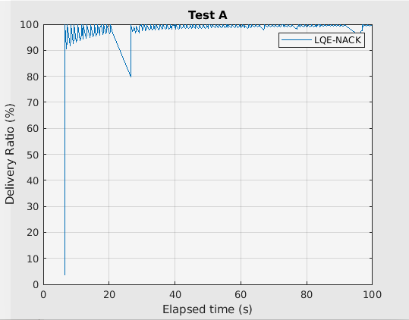
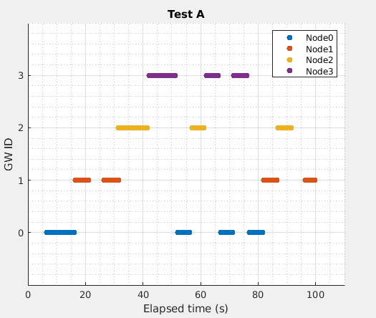
A: M3SC
A: M1S/L
100%
Overhead:9522
R.Overhead:13
Gws:4
NºHops:472
Battery at 100s (%):
0->93;
1->95;
2->95;
3->95;
Simulation events:
277355
Rank at 197s:
0->83.0
1->84.0
2->83.5
3->84.0
100%
Overhead:9710
R.Overhead:10
Gws:4
NºHops:571
Battery at 100s(%):
0->94;
1->94;
2->95;
3->95;
Simulation events:
279206
Rank at 197s:
0->94.0
1->94.0
2->95.0
3->95.0
Notes:
M3C3:
Changed gw at 82s when [0] rank=77.5 and [1]rank=86.5

Slide 9
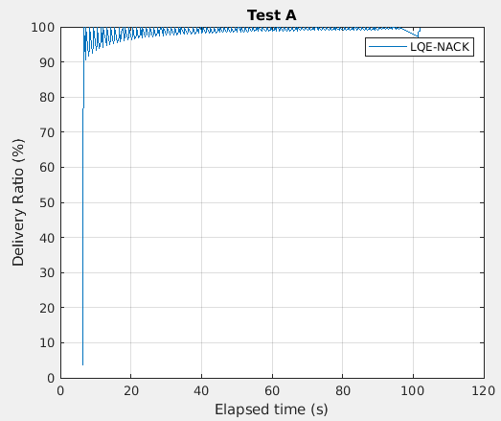
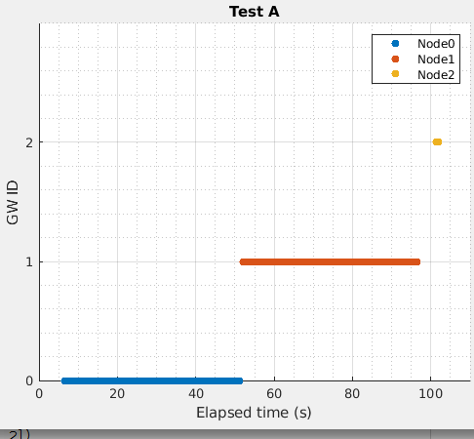
A: M1C3
A: M3C3
100%
Overhead:9426
R.Overhead:0
Gws:3
NºHops:369
Battery at 100s (%):
0->89;
1->89;
2->99;
3->100;
Simulation events:
276387
Rank at 197s:
0->89.0
1->89.0
2->99.0
3->100.0
100%
Overhead:9288
R.Overhead:0
Gws:2
NºHops:300
Battery at 100s(%):
0->82;
1->96;
2->100;
3->100;
Simulation events:
275006
Rank at 197s:
0->77.5
1->84.5
2->86.5
3->86.5
Notes:
M3C3:
Changed gw at 82s when [0] rank=77.5 and [1]rank=86.5

Slide 10
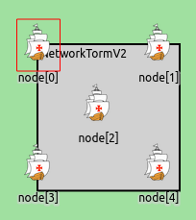
Test C
-1Msg/sec durante primeiros 100s;
-Sem movimento;
-Nós distanciados a 20m {0,1,3,4};
-Nó 2 no centro;
-Bateria inicial de 100J;
-Simulação de 200s.

Slide 11
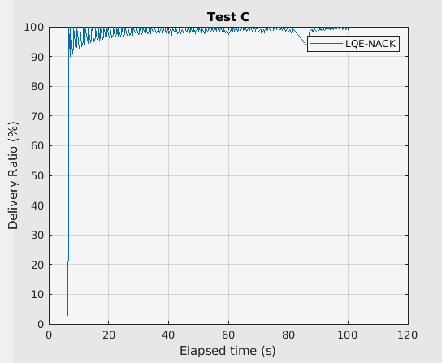
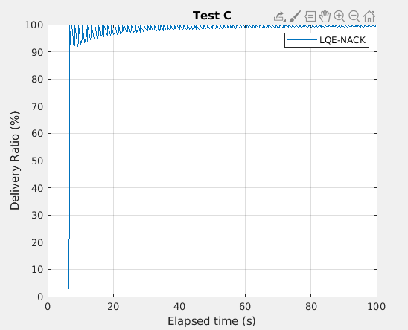
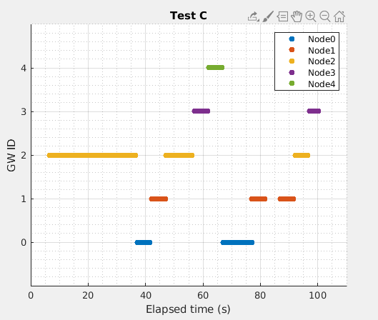
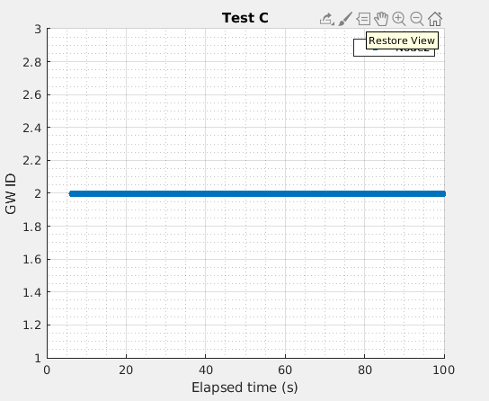
A: M3SC
A: M3C3
100%
Overhead:12600
R.Overhead:15
Gws:5
NºHops:588
Battery at 100s (%):
0->95;
1->93;
2->83;
3->98;
4->98;
Simulation events:
358231
Rank at 197s:
0->74.0
1->73.2
2->74.6
3->74.8
4->75.2
100%
Overhead:12235
R.Overhead:0
Gws:1
NºHops:400
Battery (%):
0->100;
1->100;
2->69;
3->100;
4->100;
Simulation events:
354457
Rank at 197s:
0->76.0
1->76.0
2->68.6
3->76.0
4->76.0

Slide 12
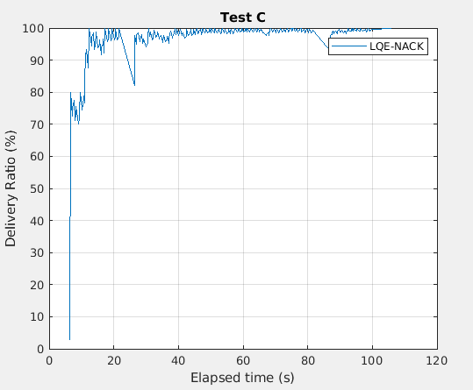
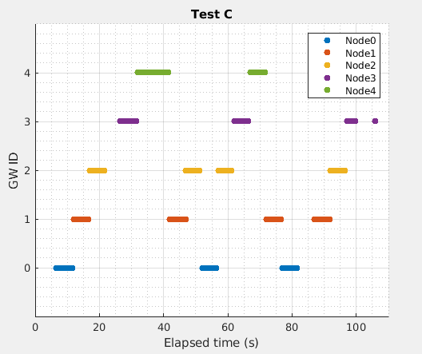
A: M3SC
A: M1SC
100%
Overhead:12600
R.Overhead:15
Gws:5
NºHops:588
Battery at 100s (%):
0->95;
1->93;
2->83;
3->98;
4->98;
Simulation events:
358231
Rank at 197s:
0->74.0
1->73.2
2->74.6
3->74.8
4->75.2
100%
Overhead:12718
R.Overhead:37
Gws:5
NºHops:804
Battery (%):
0->94;
1->91;
2->94;
3->94;
4->95;
Simulation events:
359206
Rank at 197s:
0->94.0
1->91.0
2->94.0
3->94.0
4->95.0

Slide 13
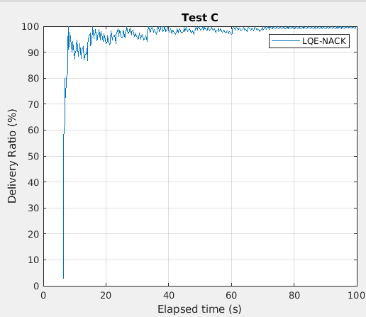
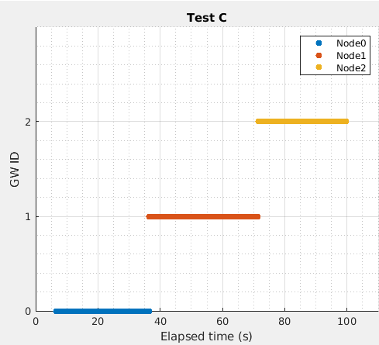
A: M1C3
A: M3C3
100%
Overhead:12285
R.Overhead:3
Gws:5
NºHops:403
Battery at 100s (%):
0->88;
1->88;
2->91;
3->99;
4->100;
Simulation events:
355347
Rank at 197s:
0->88.0
1->88.0
2->91.0
3->99.0
4->100.0
100%
Overhead:12235
R.Overhead:0
Gws:1
NºHops:400
Battery (%):
0->100;
1->100;
2->69;
3->100;
4->100;
Simulation events:
354457
Rank at 197s:
0->76.0
1->76.0
2->68.6
3->76.0
4->76.0

Slide 14
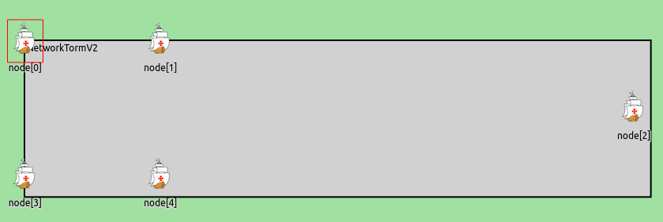
Test Cmov
-1Msg/sec durante primeiros 100s;
-Sem movimento;
-Nós distanciados a 20m {0,1,3,4};
-Nó 2 no centro;
-Bateria inicial de 100J;
-Simulação de 200s.
- O nó 2 aos 20s afasta-se para fora do cluster, parando aos 50s.
T1
T2
Notes:
20->50s

Slide 15
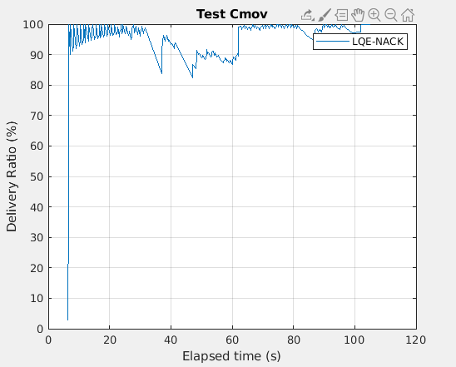
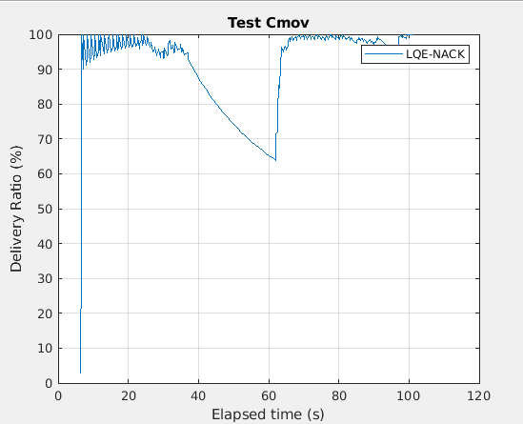
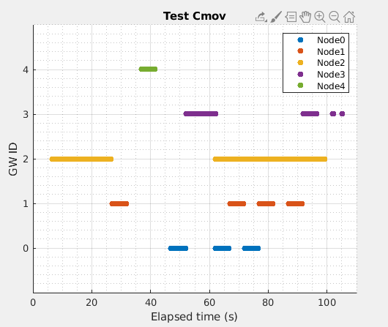
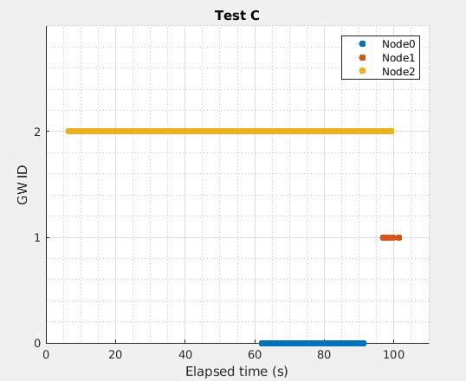
A: M3SC
A: M3C3
100%
Overhead:7920
R.Overhead:15
Gws:5
NºHops:644
Battery at 100s (%):
0->94;
1->94;
3->96;
4->97;
Simulation events:
288997
Rank at 197s:
0->75.5
1->75.5
3->76.0
4->77.0
100%
Overhead:7543
R.Overhead:5
Gws:3
NºHops:527
Battery at 100s (%):
0->84;
1->99;
2->88;
3->100;
4->100;
Simulation events:
284937
Rank at 197s:
0->70.5
1->77.5
3->78.5
4->78.5
Notes:
M3C3:
Gw changes:
0->78.500000 | 2->0.000000 => 62.000000
1->78.500000 | 0->70.500000 => 92.000000

Slide 16
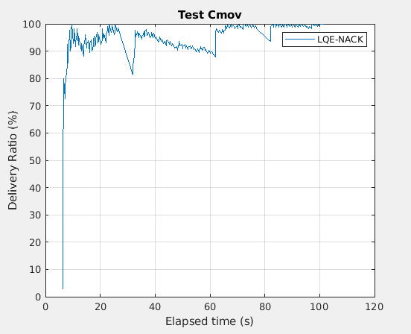
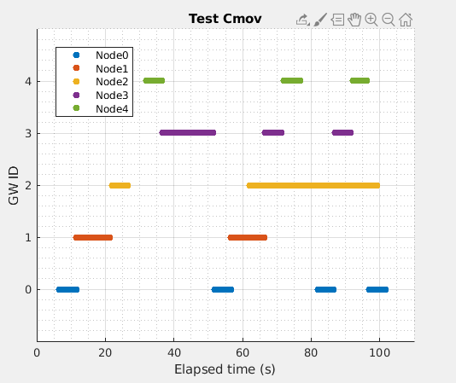
A: M3SC
A: M1SC
100%
Overhead:7920
R.Overhead:15
Gws:5
NºHops:644
Battery at 100s (%):
0->94;
1->94;
3->96;
4->97;
Simulation events:
288997
Rank at 197s:
0->75.5
1->75.5
3->76.0
4->77.0
100%
Overhead:7574
R.Overhead:25
Gws:5
NºHops:565
Battery at 100s (%):
0->93;
1->94;
2->98;
3->93;
4->94;
Simulation events:
285431
Rank at 197s:
0->93.0
1->94.0
1->98.0
3->93.0
4->94.0
Notes:
M3C3:
Gw changes:
0->78.500000 | 2->0.000000 => 62.000000
1->78.500000 | 0->70.500000 => 92.000000

Slide 17
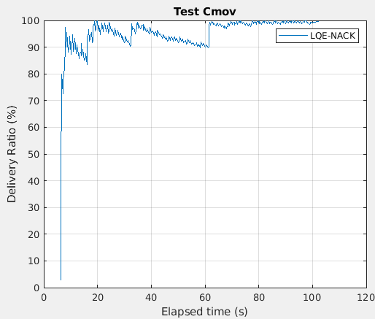
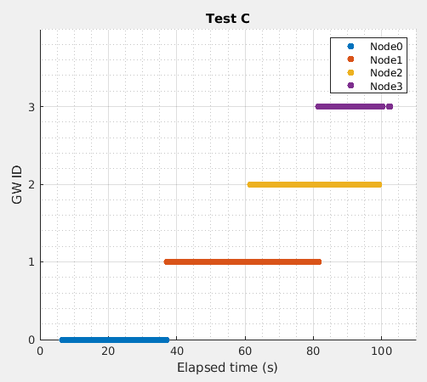
A: M1C3
A: M3C3
100%
Overhead:7240
R.Overhead:4
Gws:4
NºHops:343
Battery at 100s (%):
0->88;
1->89;
2->99;
3->95;
4->100;
Simulation events:
281885
Rank at 197s:
0->88.0
1->89.0
2->99.0
3->95.0
4->100.0
100%
Overhead:7543
R.Overhead:5
Gws:3
NºHops:527
Battery at 100s (%):
0->84;
1->99;
2->88;
3->100;
4->100;
Simulation events:
284937
Rank at 197s:
0->70.5
1->77.5
3->78.5
4->78.5
Notes:
M3C3:
Gw changes:
0->78.500000 | 2->0.000000 => 62.000000
1->78.500000 | 0->70.500000 => 92.000000

Slide 18
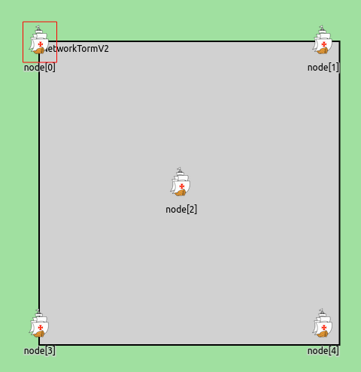
Test D
-1Msg/sec durante primeiros 100s;
-Sem movimento;
-Nós distanciados a 44m {0,1,3,4};
-Nó 2 no centro;
-Bateria inicial de 100J;
-Simulação de 200s.

Slide 19
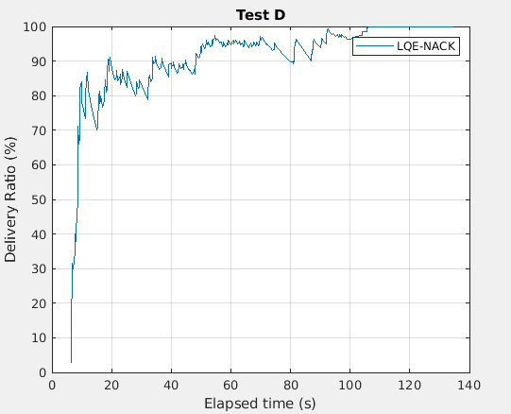
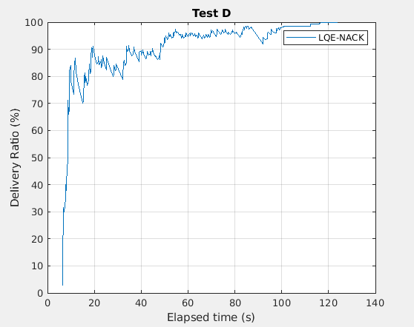
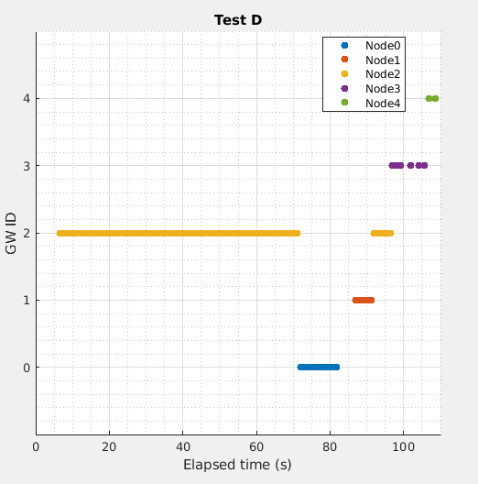
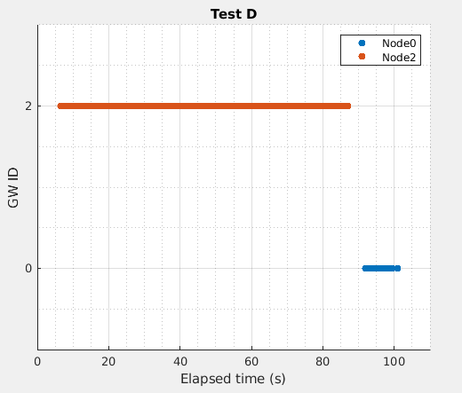
A: M3SC
A: M3C3
100%
Overhead:2595
R.Overhead:49
Gws:4
NºHops:542
Battery at 100s (%):
0->96;
1->95;
2->64;
3->100;
4->100;
Simulation events:
247604
Rank at 197s:
0->64.2
1->63.8
2->64.0
3->65.0
4->65.4
100%
Overhead:2623
R.Overhead:2
Gws:2
NºHops:439
Battery at 100s (%):
0->95;
1->100;
2->57;
3->100;
4->100;
Simulation events:
248223
Rank at 197s:
0->62.6
1->65.8
2->57.0
3->65.8
4->65.8
Notes:
M3C3:
Changed Gw:
0->65.800000 | 2->58.000000 => 87.000000

Slide 20
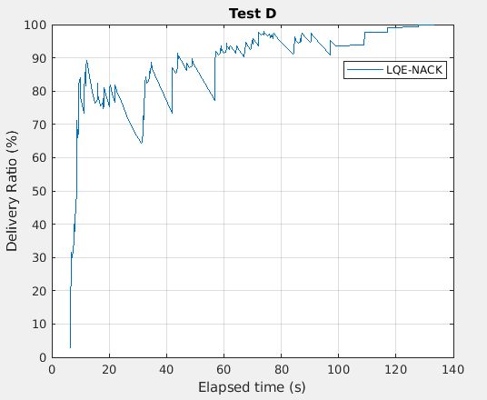
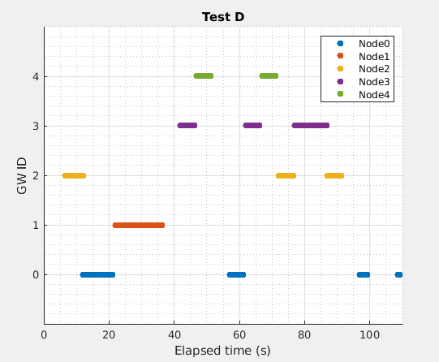
A: M1SC
A: M3SC
100%
Overhead:2595
R.Overhead:49
Gws:5
NºHops:542
Battery at 100s (%):
0->96;
1->95;
2->64;
3->100;
4->100;
Simulation events:
247604
Rank at 197s:
0->64.2
1->63.8
2->64.0
3->65.0
4->65.4
100%
Overhead:2995
R.Overhead:162
Gws:5
NºHops:866
Battery at 100s (%):
0->95;
1->94;
2->93;
3->93;
4->95;
Simulation events:
252869
Rank at 197s:
0->92.0
1->93.0
2->93.0
3->93.0
4->93.0
Notes:
M3C3:
Changed Gw:
0->65.800000 | 2->58.000000 => 87.000000

Slide 21
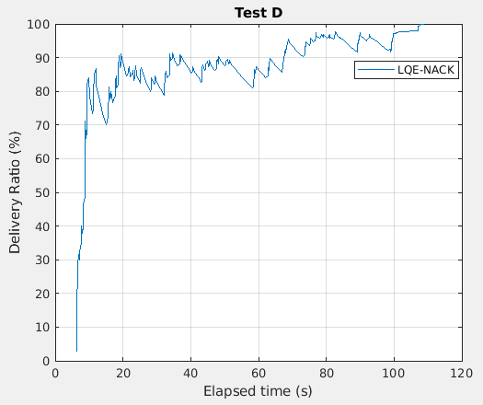
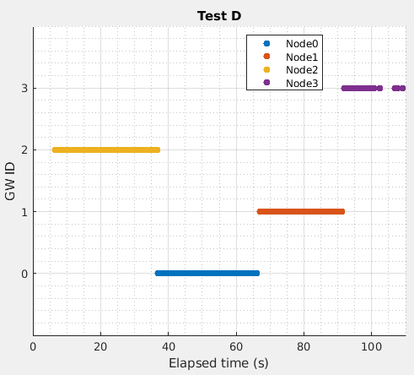
A: M1C3
A: M3C3
100%
Overhead:3081
R.Overhead:44
Gws:4
NºHops:650
Battery at 100s (%):
0->89;
1->82;
2->86;
3->99;
4->100;
Simulation events:
253419
Rank at 197s:
0->89.0
1->82.0
2->86.0
3->90.0
4->100.0
100%
Overhead:2623
R.Overhead:2
Gws:2
NºHops:439
Battery at 100s (%):
0->95;
1->100;
2->57;
3->100;
4->100;
Simulation events:
248223
Rank at 197s:
0->62.6
1->65.8
2->57.0
3->65.8
4->65.8
Notes:
M3C3:
Changed Gw:
0->65.800000 | 2->58.000000 => 87.000000

Slide 22
Without a control method, the simulation consumes much more hardware resources and time as it handles many more events.
Notes:
O maior overhead deve-se ao aumento de nº de hops e, consequentemente, acks

Slide 23
New 1s

Slide 24
Test A
-1Msg/sec durante primeiros 100s;
-Sem movimento;
-Nós distanciados a 10m {0,1,2,3};
-Bateria inicial de 100J;
-Simulação de 200s.

Slide 25
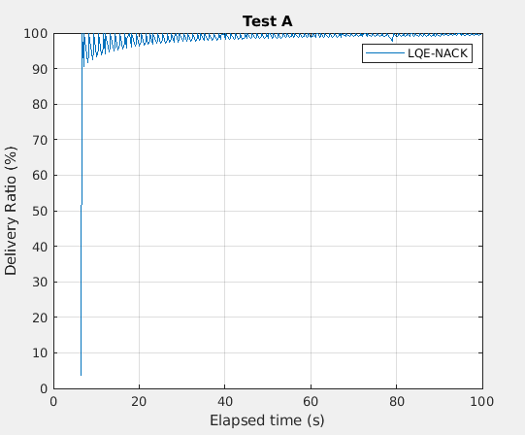
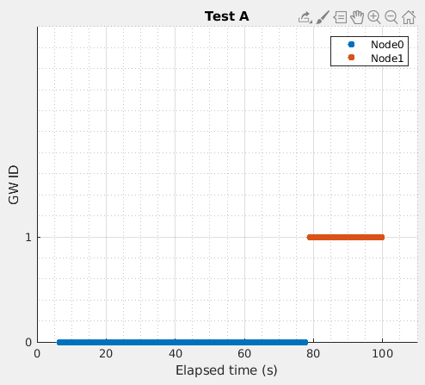
A: M3C3-New1s
A: M3C3
100%
Overhead:9300
R.Overhead:0
Gws:2
NºHops:306
Battery at 100s (%):
0->82;
1->95;
2->100;
3->100;
Simulation events:
275707
Rank at 197s:
0->77.5
1->84.0
2->86.5
3->86.5
100%
Overhead:9288
R.Overhead:0
Gws:2
NºHops:300
Battery at 100s(%):
0->82;
1->96;
2->100;
3->100;
Simulation events:
275006
Rank at 197s:
0->77.5
1->84.5
2->86.5
3->86.5
Notes:
M3C3:
Changed gw at 82s when [0] rank=77.5 and [1]rank=86.5

Slide 26
Test Cmov
-1Msg/sec durante primeiros 100s;
-Sem movimento;
-Nós distanciados a 20m {0,1,3,4};
-Nó 2 no centro;
-Bateria inicial de 100J;
-Simulação de 200s.
- O nó 2 aos 20s afasta-se para fora do cluster, parando aos 50s.
T1
T2
Notes:
20->50s

Slide 27
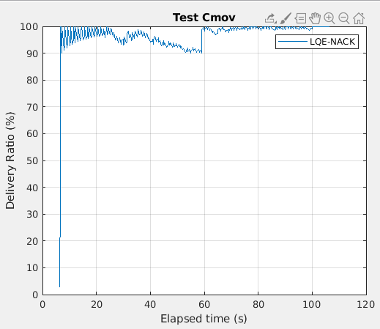
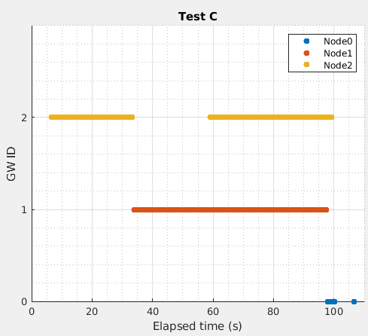
A: M3C3-New1s
A: M3C3
100%
Overhead:7448
R.Overhead:0
Gws:3
NºHops:412
Battery at 100s (%):
0->100;
1->84;
2->89;
3->100;
4->100;
Simulation events:
284166
Rank at 197s:
0->78.0
1->70.5
3->78.5
4->78.5
100%
Overhead:7543
R.Overhead:5
Gws:3
NºHops:527
Battery at 100s (%):
0->84;
1->99;
2->88;
3->100;
4->100;
Simulation events:
284937
Rank at 197s:
0->70.5
1->77.5
3->78.5
4->78.5
Notes:
M3C3:
Gw changes:
0->78.500000 | 2->0.000000 => 62.000000
1->78.500000 | 0->70.500000 => 92.000000
M3C3 new: o no1 apresenta maio centralidade devido a estar ainda com o no 2 em linha, como demora menos a haver eleiçao, isso ainda tem impacto e dai ser eleito primeiro que o 0 que teria o mesmo valor energetico, mas nao central nem de qualidade

Slide 28
Test D
-1Msg/sec durante primeiros 100s;
-Sem movimento;
-Nós distanciados a 44m {0,1,3,4};
-Nó 2 no centro;
-Bateria inicial de 100J;
-Simulação de 200s.

Slide 29
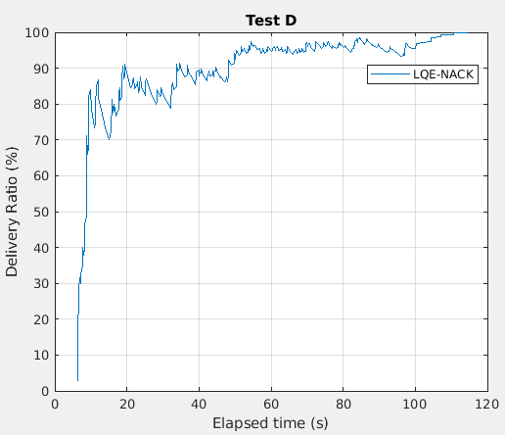
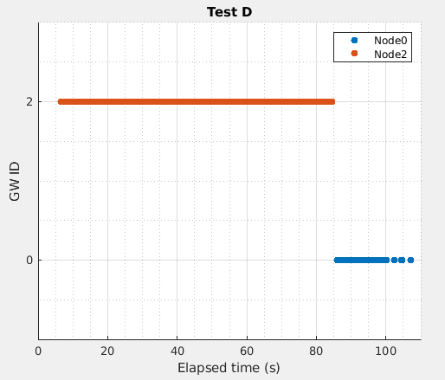
A: M3C3-New1s
A: M3C3
100%
Overhead:2633
R.Overhead:2
Gws:2
NºHops:461
Battery at 100s (%):
0->95;
1->100;
2->58;
3->100;
4->100;
Simulation events:
248937
Rank at 197s:
0->62.2
1->65.8
2->58.0
3->65.8
4->65.8
100%
Overhead:2623
R.Overhead:2
Gws:2
NºHops:439
Battery at 100s (%):
0->95;
1->100;
2->57;
3->100;
4->100;
Simulation events:
248223
Rank at 197s:
0->62.6
1->65.8
2->57.0
3->65.8
4->65.8
Notes:
M3C3:
Changed Gw:
0->65.800000 | 2->58.000000 => 87.000000

