Slide 1
Furniture & Home Goods Recognition
Deep Learning - Project

Slide 2
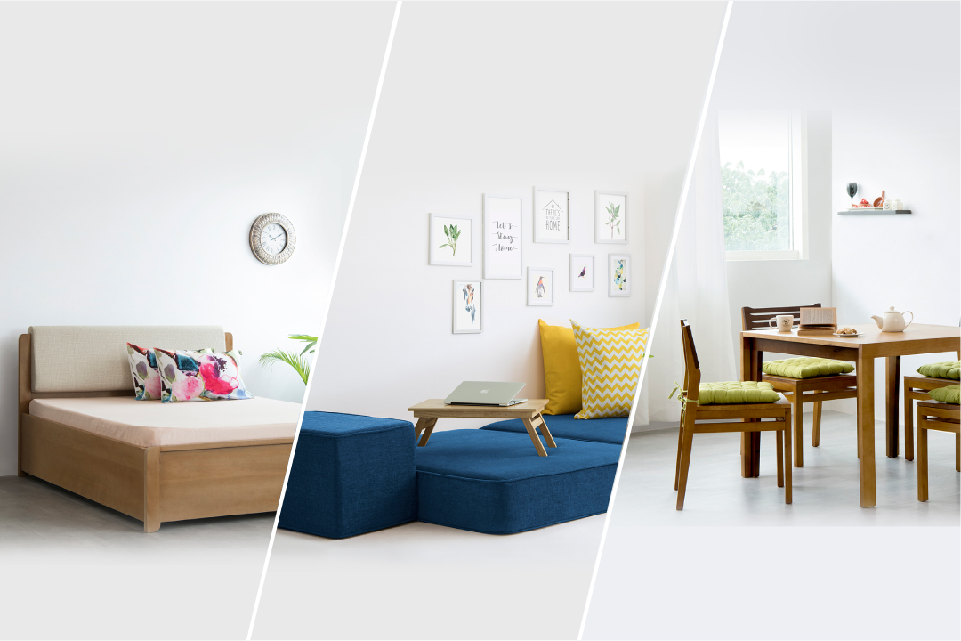
Campaign Goal
Develop an algorithm that will help online stores move towards automatic product recognition and accurately assign category labels and home goods images.

Slide 3
What was done?
Gather images from Kaggle - https://www.kaggle.com/c/imaterialist-challenge-furniture-2018
Apply Data Wrangling
- Label images with its correct number
- Get a subset of the data to apply deep learning
- Total images 3969
- 8 different categories
Apply Deep Learning

Slide 4
Deep Learning Models
Transfer Learning
VGG16
Feature Extractor -
Fine-tuning
Inception
Feature Extractor
Feature Extraction - Freeze the entire models weight but the fully connected layers. So, we can train on our images.
Fine-Tuning - Freeze most of the model, but leave some blocks as trainable. So, we will use the model architecture and some of the trained weights.

Slide 5
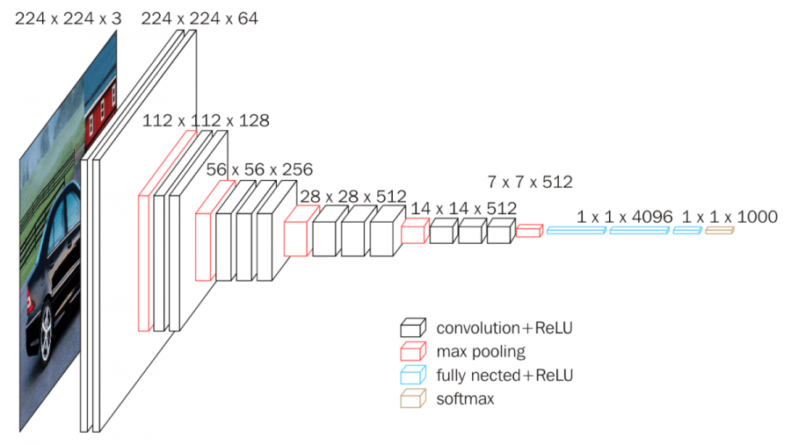
VGG-16 | Feature Extractor
Accuracy - 93.4%
Validation Accuracy - 85%

Slide 6
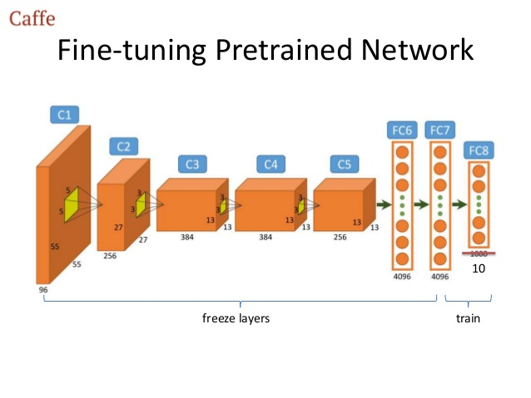
VGG-16 | Fine Tuning
Accuracy - 93.4%
Validation Accuracy - 83.6%

Slide 7
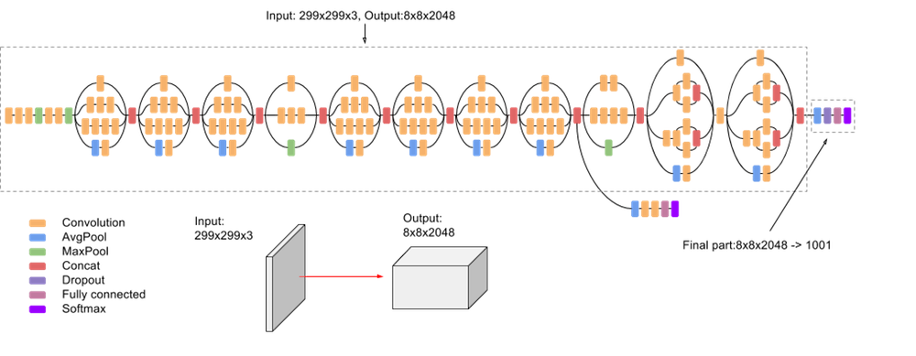
InceptionV3 | Feature Extractor
Accuracy: 93.6
Validation Accuracy: 78.2%

Slide 8
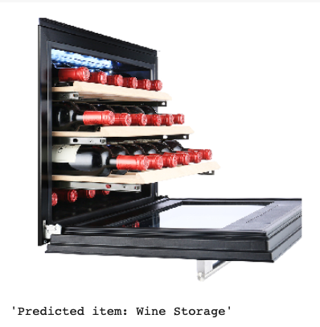
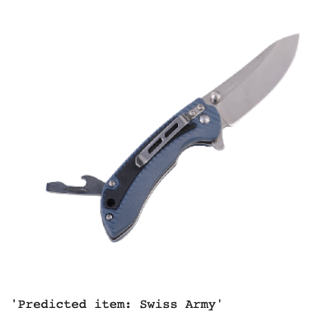
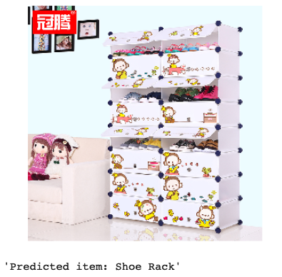
Best model & Images Recognized
VGG-16 as feature extractor

Slide 9
Next step:
Introduce more categories to our model
Use API of a large furniture & home goods store to import and use their images/products.
Create an app where people can take a picture of their dream furniture/home goods, upload and we will use a model to cluster similar products with a better price.

