Slide 1

$$u(x)$$

Slide 2
$$u(x)$$

Slide 3
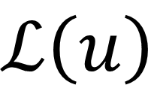
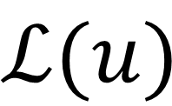
$$u(x)$$
$$ℒ\left(u\right)$$
$$ℒ(u)$$

Slide 4
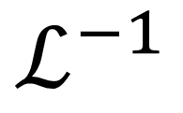
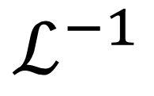
$$u(x)$$
$$ℒ\left(u\right)$$
$$ℒ(u)$$
$$ℒ^{−1}$$
$$ℒ^{−1}$$

