Slide 1
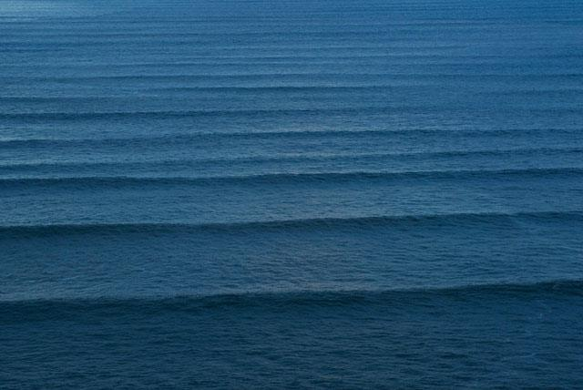
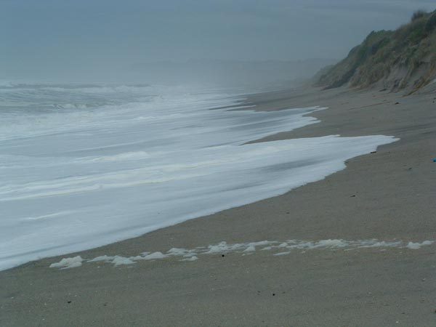
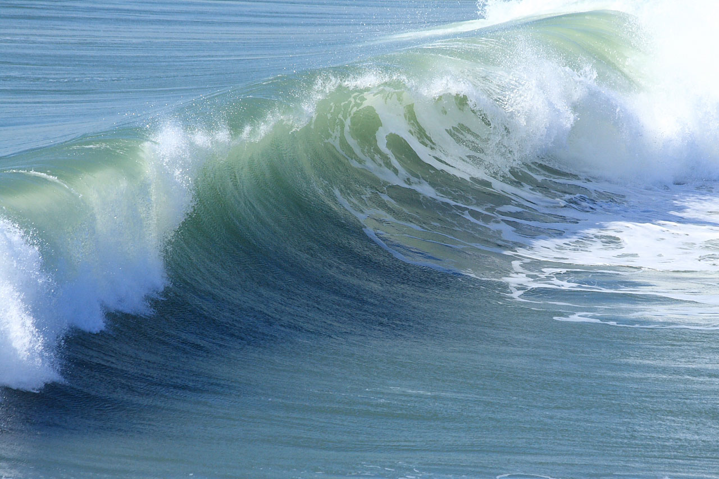
Model 1
Model n-1
Model n
. . .

Slide 2
Model 1
Model n-1
Model n
. . .
Ocean propagation
Shore interaction
Spectral models
Time domain models
Low resolution
High resolution
Linear phenomena
Strong non-linear phenomena

Slide 3
Model 1
Model n-1
Model n
. . .
Ocean propagation
Shore interaction
Spectral models
Time domain models
Low resolution
High resolution
Linear phenomena
Strong non-linear phenomena

Slide 4
Model 1
Model n-1
Model n
. . .
Ocean propagation
Shore interaction
Spectral models
Time domain models
Low resolution
High resolution
Linear phenomena
Strong non-linear phenomena

