Slide 1
Active IT Audit Manual
Tutorial

Slide 2
Applicable to versions:
Web
Desktop v2.x

Slide 3
“IT Audit is an examination of implementation of IT systems to ensure that they meet the organization’s business needs without compromising security, privacy, cost, and other critical business elements.”
(WGITA – IDI HANDBOOK ON IT AUDIT FOR SUPREME AUDIT INSTITUTIONS)

Slide 4
“Audit of Information Systems may be defined as the examination of controls related to IT-driven information systems, in order to identify instances of deviation from criteria, which have in turn been identified based on the type of audit engagement - i.e. Financial Audit, Compliance Audit or Performance Audit.”
(GUID 5100 PARAGRAPH 3.2)

Slide 5
Objective
The Active IT Audit Manual tool is based on the IT Audit Handbook and have the essential objective of helping the auditor to plan and conduct IT audits
It provides the users with:
practical guidance
essential technical information, and
key audit questions

Slide 6
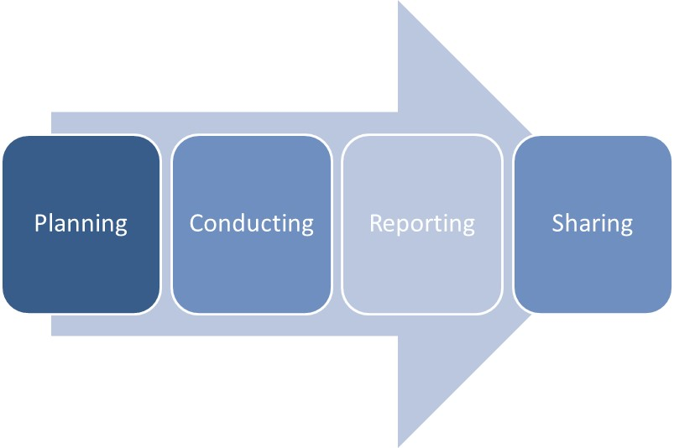
The full process diagram can be see next:

Slide 7
It’s important to ensure that the audit process is preserved to enable subsequent verification, monitoring and share of the audit analysis procedures (ISSAI 100 PARAGRAPH 42). This involves documenting:
• The plan, scope and objectives,
• Audit program,
• Evidences collected.

Slide 8
Template activity plans, which includes the subject, criteria and scope are produced, as well audit matrices to help recording the findings during the IT audit conduct and executive summaries.
The matrices are actually taken from the annexes of the WGITA – IDI Handbook on IT Audit for Supreme Audit Institutions and can be used by the auditors as working papers.

Slide 9
The obtained findings can be latter collected in a central point to help the auditor interpreting and judging against the audit questions previously raised at the planning stage. They also form the core of the information to share with the community, along with references for the published audit report, in the project” Control Space of e-Government” (the CUBE), an EUROSAI Initiative.

Slide 10





Desktop versions and coverage
Developed and maintained:
Under stable, wide accepted and (even) open productivity software;
To support the major desktop ecosystems;

Slide 11
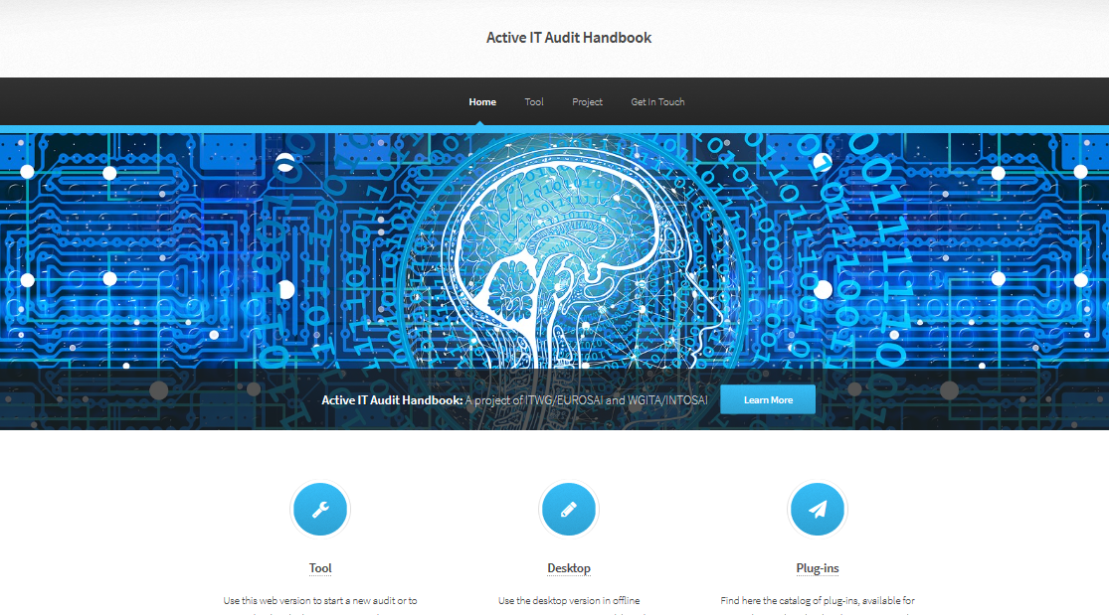
Web version
http://aitam.tcontas.pt

Slide 12
Configure the working environment
The desktop version is provided as a zip folder. It contains a spreadsheet in MS Office (StartHereMSOffice.xlsm) and in Libre Office (StartHereLibreOffice.ods) as a control dashboard for the audit development and several matrixes templates.
Once extracted, all files must be kept in the same folder and subfolders.

Slide 13
Configure the working environment
The internal behavior of the spreadsheets in desktop versions, as well of some text templates, was customized through macros, in VBA/BASIC. To help the code inspection is full commented in English. It only references functions and objects (late binding) pre-installed in OS (no need to reference additional libraries).
So, you only have to enable macros!

Slide 14
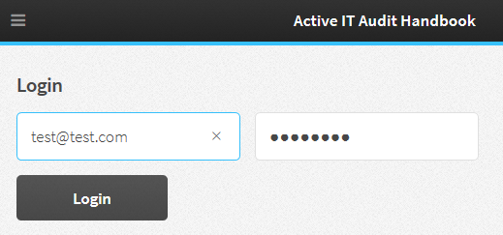
Web version
Single prerequisite to work in:
Username / password.

Slide 15






WEB
Physical
Working Session
Local copy of document
Metadata
AITAM WEB working session infrastructure
Automatic garbage collection
(does not store information permanently on servers)

Slide 16
Web version
(Main) key ideas and challenges
A unique software solution, used and shared by all
Maintenance of core functionalities and behaviours
Common base parameterization and update
Based on open-source software (Node.js and JavaScript)
Solution published in collaborative repository
Universal experience across wide spectrum of devices (HTML5)

Slide 17
Web and desktop versions
(Main) key ideas and challenges
Core functionalities are maintained (but with slightly different mechanisms).
Same internal structure to store and distribute data (XML) as desktop version, preserving the formal description of the elements and the attributes.
Means: electronic data interchange across desktop and web current versions.

Slide 18
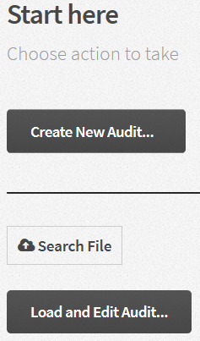
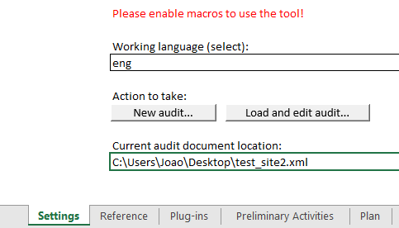
Working environment (initial set.)
Start creating an audit or loading an existent one to work on it.
Notes:
Desktop versions allow multi-language

Slide 19
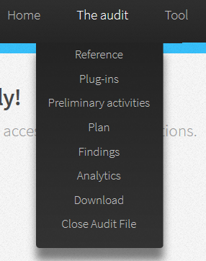
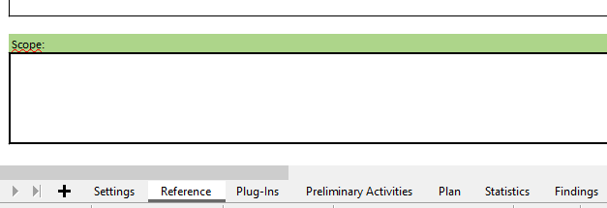
Working environment (structure)
The core working areas are structured in worksheets (desktop version) or submenus/commands under the “Audit Menu”.

Slide 20
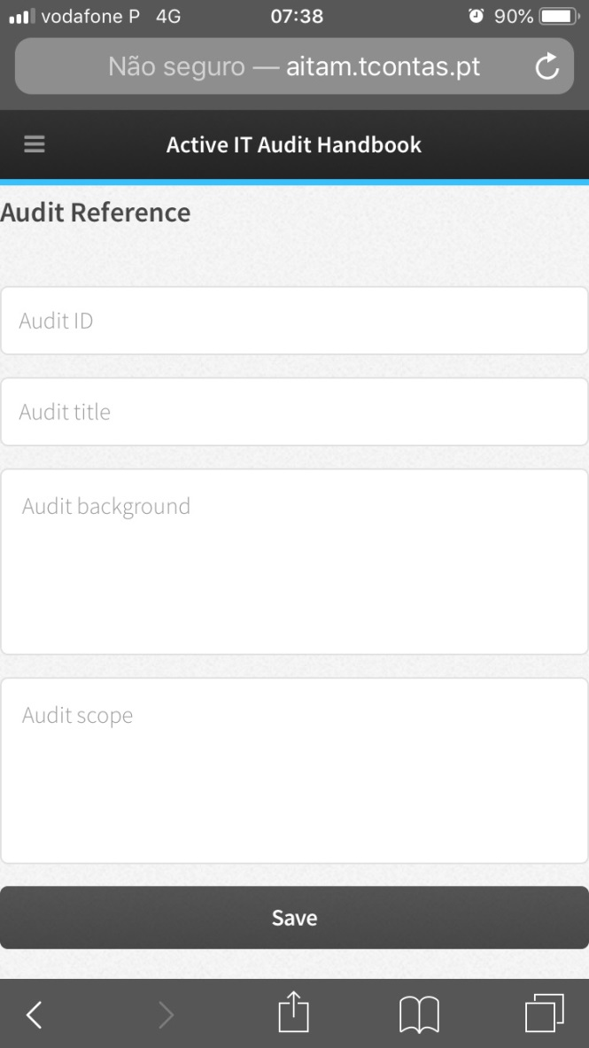
(Audit) Reference
In the first worksheet/command (named “Reference”) auditors can describe the audit in more detail, starting customizing it.

Slide 21
Preliminary activities
“auditors should obtain an understanding of the nature of the entity/programme to be audited.” (ISSAI 100 paragraph 49)
The worksheet/command “Preliminary activities” provides the user with additional guidance (as pointed out on GUID 5100):
The role and timing of planning;
Preliminary engagement activities;
Planning activities;
Knowledge of the auditee and of the environment;
Scope of the assessment: Which information systems, which logical, physical or geographical boundaries?
Resources available: Qualified staff or consultants, budgets, timeframes;
Availability of reliable threat statistics and cost figures, appropriate for the local conditions; adaptation of the default values, as necessary;
Additional considerations in initial audit engagements.

Slide 22
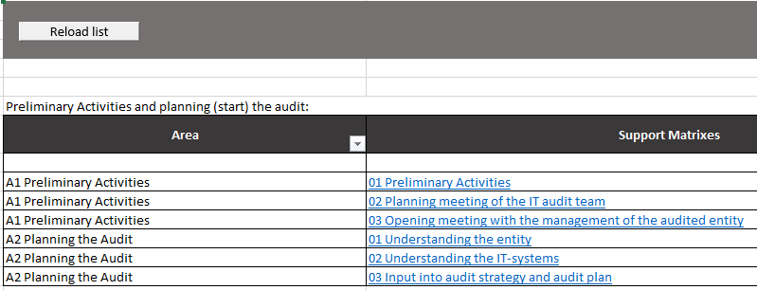
Preliminary activities
Those activities are aggregated in domains. They are a hyperlink for the corresponding matrix, which will assist the auditor.

Slide 23
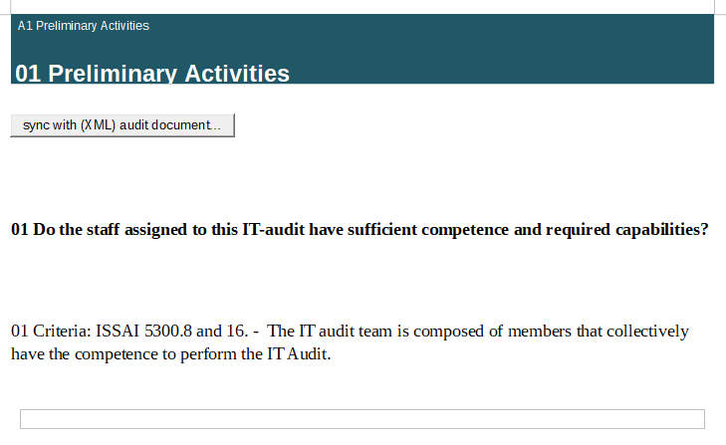
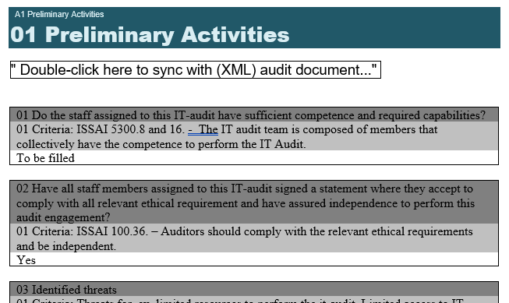
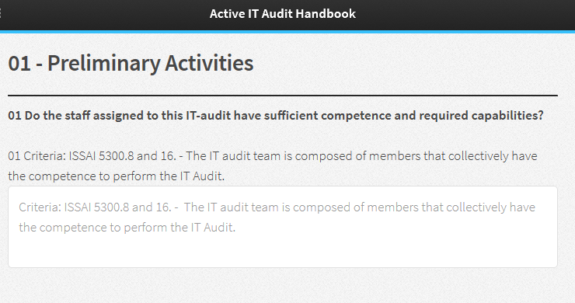
Preliminary activities
In the desktop versions the auditor will use the matrix to fill information and sync with dashboard. At web version, a form is provided, but the user can generate a print version.

Slide 24
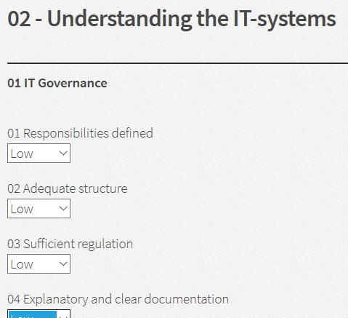
Preliminary activities
In particular, the matrix named 02 Understanding the IT-systems, under preliminary activities domain A2, is also automated. It maps the different IT domains and areas in order to help the auditor perform a preliminary assessment of IT Controls. Once used and filled, it can be later synchronized with risk analysis as a suggestion and a guide to auditor judgment.

Slide 25
Pre-audit analysis
The pre-audit analysis goal is to provide data, which will support risk analysis, i.e. basis for the planning the audit and organising the initial audit folder. The process looks as follows:
Input:
information obtained from auditee in the pre-audit phase;
additional relevant data concerning the auditee and their IT systems;
results of other audits at the auditee or covering similar types of problems.

Slide 26
Pre-audit analysis
The pre-audit analysis goal is to provide data, which will support risk analysis, i.e. basis for the planning the audit and organising the initial audit folder. The process looks as follows:
Steps:
Analyze available input data.
Generate the form A2.02 Understanding IT systems – it will depend of the type of IT audit you perform – standard IT Audit Handbook based or Plug-in based. The form will by generated automatically after clicking the A2.02 Understanding IT systems, and will take into account the basis of the IT audit.
Decide about qualifications of relevant fields in the form A2.02 Understanding IT systems.

Slide 27


Pre-audit analysis
The pre-audit analysis goal is to provide data, which will support risk analysis, i.e. basis for the planning the audit and organising the initial audit folder. The process looks as follows:
Steps (cont.):
Map the pre-audit analysis results to the risk analysis grid. For this particular step the user must, at first, access the “Plan” worksheet and press the action button “Get Areas and Issues” to obtain the information about different IT domains which will assist the IT auditors in identifying potential auditable areas. At the top an action button, named “Sync with pre-Assessment”, is available. Once pressed, triggers the synchronization process between the information previously collected and evaluated in the pre-assessment and the risk analysis.

Slide 28
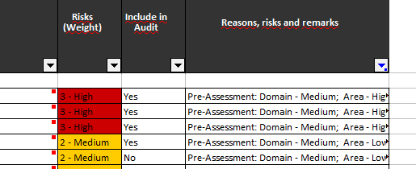
Pre-audit analysis
The pre-audit analysis goal is to provide data, which will support risk analysis, i.e. basis for the planning the audit and organizing the initial audit folder. The process looks as follows:
Steps (cont.):
Complete the risk analysis by applying professional judgement
The pre-audit analysis can be helpful in preparation of the audit and in more precise risk analysis. The tool will work, however, even if the analysis is not performed, which means the risk analysis is based on the professional judgment only.

Slide 29
Plan
Plan on a risk assessment based selection (map domains, areas and issues, design the audit)
Centered in detailed description of different IT domains which will assist the IT auditors in identifying potential auditable areas
IT Governance
IT Operations
Development and Acquisition
Outsourcing
Information Security
Business Continuity and Disaster Recovery
Application Controls

Slide 30
Plan (scoping)
Start with planning on a risk assessment based selection
We call it scoping through IT domain cascade:
Identify a specific domain or a combination of domains
Select the most critical areas and issues

Slide 31
Plan (scoping)
“The scoping of IT Audit would involve deciding the extent of audit scrutiny, the coverage of IT systems and their functionalities, IT processes to be audited, locations of IT systems to be covered and the time period to be covered.”
(WGITA – IDI Handbook on IT Audit for Supreme Audit Institutions)
The auditors should select the audit areas and issues through the planning process by analyzing potential areas and issues, as well identifying risks and problems.
As soon as you access the worksheet or the command named “Plan”. It establishes the mapping table of different IT domains which will assist the IT auditors in identifying potential auditable areas.

Slide 32
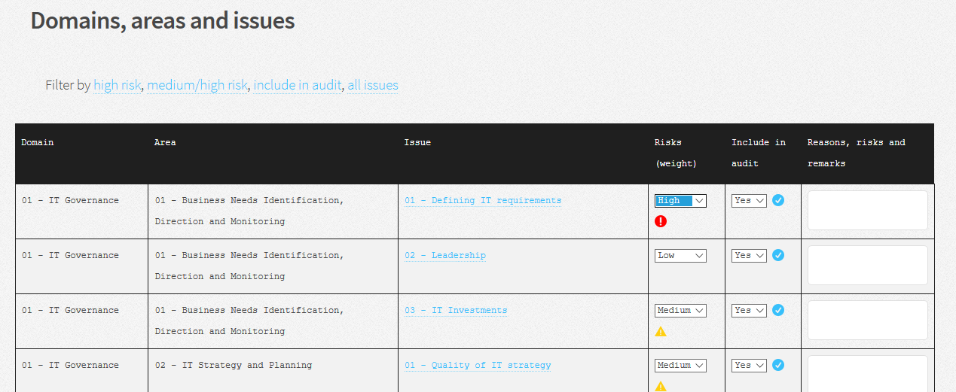
Plan (scoping)

Slide 33
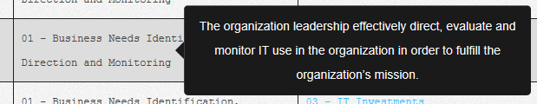
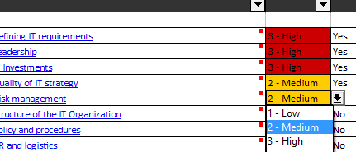
Plan (scoping)
A dashboard with the different IT domains and respective areas and issues is obtained.
The domain and the area names have tooltips associated, which provides a short description. The guidance provided on each domain or area may help the auditor plan their audits.
In this dashboard the user can mark (to include in audit) and score the appropriate issues (weight) for the selected audit focus.
Note: a high score (3) marks automatically the issue

Slide 34
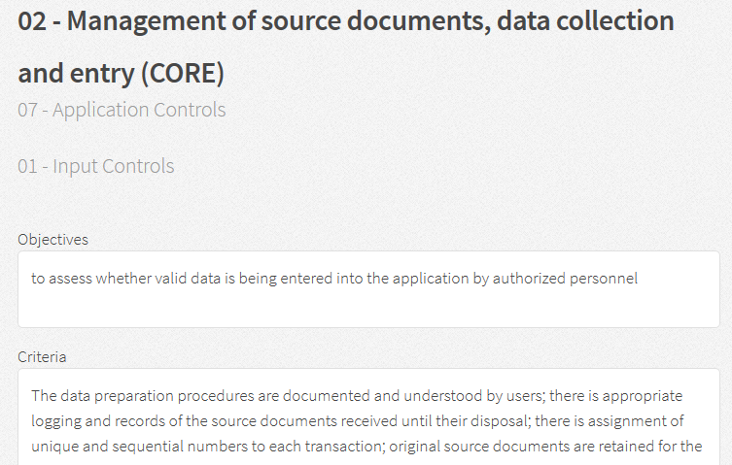
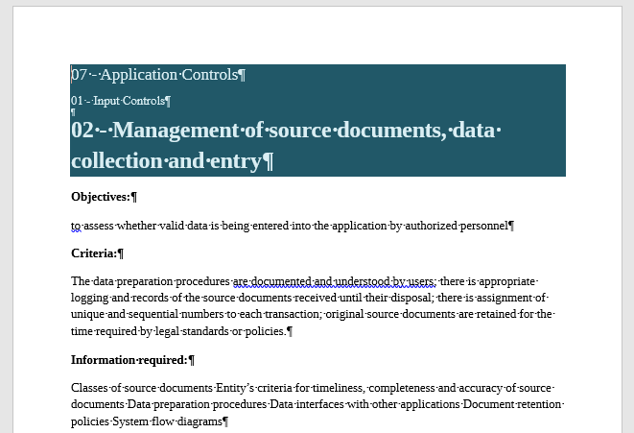
Plan (scoping)
IT issues are now a hyperlink for the corresponding matrix, which will assist the auditor as a starting point to assess the controls that the organization has put in place to manage at an acceptable level and mitigate the risks they face in the domain/area.

Slide 35
Plan (scoping)
The audit matrices cover the IT auditing process. Their internal structure outline important audit issues, criteria, analysis methods under the different IT Audit domains/areas.

Slide 36
Plan (scoping)
The matrices should be prepared at the planning stage, however the contents can be updated during IT audit process, if necessary.
Tips, examples and best practices are included in grey to guide the auditor. They can and should be replaced/extended with the appropriate information for the particular audit.
Note on matrices behavior:
In the desktop versions the auditor will use the matrix to fill information and sync with dashboard. At web version, a form is provided, but the user can generate a print version.

Slide 37
Plan (Mechanics)
Extract based on the scope and objective, then
On each level:
Analyze, validate and optimize each selection
Score relative importance within the extracted list
Develop a weighted list
Scope and objective
Domains
Areas
Issues
Use the information in related Audit Matrices at Criteria, Information Required and Analysis Method levels as work base and extend as necessary
Assertions
Audit tests plan
Extract the audit steps
Check and adapt so that all key audit questions are covered
Identify the accountable and responsible roles
Establish what management claims are in place and if they are working well

Slide 38
Plan (Mechanics)
Formal techniques, such as risk analysis or problem assessments, possible sources of evidence, auditability and significance of the issue considered, that can help the planning process can be recorded in the remarks column.
The key idea is to help the auditor to acquire sufficient knowledge about the audit objective and scope, discuss and mature it, ensuring therefore a proper plan.
The user should analyze the result and adjust where necessary.

Slide 39
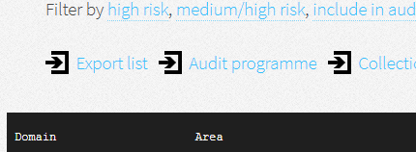
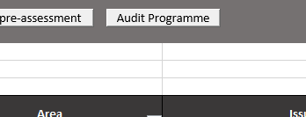
Plan (products)
Meeting with the ISSAI requirements related with the planning stage of audit process, the tool generates audit programmes, populated with the data previously recorded in the audit matrices, and ensures that they are preserved in standard containers to enable subsequent verification of the audit analysis procedures.
Only the issues marked to be included in audit will take part of the audit programme. Is generated by the auditor when pressing the matching action button.

Slide 40
Plan (products)
Despite the fact that the audit programme is produced at the audit planning stage, it includes the following features:

Slide 41
The introduction and use of
plug-ins
A plug-in (or plug-in, or extension) is a component that adds a specific feature to the “standard” Handbook on IT Audit for Supreme Audit Institutions

Slide 42
Purpose of plug-ins
To enable SAI’s creating abilities which extend or customize the tool
To share and reuse knowledge among auditors in SAI or between SAI’s
To address new and emerging areas of interest for IT auditors, like cloud computing, Web Services or OPEN DATA initiatives

Slide 43
Cosoistic
view
The plugins can be seen in the overall context of the tool as follows:

Slide 44
Future of plug-ins
The plug-in will be used to add new features and update the Handbook on IT Audit for SAI’s, highlighting emerging areas of interest and providing the users with essential information and key questions needed for an effective planning of IT Audits.

Slide 45
Examples of plug-ins

Slide 46
Plug-ins (Mechanics)
The tool provides services that the plug-in can use, including a way for plug-in to register with the tool (desktop version) and a defined structure for the exchange of data with plug-ins.
A plug-in still depend on the service and the structures provided by the tool and do not usually work by himself. Conversely, the tool operates independently of the plug-in, using the “core” Handbook on IT Audit for Supreme Audit Institutions as operational and informational basis, making it possible for end-users to add and update plugins dynamically without needing to make changes to the host tool:
A plug-in extends (doesn’t replace) the core IT Audit Handbook, adding new functionalities or characteristics.
A plug-in is instantiated and executed inside the application and interacts with core through the same user interface.

Slide 47
Plug-ins (Mechanics)
The Active IT Audit Handbook supports a type of plug-in that reflects at least the general structure of the core Handbook (domain structure).
To include a new plug-in, some simple rules must be followed:
At the web version, if present in catalogue, the plug-in is automatically available.
At the desktop version:
Download the desired plug-in from catalogue (is a xml file);
Save it inside the folder “plugin”, under “ActiveManual”;
If the spreadsheet (“StartHere.xlsm”) was already open, reload the list, pushing the corresponding action button.

Slide 48
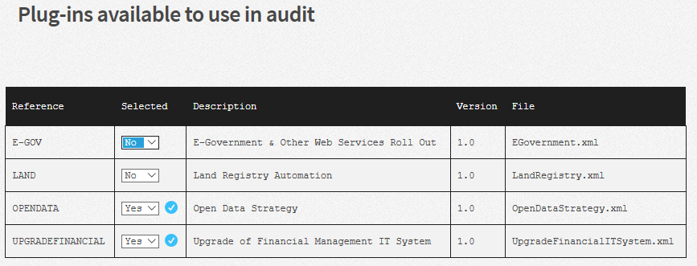
Plug-ins (Mechanics)
The application have a plug-in manager to guide the user

Slide 49
Plug-ins (Mechanics)
The plug-ins depend on the core IT Audit Handbook and preserve the global mechanics.
E-Government
Scope and objective
Domains
Areas
Issues
Land Registry
Open Data
…
Related Audit Matrices
Assertions
Audit tests plan

Slide 50
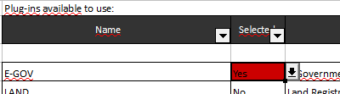
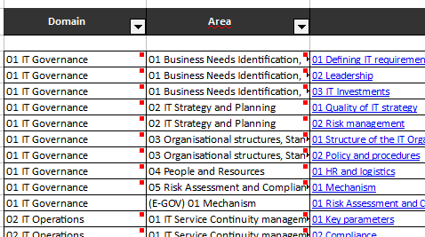
Plug-ins (Mechanics)
The plug-ins depend on the core IT Audit Handbook and preserve the global mechanics.

Slide 51
Conduct
(collect and consolidate obtained findings)
Evidence, findings and conclusions
“Auditors should obtain sufficient appropriate audit evidence to establish findings, reach conclusions in response to the audit objectives and questions and issue recommendations.”
(ISSAI 300 paragraph 38)
Collect findings
To assist the auditor collecting findings and suitable conclusions derived from the assessment the tool provides a dashboard inside the worksheet /command “Findings”.
Support matrices are available.

Slide 52
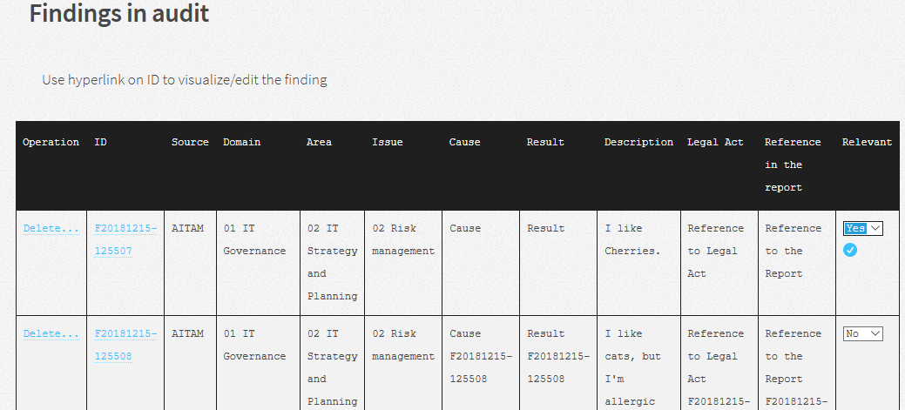
Conduct
(collect and consolidate obtained findings)

Slide 53
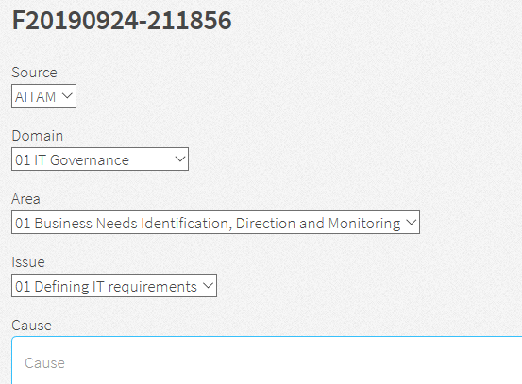
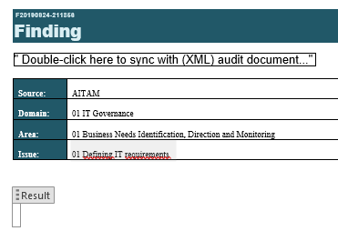
Conduct
(collect and consolidate obtained findings)
Support matrices are available.
In the desktop versions the auditor will use the matrix to fill information and sync with dashboard. At web version, a form is provided, but the user can generate a print version.

Slide 54
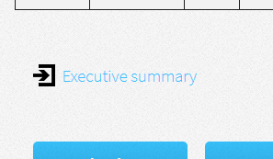
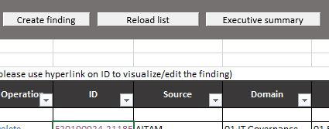
Conduct (products)
The tool generates executive summaries, populated with the information of the audit findings.
Only the findings marked as relevant will take part of the executive summary. This document is produced by the auditor when pressing the matching action button.

Slide 55
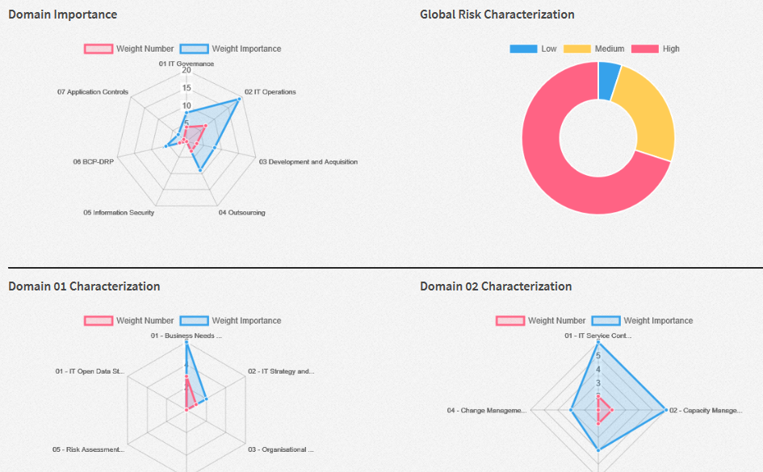
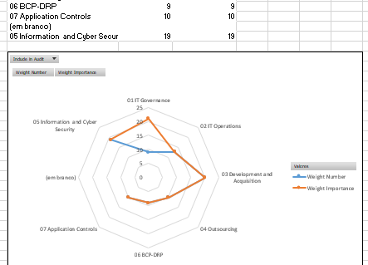
Analytics
By making use of spreadsheet analytical and web graphical features, the tool provides the auditor with a simple range of data (“Metrics” worksheet / Analytics menu), to evaluate the domain importance and characterization (global and specific).

Slide 56
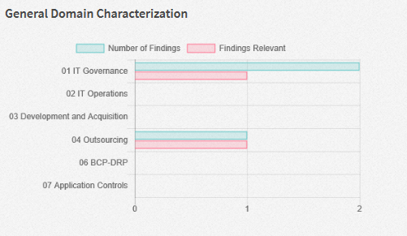
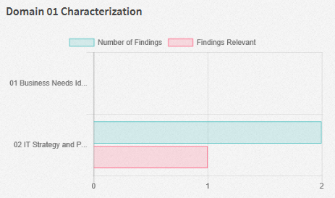
Analytics (web version only)
Includes an evaluation of findings to look for gaps among related relevant areas for audit

Slide 57
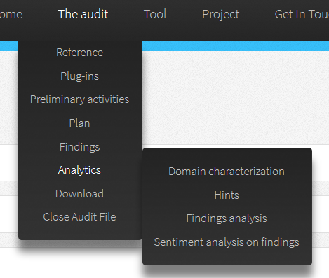
Analytics (web version only)
Opportunity to experiment and improve:
New integration paths with CUBE;
Apply Natural Language Processing (NLP), Graph Analytics and Machine Learning (ML).

Slide 58
Hints for the audit (web version only)
An analysis based on NLP to consider and find out through the CUBE how other nearby audits can help to make better use of current resources, heading the user to know:
Where are you?
Opportunities, risks and threats to look for!
How to get there? (and, potentially, obtain the desired outcome)
Such analysis can be performed at the planning or the execution phases of the audit.

Slide 59
Hints for the audit (web version only)
XML audit file
Pre-process data cycle to bring the data into a form that is predictable and analysable
Crawler
NLP processing
Graph visualization

Slide 60
Hints for the audit (web version only)
XML audit file
Pre-process data cycle to bring the data into a form that is predictable and analysable
Crawler
NLP processing
Graph visualization
(what is) Collected:
Risks and notes selected to “Include in audit”
Reference data form (attributes “title”, “background” and “ application notes”)
Pre-assessment data form
Findings (all)
Issue Matrices selected for audit (attributes “objectives”, “criteria”, “Information Required”, “Analysis Method”, “Found Previously” and “Conclusion”)
07/11/2019

Slide 61
Hints for the audit (web version only)
XML audit file
Pre-process data cycle to bring the data into a form that is predictable and analysable
Crawler
NLP processing
Graph visualization
Steps:
Tokenizer
Normalize (convert to lower case and inflector to singularize)
Filter (tokens not alphabetic)
Stop words filtering
Entity extraction (identify potential tokens using gazetteers: token + annotation/context)
Combine (list of unique terms/tokens)
Term weighting (ID/IDF)
Vector of terms
Lemmatization (Wordnet for mappings) and Stemming processes (like Porters Algorithm) not used: tests didn’t show improvements in classification accuracy
07/11/2019

Slide 62
Hints for the audit (web version only)
XML audit file
Pre-process data cycle to bring the data into a form that is predictable and analysable
Crawler
NLP processing
Graph visualization
Steps:
Cypher query (using vector of terms to find audit recommendations)
Model served through a graph, using traditional graph metrics
Connects with graph database
07/11/2019

Slide 63
Hints for the audit (web version only)
Graph-like structures to support the find of similarities (an experiment to model audit):
Graph-like structures to describe the audits and risk cases (use of a graph structure to find out useful paths between data);
Store and present the information as nodes (data points) and relationships (connections) that the user can query and traverse;
They can be represented as a "graph" and they can have one or more starting points in queries, or "anchors", in the graph from where the user can start traversing out and reach the audit report in the CUBE;

Slide 64
Hints for the audit (web version only)
Descriptive diagram (example)
Topic
Cover a:
Identified a:
Risk Case
Address a:
Audit
Public Activity Domain
Resulting in:
Evaluate a:
Process Control
Observation
Risk: Yes

Slide 65
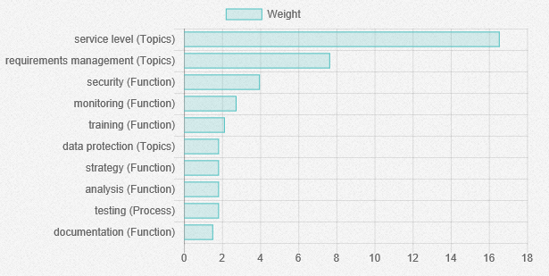
Hints for the audit (web version only)
Most relevant terms discovered and analyzed using Term Frequency-Inverse Document Frequency (TF-IDF) mechanism:

Slide 66
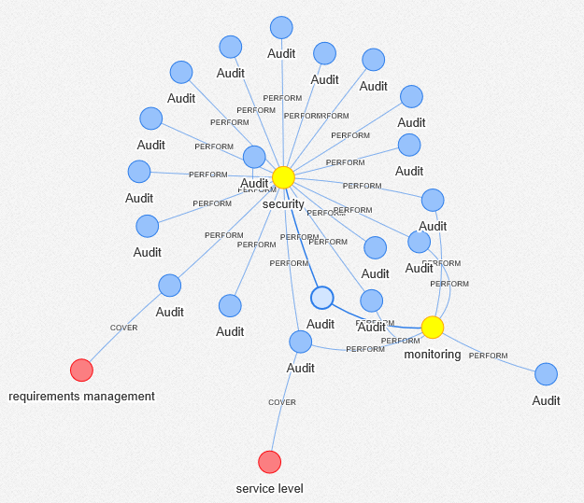
Hints for the audit (web version only)
Results as a graph

Slide 67
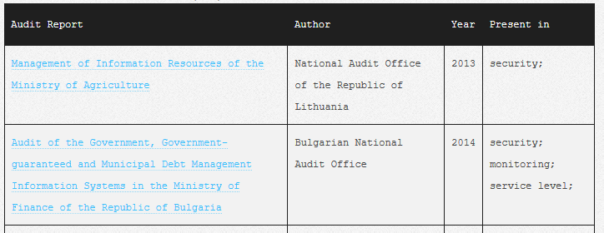
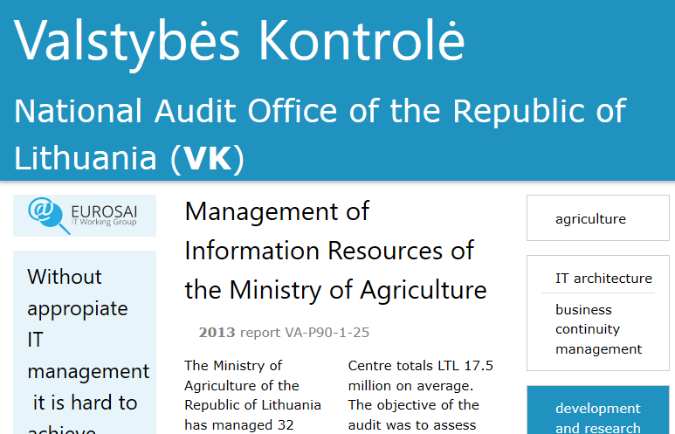
Hints for the audit (web version only)
Results as a table

Slide 68
Sentiment analysis on findings
(web version only and experimental)
Analysis to measure attitude towards findings. Based on Natural language processing (AFINN algorithms) to consider and find out the polarity of a given text at the document:
Addresses findings;
Possibility: compare with pre-assessment and discover differences in emotional tones about same realities;
Still in an early stage phase with comparative tests against Microsoft and Google API’s.

Slide 69
Sentiment analysis on findings
(web version only and experimental)
XML audit file
Pre-process data cycle to bring the data into a form that is analysable
Crawler
NLP processing
Presentation
(what is) Collected:
Findings (all)
Steps:
Tokenizer (NLP sentence tokenizer)
Sentiment Analysis (AFINN)
Results presented for each sentence and expressed in -5/5 numerical range
-1,0 to -0,25: negative;
-0,25 to 0,25: mixed / neutral;
0,25 to 1,00: positive

Slide 70
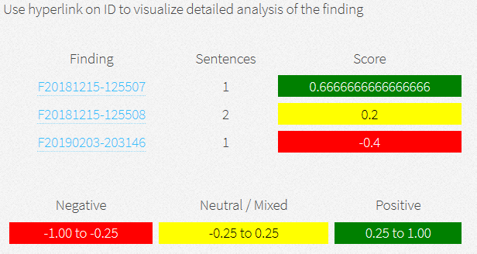
Sentiment analysis on findings
(web version only and experimental)

Slide 71
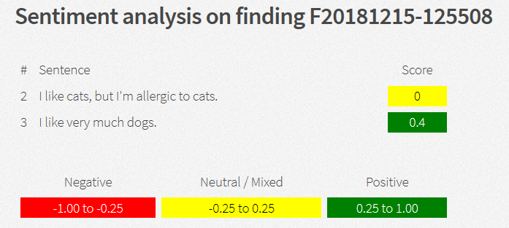
Sentiment analysis on findings
(web version only and experimental)

Slide 72
Active IT Audit Manual
Happy IT Audits!

