Slide 1
WORLD POPULATION
Business Intelligence – Systems Infrastructure Data Visualization
Ife, Joao Carolino, Micky, Vinicius

Slide 2

Datasets
Data sources from UN
GDP
2 datasets
Population
Life expectancy
Data since 1970

Slide 3




Tools
Tools used
PowerBI
Visualizations
Forecast
Python
Data processing and forecast
Google Colab
Free colaboratory jupyter notebook environment
Google drive
Live “extract” using PowerBI
Refresh data

Slide 4
Data Processing
Data processing with python
Google Colab
Combine information from many files
Joined files to create one final file to be used containing all the information
Data processing made it easier to write the final file
Check for blank or null values
Fill up missing values from other sources
Reusable code to rewrite the file

Slide 5
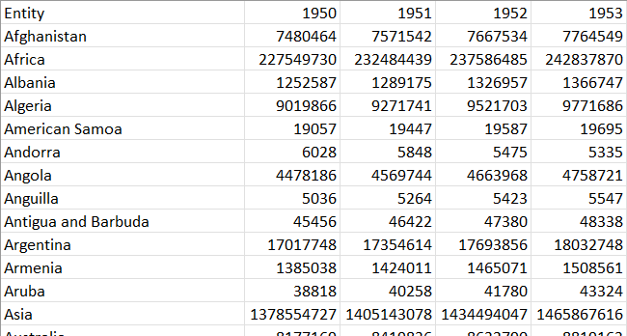
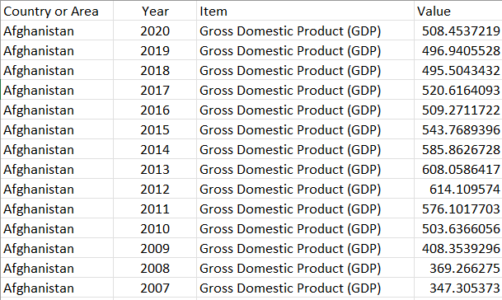
Data Processing
Examples of datasets used
Population
Gdp

Slide 6
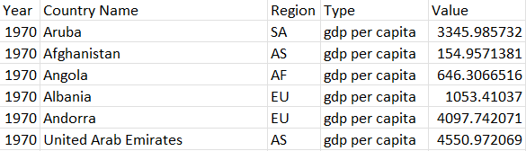
Data Processing
Example of the final dataset after data processing
Columns for Years, Country Name, Region, Type and Value
Type as the series (gdp, population, life expectancy, etc)

Slide 7
Data Processing
Issues faced during data processing:
Missing values
Country names were slightly different
Country names were used as Foreign Keys to join the information together
Validation required to not miss any values
Datasets format
Columns and rows

Slide 8
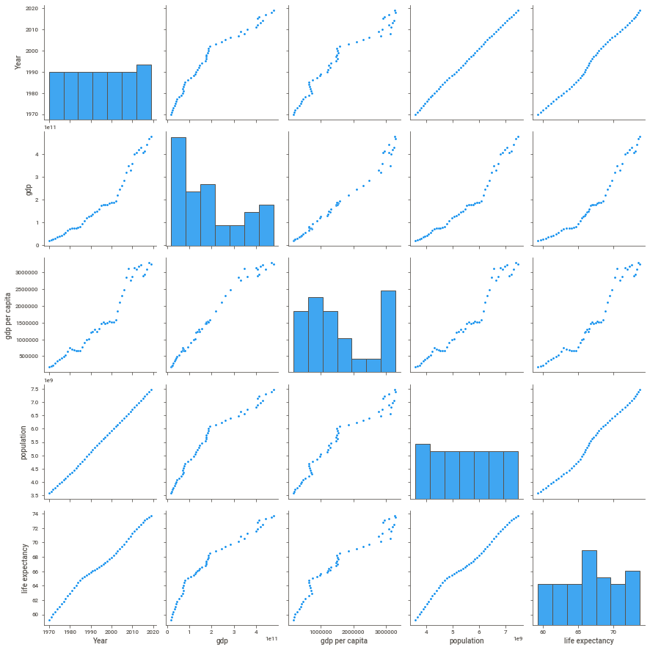
Correlational Analysis

Slide 9
Model Creation
In order to do the prediction for the populations and compare the performance, multiple models were applied to the dataset:
Power BI forecasting (ETS (ANN) Model) - model glorifies the chances of capturing different combination of linear and/or nonlinear patterns in time series
Linear Regression Model

Slide 10
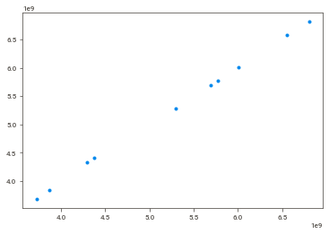
Performance Comparison
The regression model predicted the population with a high accuracy as proven by a coefficient of determination value of 0.99967 (99.6%)
This is also further proven by the comparison between the predicted values and actual values as provided in the chart below.

Slide 11
Reason for Model Selection
The linear regression, which fits a least squares line to the historical data (or transformed historical data), represents the long range, which is conditioned on the basic trend. Holt's linear exponential smoothing captures information about recent trend.

Slide 12
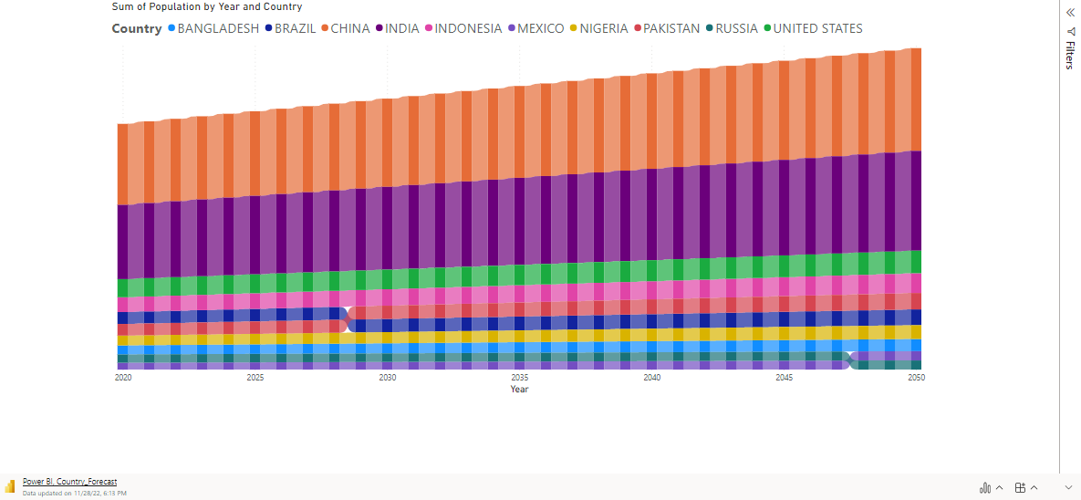
Population Prediction by Top 10 Countries

Slide 13
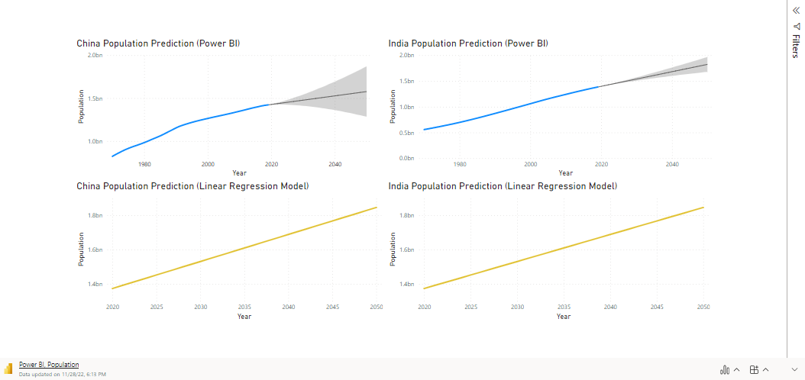
Performance Comparison - Example

Slide 14
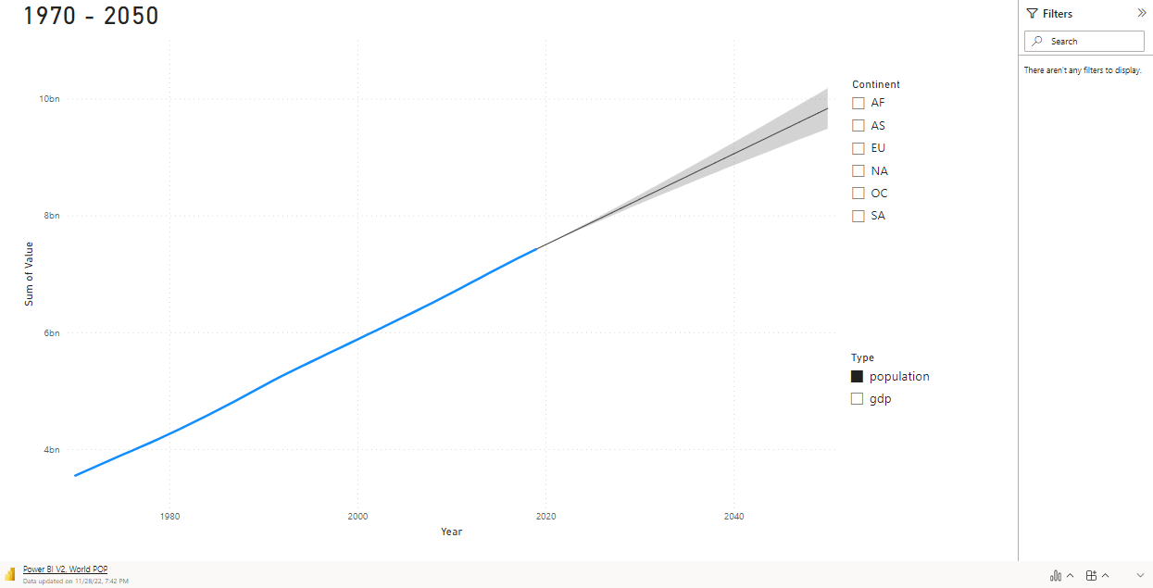

Slide 15
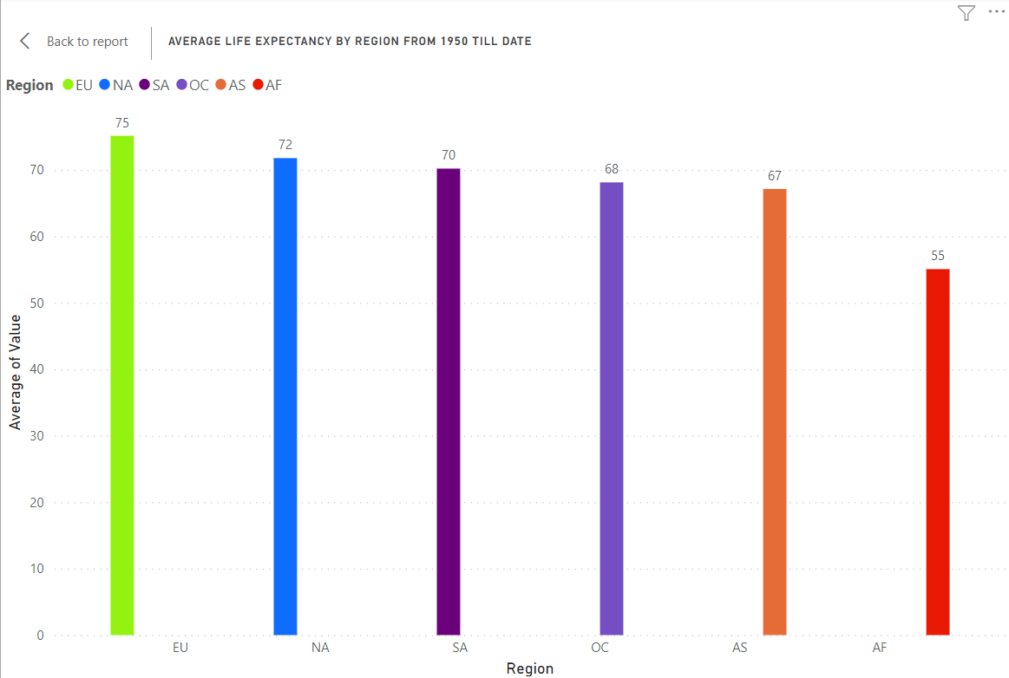
Average Life expectancy by Region from 1970 till date
Factors Affecting Life Expectancy
Gender
Education
Lifestyle

Slide 16
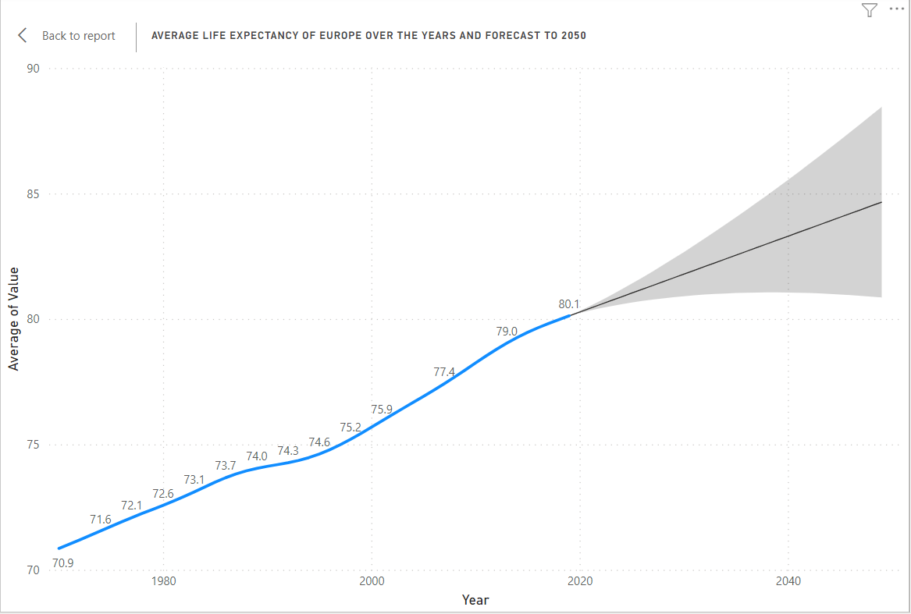
Average Life Expectancy of Europe over the years and forecast to 2050
Factors Affecting low life expectancy
Availability of health facilities
Education and literacy
Low birth rates
Retirements
Advanced technology

Slide 17
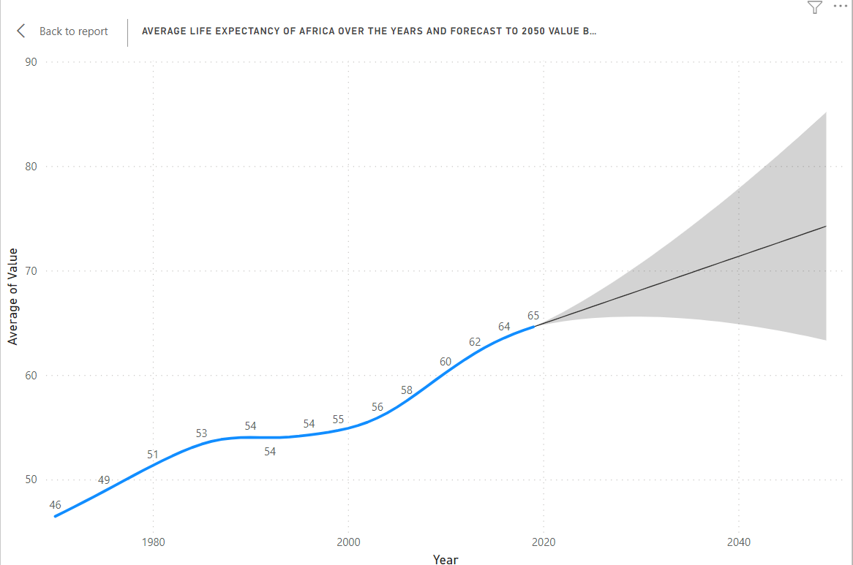
Average Life expectancy of Africa over the years and Forecast to 2050
Factors Affecting low life expectancy
Poverty
Poor and limited health facilities
High birth rates and fertility
Illiteracy
Working beyond 65 years instead of retiring

Slide 18
POPULATION X GDP

Slide 19
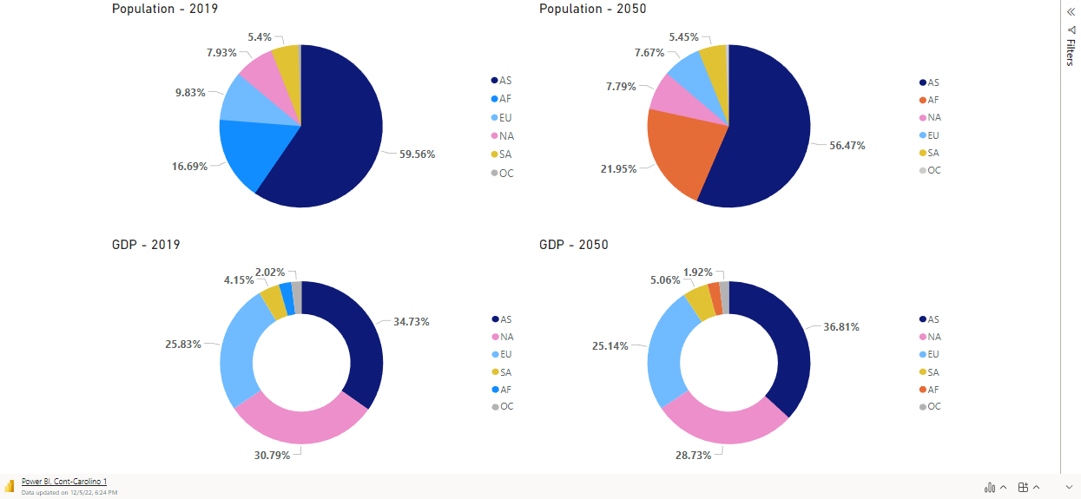
Continents Comparison

Slide 20



Slide 21
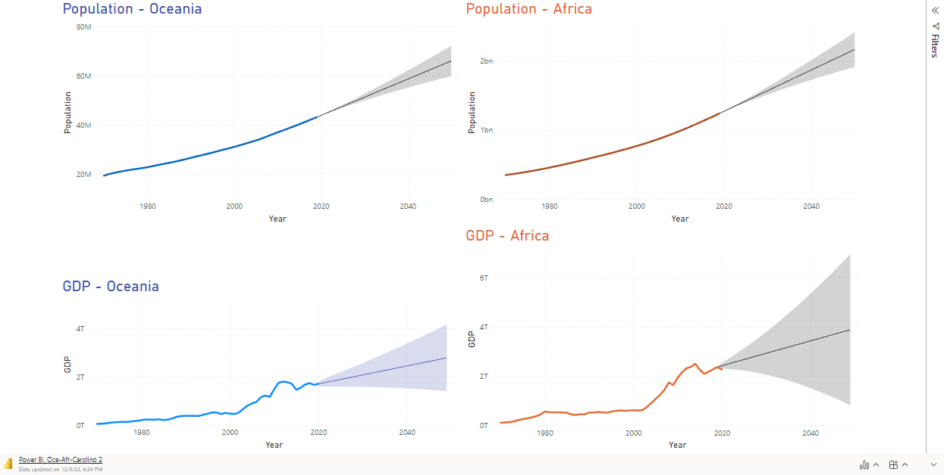

Slide 22
Thank you!

