Slide 1
The Effect of Gasoline and Diesel Prices on Consumption in Canada
Joao Carolino de Oliveira, Lauren Lussier, Micky Mwiti
Notes:
1

Slide 2

Does the price you pay dictate what you buy?
------------------------------------------------------------------------------------------------------------
Gas and diesel are essential to our everyday lives
With prices rising consistently, what does that mean to Canada’s buying patterns?
Domestic consumption, production, import and export on the price of Gasoline and Diesel
Notes:
1-Why we choose these factor

Slide 3
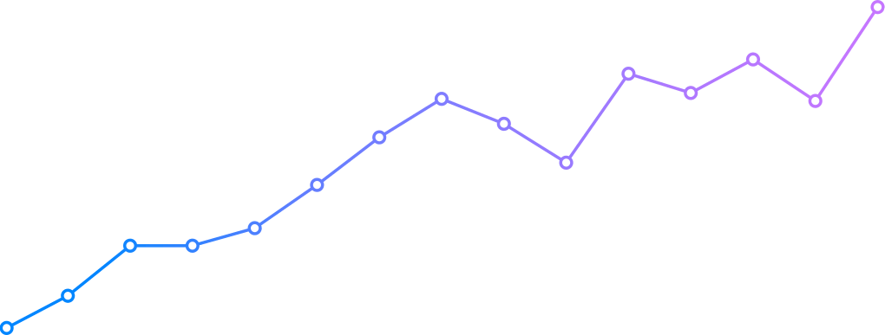
Our Data
Sources used:
International Energy Agency (IEA)
Monthly gasoline and diesel prices
Statistics Canada
Oil production, imports, exports, and domestic consumption
7 years of collected data
6 years of predictive data
Notes:
1-Stats Canada, IET

Slide 4
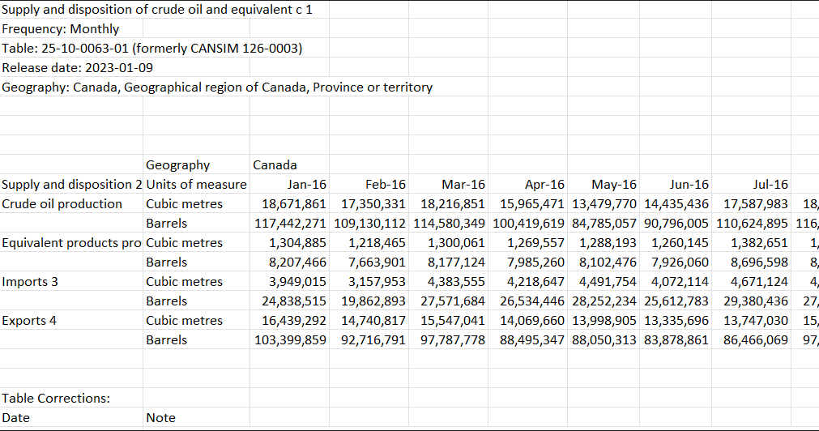
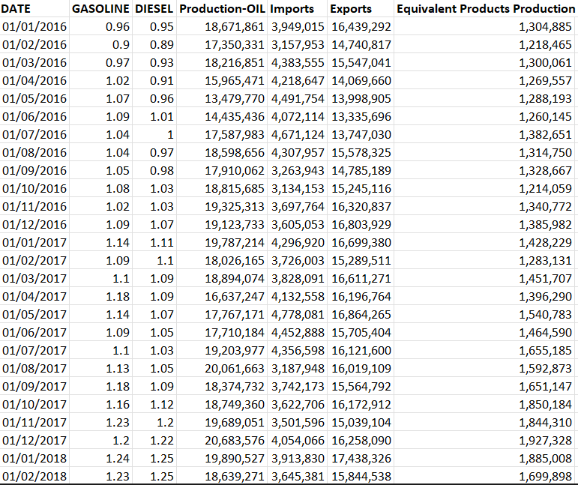
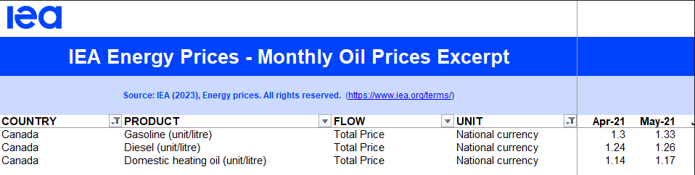
Data Processing
Notes:
1-What we had to do to selected data

Slide 5
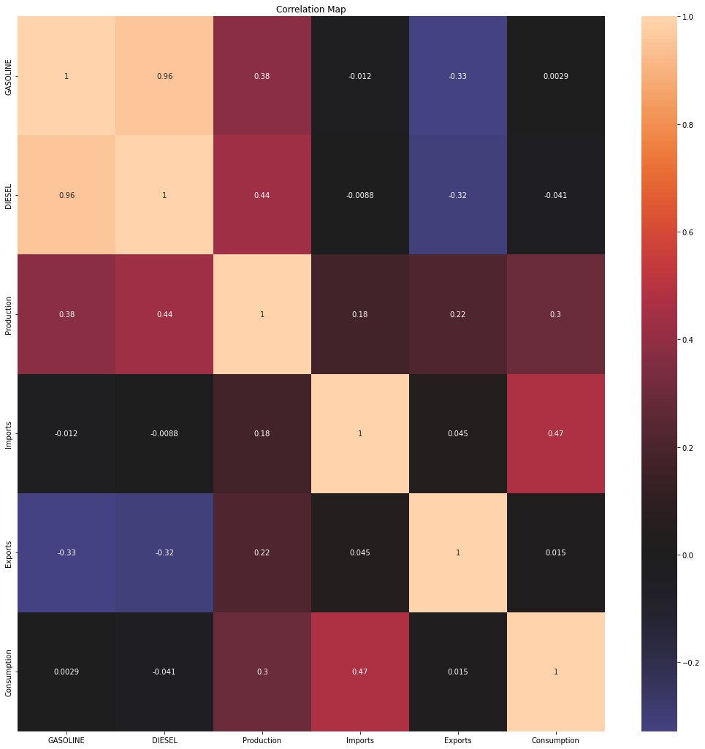
Correlation
Matrix
Notes:
2-Correlational Analysis - Explain

Slide 6
Selected Models
In order to do the prediction compare the performance, multiple models were applied to the dataset:
Exponential Smoothing (ANN) Model - model glorifies the chances of capturing different combination of linear and/or nonlinear patterns in time series
Linear Regression Model - is a regression model that estimates the relationship between one independent variable and one dependent variable using a straight line.
Autoregressive Integrated Moving Average (ARIMA) - is a method for forecasting or predicting future outcomes based on a historical time series.
SARIMA - ARIMA takes into account the past values (autoregressive, moving average) and predicts future values based on that. SARIMA similarly uses past values but also takes into account any seasonality patterns.
Notes:
2-Briefly explain the different models

Slide 7
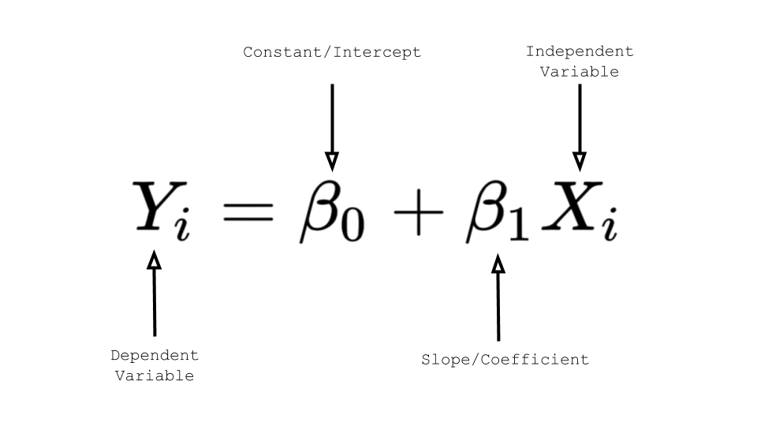
Linear Regression
Linear regression models have two main parameters:
the coefficients that represent the relationship between each independent variable and the dependent variable, and the intercept which is the point at which the regression line crosses the y-axis. These parameters are estimated during the training process.
Notes:
2-Short description

Slide 8
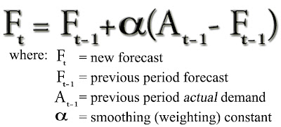
Exponential Smoothing
Exponential smoothing models have three main parameters:
Alpha represents the smoothing factor for the level
Beta represents the smoothing factor for the trend
Gamma represents the smoothing factor for the seasonality.
Notes:
2-Short description

Slide 9
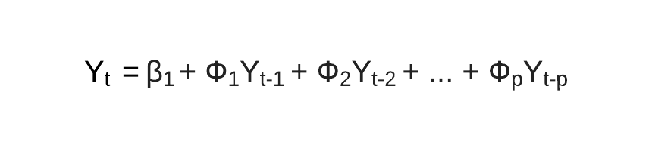
Arima
ARIMA (Auto-Regressive Integrated Moving Average) models have three main parameters: p, d, and q.
p is the number of autoregressive terms
d is the number of differences needed for stationarity
q is the number of moving average terms.
Notes:
2-Short description
These parameters are used to model the temporal dependencies in the data. The p parameter models the dependency on past values of the same variable, d parameter is used to make the series stationary by differencing, and q parameter models the dependency on the errors or residuals of the past predictions.

Slide 10
Performance Evaluation
Accuracy comparison each model and Error measure comparison
 | Mean Absolute Error | Root Mean Squared Error | Mean Squared Error
Linear Regression | 0.14388645513302264 | 0.13996064812072576 | 0.019588983022373618
ARIMA | 0.42913918335163104 | -4.227052460719478 | 0.24836276463705098
SARIMA | 0.14388645513302264 | 0.1793471748408522 | 0.0321654091233952
Notes:
2-

Slide 11
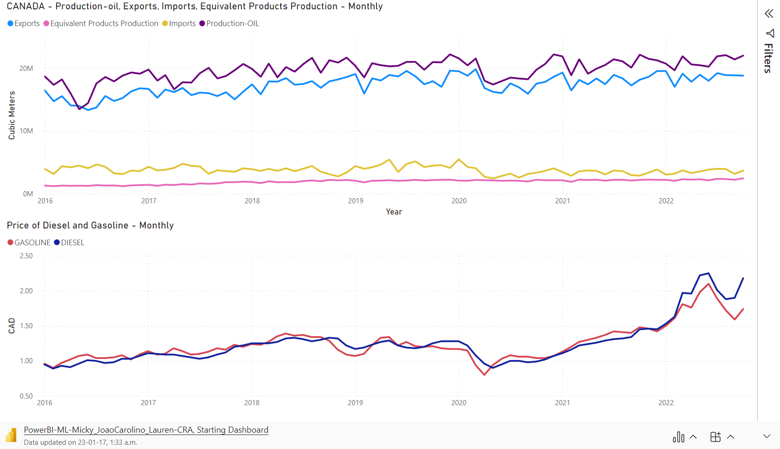
Dataset - Dashboard

Slide 12
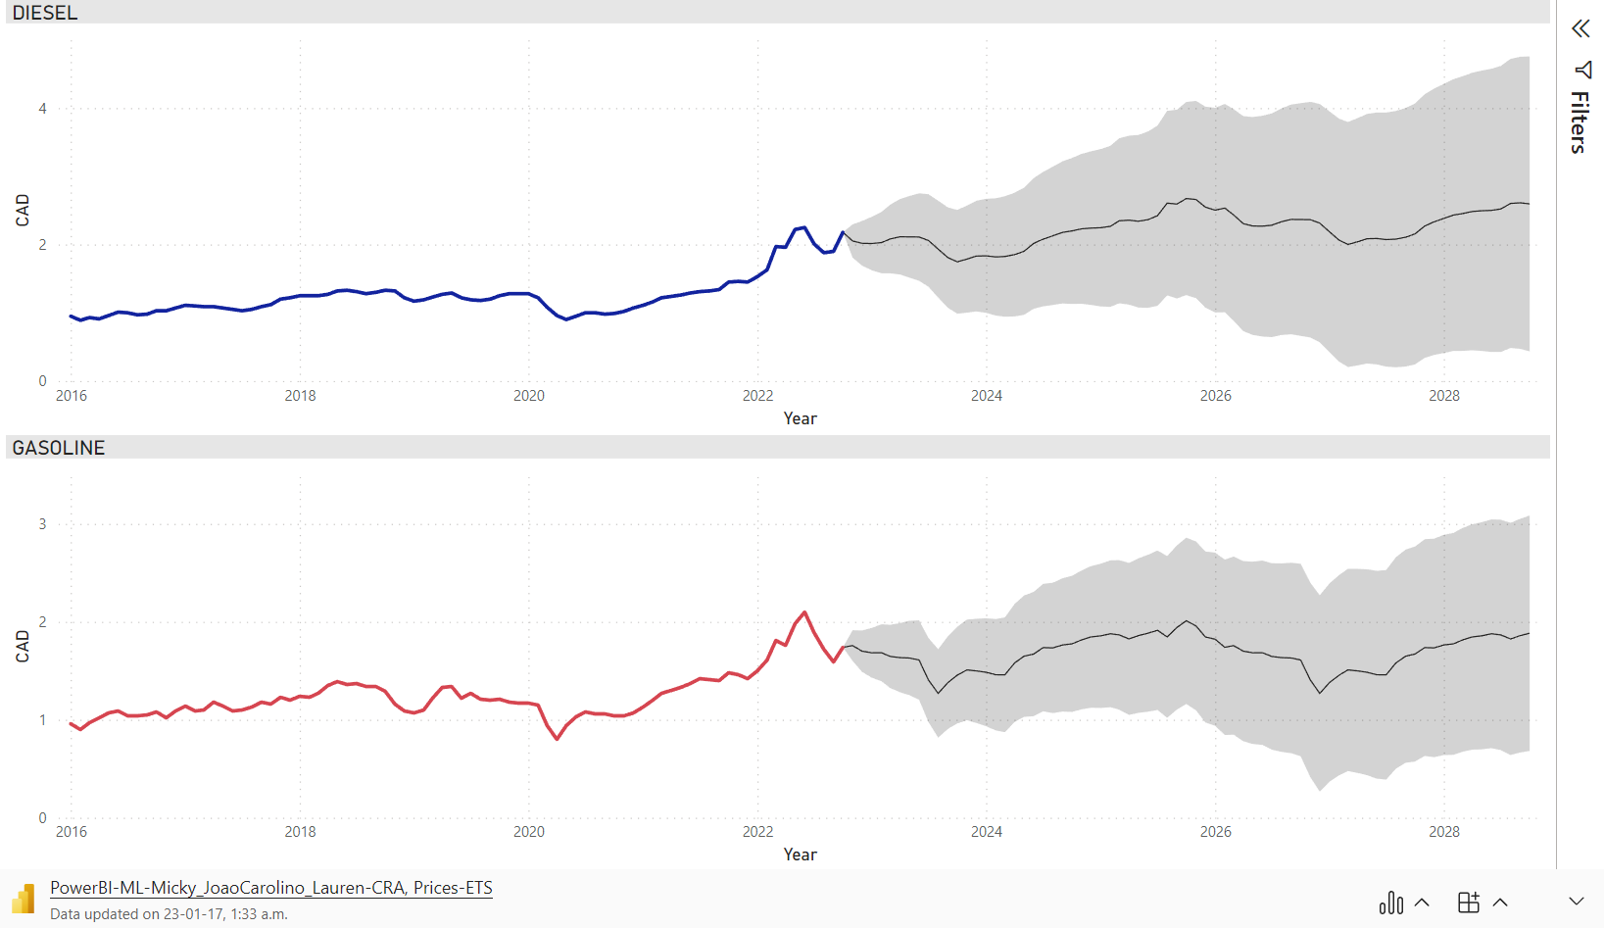
ETS -PRICES

Slide 13
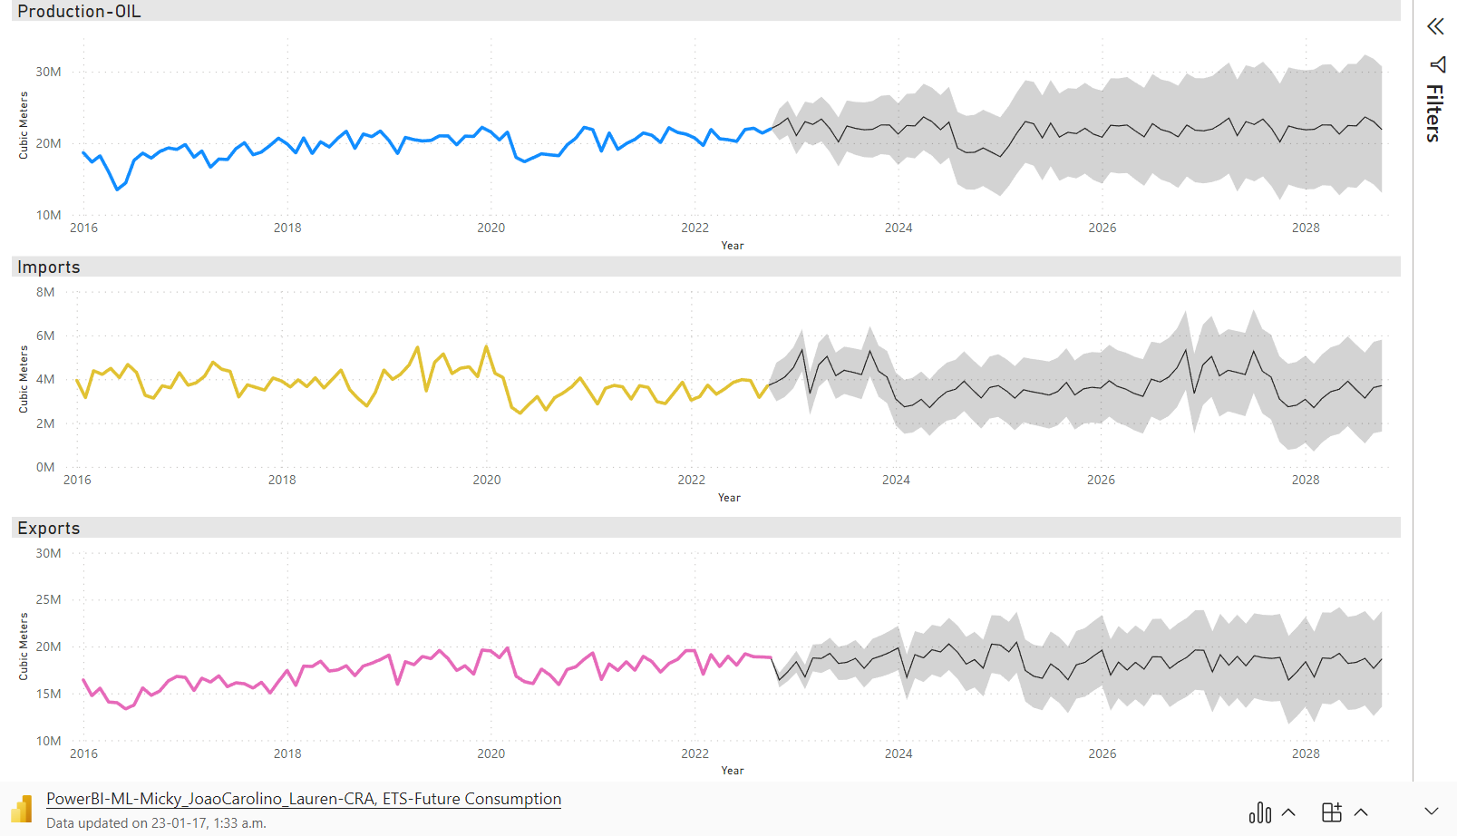
ETS –Disposition OIL

Slide 14
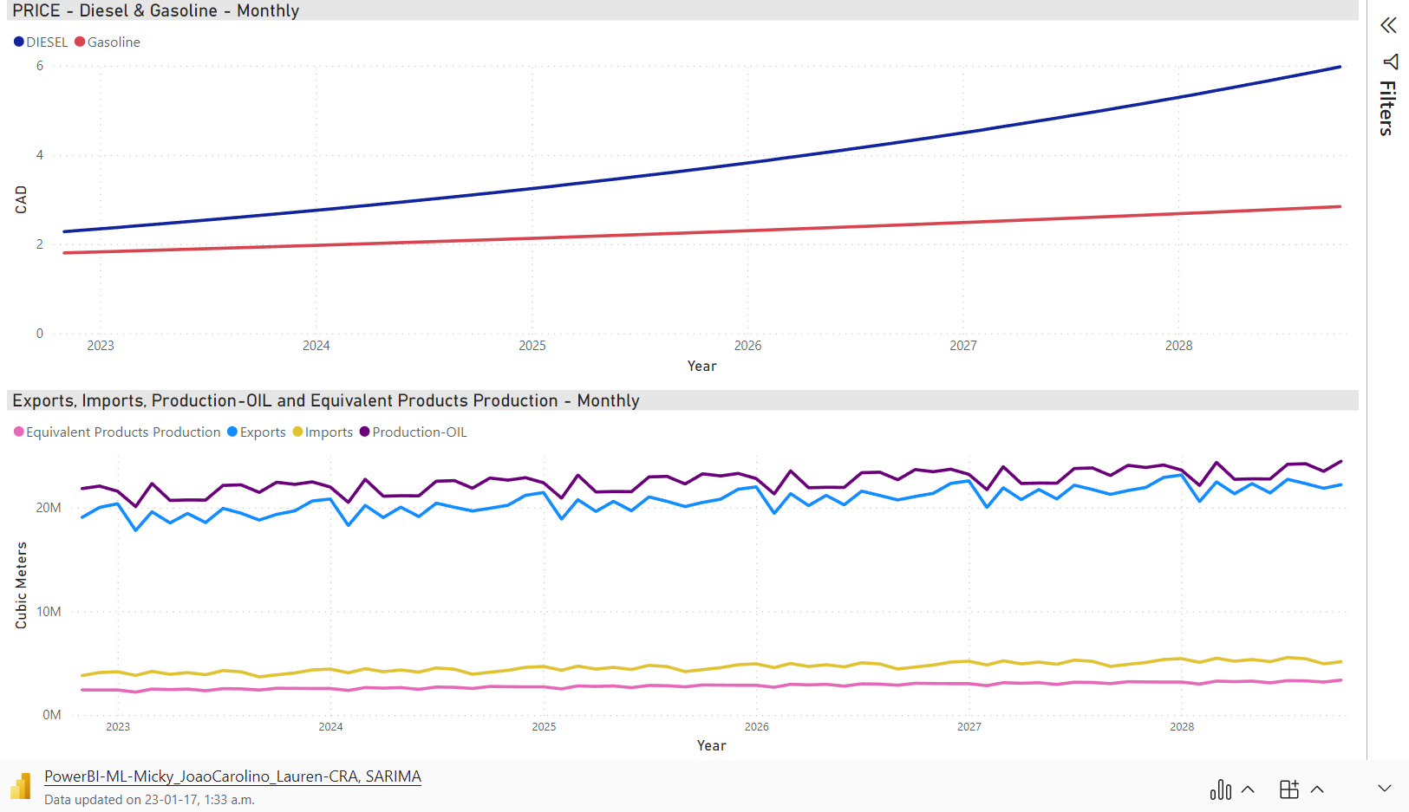
SARIMA
Notes:
3-

Slide 15
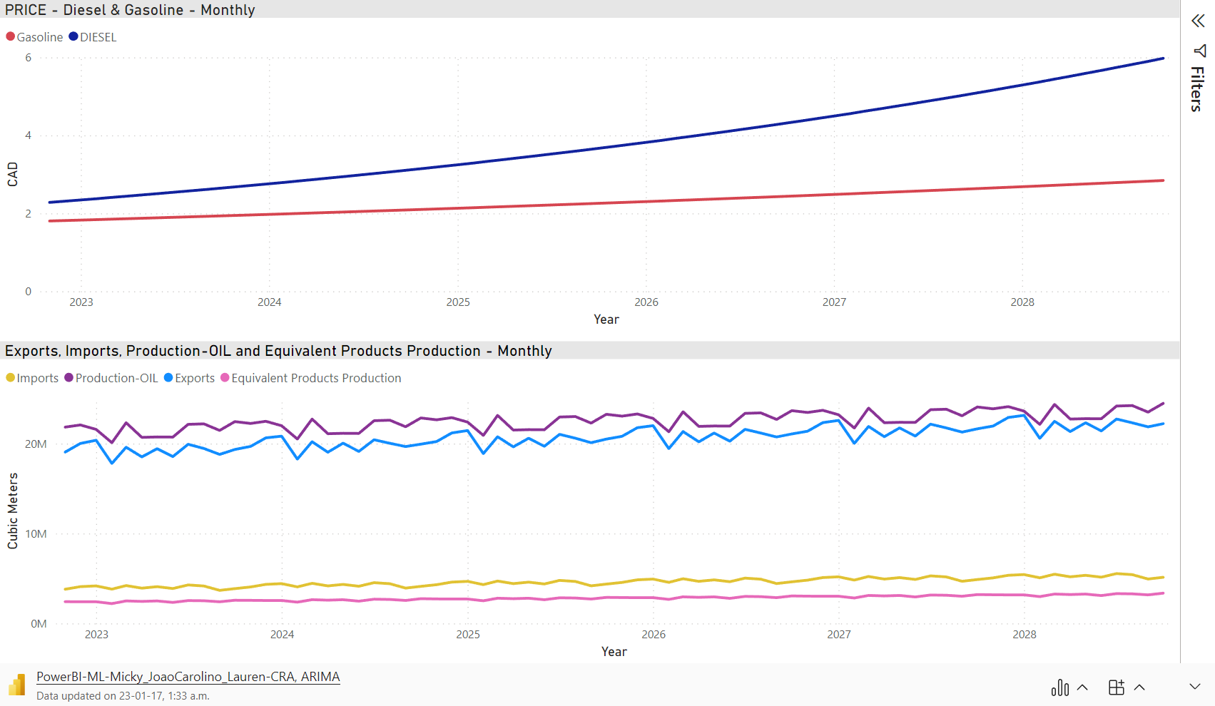
ARIMA

Slide 16
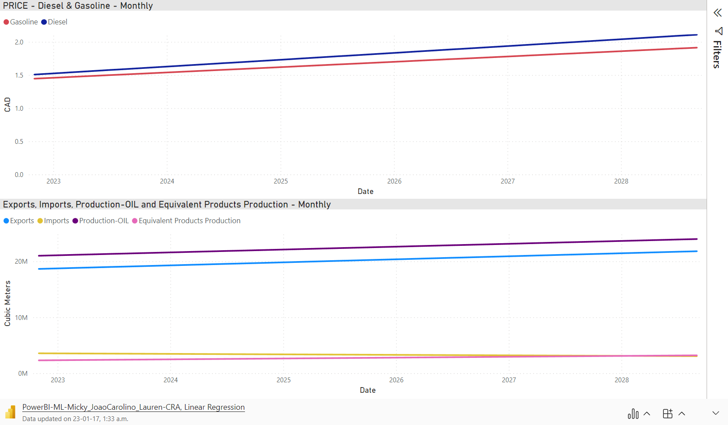
LINEAR REGRESSION

Slide 17


CONCLUSIONS
1 – The price of Diesel and Gasoline is having a small impact on production/consumption inside Canada
2 – External factors may have more impact in the price of Diesel and Gasoline than we thought
3 – Price of Diesel expected to grow more than Gasoline.
Notes:
3-

Slide 18

LESSONS LEARNED
TAKING IT TO THE NEXT LEVEL
More attributes:
Other refined oil products individually
Natural Gas
Other types of energy
Investiments in Oil production
Paywall IEA to acess more data
Analyse external factors
Combine the best factors from the ML models in use
Python Scrips to facilitate data processing
Notes:
3-explanation

Slide 19
Thank You
For Your Attention
Any Questions?
Notes:
3-

