Slide 1
Predictive Models in Patient Care
Predicting the Length of Stay for patients in Intensive Care Unit diagnosed with Pneumonia
João Carvalho
DETI, Universidade de Aveiro
Fundamentos de Aprendizagem Automática
Prof. Petia Georgieva

Slide 2
Motivation
This project purpose is to use supervised techniques to predict the Length of Stay(LOS) of patients in Intensive Care Unit(ICU) diagnosed with pneumonia.
This metric is a crucial factor:
Effective planning and management of hospital resources and costs;
Increase service efficiency;
It enables patients and their families to estimate the cost of a stay in paid hospitalizations.
Notes:
OS can be defined as the number of days that an in-patient will remain in hospital duringa single admission event

Slide 3
Data description
The data under analysis contains information of a large number of real patients admissions in ICU diagnosed with pneumonia, in Portugal.
Partnership between Ritain.io and the Institute of Electronics and Informatics Engineering of Aveiro, IEETA at University of Aveiro.
15.355 examples (admissions) and 102 variables, including :
personal information of the patient;
medical prescriptions;
relevant health metrics;
the LOS value.

Slide 4
Dimension reduction and Downsampling
The selection of the relevant features was supported by a literature search targeting this specific problem.
”DoenteIdadeEmAnos” (age); | ”ServicoId” (service type); | ”TipoAdmissaoId” (admission type),
”APACHEScore” (disease severity score); | ”SAPSScore” (disease severity score);
”NumeroDiasEntubacao” (Intubation days); | ”NumeroDiasVentilacaoInvasiva” (IV days),
”NrPrescricoesAntibiotico” (number of AP).
Downsampling process was performed by considered 10% of the original examples without missing data in the selected variables, chosen at random, resulting in a sample of 1.294 examples.

Slide 5
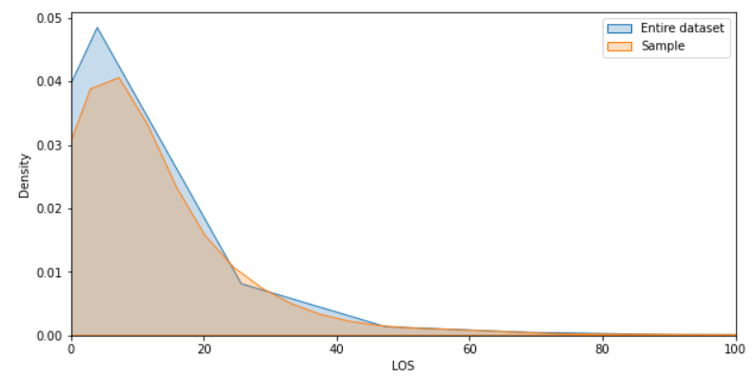
The density plot of LOS - Entire Dataset / Sample

Slide 6
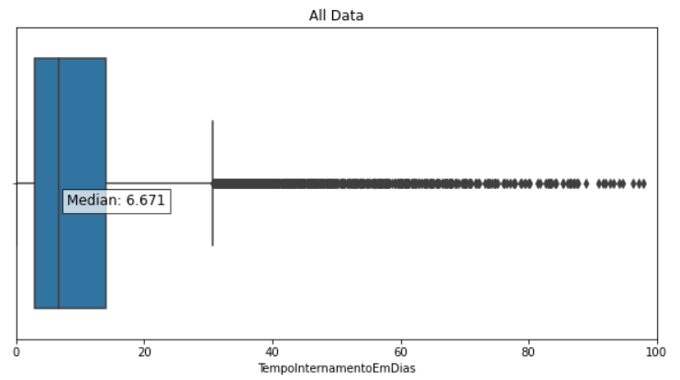
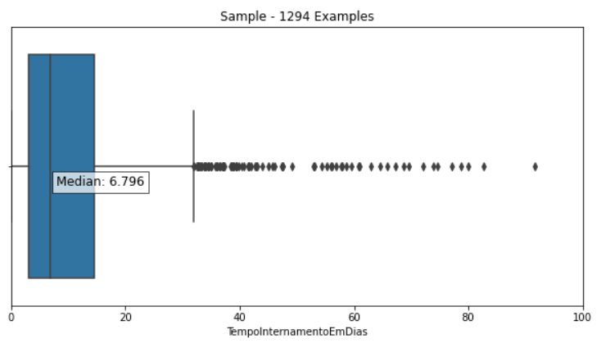
Box plots - Entire Dataset / Sample
Notes:
falar porque a mediana as vezes é melhor que a media

Slide 7
ML models
Deep Learning (DL)
The Python implementation was based on the library Keras (DL).
Artificial neural network (ANN)
The Python implementation was based on the class MLPRegression from library Sklearn.
Random Forest (RF)
The Python implementation was based on the class RandomForestRegressor from library Sklearn.
Linear Regression (LR)
The Python implementation was based on the class LinearRegression from Sklearn as well as the class ”Lasso” from the library Sklearn.
Notes:
Lasso - L1 regula…

Slide 8
Model training and validation
Model validation refers to the process of evaluating a trained model with a testing data set.
The validation of the models was based into two main approaches:
Cross Validation (CV);
K-Fold - 4 folds
Hyper-parameter selection (HPS).
Determining the combination of hyper-parameters or coefficients that maximizes the model performance;
Minimize Mean Square Error.
Notes:
-The main reason for using the testing dataset is to test the model’s capacity to predict in the context of new data.

Slide 9
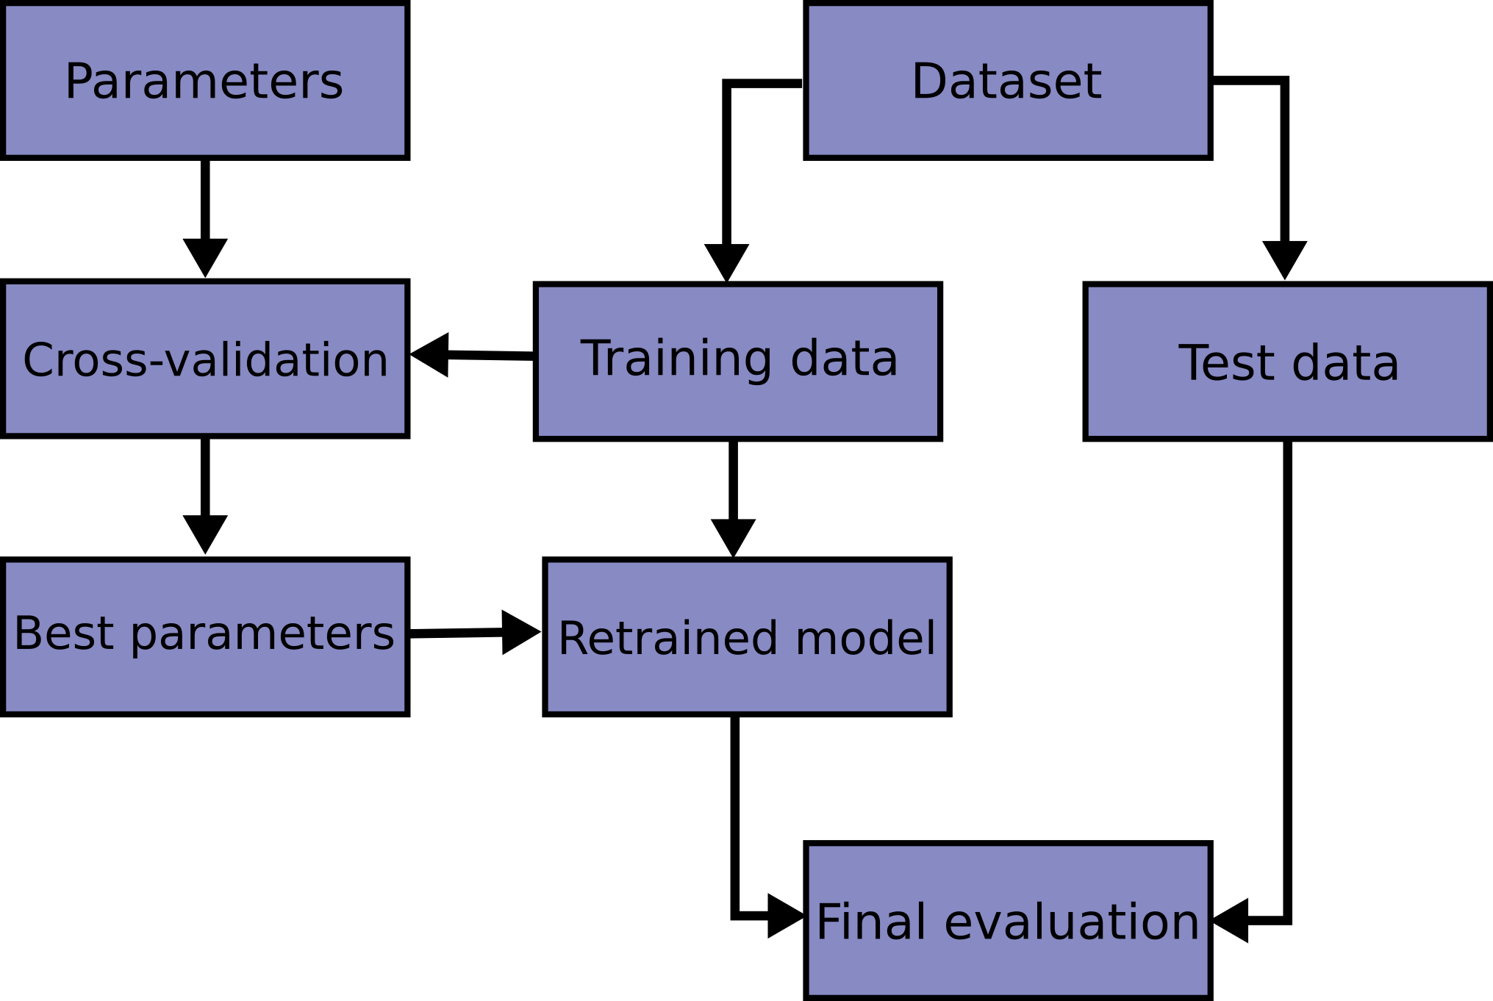
Validation pipeline
The dataset is divided into a set of training data (80% of the data) and another set of test data (20%). The training data is used to search for an optimal model, via HPS and cross-validation, which will have a final evaluation in the test data.
Notes:
resents a diagram representing the overall tasks involved in the validation of a mode

Slide 10
Results
Three metrics were used:
R2 Score(R2): Varies between 0 and 1. Is the proportion of the variance in the dependent variable that is predictable from the independent variable(s).
Mean Absolute Percentage Error(MAPE): Represents the average of the absolute percentage errors of each entry in a dataset.
Mean Squared Percentage Error(MSPE):Measures the amount of error in statistical models. It assesses the average squared difference between the observed and predicted values.

Slide 11
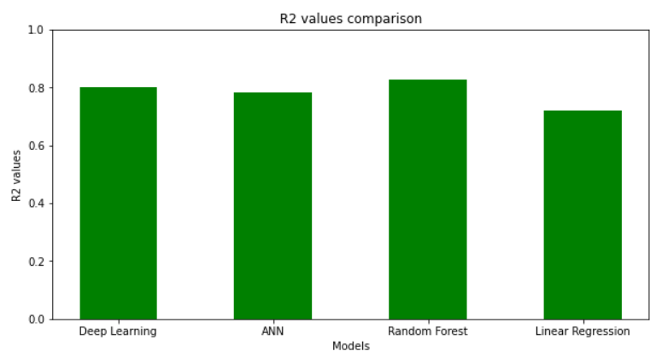
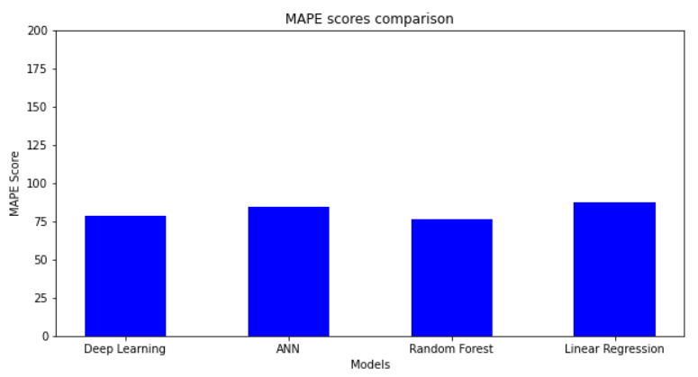
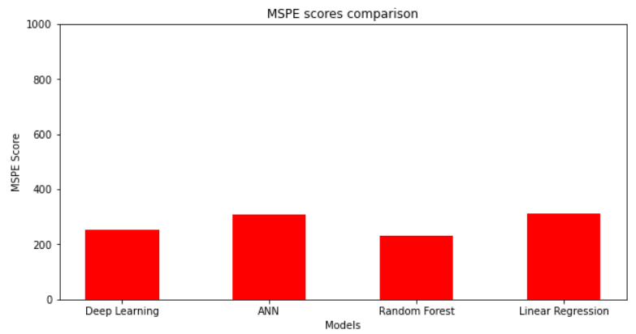
Notes:
The graphics and tables below represent the results of running the models with the optimal hyper-parameters described in the section
we may see that the results of the models are very similiar toeach other

Slide 12
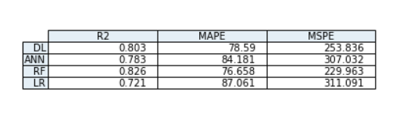
Models performance table

Slide 13
Conclusion
Comparing with the literature, it can be inferred that the results were reasonably good. The paper [1] obtained 0.655 and 0.613 for R2 values using ANN and the paper [2] got the R2 equals to 0.81 for the best model tested which was also a RF model.
Performance/Complexity Trade-of
Most complex models didn’t bring performance improvement - Small datasets
Future work
Deeper analysis into the dataset variables in order to try to improve the model performance.
Work with the entire dataset could give a different and relevant view of the models behavior.

Slide 14
References
[1] Hamed M. Zolbanin, Behrooz Davazdahemami, Dursun Delen, and
Amir Hassan Zadeh. Data analytics for the sustainable use of resources in hospitals: Predicting the length of stay for patients with chronic diseases. Information Management, 59(5):103282, 2022. Big Data Analytics for Sustainability.
[2] Jingyi Wu, Yu Lin, Pengfei Li, Yonghua Hu, Luxia Zhang, and Guilan
Kong. Predicting prolonged length of icu stay through machine learning. Diagnostics, 11(12), 2021.

