Slide 1
Neural Networks:
Brain Activities Classification
Joao Canto de Almeida

Slide 2
Brief History Of BCI
EEG – Hans Berger (1924)
Jacques Vidal (1970’s)
Military Research
Mostly related to neuroprosthetics

Slide 3
Three Components Of A BCI
Recording
  EEG
  Feedback
Processing
  Filtering the data
Classification
  Machine Learning (1990’s)

Slide 4
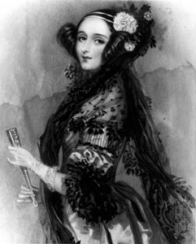
Machine Learning
Artificial Intelligence
“The Analytical Engine has no pretensions to originate anything. It can do whatever we know how to order it to perform.”
                - Lady Ada Lovelace

Slide 5
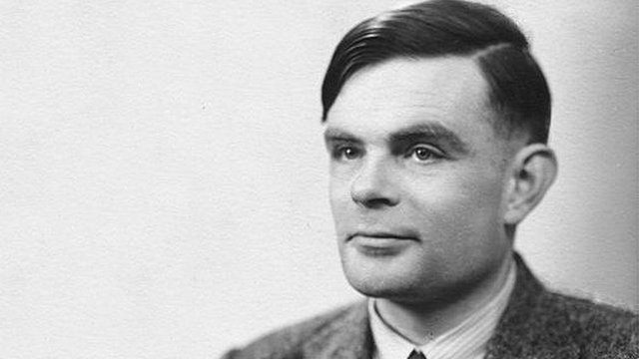
Machine Learning
Artificial Intelligence
Three components of Turing’s Learning Machine
  Structure of the child machine = hereditary material
  Changes of the child machine = mutation
  Natural Selection = judgment of the experiment

Slide 6
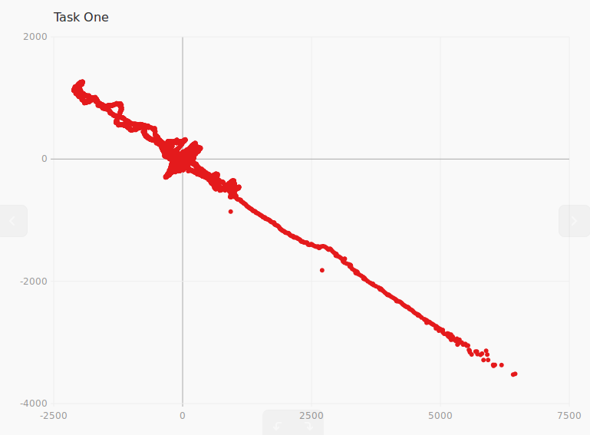
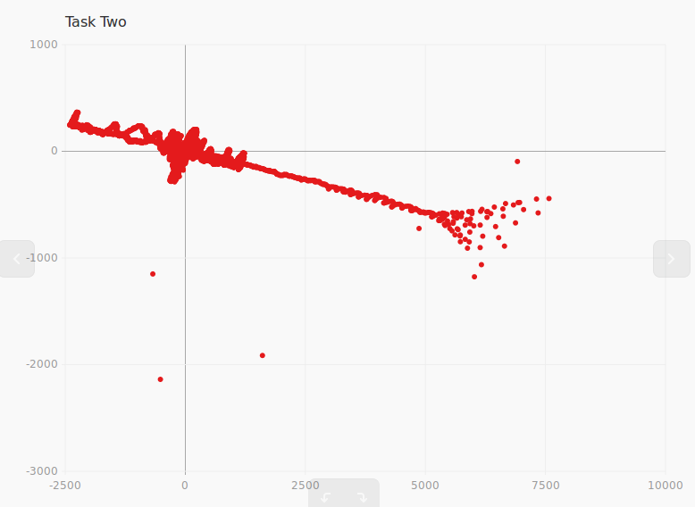
Data

Slide 7
Neural Network
First Try
Activation Function: sigmoid
Learning Rate: .1
Training Data: 80%
Test Data: 20%
Structure: 31 – Hidden Layer – 1
Label: 1

Slide 8
Neural Network
Second Try
Activation Function: sigmoid
Learning Rate: .3
Training Data: 99%
Test Data: 1%
Structure: 31 – Hidden Layer – 2
Label: 1, 0

Slide 9
Result
Neural Network: Task One
Task One Task Two Task Three Task Four
True | False
.15912 | .84088
.49825 | .50174
.50000 | .50000
.50000 | .50000
.19583 | .80416
.50000 | .50000
.15213 | .84786
.00004 | .99995
.50000 | .50000
.50000 | .50000
True | False
.00004 | .99995
.50000 | .50000
.00005 | .99995
.50000 | .50000
.00006 | .99994
.05570 | .94429
.00005 | .99995
.48745 | .51255
.24626 | .75374
.09628 | .90377
True | False
.12892 | .87108
.02453 | .97547
.19827 | .80173
.04086 | .99994
.29433 | .70567
.07079 | .92921
.15105 | .84895
.15105 | .84895
.07352 | .92648
.08113 | .91887
True | False
.02004 | .97996
.21386 | .78613
.01205 | .98795
.00407 | .99593
.08206 | .91794
.00795 | .99205
.03795 | .96204
.33601 | .663986
.00205 | .99795
.01405 | .92594

Slide 10
Result
Neural Network: Task Two
Task One Task Two Task Three Task Four
True | False
.16449 | .83561
.00007 | .99993
.17129 | .82870
.00007 | .99992
.39687 | .60313
.00008 | .99992
.50000 | .50000
.21158 | .78842
.14691 | .85309
.48077 | .51923
True | False
.00007 | .99992
.00007 | .99993
.00426 | .99574
.00007 | .99992
.49163 | .50837
.48536 | .51464
.5000 | .50000
.09959 | .90041
.00008 | .99992
.00009 | .99992
True | False
.05807 | .94193
.26558 | .73442
.32433 | .67567
.40206 | .59794
.15515 | .84485
.22901 | .77099
.12658 | .87342
.14687 | .85313
.33676 | .66324
.36533 | .63467
True | False
.05807 | .94193
.43601 | .56399
.08979 | .91021
.30603 | .69397
.35150 | .64849
.43109 | .56890
.05007 | .94993
.24802 | .75198
.08006 | .91994
.13003 | .86997

