Slide 1
2nd Mini-Project: File Transfer
Reliable Data Transfer

Slide 2
Overview
What you’ll learn:
  Reliable data xfer
  UDP sockets
Create file transfer system
  File Sender
  File Receiver
Sender
Receiver
Chunks
Acks
Input File
Output File

Slide 3
Overview: Files to Chunks
3500B
1
2
3
4
1000B
Last Chunk: <1000B
typedef struct __attribute__((__packed__)) data_pkt_t {
uint32_t seq_num;
char data[1000];
} data_pkt_t;
typedef struct __attribute__((__packed__)) ack_pkt_t {
uint32_t seq_num;
uint32_t selective_acks;
} ack_pkt_t;

Slide 4
Overview: Reliable Data Transfer
Send Window
1
2
3
4
5
1
2
3
4
5
Recv. Window

Slide 5
Overview: Reliable Data Transfer
seq_num=1,2,3
Send Window
1
2
3
4
5
seq_num=1,2,3
1
2
3
4
5
Recv. Window

Slide 6
Overview: Reliable Data Transfer
Send Window
1
2
3
4
5
seq_num=2
selective_acks=0b000
1
2
3
4
5
Recv. Window

Slide 7
Overview: Reliable Data Transfer
Send Window
1
2
3
4
5
seq_num=2,3,4
1
2
3
4
5
Recv. Window

Slide 8
Overview: Reliable Data Transfer
Send Window
1
2
3
4
5
seq_num=2
selective_acks=0b001
1
2
3
4
5
Recv. Window

Slide 9
Overview: Reliable Data Transfer
Send Window
1
2
3
4
5
seq_num=2
selective_acks=0b011
1
2
3
4
5
Recv. Window

Slide 10
Overview: Reliable Data Transfer
Send Window
*** 1s Later ***
1
2
3
4
5
seq_num=2
1
2
3
4
5
Recv. Window

Slide 11
Overview: Reliable Data Transfer
Send Window
1
2
3
4
5
seq_num=5
selective_acks=0b000
1
2
3
4
5
Recv. Window

Slide 12
Overview: Reliable Data Transfer
Send Window
1
2
3
4
5
seq_num=5
1
2
3
4
5
Recv. Window

Slide 13
Overview: Reliable Data Transfer
Send Window
1
2
3
4
5
seq_num=6
selective_acks=0b000
1
2
3
4
5

Slide 14
Overview: Reliable Data Transfer
1
2
3
4
5
1
2
3
4
5

Slide 15
Overview: Reliable Data Transfer
Notes
Chunks start at 1
Fields in network order
Ack = recv. window
  seq_num = base
  selective_acks skips first
  (will always be 0)
RDT Modes and Window Size
Stop-and-Wait
  Send = 1, Receive = 1
Go-Back-N
  Send = N, Receive = 1
Selective Repeat
  Send = N, Receive = M <= N

Slide 16
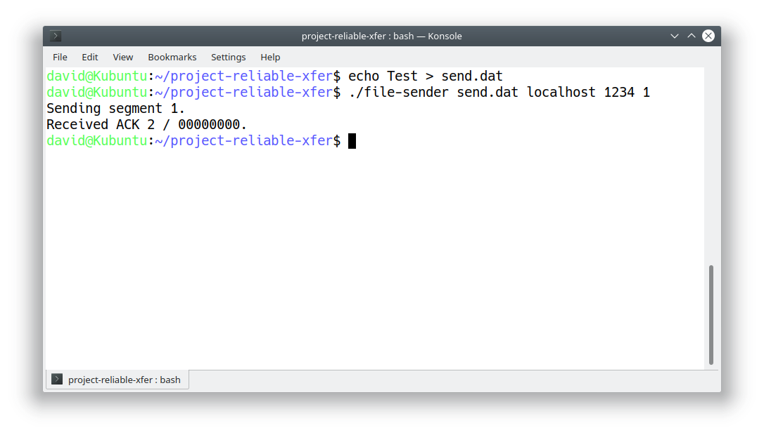
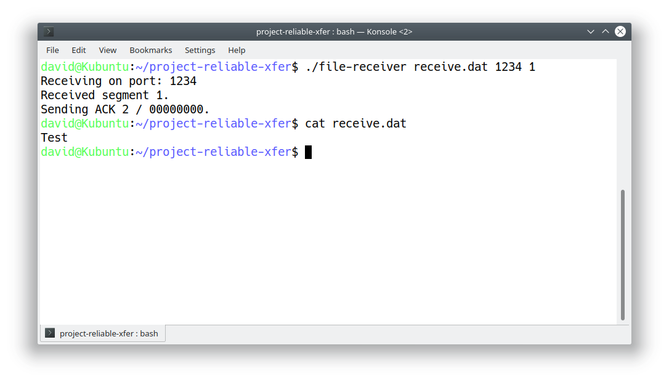
File Transfer in Action

Slide 17
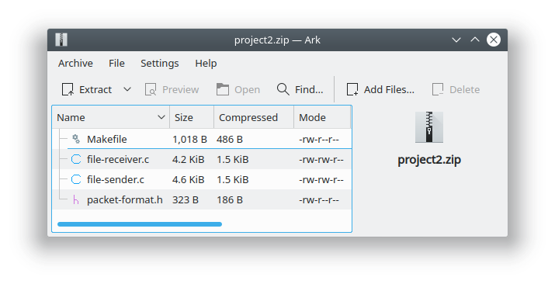
Submission
Submit project2.zip
to Fénix
  Code
  Makefile in base folder
  No build artifacts
Must build with make
  Generate file-sender & file-receiver

Slide 18
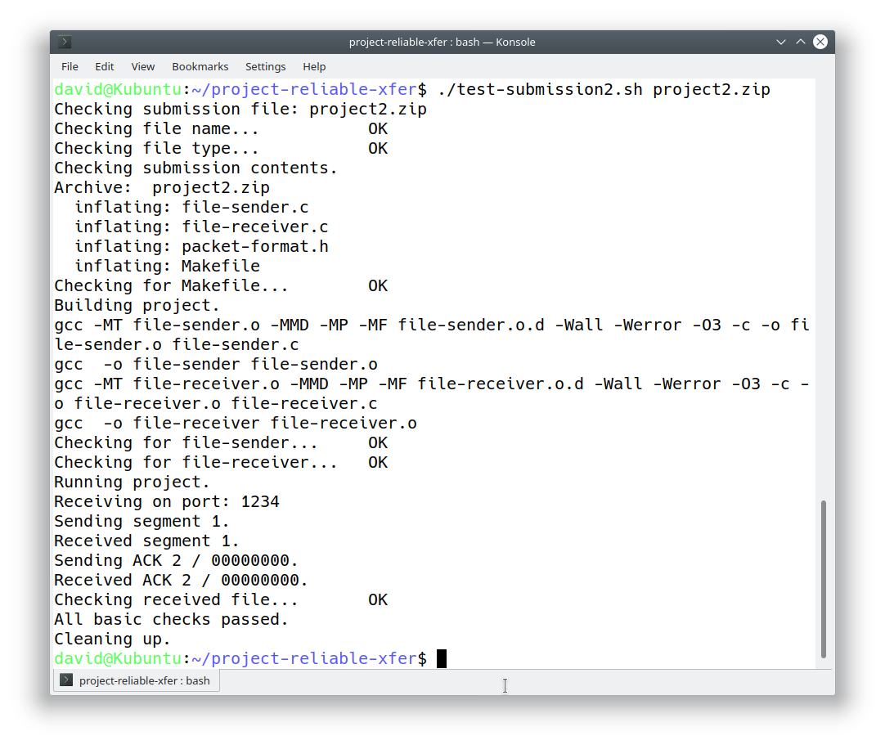
Pre-Submission Checks

Slide 19
Advice: Debugging
Standard output/error will be ignored during grading
  printf(…)
Debug tools also available
  log-packets.c: Packet logging & fault injection
  generate-msc.sh: Log analysis & MSC generation
Testing
  Look into test-submission2.sh / run.sh for ideas.

Slide 20
Advice: Task Breakdown
Sender
(Win=1)
Sender
(Win=N)
Sender
(S. Acks)
Start
Receiver
(Win=1)
Receiver
(Win=N)
Final
Integration
QA

Slide 21
Advice: MSC Generation
gcc -shared -fPIC -Wall -Werror -O3 \
-o log-packets.so log-packets.c -ldl
LD_PRELOAD = "./log-packets.so" \
SEND_DELAY="500" \
DROP_PATTERN="01" \
PACKET_LOG="sender.log" \
./file-sender …
./generate-msc.sh msc.eps sender.log receiver.log
See: run.sh

Slide 22
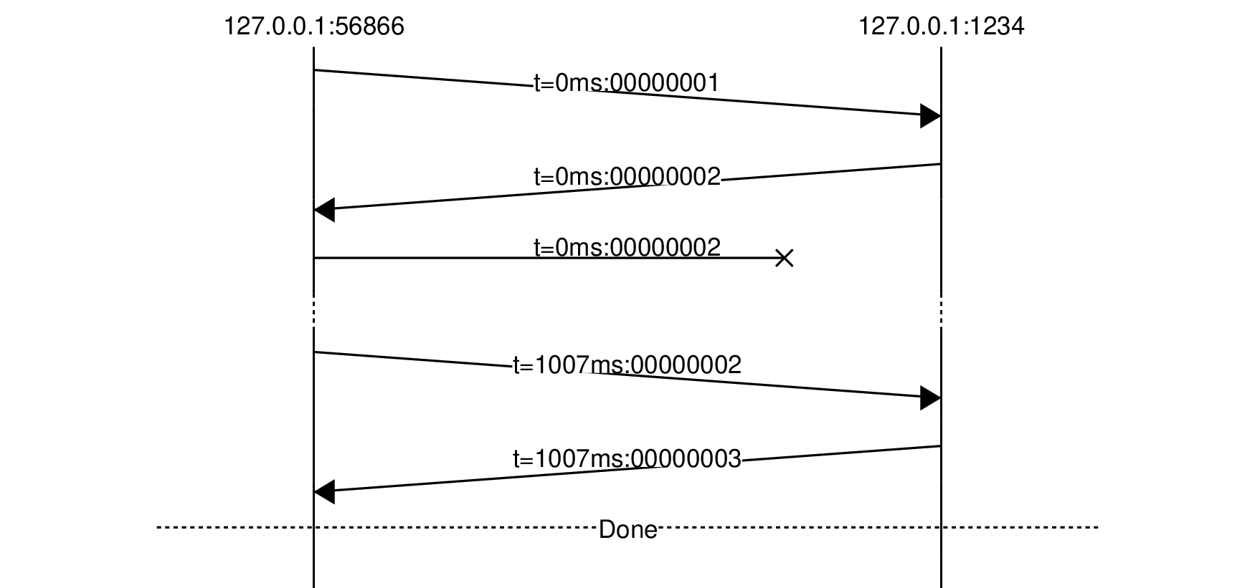
Advice: MSCs
Stop-and-Wait
2 Chunks
Sender
  DROP_PATTERN="01"
  Send Window = 1
Receiver
  DROP_PATTERN=""
  Receive Window = 1

Slide 23
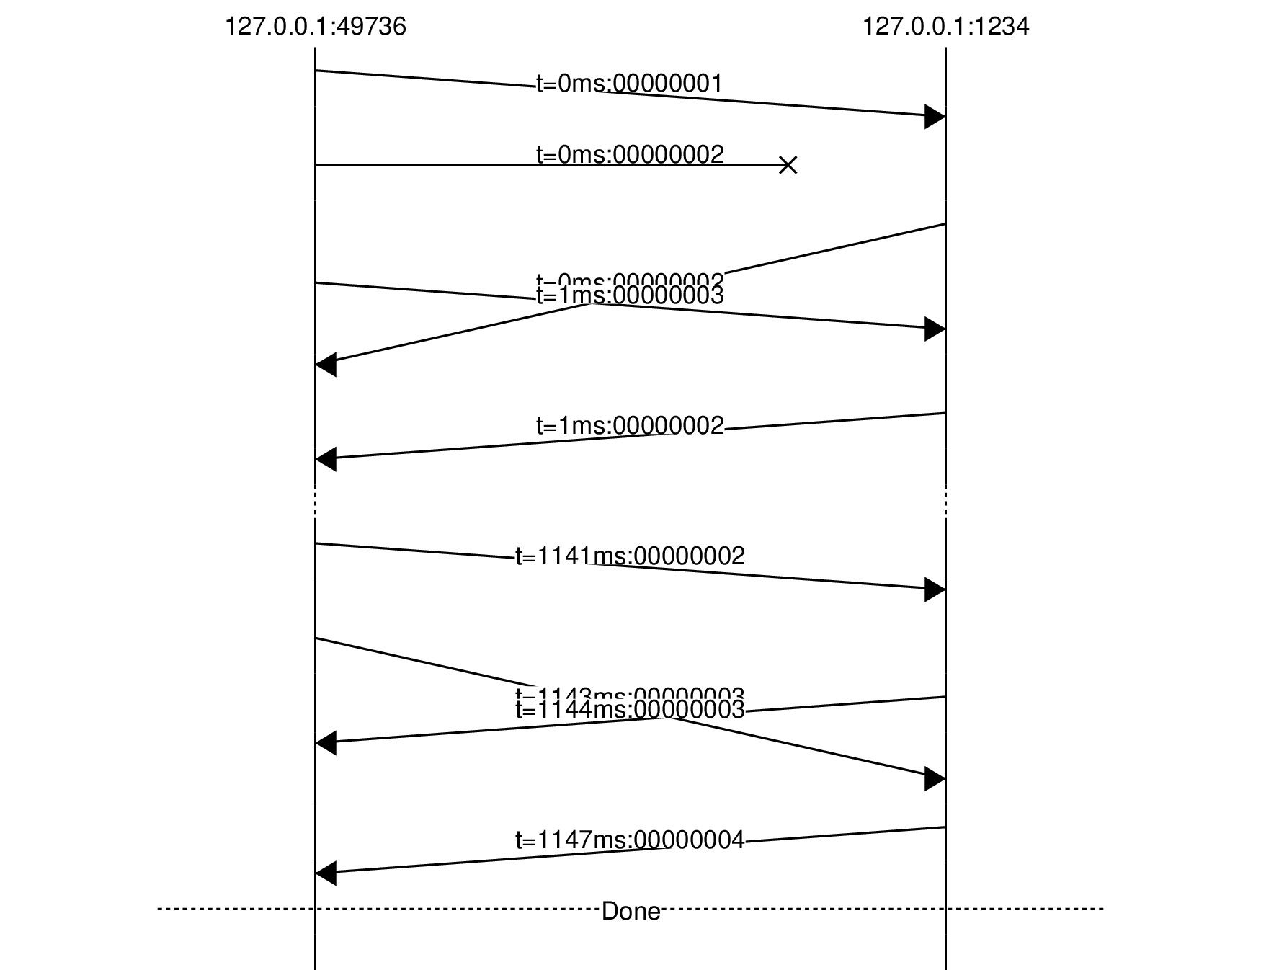
Advice: MSCs
Go-Back-N
3 Chunks
Sender
  DROP_PATTERN="01"
  Send Window = 3
Receiver
  DROP_PATTERN=""
  Receive Window = 1

Slide 24
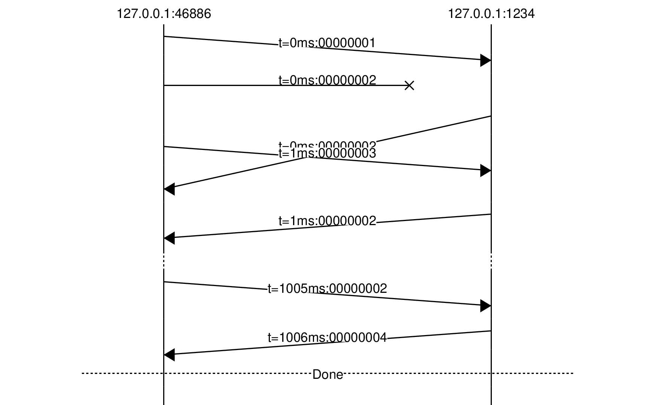
Advice: MSCs
Selective-Repeat
3 Chunks
Sender
  DROP_PATTERN="01"
  Send Window = 3
Receiver
  DROP_PATTERN=""
  Receive Window = 3

Slide 25
Advice: MSCs
Improv
How Many Chunks?
Sender
  DROP_PATTERN="?"
  Send Window = ?
Receiver
  DROP_PATTERN="?"
  Receive Window = ?
?

