Slide 1
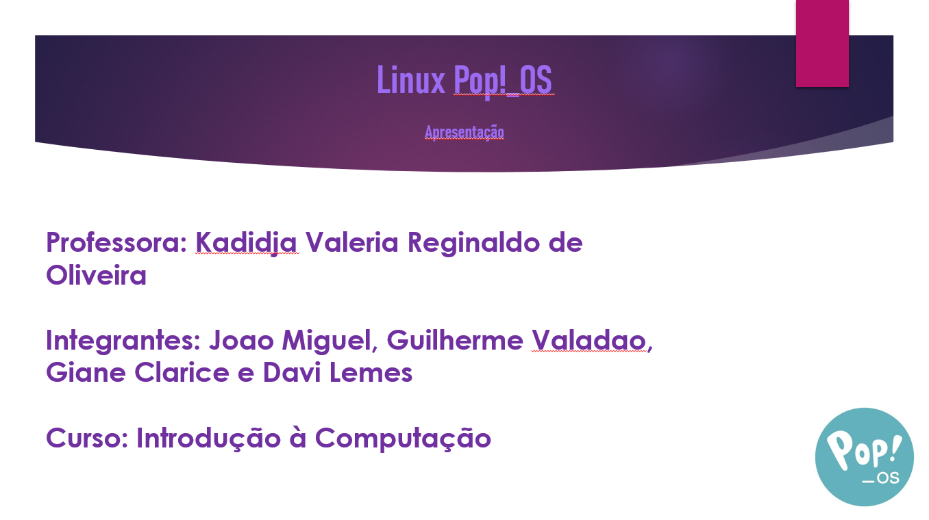

Slide 2
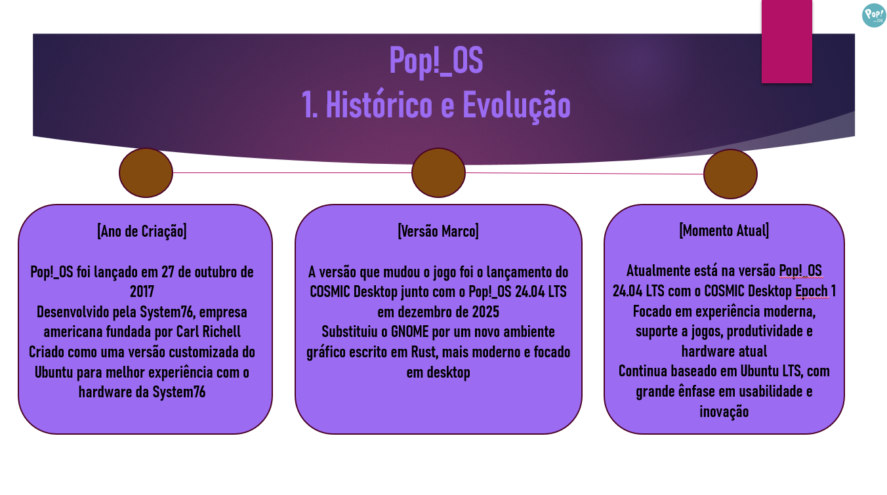

Slide 3
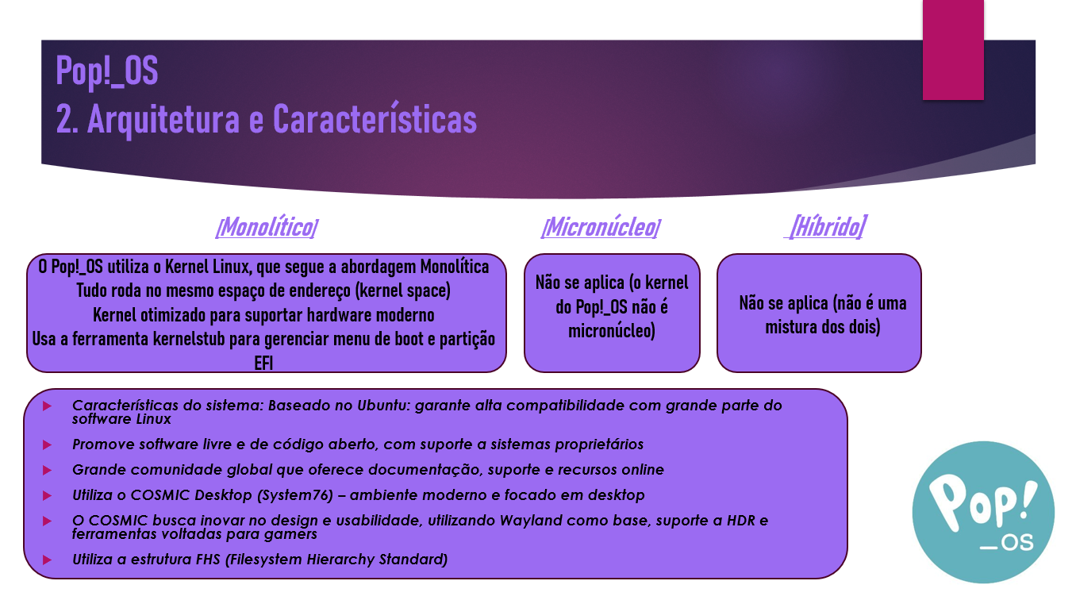

Slide 4
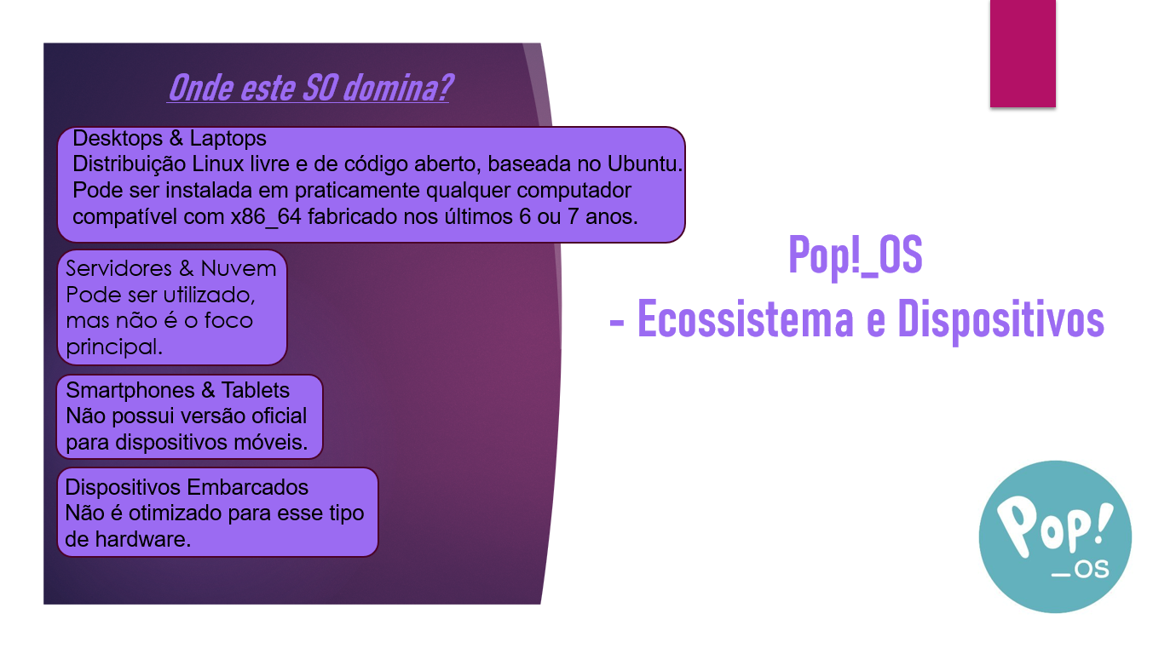

Slide 5
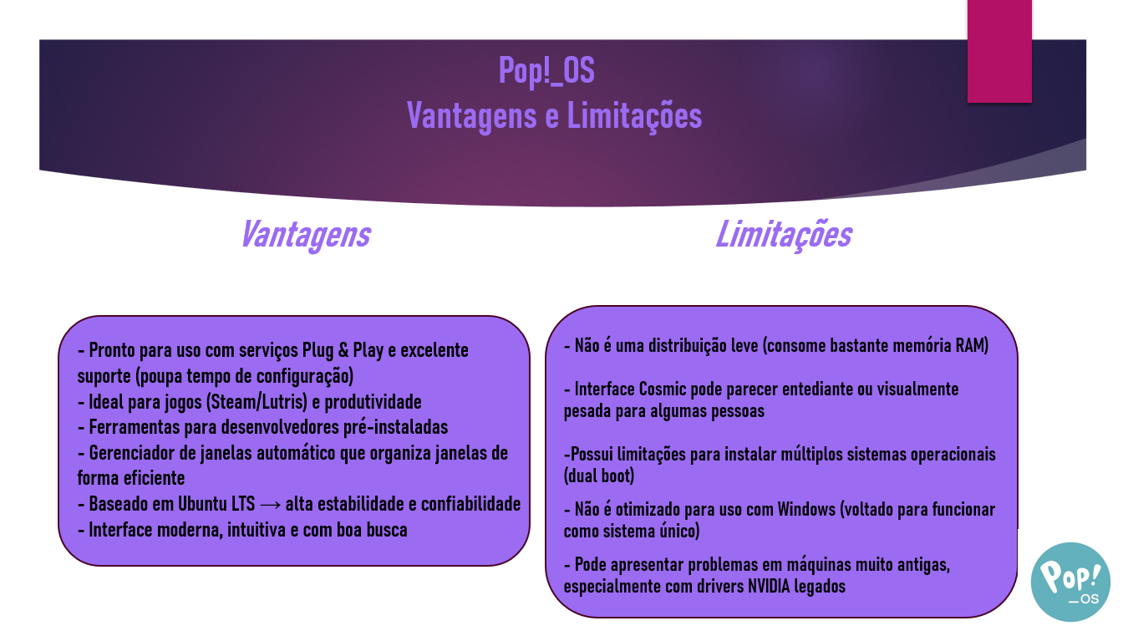

Slide 6
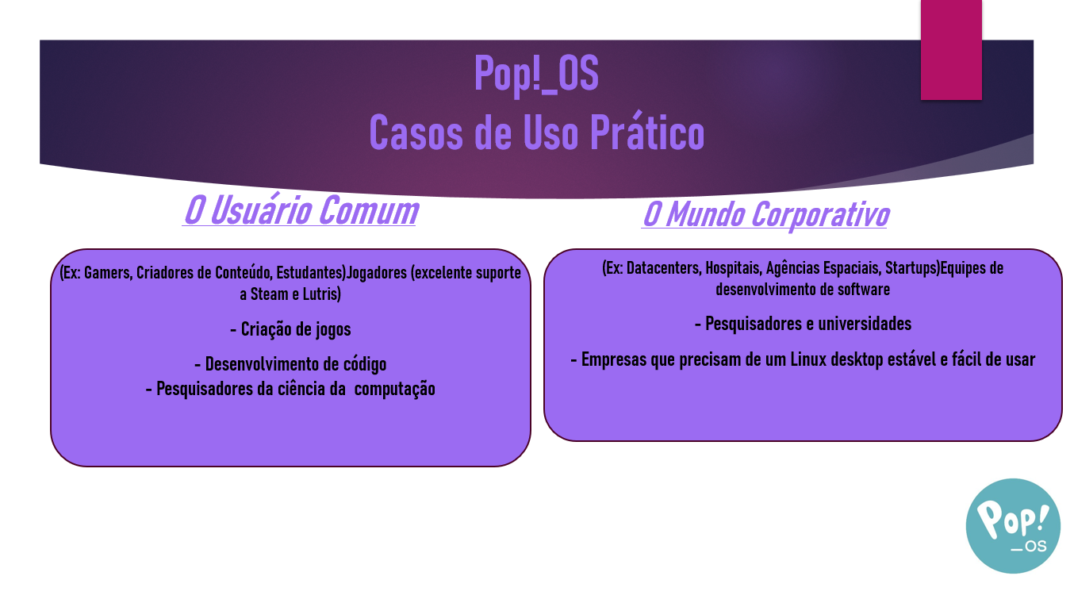

Slide 7
Fontes
https://diolinux.com.br/noticias/pop-os-24-04-arquitetura-arm-e-mais.html
https://itsfoss.com/pop-os-linux-review/
https://diolinux.com.br/editorial/cosmic-desktop-o-primeiro-nova-era.html
https://www.controle.net/faq/ubuntu-linux https://www.google.com/url?sa=i&source=web&rct=j&url=https://www.reddit.com/r/linux4noobs/comments/1jqm4zp/whats_the_use_case_for_pop_os_and_what_advantages/?tl%3Dpt-br%23:~:text%3DE%2520a%25C3%25AD%252C%2520eu%2520usei%2520v%25C3%25A1rias,%252C%2520e%2520funcionou%2520muito%2520bem).&ved=2ahUKEwiB5p3IvMiTAxXTrJUCHbBbHTIQ1fkOegQICxAC&opi=89978449&cd&psig=AOvVaw3AJ7TghwaExHsv88pB4P0Q&ust=1774989302748000https://www.google.com/url?sa=i&source=web&rct=j&url=https://www.vivaolinux.com.br/artigo/Pop-OS-Linux-Uma-boa-distribuicao-baseada-no-Ubuntu%23:~:text%3DRecursos%2520de%2520repara%25C3%25A7%25C3%25A3o,mesmo%2520espa%25C3%25A7o%2520dos%2520arquivos%2520originais.&ved=2ahUKEwiB5p3IvMiTAxXTrJUCHbBbHTIQ1fkOegQICxAh&opi=89978449&cd&psig=AOvVaw3AJ7TghwaExHsv88pB4P0Q&ust=1774989302748000Ecossistema https://www.google.com/url?sa=i&source=web&rct=j&url=https://www.youtube.com/watch?v%3DI0Xc4ARgWtA%26t%3D14&ved=2ahUKEwidofb5vMiTAxWyRLgEHc05O-IQ1fkOegQIEBAC&opi=89978449&cd&psig=AOvVaw2Jy9QldWIxqWi8qxyyQDmL&ust=1774989406957000https://en.wikipedia.org/wiki/Pop!_OS#:~:text=editar-,O%20Pop!_,desktop%20COSMIC%20%2C%20desenvolvido%20pela%20System76. https://diolinux.com.br/noticias/pop-os-24-04-arquitetura-arm-e-mais.html
https://itsfoss.com/pop-os-linux-review/
https://diolinux.com.br/editorial/cosmic-desktop-o-primeiro-nova-era.html
https://www.controle.net/faq/ubuntu-linux
https://pt.wikipedia.org/wiki/Pop!_OS https://blog.system76.com/post/pop-24-04-lts-upgrade https://www.phoronix.com/news/System76-Ships-Pop-OS-24.04 https://www.omgubuntu.co.uk/2025/12/pop_os-24-04-lts-stable-release https://www.reddit.com/r/LinusTechTips/comments/1rgr2hl/linus_please_stop_trying_pop_os/ https://www.reddit.com/r/pop_os/comments/1n4z2ac/pop_os_is_the_best_linux_distro_for_daily_driving/ https://medium.com/electronics-technologies-sciences/pop-os-a-brand-new-linux-distribution-journey-for-computer-expert-and-everyone-51018b7260b9

