Slide 1
Nice Guys Don’t (Always) Finish Last
Optimization Methods for Engineers — Spring 2020
A story about hope.
João Dinis Sanches Ferreira — 18-941-211

Slide 2
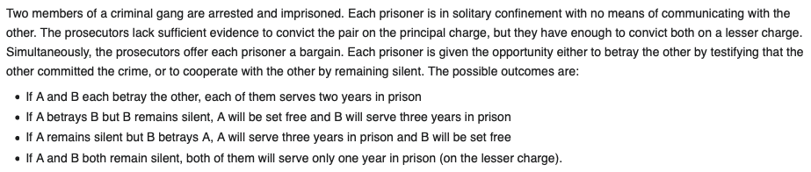
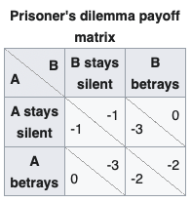
The Prisoner’s Dilemma

Slide 3
Strategies in the Literature
Always cooperate (AC)
Always defect (AD)
Random (R)

Slide 4
Strategies in the Literature (cont.)
Grudger (G): AC until the adversary defects. Then, AD.
Tit for tat (TFT): Always reciprocate the previous decision from the adversary.
Detective (D): (CDCC, followed by TFT if defected on or AD if adversary only cooperates)

Slide 5
Strategies in the Literature (cont.) Dealing with mistakes
Tit for tat with forgiveness (TFTWF): TFT, but only defects after if the adversary defects 2+ times in a row.
Notes:
Pavlov (P): Starts with cooperate. If adversary cooperates, repeat last action, even if it was a mistake. If adversary defects, perform opposite action, even if it was a mistake.

Slide 6
Optimization Task
The literature shows that the TFT strategy is oftentimes optimal, when the population is sufficiently diverse.
Can we derive (or outperform) the optimal strategy for the prisoner’s dillema using genetic algorithms?

Slide 7
Optimization Task
The literature shows that the TFT strategy is oftentimes optimal, when the population is sufficiently diverse.
Can we derive (or outperform) the optimal strategy for the prisoner’s dillema using genetic algorithms?
(This task is inherently well-suited for evolutionary algorithms!)

Slide 8
General Algorithm Overview
Initialize parameters for the prisoner’s dilemma:
Rewards for cooperating / defecting.
Number of iterations.
Initialize evolutionary parameters:
Mutation rate.
Fraction of reproducing ancestors.
Probability of reproducing given fitness.

Slide 9
General Algorithm Overview
Create first generation.
For N-1 generations:
Run all strategies against each other.
Pick the top strategies using the parameters initialized in (2).
Apply mutations when generating the offspring.

Slide 10
1D Problem Optimizing for Cooperation
“Cooperation”: probability of cooperating.
Independent of own previous actions.
Independent of adversary’s previous actions.

Slide 11
1D Problem Optimizing for Cooperation

Slide 12
4D Problem Optimizing for Cooperation / Retaliation
“Cooperation”: same as before
“Retaliation”: probability of defecting, given that the adversary has defected at least once in the last Window iterations, ignoring the most recent ForgivenessWindow iterations.
NB:
TFT corresponds to (C = 1, R = 1, W = 1, F = 0)
TFTWF corresponds to (C = 1, R = 1, W = 2, F = 1)

Slide 13
4D Problem Optimizing for Cooperation / Retaliation

Slide 14
4D Problem Optimizing for Cooperation / Retaliation
Can we do something about this?

Slide 15
4D Problem Optimizing for Cooperation / Retaliation
Can we do something about this?
Yes!

Slide 16
4D Problem Optimizing for Cooperation / Retaliation
Nice guy injection™

Slide 17
4D Problem Optimizing for Cooperation / Retaliation

Slide 18
4D Problem Optimizing for Cooperation / Retaliation

Slide 19
Key Takeaways
Updates to the population influence the fitness function.
Optimum depends on the environment!
Initialization is very important.
Distrust generates distrust.
Cooperation pays…
…if you have friends.

