Slide 1
Linear-Feedback Shift Register Pseudo-Random Number Generator
Computação Reconfigurável
João Ferreira. 93305
Roberto Graça, 93020

Slide 2
Context
Creation of a pseudo-random number sequence using a Linear-Feedback Shift Register(LFSR)
Options:
Fibonacci LFSR
Galois LFSR
Test hardware vs software implementations
Notes:
LFSR - is a shift register whose input bit is a linear function of its previous state

Slide 3
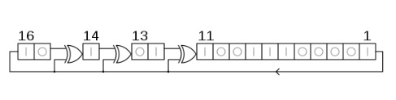
Appraising Non-chosen Options
Galois:
Figure: Galois LFSR 16-bit representation
Notes:
Advantages:
Less propagation delay, therefore its faster
Disadvantages:
Harder to manipulate the bits, therefore its more complex

Slide 4
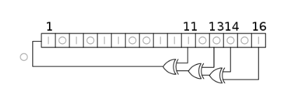
Algorithm (Fibonacci LFSR)
Takes an initial seed of N bits
Using the taps creates the new bit to enter the shift register
The new state is composed of the new bit and bits N-1 to 1 from the previous state
Repeat N times to get a new number
Figure: Fibonacci LFSR 16-bit representation

Slide 5
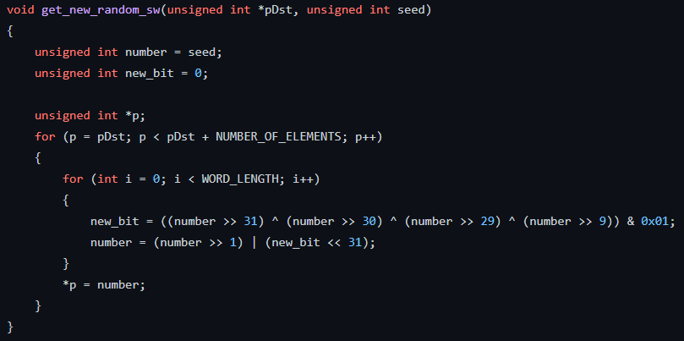
Algorithm

Slide 6
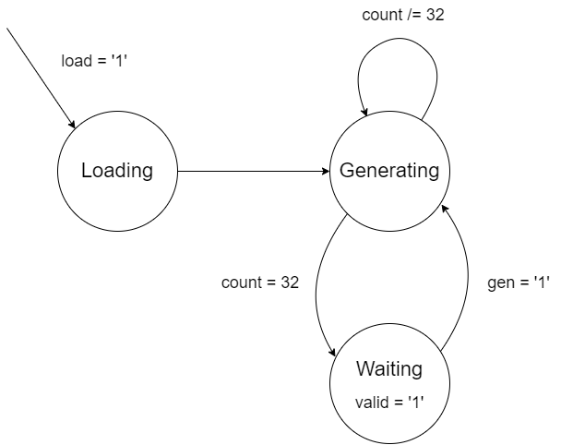
VHDL Implementation
State machine of the LFSR random number generator

Slide 7
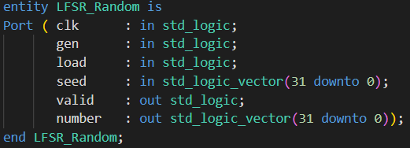
VHDL Implementation

Slide 8
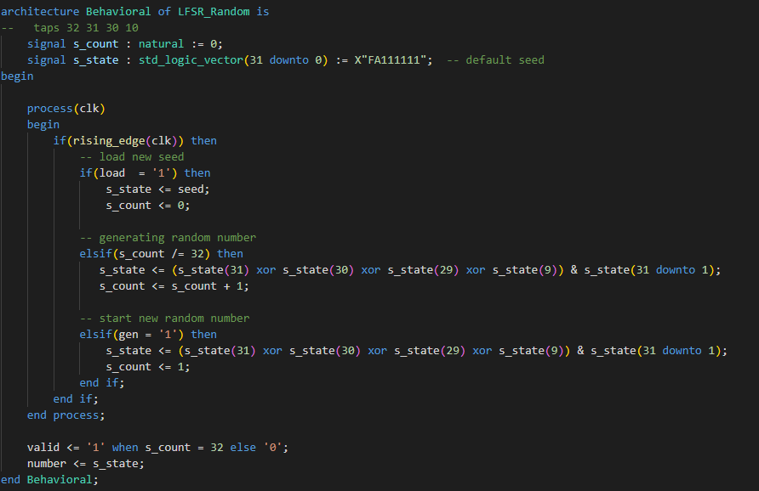
VHDL Implementation

Slide 9
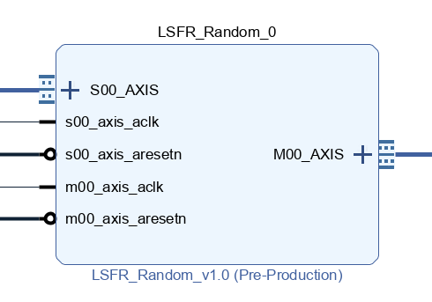
Block Diagram

Slide 10
Results
The software implementation took 187041 microseconds
The hardware implementation took 1321 microseconds
Due to the large gap between timing results, this operation is most suited to be executed on hardware

Slide 11
References
https://en.wikipedia.org/wiki/Linear-feedback_shift_register

