Slide 1
Async all the things
async, await, Task and friends

Slide 2
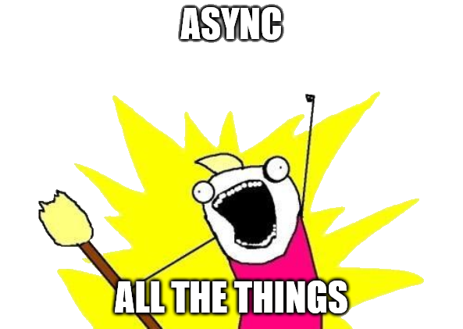
(mandatory meme)

Slide 3
Summary
Why is asynchronous programming important?
Common patterns, practices and pitfalls
Some less discussed scenarios

Slide 4
Why is async programming important?
Why do we need this?
Weren't we all happy with simpler code, without Task, async and await all over the place?

Slide 5



Example scenario: web application
Client
Server
Database
Thread pool
Thread 1 (T1)
Thread 2 (T2)

Slide 6

No async
Client 1
Thread pool
Blocked
T1
T2
T1
T2
Client 2
Client 3

