Slide 1
Async all the things
Example driven presentation on using Task, async, await and related bits in C#, with focus on ASP.NET (Core)

Slide 2
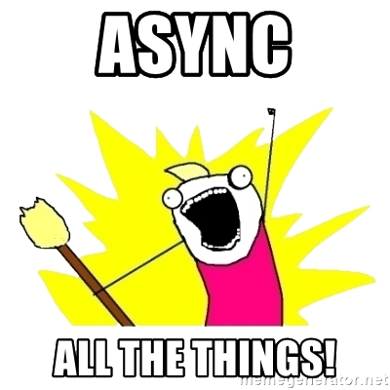
(mandatory meme)

Slide 3
Summary
Why async/await?
Some regularly used practices and patterns with async/await and other related bits
Some less used but interesting scenarios
Some common issues
Lots of demos!

Slide 4
Before getting into code…

Slide 5
Why is async important?
Why do we need this? Weren't we all happy with simpler code, without Task, async and await all over the place?

Slide 6
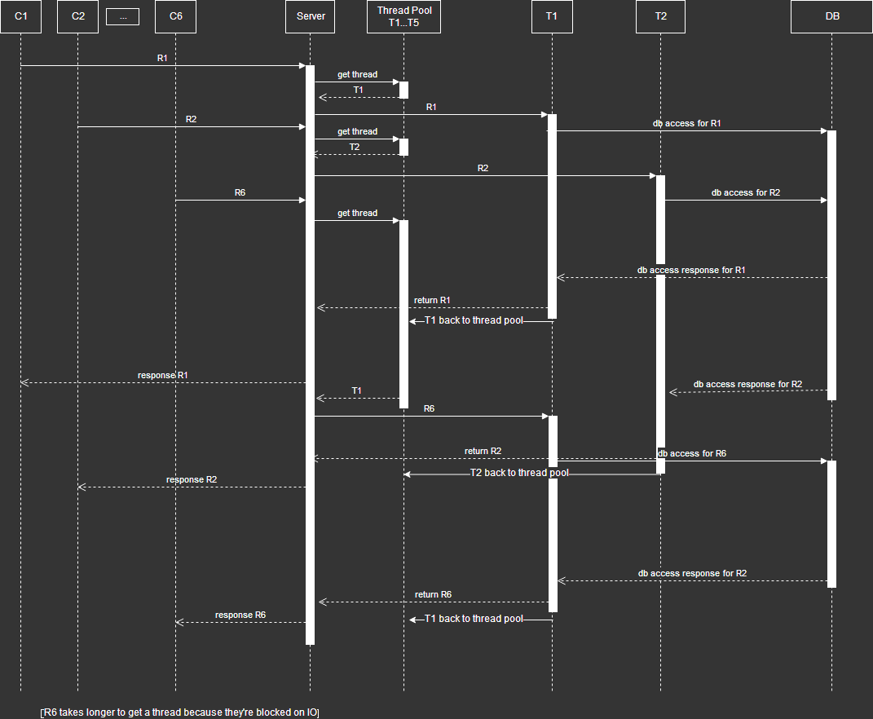
Example: DB access without async features

Slide 7
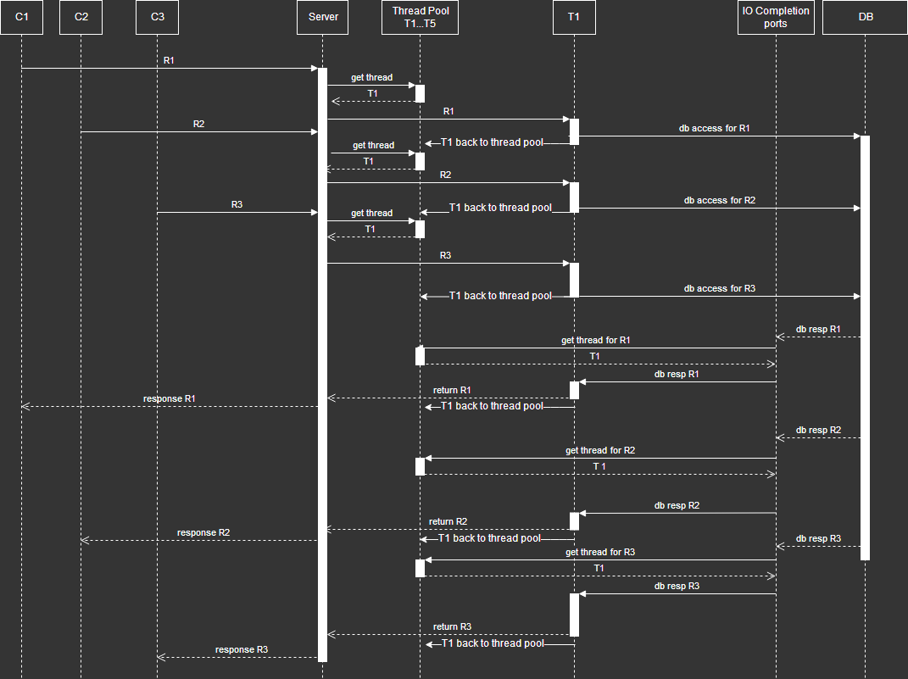
Example: DB access with async features

Slide 8
Side note: before async/await
There were mechanisms to write async code prior to the introduction of async/await

Slide 9
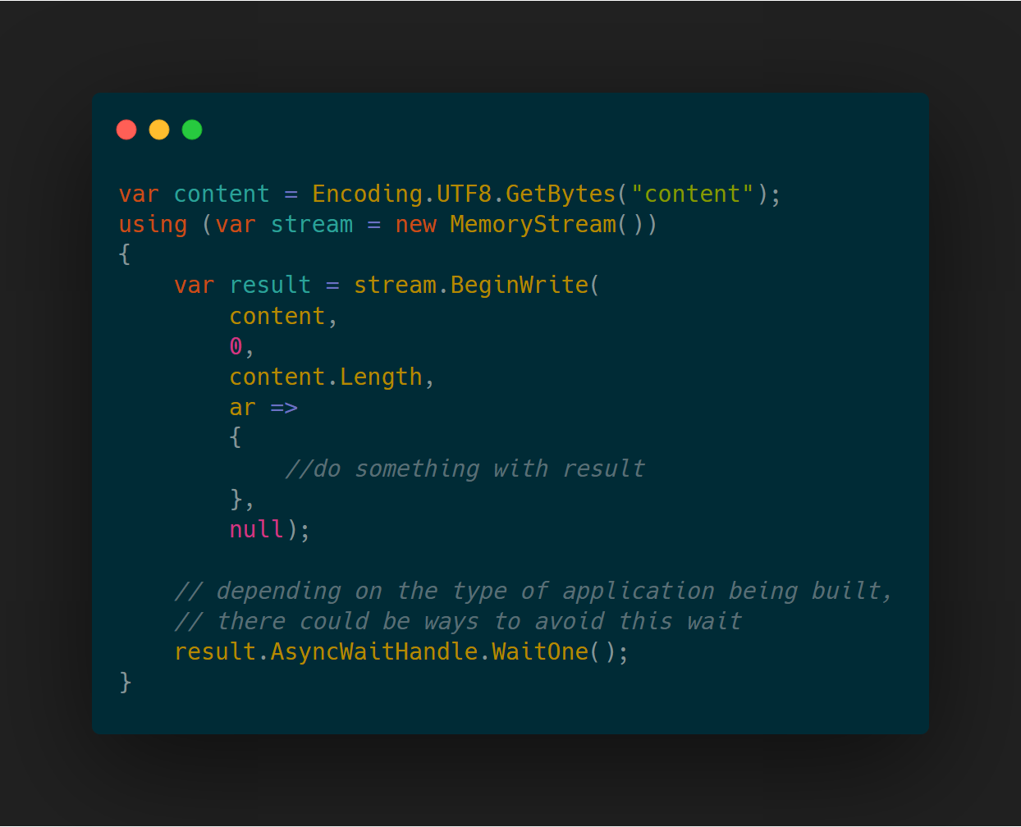
Before async/await - IAsyncResult

Slide 10
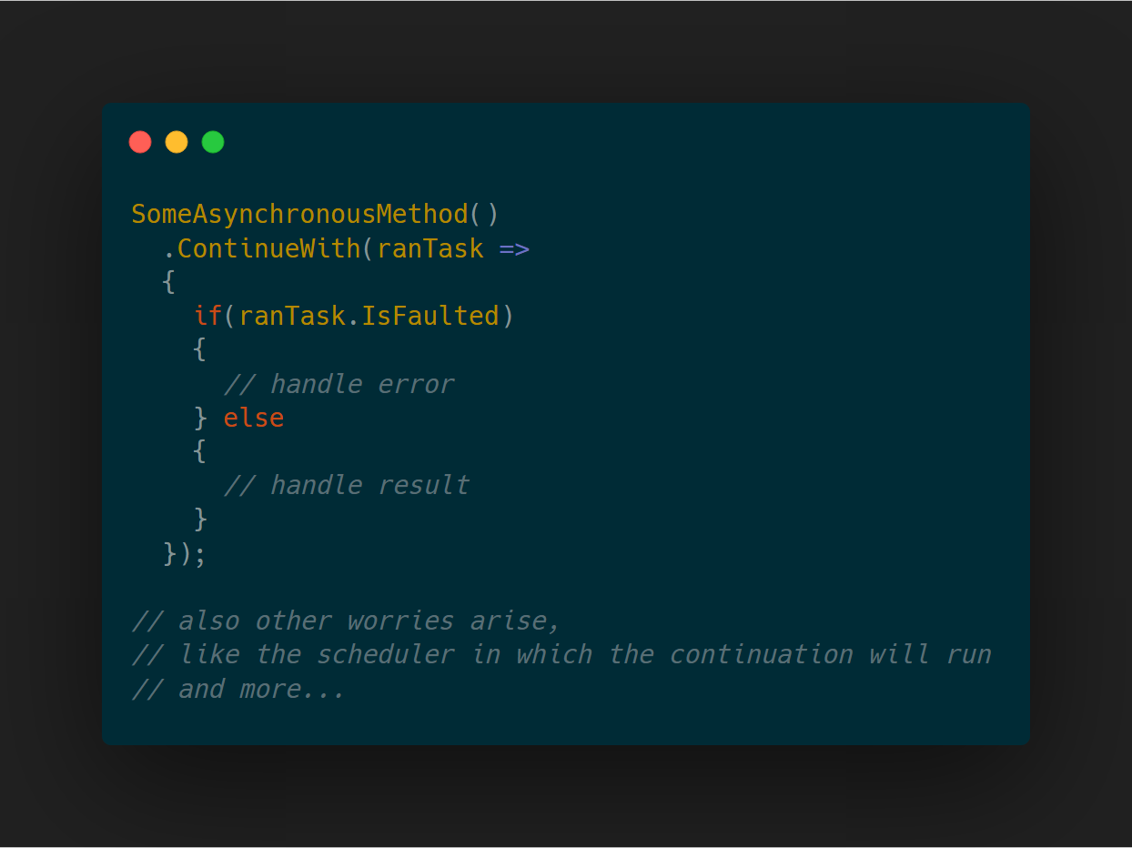
Before async/await – TPL only

Slide 11
Before async/await - takeaways
We could implement async operations, but it wasn’t as simple as with async/await (which in turn could be simpler as well, one can dream about “green threads”)

Slide 12
Getting started
Let's start with the basics, adapting a non-async service into async

Slide 13
DEMO #01: Getting started

Slide 14
Getting started - takeaways
Methods return Task
Most of the times. There are alternatives we'll see later
Convention for async methods is to have the “Async” suffix

Slide 15
Async all the way
When we go async, we must go all in
Going half async is worse than not going at all
Possible deadlocks
Worse performance

Slide 16
DEMO #02: Async all the way

Slide 17
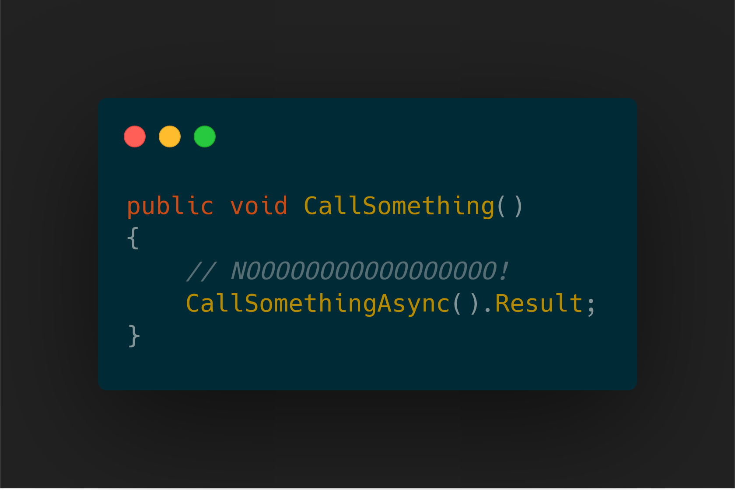
Async all the way - takeaways
No sync over async! *
* unless you really know what and why you are doing

Slide 18
.Result vs .GetAwaiter().GetResult()
Ideally we shouldn't use either, but if we must...

Slide 19
DEMO #03: .Result vs .GetAwaiter().GetResult()

Slide 20
.Result vs .GetAwaiter().GetResult() - takeaways
Valid use of .Result:
after checking Task.Status == TaskStatus.RanToCompletion
Valid use of .GetAwaiter().GetResult():
Never? 🤔
If we **MUST** do sync over async

Slide 21
Wasting threads
Even when we do sync over async safely* we lose on something
* as in without deadlocks, we can still cause thread starvation

Slide 22
DEMO #04: Wasting threads

Slide 23
Wasting threads - takeaways
No sync over async! *
* yes, I'm repeating the same slide 🙂

Slide 24
ConfigureAwait(false)
Using it appropriately:
One less thing to copy when synchronizing threads
Avoids deadlocks due to sync over async (don't!)

Slide 25
DEMO #05: ConfigureAwait(false)

Slide 26
ConfigureAwait(false) - takeaways
Use it in the application, where you're sure you don't need the context
Not needed in ASP.NET Core or console applications
Use it in class libraries

Slide 27
Return Task without awaiting
When we have a method that returns the execution of another async method, can we just return it without awaiting?
Do we lose anything?
Do we gain anything?

Slide 28
DEMO #06: Return Task without awaiting

Slide 29
Return Task without awaiting - takeaways
We can return it immediately:
Being careful with:
try blocks
using blocks
other things I can't think of now
Keep in mind the stack trace is different
Has performance benefits
One less async state machine (more on this later)

Slide 30
Parallel requests
We can take advantage of async methods to make multiple requests in parallel

Slide 31
DEMO #07: Parallel requests

Slide 32
Parallel requests - takeaways
May improve performance by doing multiple things in parallel
Keep in mind:
Some methods seem async, but aren't (are just implementing an async interface) – in these cases, if we want to make sure things are made in parallel, we can for instance use Task.Run (but we might be wasting threads)
Some things, e.g. an EF DbContext, aren't thread safe, so parallel requests are dangerous
There are static Task helper methods to work with multiple Tasks

Slide 33
It ain't async as soon as its called
Just because a method is async, it doesn't mean it'll suspend as soon as it's called

Slide 34
DEMO #08: It ain't async as soon as its called

Slide 35
It ain't async as soon as its called - takeaways
Don't assume an async method yields control immediately
If you really need it to, put it in another thread (e.g. Task.Run)

Slide 36
Task.FromResult vs Task.Run
When implementing an async interface but the implementation isn't really async, how to go about it?

Slide 37
DEMO #09: Task.FromResult vs Task.Run

Slide 38
Task.FromResult vs Task.Run - takeaways
Namely in ASP.NET, doing Task.Run just worsens performance with unneeded context switches
Prefer Task.FromResult (or Task.CompletedTask for void methods)
If the caller really requires something to be run on another thread, it should ensure it

Slide 39
CancellationToken
In .NET, cancellation of ongoing work (requests, long running processes, ...) is collaborative. To do this collaboration, there's a nice little struct named CancellationToken which allows code to check if "someone" asked for its cancellation.

Slide 40
DEMO #10: CancellationToken

Slide 41
CancellationToken - takeaways
Use the CancellationToken as much as possible when doing cancellable work
May avoid wasting resources on unneeded work
Stop passing the CancellationToken around when a cancellation can be troublesome
Don't rely on it to ensure something already started isn't done

Slide 42
Under the hood
A lot of talk about async and await, but what happens when the code is running? What's does the compiler generate?

Slide 43
DEMO #11: Under the hood

Slide 44
Under the hood - takeaways
async/await is C# specific, doesn't transpose to the generated IL
When we use it, the compiler generates the required bits
An async method (with the async keyword in it) has a corresponding state machine class generated
An instance of this class is created when it's called

Slide 45
TaskCompletionSource
We've seen how to get Tasks when calling code that provides them, like making HTTP requests with the HttpClient.
What about if we wanted to set the result of a Task later, in a different way, having other code awaiting on it?

Slide 46
DEMO #12: TaskCompletionSource

Slide 47
TaskCompletionSource - takeaways
Can be useful to:
Create familiar Task based APIs without relying exclusively on calling other async methods
Make abstractions over non-Task APIs (e.g. events)
Make sure the Task continuation doesn't cause problems when the result is set

Slide 48
CancellationTokenSource
Considering the CancellationToken we talked about earlier, how can we not only be receivers of the cancellation, but also the ones that cause the cancellation?

Slide 49
DEMO #13: CancellationTokenSource

Slide 50
CancellationTokenSource - takeaways
Useful when we want to control the cancellation of work

Slide 51
Duck typing
There are a bunch of things in .NET that can be done with duck typing (e.g. we don't need to implement IEnumerable to do a foreach, it just needs to have a GetEnumerator)
One of those is the usage of async and await. It doesn't need to be a Task, it just needs a GetAwaiter method that returns something implementing INotifyCompletion.

Slide 52
DEMO #14: Duck typing

Slide 53
Duck typing - takeaways
We can make everything awaitable:
With an instance method in the class we want to await
With an extension method for the class we want to await
When is this useful?
¯\_(ツ)_/¯
There probably is a good use case for it, haven't come across it
May be confusing to someone unaware of this, when looking at an API returning such a type

Slide 54
ValueTask
ValueTask is another awaitable type in .NET
Similar to a Task, but a struct instead of a class

Slide 55
DEMO #15: ValueTask

Slide 56
ValueTask - takeaways
The default choice continues to be Task
Only use ValueTask after confirming it’ll bring performance improvements
It can have the opposite effect
Beware that, depending on the way the ValueTask is created, it may not be safe to await it multiple times
The DEMO I created is the most basic of things, be sure to read a lot more about it before using ValueTask

Slide 57
AsyncLocal
Remember thread local storage? Well it doesn’t really work well in this new async world, AsyncLocal to the rescue

Slide 58
DEMO #16: AsyncLocal

Slide 59
AsyncLocal - takeaways
Enables us to flow ambient information through an async workflow
Acts like thread local storage, but in an async world where an execution flow can go through multiple threads
It has some tricky semantics, so be aware of that when using it
Example usage: ASP.NET Core’s HttpContextAccessor

Slide 60
Wrapping up

Slide 61
Wrapping up
We've seen:
Why async/await
Some regularly used practices and patterns with async/await and other related bits
Some less used but interesting scenarios
Some common issues
There’s much more depth to the subject, but hopefully this should be a good overview

Slide 62
Some links
David Fowler's async guidance article: https://github.com/davidfowl/AspNetCoreDiagnosticScenarios/blob/master/AsyncGuidance.md
Stephen Cleary's blog: https://blog.stephencleary.com/
"Task.Run Etiquette Examples: Don't Use Task.Run in the Implementation": https://blog.stephencleary.com/2013/11/taskrun-etiquette-examples-dont-use.html
“There Is No Thread”: https://blog.stephencleary.com/2013/11/there-is-no-thread.html
Stephen Cleary MSDN post on "Async/Await - Best Practices in Asynchronous Programming": https://msdn.microsoft.com/en-us/magazine/jj991977.aspx
Sergey Teplyakov's "The danger of TaskCompletionSource<T> class": https://blogs.msdn.microsoft.com/seteplia/2018/10/01/the-danger-of-taskcompletionsourcet-class/
Stephen Toub's "Understanding the Whys, Whats, and Whens of ValueTask" https://devblogs.microsoft.com/dotnet/understanding-the-whys-whats-and-whens-of-valuetask/
Stephen Toub’s “ExecutionContext vs SynchronizationContext” https://devblogs.microsoft.com/pfxteam/executioncontext-vs-synchronizationcontext/
And there’s a looooot more! 😛

Slide 63
Thanks!
Presentation and sample code:
https://github.com/joaofbantunes/AsyncAllTheThings

