Slide 1
OOPs, I did it again
(aka Untangling the mess we're making out of OOP)

Slide 2
About me (in 15 seconds)
João Antunes
From Portugal
Software Architect @ Openvia Mobility
Microsoft MVP – Developer Technologies

Slide 3
Intro
Object-oriented is (still) the most broadly used programming paradigm
But are we really doing OO?
I'd argue a lot of the "OO" code we see is actually procedural
My experience, maybe you have been luckier

Slide 4
Goals of the presentation
Goals:
Remember some of the basics of OO and other paradigms
Provide some ideas to help improve codebases
!Goals:
Show the "one true way“ ™
Start a paradigm flame war (e.g. OO vs functional)

Slide 5
Overview
The super controller
The super service
Individual request handlers
OOifying
Make use of type safety
Minimize exceptions

Slide 6
Sample: supermarket API
Common cart operations
Create cart
Get cart info
Add item to cart
Update item in cart
Remove item from cart
(where we’ll focus the presentation)

Slide 7

The super controller

Slide 8
Time to look at code!

Slide 9

SOLID/CUPID/other principles

Slide 10
Aside on principles
Beware on blindly following “principles”
I’ll use SOLID in these examples, due to it being commonly referenced

Slide 11
People love to preach SOLID...
But is it being practiced?
(S)ingle responsibility principle
(O)pen-closed principle
(I)nterface segregation principle

Slide 12
The super service

Slide 13
Back to the IDE!

Slide 14
SOLID/CUPID/other principles

Slide 15
Are we SOLID now?
(S)ingle responsibility principle
(O)pen-closed principle
(I)nterface segregation principle

Slide 16
Individual request handlers

Slide 17
Let’s get back to code
Segregate the service responsibilities
Reap benefits of this segregation

Slide 18
Still not very OO, but:
No more giant class that does everything
One operation/use case → one class
Clearer relation between dependencies & use cases
Some typical OO patterns emerge
E.g. implement crosscutting concerns with decorators

Slide 19
We can go further
Ideally, we'd like our handlers to orchestrate each use case logic, not do everything

Slide 20
OOifying

Slide 21
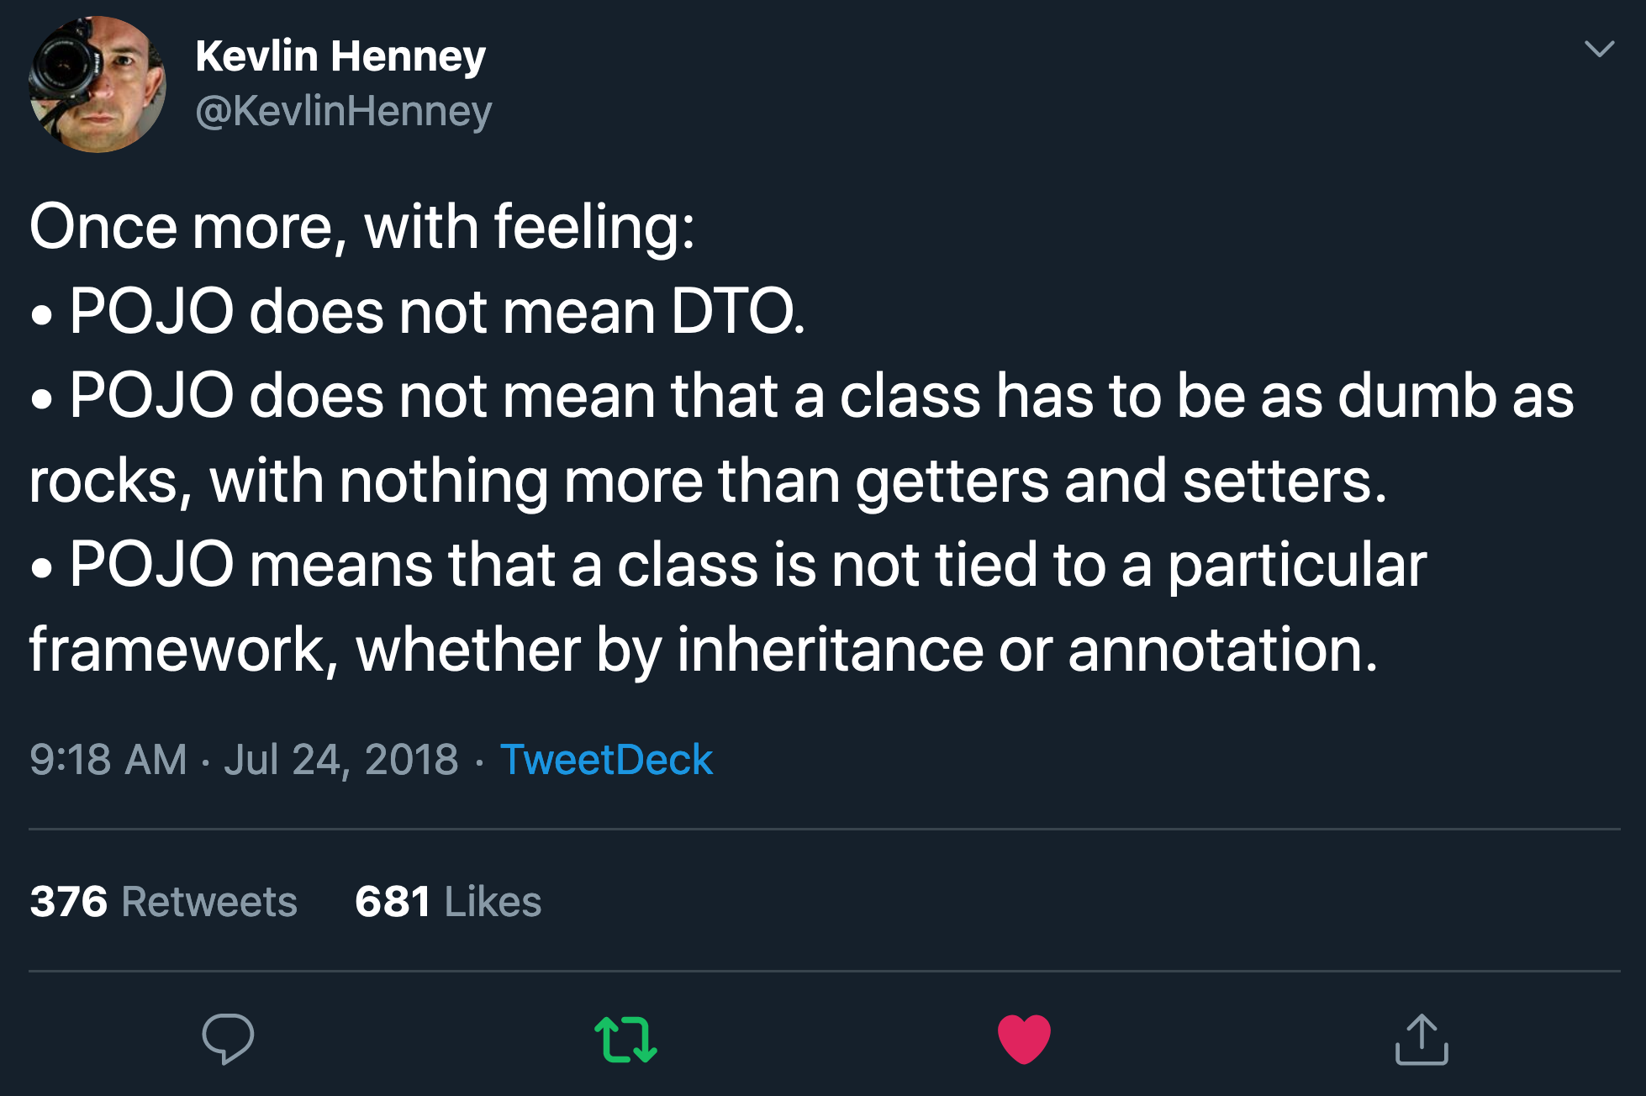

Slide 22
POCO vs DTO
POCO
DTO

Slide 23
Object-oriented programming
object = data + behavior (oversimplifying)
If all we have are data classes and behavior classes, we're not taking advantage of the paradigm

Slide 24
Thy code!
Consolidate logic in the respective classes
Each class represents a specific concept that:
Exposes the concept's capabilities
Enforces its invariants, keeping itself valid
Abstracts the rest of the code from its internal details
Keep use case orchestration in the handlers

Slide 25
Some takeaways
Even better separation of concerns
More readable and cohesive components
The handler code reads like steps of a recipe
Smaller units → simpler unit testing
Bonus: null object and composite patterns

Slide 26
Make use of type safety

Slide 27
(Not really object-oriented specific, but common in such languages)

Slide 28
One more look at some code
Avoid primitive obsession
Use strongly typed identifiers
Use Maybe type or nullable reference types
Implement a discriminated union to enforce handling of all expected scenarios

Slide 29
Some takeaways
Avoiding primitive obsession
Harder to mixup values than relying solely on primitive types
Encapsulate logic where it makes sense
Focused on ids, but it also applies to other usages of primitive types
Maybe/NRTs forces us to think → “old-school” null handling is easy to forget/mess up
Discriminated unions → harder to forget to handle a new scenario

Slide 30
Minimize exceptions

Slide 31
Exceptions
In the previous samples, I’ve been misusing exceptions
Some business logic rule fail → throw
Not good...
Exceptions should be exceptional
What if we make the possible business logic errors obvious?

Slide 32
Last look at some code
Return explicit success/error information

Slide 33
Some takeaways
Handling the errors becomes explicit
Forcing us to think about it
Not to replace all exceptions, focus on business logic
A method receives null on a non optional parameter - that's an exception, we're failing a pre-condition
Trying to buy more items than allowed, not really an exception, but a business logic error
Downside: the code may become a little less linear

Slide 34
Outro
Revisiting this subject reminded me when I first learned OOP
Got me thinking why as soon as I started working, all was mostly forgotten
Procedural, object-oriented and functional are all valid
But don’t hate object-oriented if writing procedural

Slide 35
Outro
Probably some samples remind of things seen in content about DDD, maybe also CQRS and other such buzzwords
I’d argue that’s because these went back to the basics to use tried and true patterns and practices

Slide 36
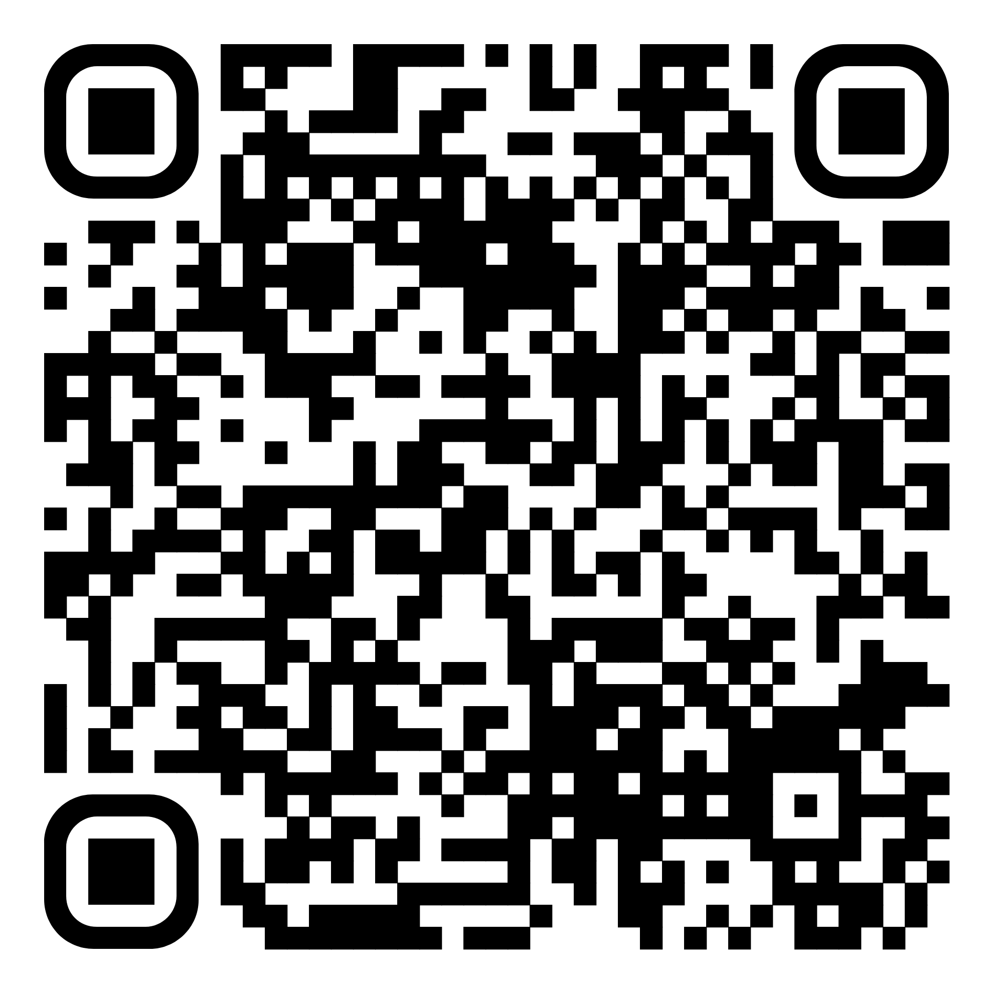
Demo code and presentation
https://github.com/joaofbantunes/OOPsIDidItAgain

Slide 37
Thanks!
Feel free to reach out
antunes.dev
blog.codingmilitia.com
mastodon.social/@joaofbantunes
linkedin.com/in/joaofbantunes
twitter.com/joaofbantunes

