Slide 1
OOPs, I did it again
(aka Untangling the mess we're making out of OOP)

Slide 2
About me (in 15 seconds)
João Antunes
From Portugal
Software engineer @ BOLD by Devoteam
Microsoft MVP – Developer Technologies
Find me on Twitter @joaofbantunes

Slide 3
Intro
Object oriented is (still) the most broadly used programming paradigm
But are we really doing OO?
I'd argue a lot of the "OO" code we see is actually procedural
My experience, maybe you have been luckier

Slide 4
Goals of the presentation
Goals:
Remember some of the basics of OO and other paradigms
Provide some ideas to help improve codebases
!Goals:
Show the "one true way“ ™
Start a paradigm flame war (e.g. OO vs functional)

Slide 5
Overview
The super controller
The super service
Individual request handlers
OOifying
Make use of type safety
Minimize exceptions

Slide 6
Sample: supermarket API
Common cart operations
Create cart
Get cart info
Add item to cart
Update item in cart
Checkout cart
(where we’ll focus the presentation)

Slide 7

The super controller

Slide 8
Time to look at code!

Slide 9

SOLID Principles

Slide 10
People love to preach SOLID...
But is it being practiced?
(S)ingle responsibility principle
(O)pen-closed principle

Slide 11
The super service

Slide 12
Back to the IDE!

Slide 13
SOLID Principles

Slide 14
Are we SOLID now?
(S)ingle responsibility principle
(O)pen-closed principle
(I)nterface segregation principle

Slide 15
Individual request handlers

Slide 16
Let’s get back to code
Segregate the service responsibilities
Reap benefits of this segregation

Slide 17
Still not very OO, but:
No more giant class that does everything
One operation/use case → one class
Easier to unit test → stub/mock actual dependencies
Some typical OO patterns emerge
E.g. implement crosscutting concerns with decorators

Slide 18
We can go further
*
Ideally, we'd like our handlers to orchestrate each use case logic, not do everything
* But if we didn't, this could be a nice middle ground

Slide 19
OOifying

Slide 20
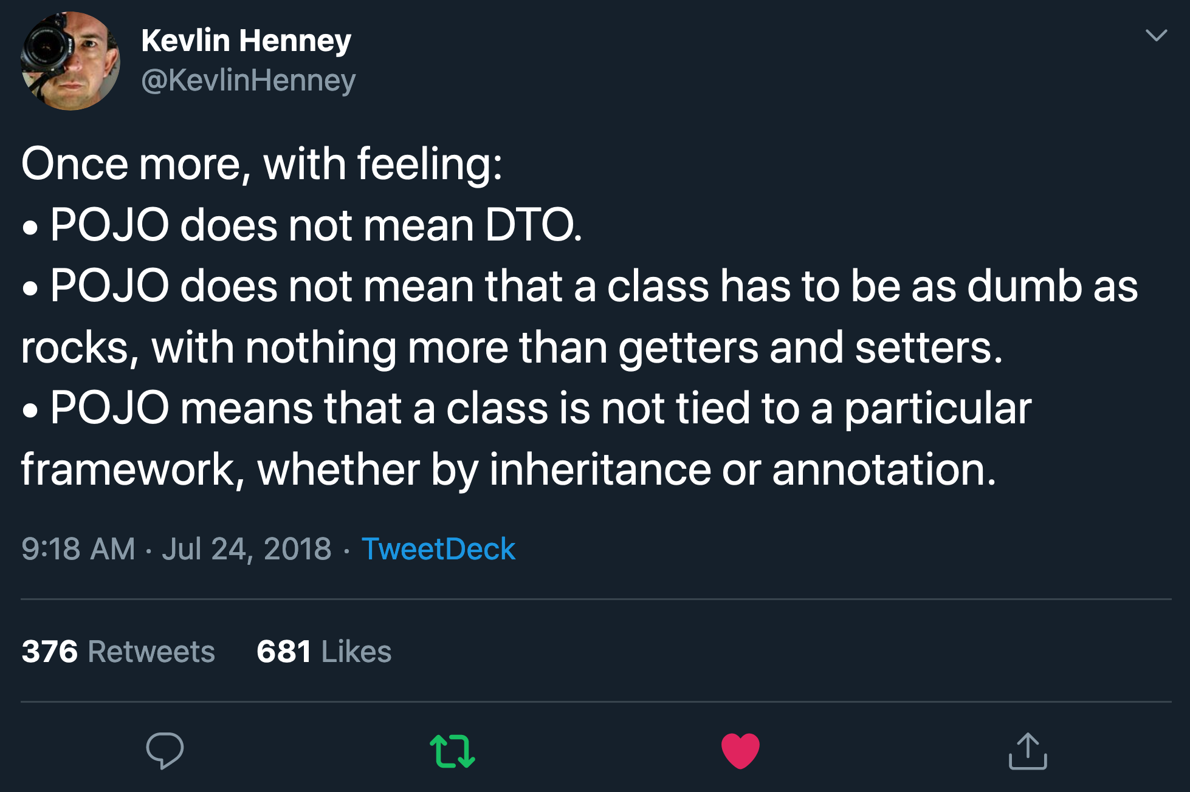

Slide 21
Object oriented programming
object = data + behavior (oversimplifying)
If all we have are data classes and behavior classes, we're not taking advantage of the paradigm

Slide 22
Thy code!
Consolidate domain logic in the respective classes
Each class represents a specific concept that:
Exposes the concept's capabilities
Enforces its invariants, keeping itself valid
Keep use case orchestration in the handlers

Slide 23
Some takeaways
Even better separation of concerns
More readable and cohesive components
The handler code reads like steps of a recipe
Smaller units → simpler unit testing
Bonus: null object and composite patterns

Slide 24
Make use of type safety

Slide 25
(Not really object oriented specific, but common in such languages)

Slide 26
One more look at some code
Use Maybe type or nullable reference types
Avoid primitive obsession
Use strongly typed identifiers
Implement a discriminated union to enforce handling of all expected scenarios

Slide 27
Some takeaways
Maybe/NRTs forces us to think → “old-school” null handling is easy to forget/mess up
Avoiding primitive obsession
Harder to mixup values than relying solely on primitive types
Encapsulate logic where it makes sense
Focused on ids, but it also applies to other usages of primitive types
Discriminated unions → harder to forget to handle a new scenario

Slide 28
Minimize exceptions

Slide 29
Exceptions
In the previous samples, I’ve been misusing exceptions
Some domain rule fail → throw
Not good...
Exceptions should be exceptional
What if we make the possible domain errors obvious?

Slide 30
Last look at some code
Return explicit success/error information

Slide 31
Some takeaways
Handling the errors becomes explicit
Forcing us to think about it
Not to replace all exceptions, but at least domain specific
A method receives null on a non optional parameter - that's an exception, we're failing a pre-condition
Trying to buy more items than allowed, not really an exception, but a domain error
Downside: the code may become a little less linear

Slide 32
Outro
Revisiting this subject reminded me when I first learned OOP
Got me thinking why as soon as I started working, all was mostly forgotten
Probably some samples remind of things seen in content about DDD, maybe also CQRS and other such buzzwords
I’d argue that’s because these went back to the basics to use tried and true patterns and practices

Slide 33

Demo code and presentation
https://github.com/joaofbantunes/OOPsIDidItAgain

Slide 34
Thanks!
Feel free to reach out
antunes.dev
blog.codingmilitia.com
twitter.com/joaofbantunes
linkedin.com/in/joaofbantunes

