Slide 1
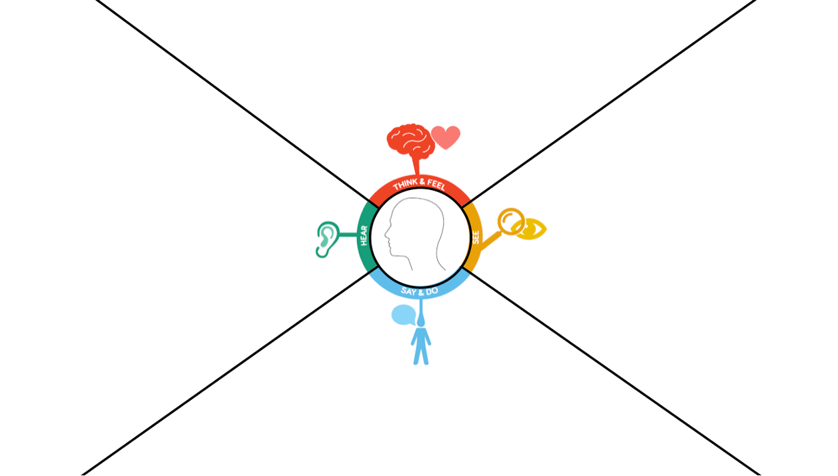
Anthony
Ease of use
I hope it’s easy and quick to pay
Cleanliness
I want the place to be clean
Service
I’d like the service to be great to come back again
Friendliness
I’d like to see
familiar faces
Fears
I want to feel like technology won’t be an issue
Recognition
I’d like to hear my name when it’s my turn to be served
Service
I want to be served by a friendly face
Environment
I want the place to be quiet and friendly
Lighting
I’d like the place to be not too bright
and not too dark
Socializing
I want the staff to chat with me
Crowd
I want to see a very short line of people
Greeting
I’d like to be greeted when I’m served and when I’m about to leave the pharmacy
Courtesy
I’d say grateful words to the staff for helping me
I’d say how helpful the staff was
I’d happily say hello and goodbye to the staff
I’d ask the staff how their day is going

Slide 2
Bill
Fast service
I’d think “the service is blazing fast”
Habit
I’d like to feel like I’ve used a similar app before
Cleanliness
I want the place to be clean
Ease of use
I hope it’s easy and quick to be served
Space
I’d like to see a modern waiting room with few people
Fast service
I’d like the conversations with the pharmacist to be minimal
Environment
I’d like the pharmacy to be a relatively quiet and calm environment
App
I’d like to see a modern and responsive interface for the prescription’s app
Recognition
I’d like to hear my name when it’s my turn to be served
Staff
I want to see plenty of staff
so that I don’t have to wait
Greeting
I’d like to be greeted when I’m served and when I’m about to leave the pharmacy
Frequency
I’d use the prescription’s app every time
Recommendation
I’d like to recommend the app to other people
Courtesy
I’d happily say hello and goodbye to the staff

