Slide 1
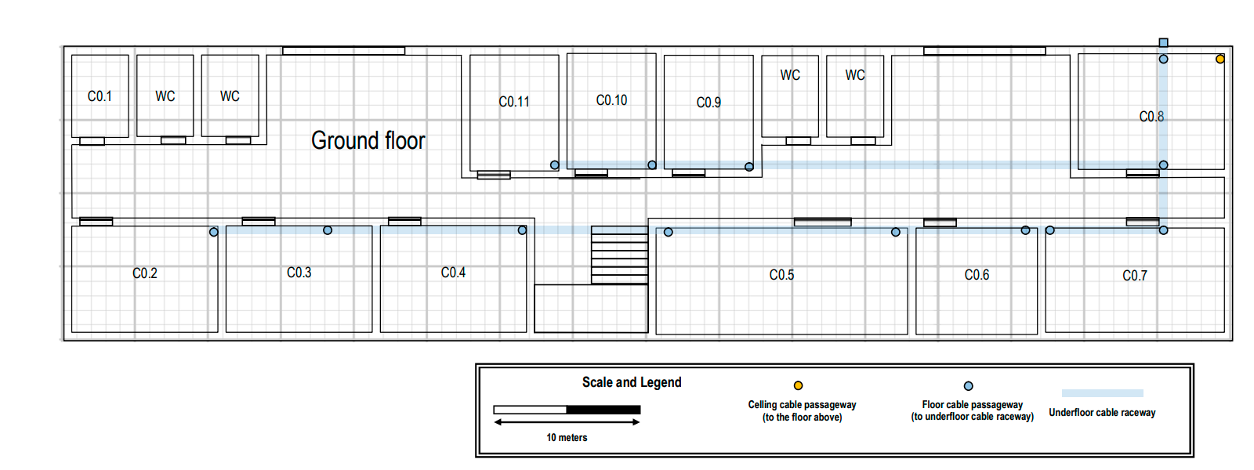
Router(wifi)
Consolidation point(Cp)
Intermediate-cross connect(ic)
Horizontal-cross connect (Hc)
Cat7 cable
Outlets

Slide 2
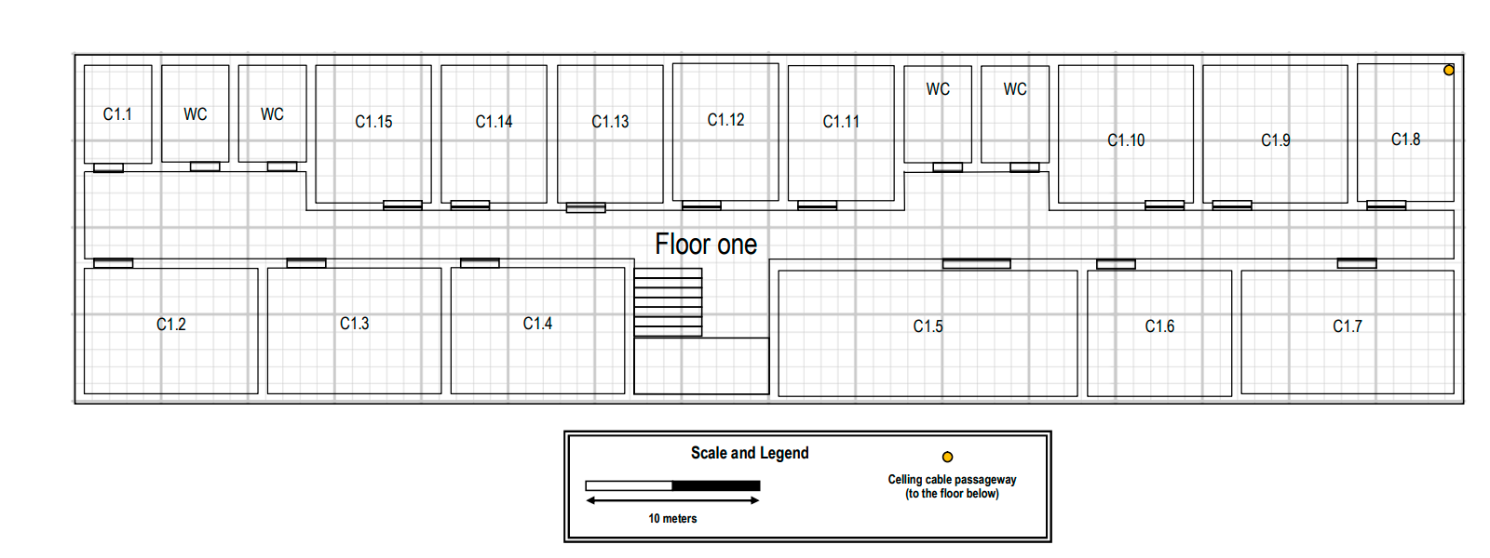
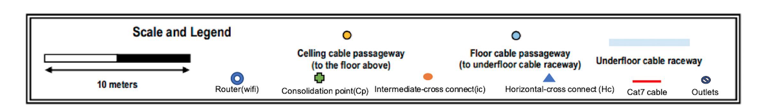
to the celling cable raceway
Celling cable raceway

