Slide 1
Aula 17 – Redes Neurais Convolucionais
SIN 392 – Introdução ao Processamento Digital de Imagens (2023-1)
Prof. João Fernando Mari
joaofmari.github.io
joaof.mari@ufv.br

Slide 2
Roteiro
Perceptron de multiplas camadas (MLP)
Redes Neurais Convolucionais (CNNs)
Camada convolucional
Camada de pooling
Modelos
Bibliotecas e ambientes de desenvolvimento
Conjuntos de imagens

Slide 3
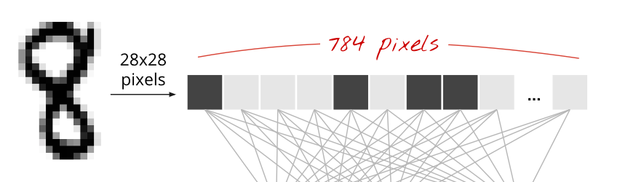
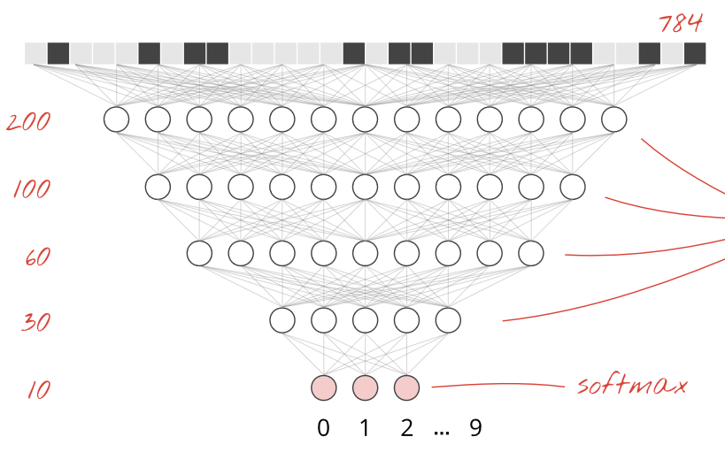
Perceptron de multiplas camadas (MLP)
Learn TensorFlow and deep learning, without a Ph.D.

Slide 4

Redes Neurais Convolucionais (CNNs)
MathWorks, Inc. https://www.mathworks.com/discovery/convolutional-neural-network-matlab.html

Slide 5
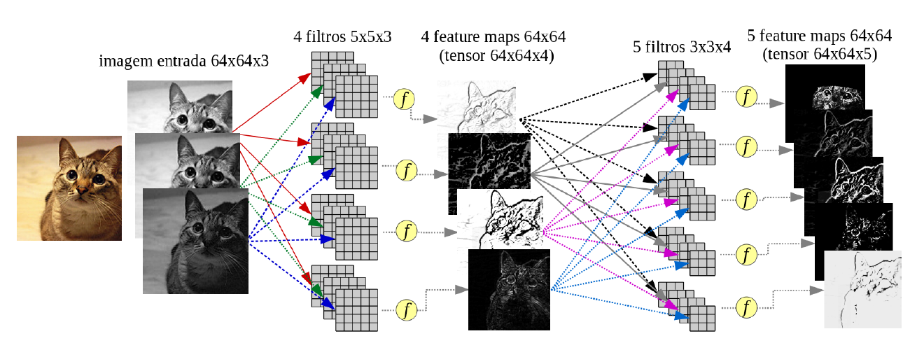
Redes Neurais Convolucionais (CNNs)
Moacir Ponti. http://conteudo.icmc.usp.br/pessoas/moacir/p17sibgrapi-tutorial/

Slide 6

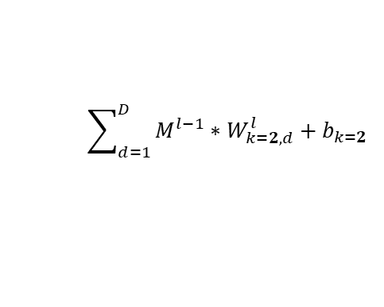

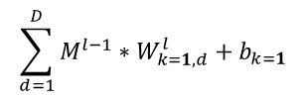


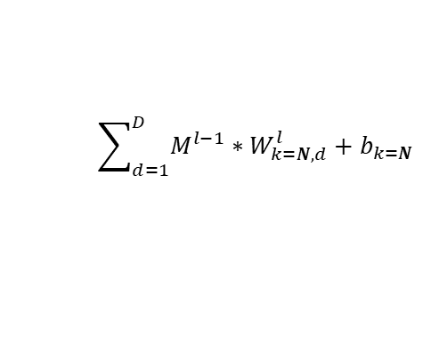








Camada convolucional
*
$$\sum_{d=1}^{D}{{M^{l−1}∗W}_{k=1,d}^{l}}+b_{k=1}$$
$$Convolutional Layer C_{}^{l}$$
*
...
*
$$W_{k=1, d}^{l}$$
...
$$\sum_{d=1}^{D}{{M^{l−1}∗W}_{k=1,d}^{l}}$$
$$M_{}^{l−1}$$
...
k=1
$b_{k=1}^{l}$
...
$$+$$
$${M^{l−1}∗W}_{k=1,d}^{l}$$
...
$$d=1, …,D$$
$$W_{k=2, d}^{l}$$
$$\sum_{d=1}^{D}{{M^{l−1}∗W}_{k=2,d}^{l}}+b_{k=2}$$
$$M_{}^{l}$$
k=2
...
...
...
$$W_{k=N, d}^{l}$$
$$\sum_{d=1}^{D}{{M^{l−1}∗W}_{k=N,d}^{l}}+b_{k=N}$$
k=N

Slide 7
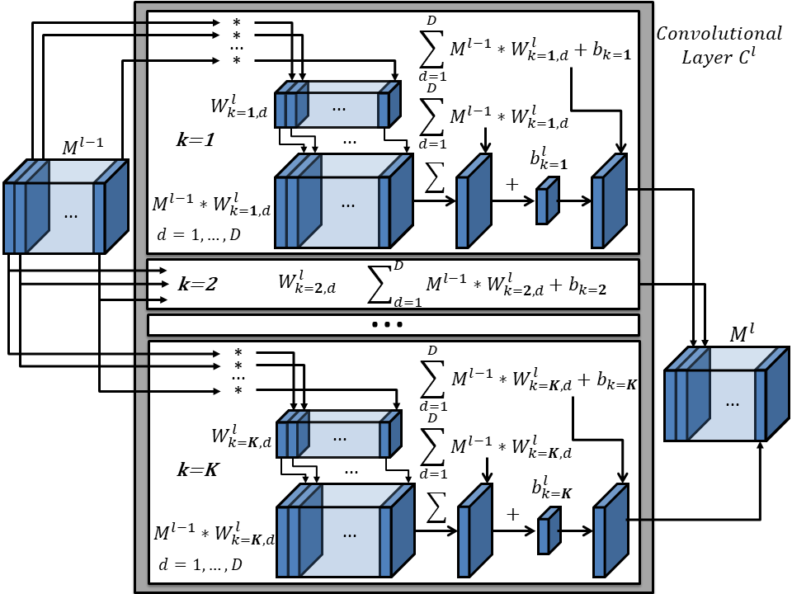
Camada convolucional

Slide 8
Camada de pooling
Max-pooling
(2 x 2)
0.5
0.7
H/2
0.2
0.5
0.7
0.4
0.4
0.9
H
D
0.4
0.1
0.3
0.6
W/2
0.4
0.1
0.7
0.5
Average-pooling
(2 x 2)
0.3
0.2
0.5
0.9
0.3
0.5
D
H/2
W
0.25
0.65
D
W/2

Slide 9
Modelos

Slide 10
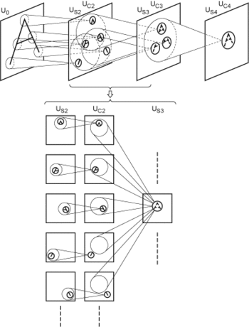

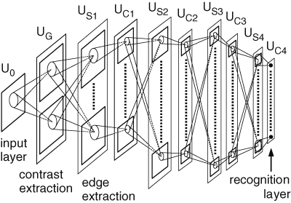
Neocognitron (1980)
Kunihiko Fukushima

Slide 11
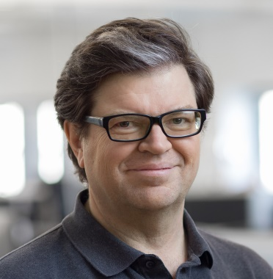
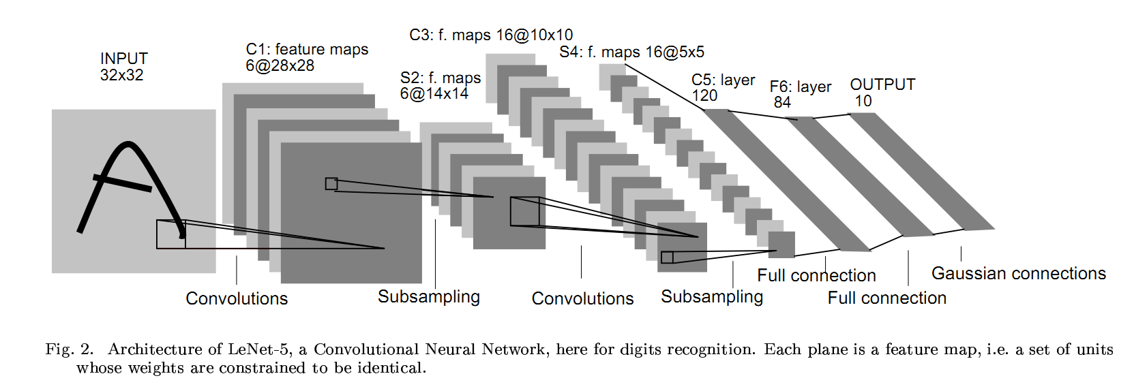
LeNet-5 (1998)
Yann LeCun

Slide 12
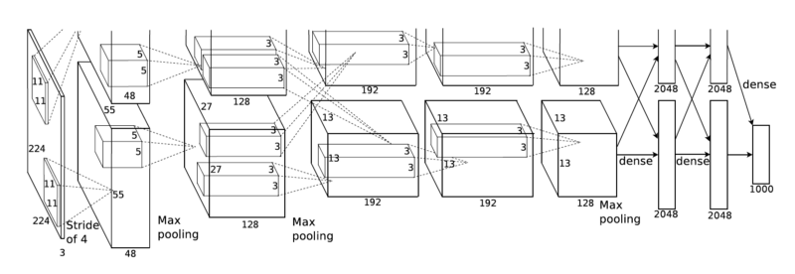
AlexNet (2012)

Slide 13
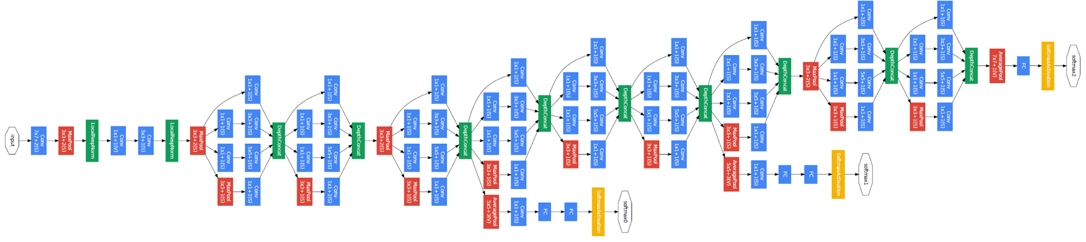
Inception (GoogLeNet) (2014)

Slide 14
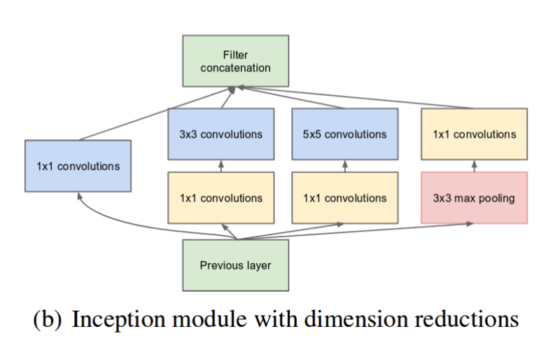
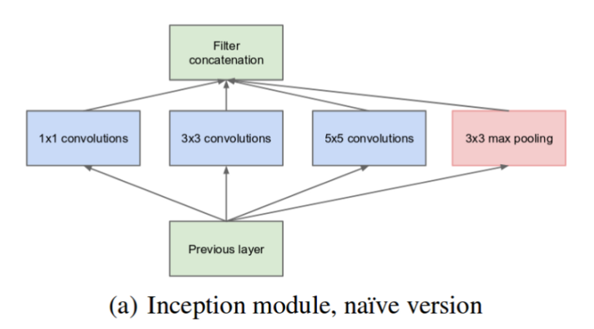
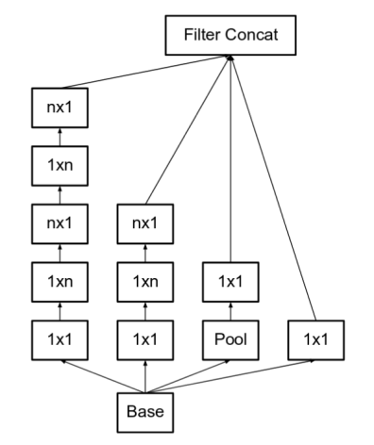
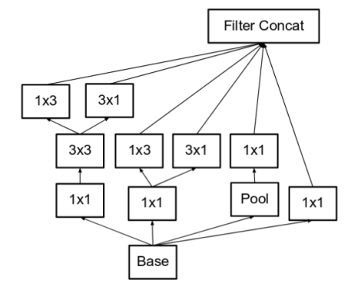
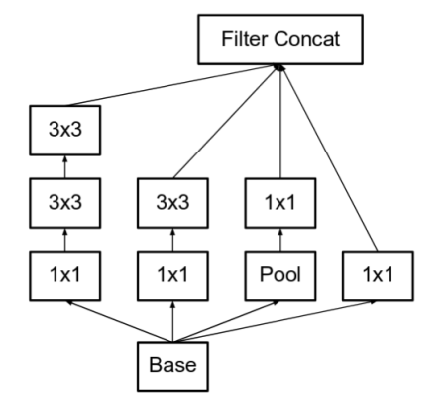
Módulos Inception

Slide 15
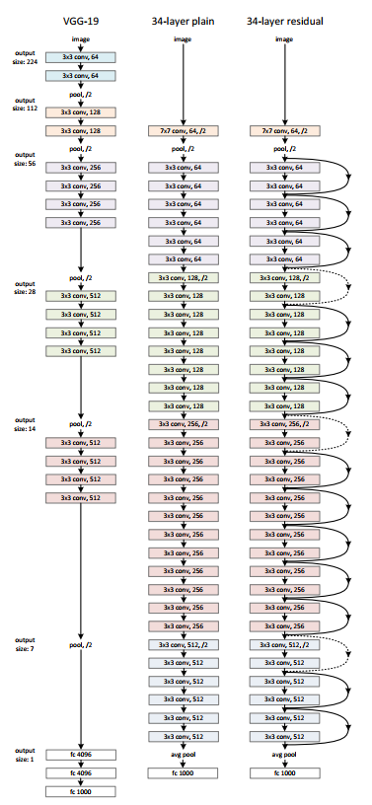
VGG (2014) e ResNet (2015)

Slide 16
Bibliotecas e ambientes de desenvolvimento

Slide 17
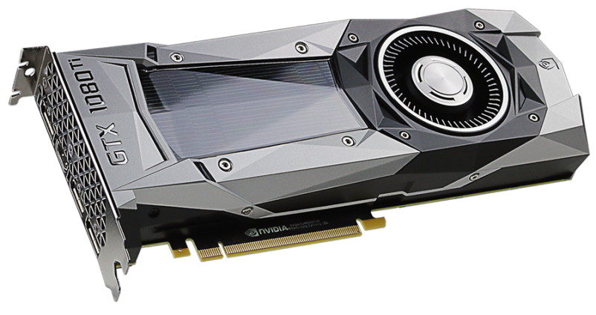
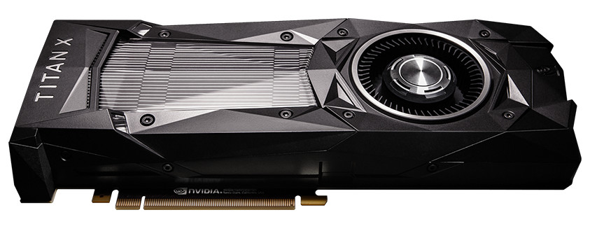
Bibliotecas e ambientes de desenvolvimento
O treinamento de CNNs possui alto custo computacional.
Recomenda-se que sejam treinados usando GPUs.
O Google Colab fornece acesso à GPUs (com algumas restrições).

Slide 18


Bibliotecas e ambientes de desenvolvimento

Slide 19


Bibliotecas e ambientes de desenvolvimento

Slide 20
Conjuntos de imagens

Slide 21
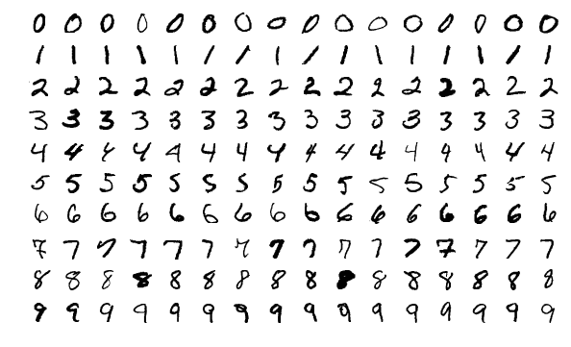
Conjuntos de imagens
MNIST
http://yann.lecun.com/exdb/mnist/
60,000 training images
10,000 testing images
28 x 28 pixels
Níveis de cinza

Slide 22
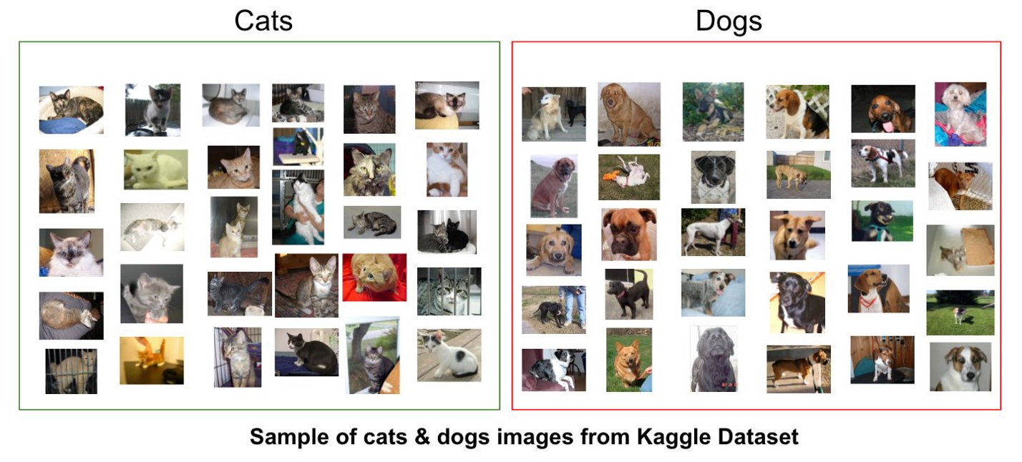
Conjuntos de imagens
Cats vs. Dogs
https://www.kaggle.com/c/dogs-vs-cats
25,000 images de treinamento
12,500 imagens de teste
2 classes
Diversos tamanhos
RGB

Slide 23
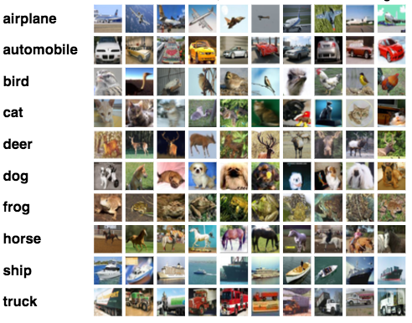
Conjuntos de imagens
CIFAR10
https://www.cs.toronto.edu/~kriz/cifar.html
50,000 training images
10,000 testing images
10 classes
32 x 32 pixels
RGB

Slide 24
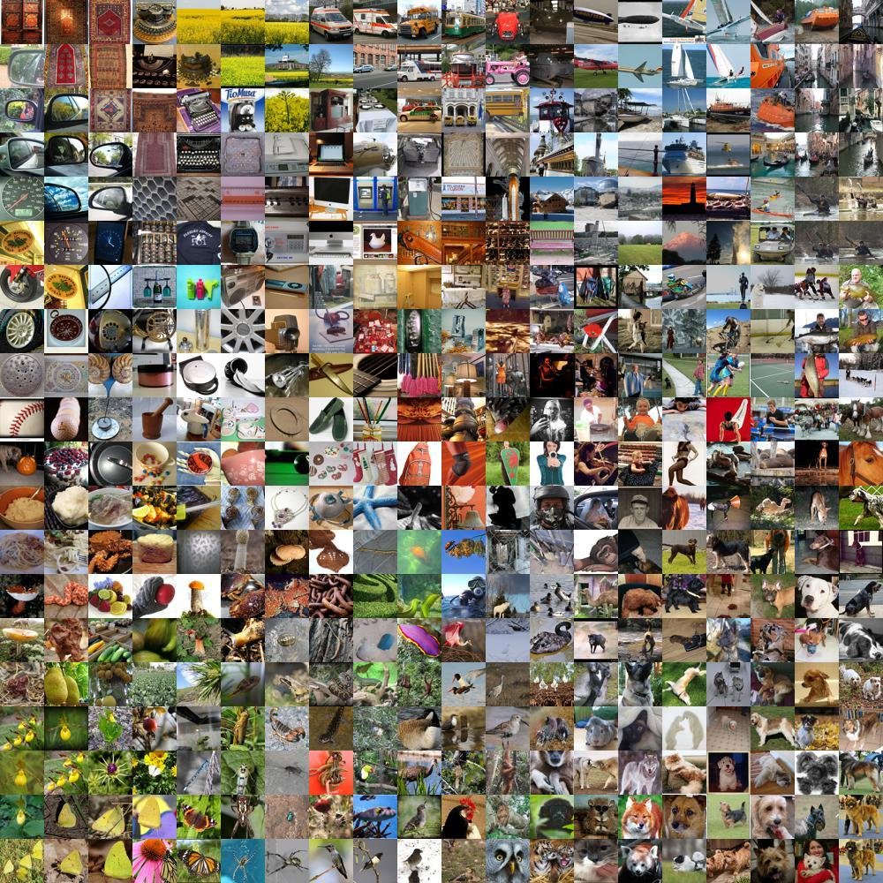
Conjuntos de imagens
ImageNet
https://www.image-net.org/
~1,000,000 imagens
1,000 classes
RGB

Slide 25
Bibliografia
Prof. Moacir Ponti (ICMC-USP). Material para o minicurso Deep Learning
https://github.com/maponti/deeplearning_intro_datascience
Learn TensorFlow and deep learning, without a Ph.D.
https://cloud.google.com/blog/products/gcp/learn-tensorflow-and-deep-learning-without-a-phd
CS231n: Convolutional Neural Networks for Visual Recognition
http://cs231n.github.io/
Goodfellow, Bengio e Courville. Deep Learning. MIT Press, 2016
https://www.deeplearningbook.org/
The MathWorks, Inc. What is a Convolutional Neural Network? 3 things you need to know.
https://www.mathworks.com/discovery/convolutional-neural-network-matlab.html

Slide 26
Bibliografia
Rodrigues, L. F.; Naldi M. C., Mari, J. F. Comparing convolutional neural networks and preprocessing techniques for HEp-2 cell classification in immunofluorescence images. Computers in Biology and Medicine, 2019.
https://doi.org/10.1016/j.compbiomed.2019.103542

Slide 27
FIM da disciplina!
@misc{mari_im_proc_2023,
author = {João Fernando Mari},
title = {Redes Neurais Convolucionais},
year = {2023},
publisher = {GitHub},
journal = {Introdução ao Processamento Digital de Imagens - UFV},
howpublished = {\url{https://github.com/joaofmari/SIN392_Introduction-to-digital-image-processing_2023}}
}

