Slide 1
Aula 16 – Redes Neurais Artificiais
SIN 392 – Introdução ao Processamento Digital de Imagens (2023-1)
Prof. João Fernando Mari
joaofmari.github.io
joaof.mari@ufv.br

Slide 2
Roteiro
O neurônio biológico
O neurônio de McCulloch e Pitts
O Perceptron
Algoritmo de aprendizado do Perceptron

Slide 3
O neurônio biológico

Slide 4
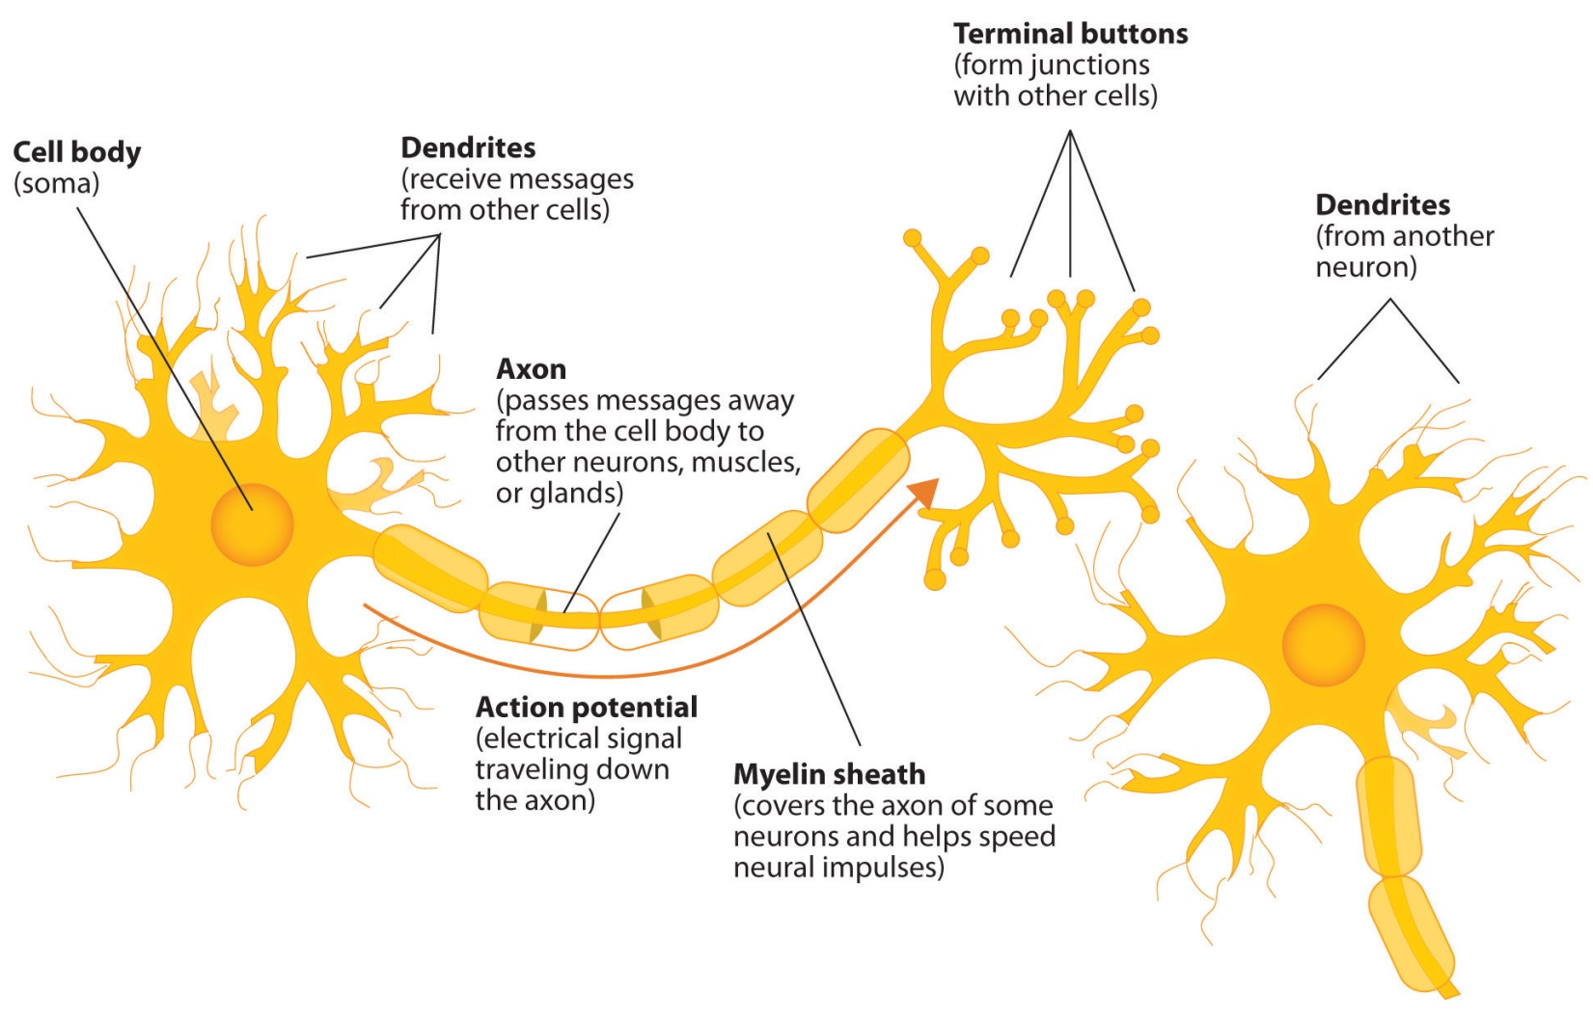
O neurônio biológico
“ Diagram of basic neuron and components”. Jennifer Walinga. Licença BY-SA 4.0.

Slide 5
O neurônio de McCulloch e Pitts

Slide 6
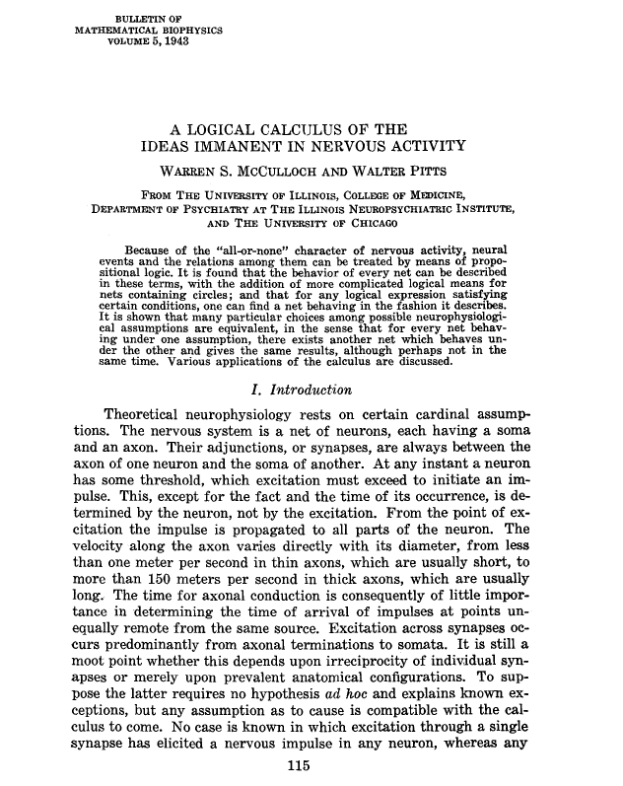
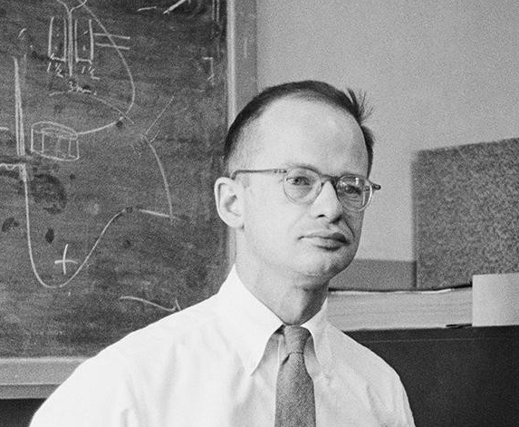
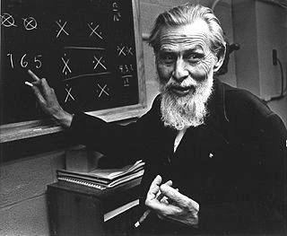
O neurônio de McCulloch e Pitts
Walter Pitts
Warren McCulloch

Slide 7
















O neurônio de McCulloch e Pitts
$$x$$
$$w$$
$$v, y$$
$$x_{0}$$
$$w_{0,0}^{}$$
$$x_{1}$$
$$w_{1,0}^{}$$
$${\hat{y}}_{0}$$
$$Σ$$
$$v_{0}$$
$$g\left(v\right)$$
$${\hat{y}}_{0}$$
$$v_{0}$$
...
$$w_{n−1,0}^{}$$
$$θ$$
$$x_{n−1}$$

Slide 8

O neurônio de McCulloch e Pitts
$$x$$
$$w$$
$$v, y$$
$$x_{0}$$
NEURÔNIO
$$w_{0,0}^{}$$
$$x_{1}$$
$$w_{1,0}^{}$$
$${\hat{y}}_{0}$$
$$Σ$$
$$v_{0}$$
$$g\left(v\right)$$
$${\hat{y}}_{0}$$
$$v_{0}$$
...
$$w_{n−1,0}^{}$$
$$θ$$
$$x_{n−1}$$

Slide 9
O neurônio de McCulloch e Pitts
$$x$$
$$w$$
$$v, y$$
$$x_{0}$$
$$w_{0,0}^{}$$
$$x_{1}$$
$$w_{1,0}^{}$$
$${\hat{y}}_{0}$$
$$Σ$$
$$v_{0}$$
$$g\left(v\right)$$
$${\hat{y}}_{0}$$
$$v_{0}$$
...
$$w_{n−1,0}^{}$$
$$θ$$
$$x_{n−1}$$
pesos fixos...

Slide 10




O neurônio de McCulloch e Pitts
$$x$$
$$w$$
$$v, y$$
$$x_{0}$$
$$w_{0,0}^{}$$
$$x_{1}$$
$$w_{1,0}^{}$$
$${\hat{y}}_{0}$$
$$Σ$$
$$v_{0}$$
$$g\left(v\right)$$
$${\hat{y}}_{0}$$
$$v_{0}$$
...
$$w_{n−1,0}^{}$$
$$θ$$
$$x_{n−1}$$

Slide 11





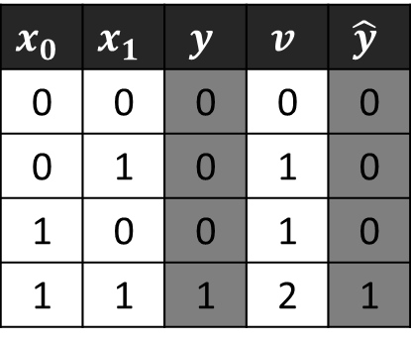




O neurônio de McCulloch e Pitts
AND
$$x_{0}$$
$$w_{0}^{}=1$$
$$x_{0}$$ | $$x_{1}$$ | $$y$$ | $$v$$ | $$\hat{y}$$
0 | 0 | 0 | 0 | 0
0 | 1 | 0 | 1 | 0
1 | 0 | 0 | 1 | 0
1 | 1 | 1 | 2 | 1
$$Σ$$
$$v_{0}$$
$$g\left(v\right)$$
$${\hat{y}}_{0}$$
$$w_{1}^{}=1$$
$$θ=2$$
$$x_{1}$$

Slide 12

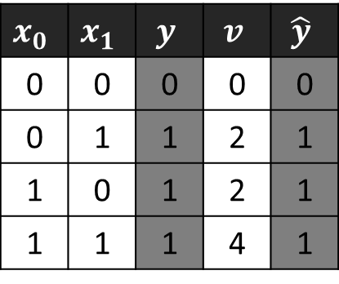

O neurônio de McCulloch e Pitts
OR
$$x_{0}$$
$$w_{0}^{}=2$$
$$x_{0}$$ | $$x_{1}$$ | $$y$$ | $$v$$ | $$\hat{y}$$
0 | 0 | 0 | 0 | 0
0 | 1 | 1 | 2 | 1
1 | 0 | 1 | 2 | 1
1 | 1 | 1 | 4 | 1
$$Σ$$
$$v_{0}$$
$$g\left(v\right)$$
$${\hat{y}}_{0}$$
$$w_{1}^{}=2$$
$$θ=2$$
$$x_{1}$$

Slide 13
O Perceptron

Slide 14
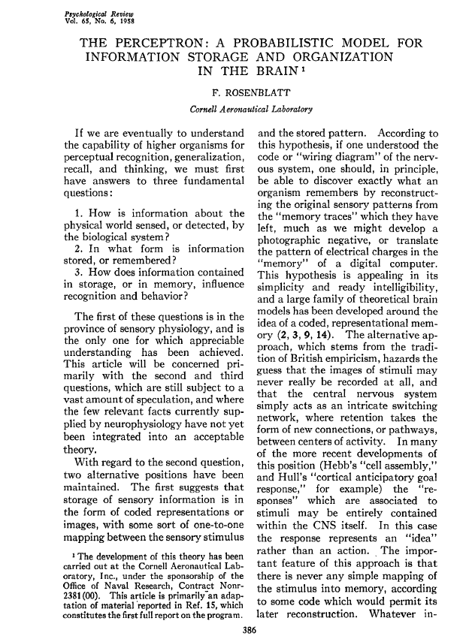
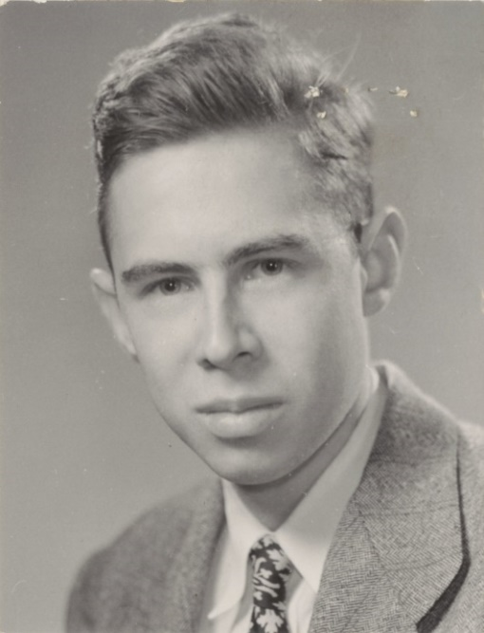
O Perceptron
Frank Rosenblatt

Slide 15



















Perceptron de camada simples
$$x$$
$$w$$
$$v, y$$
$$y, e$$
$$x_{0}$$
$$1$$
$$y_{0}$$
$$w_{0,0}^{}$$
$$b_{0}^{}$$
$$x_{1}$$
$$w_{1,0}^{}$$
$${\hat{y}}_{0}$$
$$Σ$$
$$v_{0}$$
$$g\left(v\right)$$
$${\hat{y}}_{0}$$
$$e_{0}$$
$$v_{0}$$
...
$$w_{n−1,0}^{}$$
$$x_{n−1}$$

Slide 16


Perceptron de camada simples
$$x$$
$$w$$
$$v, y$$
$$y, e$$
$$x_{0}$$
$$1$$
$$y_{0}$$
$$w_{0,0}^{}$$
$$b_{0}^{}$$
$$x_{1}$$
$$w_{1,0}^{}$$
$${\hat{y}}_{0}$$
$$Σ$$
$$v_{0}$$
$$g\left(v\right)$$
$${\hat{y}}_{0}$$
$$e_{0}$$
$$v_{0}$$
...
$$w_{n−1,0}^{}$$
pesos e bias ajustáveis...
$$x_{n−1}$$

Slide 17






Perceptron de camada simples
$$x$$
$$w$$
$$v, y$$
$$y, e$$
$$x_{0}$$
$$1$$
$$y_{0}$$
$$w_{0,0}^{}$$
$$b_{0}^{}$$
$$x_{1}$$
$$w_{1,0}^{}$$
$${\hat{y}}_{0}$$
$$Σ$$
$$v_{0}$$
$$g\left(v\right)$$
$${\hat{y}}_{0}$$
$$e_{0}$$
$$v_{0}$$
...
$$w_{n−1,0}^{}$$
$$x_{n−1}$$

Slide 18





Perceptron de camada simples
$$x$$
$$w$$
$$v, y$$
$$y, e$$
$$x_{1}=−\frac{w_{0,0}^{}}{w_{1,0}^{}}×x_{0}−\frac{b_{0}^{}}{w_{1,0}^{}}$$
$$x_{0}$$
$$1$$
$$y_{0}$$
$$x_{1}$$
$$w_{0,0}^{}$$
$$b_{0}^{}$$
$$Σ$$
$$v_{0}$$
$$g\left(v\right)$$
$${\hat{y}}_{0}$$
$$e_{0}$$
$$x_{0}$$
$$w_{1,0}^{}$$
$$x_{1}$$

Slide 19
Algoritmo de aprendizado do Perceptron

Slide 20




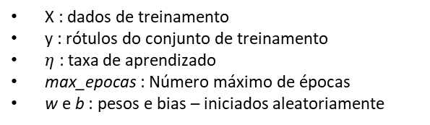















Algoritmo de aprendizado do Perceptron
Para t de 1 até max_epocas:
$e_{época}=0$
Para todo x, y em (X, y):
$v_{0}=\sum_{i=0}^{n−1}{w_{i,0}x_{i}+b_{0}}$
${\hat{y}}_{0}=g\left(v\right)= \left\{\begin{aligned}1, v≥0 \\ 0, v<0\end{aligned}\right.$
$e_{0}=y_{0}−{\hat{y}}_{0}$
${∆w}_{i,0}=e_{0}x_{i},$
$para i=0, 1, …, n−1$
$w_{i,0}\left(t\right)={w_{i,0}\left(t−1\right)+η∆w}_{i,0},$
$para i=0, 1, …, n−1$
$b_{0}\left(t\right)={b_{0}\left(t−1\right)+ηe}_{0}$
$e_{época}={e_{época}+\left(e_{0}\right)}^{2}$
$e_{época}=e_{época}/2$
Se $e_{época}<e_{mínimo}$, interromper o laço.
$$x$$
$$w$$
$$v, y$$
$$y, e$$
$$x_{0}$$
$$w_{0,0}^{}$$
$$1$$
$$y_{0}$$
$$b_{0}^{}$$
$$w_{1,0}^{}$$
$$x_{1}$$
$$v_{0}$$
$${\hat{y}}_{0}$$
$$Σ$$
$$g\left(v\right)$$
$$e_{0}$$
$$w_{n−1,0}^{}$$
...
$$x_{n−1}$$
X : dados de treinamento
y : rótulos do conjunto de treinamento
$η$ : taxa de aprendizado
max_epocas : Número máximo de épocas
w e b : pesos e bias – iniciados aleatoriamente

Slide 21

Algoritmo de aprendizado do Perceptron
Produto interno:
$v_{0}=\sum_{i=0}^{n−1}{w_{i,0}x_{i}+b_{0}}$
Função de ativação:
${\hat{y}}_{0}=g\left(v\right)= \left\{\begin{aligned}1, v≥0 \\ 0, v<0\end{aligned}\right.$
Erro:
$e_{0}=y_{0}−{\hat{y}}_{0}$
Valor utilizado para atualizar os pesos:
${∆w}_{i,0}=e_{0}x_{i}, para i=0, 1, …, n−1$
Atualização dos pesos:
$w_{i,0}\left(t\right)={w_{i,0}\left(t−1\right)+η∆w}_{i,0}, para i=0, 1, …, n−1$
Atualização do bias:
$b_{0}\left(t\right)={b_{0}\left(t−1\right)+ηe}_{0}$
$$x$$
$$w$$
$$v, y$$
$$y, e$$
$$x_{0}$$
$$w_{0,0}^{}$$
$$1$$
$$y_{0}$$
$$b_{0}^{}$$
$$w_{1,0}^{}$$
$$x_{1}$$
$$v_{0}$$
$${\hat{y}}_{0}$$
$$Σ$$
$$g\left(v\right)$$
$$e_{0}$$
$$w_{n−1,0}^{}$$
...
$$x_{n−1}$$

Slide 22
Exemplo: Perceptron de camada simples

Slide 23




Exemplo: Perceptron de camada simples
Época 0:
Iteração 0:
$x=\left[\begin{matrix}x_{0} & x_{1}\end{matrix}\right]=\left[\begin{matrix}0 & 0\end{matrix}\right]$
$w=\left[\begin{matrix}w_{0,0} \\ w_{1,0}\end{matrix}\right]=\left[\begin{matrix}0.1 \\ 0.2\end{matrix}\right]$, $b=\left[b_{0}\right]=\left[0.6\right]$
$v_{0}=xw+b_{0}=\left[\begin{matrix}0.0 & 0.0\end{matrix}\right]\left[\begin{matrix}0.1 \\ 0.2\end{matrix}\right]+0.6$
$v_{0}=0.0+0.6=0.6$
${\hat{y}}_{0}=1.0, pois v>0$
$e_{0}=y−\hat{y}=0.0−1.0=−1.0$
$∆w=ex=−1.0\left[\begin{matrix}0.0 & 0.0\end{matrix}\right]=\left[\begin{matrix}0.0 & 0.0\end{matrix}\right]$
$w\left(t\right)=w\left(t−1\right)+η∆w=\left[\begin{matrix}0.1 & 0.2\end{matrix}\right]+0.1\left[\begin{matrix}0.0 & 0.0\end{matrix}\right]$
$w\left(t\right)=\left[\begin{matrix}0.1 & 0.2\end{matrix}\right]$
$b_{0}\left(t\right)=b_{0}\left(t−1\right)+ηe_{0}=0.6+0.1×\left(−1.0\right)=0.$5
$e_{época}=e_{época}+{e_{0}}^{2}=0.0+{\left(−1.0\right)}^{2}=1.0$
$$x$$
$$w$$
$$v, y$$
$$y, e$$
0.0
$$x_{0}$$
$$1$$
$$w_{0,0}^{}$$
$$y_{0}$$
$$b_{0}^{}$$
0.6
0.1
$$Σ$$
$$v_{0}$$
$$g\left(v\right)$$
$${\hat{y}}_{0}$$
$$e_{0}$$
$$w_{n−1,0}^{}$$
0.0
0.2
AND
$$x_{1}$$
$$X=\left[\begin{matrix}0 & 0 \\ 0 & 1 \\ \begin{matrix}1 \\ 1\end{matrix} & \begin{matrix}0 \\ 1\end{matrix}\end{matrix}\right]$$
$$y=\left[\begin{matrix}0 & 0 & \begin{matrix}0 & 1\end{matrix}\end{matrix}\right]$$

Slide 24















Exemplo: Perceptron de camada simples
Época 0:
Iteração 1:
$x=\left[\begin{matrix}x_{0} & x_{1}\end{matrix}\right]=\left[\begin{matrix}0.0 & 1.0\end{matrix}\right]$
$w=\left[\begin{matrix}w_{0,0} \\ w_{1,0}\end{matrix}\right]=\left[\begin{matrix}0.1 \\ 0.2\end{matrix}\right]$, $b=\left[b_{0}\right]=\left[0.5\right]$
$v_{0}=xw+b_{0}=\left[\begin{matrix}0.0 & 1.0\end{matrix}\right]\left[\begin{matrix}0.1 \\ 0.2\end{matrix}\right]+0.$5
$v_{0}=0.2+0.5=0.7$
${\hat{y}}_{0}=1.0, pois v_{0}>0.0$
$e_{0}=y−\hat{y}=0.0−1.0=−1.0$
$∆w=ex=−1.0\left[\begin{matrix}0.0 & 1.0\end{matrix}\right]=\left[\begin{matrix}0.0 & −1.0\end{matrix}\right]$
$w\left(t\right)=w\left(t−1\right)+η∆w=\left[\begin{matrix}0.1 & 0.2\end{matrix}\right]+0.1\left[\begin{matrix}0.0 & −1.0\end{matrix}\right]$
$w\left(t\right)=\left[\begin{matrix}0.1 & 0.1\end{matrix}\right]$
$b_{0}\left(t\right)=b_{0}\left(t−1\right)+ηe_{0}=0.9+0.1×\left(−1.0\right)=0.$4
$e_{época}=e_{época}+{e_{0}}^{2}=1.0+{\left(−1.0\right)}^{2}=2.0$
$$x$$
$$w$$
$$v, y$$
$$y, e$$
0.0
$$x_{0}$$
$$1$$
$$w_{0,0}^{}$$
$$y_{0}$$
$$b_{0}^{}$$
0.5
0.1
$$Σ$$
$$v_{0}$$
$$g\left(v\right)$$
$${\hat{y}}_{0}$$
$$e_{0}$$
$$w_{n−1,0}^{}$$
...
1.0
0.2
AND
$$x_{n−1}$$
$$X=\left[\begin{matrix}0 & 0 \\ 0 & 1 \\ \begin{matrix}1 \\ 1\end{matrix} & \begin{matrix}0 \\ 1\end{matrix}\end{matrix}\right]$$
$$y=\left[\begin{matrix}0 & 0 & \begin{matrix}0 & 1\end{matrix}\end{matrix}\right]$$

Slide 25

Exemplo: Perceptron de camada simples
Época 0:
Iteração 2:
$x=\left[\begin{matrix}x_{0} & x_{1}\end{matrix}\right]=\left[1.\begin{matrix}0 & 0.0\end{matrix}\right]$
$w=\left[\begin{matrix}w_{0,0} \\ w_{1,0}\end{matrix}\right]=\left[\begin{matrix}0.1 \\ 0.1\end{matrix}\right]$, $b=\left[b_{0}\right]=\left[0.4\right]$
$v_{0}=xw+b_{0}=\left[1.\begin{matrix}0 & 0.0\end{matrix}\right]\left[\begin{matrix}0.1 \\ 0.1\end{matrix}\right]+0.4$
$v_{0}=0.1+0.4=0.5$
${\hat{y}}_{0}=1.0, pois{ v}_{0}>0.0$
$e_{0}=y−\hat{y}=0.0−1.0=−1.0$
$∆w=ex=−1.0\left[\begin{matrix}1.0 & 0.0\end{matrix}\right]=\left[\begin{matrix}−1.0 & 0.0\end{matrix}\right]$
$w\left(t\right)=w\left(t−1\right)+η∆w=\left[\begin{matrix}0.1 & 0.1\end{matrix}\right]+0.1\left[\begin{matrix}−1.0 & 0.0\end{matrix}\right]$
$w\left(t\right)=\left[\begin{matrix}0.0 & 0.1\end{matrix}\right]$
$b_{0}\left(t\right)=b_{0}\left(t−1\right)+ηe_{0}=0.4+0.1×\left(−1.0\right)=0.3$
$e_{época}=e_{época}+{e_{0}}^{2}=2.0+{\left(−1.0\right)}^{2}=3.0$
$$x$$
$$w$$
$$v, y$$
$$y, e$$
1.0
$$x_{0}$$
$$1$$
$$w_{0,0}^{}$$
$$y_{0}$$
$$b_{0}^{}$$
0.4
0.1
$$Σ$$
$$v_{0}$$
$$g\left(v\right)$$
$${\hat{y}}_{0}$$
$$e_{0}$$
$$w_{n−1,0}^{}$$
...
0.0
0.1
AND
$$x_{n−1}$$
$$X=\left[\begin{matrix}0 & 0 \\ 0 & 1 \\ \begin{matrix}1 \\ 1\end{matrix} & \begin{matrix}0 \\ 1\end{matrix}\end{matrix}\right]$$
$$y=\left[\begin{matrix}0 & 0 & \begin{matrix}0 & 1\end{matrix}\end{matrix}\right]$$

Slide 26

Exemplo: Perceptron de camada simples
Época 0:
Iteração 3:
$x=\left[\begin{matrix}x_{0} & x_{1}\end{matrix}\right]=\left[1.\begin{matrix}0 & 1.0\end{matrix}\right]$
$w=\left[\begin{matrix}w_{0,0} \\ w_{1,0}\end{matrix}\right]=\left[\begin{matrix}0.0 \\ 0.1\end{matrix}\right]$, $b=\left[b_{0}\right]=\left[0.3\right]$
$v_{0}=xw+b_{0}=\left[1.\begin{matrix}0 & 1.0\end{matrix}\right]\left[\begin{matrix}0.0 \\ 0.1\end{matrix}\right]+0.3$
$v_{0}=0.1+0.3=0.4$
${\hat{y}}_{0}=1.0, pois{ v}_{0}>0.0$
$e_{0}=y−\hat{y}=1.0−1.0=0.0$
$∆w=ex=0.0\left[\begin{matrix}1.0 & 1.0\end{matrix}\right]=\left[\begin{matrix}0.0 & 0.0\end{matrix}\right]$
$w\left(t\right)=w\left(t−1\right)+η∆w=\left[\begin{matrix}0.0 & 0.1\end{matrix}\right]+0.1\left[\begin{matrix}0.0 & 0.0\end{matrix}\right]$
$w\left(t\right)=\left[\begin{matrix}0.0 & 0.1\end{matrix}\right]$
$b_{0}\left(t\right)=b_{0}\left(t−1\right)+ηe_{0}=0.3+0.1×\left(0.0\right)=0.3$
$e_{época}=e_{época}+{e_{0}}^{2}=3.0+{\left(0.0\right)}^{2}=3.0$
$$x$$
$$w$$
$$v, y$$
$$y, e$$
1.0
$$x_{0}$$
$$1$$
$$w_{0,0}^{}$$
$$y_{0}$$
$$b_{0}^{}$$
0.3
0.0
$$Σ$$
$$v_{0}$$
$$g\left(v\right)$$
$${\hat{y}}_{0}$$
$$e_{0}$$
$$w_{n−1,0}^{}$$
...
1.0
0.1
AND
$$x_{n−1}$$
$$X=\left[\begin{matrix}0 & 0 \\ 0 & 1 \\ \begin{matrix}1 \\ 1\end{matrix} & \begin{matrix}0 \\ 1\end{matrix}\end{matrix}\right]$$
$$y=\left[\begin{matrix}0 & 0 & \begin{matrix}0 & 1\end{matrix}\end{matrix}\right]$$

Slide 27

Exemplo: Perceptron de camada simples
Fim da Época 0.
$e_{época}=\frac{e_{época}}{2}=\frac{3.0}{2}=1.5$
Época 1:
Iteração 0:
Repetir até atingir o limite de épocas ou o erro da época ficar abaixo de um limiar pré-definido...
$$x$$
$$w$$
$$v, y$$
$$y, e$$
0.0
$$x_{0}$$
$$1$$
$$w_{0,0}^{}$$
$$y_{0}$$
$$b_{0}^{}$$
?
?
$$Σ$$
$$v_{0}$$
$$g\left(v\right)$$
$${\hat{y}}_{0}$$
$$e_{0}$$
$$w_{n−1,0}^{}$$
...
0.0
?
AND
$$x_{n−1}$$
$$X=\left[\begin{matrix}0 & 0 \\ 0 & 1 \\ \begin{matrix}1 \\ 1\end{matrix} & \begin{matrix}0 \\ 1\end{matrix}\end{matrix}\right]$$
$$y=\left[\begin{matrix}0 & 0 & \begin{matrix}0 & 1\end{matrix}\end{matrix}\right]$$

Slide 28
Bibliografia
GONZALEZ, R.C.; WOODS, R.E.; Processamento Digital de Imagens. 3ª edição. Editora Pearson, 2009.
Prof. Moacir Ponti (ICMC-USP). Material para o minicurso Deep Learning
https://github.com/maponti/deeplearning_intro_datascience
Learn TensorFlow and deep learning, without a Ph.D.
https://cloud.google.com/blog/products/gcp/learn-tensorflow-and-deep-learning-without-a-phd
CS231n: Convolutional Neural Networks for Visual Recognition
http://cs231n.github.io/
Goodfellow, Bengio e Courville. Deep Learning. MIT Press, 2016
https://www.deeplearningbook.org/

Slide 29
FIM
@misc{mari_im_proc_2023,
author = {João Fernando Mari},
title = {Redes Neurais Artificiais},
year = {2023},
publisher = {GitHub},
journal = {Introdução ao Processamento Digital de Imagens - UFV},
howpublished = {\url{https://github.com/joaofmari/SIN392_Introduction-to-digital-image-processing_2023}}
}

