Slide 1
Lecture 07 – Spatial filtering II
SIN 392 – Introduction to Digital Image Processing (2023)
Prof. João Fernando Mari
joaofmari.github.io
joaof.mari@ufv.br

Slide 2
Agenda
Derivatives of 1D discrete functions
The Laplacian
Laplacian variations
The Gradient
Roberts cross-gradient operators
Prewitt and Sobel operators

Slide 3
Derivatives of 1D discrete functions

Slide 4

Derivatives of 1D discrete functions
7
6
5
4
3
2
1
0
-1
-2
-3
-4
-5
-6
-7
First order derivative of a 1D function f(x):
$$\frac{∂f}{∂x}=f\left(x+1\right)−f(x)$$
Second order derivative of a 1D function f(x):
$$\frac{∂^{2}f}{∂x^{2}}=f\left(x+1\right)+f\left(x−1\right)−2f(x)$$
0 | 1 | 2 | 3 | 4 | 5 | 6 | 7 | 8 | 9 | 10 | 11 | 12 | 13 | 14 | 15 | 16 | 17 | 18 | 19 | 20 | 21 | 22 | 23 | 24
5 | 5 | 5 | 5 | 5 | 4 | 3 | 2 | 1 | 1 | 1 | 1 | 1 | 1 | 1 | 6 | 6 | 5 | 6 | 6 | 7 | 5 | 6 | 6 | 6
Signal
First order derivative
Second order derivative

Slide 5
Derivadas de funções discretas 1D
7
6
5
4
3
2
1
0
-1
-2
-3
-4
-5
-6
-7
First order derivative of a 1D function f(x):
$$\frac{∂f}{∂x}=f\left(x+1\right)−f(x)$$
Second order derivative of a 1D function f(x):
$$\frac{∂^{2}f}{∂x^{2}}=f\left(x+1\right)+f\left(x−1\right)−2f(x)$$
0 | 1 | 2 | 3 | 4 | 5 | 6 | 7 | 8 | 9 | 10 | 11 | 12 | 13 | 14 | 15 | 16 | 17 | 18 | 19 | 20 | 21 | 22 | 23 | 24
5 | 5 | 5 | 5 | 5 | 4 | 3 | 2 | 1 | 1 | 1 | 1 | 1 | 1 | 1 | 6 | 6 | 5 | 6 | 6 | 7 | 5 | 6 | 6 | 6
0 | 0 | 0 | 0 | -1 | -1 | -1 | -1 | 0 | 0 | 0 | 0 | 0 | 0 | 5 | 0 | -1 | 1 | 0 | 1 | -2 | 1 | 0 | 0
Signal
First order derivative
Second order derivative

Slide 6
Derivatives of 1D discrete functions
7
6
5
4
3
2
1
0
-1
-2
-3
-4
-5
-6
-7
First order derivative of a 1D function f(x):
$$\frac{∂f}{∂x}=f\left(x+1\right)−f(x)$$
Second order derivative of a 1D function f(x):
$$\frac{∂^{2}f}{∂x^{2}}=f\left(x+1\right)+f\left(x−1\right)−2f(x)$$
0 | 1 | 2 | 3 | 4 | 5 | 6 | 7 | 8 | 9 | 10 | 11 | 12 | 13 | 14 | 15 | 16 | 17 | 18 | 19 | 20 | 21 | 22 | 23 | 24
5 | 5 | 5 | 5 | 5 | 4 | 3 | 2 | 1 | 1 | 1 | 1 | 1 | 1 | 1 | 6 | 6 | 5 | 6 | 6 | 7 | 5 | 6 | 6 | 6
0 | 0 | 0 | 0 | -1 | -1 | -1 | -1 | 0 | 0 | 0 | 0 | 0 | 0 | 5 | 0 | -1 | 1 | 0 | 1 | -2 | 1 | 0 | 0
 | 0 | 0 | 0 | -1 | 0 | 0 | 0 | 1 | 0 | 0 | 0 | 0 | 0 | 5 | -5 | -1 | 2 | -1 | 1 | -3 | 3 | -1 | 0
Signal
First order derivative
Second order derivative

Slide 7
Derivatives of 1D discrete functions
7
6
5
4
3
2
1
0
-1
-2
-3
-4
-5
-6
-7
First order derivative of a 1D function f(x):
$$\frac{∂f}{∂x}=f\left(x+1\right)−f(x)$$
Second order derivative of a 1D function f(x):
$$\frac{∂^{2}f}{∂x^{2}}=f\left(x+1\right)+f\left(x−1\right)−2f(x)$$
0 | 1 | 2 | 3 | 4 | 5 | 6 | 7 | 8 | 9 | 10 | 11 | 12 | 13 | 14 | 15 | 16 | 17 | 18 | 19 | 20 | 21 | 22 | 23 | 24
5 | 5 | 5 | 5 | 5 | 4 | 3 | 2 | 1 | 1 | 1 | 1 | 1 | 1 | 1 | 6 | 6 | 5 | 6 | 6 | 7 | 5 | 6 | 6 | 6
0 | 0 | 0 | 0 | -1 | -1 | -1 | -1 | 0 | 0 | 0 | 0 | 0 | 0 | 5 | 0 | -1 | 1 | 0 | 1 | -2 | 1 | 0 | 0
 | 0 | 0 | 0 | -1 | 0 | 0 | 0 | 1 | 0 | 0 | 0 | 0 | 0 | 5 | -5 | -1 | 2 | -1 | 1 | -3 | 3 | -1 | 0
Signal
First order derivative
Second order derivative

Slide 8
The Laplacian

Slide 9
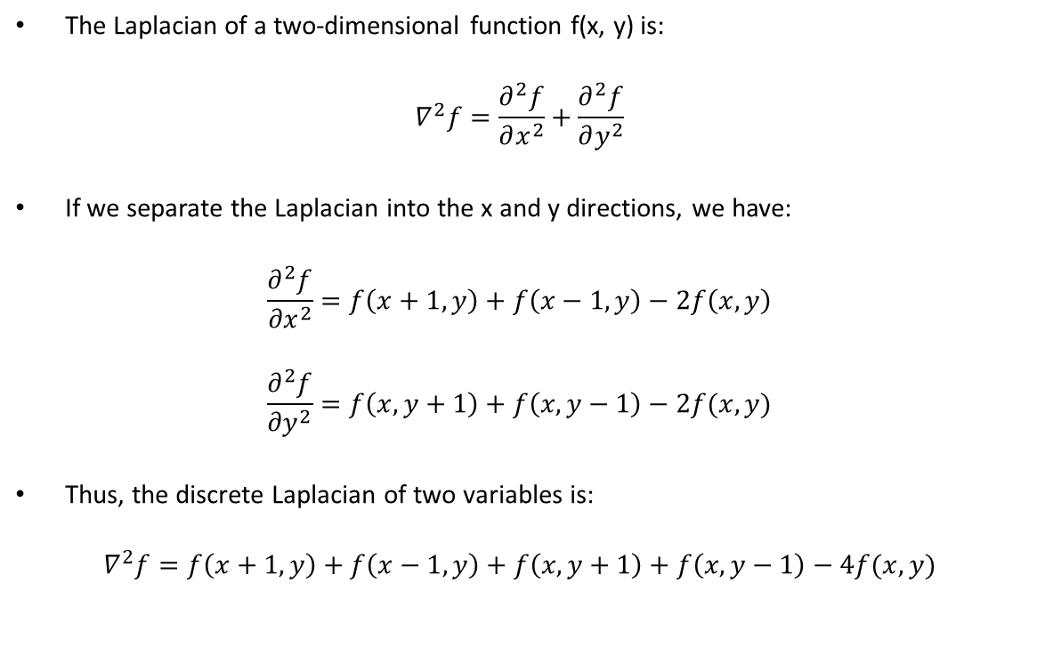
The Laplacian
The Laplacian of a two-dimensional function f(x, y) is:
$$∇^{2}f=\frac{∂^{2}f}{∂x^{2}}+\frac{∂^{2}f}{∂y^{2}}$$
If we separate the Laplacian into the x and y directions, we have:
$$\frac{∂^{2}f}{{∂x}^{2}}=f\left(x+1, y\right)+f\left(x−1, y\right)−2f\left(x, y\right)$$
$$\frac{∂^{2}f}{{∂y}^{2}}=f\left(x, y+1\right)+f\left(x, y−1\right)−2f(x,y)$$
Thus, the discrete Laplacian of two variables is:
$$∇^{2}f=f\left(x+1, y\right)+f\left(x−1, y\right)+f\left(x, y+1\right)+f\left(x, y−1\right)−4f(x, y)$$
 | -1 | 0 | 1
-1 | 0 | 1 | 0
0 | 1 | -4 | 1
1 | 0 | 1 | 0

Slide 10
Laplacian variations
 | -1 | 0 | 1
-1 | 0 | 1 | 0
0 | 1 | -4 | 1
1 | 0 | 1 | 0
 | -1 | 0 | 1
-1 | 0 | -1 | 0
0 | -1 | 4 | -1
1 | 0 | -1 | 0
 | -1 | 0 | 1
-1 | 1 | 1 | 1
0 | 1 | -8 | 1
1 | 1 | 1 | 1
 | -1 | 0 | 1
-1 | -1 | -1 | -1
0 | -1 | 8 | -1
1 | -1 | -1 | -1

Slide 11
The Gradient

Slide 12
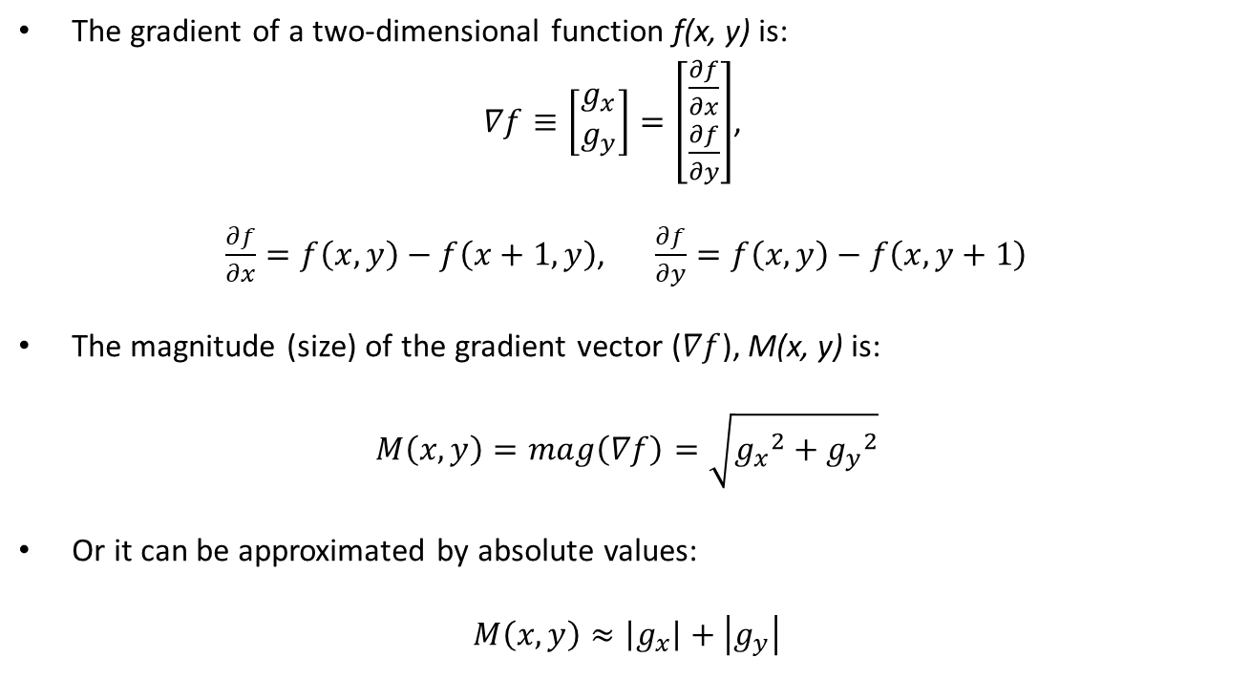
The Gradient
The gradient of a two-dimensional function f(x, y) is:
$∇f≡\left[\begin{matrix}g_{x} \\ g_{y}\end{matrix}\right]=\left[\begin{matrix}\frac{∂f}{∂x} \\ \frac{∂f}{∂y}\end{matrix}\right]$,
$\frac{∂f}{∂x}=f\left(x,y\right)−f\left(x+1, y\right)$, $\frac{∂f}{∂y}=f\left(x,y\right)−f\left(x, y+1\right)$
The magnitude (size) of the gradient vector ($∇f$), M(x, y) is:
$$M\left(x, y\right)=mag\left(∇f\right)=\sqrt{{g_{x}}^{2}+{g_{y}}^{2}}$$
Or it can be approximated by absolute values:
$$M\left(x, y\right)≈\left|g_{x}\right|+\left|g_{y}\right|$$
 | 0 | 1
0 | 1 | 0
1 | -1 | 0
 | 0 | 1
0 | 1 | -1
1 | 0 | 0

Slide 13

The Gradient – Roberts cross-gradient operators
Roberts diagonal operators consider diagonal differences:
$\frac{∂f}{∂x}=f\left(x,y\right)−f\left(x+1, y+1\right)$, $\frac{∂f}{∂y}=f\left(x+1,y\right)−f\left(x, y+1\right)$
 | 0 | 1
0 | 1 | 0
1 | 0 | -1
 | 0 | 1
0 | 0 | -1
1 | 1 | 0

Slide 14




The Gradient – Prewitt and Sobel operators
$$g_{x}$$
 | -1 | 0 | 1
-1 | -1 | -1 | -1
0 | 0 | 0 | 0
1 | 1 | 1 | 1
$$g_{y}$$
 | -1 | 0 | 1
-1 | -1 | 0 | 1
0 | -1 | 0 | 1
1 | -1 | 0 | 1
Prewitt:
$$g_{x}$$
 | -1 | 0 | 1
-1 | -1 | -2 | -1
0 | 0 | 0 | 0
1 | 1 | 2 | 1
$$g_{y}$$
 | -1 | 0 | 1
-1 | -1 | 0 | 1
0 | -2 | 0 | 2
1 | -1 | 0 | 1
Sobel:

Slide 15
Bibliography
GONZALEZ, R.C.; WOODS, R.E. Digital Image Processing. 3rd ed. Pearson, 2007.
MARQUES FILHO, O.; VIEIRA NETO, H. Processamento digital de imagens. Brasport, 1999.
(in Brazilian Portuguese)
Available on the author's website (for personal use only)
http://dainf.ct.utfpr.edu.br/~hvieir/pub.html
J. E. R. Queiroz, H. M. Gomes. Introdução ao Processamento Digital de Imagens. RITA. v. 13, 2006.
(in Brazilian Portuguese)
http://www.dsc.ufcg.edu.br/~hmg/disciplinas/graduacao/vc-2016.2/Rita-Tutorial-PDI.pdf

Slide 16
THE END
@misc{mari_im_proc_2023,
author = {João Fernando Mari},
title = {Spatial filtering II},
year = {2023},
publisher = {GitHub},
journal = {Introduction to digital image processing - UFV},
howpublished = {\url{https://github.com/joaofmari/SIN392_Introduction-to-digital-image-processing_2023}}
}

