Slide 1
Lecture 09 – Image segmentation II Thresholding
SIN 392 – Introduction to Digital Image Processing (2023)
Prof. João Fernando Mari
joaofmari.github.io
joaof.mari@ufv.br

Slide 2
Agenda
Thresholding
Basic global thresholding
Otsu’s method

Slide 3
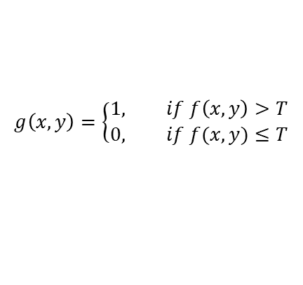
Thresholding
Image thresholding:
Central position in image segmentation applications
Ease of implementation
Computational speed
Global thresholding:
T is a constant applicable to an entire image
Local threshold (variable or regional):
T changes throughout the image
$$g\left(x,y\right)=\left\{\begin{aligned}1, if f\left(x,y\right)>T \\ &0, if f(x,y)≤T\end{aligned}\right.$$
T

Slide 4
Thresholding
Image thresholding:
Central position in image segmentation applications
Ease of implementation
Computational speed
Global thresholding:
T is a constant applicable to an entire image
Local threshold (variable or regional):
T changes throughout the image
$$g\left(x,y\right)=\left\{\begin{aligned}1, if f\left(x,y\right)>T \\ &0, if f(x,y)≤T\end{aligned}\right.$$
T

Slide 5
Basic global thresholding

Slide 6
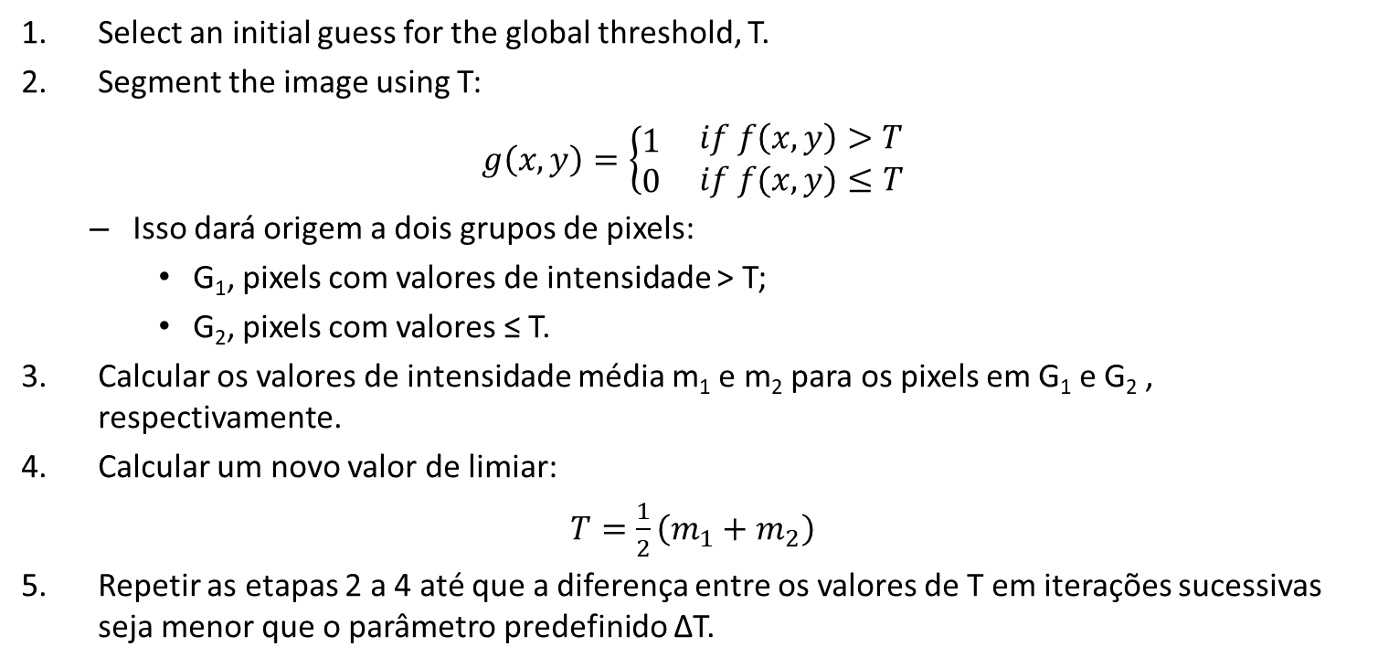
Basic global thresholding
Select an initial guess for the global threshold, T.
Segment the image using T:
$g\left(x,y\right)=\left\{\begin{matrix}1 \\ 0\end{matrix}\begin{matrix} if f\left(x,y\right)>T \\ if f(x,y)≤T\end{matrix}\right.$
Isso dará origem a dois grupos de pixels:
G₁, pixels com valores de intensidade > T;
G₂, pixels com valores ≤ T.
Calcular os valores de intensidade média m₁ e m₂ para os pixels em G₁ e G₂ , respectivamente.
Calcular um novo valor de limiar:
$T=\frac{1}{2}\left(m_{1}+m_{2}\right)$
Repetir as etapas 2 a 4 até que a diferença entre os valores de T em iterações sucessivas seja menor que o parâmetro predefinido ∆T.

Slide 7
Basic global thresholding
Image I
2 | 3 | 6 | 5
3 | 1 | 1 | 1
6 | 7 | 6 | 3
5 | 7 | 0 | 3
T₀ = min(I) = 0
∆T = 0.001
7
6
5
4
3
2
1
 | 0 | 1 | 2 | 3 | 4 | 5 | 6 | 7

Slide 8
Basic global thresholding
Image I
T₀ = min(I) = 0
G₁ = [2, 3, 6, 5, 3, 1, 1, 1, 6, 7, 6, 3, 5, 7, 3]
G₂ = [0]
m₁ = (2 + 3 + 6 + 5 + 3 + 1 + 1 + 1 + 6 + 7 + 6 + 3 + 5 + 7 + 3) / 15 = 59 / 15 = 3.9333
m₂ = 0 / 1 = 0
T₁ = (3.9333 + 0) / 2 = 1.9667
|T₁ – T₀| = |1.9667 – 0| = 1.9667 > ∆T. Then, new iteration.
2 | 3 | 6 | 5
3 | 1 | 1 | 1
6 | 7 | 6 | 3
5 | 7 | 0 | 3
T₀ = min(I) = 0
∆T = 0.001
7
6
5
4
3
2
1
 | 0 | 1 | 2 | 3 | 4 | 5 | 6 | 7
T₀
T₁
∆₁

Slide 9
Basic global thresholding
Image I
T₁ = 1.9667
G₁ = [2, 3, 6, 5, 3, 6, 7, 6, 3, 5, 7, 3]
G₂ = [1, 1, 1, 0]
m₁ = (2 + 3 + 6 + 5 + 3 + 6 + 7 + 6 + 3 + 5 + 7 + 3) / 12 = 56 / 12 = 4.6667
m₂ = (1 + 1 + 1 + 0) / 4 = 3 / 4 = 0.75
T₂ = (4.6667 + 0.75) / 2 = 2.7084
|T₂ – T₁| = |2.7084 – 1.9667| = 0.7417 > ∆T. Then, new iteration.
2 | 3 | 6 | 5
3 | 1 | 1 | 1
6 | 7 | 6 | 3
5 | 7 | 0 | 3
T₀ = min(I) = 0
∆T = 0.001
7
6
5
4
3
2
1
 | 0 | 1 | 2 | 3 | 4 | 5 | 6 | 7
T₀
T₁
T₂
∆₁
∆₂

Slide 10
Basic global thresholding
Imagem I
T₂ = 2,7084
G₁ = [3, 6, 5, 3, 6, 7, 6, 3, 5, 7, 3]
G₂ = [2, 1, 1, 1, 0]
m₁ = (3 + 6 + 5 + 3 + 6 + 7 + 6 + 3 + 5 + 7 + 3) / 11 = 54 / 11 = 4.9091
m₂ = (2 + 1 + 1 + 1 + 0) / 5 = 1
T₃ = (4.9091 + 1) / 2 = 2.9546
|T₃ – T₂| = |2.9546 – 2,7084| = 0.2462 > ∆T. Then, new iteration.
2 | 3 | 6 | 5
3 | 1 | 1 | 1
6 | 7 | 6 | 3
5 | 7 | 0 | 3
T₀ = min(I) = 0
∆T = 0.001
7
6
5
4
3
2
1
 | 0 | 1 | 2 | 3 | 4 | 5 | 6 | 7
T₀
T₁
T₂
T₃
∆₁
∆₂
∆₃

Slide 11
Basic global thresholding
Image I
T₃ = 2.9546
G₁ = [3, 6, 5, 3, 6, 7, 6, 3, 5, 7, 3]
G₂ = [2, 1, 1, 1, 0]
m₁ = (3 + 6 + 5 + 3 + 6 + 7 + 6 + 3 + 5 + 7 + 3) / 11 = 54 / 11 = 4.9091
m₂ = (2 + 1 + 1 + 1 + 0) / 5 = 1
T₄ = (4.9091 + 1) / 2 = 2.9546
|T₄ – T₃| = |2.9546 – 2.9546| = 0.0 <= ∆T. Then, end of the algorithm.
2 | 3 | 6 | 5
3 | 1 | 1 | 1
6 | 7 | 6 | 3
5 | 7 | 0 | 3
T₀ = min(I) = 0
∆T = 0.001
7
6
5
4
3
2
1
 | 0 | 1 | 2 | 3 | 4 | 5 | 6 | 7
T₀
T₁
T₂
T_{3,4}
∆₁
∆₂
∆₃

Slide 12
Basic global thresholding
Image I
T₃ = 2.9546
G₁ = [3, 6, 5, 3, 6, 7, 6, 3, 5, 7, 3]
G₂ = [2, 1, 1, 1, 0]
m₁ = (3 + 6 + 5 + 3 + 6 + 7 + 6 + 3 + 5 + 7 + 3) / 11 = 54 / 11 = 4.9091
m₂ = (2 + 1 + 1 + 1 + 0) / 5 = 1
T₄ = (4.9091 + 1) / 2 = 2.9546
|T₄ – T₃| = |2.9546 – 2.9546| = 0.0 <= ∆T. Then, end of the algorithm.
2 | 3 | 6 | 5
3 | 1 | 1 | 1
6 | 7 | 6 | 3
5 | 7 | 0 | 3
T₀ = min(I) = 0
∆T = 0.001
7
6
5
4
3
2
1
 | 0 | 1 | 2 | 3 | 4 | 5 | 6 | 7
Image I’
2 | 3 | 6 | 5
3 | 1 | 1 | 1
6 | 7 | 6 | 3
5 | 7 | 0 | 3
T₄

Slide 13
Otsu’s method

Slide 14
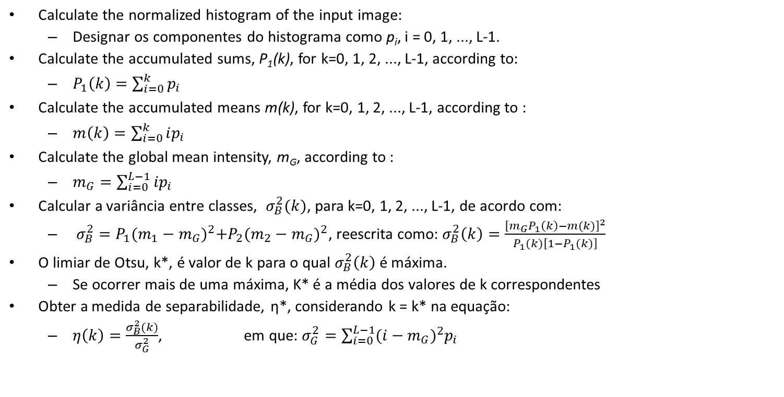
Otsu’s method
Calculate the normalized histogram of the input image:
Designar os componentes do histograma como p_{i}, i = 0, 1, ..., L-1.
Calculate the accumulated sums, P₁(k), for k=0, 1, 2, ..., L-1, according to:
$P_{1}\left(k\right)=\sum_{i=0}^{k}{p_{i}}$
Calculate the accumulated means m(k), for k=0, 1, 2, ..., L-1, according to :
$m\left(k\right)=\sum_{i=0}^{k}{ip_{i}}$
Calculate the global mean intensity, m_{G}, according to :
$m_{G}=\sum_{i=0}^{L−1}{ip_{i}}$
Calcular a variância entre classes, $σ_{B}^{2}(k)$, para k=0, 1, 2, ..., L-1, de acordo com:
$σ_{B}^{2}=P_{1}{(m_{1}−m_{G})}^{2}+P_{2}{(m_{2}−m_{G})}^{2}$, reescrita como: $σ_{B}^{2}\left(k\right)=\frac{{\left[m_{G}P_{1}\left(k\right)−m(k)\right]}^{2}}{P_{1}(k)\left[1−P_{1}(k)\right]}$
O limiar de Otsu, k*, é valor de k para o qual $σ_{B}^{2}\left(k\right)$ é máxima.
Se ocorrer mais de uma máxima, K* é a média dos valores de k correspondentes
Obter a medida de separabilidade, η*, considerando k = k* na equação:
$η\left(k\right)=\frac{σ_{B}^{2}(k)}{σ_{G}^{2}}$, em que: $σ_{G}^{2}=\sum_{i=0}^{L−1}{{(i−m_{G})}^{2}p_{i}}$

Slide 15
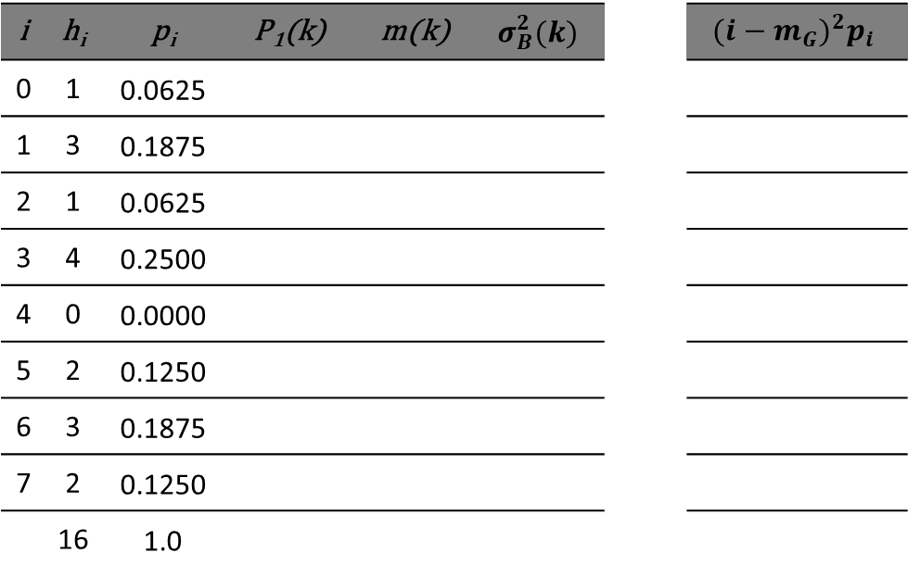
Otsu’s method
Image I
i | h_{i} | p_{i} | P₁(k) | m(k) | $$σ_{B}^{2}(k)$$ |  | $${(i−m_{G})}^{2}p_{i}$$
0 | 1 | 0.0625
1 | 3 | 0.1875
2 | 1 | 0.0625
3 | 4 | 0.2500
4 | 0 | 0.0000
5 | 2 | 0.1250
6 | 3 | 0.1875
7 | 2 | 0.1250
 | 16 | 1.0
2 | 3 | 6 | 5
3 | 1 | 1 | 1
6 | 7 | 6 | 3
5 | 7 | 0 | 3
16 pixels (4 x 4)
3 bits = 8 gray levels.
[0, ..., 7]
7
6
5
4
3
2
1
 | 0 | 1 | 2 | 3 | 4 | 5 | 6 | 7

Slide 16
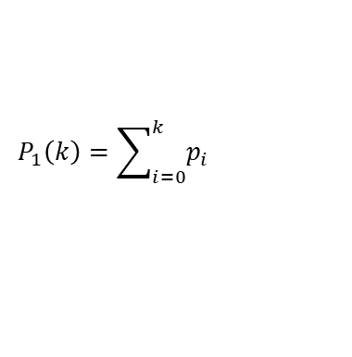
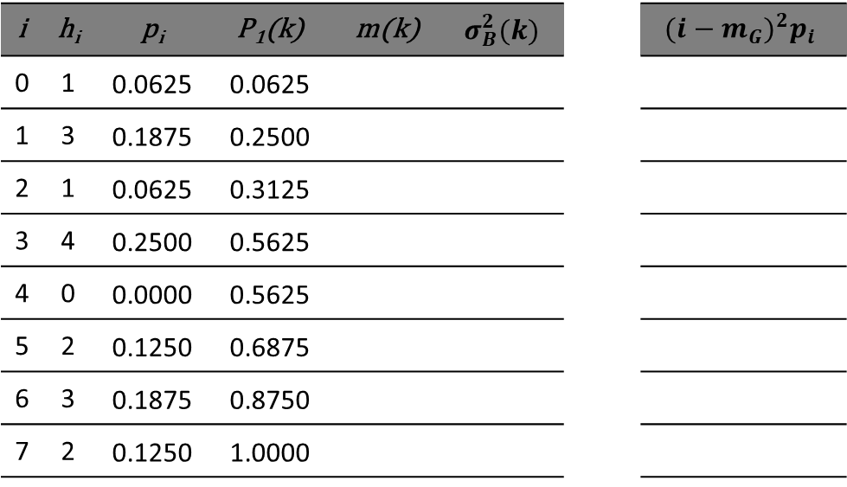
Otsu’s method
$$P_{1}\left(k\right)=\sum_{i=0}^{k}{p_{i}}$$
i | h_{i} | p_{i} | P₁(k) | m(k) | $$σ_{B}^{2}(k)$$ |  | $${(i−m_{G})}^{2}p_{i}$$
0 | 1 | 0.0625 | 0.0625
1 | 3 | 0.1875 | 0.2500
2 | 1 | 0.0625 | 0.3125
3 | 4 | 0.2500 | 0.5625
4 | 0 | 0.0000 | 0.5625
5 | 2 | 0.1250 | 0.6875
6 | 3 | 0.1875 | 0.8750
7 | 2 | 0.1250 | 1.0000

Slide 17
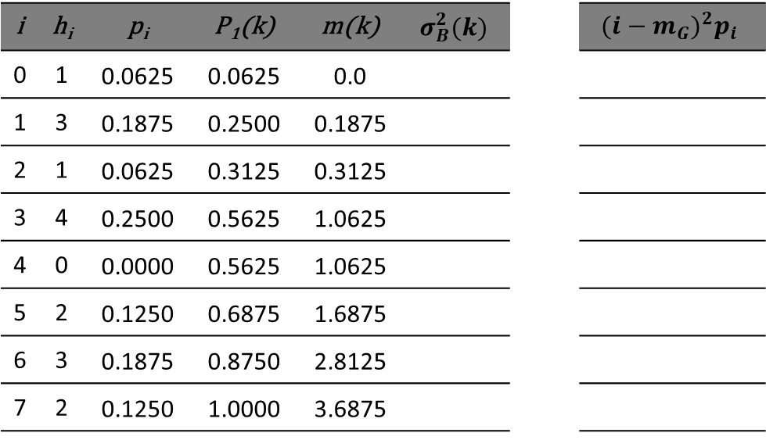
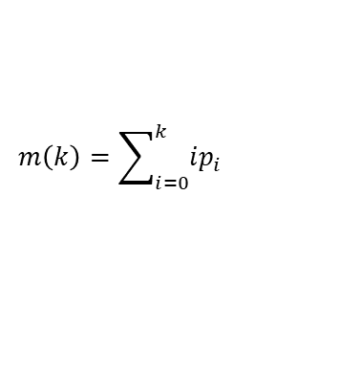
Otsu’s method
$$P_{1}\left(k\right)=\sum_{i=0}^{k}{p_{i}}$$
i | h_{i} | p_{i} | P₁(k) | m(k) | $$σ_{B}^{2}(k)$$ |  | $${(i−m_{G})}^{2}p_{i}$$
0 | 1 | 0.0625 | 0.0625 | 0.0
1 | 3 | 0.1875 | 0.2500 | 0.1875
2 | 1 | 0.0625 | 0.3125 | 0.3125
3 | 4 | 0.2500 | 0.5625 | 1.0625
4 | 0 | 0.0000 | 0.5625 | 1.0625
5 | 2 | 0.1250 | 0.6875 | 1.6875
6 | 3 | 0.1875 | 0.8750 | 2.8125
7 | 2 | 0.1250 | 1.0000 | 3.6875
$$m\left(k\right)=\sum_{i=0}^{k}{ip_{i}}$$

Slide 18

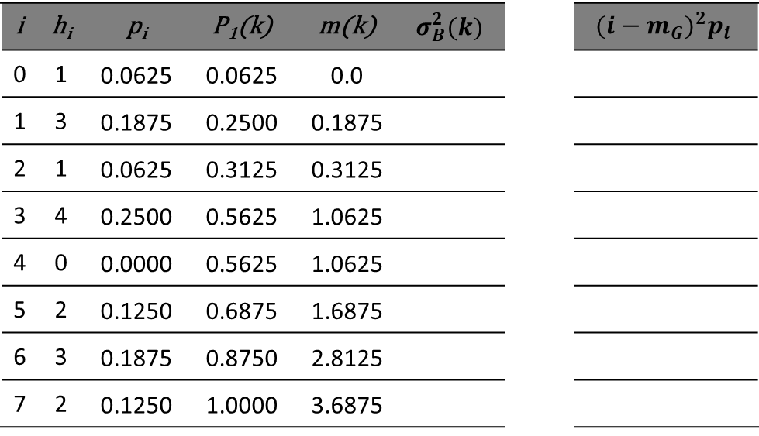
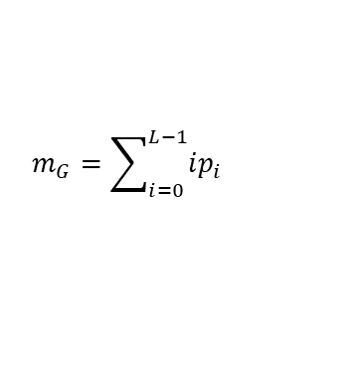
Otsu’s method
$$P_{1}\left(k\right)=\sum_{i=0}^{k}{p_{i}}$$
i | h_{i} | p_{i} | P₁(k) | m(k) | $$σ_{B}^{2}(k)$$ |  | $${(i−m_{G})}^{2}p_{i}$$
0 | 1 | 0.0625 | 0.0625 | 0.0
1 | 3 | 0.1875 | 0.2500 | 0.1875
2 | 1 | 0.0625 | 0.3125 | 0.3125
3 | 4 | 0.2500 | 0.5625 | 1.0625
4 | 0 | 0.0000 | 0.5625 | 1.0625
5 | 2 | 0.1250 | 0.6875 | 1.6875
6 | 3 | 0.1875 | 0.8750 | 2.8125
7 | 2 | 0.1250 | 1.0000 | 3.6875
$$m\left(k\right)=\sum_{i=0}^{k}{ip_{i}}$$
$$m_{G}=\sum_{i=0}^{L−1}{ip_{i}}$$
$m_{G}=$ 3.6875

Slide 19

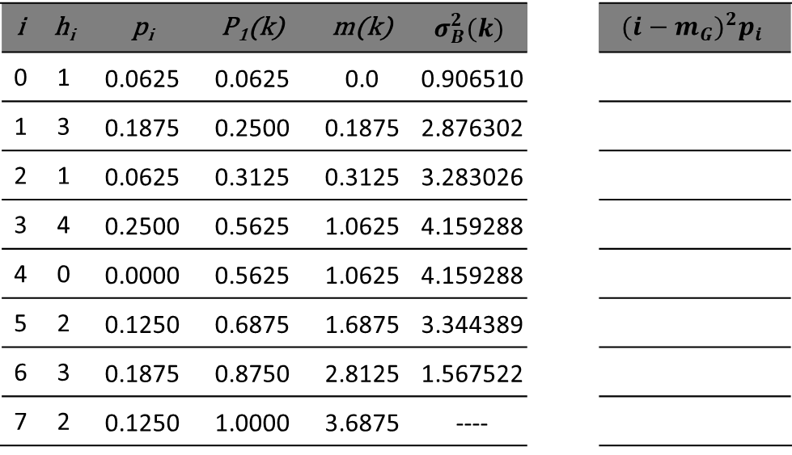
Otsu’s method
$$P_{1}\left(k\right)=\sum_{i=0}^{k}{p_{i}}$$
i | h_{i} | p_{i} | P₁(k) | m(k) | $$σ_{B}^{2}(k)$$ |  | $${(i−m_{G})}^{2}p_{i}$$
0 | 1 | 0.0625 | 0.0625 | 0.0 | 0.906510
1 | 3 | 0.1875 | 0.2500 | 0.1875 | 2.876302
2 | 1 | 0.0625 | 0.3125 | 0.3125 | 3.283026
3 | 4 | 0.2500 | 0.5625 | 1.0625 | 4.159288
4 | 0 | 0.0000 | 0.5625 | 1.0625 | 4.159288
5 | 2 | 0.1250 | 0.6875 | 1.6875 | 3.344389
6 | 3 | 0.1875 | 0.8750 | 2.8125 | 1.567522
7 | 2 | 0.1250 | 1.0000 | 3.6875 | ----
$$m\left(k\right)=\sum_{i=0}^{k}{ip_{i}}$$
$$m_{G}=\sum_{i=0}^{L−1}{ip_{i}}$$
$$σ_{B}^{2}\left(k\right)=\frac{{\left[m_{G}P_{1}\left(k\right)−m(k)\right]}^{2}}{P_{1}(k)\left[1−P_{1}(k)\right]}$$
$m_{G}=$ 3.6875

Slide 20

Otsu’s method
$$P_{1}\left(k\right)=\sum_{i=0}^{k}{p_{i}}$$
i | h_{i} | p_{i} | P₁(k) | m(k) | $$σ_{B}^{2}(k)$$ |  | $${(i−m_{G})}^{2}p_{i}$$
0 | 1 | 0.0625 | 0.0625 | 0.0 | 0.906510
1 | 3 | 0.1875 | 0.2500 | 0.1875 | 2.876302
2 | 1 | 0.0625 | 0.3125 | 0.3125 | 3.283026
3 | 4 | 0.2500 | 0.5625 | 1.0625 | 4.159288
4 | 0 | 0.0000 | 0.5625 | 1.0625 | 4.159288
5 | 2 | 0.1250 | 0.6875 | 1.6875 | 3.344389
6 | 3 | 0.1875 | 0.8750 | 2.8125 | 1.567522
7 | 2 | 0.1250 | 1.0000 | 3.6875 | ----
$$m\left(k\right)=\sum_{i=0}^{k}{ip_{i}}$$
$$m_{G}=\sum_{i=0}^{L−1}{ip_{i}}$$
$$σ_{B}^{2}\left(k\right)=\frac{{\left[m_{G}P_{1}\left(k\right)−m(k)\right]}^{2}}{P_{1}(k)\left[1−P_{1}(k)\right]}$$
$$k^{∗}= \frac{1}{2}\left(3+4\right)=3.5$$
$m_{G}=$ 3.6875

Slide 21

Otsu’s method
$$P_{1}\left(k\right)=\sum_{i=0}^{k}{p_{i}}$$
i | h_{i} | p_{i} | P₁(k) | m(k) | $$σ_{B}^{2}(k)$$ |  | $${(i−m_{G})}^{2}p_{i}$$
0 | 1 | 0.0625 | 0.0625 | 0.0 | 0.906510
1 | 3 | 0.1875 | 0.2500 | 0.1875 | 2.876302
2 | 1 | 0.0625 | 0.3125 | 0.3125 | 3.283026
3 | 4 | 0.2500 | 0.5625 | 1.0625 | 4.159288
4 | 0 | 0.0000 | 0.5625 | 1.0625 | 4.159288
5 | 2 | 0.1250 | 0.6875 | 1.6875 | 3.344389
6 | 3 | 0.1875 | 0.8750 | 2.8125 | 1.567522
7 | 2 | 0.1250 | 1.0000 | 3.6875 | ----
$$m\left(k\right)=\sum_{i=0}^{k}{ip_{i}}$$
$$m_{G}=\sum_{i=0}^{L−1}{ip_{i}}$$
$$σ_{B}^{2}\left(k\right)=\frac{{\left[m_{G}P_{1}\left(k\right)−m(k)\right]}^{2}}{P_{1}(k)\left[1−P_{1}(k)\right]}$$
$$k^{∗}= \frac{1}{2}\left(3+4\right)=3.5$$
$$η\left(k\right)=\frac{σ_{B}^{2}(k)}{σ_{G}^{2}},$$
$m_{G}=$ 3.6875

Slide 22

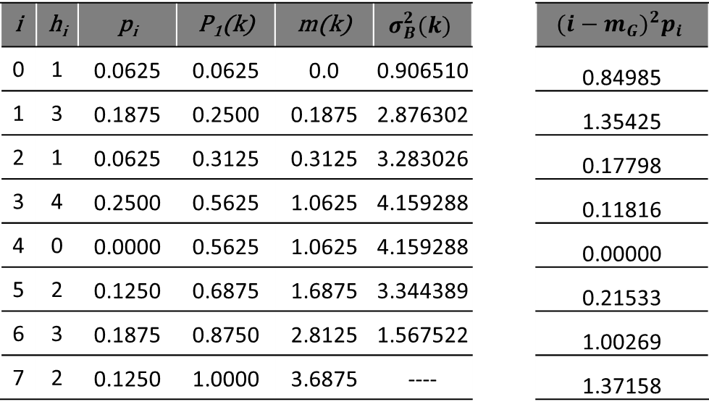
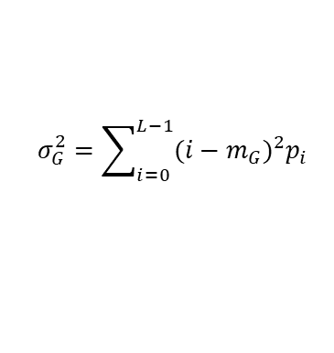
Otsu’s method
$$P_{1}\left(k\right)=\sum_{i=0}^{k}{p_{i}}$$
i | h_{i} | p_{i} | P₁(k) | m(k) | $$σ_{B}^{2}(k)$$ |  | $${(i−m_{G})}^{2}p_{i}$$
0 | 1 | 0.0625 | 0.0625 | 0.0 | 0.906510 |  | 0.84985
1 | 3 | 0.1875 | 0.2500 | 0.1875 | 2.876302 |  | 1.35425
2 | 1 | 0.0625 | 0.3125 | 0.3125 | 3.283026 |  | 0.17798
3 | 4 | 0.2500 | 0.5625 | 1.0625 | 4.159288 |  | 0.11816
4 | 0 | 0.0000 | 0.5625 | 1.0625 | 4.159288 |  | 0.00000
5 | 2 | 0.1250 | 0.6875 | 1.6875 | 3.344389 |  | 0.21533
6 | 3 | 0.1875 | 0.8750 | 2.8125 | 1.567522 |  | 1.00269
7 | 2 | 0.1250 | 1.0000 | 3.6875 | ---- |  | 1.37158
$$m\left(k\right)=\sum_{i=0}^{k}{ip_{i}}$$
$$m_{G}=\sum_{i=0}^{L−1}{ip_{i}}$$
$$σ_{B}^{2}\left(k\right)=\frac{{\left[m_{G}P_{1}\left(k\right)−m(k)\right]}^{2}}{P_{1}(k)\left[1−P_{1}(k)\right]}$$
$$k^{∗}= \frac{1}{2}\left(3+4\right)=3.5$$
$$η\left(k\right)=\frac{σ_{B}^{2}(k)}{σ_{G}^{2}},$$
em que:
$$σ_{G}^{2}=\sum_{i=0}^{L−1}{{(i−m_{G})}^{2}p_{i}}$$
$σ_{G}^{2}=$ 5.08984
$m_{G}=$ 3.6875

Slide 23
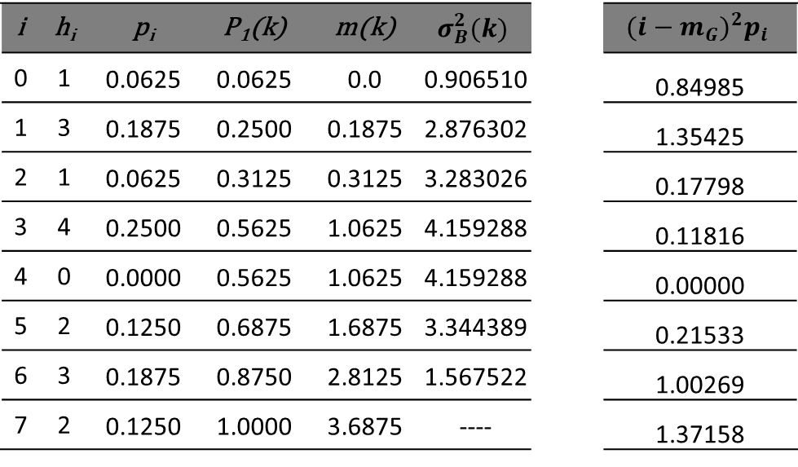

Otsu’s method
$$P_{1}\left(k\right)=\sum_{i=0}^{k}{p_{i}}$$
i | h_{i} | p_{i} | P₁(k) | m(k) | $$σ_{B}^{2}(k)$$ |  | $${(i−m_{G})}^{2}p_{i}$$
0 | 1 | 0.0625 | 0.0625 | 0.0 | 0.906510 |  | 0.84985
1 | 3 | 0.1875 | 0.2500 | 0.1875 | 2.876302 |  | 1.35425
2 | 1 | 0.0625 | 0.3125 | 0.3125 | 3.283026 |  | 0.17798
3 | 4 | 0.2500 | 0.5625 | 1.0625 | 4.159288 |  | 0.11816
4 | 0 | 0.0000 | 0.5625 | 1.0625 | 4.159288 |  | 0.00000
5 | 2 | 0.1250 | 0.6875 | 1.6875 | 3.344389 |  | 0.21533
6 | 3 | 0.1875 | 0.8750 | 2.8125 | 1.567522 |  | 1.00269
7 | 2 | 0.1250 | 1.0000 | 3.6875 | ---- |  | 1.37158
$$m\left(k\right)=\sum_{i=0}^{k}{ip_{i}}$$
$$m_{G}=\sum_{i=0}^{L−1}{ip_{i}}$$
$$σ_{B}^{2}\left(k\right)=\frac{{\left[m_{G}P_{1}\left(k\right)−m(k)\right]}^{2}}{P_{1}(k)\left[1−P_{1}(k)\right]}$$
$$k^{∗}= \frac{1}{2}\left(3+4\right)=3.5$$
$$η\left(k\right)=\frac{σ_{B}^{2}(k)}{σ_{G}^{2}},$$
em que:
$$σ_{G}^{2}=\sum_{i=0}^{L−1}{{(i−m_{G})}^{2}p_{i}}$$
$σ_{G}^{2}=$ 5.08984
$m_{G}=$ 3.6875
$η(k^{∗})=$ 0.81717

Slide 24
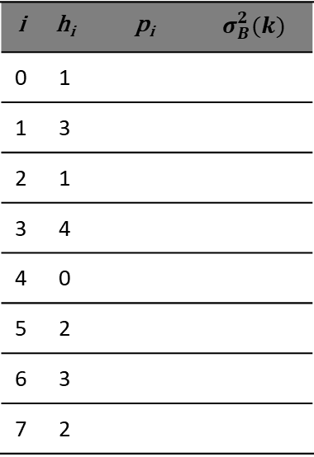
Otsu’s method
2 | 3 | 6 | 5
3 | 1 | 1 | 1
6 | 7 | 6 | 3
5 | 7 | 0 | 3
i | h_{i} | p_{i} | $$σ_{B}^{2}(k)$$
0 | 1
1 | 3
2 | 1
3 | 4
4 | 0
5 | 2
6 | 3
7 | 2
7
6
5
4
3
2
1
 | 0 | 1 | 2 | 3 | 4 | 5 | 6 | 7
0 | 0 | 0 | 0
0 | 0 | 0 | 0
0 | 0 | 0 | 0
0 | 0 | 0 | 0

Slide 25
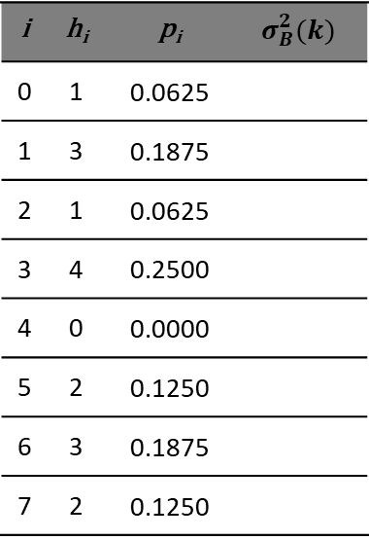
Otsu’s method
2 | 3 | 6 | 5
3 | 1 | 1 | 1
6 | 7 | 6 | 3
5 | 7 | 0 | 3
i | h_{i} | p_{i} | $$σ_{B}^{2}(k)$$
0 | 1 | 0.0625
1 | 3 | 0.1875
2 | 1 | 0.0625
3 | 4 | 0.2500
4 | 0 | 0.0000
5 | 2 | 0.1250
6 | 3 | 0.1875
7 | 2 | 0.1250
7
6
5
4
3
2
1
 | 0 | 1 | 2 | 3 | 4 | 5 | 6 | 7
0 | 0 | 0 | 0
0 | 0 | 0 | 0
0 | 0 | 0 | 0
0 | 0 | 0 | 0

Slide 26

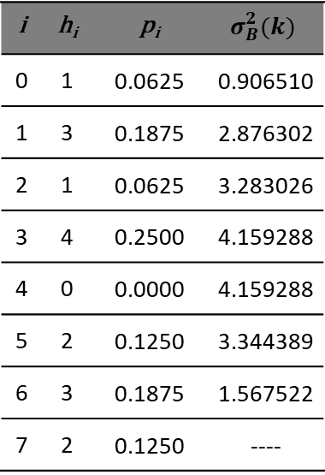
Otsu’s method
2 | 3 | 6 | 5
3 | 1 | 1 | 1
6 | 7 | 6 | 3
5 | 7 | 0 | 3
i | h_{i} | p_{i} | $$σ_{B}^{2}(k)$$
0 | 1 | 0.0625 | 0.906510
1 | 3 | 0.1875 | 2.876302
2 | 1 | 0.0625 | 3.283026
3 | 4 | 0.2500 | 4.159288
4 | 0 | 0.0000 | 4.159288
5 | 2 | 0.1250 | 3.344389
6 | 3 | 0.1875 | 1.567522
7 | 2 | 0.1250 | ----
7
6
5
4
3
2
1
 | 0 | 1 | 2 | 3 | 4 | 5 | 6 | 7
0 | 0 | 0 | 0
0 | 0 | 0 | 0
0 | 0 | 0 | 0
0 | 0 | 0 | 0
$$σ_{B}^{2}$$
0.9065
2.8763
3.2830
4.1592
4.1592
3.3443
1.5675

Slide 27
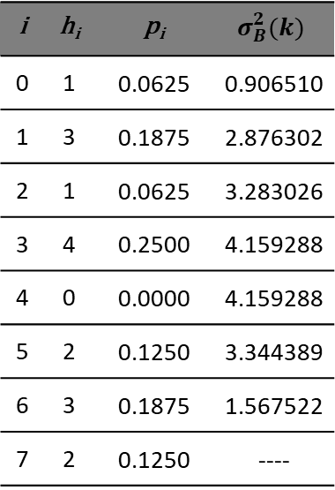

Otsu’s method
2 | 3 | 6 | 5
3 | 1 | 1 | 1
6 | 7 | 6 | 3
5 | 7 | 0 | 3
i | h_{i} | p_{i} | $$σ_{B}^{2}(k)$$
0 | 1 | 0.0625 | 0.906510
1 | 3 | 0.1875 | 2.876302
2 | 1 | 0.0625 | 3.283026
3 | 4 | 0.2500 | 4.159288
4 | 0 | 0.0000 | 4.159288
5 | 2 | 0.1250 | 3.344389
6 | 3 | 0.1875 | 1.567522
7 | 2 | 0.1250 | ----
7
6
5
4
3
2
1
 | 0 | 1 | 2 | 3 | 4 | 5 | 6 | 7
2 | 3 | 6 | 5
3 | 1 | 1 | 1
6 | 7 | 6 | 3
5 | 7 | 0 | 3
$$k^{∗}$$
$$σ_{B}^{2}$$
0.9065
2.8763
3.2830
4.1592
4.1592
3.3443
1.5675

Slide 28
Bibliography
GONZALEZ, R.C.; WOODS, R.E. Digital Image Processing. 3rd ed. Pearson, 2007.
MARQUES FILHO, O.; VIEIRA NETO, H. Processamento digital de imagens. Brasport, 1999.
(in Brazilian Portuguese)
Available on the author's website (for personal use only)
http://dainf.ct.utfpr.edu.br/~hvieir/pub.html
J. E. R. Queiroz, H. M. Gomes. Introdução ao Processamento Digital de Imagens. RITA. v. 13, 2006.
(in Brazilian Portuguese)
http://www.dsc.ufcg.edu.br/~hmg/disciplinas/graduacao/vc-2016.2/Rita-Tutorial-PDI.pdf

Slide 29
THE END
@misc{mari_im_proc_2023,
author = {João Fernando Mari},
title = {Image segmentation II – Thresholding},
year = {2023},
publisher = {GitHub},
journal = {Introduction to Digital Image Processing - UFV},
howpublished = {\url{https://github.com/joaofmari/SIN392_Introduction-to-digital-image-processing_2023}}
}

