Slide 1
Lecture 04 – Artificial neural networks
SIN 393 – Introduction to computer vision (2023)
Prof. João Fernando Mari
joaofmari.github.io
joaof.mari@ufv.br

Slide 2
Agenda
The biological neuron
The McCulloch and Pitts neuron
The Perceptron
Perceptron's learning algorithm
Example: Single layer Perceptron
History of neural networks

Slide 3
The biological neuron

Slide 4
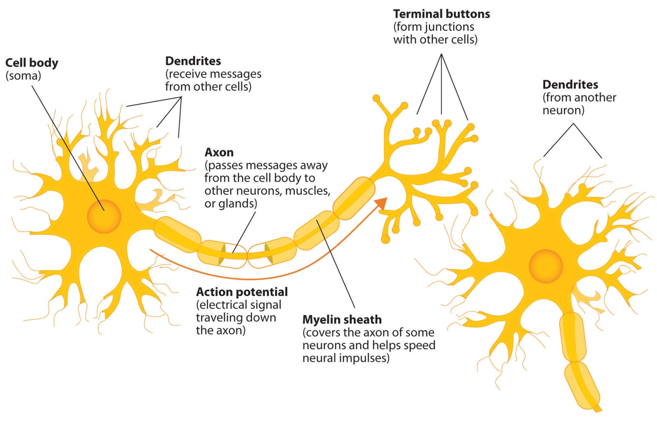
The biological neuron
Jennifer Walinga. “ Diagram of basic neuron and components”. BY-SA 4.0.

Slide 5
The McCulloch and Pitts neuron

Slide 6
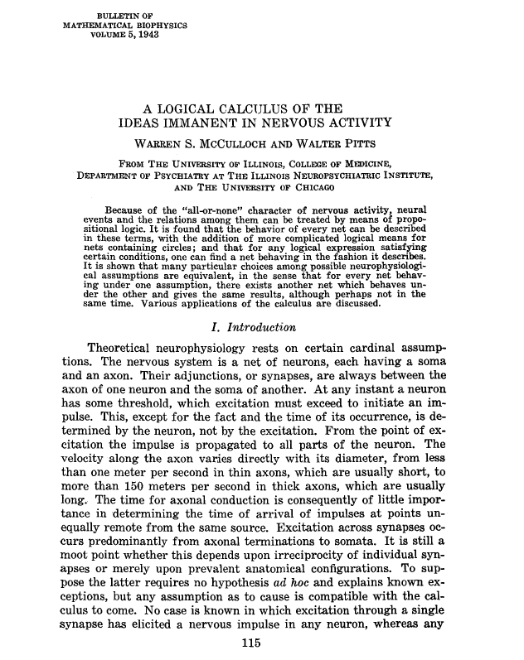
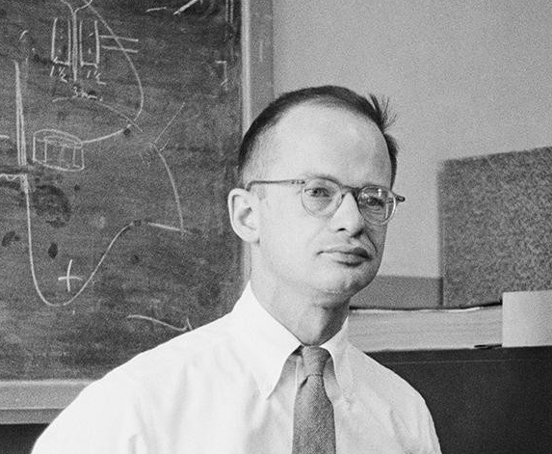
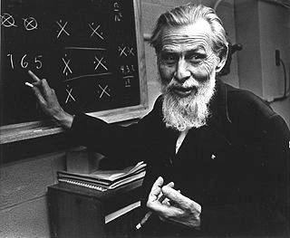
The McCulloch and Pitts neuron
Walter Pitts
(1923 – 1969)
Logic and computational neuroscience
Warren McCulloch
(1898 – 1969)
Neurophysiology

Slide 7
















The McCulloch and Pitts neuron
$$x$$
$$w$$
$$v, y$$
$$x_{0}$$
$$w_{0,0}^{}$$
$$x_{1}$$
$$w_{1,0}^{}$$
$${\hat{y}}_{0}$$
$$Σ$$
$$v_{0}$$
$$g\left(v\right)$$
$${\hat{y}}_{0}$$
$$v_{0}$$
...
$$w_{n−1,0}^{}$$
$$θ$$
$$x_{n−1}$$

Slide 8


The McCulloch and Pitts neuron
$$x$$
$$w$$
$$v, y$$
$$x_{0}$$
$$w_{0,0}^{}$$
$$x_{1}$$
$$w_{1,0}^{}$$
$${\hat{y}}_{0}$$
$$Σ$$
$$v_{0}$$
$$g\left(v\right)$$
$${\hat{y}}_{0}$$
$$v_{0}$$
...
$$w_{n−1,0}^{}$$
$$θ$$
$$x_{n−1}$$
$$v_{0}=\sum_{i=0}^{n−1}{w_{i,0}x_{i}+b_{0}}$$
$${\hat{y}}_{0}=g\left(v\right)= \left\{\begin{aligned}1, v≥θ \\ 0, v<θ \end{aligned}\right.$$

Slide 9

The McCulloch and Pitts neuron
$$x$$
$$w$$
$$v, y$$
$$x_{0}$$
NEURON
$$w_{0,0}^{}$$
$$x_{1}$$
$$w_{1,0}^{}$$
$${\hat{y}}_{0}$$
$$Σ$$
$$v_{0}$$
$$g\left(v\right)$$
$${\hat{y}}_{0}$$
$$v_{0}$$
...
$$w_{n−1,0}^{}$$
$$θ$$
$$x_{n−1}$$

Slide 10
The McCulloch and Pitts neuron
$$x$$
$$w$$
$$v, y$$
$$x_{0}$$
$$w_{0,0}^{}$$
$$x_{1}$$
$$w_{1,0}^{}$$
$${\hat{y}}_{0}$$
$$Σ$$
$$v_{0}$$
$$g\left(v\right)$$
$${\hat{y}}_{0}$$
$$v_{0}$$
...
$$w_{n−1,0}^{}$$
$$θ$$
$$x_{n−1}$$
fixed weights...
binary inputs...

Slide 11



The McCulloch and Pitts neuron
$$x$$
$$w$$
$$v, y$$
$$x_{0}$$
$$w_{0,0}^{}$$
$$x_{1}$$
$$w_{1,0}^{}$$
$${\hat{y}}_{0}$$
$$Σ$$
$$v_{0}$$
$$g\left(v\right)$$
$${\hat{y}}_{0}$$
$$v_{0}$$
...
$$w_{n−1,0}^{}$$
$$θ$$
$$x_{n−1}$$
Input layer
Synaptic weights
Neuron

Slide 12





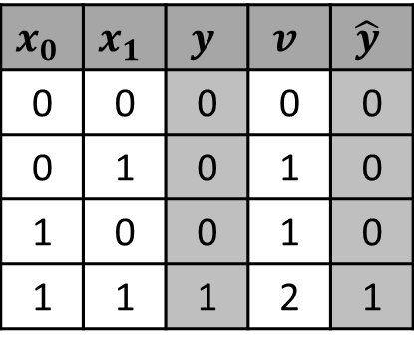




The McCulloch and Pitts neuron
AND
$$x_{0}$$
$$w_{0}^{}=1$$
$$x_{0}$$ | $$x_{1}$$ | $$y$$ | $$v$$ | $$\hat{y}$$
0 | 0 | 0 | 0 | 0
0 | 1 | 0 | 1 | 0
1 | 0 | 0 | 1 | 0
1 | 1 | 1 | 2 | 1
$$Σ$$
$$v_{0}$$
$$g\left(v\right)$$
$${\hat{y}}_{0}$$
$$w_{1}^{}=1$$
$$θ=2$$
$$x_{1}$$

Slide 13



The McCulloch and Pitts neuron
OR
$$x_{0}$$
$$w_{0}^{}=2$$
$$x_{0}$$ | $$x_{1}$$ | $$y$$ | $$v$$ | $$\hat{y}$$
0 | 0 | 0 | 0 | 0
0 | 1 | 1 | 2 | 1
1 | 0 | 1 | 2 | 1
1 | 1 | 1 | 4 | 1
$$Σ$$
$$v_{0}$$
$$g\left(v\right)$$
$${\hat{y}}_{0}$$
$$w_{1}^{}=2$$
$$θ=2$$
$$x_{1}$$

Slide 14
The Perceptron

Slide 15
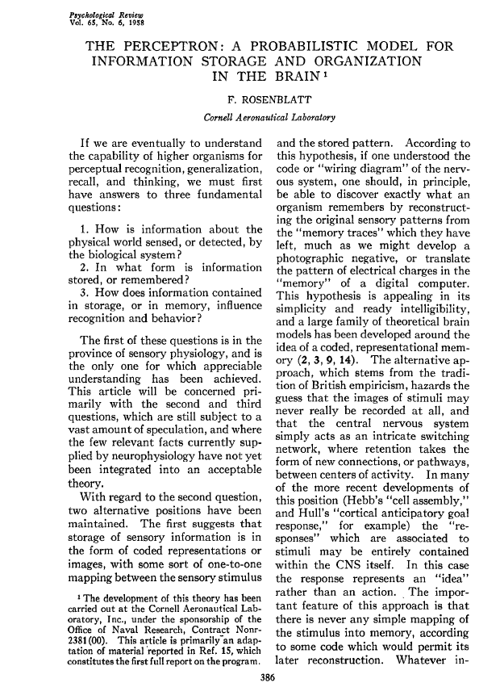
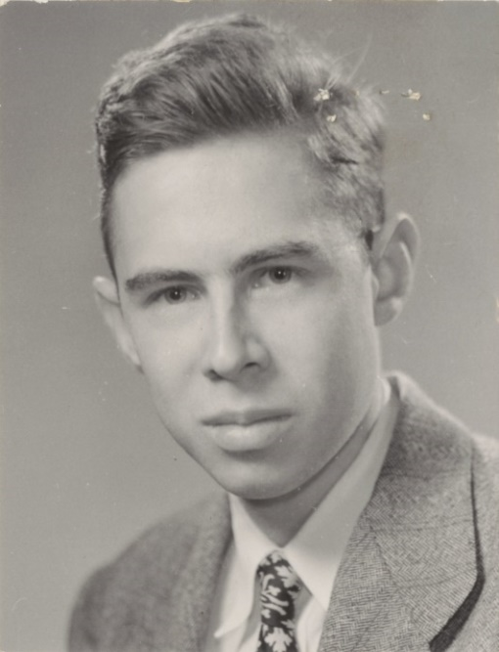
The Perceptron
Frank Rosenblatt
(1928 – 1971)
Psycology
https://news.cornell.edu/stories/2019/09/professors-perceptron-paved-way-ai-60-years-too-soon

Slide 16
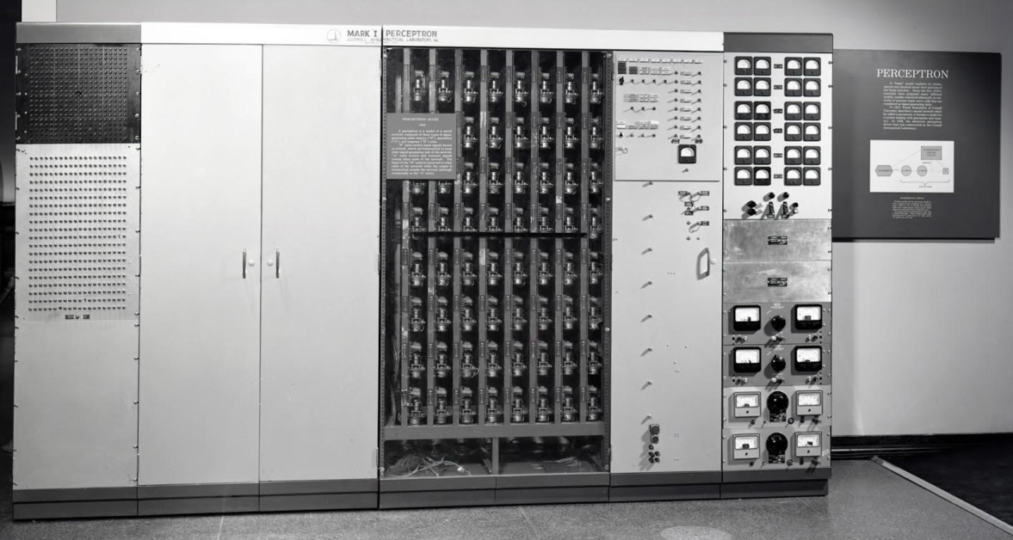
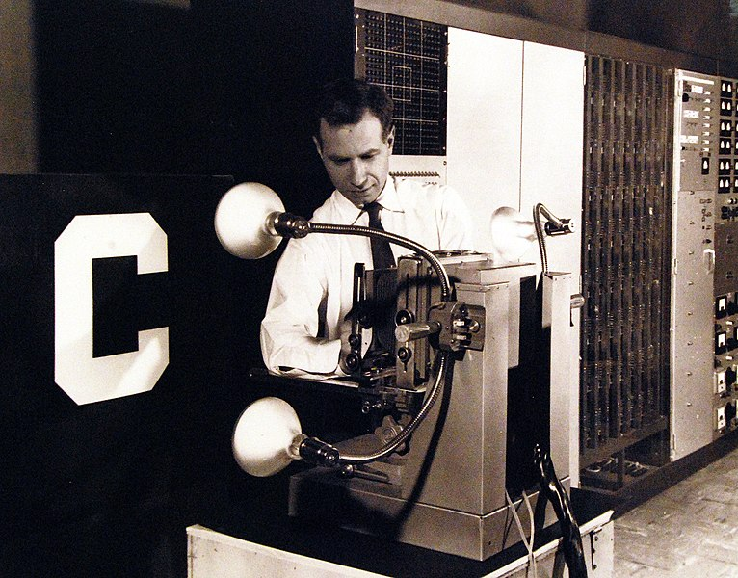
The Perceptron
Mark I Perceptron
National Museum of the U.S. Navy. Domínio público.
https://flickr.com/photos/127906254@N06/20897323365
https://ronkowitz.blogspot.com/2017/11/perceptron.html

Slide 17



















The Perceptron
$$x$$
$$w$$
$$v, y$$
$$y, e$$
$$x_{0}$$
$$1$$
$$y_{0}$$
$$w_{0,0}^{}$$
$$b_{0}^{}$$
$$x_{1}$$
$$w_{1,0}^{}$$
$${\hat{y}}_{0}$$
$$Σ$$
$$v_{0}$$
$$g\left(v\right)$$
$${\hat{y}}_{0}$$
$$e_{0}$$
$$v_{0}$$
...
$$w_{n−1,0}^{}$$
$$x_{n−1}$$

Slide 18



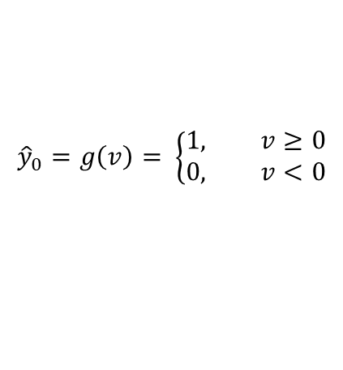

The Perceptron
$$x$$
$$w$$
$$v, y$$
$$y, e$$
$${\hat{y}}_{0}=g\left(v\right)= \left\{\begin{aligned}1, v≥0 \\ 0, v<0\end{aligned}\right.$$
$$x_{0}$$
$$1$$
$$b_{0}\left(t\right)={b_{0}\left(t−1\right)+ηe}_{0}$$
$$y_{0}$$
$$w_{0,0}^{}$$
$$b_{0}^{}$$
$$x_{1}$$
$$w_{1,0}^{}$$
$${\hat{y}}_{0}$$
$$Σ$$
$$v_{0}$$
$$g\left(v\right)$$
$${\hat{y}}_{0}$$
$$e_{0}$$
$$v_{0}$$
...
$$w_{n−1,0}^{}$$
$$v_{0}=\sum_{i=0}^{n−1}{w_{i,0}x_{i}+b_{0}}$$
$$x_{n−1}$$
$$e_{0}=y_{0}−{\hat{y}}_{0}$$
$w_{i,0}\left(t\right)={w_{i,0}\left(t−1\right)+η∆w}_{i,0}$, ${ ∆w}_{i,0}=e_{0}x_{i}$

Slide 19
The Perceptron
$$x$$
$$w$$
$$v, y$$
$$y, e$$
$$x_{0}$$
$$1$$
$$y_{0}$$
$$w_{0,0}^{}$$
$$b_{0}^{}$$
$$x_{1}$$
$$w_{1,0}^{}$$
$${\hat{y}}_{0}$$
$$Σ$$
$$v_{0}$$
$$g\left(v\right)$$
$${\hat{y}}_{0}$$
$$e_{0}$$
$$v_{0}$$
...
$$w_{n−1,0}^{}$$
learnable weights and bias...
$$x_{n−1}$$

Slide 20




The Perceptron
$$x$$
$$w$$
$$v, y$$
$$y, e$$
$$x_{0}$$
$$1$$
$$y_{0}$$
$$w_{0,0}^{}$$
$$b_{0}^{}$$
$$x_{1}$$
$$w_{1,0}^{}$$
$${\hat{y}}_{0}$$
$$Σ$$
$$v_{0}$$
$$g\left(v\right)$$
$${\hat{y}}_{0}$$
$$e_{0}$$
$$v_{0}$$
...
$$w_{n−1,0}^{}$$
$$x_{n−1}$$

Slide 21







The Perceptron
$$x$$
$$w$$
$$v, y$$
$$y, e$$
$$x_{1}=−\frac{w_{0,0}^{}}{w_{0,1}^{}}×x_{0}−\frac{b_{0}^{}}{w_{0,1}^{}}$$
$$x_{0}$$
$$1$$
$$y_{0}$$
$$x_{1}$$
$$w_{0,0}^{}$$
$$b_{0}^{}$$
${\hat{y}}_{0}$=1
$$Σ$$
$$v_{0}$$
$$g\left(v\right)$$
$${\hat{y}}_{0}$$
$$e_{0}$$
$$x_{0}$$
$$w_{1,0}^{}$$
${\hat{y}}_{0}$=0
$$x_{1}$$

Slide 22


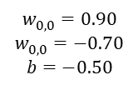






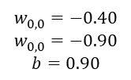





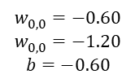



The Perceptron
$$x_{1}$$
$$x$$
$$w$$
$$v, y$$
$$w_{0,0}^{}=0.90$$
$$w_{0,0}^{}=−0.70$$
$$b=−0.50$$
$$w_{0,0}^{}=−0.40$$
$$w_{0,0}^{}=−0.90$$
$$b=0.90$$
$$x_{0}$$
$$w_{0,0}^{}$$
$$1$$
$$b_{0}^{}$$
$$Σ$$
$$v_{0}$$
$$g\left(v\right)$$
$${\hat{y}}_{0}$$
$$w_{0,0}^{}=−0.60$$
$$w_{0,0}^{}=−1.20$$
$$b=−0.60$$
$$w_{1,0}^{}$$
$$x_{0}$$
$$x_{1}$$
$$x_{1}=−\frac{w_{0,0}^{}}{w_{0,1}^{}}×x_{0}−\frac{b_{0}^{}}{w_{0,1}^{}}$$

Slide 23
Perceptron's learning algorithm

Slide 24




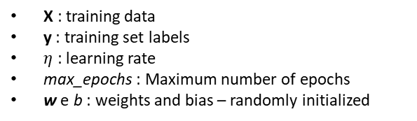















Perceptron's learning algorithm
For t from 1 to max_epochs:
$e_{epoch}=0$
For each x, y in (X, y):
$v_{0}=\sum_{i=0}^{n−1}{w_{i,0}x_{i}+b_{0}}$
${\hat{y}}_{0}=g\left(v\right)= \left\{\begin{aligned}1, v≥0 \\ 0, v<0\end{aligned}\right.$
$e_{0}=y_{0}−{\hat{y}}_{0}$
${∆w}_{i,0}=e_{0}x_{i},$
$for i=0, 1, …, n−1$
$w_{i,0}\left(t\right)={w_{i,0}\left(t−1\right)+η∆w}_{i,0},$
$for i=0, 1, …, n−1$
$b_{0}\left(t\right)={b_{0}\left(t−1\right)+ηe}_{0}$
$e_{epoch}={e_{epoch}+\left(e_{0}\right)}^{2}$
$e_{epoch}=e_{epoch}/2$
If $e_{epoch}<e_{min}$, break the loop.
$$x$$
$$w$$
$$v, y$$
$$y, e$$
$$x_{0}$$
$$w_{0,0}^{}$$
$$1$$
$$y_{0}$$
$$b_{0}^{}$$
$$w_{1,0}^{}$$
$$x_{1}$$
$$v_{0}$$
$${\hat{y}}_{0}$$
$$Σ$$
$$g\left(v\right)$$
$$e_{0}$$
$$w_{n−1,0}^{}$$
...
$$x_{n−1}$$
X : training data
y : training set labels
$η$ : learning rate
max_epochs : Maximum number of epochs
w e b : weights and bias – randomly initialized

Slide 25

Perceptron's learning algorithm
Inner product :
$v_{0}=\sum_{i=0}^{n−1}{w_{i,0}x_{i}+b_{0}}$
Activation function:
${\hat{y}}_{0}=g\left(v\right)= \left\{\begin{aligned}1, v≥0 \\ 0, v<0\end{aligned}\right.$
Error:
$e_{0}=y_{0}−{\hat{y}}_{0}$
Value used to update the weights:
${∆w}_{i,0}=e_{0}x_{i}, for i=0, 1, …, n−1$
Weights update:
$w_{i,0}\left(t\right)={w_{i,0}\left(t−1\right)+η∆w}_{i,0}, for i=0, 1, …, n−1$
Bias update:
$b_{0}\left(t\right)={b_{0}\left(t−1\right)+ηe}_{0}$
$$x$$
$$w$$
$$v, y$$
$$y, e$$
$$x_{0}$$
$$w_{0,0}^{}$$
$$1$$
$$y_{0}$$
$$b_{0}^{}$$
$$w_{1,0}^{}$$
$$x_{1}$$
$$v_{0}$$
$${\hat{y}}_{0}$$
$$Σ$$
$$g\left(v\right)$$
$$e_{0}$$
$$w_{n−1,0}^{}$$
...
$$x_{n−1}$$

Slide 26
Example: Single layer Perceptron

Slide 27





Example: Single layer Perceptron
Epoch 0:
Iteration 0:
$x=\left[\begin{matrix}x_{0} & x_{1}\end{matrix}\right]=\left[\begin{matrix}0 & 0\end{matrix}\right]$
$w=\left[\begin{matrix}w_{0,0} \\ w_{1,0}\end{matrix}\right]=\left[\begin{matrix}0.1 \\ 0.2\end{matrix}\right]$, $b=\left[b_{0}\right]=\left[0.6\right]$
$v_{0}=xw+b_{0}=\left[\begin{matrix}0.0 & 0.0\end{matrix}\right]\left[\begin{matrix}0.1 \\ 0.2\end{matrix}\right]+0.6$
$v_{0}=0.0+0.6=0.6$
${\hat{y}}_{0}=1.0, because v_{0}>0.0$
$e_{0}=y−\hat{y}=0.0−1.0=−1.0$
$∆w=ex=−1.0\left[\begin{matrix}0.0 & 0.0\end{matrix}\right]=\left[\begin{matrix}0.0 & 0.0\end{matrix}\right]$
$w\left(t\right)=w\left(t−1\right)+η∆w=\left[\begin{matrix}0.1 & 0.2\end{matrix}\right]+0.1\left[\begin{matrix}0.0 & 0.0\end{matrix}\right]$
$w\left(t\right)=\left[\begin{matrix}0.1 & 0.2\end{matrix}\right]$
$b_{0}\left(t\right)=b_{0}\left(t−1\right)+ηe_{0}=0.6+0.1×\left(−1.0\right)=0.$5
$e_{epoch}=e_{epoch}+{e_{0}}^{2}=0.0+{\left(−1.0\right)}^{2}=1.0$
$$x$$
$$w$$
$$v, y$$
$$y, e$$
0.0
$$x_{0}$$
$$1$$
$$w_{0,0}^{}$$
$$y_{0}$$
$$b_{0}^{}$$
0.6
0.1
$$Σ$$
$$v_{0}$$
$$g\left(v\right)$$
$${\hat{y}}_{0}$$
$$e_{0}$$
$$w_{1,0}^{}$$
0.0
0.2
AND
$$x_{1}$$
$$X=\left[\begin{matrix}0 & 0 \\ 0 & 1 \\ \begin{matrix}1 \\ 1\end{matrix} & \begin{matrix}0 \\ 1\end{matrix}\end{matrix}\right]$$
$$y=\left[\begin{matrix}0 & 0 & \begin{matrix}0 & 1\end{matrix}\end{matrix}\right]$$

Slide 28

Example: Single layer Perceptron
Epoch 0:
Iteration 1:
$x=\left[\begin{matrix}x_{0} & x_{1}\end{matrix}\right]=\left[\begin{matrix}0.0 & 1.0\end{matrix}\right]$
$w=\left[\begin{matrix}w_{0,0} \\ w_{1,0}\end{matrix}\right]=\left[\begin{matrix}0.1 \\ 0.2\end{matrix}\right]$, $b=\left[b_{0}\right]=\left[0.5\right]$
$v_{0}=xw+b_{0}=\left[\begin{matrix}0.0 & 1.0\end{matrix}\right]\left[\begin{matrix}0.1 \\ 0.2\end{matrix}\right]+0.$5
$v_{0}=0.2+0.5=0.7$
${\hat{y}}_{0}=1.0, because v_{0}>0.0$
$e_{0}=y−\hat{y}=0.0−1.0=−1.0$
$∆w=ex=−1.0\left[\begin{matrix}0.0 & 1.0\end{matrix}\right]=\left[\begin{matrix}0.0 & −1.0\end{matrix}\right]$
$w\left(t\right)=w\left(t−1\right)+η∆w=\left[\begin{matrix}0.1 & 0.2\end{matrix}\right]+0.1\left[\begin{matrix}0.0 & −1.0\end{matrix}\right]$
$w\left(t\right)=\left[\begin{matrix}0.1 & 0.1\end{matrix}\right]$
$b_{0}\left(t\right)=b_{0}\left(t−1\right)+ηe_{0}=0.9+0.1×\left(−1.0\right)=0.$4
$e_{epoch}=e_{epoch}+{e_{0}}^{2}=1.0+{\left(−1.0\right)}^{2}=2.0$
$$x$$
$$w$$
$$v, y$$
$$y, e$$
0.0
$$x_{0}$$
$$1$$
$$w_{0,0}^{}$$
$$y_{0}$$
$$b_{0}^{}$$
0.5
0.1
$$Σ$$
$$v_{0}$$
$$g\left(v\right)$$
$${\hat{y}}_{0}$$
$$e_{0}$$
$$w_{1,0}^{}$$
1.0
0.2
AND
$$x_{1}$$
$$X=\left[\begin{matrix}0 & 0 \\ 0 & 1 \\ \begin{matrix}1 \\ 1\end{matrix} & \begin{matrix}0 \\ 1\end{matrix}\end{matrix}\right]$$
$$y=\left[\begin{matrix}0 & 0 & \begin{matrix}0 & 1\end{matrix}\end{matrix}\right]$$

Slide 29

Example: Single layer Perceptron
Epoch 0:
Iteration 2:
$x=\left[\begin{matrix}x_{0} & x_{1}\end{matrix}\right]=\left[1.\begin{matrix}0 & 0.0\end{matrix}\right]$
$w=\left[\begin{matrix}w_{0,0} \\ w_{1,0}\end{matrix}\right]=\left[\begin{matrix}0.1 \\ 0.1\end{matrix}\right]$, $b=\left[b_{0}\right]=\left[0.4\right]$
$v_{0}=xw+b_{0}=\left[1.\begin{matrix}0 & 0.0\end{matrix}\right]\left[\begin{matrix}0.1 \\ 0.1\end{matrix}\right]+0.4$
$v_{0}=0.1+0.4=0.5$
${\hat{y}}_{0}=1.0, because{ v}_{0}>0.0$
$e_{0}=y−\hat{y}=0.0−1.0=−1.0$
$∆w=ex=−1.0\left[\begin{matrix}1.0 & 0.0\end{matrix}\right]=\left[\begin{matrix}−1.0 & 0.0\end{matrix}\right]$
$w\left(t\right)=w\left(t−1\right)+η∆w=\left[\begin{matrix}0.1 & 0.1\end{matrix}\right]+0.1\left[\begin{matrix}−1.0 & 0.0\end{matrix}\right]$
$w\left(t\right)=\left[\begin{matrix}0.0 & 0.1\end{matrix}\right]$
$b_{0}\left(t\right)=b_{0}\left(t−1\right)+ηe_{0}=0.4+0.1×\left(−1.0\right)=0.3$
$e_{época}=e_{época}+{e_{0}}^{2}=2.0+{\left(−1.0\right)}^{2}=3.0$
$$x$$
$$w$$
$$v, y$$
$$y, e$$
1.0
$$x_{0}$$
$$1$$
$$w_{0,0}^{}$$
$$y_{0}$$
$$b_{0}^{}$$
0.4
0.1
$$Σ$$
$$v_{0}$$
$$g\left(v\right)$$
$${\hat{y}}_{0}$$
$$e_{0}$$
$$w_{1,0}^{}$$
0.0
0.1
AND
$$x_{1}$$
$$X=\left[\begin{matrix}0 & 0 \\ 0 & 1 \\ \begin{matrix}1 \\ 1\end{matrix} & \begin{matrix}0 \\ 1\end{matrix}\end{matrix}\right]$$
$$y=\left[\begin{matrix}0 & 0 & \begin{matrix}0 & 1\end{matrix}\end{matrix}\right]$$

Slide 30

Example: Single layer Perceptron
Epoch 0:
Iteration 3:
$x=\left[\begin{matrix}x_{0} & x_{1}\end{matrix}\right]=\left[1.\begin{matrix}0 & 1.0\end{matrix}\right]$
$w=\left[\begin{matrix}w_{0,0} \\ w_{1,0}\end{matrix}\right]=\left[\begin{matrix}0.0 \\ 0.1\end{matrix}\right]$, $b=\left[b_{0}\right]=\left[0.3\right]$
$v_{0}=xw+b_{0}=\left[1.\begin{matrix}0 & 1.0\end{matrix}\right]\left[\begin{matrix}0.0 \\ 0.1\end{matrix}\right]+0.3$
$v_{0}=0.1+0.3=0.4$
${\hat{y}}_{0}=1.0, because{ v}_{0}>0.0$
$e_{0}=y−\hat{y}=1.0−1.0=0.0$
$∆w=ex=0.0\left[\begin{matrix}1.0 & 1.0\end{matrix}\right]=\left[\begin{matrix}0.0 & 0.0\end{matrix}\right]$
$w\left(t\right)=w\left(t−1\right)+η∆w=\left[\begin{matrix}0.0 & 0.1\end{matrix}\right]+0.1\left[\begin{matrix}0.0 & 0.0\end{matrix}\right]$
$w\left(t\right)=\left[\begin{matrix}0.0 & 0.1\end{matrix}\right]$
$b_{0}\left(t\right)=b_{0}\left(t−1\right)+ηe_{0}=0.3+0.1×\left(0.0\right)=0.3$
$e_{epoch}=e_{epoch}+{e_{0}}^{2}=3.0+{\left(0.0\right)}^{2}=3.0$
$$x$$
$$w$$
$$v, y$$
$$y, e$$
1.0
$$x_{0}$$
$$1$$
$$w_{0,0}^{}$$
$$y_{0}$$
$$b_{0}^{}$$
0.3
0.0
$$Σ$$
$$v_{0}$$
$$g\left(v\right)$$
$${\hat{y}}_{0}$$
$$e_{0}$$
$$w_{1,0}^{}$$
1.0
0.1
AND
$$x_{1}$$
$$X=\left[\begin{matrix}0 & 0 \\ 0 & 1 \\ \begin{matrix}1 \\ 1\end{matrix} & \begin{matrix}0 \\ 1\end{matrix}\end{matrix}\right]$$
$$y=\left[\begin{matrix}0 & 0 & \begin{matrix}0 & 1\end{matrix}\end{matrix}\right]$$

Slide 31

Example: Single layer Perceptron
End of Epoch 0.
$e_{epoch}=\frac{e_{epoch}}{2}=\frac{3.0}{2}=1.5$
Epoch 1:
Iteration 0:
Repeat until the limit of epochs is reached or the epoch error falls below a pre-defined threshold...
$$x$$
$$w$$
$$v, y$$
$$y, e$$
0.0
$$x_{0}$$
$$1$$
$$w_{0,0}^{}$$
$$y_{0}$$
$$b_{0}^{}$$
?
?
$$Σ$$
$$v_{0}$$
$$g\left(v\right)$$
$${\hat{y}}_{0}$$
$$e_{0}$$
$$w_{1,0}^{}$$
0.0
?
AND
$$x_{1}$$
$$X=\left[\begin{matrix}0 & 0 \\ 0 & 1 \\ \begin{matrix}1 \\ 1\end{matrix} & \begin{matrix}0 \\ 1\end{matrix}\end{matrix}\right]$$
$$y=\left[\begin{matrix}0 & 0 & \begin{matrix}0 & 1\end{matrix}\end{matrix}\right]$$

Slide 32
History of neural networks

Slide 33
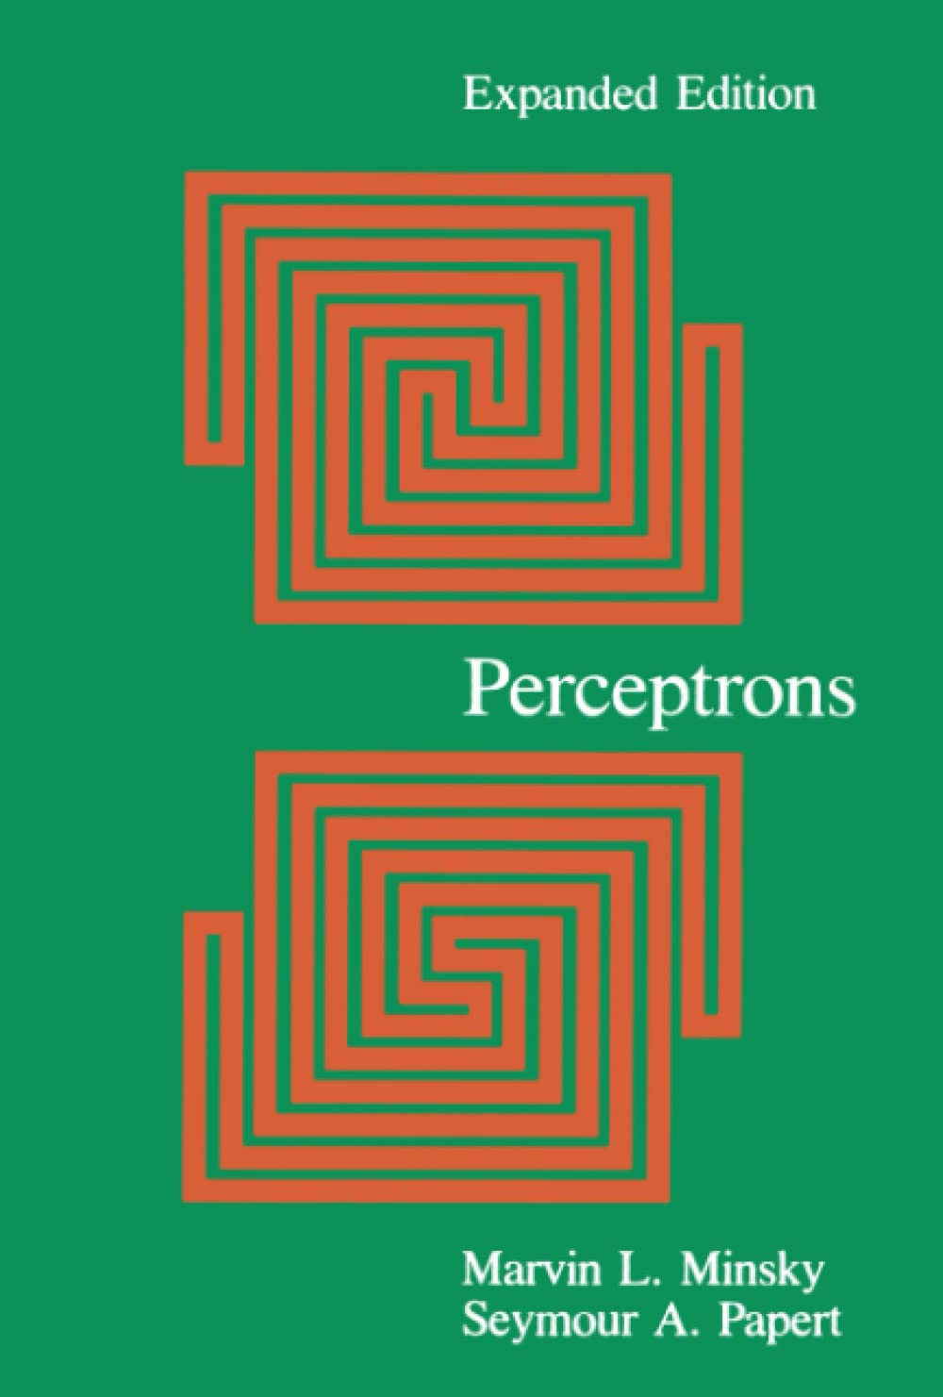
History of neural networks
Perceptrons: An Introduction to Computational Geometry
1969
Marvin Minsky, Seymour A. Papert
Criticizes the limitations of Perceptron
Inability to handle non-linear problems
XOR
Strong influence on AI's 1st winter (~1974 - ~1980)

Slide 34
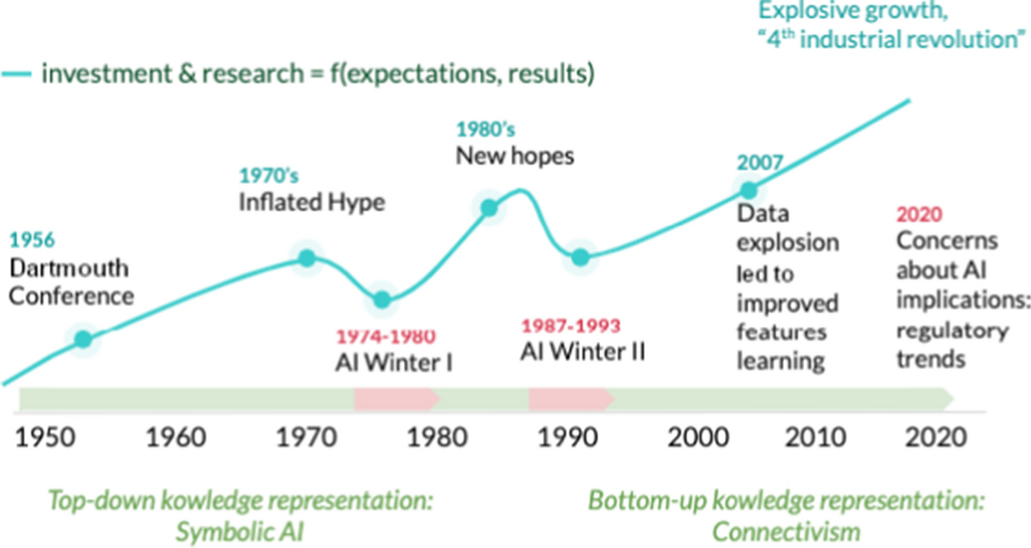
History of neural networks
Francesconi, E. The winter, the summer and the summer dream of artificial intelligence in law. Artif Intell Law 30, 147–161 (2022)

Slide 35
Bibliography
Gonzalez, R.C.; Woods, R.E. Digital Image Processing.
Pearson. 3rd edition. 2007.
Ponti et al. Everything You Wanted to Know about Deep Learning for Computer Vision but Were Afraid to Ask. Sibgrapi 2017.
https://sites.icmc.usp.br/moacir/p17sibgrapi-tutorial/
Görner, M. Learn TensorFlow and deep learning, without a Ph.D.
https://cloud.google.com/blog/products/gcp/learn-tensorflow-and-deep-learning-without-a-phd
CS231n: Convolutional Neural Networks for Visual Recognition
http://cs231n.github.io/
Goodfellow, Bengio e Courville. Deep Learning. MIT Press, 2016
https://www.deeplearningbook.org/

Slide 36
Bibliography
McCulloch, W.S., Pitts, W. A logical calculus of the ideas immanent in nervous activity.
Bulletin of Mathematical Biophysics 5, 115–133 (1943).
https://doi.org/10.1007/BF02478259
Rosenblatt, F. The perceptron: A probabilistic model for information storage and organization in the brain.
Psychological Review, 65(6), 386–408 (1958).
https://doi.org/10.1037/h0042519
Minsky, M.; Papert, S. A. Perceptrons: An Introduction to Computational Geometry.
The MIT Press, 2017
https://doi.org/10.7551/mitpress/11301.001.0001
Francesconi, E. The winter, the summer and the summer dream of artificial intelligence in law.
Artif Intell Law 30, 147–161 (2022)
https://link.springer.com/article/10.1007/s10506-022-09309-8

Slide 37
Bibliography
Strickland, E. THE TURBULENT PAST AND UNCERTAIN FUTURE OF ARTIFICIAL INTELLIGENCE. Is there a way out of AI's boom-and-bust cycle?
IEEE Spectrum, 2021
https://spectrum.ieee.org/history-of-ai

Slide 38
THE END

