Slide 1
Lecture 04 – Introduction to image classification
SIN 393 – Introduction to Computer Vision (2022-2)
Prof. João Fernando Mari
joaofmari.github.io
joaof.mari@ufv.br

Slide 2
Agenda
A classification problem
Classification pipelines
Learning models
Cross validation
Classification evaluation

Slide 3
A classification problem

Slide 4


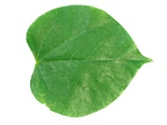


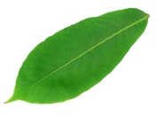
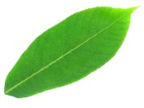

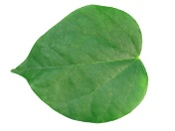
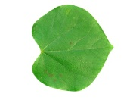



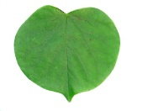
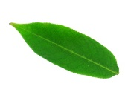

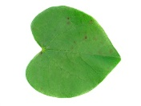

A classification problem
Learning to classify three types (classes) of leaves from images.
Flavia leaf dataset:
  http://flavia.sourceforge.net/
  1,907 images
  33 classes
We selected 3 classes:
  aesculus chinensis
  acer palmatum
  cercis chinensis

Slide 5
A classification problem
Learning to classify three types (classes) of leaves from images.
Feature extraction:
  Select features from the images that can
  be used to distinguish between classes.
Features can be:
  Shapes
  Colors
  Textures
  Histogram of gradients (HoG)
  Bag of Visual Words
  Fisher Vectors
  ...
aesculus chinensis
acer palmatum
cercis chinensis

Slide 6
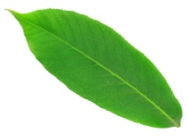
A classification problem
Some shape features:
Area:
aesculus chinensis
acer palmatum
cercis chinensis
Axis:
Roundness:
1,0
0,0
Eccentricity:
0,0
1,0
Solidity:
÷
÷

Slide 7
A classification problem
Learning to classify three types (classes) of leaves from images.
acer palmatum
aesculus chinensis
cercis chinensis
Major-axis
Area

Slide 8
A classification problem
Learning to classify three types (classes) of leaves from images.
acer palmatum
aesculus chinensis
cercis chinensis
Major-axis
Area

Slide 9
The nearest neighbor method
Learning to classify three types (classes) of leaves from images.
acer palmatum
aesculus chinensis
cercis chinensis
Major-axis
Area

Slide 10
K-nearest neighbors – K-NN
Learning to classify three types (classes) of leaves from images.
acer palmatum
aesculus chinensis
cercis chinensis
Major-axis
k = 1
Area

Slide 11
K-nearest neighbors – K-NN
Learning to classify three types (classes) of leaves from images.
acer palmatum
aesculus chinensis
cercis chinensis
Major-axis
k = 3
Area

Slide 12
K-nearest neighbors – K-NN
Learning to classify three types (classes) of leaves from images.
acer palmatum
aesculus chinensis
cercis chinensis
Major-axis
k = 3
Area

Slide 13
Linear functions (Perceptrons)
Learning to classify three types (classes) of leaves from images.
acer palmatum
aesculus chinensis
cercis chinensis
Major-axis
Area

Slide 14
Linear functions (Perceptrons)
Learning to classify three types (classes) of leaves from images.
acer palmatum
aesculus chinensis
cercis chinensis
Major-axis
Area

Slide 15
Linear functions (Perceptrons)
Learning to classify three types (classes) of leaves from images.
acer palmatum
aesculus chinensis
cercis chinensis
Major-axis
Area

Slide 16
Classification pipelines

Slide 17
Classification pipelines
Classical image classification pipeline
Image
Feature extraction
Classifier
MANUAL
TRAINABLE
Deep Learning
Image
Feature extraction
(low-level)
Feature extraction
(medium-level)
Feature extraction
(high-level)
Classifier
TRAINABLE
TRAINABLE
TRAINABLE
TRAINABLE
Yann LeCun’s Deep Learning Course at CDS - SPRING 2021

Slide 18
Learning paradigms

Slide 19
Learning paradigms
Supervised learning
Unsupervised learning
Reinforcement learning
Semi-supervised learning

Slide 20
Supervised learning
MODEL
Input
Label

Slide 21
Supervised learning
MODEL
Input
Output
Label

Slide 22
Supervised learning
MODEL
Input
Output
Error
Label

Slide 23
Supervised learning
MODEL
Input
Output
Error
Label

Slide 24


















Example: Supervised learning
0
1
0
2
0
1
0
1
1
2
2
2
0
2
1
MODEL
Input
Output
Error
Label
  0: acer palmatum
  1: aesculus chinensis
  2: cercis chinensis

Slide 25
Example: Supervised learning
1
0
2
0
1
0
1
1
2
2
2
0
2
1
MODEL
Input
Output
Error
Label
0
  0: acer palmatum
  1: aesculus chinensis
  2: cercis chinensis

Slide 26
Example: Supervised learning
1
0
2
0
1
0
1
1
2
2
2
0
2
1
MODEL
Input
Output
1
Error
Label
0
  0: acer palmatum
  1: aesculus chinensis
  2: cercis chinensis

Slide 27
Example: Supervised learning
1
0
2
0
1
0
1
1
2
2
2
0
2
1
MODEL
Input
Output
1
Error
> 0,0
Label
0
  0: acer palmatum
  1: aesculus chinensis
  2: cercis chinensis

Slide 28
Example: Supervised learning
1
0
2
0
1
0
1
1
2
2
2
0
2
1
MODEL
Input
Output
1
Error > 0,0:
Adjust the model
Error
> 0,0
Label
0
  0: acer palmatum
  1: aesculus chinensis
  2: cercis chinensis

Slide 29
Example: Supervised learning
0
0
2
0
1
0
1
1
2
2
2
0
2
1
MODEL
Input
Output
Error
Label
1
  0: acer palmatum
  1: aesculus chinensis
  2: cercis chinensis

Slide 30
Example: Supervised learning
0
0
2
0
1
0
1
1
2
2
2
0
2
1
MODEL
Input
Output
2
Error
Label
1
  0: acer palmatum
  1: aesculus chinensis
  2: cercis chinensis

Slide 31
Example: Supervised learning
0
0
2
0
1
0
1
1
2
2
2
0
2
1
MODEL
Input
Output
2
Error
> 0,0
Label
1
  0: acer palmatum
  1: aesculus chinensis
  2: cercis chinensis

Slide 32
Example: Supervised learning
0
0
2
0
1
0
1
1
2
2
2
0
2
1
MODEL
Input
Output
2
Error > 0,0:
Adjust the model
Error
> 0,0
Label
1
  0: acer palmatum
  1: aesculus chinensis
  2: cercis chinensis

Slide 33
Example: Supervised learning
0
1
2
0
1
0
1
1
2
2
2
0
2
1
MODEL
Input
Output
Error
Label
0
  0: acer palmatum
  1: aesculus chinensis
  2: cercis chinensis

Slide 34
Example: Supervised learning
0
1
2
0
1
0
1
1
2
2
2
0
2
1
MODEL
Input
Output
0
Error
Label
0
  0: acer palmatum
  1: aesculus chinensis
  2: cercis chinensis

Slide 35
Example: Supervised learning
0
1
2
0
1
0
1
1
2
2
2
0
2
1
MODEL
Input
Output
0
Error
= 0,0
Label
0
  0: acer palmatum
  1: aesculus chinensis
  2: cercis chinensis

Slide 36
Example: Supervised learning
0
1
2
0
1
0
1
1
2
2
2
0
2
1
MODEL
Input
Output
0
Error = 0,0:
Do not adjust the
model
Error
= 0,0
Label
0
  0: acer palmatum
  1: aesculus chinensis
  2: cercis chinensis

Slide 37
Example: Supervised learning
0
1
0
2
0
1
0
1
1
2
2
2
0
2
1
Continue until the model converges...
MODEL
Input
Output
0
Error
= 0,0
Label
0
  0: acer palmatum
  1: aesculus chinensis
  2: cercis chinensis

Slide 38
Unsupervised learning
Input
Output
MODEL

Slide 39
Unsupervised learning
Input
Output
MODEL

Slide 40
Unsupervised learning
Input
Output
MODEL

Slide 41
Cross validation

Slide 42
Overfiting
Without overfiting
Overfiting

Slide 43
Overfiting
Without overfiting
Overfiting

Slide 44
Overfiting
Without overfiting
Overfiting
?
?
?

Slide 45
Hold-out cross validation
Dataset
shuffle
Train
Validation
Test
Treina o modelo
Adjust hyperparameters
MODEL
Test the model

Slide 46
Hold-out cross validation
Dataset
shuffle
Train
Validation
Test
Train the model
Adjust hyperparameters
MODEL
best hyperparameters
Train
Validation
Test
Train the model
MODEL
Test the model

Slide 47
K-fold cross validation
Dataset
shuffle
Train
Test
Train
Validation
k = 0
Train
Validation
Train
k = 1
Train
Validation
Train
k = 2
k = 5
Train
Validation
Train
k = 3
Validation
Train
k = 4

Slide 48
Classification evaluation

Slide 49
Confusion matrix
True positive (TP):
  Objects of class C1 classified as C1.
True negative (TN):
  Objects of other classes (C2 and C3) classified as not being C1.
False positive (FP) (type I error):
  Objects classified as C1 but belonging to other classes (C2 or C3).
False negative (FN) (type II error):
  Objects of class C1 classified as other classes (C2 or C3).
 |  | Classification
 |  | Class C1 | Class C2 | Class C3 | Sum
Real class | Class C1 | 5 | 3 | 0 | 8
 | Class C2 | 2 | 3 | 1 | 6
 | Class C3 | 0 | 2 | 11 | 13
 | Sum | 7 | 8 | 12

Slide 50
Confusion matrix
True positive (TP):
  Objects of class C1 classified as C1.
True negative (TN):
  Objects of other classes (C2 and C3) classified as not being C1.
False positive (FP) (type I error):
  Objects classified as C1 but belonging to other classes (C2 or C3).
False negative (FN) (type II error):
  Objects of class C1 classified as other classes (C2 or C3).
Class C1 |  | Classification
 |  | Class C1 |  | Others
Real class | Class C1 |  | TP |  | FN
 | Others |  | FP |  | TN
 |  | Classification
 |  | Class C1 | Class C2 | Class C3 | Sum
Real class | Class C1 | 5 | 3 | 0 | 8
 | Class C2 | 2 | 3 | 1 | 6
 | Class C3 | 0 | 2 | 11 | 13
 | Sum | 7 | 8 | 12

Slide 51
Confusion matrix
True positive (TP):
  Objects of class C1 classified as C1.
True negative (TN):
  Objects of other classes (C2 and C3) classified as not being C1.
False positive (FP) (type I error):
  Objects classified as C1 but belonging to other classes (C2 or C3).
False negative (FN) (type II error):
  Objects of class C1 classified as other classes (C2 or C3).
Class C1 |  | Classification
 |  | Class C1 |  | Others
Real class | Class C1 | 5 | TP | 3 | FN
 | Others | 2 | FP | 17 | TN
 |  | Classification
 |  | Class C1 | Class C2 | Class C3 | Sum
Real class | Class C1 | 5 | 3 | 0 | 8
 | Class C2 | 2 | 3 | 1 | 6
 | Class C3 | 0 | 2 | 11 | 13
 | Sum | 7 | 8 | 12

Slide 52
Confusion matrix
True positive (TP):
  Objects of class C1 classified as C1.
True negative (TN):
  Objects of other classes (C2 and C3) classified as not being C1.
False positive (FP) (type I error):
  Objects classified as C1 but belonging to other classes (C2 or C3).
False negative (FN) (type II error):
  Objects of class C1 classified as other classes (C2 or C3).
Class C1 |  | Classification
 |  | Class C1 |  | Others
Real class | Class C1 | 5 | TP | 3 | FN
 | Others | 2 | FP | 17 | TN
 |  | Classification
 |  | Class C1 | Class C2 | Class C3 | Sum
Real class | Class C1 | 5 | 3 | 0 | 8
 | Class C2 | 2 | 3 | 1 | 6
 | Class C3 | 0 | 2 | 11 | 13
 | Sum | 7 | 8 | 12

Slide 53
Confusion matrix
True positive (TP):
  Objects of class C1 classified as C1.
True negative (TN):
  Objects of other classes (C2 and C3) classified as not being C1.
False positive (FP) (type I error):
  Objects classified as C1 but belonging to other classes (C2 or C3).
False negative (FN) (type II error):
  Objects of class C1 classified as other classes (C2 or C3).
Class C1 |  | Classification
 |  | Class C1 |  | Others
Real class | Class C1 | 5 | TP | 3 | FN
 | Others | 2 | FP | 17 | TN
Class C2 |  | Classification
 |  | Class C2 |  | Others
Real class | Class C2 | 3 | TP | 3 | FN
 | Others | 5 | FP | 16 | TN
 |  | Classification
 |  | Class C1 | Class C2 | Class C3 | Sum
Real class | Class C1 | 5 | 3 | 0 | 8
 | Class C2 | 2 | 3 | 1 | 6
 | Class C3 | 0 | 2 | 11 | 13
 | Sum | 7 | 8 | 12

Slide 54
Confusion matrix
True positive (TP):
  Objects of class C1 classified as C1.
True negative (TN):
  Objects of other classes (C2 and C3) classified as not being C1.
False positive (FP) (type I error):
  Objects classified as C1 but belonging to other classes (C2 or C3).
False negative (FN) (type II error):
  Objects of class C1 classified as other classes (C2 or C3).
Class C1 |  | Classification
 |  | Class C1 |  | Others
Real class | Class C1 | 5 | TP | 3 | FN
 | Others | 2 | FP | 17 | TN
Class C2 |  | Classification
 |  | Class C2 |  | Others
Real class | Class C2 | 3 | TP | 3 | FN
 | Others | 5 | FP | 16 | TN
 |  | Classification
 |  | Class C1 | Class C2 | Class C3 | Sum
Real class | Class C1 | 5 | 3 | 0 | 8
 | Class C2 | 2 | 3 | 1 | 6
 | Class C3 | 0 | 2 | 11 | 13
 | Sum | 7 | 8 | 12
Class C3 |  | Classification
 |  | Class C3 |  | Others
Real class | Class C3 | 11 | TP | 2 | FN
 | Others | 1 | FP | 13 | TN

Slide 55
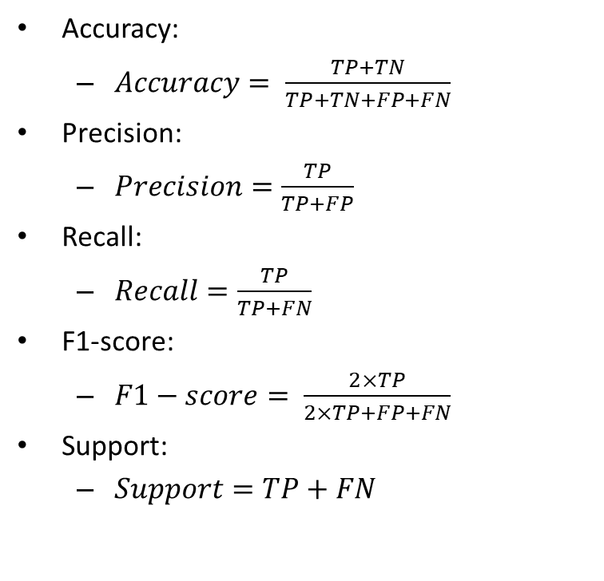
Accuracy, precision, recall, and F1-score
Accuracy:
  $Accuracy= \frac{TP+TN}{TP+TN+FP+FN}$
Precision:
  $Precision=\frac{TP}{TP+FP}$
Recall:
  $Recall=\frac{TP}{TP+FN}$
F1-score:
  $F1−score= \frac{2×TP}{2×TP+FP+FN}$
Support:
  $Support=TP+FN$

Slide 56
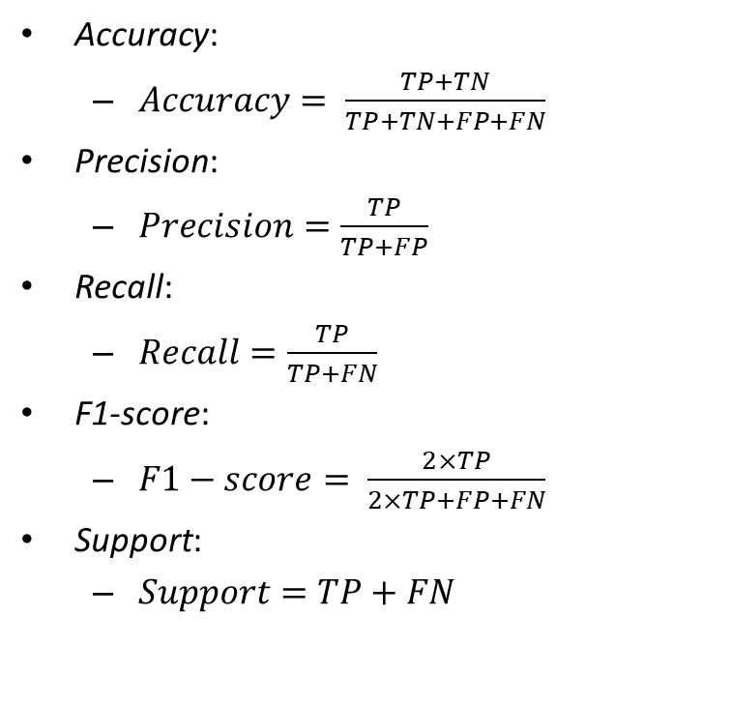
Accuracy, precision, recall, and F1-score
Accuracy:
  $Accuracy= \frac{TP+TN}{TP+TN+FP+FN}$
Precision:
  $Precision=\frac{TP}{TP+FP}$
Recall:
  $Recall=\frac{TP}{TP+FN}$
F1-score:
  $F1−score= \frac{2×TP}{2×TP+FP+FN}$
Support:
  $Support=TP+FN$
  How close the classification is to the true value.
  The ability not to classify a negative sample as positive.
  The ability to find all positive samples.
  The harmonic average between accuracy and sensitivity.
  The number of samples in the actual classes.
https://scikit-learn.org/stable/modules/generated/sklearn.metrics.precision_recall_fscore_support.html

Slide 57


Accuracy, precision, recall, and F1-score
Accuracy:
  $Accuracy= \frac{TP+TN}{TP+TN+FP+FN}$
Precision:
  $Precision=\frac{TP}{TP+FP}$
Recall:
  $Recall=\frac{TP}{TP+FN}$
F1-score:
  $F1−score= \frac{2×TP}{2×TP+FP+FN}$
Support:
  $Support=TP+FN$
Classes | TP | TN | FP | FN | Accuracy | Precision | Recall | F1-Score | Support
C1 | 5 | 17 | 2 | 3
C2 | 3 | 16 | 5 | 3
C3 | 11 | 13 | 1 | 2
MEAN
STD. DEV.

Slide 58
Accuracy, precision, recall, and F1-score
Accuracy:
  $Accuracy= \frac{TP+TN}{TP+TN+FP+FN}$
Precision:
  $Precision=\frac{TP}{TP+FP}$
Recall:
  $Recall=\frac{TP}{TP+FN}$
F1-score:
  $F1−score= \frac{2×TP}{2×TP+FP+FN}$
Support:
  $Support=TP+FN$
Classes | TP | TN | FP | FN | Accuracy | Precision | Recall | F1-Score | Support
C1 | 5 | 17 | 2 | 3 | 0.8148 | 0.7143 | 0.6250 | 0.6667 | 8
C2 | 3 | 16 | 5 | 3 | 0.7037 | 0.3750 | 0.5000 | 0.4286 | 6
C3 | 11 | 13 | 1 | 2 | 0.8889 | 0.9167 | 0.8462 | 0.8800 | 13
MEAN
STD. DEV.

Slide 59
Accuracy, precision, recall, and F1-score
Accuracy:
  $Accuracy= \frac{TP+TN}{TP+TN+FP+FN}$
Precision:
  $Precision=\frac{TP}{TP+FP}$
Recall:
  $Recall=\frac{TP}{TP+FN}$
F1-score:
  $F1−score= \frac{2×TP}{2×TP+FP+FN}$
Support:
  $Support=TP+FN$
Classes | TP | TN | FP | FN | Accuracy | Precision | Recall | F1-Score | Support
C1 | 5 | 17 | 2 | 3 | 0.8148 | 0.7143 | 0.6250 | 0.6667 | 8
C2 | 3 | 16 | 5 | 3 | 0.7037 | 0.3750 | 0.5000 | 0.4286 | 6
C3 | 11 | 13 | 1 | 2 | 0.8889 | 0.9167 | 0.8462 | 0.8800 | 13
MEAN |  |  |  |  | 0.8025 | 0.6687 | 0.6571 | 0.6584
STD. DEV. |  |  |  |  | 0.0761 | 0.2235 | 0.1431 | 0.1844

Slide 60
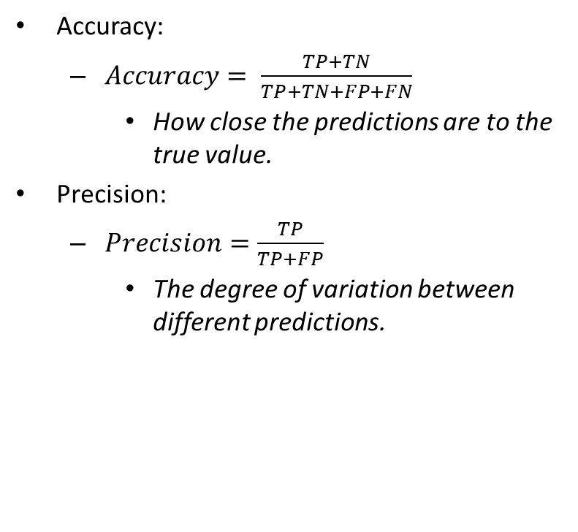
Accuracy Vs. Precision
Accuracy:
  $Accuracy= \frac{TP+TN}{TP+TN+FP+FN}$
    How close the predictions are to the true value.
Precision:
  $Precision=\frac{TP}{TP+FP}$
    The degree of variation between different predictions.
Precision
Accuracy

Slide 61
Bibliography
GONZALEZ, R.C.; WOODS, R.E. Digital Image Processing. 3rd ed. Pearson, 2007.
COSTA, L. DA F.; CESAR-JR., R. M. Shape analysis and classification : theory and practice. CRC Press, 2000. Capítulo 8.
Yann LeCun’, Alfredo Canziani. Yann LeCun’s Deep Learning Course at CDS - SPRING 2021
  https://cds.nyu.edu/deep-learning/
scikit-learn – User Guide.
  https://scikit-learn.org/stable/user_guide.html

Slide 62
THE END

