Slide 1
Aula 04 – Redes neurais artificiais
SIN 393 – Introdução à Visão Computacional (2023)
Prof. João Fernando Mari
joaofmari.github.io
joaof.mari@ufv.br

Slide 2
Roteiro
O neurônio biológico
O neurônio de McCulloch e Pitts
O Perceptron
Algoritmo de aprendizado do Perceptron
Exemplo: Perceptron de camada simples
Histórico das redes neurais

Slide 3
O neurônio biológico

Slide 4
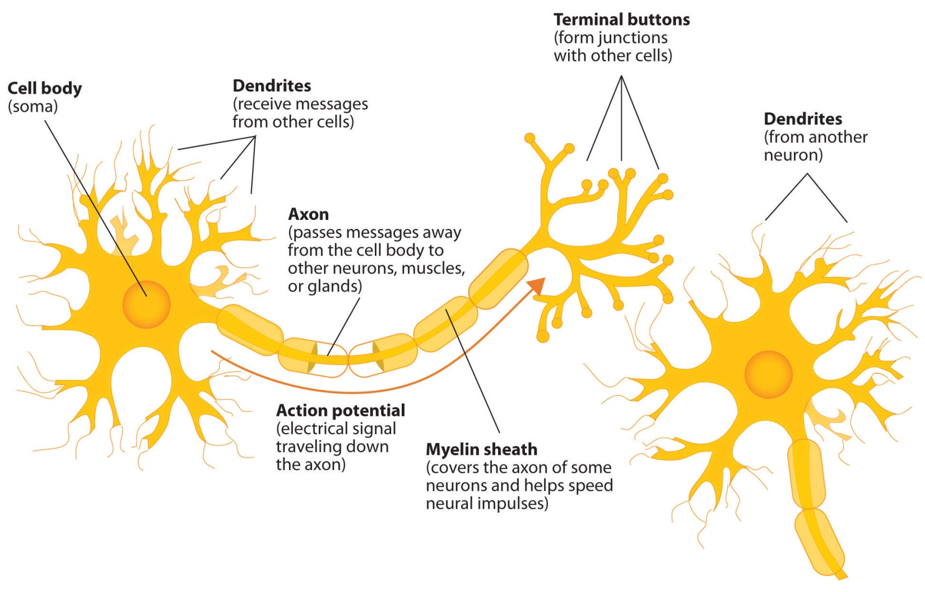
O neurônio biológico
Jennifer Walinga. “ Diagram of basic neuron and components”. BY-SA 4.0.

Slide 5
O neurônio de McCulloch e Pitts

Slide 6
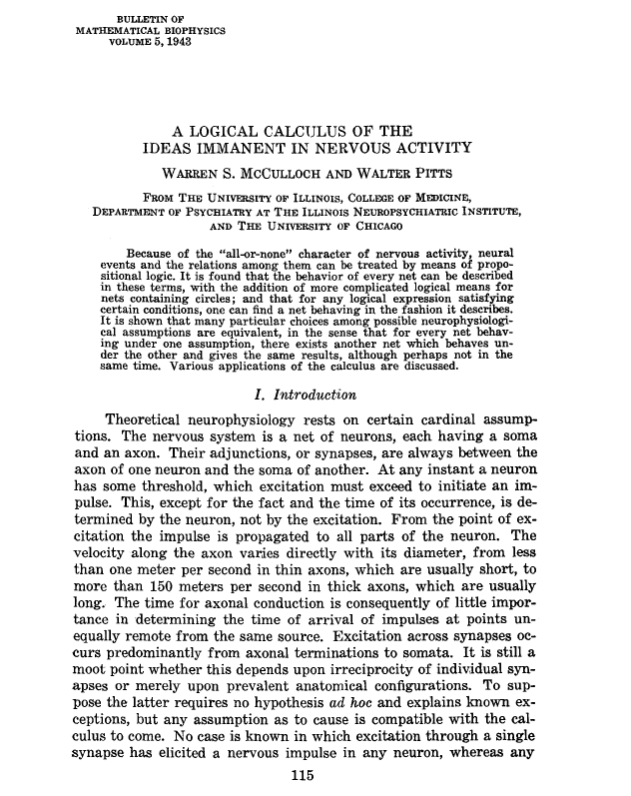
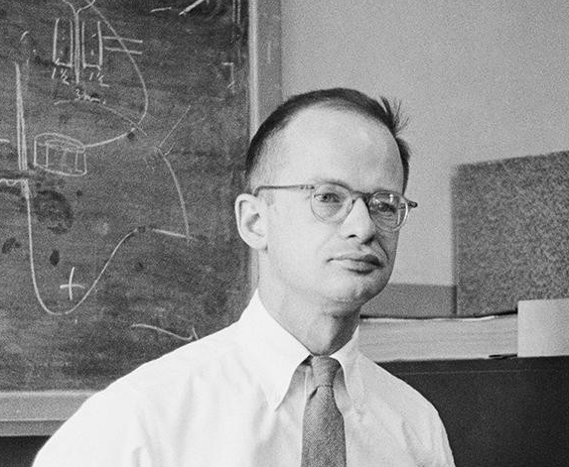
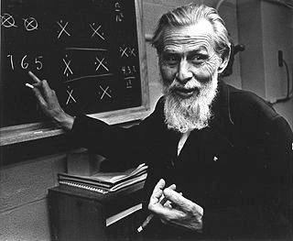
O neurônio de McCulloch e Pitts
Walter Pitts
(1923 – 1969)
Lógica e neurociência computacional
Warren McCulloch
(1898 – 1969)
Neurofisiologia

Slide 7
















O neurônio de McCulloch e Pitts
$$x$$
$$w$$
$$v, y$$
$$x_{0}$$
$$w_{0,0}^{}$$
$$x_{1}$$
$$w_{1,0}^{}$$
$${\hat{y}}_{0}$$
$$Σ$$
$$v_{0}$$
$$g\left(v\right)$$
$${\hat{y}}_{0}$$
$$v_{0}$$
...
$$w_{n−1,0}^{}$$
$$θ$$
$$x_{n−1}$$

Slide 8


O neurônio de McCulloch e Pitts
$$x$$
$$w$$
$$v, y$$
$$x_{0}$$
$$w_{0,0}^{}$$
$$x_{1}$$
$$w_{1,0}^{}$$
$${\hat{y}}_{0}$$
$$Σ$$
$$v_{0}$$
$$g\left(v\right)$$
$${\hat{y}}_{0}$$
$$v_{0}$$
...
$$w_{n−1,0}^{}$$
$$θ$$
$$x_{n−1}$$
$$v_{0}=\sum_{i=0}^{n−1}{w_{i,0}x_{i}+b_{0}}$$
$${\hat{y}}_{0}=g\left(v\right)= \left\{\begin{aligned}1, v≥θ \\ 0, v<θ \end{aligned}\right.$$

Slide 9

O neurônio de McCulloch e Pitts
$$x$$
$$w$$
$$v, y$$
$$x_{0}$$
NEURÔNIO
$$w_{0,0}^{}$$
$$x_{1}$$
$$w_{1,0}^{}$$
$${\hat{y}}_{0}$$
$$Σ$$
$$v_{0}$$
$$g\left(v\right)$$
$${\hat{y}}_{0}$$
$$v_{0}$$
...
$$w_{n−1,0}^{}$$
$$θ$$
$$x_{n−1}$$

Slide 10
O neurônio de McCulloch e Pitts
$$x$$
$$w$$
$$v, y$$
$$x_{0}$$
$$w_{0,0}^{}$$
$$x_{1}$$
$$w_{1,0}^{}$$
$${\hat{y}}_{0}$$
$$Σ$$
$$v_{0}$$
$$g\left(v\right)$$
$${\hat{y}}_{0}$$
$$v_{0}$$
...
$$w_{n−1,0}^{}$$
$$θ$$
$$x_{n−1}$$
pesos fixos...
entradas binárias...

Slide 11



O neurônio de McCulloch e Pitts
$$x$$
$$w$$
$$v, y$$
$$x_{0}$$
$$w_{0,0}^{}$$
$$x_{1}$$
$$w_{1,0}^{}$$
$${\hat{y}}_{0}$$
$$Σ$$
$$v_{0}$$
$$g\left(v\right)$$
$${\hat{y}}_{0}$$
$$v_{0}$$
...
$$w_{n−1,0}^{}$$
$$θ$$
$$x_{n−1}$$
Camada de entrada
Pesos sinápticos
Neurônio

Slide 12





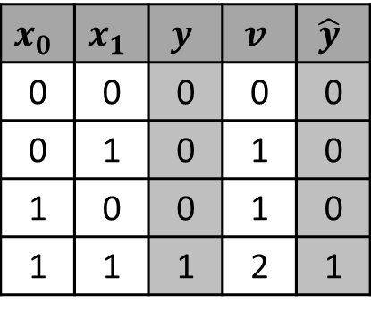




O neurônio de McCulloch e Pitts
AND
$$x_{0}$$
$$w_{0}^{}=1$$
$$x_{0}$$ | $$x_{1}$$ | $$y$$ | $$v$$ | $$\hat{y}$$
0 | 0 | 0 | 0 | 0
0 | 1 | 0 | 1 | 0
1 | 0 | 0 | 1 | 0
1 | 1 | 1 | 2 | 1
$$Σ$$
$$v_{0}$$
$$g\left(v\right)$$
$${\hat{y}}_{0}$$
$$w_{1}^{}=1$$
$$θ=2$$
$$x_{1}$$

Slide 13



O neurônio de McCulloch e Pitts
OR
$$x_{0}$$
$$w_{0}^{}=2$$
$$x_{0}$$ | $$x_{1}$$ | $$y$$ | $$v$$ | $$\hat{y}$$
0 | 0 | 0 | 0 | 0
0 | 1 | 1 | 2 | 1
1 | 0 | 1 | 2 | 1
1 | 1 | 1 | 4 | 1
$$Σ$$
$$v_{0}$$
$$g\left(v\right)$$
$${\hat{y}}_{0}$$
$$w_{1}^{}=2$$
$$θ=2$$
$$x_{1}$$

Slide 14
O Perceptron

Slide 15
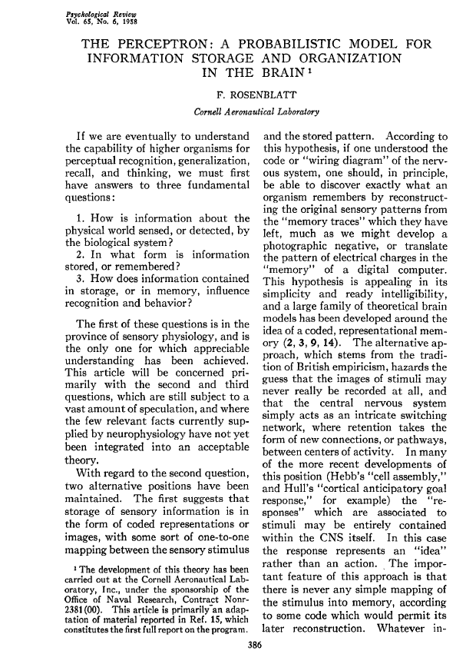
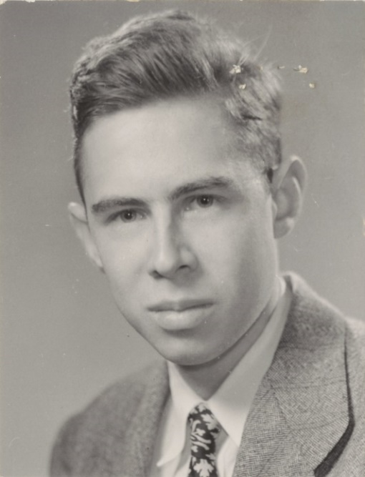
O Perceptron
Frank Rosenblatt
(1928 – 1971)
Psicologia
https://news.cornell.edu/stories/2019/09/professors-perceptron-paved-way-ai-60-years-too-soon

Slide 16
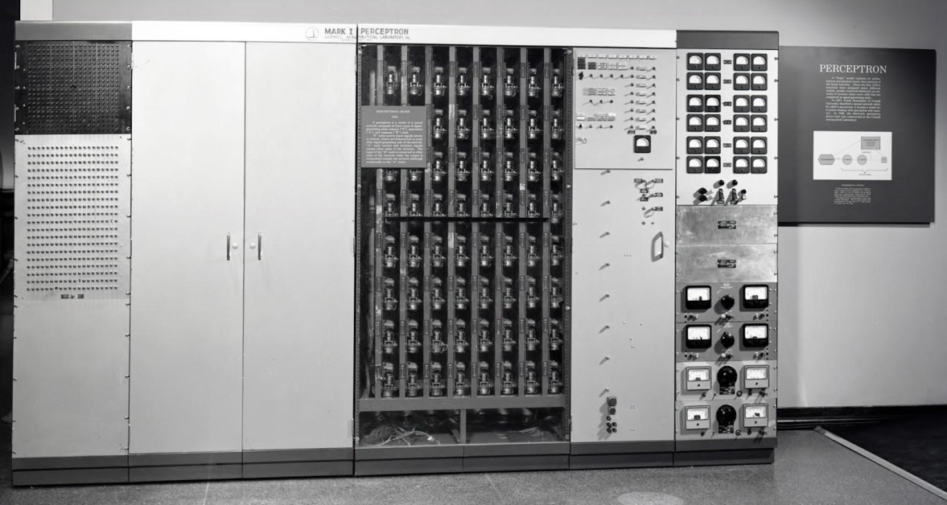
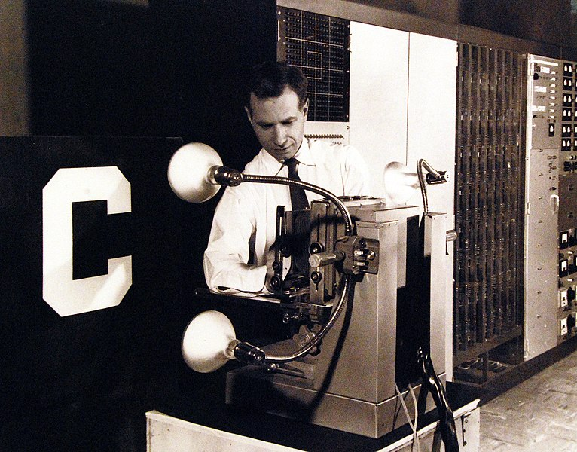
O Perceptron
Mark I Perceptron
National Museum of the U.S. Navy. Domínio público.
https://flickr.com/photos/127906254@N06/20897323365
https://ronkowitz.blogspot.com/2017/11/perceptron.html

Slide 17



















O Perceptron
$$x$$
$$w$$
$$v, y$$
$$y, e$$
$$x_{0}$$
$$1$$
$$y_{0}$$
$$w_{0,0}^{}$$
$$b_{0}^{}$$
$$x_{1}$$
$$w_{1,0}^{}$$
$${\hat{y}}_{0}$$
$$Σ$$
$$v_{0}$$
$$g\left(v\right)$$
$${\hat{y}}_{0}$$
$$e_{0}$$
$$v_{0}$$
...
$$w_{n−1,0}^{}$$
$$x_{n−1}$$

Slide 18


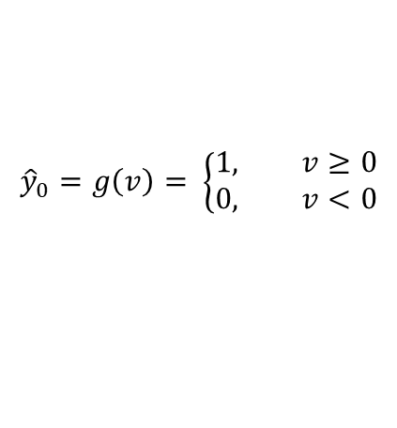


O Perceptron
$$x$$
$$w$$
$$v, y$$
$$y, e$$
$${\hat{y}}_{0}=g\left(v\right)= \left\{\begin{aligned}1, v≥0 \\ 0, v<0\end{aligned}\right.$$
$$x_{0}$$
$$1$$
$$b_{0}\left(t\right)={b_{0}\left(t−1\right)+ηe}_{0}$$
$$y_{0}$$
$$w_{0,0}^{}$$
$$b_{0}^{}$$
$$x_{1}$$
$$w_{1,0}^{}$$
$${\hat{y}}_{0}$$
$$Σ$$
$$v_{0}$$
$$g\left(v\right)$$
$${\hat{y}}_{0}$$
$$e_{0}$$
$$v_{0}$$
...
$$w_{n−1,0}^{}$$
$$v_{0}=\sum_{i=0}^{n−1}{w_{i,0}x_{i}+b_{0}}$$
$$x_{n−1}$$
$$e_{0}=y_{0}−{\hat{y}}_{0}$$
$w_{i,0}\left(t\right)={w_{i,0}\left(t−1\right)+η∆w}_{i,0}$, ${ ∆w}_{i,0}=e_{0}x_{i}$

Slide 19
O Perceptron
$$x$$
$$w$$
$$v, y$$
$$y, e$$
$$x_{0}$$
$$1$$
$$y_{0}$$
$$w_{0,0}^{}$$
$$b_{0}^{}$$
$$x_{1}$$
$$w_{1,0}^{}$$
$${\hat{y}}_{0}$$
$$Σ$$
$$v_{0}$$
$$g\left(v\right)$$
$${\hat{y}}_{0}$$
$$e_{0}$$
$$v_{0}$$
...
$$w_{n−1,0}^{}$$
pesos e bias ajustáveis...
$$x_{n−1}$$

Slide 20




O Perceptron
$$x$$
$$w$$
$$v, y$$
$$y, e$$
$$x_{0}$$
$$1$$
$$y_{0}$$
$$w_{0,0}^{}$$
$$b_{0}^{}$$
$$x_{1}$$
$$w_{1,0}^{}$$
$${\hat{y}}_{0}$$
$$Σ$$
$$v_{0}$$
$$g\left(v\right)$$
$${\hat{y}}_{0}$$
$$e_{0}$$
$$v_{0}$$
...
$$w_{n−1,0}^{}$$
$$x_{n−1}$$

Slide 21







O Perceptron
$$x$$
$$w$$
$$v, y$$
$$y, e$$
$$x_{1}=−\frac{w_{0,0}^{}}{w_{0,1}^{}}×x_{0}−\frac{b_{0}^{}}{w_{0,1}^{}}$$
$$x_{0}$$
$$1$$
$$y_{0}$$
$$x_{1}$$
$$w_{0,0}^{}$$
$$b_{0}^{}$$
${\hat{y}}_{0}$=1
$$Σ$$
$$v_{0}$$
$$g\left(v\right)$$
$${\hat{y}}_{0}$$
$$e_{0}$$
$$x_{0}$$
$$w_{1,0}^{}$$
${\hat{y}}_{0}$=0
$$x_{1}$$

Slide 22


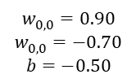






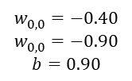





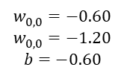



O Perceptron
$$x_{1}$$
$$x$$
$$w$$
$$v, y$$
$$w_{0,0}^{}=0.90$$
$$w_{0,0}^{}=−0.70$$
$$b=−0.50$$
$$w_{0,0}^{}=−0.40$$
$$w_{0,0}^{}=−0.90$$
$$b=0.90$$
$$x_{0}$$
$$w_{0,0}^{}$$
$$1$$
$$b_{0}^{}$$
$$Σ$$
$$v_{0}$$
$$g\left(v\right)$$
$${\hat{y}}_{0}$$
$$w_{0,0}^{}=−0.60$$
$$w_{0,0}^{}=−1.20$$
$$b=−0.60$$
$$w_{1,0}^{}$$
$$x_{0}$$
$$x_{1}$$
$$x_{1}=−\frac{w_{0,0}^{}}{w_{0,1}^{}}×x_{0}−\frac{b_{0}^{}}{w_{0,1}^{}}$$

Slide 23
Algoritmo de aprendizado do Perceptron

Slide 24




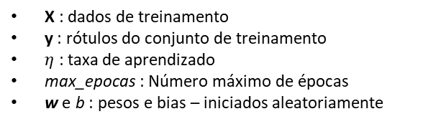















Algoritmo de aprendizado do Perceptron
Para t de 1 até max_epocas:
$e_{época}=0$
Para todo x, y em (X, y):
$v_{0}=\sum_{i=0}^{n−1}{w_{i,0}x_{i}+b_{0}}$
${\hat{y}}_{0}=g\left(v\right)= \left\{\begin{aligned}1, v≥0 \\ 0, v<0\end{aligned}\right.$
$e_{0}=y_{0}−{\hat{y}}_{0}$
${∆w}_{i,0}=e_{0}x_{i},$
$para i=0, 1, …, n−1$
$w_{i,0}\left(t\right)={w_{i,0}\left(t−1\right)+η∆w}_{i,0},$
$para i=0, 1, …, n−1$
$b_{0}\left(t\right)={b_{0}\left(t−1\right)+ηe}_{0}$
$e_{época}={e_{época}+\left(e_{0}\right)}^{2}$
$e_{época}=e_{época}/2$
Se $e_{época}<e_{mínimo}$, interromper o laço.
$$x$$
$$w$$
$$v, y$$
$$y, e$$
$$x_{0}$$
$$w_{0,0}^{}$$
$$1$$
$$y_{0}$$
$$b_{0}^{}$$
$$w_{1,0}^{}$$
$$x_{1}$$
$$v_{0}$$
$${\hat{y}}_{0}$$
$$Σ$$
$$g\left(v\right)$$
$$e_{0}$$
$$w_{n−1,0}^{}$$
...
$$x_{n−1}$$
X : dados de treinamento
y : rótulos do conjunto de treinamento
$η$ : taxa de aprendizado
max_epocas : Número máximo de épocas
w e b : pesos e bias – iniciados aleatoriamente

Slide 25

Algoritmo de aprendizado do Perceptron
Produto interno:
$v_{0}=\sum_{i=0}^{n−1}{w_{i,0}x_{i}+b_{0}}$
Função de ativação:
${\hat{y}}_{0}=g\left(v\right)= \left\{\begin{aligned}1, v≥0 \\ 0, v<0\end{aligned}\right.$
Erro:
$e_{0}=y_{0}−{\hat{y}}_{0}$
Valor utilizado para atualizar os pesos:
${∆w}_{i,0}=e_{0}x_{i}, para i=0, 1, …, n−1$
Atualização dos pesos:
$w_{i,0}\left(t\right)={w_{i,0}\left(t−1\right)+η∆w}_{i,0}, para i=0, 1, …, n−1$
Atualização do bias:
$b_{0}\left(t\right)={b_{0}\left(t−1\right)+ηe}_{0}$
$$x$$
$$w$$
$$v, y$$
$$y, e$$
$$x_{0}$$
$$w_{0,0}^{}$$
$$1$$
$$y_{0}$$
$$b_{0}^{}$$
$$w_{1,0}^{}$$
$$x_{1}$$
$$v_{0}$$
$${\hat{y}}_{0}$$
$$Σ$$
$$g\left(v\right)$$
$$e_{0}$$
$$w_{n−1,0}^{}$$
...
$$x_{n−1}$$

Slide 26
Exemplo: Perceptron de camada simples

Slide 27





Exemplo: Perceptron de camada simples
Época 0:
Iteração 0:
$x=\left[\begin{matrix}x_{0} & x_{1}\end{matrix}\right]=\left[\begin{matrix}0 & 0\end{matrix}\right]$
$w=\left[\begin{matrix}w_{0,0} \\ w_{1,0}\end{matrix}\right]=\left[\begin{matrix}0.1 \\ 0.2\end{matrix}\right]$, $b=\left[b_{0}\right]=\left[0.6\right]$
$v_{0}=xw+b_{0}=\left[\begin{matrix}0.0 & 0.0\end{matrix}\right]\left[\begin{matrix}0.1 \\ 0.2\end{matrix}\right]+0.6$
$v_{0}=0.0+0.6=0.6$
${\hat{y}}_{0}=1.0, pois v>0.0$
$e_{0}=y−\hat{y}=0.0−1.0=−1.0$
$∆w=ex=−1.0\left[\begin{matrix}0.0 & 0.0\end{matrix}\right]=\left[\begin{matrix}0.0 & 0.0\end{matrix}\right]$
$w\left(t\right)=w\left(t−1\right)+η∆w=\left[\begin{matrix}0.1 & 0.2\end{matrix}\right]+0.1\left[\begin{matrix}0.0 & 0.0\end{matrix}\right]$
$w\left(t\right)=\left[\begin{matrix}0.1 & 0.2\end{matrix}\right]$
$b_{0}\left(t\right)=b_{0}\left(t−1\right)+ηe_{0}=0.6+0.1×\left(−1.0\right)=0.$5
$e_{época}=e_{época}+{e_{0}}^{2}=0.0+{\left(−1.0\right)}^{2}=1.0$
$$x$$
$$w$$
$$v, y$$
$$y, e$$
0.0
$$x_{0}$$
$$1$$
$$w_{0,0}^{}$$
$$y_{0}$$
$$b_{0}^{}$$
0.6
0.1
$$Σ$$
$$v_{0}$$
$$g\left(v\right)$$
$${\hat{y}}_{0}$$
$$e_{0}$$
$$w_{1,0}^{}$$
0.0
0.2
AND
$$x_{1}$$
$$X=\left[\begin{matrix}0 & 0 \\ 0 & 1 \\ \begin{matrix}1 \\ 1\end{matrix} & \begin{matrix}0 \\ 1\end{matrix}\end{matrix}\right]$$
$$y=\left[\begin{matrix}0 & 0 & \begin{matrix}0 & 1\end{matrix}\end{matrix}\right]$$

Slide 28

Exemplo: Perceptron de camada simples
Época 0:
Iteração 1:
$x=\left[\begin{matrix}x_{0} & x_{1}\end{matrix}\right]=\left[\begin{matrix}0.0 & 1.0\end{matrix}\right]$
$w=\left[\begin{matrix}w_{0,0} \\ w_{1,0}\end{matrix}\right]=\left[\begin{matrix}0.1 \\ 0.2\end{matrix}\right]$, $b=\left[b_{0}\right]=\left[0.5\right]$
$v_{0}=xw+b_{0}=\left[\begin{matrix}0.0 & 1.0\end{matrix}\right]\left[\begin{matrix}0.1 \\ 0.2\end{matrix}\right]+0.$5
$v_{0}=0.2+0.5=0.7$
${\hat{y}}_{0}=1.0, pois v_{0}>0.0$
$e_{0}=y−\hat{y}=0.0−1.0=−1.0$
$∆w=ex=−1.0\left[\begin{matrix}0.0 & 1.0\end{matrix}\right]=\left[\begin{matrix}0.0 & −1.0\end{matrix}\right]$
$w\left(t\right)=w\left(t−1\right)+η∆w=\left[\begin{matrix}0.1 & 0.2\end{matrix}\right]+0.1\left[\begin{matrix}0.0 & −1.0\end{matrix}\right]$
$w\left(t\right)=\left[\begin{matrix}0.1 & 0.1\end{matrix}\right]$
$b_{0}\left(t\right)=b_{0}\left(t−1\right)+ηe_{0}=0.9+0.1×\left(−1.0\right)=0.$4
$e_{época}=e_{época}+{e_{0}}^{2}=1.0+{\left(−1.0\right)}^{2}=2.0$
$$x$$
$$w$$
$$v, y$$
$$y, e$$
0.0
$$x_{0}$$
$$1$$
$$w_{0,0}^{}$$
$$y_{0}$$
$$b_{0}^{}$$
0.5
0.1
$$Σ$$
$$v_{0}$$
$$g\left(v\right)$$
$${\hat{y}}_{0}$$
$$e_{0}$$
$$w_{1,0}^{}$$
1.0
0.2
AND
$$x_{1}$$
$$X=\left[\begin{matrix}0 & 0 \\ 0 & 1 \\ \begin{matrix}1 \\ 1\end{matrix} & \begin{matrix}0 \\ 1\end{matrix}\end{matrix}\right]$$
$$y=\left[\begin{matrix}0 & 0 & \begin{matrix}0 & 1\end{matrix}\end{matrix}\right]$$

Slide 29

Exemplo: Perceptron de camada simples
Época 0:
Iteração 2:
$x=\left[\begin{matrix}x_{0} & x_{1}\end{matrix}\right]=\left[1.\begin{matrix}0 & 0.0\end{matrix}\right]$
$w=\left[\begin{matrix}w_{0,0} \\ w_{1,0}\end{matrix}\right]=\left[\begin{matrix}0.1 \\ 0.1\end{matrix}\right]$, $b=\left[b_{0}\right]=\left[0.4\right]$
$v_{0}=xw+b_{0}=\left[1.\begin{matrix}0 & 0.0\end{matrix}\right]\left[\begin{matrix}0.1 \\ 0.1\end{matrix}\right]+0.4$
$v_{0}=0.1+0.4=0.5$
${\hat{y}}_{0}=1.0, pois{ v}_{0}>0.0$
$e_{0}=y−\hat{y}=0.0−1.0=−1.0$
$∆w=ex=−1.0\left[\begin{matrix}1.0 & 0.0\end{matrix}\right]=\left[\begin{matrix}−1.0 & 0.0\end{matrix}\right]$
$w\left(t\right)=w\left(t−1\right)+η∆w=\left[\begin{matrix}0.1 & 0.1\end{matrix}\right]+0.1\left[\begin{matrix}−1.0 & 0.0\end{matrix}\right]$
$w\left(t\right)=\left[\begin{matrix}0.0 & 0.1\end{matrix}\right]$
$b_{0}\left(t\right)=b_{0}\left(t−1\right)+ηe_{0}=0.4+0.1×\left(−1.0\right)=0.3$
$e_{época}=e_{época}+{e_{0}}^{2}=2.0+{\left(−1.0\right)}^{2}=3.0$
$$x$$
$$w$$
$$v, y$$
$$y, e$$
1.0
$$x_{0}$$
$$1$$
$$w_{0,0}^{}$$
$$y_{0}$$
$$b_{0}^{}$$
0.4
0.1
$$Σ$$
$$v_{0}$$
$$g\left(v\right)$$
$${\hat{y}}_{0}$$
$$e_{0}$$
$$w_{1,0}^{}$$
0.0
0.1
AND
$$x_{1}$$
$$X=\left[\begin{matrix}0 & 0 \\ 0 & 1 \\ \begin{matrix}1 \\ 1\end{matrix} & \begin{matrix}0 \\ 1\end{matrix}\end{matrix}\right]$$
$$y=\left[\begin{matrix}0 & 0 & \begin{matrix}0 & 1\end{matrix}\end{matrix}\right]$$

Slide 30

Exemplo: Perceptron de camada simples
Época 0:
Iteração 3:
$x=\left[\begin{matrix}x_{0} & x_{1}\end{matrix}\right]=\left[1.\begin{matrix}0 & 1.0\end{matrix}\right]$
$w=\left[\begin{matrix}w_{0,0} \\ w_{1,0}\end{matrix}\right]=\left[\begin{matrix}0.0 \\ 0.1\end{matrix}\right]$, $b=\left[b_{0}\right]=\left[0.3\right]$
$v_{0}=xw+b_{0}=\left[1.\begin{matrix}0 & 1.0\end{matrix}\right]\left[\begin{matrix}0.0 \\ 0.1\end{matrix}\right]+0.3$
$v_{0}=0.1+0.3=0.4$
${\hat{y}}_{0}=1.0, pois{ v}_{0}>0.0$
$e_{0}=y−\hat{y}=1.0−1.0=0.0$
$∆w=ex=0.0\left[\begin{matrix}1.0 & 1.0\end{matrix}\right]=\left[\begin{matrix}0.0 & 0.0\end{matrix}\right]$
$w\left(t\right)=w\left(t−1\right)+η∆w=\left[\begin{matrix}0.0 & 0.1\end{matrix}\right]+0.1\left[\begin{matrix}0.0 & 0.0\end{matrix}\right]$
$w\left(t\right)=\left[\begin{matrix}0.0 & 0.1\end{matrix}\right]$
$b_{0}\left(t\right)=b_{0}\left(t−1\right)+ηe_{0}=0.3+0.1×\left(0.0\right)=0.3$
$e_{época}=e_{época}+{e_{0}}^{2}=3.0+{\left(0.0\right)}^{2}=3.0$
$$x$$
$$w$$
$$v, y$$
$$y, e$$
1.0
$$x_{0}$$
$$1$$
$$w_{0,0}^{}$$
$$y_{0}$$
$$b_{0}^{}$$
0.3
0.0
$$Σ$$
$$v_{0}$$
$$g\left(v\right)$$
$${\hat{y}}_{0}$$
$$e_{0}$$
$$w_{1,0}^{}$$
1.0
0.1
AND
$$x_{1}$$
$$X=\left[\begin{matrix}0 & 0 \\ 0 & 1 \\ \begin{matrix}1 \\ 1\end{matrix} & \begin{matrix}0 \\ 1\end{matrix}\end{matrix}\right]$$
$$y=\left[\begin{matrix}0 & 0 & \begin{matrix}0 & 1\end{matrix}\end{matrix}\right]$$

Slide 31

Exemplo: Perceptron de camada simples
Fim da Época 0.
$e_{época}=\frac{e_{época}}{2}=\frac{3.0}{2}=1.5$
Época 1:
Iteração 0:
Repetir até atingir o limite de épocas ou o erro da época ficar abaixo de um limiar pré-definido...
$$x$$
$$w$$
$$v, y$$
$$y, e$$
0.0
$$x_{0}$$
$$1$$
$$w_{0,0}^{}$$
$$y_{0}$$
$$b_{0}^{}$$
?
?
$$Σ$$
$$v_{0}$$
$$g\left(v\right)$$
$${\hat{y}}_{0}$$
$$e_{0}$$
$$w_{1,0}^{}$$
...
0.0
?
AND
$$x_{1}$$
$$X=\left[\begin{matrix}0 & 0 \\ 0 & 1 \\ \begin{matrix}1 \\ 1\end{matrix} & \begin{matrix}0 \\ 1\end{matrix}\end{matrix}\right]$$
$$y=\left[\begin{matrix}0 & 0 & \begin{matrix}0 & 1\end{matrix}\end{matrix}\right]$$

Slide 32
Histórico das redes neurais

Slide 33
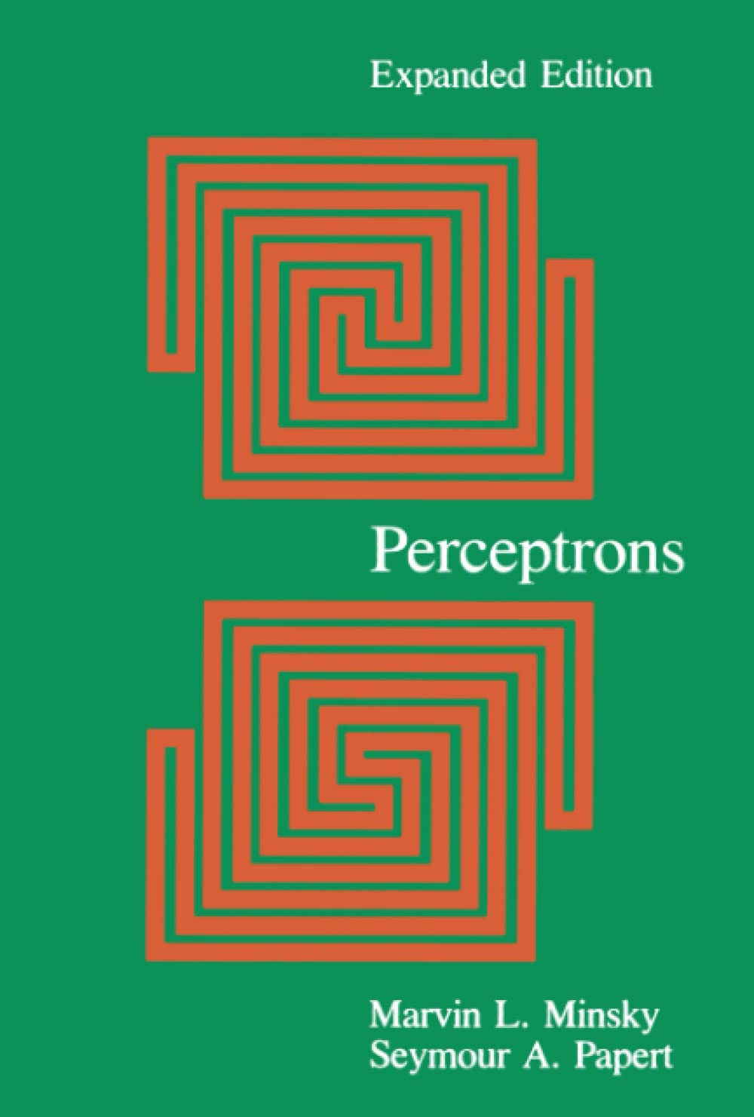
Histórico das redes neurais
Perceptrons: An Introduction to Computational Geometry
1969
Marvin Minsky, Seymour A. Papert
Critica às limitações do Perceptron
Incapacidade de lidar com problemas não lineares
XOR.
Forte influência no 1º inverno da IA (~1974 - ~1980)

Slide 34
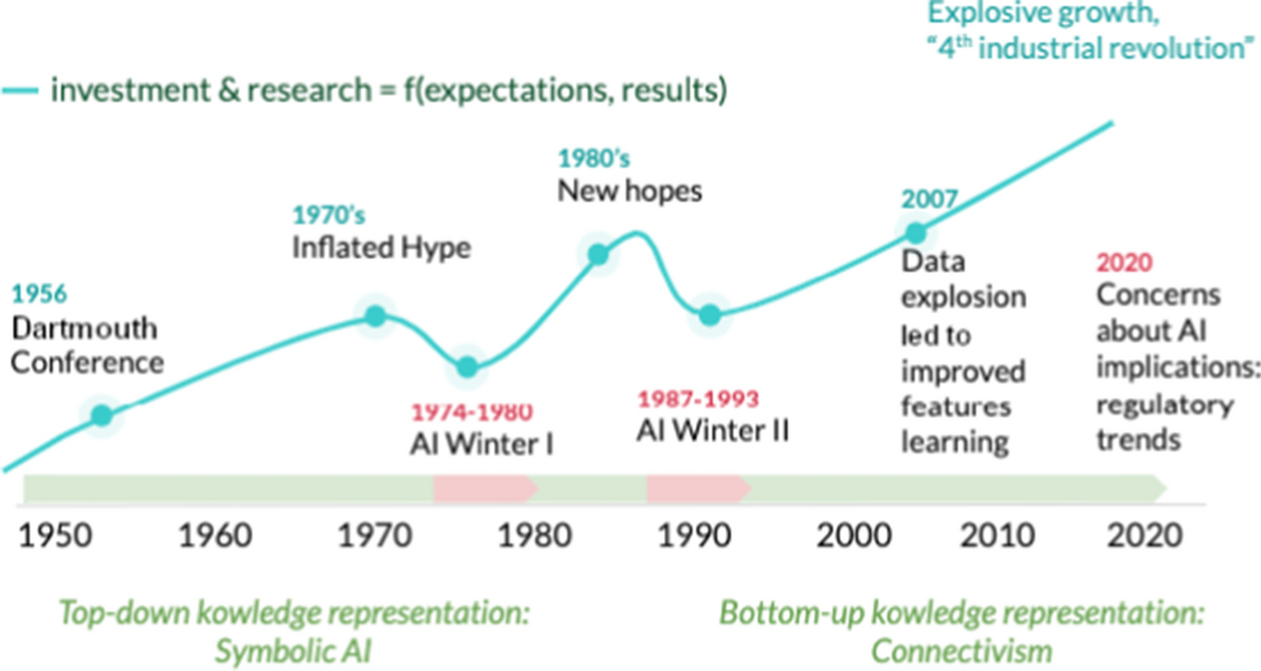
Histórico das redes neurais
Francesconi, E. The winter, the summer and the summer dream of artificial intelligence in law. Artif Intell Law 30, 147–161 (2022)

Slide 35
Bibliografia
Gonzalez, R.C.; Woods, R.E.; Processamento Digital de Imagens.
Editora Pearson. 3ª edição. 2009.
Ponti et al. Everything You Wanted to Know about Deep Learning for Computer Vision but Were Afraid to Ask. Sibgrapi 2017.
https://sites.icmc.usp.br/moacir/p17sibgrapi-tutorial/
Görner, M. Learn TensorFlow and deep learning, without a Ph.D.
https://cloud.google.com/blog/products/gcp/learn-tensorflow-and-deep-learning-without-a-phd
CS231n: Convolutional Neural Networks for Visual Recognition
http://cs231n.github.io/
Goodfellow, Bengio e Courville. Deep Learning. MIT Press, 2016
https://www.deeplearningbook.org/

Slide 36
Bibliografia
McCulloch, W.S., Pitts, W. A logical calculus of the ideas immanent in nervous activity.
Bulletin of Mathematical Biophysics 5, 115–133 (1943).
https://doi.org/10.1007/BF02478259
Rosenblatt, F. The perceptron: A probabilistic model for information storage and organization in the brain.
Psychological Review, 65(6), 386–408 (1958).
https://doi.org/10.1037/h0042519
Minsky, M.; Papert, S. A. Perceptrons: An Introduction to Computational Geometry.
The MIT Press, 2017
https://doi.org/10.7551/mitpress/11301.001.0001
Francesconi, E. The winter, the summer and the summer dream of artificial intelligence in law.
Artif Intell Law 30, 147–161 (2022)
https://link.springer.com/article/10.1007/s10506-022-09309-8

Slide 37
Bibliografia
Strickland, E. THE TURBULENT PAST AND UNCERTAIN FUTURE OF ARTIFICIAL INTELLIGENCE. Is there a way out of AI's boom-and-bust cycle?
IEEE Spectrum, 2021
https://spectrum.ieee.org/history-of-ai

Slide 38
FIM

