Slide 1
Aula 05 – Redes neurais artificiais e deep learning
SIN 393 – Introdução à Visão Computacional (2023)
Prof. João Fernando Mari
joaofmari.github.io
joaof.mari@ufv.br

Slide 2
Roteiro
Perceptron de múltiplas camadas
Arquitetura da rede
Backpropagation – Algoritmo e equações
Backpropagation – Funções e derivadas
Backpropagation – Exemplos

Slide 3
Perceptron de múltiplas camadas

Slide 4
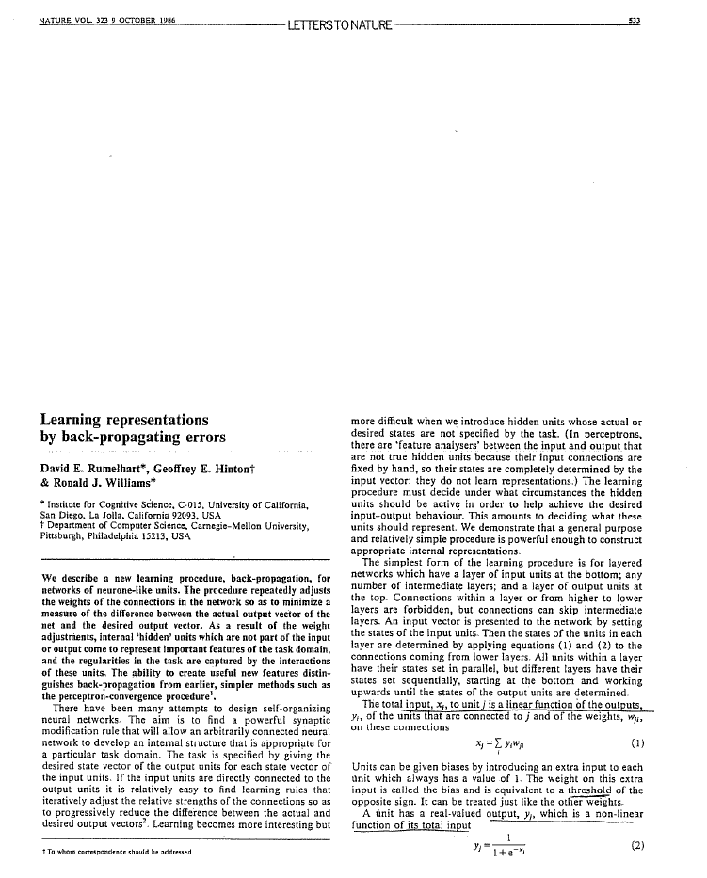
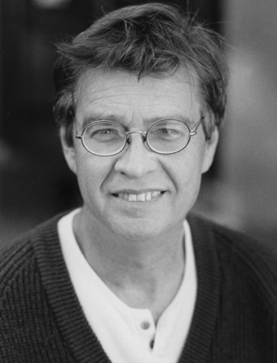
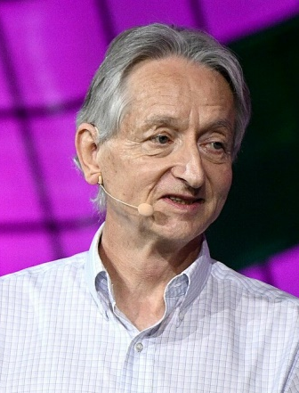
Perceptron de múltiplas camadas
David E. Rumelhart
(1942 – 2011)
Psicologia cognitiva
Geoffrey E. Hinton
(1947 - )
Psicologia cognitiva
Ciência da computação

Slide 5









































Perceptron de múltiplas camadas
$$W^{0}, b^{0}$$
$${ }_{ }v^{0}, y^{0}$$
$$W^{1}, b^{1}$$
$$v^{1}, y^{1}$$
1
$$b_{0}^{0}$$
$$v_{0}^{0}$$
$$y_{0}^{0}$$
$$Σ$$
g
$$w_{0,0}^{1}$$
1
$$w_{0,0}^{0}$$
$$b_{0}^{1}$$
$$w_{0,1}^{1}$$
$$v_{0}^{1}$$
$${\hat{y}}_{0}^{1}$$
$$x_{0}$$
$$w_{0,1}^{0}$$
1
$$Σ$$
g
$$l$$
$$b_{1}^{0}$$
$$w_{0,2}^{0}$$
$$v_{1}^{0}$$
$$y_{1}^{0}$$
$$w_{1,0}^{1}$$
$$L$$
$$Σ$$
g
1
$$w_{1,0}^{1}$$
$$w_{1,1}^{1}$$
$$b_{1}^{1}$$
$$v_{1}^{1}$$
$${\hat{y}}_{1}^{1}$$
$$x_{1}$$
$$w_{1,1}^{0}$$
1
$$Σ$$
g
$$w_{1,2}^{0}$$
$$b_{2}^{0}$$
$$w_{2,0}^{1}$$
$$v_{2}^{0}$$
$$y_{2}^{0}$$
$$Σ$$
g
$$w_{2,1}^{1}$$
$$[y_{0}^{},y_{1}^{}]$$

Slide 6












Perceptron de múltiplas camadas
$$W^{0}, b^{0}$$
$${ }_{ }v^{0}, y^{0}$$
$$W^{1}, b^{1}$$
$$v^{1}, y^{1}$$
$$l$$
1
$$b_{0}^{0}$$
$$v_{0}^{0}$$
$$y_{0}^{0}$$
$$Σ$$
g
$$w_{0,0}^{1}$$
1
$$w_{0,0}^{0}$$
$$b_{0}^{1}$$
$$w_{0,1}^{1}$$
$$v_{0}^{1}$$
$$y_{0}^{1}$$
$$x_{0}$$
$$w_{0,1}^{0}$$
1
$$Σ$$
g
$$l$$
$$b_{1}^{0}$$
$$w_{0,2}^{0}$$
$$v_{1}^{0}$$
$$y_{1}^{0}$$
$$w_{1,0}^{1}$$
$$L$$
$$Σ$$
g
1
$$w_{1,0}^{1}$$
$$w_{1,1}^{1}$$
$$b_{1}^{1}$$
$$v_{1}^{1}$$
$$y_{1}^{1}$$
$$x_{1}$$
$$w_{1,1}^{0}$$
1
$$Σ$$
g
$$w_{1,2}^{0}$$
$$b_{2}^{0}$$
$$w_{2,0}^{1}$$
$$v_{2}^{0}$$
$$y_{2}^{0}$$
$$Σ$$
g
$$w_{2,1}^{1}$$
$$[y_{0}^{},y_{1}^{}]$$

Slide 7
Arquitetura da rede

Slide 8








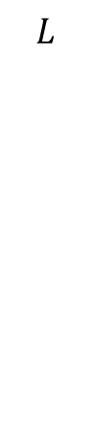





























Arquitetura da rede
$$x$$
$$W^{0}, b^{0}$$
$${ }_{ }v^{0}, y^{0}$$
$$W^{1}, b^{1}$$
$$v^{1}, y^{1}$$
$$L$$
1
$$b_{0}^{0}$$
$$v_{0}^{0}$$
$$y_{0}^{0}$$
$$Σ$$
g
1
$$w_{0,0}^{1}$$
$$b_{0}^{1}$$
$$w_{0,0}^{0}$$
$$w_{0,1}^{1}$$
$$v_{0}^{1}$$
$${\hat{y}}_{0}^{1}$$
$$x_{0}$$
$$w_{0,1}^{0}$$
1
$$Σ$$
g
$$l$$
$$b_{1}^{0}$$
$$w_{0,2}^{0}$$
$$v_{1}^{0}$$
$$y_{1}^{0}$$
$$w_{1,0}^{1}$$
$$L$$
$$Σ$$
g
1
$$w_{1,0}^{1}$$
$$b_{1}^{1}$$
$$w_{1,1}^{0}$$
$$w_{1,1}^{1}$$
$$v_{1}^{1}$$
$${\hat{y}}_{1}^{1}$$
$$x_{1}$$
1
$$w_{2,0}^{1}$$
$$Σ$$
g
$$b_{2}^{0}$$
$$w_{1,2}^{0}$$
$$v_{2}^{0}$$
$$y_{2}^{0}$$
$$Σ$$
g
$$w_{2,1}^{1}$$
$$[y_{0}^{},y_{1}^{}]$$
$$x=\left[\begin{matrix}x_{0} & x_{1}\end{matrix}\right]$$

Slide 9







Arquitetura da rede
$$x$$
$$W^{0}, b^{0}$$
$${ }_{ }v^{0}, y^{0}$$
$$W^{1}, b^{1}$$
$$v^{1}, y^{1}$$
$$L$$
1
$$b_{0}^{0}$$
$$v_{0}^{0}$$
$$y_{0}^{0}$$
$$Σ$$
g
1
$$w_{0,0}^{1}$$
$$b_{0}^{1}$$
$$w_{0,0}^{0}$$
$$w_{0,1}^{1}$$
$$v_{0}^{1}$$
$${\hat{y}}_{0}^{1}$$
$$x_{0}$$
$$w_{0,1}^{0}$$
1
$$Σ$$
g
$$l$$
$$b_{1}^{0}$$
$$w_{0,2}^{0}$$
$$v_{1}^{0}$$
$$y_{1}^{0}$$
$$w_{1,0}^{1}$$
$$L$$
$$Σ$$
g
1
$$w_{1,0}^{1}$$
$$b_{1}^{1}$$
$$w_{1,1}^{0}$$
$$w_{1,1}^{1}$$
$$v_{1}^{1}$$
$${\hat{y}}_{1}^{1}$$
$$x_{1}$$
1
$$w_{2,0}^{1}$$
$$Σ$$
g
$$b_{2}^{0}$$
$$w_{1,2}^{0}$$
$$v_{2}^{0}$$
$$y_{2}^{0}$$
$$Σ$$
g
$$w_{2,1}^{1}$$
$$[y_{0}^{},y_{1}^{}]$$
$$W_{}^{0}=\left[\begin{matrix}w_{0,0}^{0} & w_{0,1}^{0} & w_{0,2}^{0} \\ w_{1,0}^{0} & w_{1,1}^{0} & w_{1,2}^{0}\end{matrix}\right]$$
$$v_{}^{0}=\left[\begin{matrix}v_{0}^{0} & v_{1}^{0} & v_{2}^{0}\end{matrix}\right]$$
$$x=\left[\begin{matrix}x_{0} & x_{1}\end{matrix}\right]$$
$$y_{}^{0}=\left[\begin{matrix}y_{0}^{0} & y_{1}^{0} & y_{2}^{0}\end{matrix}\right]$$
$$b_{}^{0}=\left[\begin{matrix}b_{0}^{0} & b_{1}^{0} & b_{2}^{0}\end{matrix}\right]$$

Slide 10
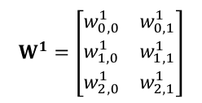





Arquitetura da rede
$$x$$
$$W^{0}, b^{0}$$
$${ }_{ }v^{0}, y^{0}$$
$$W^{1}, b^{1}$$
$$v^{1}, y^{1}$$
$$L$$
1
$$b_{0}^{0}$$
$$v_{0}^{0}$$
$$y_{0}^{0}$$
$$Σ$$
g
1
$$w_{0,0}^{1}$$
$$b_{0}^{1}$$
$$w_{0,0}^{0}$$
$$w_{0,1}^{1}$$
$$v_{0}^{1}$$
$${\hat{y}}_{0}^{1}$$
$$x_{0}$$
$$w_{0,1}^{0}$$
1
$$Σ$$
g
$$l$$
$$b_{1}^{0}$$
$$w_{0,2}^{0}$$
$$v_{1}^{0}$$
$$y_{1}^{0}$$
$$w_{1,0}^{1}$$
$$L$$
$$Σ$$
g
1
$$w_{1,0}^{1}$$
$$b_{1}^{1}$$
$$w_{1,1}^{0}$$
$$w_{1,1}^{1}$$
$$v_{1}^{1}$$
$${\hat{y}}_{1}^{1}$$
$$x_{1}$$
1
$$w_{2,0}^{1}$$
$$Σ$$
g
$$b_{2}^{0}$$
$$w_{1,2}^{0}$$
$$v_{2}^{0}$$
$$y_{2}^{0}$$
$$Σ$$
g
$$w_{2,1}^{1}$$
$$[y_{0}^{},y_{1}^{}]$$
$$W_{}^{1}=\left[\begin{matrix}w_{0,0}^{1} & w_{0,1}^{1} \\ w_{1,0}^{1} & w_{1,1}^{1} \\ w_{2,0}^{1} & w_{2,1}^{1}\end{matrix}\right]$$
$$W_{}^{0}=\left[\begin{matrix}w_{0,0}^{0} & w_{0,1}^{0} & w_{0,2}^{0} \\ w_{1,0}^{0} & w_{1,1}^{0} & w_{1,2}^{0}\end{matrix}\right]$$
$$v_{}^{0}=\left[\begin{matrix}v_{0}^{0} & v_{1}^{0} & v_{2}^{0}\end{matrix}\right]$$
$$v_{}^{1}=\left[\begin{matrix}v_{0}^{1} & v_{1}^{1}\end{matrix}\right]$$
$$x=\left[\begin{matrix}x_{0} & x_{1}\end{matrix}\right]$$
$$y_{}^{0}=\left[\begin{matrix}y_{0}^{0} & y_{1}^{0} & y_{2}^{0}\end{matrix}\right]$$
$${\hat{y}}_{}^{1}=\left[\begin{matrix}{\hat{y}}_{0}^{1} & {\hat{y}}_{1}^{1}\end{matrix}\right]$$
$$b_{}^{0}=\left[\begin{matrix}b_{0}^{0} & b_{1}^{0} & b_{2}^{0}\end{matrix}\right]$$
$$b_{}^{1}=\left[\begin{matrix}b_{0}^{1} & b_{1}^{1}\end{matrix}\right]$$

Slide 11




Arquitetura da rede
$$x$$
$$W^{0}, b^{0}$$
$${ }_{ }v^{0}, y^{0}$$
$$W^{1}, b^{1}$$
$$v^{1}, y^{1}$$
$$L$$
1
$$b_{0}^{0}$$
$$v_{0}^{0}$$
$$y_{0}^{0}$$
$$Σ$$
g
1
$$w_{0,0}^{1}$$
$$b_{0}^{1}$$
$$w_{0,0}^{0}$$
$$w_{0,1}^{1}$$
$$v_{0}^{1}$$
$${\hat{y}}_{0}^{1}$$
$$x_{0}$$
$$w_{0,1}^{0}$$
1
$$Σ$$
g
$$l$$
$$b_{1}^{0}$$
$$w_{0,2}^{0}$$
$$v_{1}^{0}$$
$$y_{1}^{0}$$
$$w_{1,0}^{1}$$
$$L$$
$$Σ$$
g
1
$$w_{1,0}^{1}$$
$$b_{1}^{1}$$
$$w_{1,1}^{0}$$
$$w_{1,1}^{1}$$
$$v_{1}^{1}$$
$${\hat{y}}_{1}^{1}$$
$$x_{1}$$
1
$$w_{2,0}^{1}$$
$$Σ$$
g
$$b_{2}^{0}$$
$$w_{1,2}^{0}$$
$$v_{2}^{0}$$
$$y_{2}^{0}$$
$$Σ$$
g
$$w_{2,1}^{1}$$
$$[y_{0}^{},y_{1}^{}]$$
$$W_{}^{1}=\left[\begin{matrix}w_{0,0}^{1} & w_{0,1}^{1} \\ w_{1,0}^{1} & w_{1,1}^{1} \\ w_{2,0}^{1} & w_{2,1}^{1}\end{matrix}\right]$$
$$W_{}^{0}=\left[\begin{matrix}w_{0,0}^{0} & w_{0,1}^{0} & w_{0,2}^{0} \\ w_{1,0}^{0} & w_{1,1}^{0} & w_{1,2}^{0}\end{matrix}\right]$$
$$v_{}^{0}=\left[\begin{matrix}v_{0}^{0} & v_{1}^{0} & v_{2}^{0}\end{matrix}\right]$$
$$v_{}^{1}=\left[\begin{matrix}v_{0}^{1} & v_{1}^{1}\end{matrix}\right]$$
$$x=\left[\begin{matrix}x_{0} & x_{1}\end{matrix}\right]$$
$$y_{}^{0}=\left[\begin{matrix}y_{0}^{0} & y_{1}^{0} & y_{2}^{0}\end{matrix}\right]$$
$${\hat{y}}_{}^{1}=\left[\begin{matrix}{\hat{y}}_{0}^{1} & {\hat{y}}_{1}^{1}\end{matrix}\right]$$
$$y=\left[\begin{matrix}y_{0}^{} & y_{1}^{}\end{matrix}\right]$$
$$b_{}^{0}=\left[\begin{matrix}b_{0}^{0} & b_{1}^{0} & b_{2}^{0}\end{matrix}\right]$$
$$b_{}^{1}=\left[\begin{matrix}b_{0}^{1} & b_{1}^{1}\end{matrix}\right]$$
$$l=\left[\begin{matrix}l_{0}^{} & l_{1}^{}\end{matrix}\right]$$
$$L=l_{0}+l_{1}$$

Slide 12
Arquitetura da rede
$$x$$
$$W^{0}, b^{0}$$
$${ }_{ }v^{0}, y^{0}$$
$$W^{1}, b^{1}$$
$$v^{1}, y^{1}$$
$$L$$
1
$$b_{0}^{0}$$
$$v_{0}^{0}$$
$$y_{0}^{0}$$
$$Σ$$
g
1
$$w_{0,0}^{1}$$
$$b_{0}^{1}$$
$$w_{0,0}^{0}$$
$$w_{0,1}^{1}$$
$$v_{0}^{1}$$
$${\hat{y}}_{0}^{1}$$
$$x_{0}$$
$$w_{0,1}^{0}$$
1
$$Σ$$
g
$$l$$
$$b_{1}^{0}$$
$$w_{0,2}^{0}$$
$$v_{1}^{0}$$
$$y_{1}^{0}$$
$$w_{1,0}^{1}$$
$$L$$
$$Σ$$
g
1
$$w_{1,0}^{1}$$
$$b_{1}^{1}$$
$$w_{1,1}^{0}$$
$$w_{1,1}^{1}$$
$$v_{1}^{1}$$
$${\hat{y}}_{1}^{1}$$
$$x_{1}$$
1
$$w_{2,0}^{1}$$
$$Σ$$
g
$$b_{2}^{0}$$
$$w_{1,2}^{0}$$
$$v_{2}^{0}$$
$$y_{2}^{0}$$
$$Σ$$
g
$$w_{2,1}^{1}$$
$$[y_{0}^{},y_{1}^{}]$$
$$W_{}^{1}=\left[\begin{matrix}w_{0,0}^{1} & w_{0,1}^{1} \\ w_{1,0}^{1} & w_{1,1}^{1} \\ w_{2,0}^{1} & w_{2,1}^{1}\end{matrix}\right]$$
$$W_{}^{0}=\left[\begin{matrix}w_{0,0}^{0} & w_{0,1}^{0} & w_{0,2}^{0} \\ w_{1,0}^{0} & w_{1,1}^{0} & w_{1,2}^{0}\end{matrix}\right]$$
$$v_{}^{0}=\left[\begin{matrix}v_{0}^{0} & v_{1}^{0} & v_{2}^{0}\end{matrix}\right]$$
$$v_{}^{1}=\left[\begin{matrix}v_{0}^{1} & v_{1}^{1}\end{matrix}\right]$$
$$x=\left[\begin{matrix}x_{0} & x_{1}\end{matrix}\right]$$
$$y_{}^{0}=\left[\begin{matrix}y_{0}^{0} & y_{1}^{0} & y_{2}^{0}\end{matrix}\right]$$
$${\hat{y}}_{}^{1}=\left[\begin{matrix}{\hat{y}}_{0}^{1} & {\hat{y}}_{1}^{1}\end{matrix}\right]$$
$$y=\left[\begin{matrix}y_{0}^{} & y_{1}^{}\end{matrix}\right]$$
$$b_{}^{0}=\left[\begin{matrix}b_{0}^{0} & b_{1}^{0} & b_{2}^{0}\end{matrix}\right]$$
$$b_{}^{1}=\left[\begin{matrix}b_{0}^{1} & b_{1}^{1}\end{matrix}\right]$$
$$l=\left[\begin{matrix}l_{0}^{} & l_{1}^{}\end{matrix}\right]$$
$$L=l_{0}+l_{1}$$

Slide 13
Backpropagation – Algoritmo e equações

Slide 14




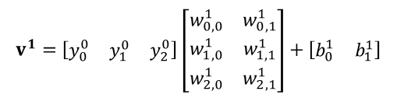


















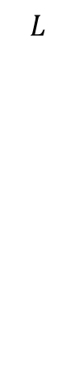










Backpropagation – Algoritmo e equações
$$x$$
$$W^{0}, b^{0}$$
$${ }_{ }v^{0}, y^{0}$$
$$W^{1}, b^{1}$$
$$v^{1}, y^{1}$$
$$L$$
1
$$b_{0}^{0}$$
$$v_{0}^{0}$$
$$y_{0}^{0}$$
$$Σ$$
g
1
$$w_{0,0}^{1}$$
$$b_{0}^{1}$$
$$w_{0,0}^{0}$$
$$w_{0,1}^{1}$$
$$v_{0}^{1}$$
$${\hat{y}}_{0}^{1}$$
$$x_{0}$$
$$w_{0,1}^{0}$$
1
$$Σ$$
g
$$l$$
$$b_{1}^{0}$$
$$w_{0,2}^{0}$$
$$v_{1}^{0}$$
$$y_{1}^{0}$$
$$w_{1,0}^{1}$$
$$L$$
$$Σ$$
g
1
$$w_{1,0}^{1}$$
$$b_{1}^{1}$$
$$w_{1,1}^{0}$$
$$w_{1,1}^{1}$$
$$v_{1}^{1}$$
$${\hat{y}}_{1}^{1}$$
$$x_{1}$$
1
$$w_{2,0}^{1}$$
$$Σ$$
g
$$b_{2}^{0}$$
$$w_{1,2}^{0}$$
$$v_{2}^{0}$$
$$y_{2}^{0}$$
$$Σ$$
g
$$w_{2,1}^{1}$$
$$[y_{0}^{},y_{1}^{}]$$
$$v^{0}=xW^{0}+b^{0}$$
$$y^{0}=g^{0}\left(v^{0}\right)$$
$$v^{1}=y^{0}W^{1}+b^{1}$$
$$y^{1}=g^{1}\left(v^{1}\right)$$
$$l=l\left(y,{\hat{y}}^{1}\right)$$
$$L=l_{0}+l_{1}$$
$$v_{}^{0}=\left[\begin{matrix}x_{0} & x_{1}\end{matrix}\right]\left[\begin{matrix}w_{0,0}^{0} & w_{0,1}^{0} & w_{0,2}^{0} \\ w_{1,0}^{0} & w_{1,1}^{0} & w_{1,2}^{0}\end{matrix}\right]+\left[\begin{matrix}b_{0}^{0} & b_{1}^{0} & b_{2}^{0}\end{matrix}\right]$$
$$v_{}^{0}=\left[\begin{matrix}{x_{0}w_{0,0}^{0}+x_{1}w_{1,0}^{0}+b}_{0}^{0} & {x_{0}w_{0,1}^{0}+x_{1}w_{1,1}^{0}+b}_{1}^{0} & {x_{0}w_{0,2}^{0}+x_{1}w_{1,2}^{0}+b}_{2}^{0}\end{matrix}\right]$$
$$y_{}^{0}=\left[\begin{matrix}g(v_{0}^{0}) & g(v_{1}^{0}) & g(v_{2}^{0})\end{matrix}\right]$$
$$v_{}^{1}=\left[\begin{matrix}y_{0}^{0} & y_{1}^{0} & y_{2}^{0}\end{matrix}\right]\left[\begin{matrix}w_{0,0}^{1} & w_{0,1}^{1} \\ w_{1,0}^{1} & w_{1,1}^{1} \\ w_{2,0}^{1} & w_{2,1}^{1}\end{matrix}\right]+\left[\begin{matrix}b_{0}^{1} & b_{1}^{1}\end{matrix}\right]$$
$$v_{}^{1}=\left[\begin{matrix}{y_{0}^{0}w_{0,0}^{1}+y_{1}^{0}w_{1,0}^{1}+y_{2}^{0}w_{2,0}^{1}+b}_{0}^{1} & y_{0}^{0}w_{0,1}^{1}+y_{1}^{0}w_{1,1}^{1}+y_{2}^{0}w_{2,1}^{1}+b_{1}^{1}\end{matrix}\right]$$
$${\hat{y}}_{}^{1}=\left[\begin{matrix}g(v_{0}^{1}) & g(v_{1}^{1})\end{matrix}\right]$$

Slide 15




























Backpropagation – Algoritmo e equações
$$x$$
$$W^{0}, b^{0}$$
$${ }_{ }v^{0}, y^{0}$$
$$W^{1}, b^{1}$$
$$v^{1}, y^{1}$$
$$L$$
1
$$b_{0}^{0}$$
$$v_{0}^{0}$$
$$y_{0}^{0}$$
$$Σ$$
g
1
$$w_{0,0}^{1}$$
$$b_{0}^{1}$$
$$w_{0,0}^{0}$$
$$w_{0,1}^{1}$$
$$v_{0}^{1}$$
$${\hat{y}}_{0}^{1}$$
$$x_{0}$$
$$w_{0,1}^{0}$$
1
$$Σ$$
g
$$l$$
$$b_{1}^{0}$$
$$w_{0,2}^{0}$$
$$v_{1}^{0}$$
$$y_{1}^{0}$$
$$w_{1,0}^{1}$$
$$L$$
$$Σ$$
g
1
$$w_{1,0}^{1}$$
$$b_{1}^{1}$$
$$w_{1,1}^{0}$$
$$w_{1,1}^{1}$$
$$v_{1}^{1}$$
$${\hat{y}}_{1}^{1}$$
$$x_{1}$$
1
$$w_{2,0}^{1}$$
$$Σ$$
g
$$b_{2}^{0}$$
$$w_{1,2}^{0}$$
$$v_{2}^{0}$$
$$y_{2}^{0}$$
$$Σ$$
g
$$w_{2,1}^{1}$$
$$[y_{0}^{},y_{1}^{}]$$
$$\frac{∂L}{∂W^{0}}=\frac{∂L}{∂y^{0}}×\frac{∂y^{0}}{∂v^{0}}×\frac{∂v^{0}}{∂W^{0}}$$
$$\frac{∂L}{∂b^{0}}=\frac{∂L}{∂y^{0}}×\frac{∂y^{0}}{∂v^{0}}×\frac{∂v^{0}}{∂b^{0}}$$
$$\frac{∂L}{∂W^{1}}=\frac{∂L}{∂{\hat{y}}^{1}}×\frac{∂{\hat{y}}^{1}}{∂v^{1}}×\frac{∂v^{1}}{∂W^{1}}$$
$$\frac{∂L}{∂b^{1}}=\frac{∂L}{∂{\hat{y}}^{1}}×\frac{∂{\hat{y}}^{1}}{∂v^{1}}×\frac{∂v^{1}}{∂b^{1}}$$
$$\frac{∂L}{∂y^{0}}=\frac{∂L}{∂{\hat{y}}^{1}}×\frac{∂{\hat{y}}^{1}}{∂v^{1}}×\frac{∂v^{0}}{∂y^{0}}$$

Slide 16





Backpropagation – Algoritmo e equações
$$x$$
$$W^{0}, b^{0}$$
$${ }_{ }v^{0}, y^{0}$$
$$W^{1}, b^{1}$$
$$v^{1}, y^{1}$$
$$L$$
$$\frac{∂L}{∂W^{1}}=\frac{∂L}{∂{\hat{y}}^{1}}×\frac{∂{\hat{y}}^{1}}{∂v^{1}}×\frac{∂v^{1}}{∂W^{1}}$$
1
$$\frac{∂v^{1}}{∂W^{1}}$$
$$b_{0}^{0}$$
$$\frac{∂{\hat{y}}^{1}}{∂v^{1}}$$
$$\frac{∂L}{∂{\hat{y}}^{1}}$$
$$v_{0}^{0}$$
$$y_{0}^{0}$$
$$Σ$$
g
1
$$w_{0,0}^{1}$$
$$b_{0}^{1}$$
$$w_{0,0}^{0}$$
$$w_{0,1}^{1}$$
$$v_{0}^{1}$$
$${\hat{y}}_{0}^{1}$$
$$x_{0}$$
$$w_{0,1}^{0}$$
1
$$Σ$$
g
$$l$$
$$b_{1}^{0}$$
$$v_{1}^{0}$$
$$y_{1}^{0}$$
$$w_{1,0}^{1}$$
$$L$$
$$Σ$$
g
1
$$w_{1,0}^{1}$$
$$b_{1}^{1}$$
$$w_{1,1}^{0}$$
$$w_{1,1}^{1}$$
$$v_{1}^{1}$$
$${\hat{y}}_{1}^{1}$$
$$x_{1}$$
$$w_{0,2}^{0}$$
1
$$w_{2,0}^{1}$$
$$Σ$$
g
$$b_{2}^{0}$$
$$v_{2}^{0}$$
$$y_{2}^{0}$$
$$w_{1,2}^{0}$$
$$Σ$$
g
$$w_{2,1}^{1}$$
$$[y_{0}^{},y_{1}^{}]$$
$$\frac{∂L}{∂W^{0}}=\frac{∂L}{∂y^{0}}×\frac{∂y^{0}}{∂v^{0}}×\frac{∂v^{0}}{∂W^{0}}$$
$$\frac{∂L}{∂b^{0}}=\frac{∂L}{∂y^{0}}×\frac{∂y^{0}}{∂v^{0}}×\frac{∂v^{0}}{∂b^{0}}$$
$$\frac{∂L}{∂W^{1}}=\frac{∂L}{∂{\hat{y}}^{1}}×\frac{∂{\hat{y}}^{1}}{∂v^{1}}×\frac{∂v^{1}}{∂W^{1}}$$
$$\frac{∂L}{∂b^{1}}=\frac{∂L}{∂{\hat{y}}^{1}}×\frac{∂{\hat{y}}^{1}}{∂v^{1}}×\frac{∂v^{1}}{∂b^{1}}$$
$$\frac{∂L}{∂y^{0}}=\frac{∂L}{∂{\hat{y}}^{1}}×\frac{∂{\hat{y}}^{1}}{∂v^{1}}×\frac{∂v^{0}}{∂y^{0}}$$

Slide 17




Backpropagation – Algoritmo e equações
$$x$$
$$W^{0}, b^{0}$$
$${ }_{ }v^{0}, y^{0}$$
$$W^{1}, b^{1}$$
$$v^{1}, y^{1}$$
$$L$$
$$\frac{∂L}{∂b^{1}}=\frac{∂L}{∂{\hat{y}}^{1}}×\frac{∂{\hat{y}}^{1}}{∂v^{1}}×\frac{∂v^{1}}{∂b^{1}}$$
1
$$\frac{∂v^{1}}{∂b^{1}}$$
$$\frac{∂{\hat{y}}^{1}}{∂v^{1}}$$
$$\frac{∂L}{∂{\hat{y}}^{1}}$$
$$b_{0}^{0}$$
$$v_{0}^{0}$$
$$y_{0}^{0}$$
$$Σ$$
g
1
$$w_{0,0}^{1}$$
$$b_{0}^{1}$$
$$w_{0,0}^{0}$$
$$w_{0,1}^{1}$$
$$v_{0}^{1}$$
$${\hat{y}}_{0}^{1}$$
$$x_{0}$$
$$w_{0,1}^{0}$$
1
$$Σ$$
g
$$l$$
$$b_{1}^{0}$$
$$v_{1}^{0}$$
$$y_{1}^{0}$$
$$w_{1,0}^{1}$$
$$L$$
$$Σ$$
g
1
$$w_{1,0}^{1}$$
$$b_{1}^{1}$$
$$w_{1,1}^{0}$$
$$w_{1,1}^{1}$$
$$v_{1}^{1}$$
$${\hat{y}}_{1}^{1}$$
$$x_{1}$$
$$w_{0,2}^{0}$$
1
$$w_{2,0}^{1}$$
$$Σ$$
g
$$b_{2}^{0}$$
$$v_{2}^{0}$$
$$y_{2}^{0}$$
$$w_{1,2}^{0}$$
$$Σ$$
g
$$w_{2,1}^{1}$$
$$[y_{0}^{},y_{1}^{}]$$
$$\frac{∂L}{∂W^{0}}=\frac{∂L}{∂y^{0}}×\frac{∂y^{0}}{∂v^{0}}×\frac{∂v^{0}}{∂W^{0}}$$
$$\frac{∂L}{∂b^{0}}=\frac{∂L}{∂y^{0}}×\frac{∂y^{0}}{∂v^{0}}×\frac{∂v^{0}}{∂b^{0}}$$
$$\frac{∂L}{∂W^{1}}=\frac{∂L}{∂{\hat{y}}^{1}}×\frac{∂{\hat{y}}^{1}}{∂v^{1}}×\frac{∂v^{1}}{∂W^{1}}$$
$$\frac{∂L}{∂b^{1}}=\frac{∂L}{∂{\hat{y}}^{1}}×\frac{∂{\hat{y}}^{1}}{∂v^{1}}×\frac{∂v^{1}}{∂b^{1}}$$
$$\frac{∂L}{∂y^{0}}=\frac{∂L}{∂{\hat{y}}^{1}}×\frac{∂{\hat{y}}^{1}}{∂v^{1}}×\frac{∂v^{0}}{∂y^{0}}$$

Slide 18





Backpropagation – Algoritmo e equações
$$x$$
$$W^{0}, b^{0}$$
$${ }_{ }v^{0}, y^{0}$$
$$W^{1}, b^{1}$$
$$v^{1}, y^{1}$$
$$L$$
$$\frac{∂L}{∂W^{0}}=\frac{∂L}{∂y^{0}}×\frac{∂y^{0}}{∂v^{0}}×\frac{∂v^{0}}{∂W^{0}}$$
$$\frac{∂y^{0}}{∂v^{0}}$$
$$\frac{∂v^{0}}{∂W^{0}}$$
$$\frac{∂L}{∂y^{0}}$$
1
$$b_{0}^{0}$$
$$v_{0}^{0}$$
$$y_{0}^{0}$$
$$Σ$$
g
1
$$w_{0,0}^{1}$$
$$b_{0}^{1}$$
$$w_{0,0}^{0}$$
$$w_{0,1}^{1}$$
$$v_{0}^{1}$$
$${\hat{y}}_{0}^{1}$$
$$x_{0}$$
$$w_{0,1}^{0}$$
1
$$Σ$$
g
$$l$$
$$b_{1}^{0}$$
$$v_{1}^{0}$$
$$y_{1}^{0}$$
$$w_{1,0}^{1}$$
$$L$$
$$Σ$$
g
1
$$w_{1,0}^{1}$$
$$b_{1}^{1}$$
$$w_{1,1}^{0}$$
$$w_{1,1}^{1}$$
$$v_{1}^{1}$$
$${\hat{y}}_{1}^{1}$$
$$x_{1}$$
$$w_{0,2}^{0}$$
1
$$w_{2,0}^{1}$$
$$Σ$$
g
$$b_{2}^{0}$$
$$v_{2}^{0}$$
$$y_{2}^{0}$$
$$w_{1,2}^{0}$$
$$Σ$$
g
$$w_{2,1}^{1}$$
$$[y_{0}^{},y_{1}^{}]$$
$$\frac{∂L}{∂W^{0}}=\frac{∂L}{∂y^{0}}×\frac{∂y^{0}}{∂v^{0}}×\frac{∂v^{0}}{∂W^{0}}$$
$$\frac{∂L}{∂b^{0}}=\frac{∂L}{∂y^{0}}×\frac{∂y^{0}}{∂v^{0}}×\frac{∂v^{0}}{∂b^{0}}$$
$$\frac{∂L}{∂W^{1}}=\frac{∂L}{∂{\hat{y}}^{1}}×\frac{∂{\hat{y}}^{1}}{∂v^{1}}×\frac{∂v^{1}}{∂W^{1}}$$
$$\frac{∂L}{∂b^{1}}=\frac{∂L}{∂{\hat{y}}^{1}}×\frac{∂{\hat{y}}^{1}}{∂v^{1}}×\frac{∂v^{1}}{∂b^{1}}$$
$$\frac{∂L}{∂y^{0}}=\frac{∂L}{∂{\hat{y}}^{1}}×\frac{∂{\hat{y}}^{1}}{∂v^{1}}×\frac{∂v^{0}}{∂y^{0}}$$

Slide 19




Backpropagation – Algoritmo e equações
$$x$$
$$W^{0}, b^{0}$$
$${ }_{ }v^{0}, y^{0}$$
$$W^{1}, b^{1}$$
$$v^{1}, y^{1}$$
$$L$$
$$\frac{∂L}{∂y^{0}}=\frac{∂L}{∂{\hat{y}}^{1}}×\frac{∂{\hat{y}}^{1}}{∂v^{1}}×\frac{∂v^{0}}{∂y^{0}}$$
1
$$\frac{∂v^{0}}{∂y^{0}}$$
$$\frac{∂{\hat{y}}^{1}}{∂v^{1}}$$
$$b_{0}^{0}$$
$$\frac{∂L}{∂{\hat{y}}^{1}}$$
$$v_{0}^{0}$$
$$y_{0}^{0}$$
$$Σ$$
g
1
$$w_{0,0}^{1}$$
$$b_{0}^{1}$$
$$w_{0,0}^{0}$$
$$w_{0,1}^{1}$$
$$v_{0}^{1}$$
$${\hat{y}}_{0}^{1}$$
$$x_{0}$$
$$w_{0,1}^{0}$$
1
$$Σ$$
g
$$l$$
$$b_{1}^{0}$$
$$v_{1}^{0}$$
$$y_{1}^{0}$$
$$w_{1,0}^{1}$$
$$L$$
$$Σ$$
g
1
$$w_{1,0}^{1}$$
$$b_{1}^{1}$$
$$w_{1,1}^{0}$$
$$w_{1,1}^{1}$$
$$v_{1}^{1}$$
$${\hat{y}}_{1}^{1}$$
$$x_{1}$$
$$w_{0,2}^{0}$$
1
$$w_{2,0}^{1}$$
$$Σ$$
g
$$b_{2}^{0}$$
$$v_{2}^{0}$$
$$y_{2}^{0}$$
$$w_{1,2}^{0}$$
$$Σ$$
g
$$w_{2,1}^{1}$$
$$[y_{0}^{},y_{1}^{}]$$
$$\frac{∂L}{∂W^{0}}=\frac{∂L}{∂y^{0}}×\frac{∂y^{0}}{∂v^{0}}×\frac{∂v^{0}}{∂W^{0}}$$
$$\frac{∂L}{∂b^{0}}=\frac{∂L}{∂y^{0}}×\frac{∂y^{0}}{∂v^{0}}×\frac{∂v^{0}}{∂b^{0}}$$
$$\frac{∂L}{∂W^{1}}=\frac{∂L}{∂{\hat{y}}^{1}}×\frac{∂{\hat{y}}^{1}}{∂v^{1}}×\frac{∂v^{1}}{∂W^{1}}$$
$$\frac{∂L}{∂b^{1}}=\frac{∂L}{∂{\hat{y}}^{1}}×\frac{∂{\hat{y}}^{1}}{∂v^{1}}×\frac{∂v^{1}}{∂b^{1}}$$
$$\frac{∂L}{∂y^{0}}=\frac{∂L}{∂{\hat{y}}^{1}}×\frac{∂{\hat{y}}^{1}}{∂v^{1}}×\frac{∂v^{0}}{∂y^{0}}$$

Slide 20



Backpropagation – Algoritmo e equações
$$x$$
$$W^{0}, b^{0}$$
$${ }_{ }v^{0}, y^{0}$$
$$W^{1}, b^{1}$$
$$v^{1}, y^{1}$$
$$L$$
$$\frac{∂L}{∂b^{0}}=\frac{∂L}{∂y^{0}}×\frac{∂y^{0}}{∂v^{0}}×\frac{∂v^{0}}{∂b^{0}}$$
$$\frac{∂v^{0}}{∂b^{0}}$$
$$\frac{∂y^{0}}{∂v^{0}}$$
1
$$b_{0}^{0}$$
$$v_{0}^{0}$$
$$y_{0}^{0}$$
$$Σ$$
g
1
$$w_{0,0}^{1}$$
$$b_{0}^{1}$$
$$w_{0,0}^{0}$$
$$w_{0,1}^{1}$$
$$v_{0}^{1}$$
$${\hat{y}}_{0}^{1}$$
$$x_{0}$$
$$w_{0,1}^{0}$$
1
$$Σ$$
g
$$l$$
$$b_{1}^{0}$$
$$v_{1}^{0}$$
$$y_{1}^{0}$$
$$w_{1,0}^{1}$$
$$L$$
$$Σ$$
g
1
$$w_{1,0}^{1}$$
$$b_{1}^{1}$$
$$w_{1,1}^{0}$$
$$w_{1,1}^{1}$$
$$v_{1}^{1}$$
$${\hat{y}}_{1}^{1}$$
$$x_{1}$$
$$w_{0,2}^{0}$$
1
$$w_{2,0}^{1}$$
$$Σ$$
g
$$b_{2}^{0}$$
$$v_{2}^{0}$$
$$y_{2}^{0}$$
$$w_{1,2}^{0}$$
$$Σ$$
g
$$w_{2,1}^{1}$$
$$[y_{0}^{},y_{1}^{}]$$
$$\frac{∂L}{∂W^{0}}=\frac{∂L}{∂y^{0}}×\frac{∂y^{0}}{∂v^{0}}×\frac{∂v^{0}}{∂W^{0}}$$
$$\frac{∂L}{∂b^{0}}=\frac{∂L}{∂y^{0}}×\frac{∂y^{0}}{∂v^{0}}×\frac{∂v^{0}}{∂b^{0}}$$
$$\frac{∂L}{∂W^{1}}=\frac{∂L}{∂{\hat{y}}^{1}}×\frac{∂{\hat{y}}^{1}}{∂v^{1}}×\frac{∂v^{1}}{∂W^{1}}$$
$$\frac{∂L}{∂b^{1}}=\frac{∂L}{∂{\hat{y}}^{1}}×\frac{∂{\hat{y}}^{1}}{∂v^{1}}×\frac{∂v^{1}}{∂b^{1}}$$
$$\frac{∂L}{∂y^{0}}=\frac{∂L}{∂{\hat{y}}^{1}}×\frac{∂{\hat{y}}^{1}}{∂v^{1}}×\frac{∂v^{0}}{∂y^{0}}$$

Slide 21
Backpropagation – Funções e derivadas

Slide 22

Backpropagation – Funções e derivadas
Derivada de uma função:
$\frac{d}{dx}f\left(x\right)=\lim_{h→0}{\frac{f\left(x+h\right)−f(x)}{h}}$

Slide 23
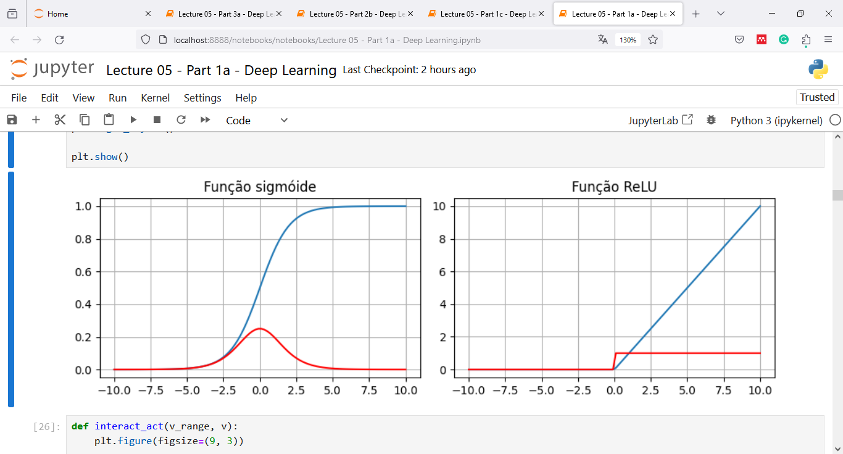

Backpropagation – Funções e derivadas
Função sigmoide:
$g\left(v\right)=\frac{1}{1+e^{−v}}$
Derivada de função sigmoide:
$\frac{d}{dv}g\left(v\right)=g(v)(1−g\left(v\right))$
Função ReLu:
$g\left(v\right)=\max\left(0, v\right)$ ou $g\left(v\right)=\left\{\begin{matrix}v, & v>0 \\ 0, & v≤0\end{matrix}\right.$
Derivada da função ReLu:
$\frac{d}{dv}g\left(v\right)=\left\{\begin{matrix}1, & v>0 \\ 0, & v≤0\end{matrix}\right.$

Slide 24
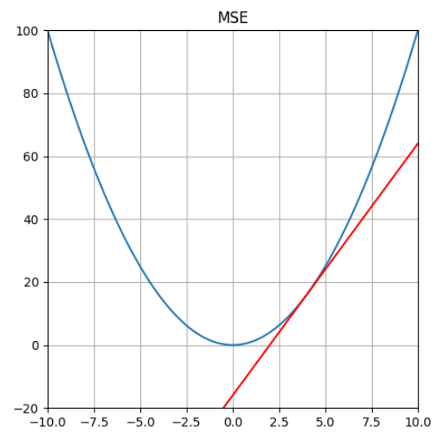

Backpropagation – Funções e derivadas
Erro médio quadrático:
$L\left(\hat{y},y\right)=\frac{1}{N}{(y−\hat{y}) }^{2}, onde N é o número de classes.$
Derivada parcial da função de erro em relação à y:
$\frac{∂L}{∂y}=−\frac{2}{N}(y−\hat{y}),$

Slide 25
Backpropagation – EXEMPLOS

Slide 26



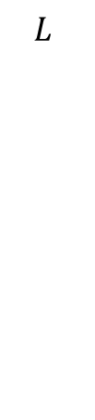










Backpropagation – Exemplo 1
$$x$$
$$W^{0}, b^{0}$$
$${ }_{ }v^{0}, y^{0}$$
$$W^{1}, b^{1}$$
$$v^{1}, y^{1}$$
$$L$$
1
1
$$b_{0}^{0}$$
$$b_{0}^{1}$$
-²
$$v_{0}^{0}$$
$$y_{0}^{0}$$
$$v_{0}^{1}$$
$${\hat{y}}_{0}^{1}$$
$$L$$
$$x_{0}$$
$$w_{0,0}^{0}$$
$$Σ$$
g
$$w_{0,0}^{1}$$
$$Σ$$
g
$$l$$
$$[y_{0}^{}]$$

Slide 27

Backpropagation – Exemplo 1
$$x$$
$$W^{0}, b^{0}$$
$${ }_{ }v^{0}, y^{0}$$
$$W^{1}, b^{1}$$
$$v^{1}, y^{1}$$
$$L$$
1
1
$$b_{0}^{0}$$
$$b_{0}^{1}$$
$$v_{0}^{0}$$
$$y_{0}^{0}$$
$$v_{0}^{1}$$
$$y_{0}^{1}$$
$$L$$
$$x_{0}$$
$$w_{0,0}^{0}$$
$$Σ$$
g
$$w_{0,0}^{1}$$
$$Σ$$
g
$$l$$
$$[y_{0}^{}]$$

Slide 28




Backpropagation – Exemplo 1
$$x$$
$$W^{0}, b^{0}$$
$${ }_{ }v^{0}, y^{0}$$
$$W^{1}, b^{1}$$
$$v^{1}, y^{1}$$
$$L$$
$$\frac{∂L}{∂W^{1}}=\frac{∂L}{∂{\hat{y}}^{1}}×\frac{∂{\hat{y}}^{1}}{∂v^{1}}×\frac{∂v^{1}}{∂W^{1}}$$
$$\frac{∂v^{1}}{∂W^{1}}$$
$$\frac{∂{\hat{y}}^{1}}{∂v^{1}}$$
$$\frac{∂L}{∂{\hat{y}}^{1}}$$
1
1
$$b_{0}^{0}$$
$$b_{0}^{1}$$
$$v_{0}^{0}$$
$$y_{0}^{0}$$
$$v_{0}^{1}$$
$$y_{0}^{1}$$
$$L$$
$$x_{0}$$
$$w_{0,0}^{0}$$
$$Σ$$
g
$$w_{0,0}^{1}$$
$$Σ$$
g
$$l$$
$$[y_{0}^{}]$$

Slide 29
Backpropagation – Exemplo 1
$$x$$
$$W^{0}, b^{0}$$
$${ }_{ }v^{0}, y^{0}$$
$$W^{1}, b^{1}$$
$$v^{1}, y^{1}$$
$$L$$
$$\frac{∂L}{∂b^{1}}=\frac{∂L}{∂{\hat{y}}^{1}}×\frac{∂{\hat{y}}^{1}}{∂v^{1}}×\frac{∂v^{1}}{∂b^{1}}$$
$$\frac{∂v^{1}}{∂b^{1}}$$
$$\frac{∂{\hat{y}}^{1}}{∂v^{1}}$$
$$\frac{∂L}{∂{\hat{y}}^{1}}$$
1
1
$$b_{0}^{0}$$
$$b_{0}^{1}$$
$$v_{0}^{0}$$
$$y_{0}^{0}$$
$$v_{0}^{1}$$
$$y_{0}^{1}$$
$$L$$
$$x_{0}$$
$$w_{0,0}^{0}$$
$$Σ$$
g
$$w_{0,0}^{1}$$
$$Σ$$
g
$$l$$
$$[y_{0}^{}]$$

Slide 30

Backpropagation – Exemplo 1
$$x$$
$$W^{0}, b^{0}$$
$${ }_{ }v^{0}, y^{0}$$
$$W^{1}, b^{1}$$
$$v^{1}, y^{1}$$
$$L$$
$$\frac{∂L}{∂y^{0}}=\frac{∂L}{∂{\hat{y}}^{1}}×\frac{∂{\hat{y}}^{1}}{∂v^{1}}×\frac{∂v^{0}}{∂y^{0}}$$
$$\frac{∂v^{0}}{∂y^{0}}$$
$$\frac{∂{\hat{y}}^{1}}{∂v^{1}}$$
$$\frac{∂L}{∂{\hat{y}}^{1}}$$
1
1
$$b_{0}^{0}$$
$$b_{0}^{1}$$
$$v_{0}^{0}$$
$$y_{0}^{0}$$
$$v_{0}^{1}$$
$$y_{0}^{1}$$
$$L$$
$$x_{0}$$
$$w_{0,0}^{0}$$
$$Σ$$
g
$$w_{0,0}^{1}$$
$$Σ$$
g
$$l$$
$$[y_{0}^{}]$$

Slide 31


Backpropagation – Exemplo 1
$$x$$
$$W^{0}, b^{0}$$
$${ }_{ }v^{0}, y^{0}$$
$$W^{1}, b^{1}$$
$$v^{1}, y^{1}$$
$$L$$
$$\frac{∂L}{∂W^{0}}=\frac{∂L}{∂y^{0}}×\frac{∂y^{0}}{∂v^{0}}×\frac{∂v^{0}}{∂W^{0}}$$
$$\frac{∂v^{0}}{∂W^{0}}$$
$$\frac{∂y^{0}}{∂v^{0}}$$
$$\frac{∂L}{∂y^{0}}$$
1
1
$$b_{0}^{0}$$
$$b_{0}^{1}$$
$$v_{0}^{0}$$
$$y_{0}^{0}$$
$$v_{0}^{1}$$
$$y_{0}^{1}$$
$$L$$
$$x_{0}$$
$$w_{0,0}^{0}$$
$$Σ$$
g
$$w_{0,0}^{1}$$
$$Σ$$
g
$$l$$
$$[y_{0}^{}]$$

Slide 32


Backpropagation – Exemplo 1
$$x$$
$$W^{0}, b^{0}$$
$${ }_{ }v^{0}, y^{0}$$
$$W^{1}, b^{1}$$
$$v^{1}, y^{1}$$
$$L$$
$$\frac{∂L}{∂b^{0}}=\frac{∂L}{∂y^{0}}×\frac{∂y^{0}}{∂v^{0}}×\frac{∂v^{0}}{∂b^{0}}$$
$$\frac{∂v^{0}}{∂b^{0}}$$
$$\frac{∂y^{0}}{∂v^{0}}$$
$$\frac{∂L}{∂y^{0}}$$
1
1
$$b_{0}^{0}$$
$$b_{0}^{1}$$
$$v_{0}^{0}$$
$$y_{0}^{0}$$
$$v_{0}^{1}$$
$$y_{0}^{1}$$
$$L$$
$$x_{0}$$
$$w_{0,0}^{0}$$
$$Σ$$
g
$$w_{0,0}^{1}$$
$$Σ$$
g
$$l$$
$$[y_{0}^{}]$$

Slide 33



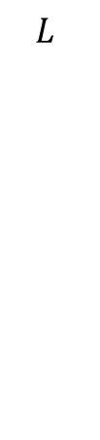















Backpropagation – Exemplo 2
$$x$$
$$W^{0}, b^{0}$$
$${ }_{ }v^{0}, y^{0}$$
$$W^{1}, b^{1}$$
$$v^{1}, y^{1}$$
$$L$$
1
$$b_{0}^{0}$$
$$v_{0}^{0}$$
$$y_{0}^{0}$$
$$Σ$$
g
1
$$w_{0,0}^{0}$$
$$w_{0,0}^{1}$$
$$b_{0}^{1}$$
-²
$$v_{0}^{1}$$
$$y_{0}^{1}$$
$$L$$
$$x_{0}$$
1
$$Σ$$
g
$$l$$
$$w_{0,1}^{0}$$
$$b_{1}^{0}$$
$$w_{1,0}^{1}$$
$$v_{1}^{0}$$
$$y_{1}^{0}$$
$$Σ$$
g
$$[y_{0}^{}]$$

Slide 34





Backpropagation – Exemplo 2
$$x$$
$$W^{0}, b^{0}$$
$${ }_{ }v^{0}, y^{0}$$
$$W^{1}, b^{1}$$
$$v^{1}, y^{1}$$
$$L$$
1
$$b_{0}^{0}$$
$$v_{0}^{0}$$
$$y_{0}^{0}$$
$$Σ$$
g
1
$$w_{0,0}^{0}$$
$$w_{0,0}^{1}$$
$$b_{0}^{1}$$
$$v_{0}^{1}$$
$$y_{0}^{1}$$
$$L$$
$$x_{0}$$
1
$$Σ$$
g
$$l$$
$$w_{0,1}^{0}$$
$$b_{1}^{0}$$
$$w_{1,0}^{1}$$
$$v_{1}^{0}$$
$$y_{1}^{0}$$
$$Σ$$
g
$$[y_{0}^{}]$$

Slide 35






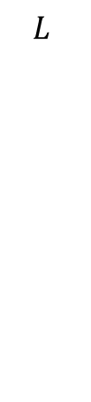




















Backpropagation – Exemplo 2
$$x$$
$$W^{0}, b^{0}$$
$${ }_{ }v^{0}, y^{0}$$
$$W^{1}, b^{1}$$
$$v^{1}, y^{1}$$
$$L$$
1
$$b_{0}^{0}$$
$$v_{0}^{0}$$
$$y_{0}^{0}$$
$$Σ$$
g
$$w_{0,0}^{1}$$
1
$$b_{0}^{1}$$
-²
$$w_{0,0}^{0}$$
$$w_{0,1}^{1}$$
$$v_{0}^{1}$$
$$y_{0}^{1}$$
$$x_{0}$$
$$w_{0,1}^{0}$$
1
$$Σ$$
g
$$l$$
$$b_{1}^{0}$$
$$w_{0,2}^{0}$$
$$v_{1}^{0}$$
$$y_{1}^{0}$$
$$w_{1,0}^{1}$$
$$L$$
$$Σ$$
g
1
$$w_{1,0}^{1}$$
$$b_{1}^{1}$$
$$w_{1,1}^{0}$$
$$w_{1,1}^{1}$$
$$v_{1}^{1}$$
$$y_{1}^{1}$$
$$x_{1}$$
1
$$w_{2,0}^{1}$$
$$Σ$$
g
$$b_{2}^{0}$$
$$w_{1,2}^{0}$$
$$v_{2}^{0}$$
$$y_{2}^{0}$$
$$Σ$$
g
$$w_{2,1}^{1}$$
$$[y_{0}^{},y_{1}^{}]$$

Slide 36
Backpropagation – Exemplo 2
$$x$$
$$W^{0}, b^{0}$$
$${ }_{ }v^{0}, y^{0}$$
$$W^{1}, b^{1}$$
$$v^{1}, y^{1}$$
$$L$$
1
$$b_{0}^{0}$$
$$v_{0}^{0}$$
$$y_{0}^{0}$$
$$Σ$$
g
$$w_{0,0}^{1}$$
1
$$b_{0}^{1}$$
$$w_{0,0}^{0}$$
$$w_{0,1}^{1}$$
$$v_{0}^{1}$$
$$y_{0}^{1}$$
$$x_{0}$$
$$w_{0,1}^{0}$$
1
$$Σ$$
g
$$l$$
$$b_{1}^{0}$$
$$w_{0,2}^{0}$$
$$v_{1}^{0}$$
$$y_{1}^{0}$$
$$w_{1,0}^{1}$$
$$L$$
$$Σ$$
g
1
$$w_{1,0}^{1}$$
$$b_{1}^{1}$$
$$w_{1,1}^{0}$$
$$w_{1,1}^{1}$$
$$v_{1}^{1}$$
$$y_{1}^{1}$$
$$x_{1}$$
1
$$w_{2,0}^{1}$$
$$Σ$$
g
$$b_{2}^{0}$$
$$w_{1,2}^{0}$$
$$v_{2}^{0}$$
$$y_{2}^{0}$$
$$Σ$$
g
$$w_{2,1}^{1}$$
$$[y_{0}^{},y_{1}^{}]$$

Slide 37
Bibliografia
Moacir Ponti. Material para o minicurso Deep Learning. ICMC-USP.
https://github.com/maponti/deeplearning_intro_datascience
Ponti et al. Everything You Wanted to Know about Deep Learning for Computer Vision but Were Afraid to Ask. Sibgrapi 2017.
https://sites.icmc.usp.br/moacir/p17sibgrapi-tutorial/
Martin Görner. Learn TensorFlow and deep learning, without a Ph.D. Google Cloud.
https://cloud.google.com/blog/products/gcp/learn-tensorflow-and-deep-learning-without-a-phd
CS231n: Convolutional Neural Networks for Visual Recognition. Stanford University.
http://cs231n.stanford.edu/
http://cs231n.github.io/
Goodfellow, Bengio and Courville. Deep Learning. MIT Press, 2016
https://www.deeplearningbook.org/

Slide 38
Bibliografia
Rabindra Lamsal. A step by step forward pass and backpropagation example
https://theneuralblog.com/forward-pass-backpropagation-example/
Matt Mazur. A Step by Step Backpropagation Example
https://mattmazur.com/2015/03/17/a-step-by-step-backpropagation-example/

Slide 39
Bibliografia
Back-Propagation is very simple. Who made it Complicated ?
https://medium.com/@14prakash/back-propagation-is-very-simple-who-made-it-complicated-97b794c97e5c
Chapter 7: Artificial neural networks with Math.
https://medium.com/deep-math-machine-learning-ai/chapter-7-artificial-neural-networks-with-math-bb711169481b
The Matrix Calculus You Need For Deep Learning
http://explained.ai/matrix-calculus/index.html
How backpropagation works, and how you can use Python to build a neural network
https://medium.freecodecamp.org/build-a-flexible-neural-network-with-backpropagation-in-python-acffeb7846d0
All the Backpropagation derivatives
https://medium.com/@pdquant/all-the-backpropagation-derivatives-d5275f727f60
Brent Scarff. Understanding Backpropagation.
https://towardsdatascience.com/understanding-backpropagation-abcc509ca9d0

Slide 40
Apendicê: Exemplo

Slide 41
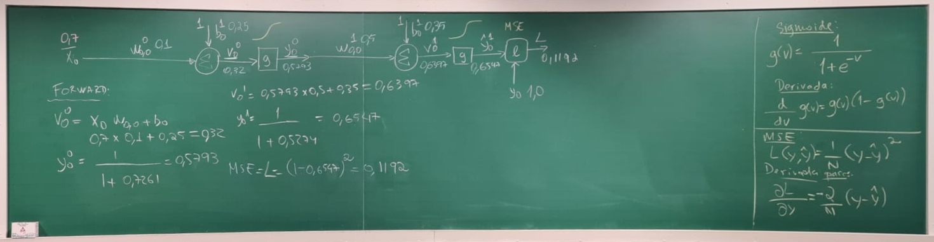
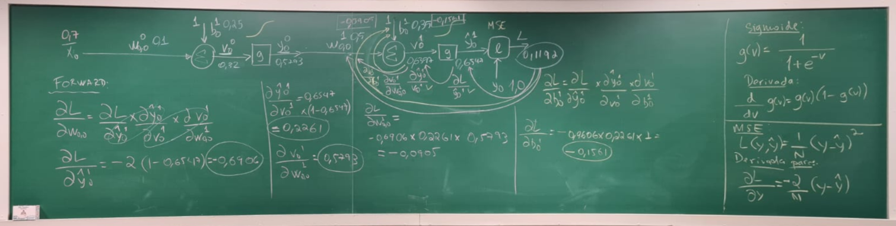
Exemplo 1

Slide 42
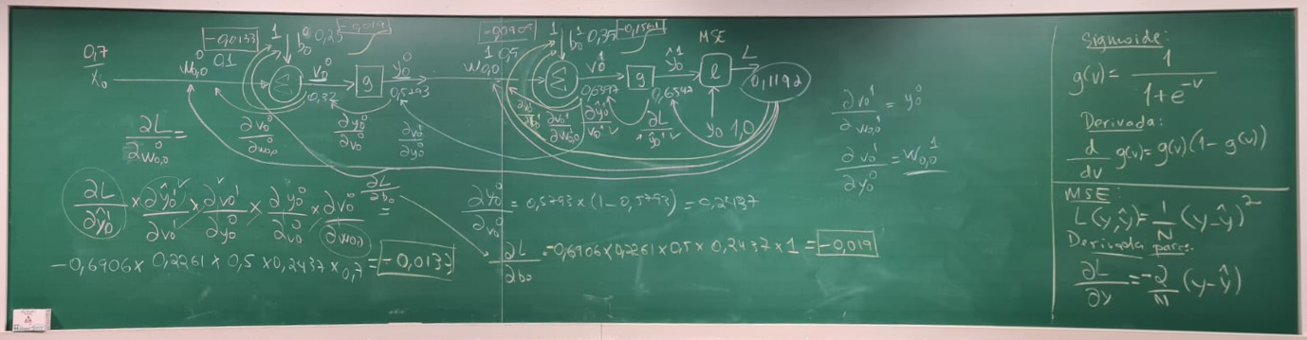
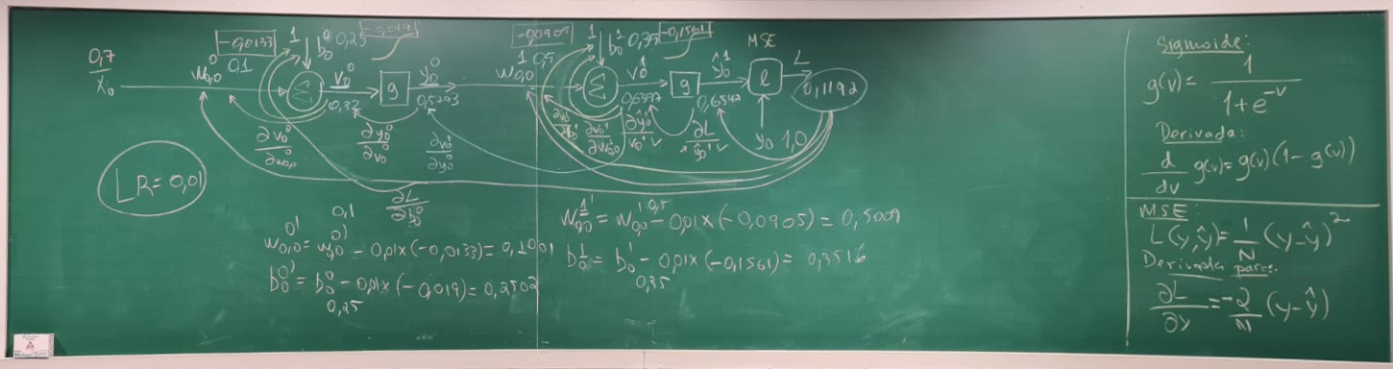
Exemplo 1

Slide 43
FIM

