Slide 1
Aula 09 – Segmentação semântica
SIN 393 – Introdução à Visão Computacional (2023)
Prof. João Fernando Mari
joaofmari.github.io
joaof.mari@ufv.br

Slide 2
Roteiro
Localização, detecção e segmentação
Modelos para segmentação semântica
Aplicações de segmentação semântica
U-Net
Upsampling

Slide 3
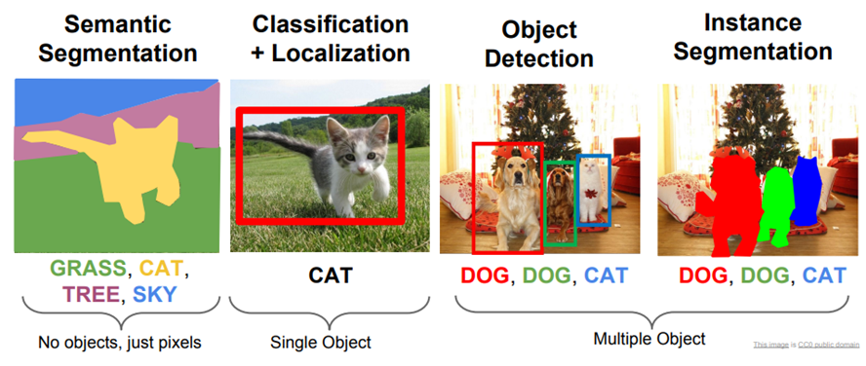
Localização, detecção e segmentação
Stanford cs231n (2022): http://cs231n.stanford.edu/slides/2022/lecture_9_jiajun.pdf

Slide 4
Modelos para segmentação semântica
Fully convolutional network
Masked R-CNN
U-Net
PSPNet
DeepLab
...

Slide 5
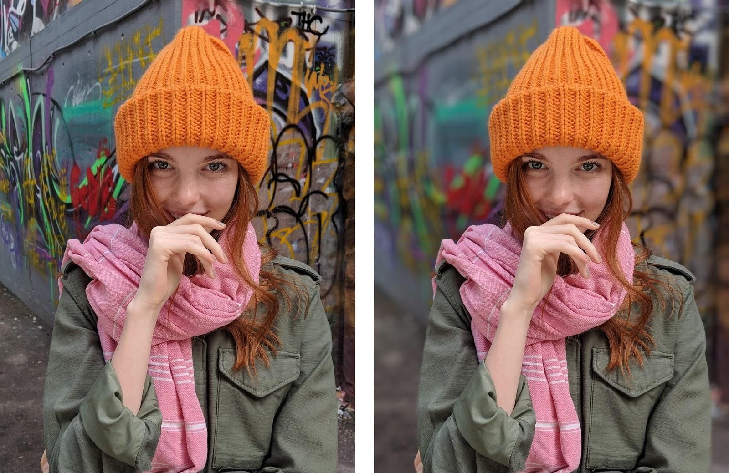
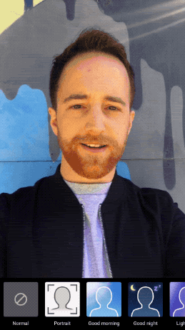
Aplicações de segmentação semântica
Modo retrato e substituição do fundo
https://ai.googleblog.com/2018/03/mobile-real-time-video-segmentation.html

Slide 6
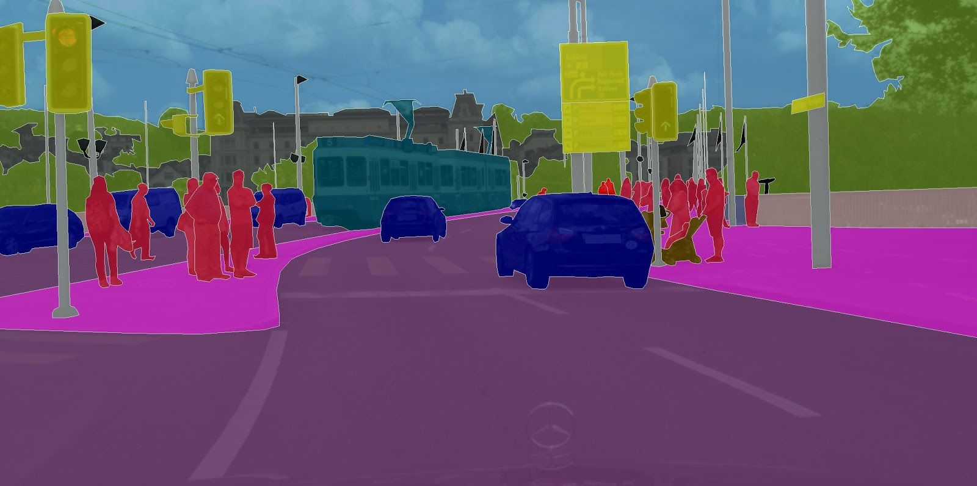
Aplicações de segmentação semântica
Self-driving cars
https://ai.googleblog.com/2018/03/mobile-real-time-video-segmentation.html

Slide 7
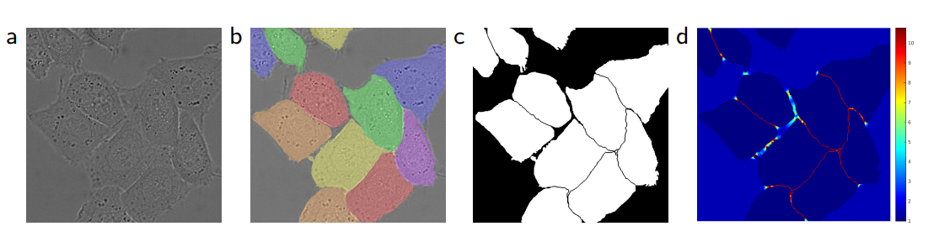
Aplicações de segmentação semântica
Imagens biomédicas
Ronneberger, Fischer, Brox. U-Net: Convolutional Networks for Biomedical Image Segmentation. 2015.

Slide 8
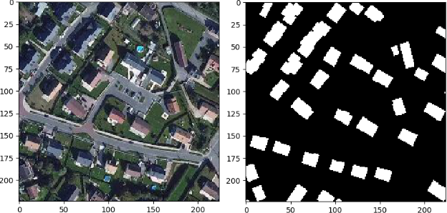
Aplicações de segmentação semântica
Segmentação de imagens de satélite
Satellite Image Segmentation for Building Detection using U-net

Slide 9
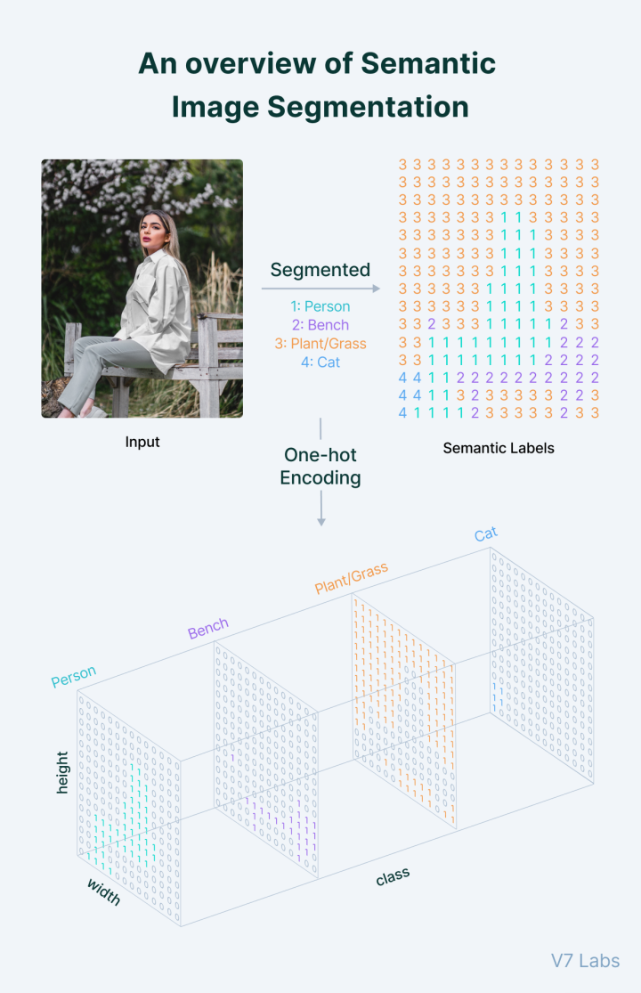
Segmentação semântica
https://www.v7labs.com/blog/semantic-segmentation-guide

Slide 10
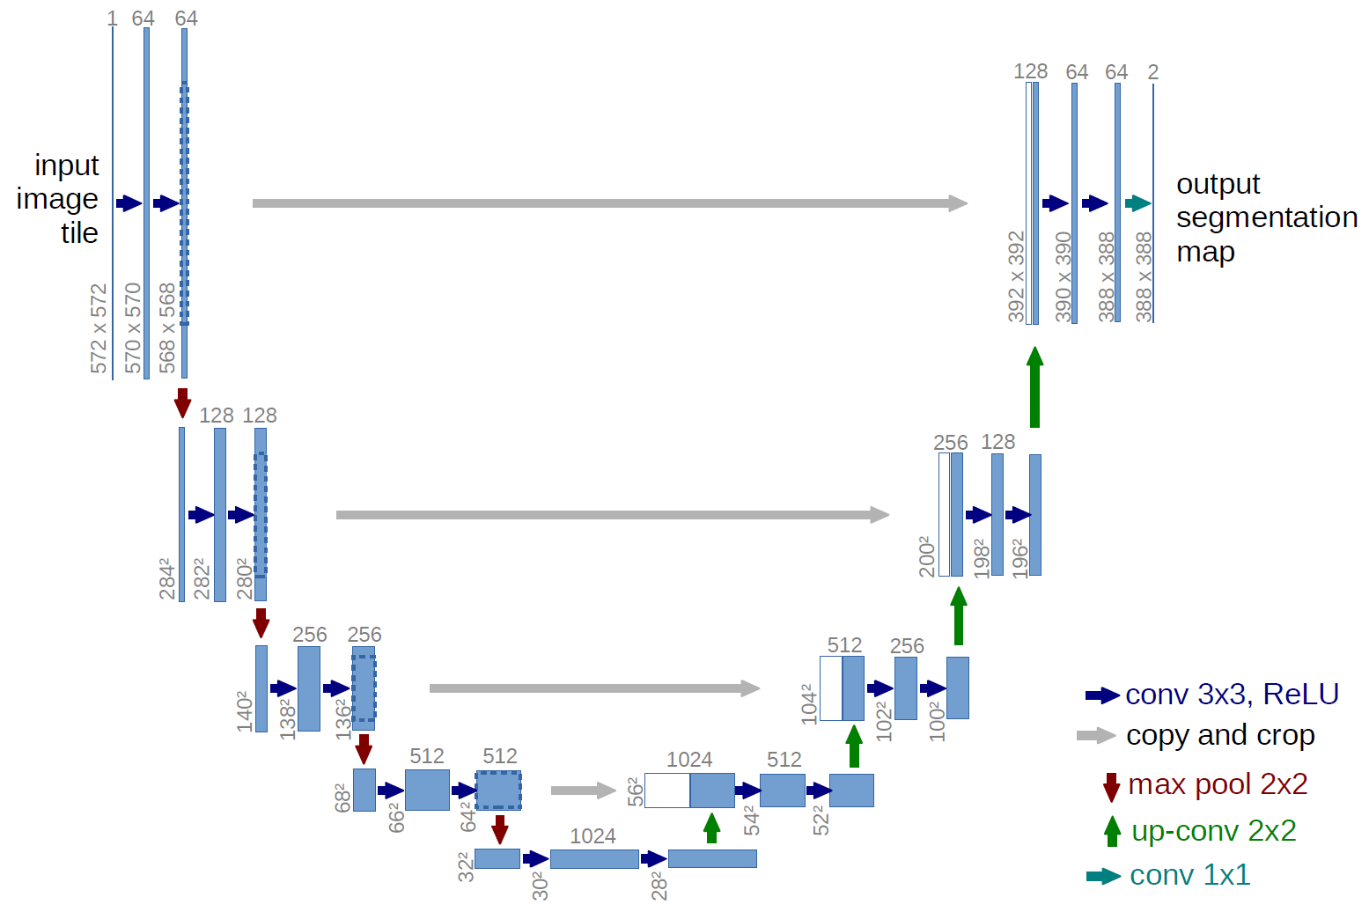
U-Net
Ronneberger, Fischer, Brox. U-Net: Convolutional Networks for Biomedical Image Segmentation. 2015.

Slide 11
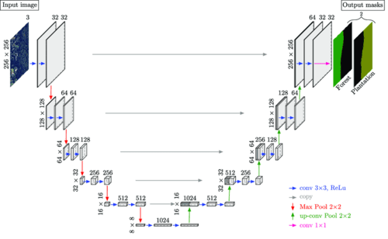
U-Net
https://pyimagesearch.com/2021/11/08/u-net-training-image-segmentation-models-in-pytorch/

Slide 12
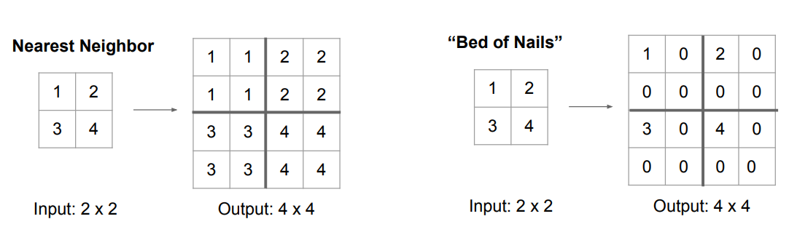
Upsampling
http://cs231n.stanford.edu/slides/2017/cs231n_2017_lecture11.pdf

Slide 13
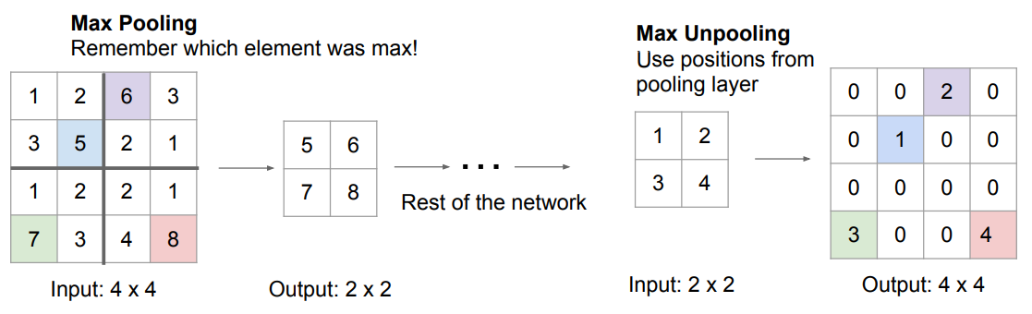
Upsampling
http://cs231n.stanford.edu/slides/2017/cs231n_2017_lecture11.pdf

Slide 14
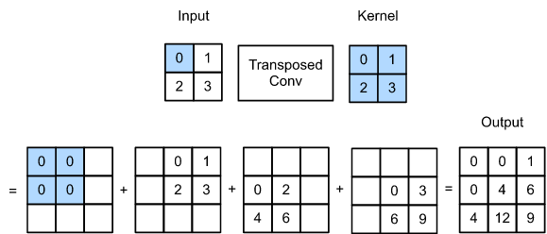
Convolução transposta
https://d2l.ai/chapter_computer-vision/transposed-conv.html

Slide 15
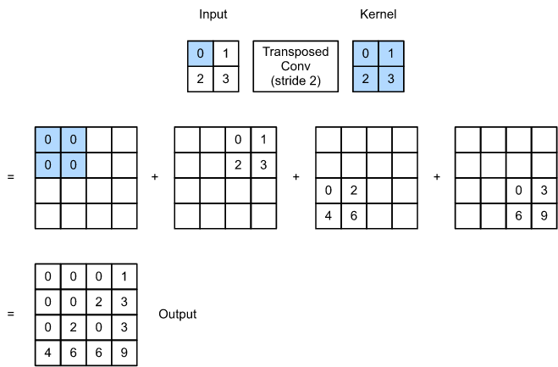
Convolução transposta

Slide 16
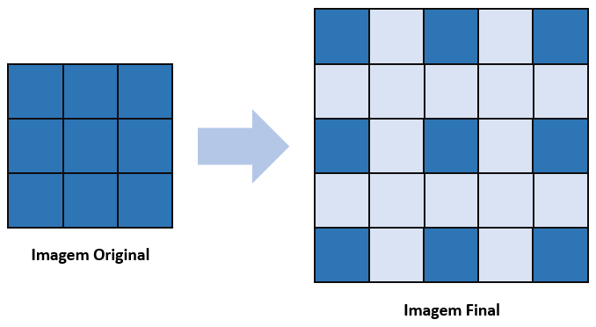
Convolução transposta
Stride 2, padding 0
https://didatica.tech/transposed-convolutional-layer/

Slide 17
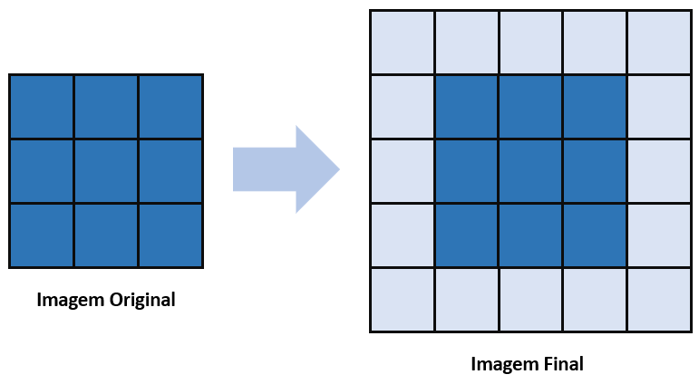
Convolução transposta
Stride 1, padding 1
https://didatica.tech/transposed-convolutional-layer/

Slide 18
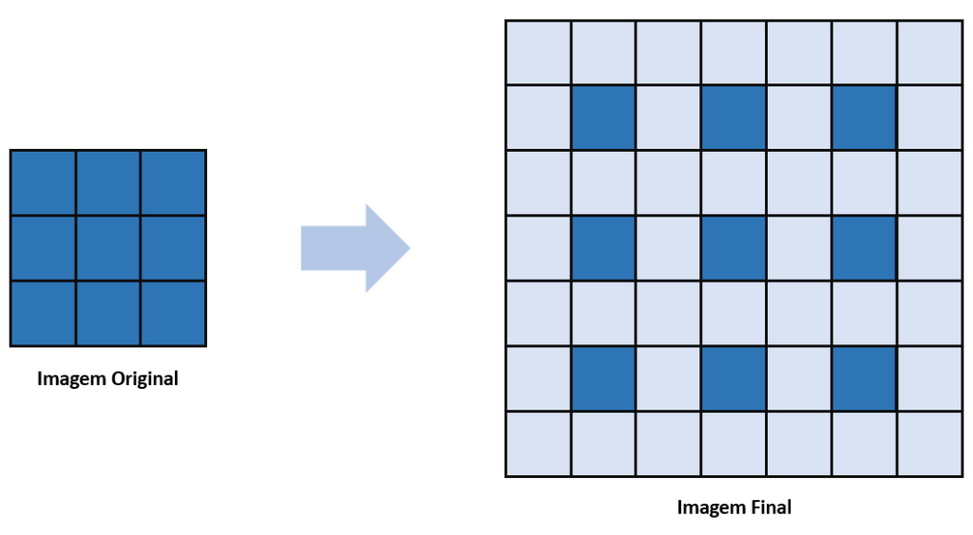
Convolução transposta
Stride 2, padding 1
https://didatica.tech/transposed-convolutional-layer/

Slide 19
Bibliografia
Ronneberger, Fischer, Brox. U-Net: Convolutional Networks for Biomedical Image Segmentation. 2015.
https://arxiv.org/pdf/1505.04597.pdf
Nilesh Barla. The Beginner’s Guide to Semantic Segmentation.
https://www.v7labs.com/blog/semantic-segmentation-guide
Anil Matcha. A 2021 guide to Semantic Segmentation.
https://nanonets.com/blog/semantic-image-segmentation-2020/
Shivam Chandhok. U-Net: Training Image Segmentation Models in PyTorch.
https://pyimagesearch.com/2021/11/08/u-net-training-image-segmentation-models-in-pytorch/
Jeremy Jordan. Evaluating image segmentation models.
https://www.jeremyjordan.me/evaluating-image-segmentation-models/
CS231n: Deep Learning for Computer Vision. Stanford - Spring 2022
http://cs231n.stanford.edu/

Slide 20
Bibliografia
https://ai.googleblog.com/2018/03/mobile-real-time-video-segmentation.html
Satellite Image Segmentation for Building Detection using U-net. Stanford CS229.
https://cs229.stanford.edu/proj2017/final-reports/5243715.pdf
https://d2l.ai/chapter_computer-vision/transposed-conv.html
https://didatica.tech/transposed-convolutional-layer/

Slide 21
FIM

