Slide 1


Social Media Text Processing and Semantic Analysis for Smart Cities
MSc Dissertation Viva
João Pereira
Supervision:
Rosaldo Rossetti
Pedro Saleiro
July 14, 2017

Slide 2
Agenda
Scope
Problem Statement
Goals
State of the Art
Framework
Exploratory Data Analysis
Text Analytics Experiments
Conclusions

Slide 3
Scope
The evolution of Web-services
Sharing of opinions, feelings and conversation by people
Research Community
Evolution of cities
Companies’ Services
Citizen Engagement Process

Slide 4
Problem Statement
Mining Twitter data is a laborious and consuming process.
  Twitter APIs have its own specifities
  The volume of data retrieved is overwhelming
  Tweets are text messages with several restrictions
    Short lenght (140 characters)
    Informallity
    Existence of abbreviations, jargons, slang and idioms

Slide 5
Goals
Continuous collection of geo-located tweets from multiple bounding-boxes in parallel and in compliance with Twitter API usage limits;
Tackling Twitter Streaming API inconsistencies and filtering noisy tweets;
Implement standard text pre-processing methods for social media texts;
Content analysis using topic modeling and comparative characterization among different bounding boxes (e.g. cities);
Travel-related classification of tweets using supervised learning;
Train word embeddings from geo-located tweets;
Study the impact of word embeddings in travel-related classification;
Creation of gold-standard data for travel-related supervised learning;
Aggregation and visualization of results.

Slide 6
State of the Art

Slide 7
Framework
The framework may contemplate the following requirements:
  Collection of multiple bounding-boxes (cities, regions or countries);
  Flexibility in each module;
  Scalability;
  The modules’ work-flow should have the fastest possible runtime to process the results;
  Results must be shown on-time to the final user.

Slide 8
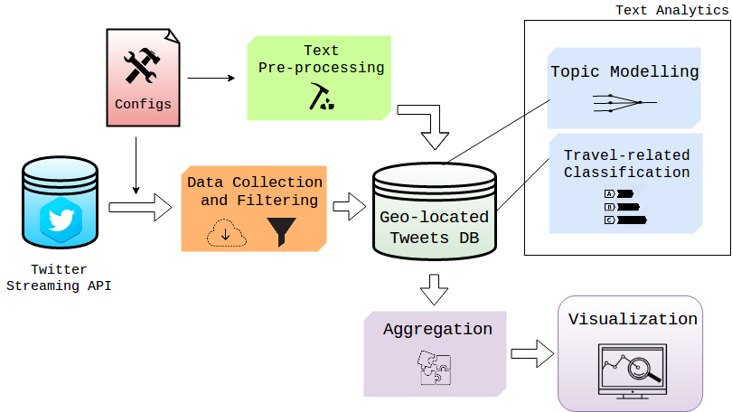
Architecture Overview

Slide 9

Data Collection
Twitter Streaming API allows three different collection heuristics:
  Term-based search;
  Follow users activity;
  Locations through bounding-box system.
Tweepy, a Python library to acess the Twitter APIs, with the ‘locations’ heuristic.
We perform a preliminary test on Tweepy to verify the limits of the API.
Overall, we implement this module to support parallelization for collecting geo-located tweets in several bounding-boxes.

Slide 10
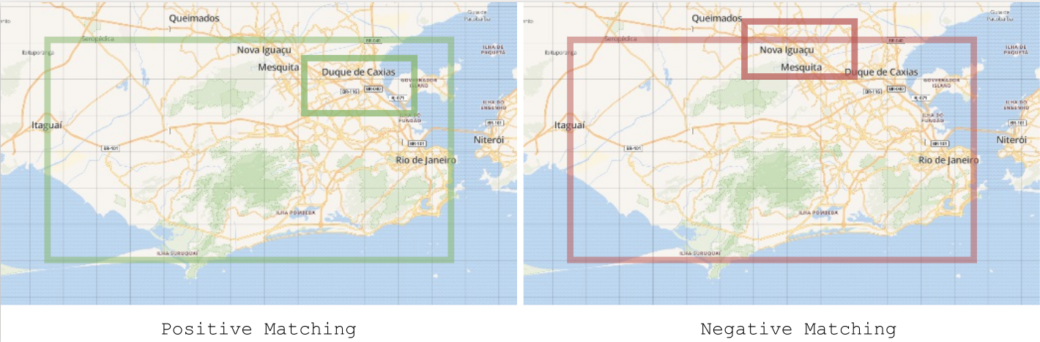
Data Filtering
The data retrieved has two inconsisitencies:
  A large amount of tweets in different idioms comparative to the one spoken in the target city;
  Tweets from outside the searching bounding-box are retrieved by the API.

Slide 11

Database
Tweets are retrieved in JSON-like format;
MongoDB is a NoSQL software to store collections/schemas of this data format;
The overwhelming amount of tweets makes conventional querying operations to perform poorly;
On the contrary, MongoDB has high performance regarding the querying system.
Nonetheless, this software allows easier and quickly deployment and scalability.

Slide 12
Text Pre-processing
The specificities present in tweets require the application of a several group of text pre-processing operations to the messages.
  Lower casing;
  Lemmatization;
  Tokenization;
  Transformation of repeated characters;
  Punctuation removal;
  Cleaning of metadata and numerical symbols in the text;
  Stop and short words removal.

Slide 13
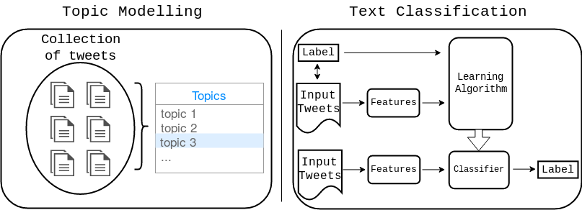
Text Analytics
Two different approaches in the implementation of the text analytics modules:
  Unsupervised approach – Topic Modelling;
  Supervised approach – Text Classification.

Slide 14
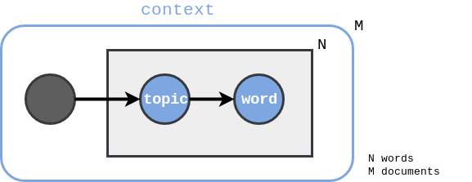
Topic Modelling
Latent Dirichlet Allocation (LDA) - Blei et al. [1]
  Generative probabilistic model;
  Aims to find the latent topics present in a collection of documents;
  Two distinct distributions:
    Distribution of words over topicsdocuments;
    Distribution of topics over the documents.

Slide 15
Topic Modelling
We use the Python’s LDA library to implement this text analytics module.
Features and Model parametrization:
  Train was performed over 20 iterations;
  Bag-of-words representation matrices as features:
    Dictionary limited to 10,000 words;
    Words occuring in a maximum percentage of 40% of documents;
    Word minimal frequency value set to 10 occurences.

Slide 16
Travel-related Classification
We produce two text classifiers with words embeddings (1, 2) and bag-of-words (1) features.
  Travel-related classifier for Portuguese tweets;
  Travel-related classifier for Engligh tweets.
Word Embeddings
  A well-known model to produce this type of text features is word2vec - Mikolov et al. [2];
  Neural network based model;
  Two different architectures:
    Skip-gram;
    Continuous Bag-of-words (CBOW).

Slide 17
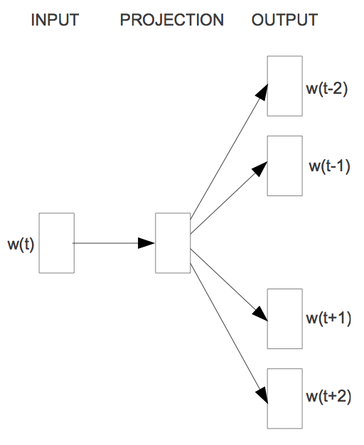
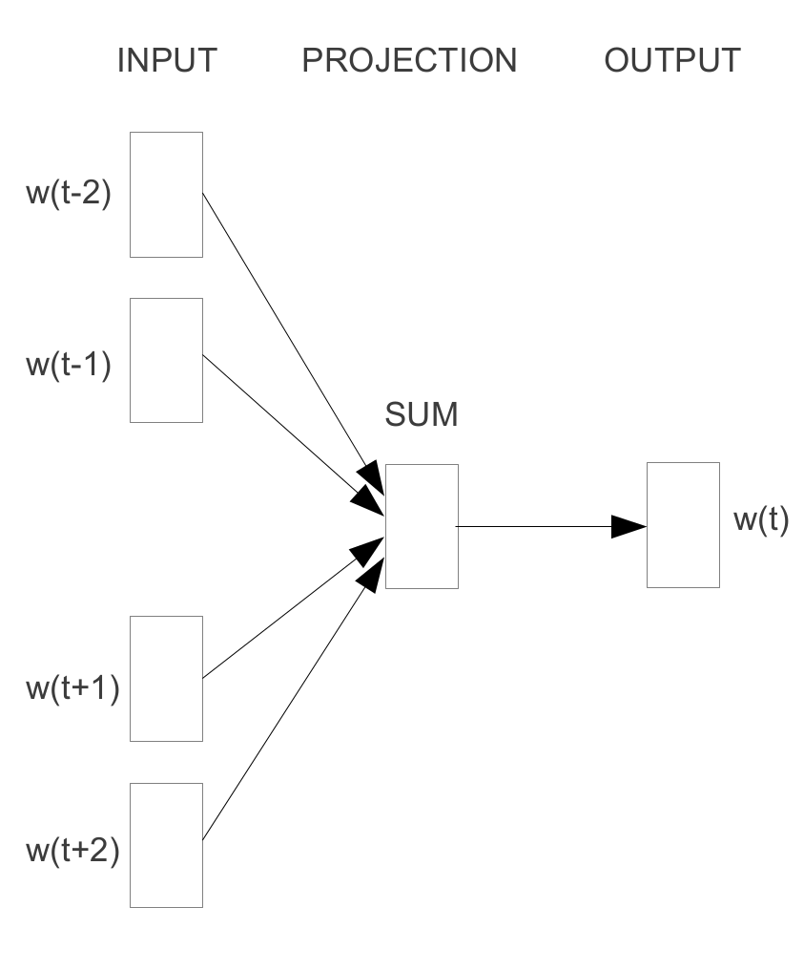
Travel-related Classification
Skip-gram
CBOW

Slide 18

Travel-related Classification
Paragraph2vec, a.k.a. doc2vec – Mikolov et al. [3]
  Similar to word2vec, however we can produce word embeddings sending a label of each document to the representation matrix;
  The tweets unique ids are sent as label for each message.
  Collection of pre-processed tweets are used as input to train the word embeedings models with support of the Gensim library for Python.

Slide 19
Travel-related Classification
Features and Model parametrization:
  Portuguese travel-related tweets classifier:
    Bag-of-words
      3,000 most frequent terms found in less than 60% of documents
    Bag-of-embeddings
      Context window of 2 and feature vectors of size 200.
      Train was performed over 10 iterations;
  English travel-related tweets classifier:
    Bag-of-embeddings
      Context window of 2 and feature vectors of size 200.
      Train was performed over 10 iterations;

Slide 20
Aggregation and Visualization
Aggregation
  MongoDB provides inner frameworks that allow aggregation of data;
  These aggregation operations are easier and quickly because they are performed using a map-reduce paradigm
  Aggregation of results are made periodically.
Visualization
  Plotly is a Python library to produce graphical visualizations of data;
  The library allows local storage of these visualizations in HTML files;
  By exploring the embedding functionality of HTML5 we can demonstrate on-time visualizations.

Slide 21
Exploratory Data Analysis
We perfom three types of statistiscal analysis over tweets from 5 different cities: Rio de Janeiro, São Paulo, New York City, London and Melbourne.
Messages collected sum up a total of 43 million tweets in a period of 3 months, between March 12 and June 12, 2017.
Statistical Analysis:
  Geographical Statistics;
  Temporal Frequencies;
  Users Distribution.

Slide 22
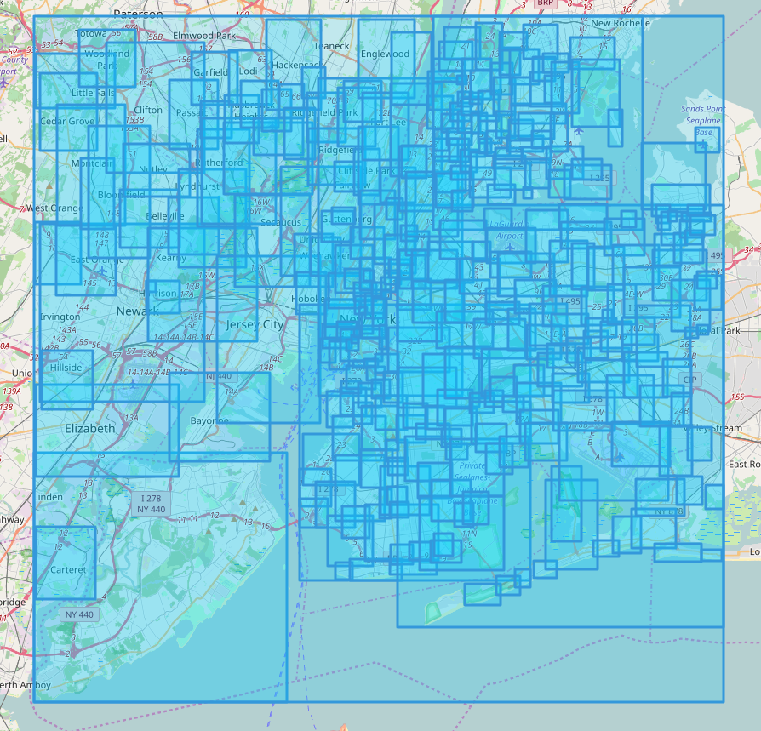
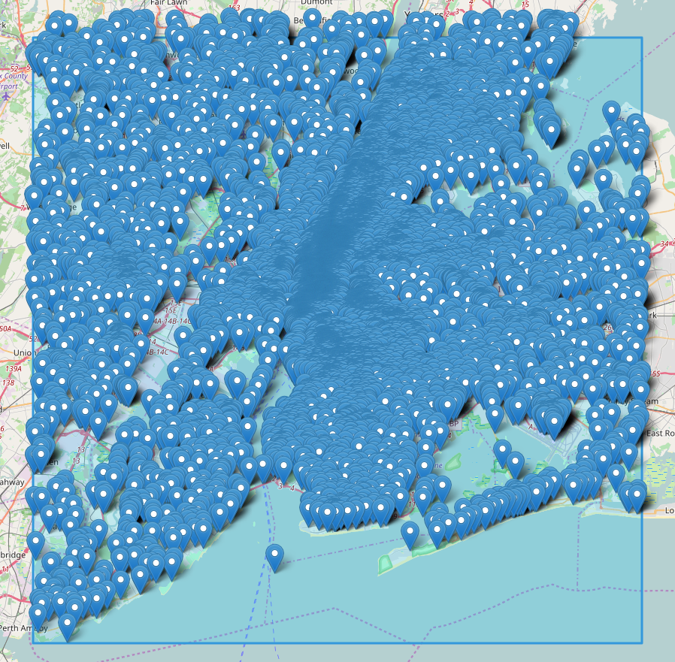
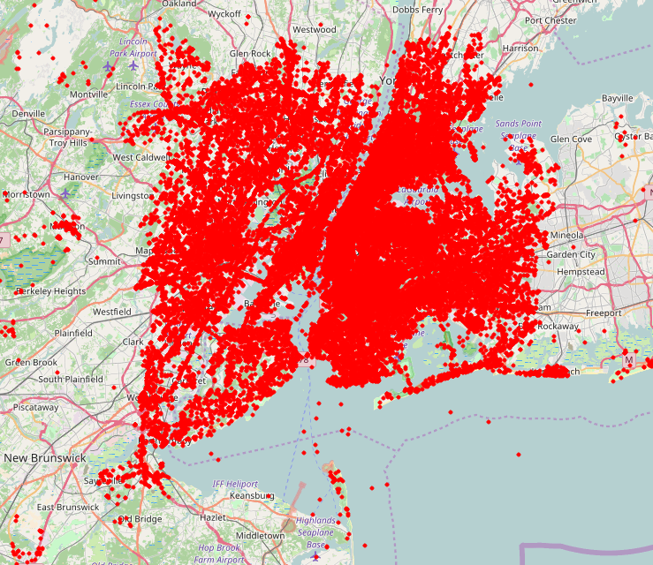
Geographical Statistics
  More than 70% tweets do not have a precise coordinate;
  The majority of studies using geo-located tweets do not report this fact;
  Extracting spatial analysis is difficult which turns on the need of explore the text content of a tweet to extract meaningful and actionable information;
  Below, we depict the geographic distribution of New York City tweets.
Bounding-boxes of variable size
Fixed places
Precise coordinates

Slide 23
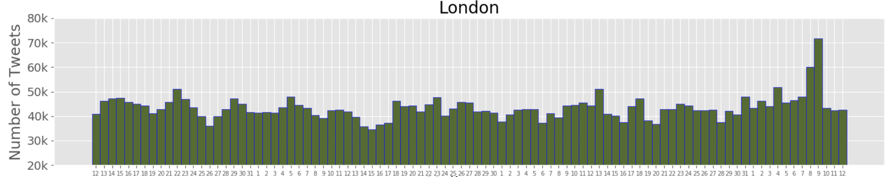
Temporal Frequencies
  Daily and hourly distributions of tweets allow the identification of potential remarkable events;
  The figure below shows a pike of the Twitter activity in London which is associated with United Kingdom General Elections 2017.

Slide 24
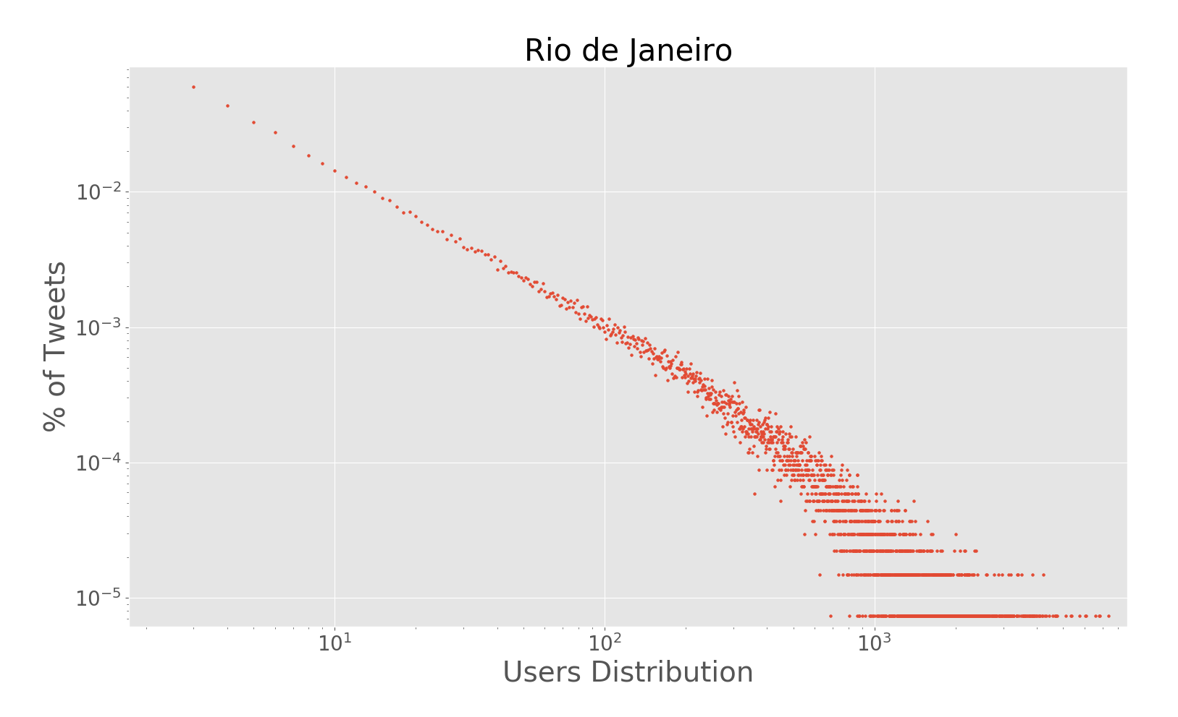
Users Distribution
  All cities presented the same distribution for its Twitter users;
  The behaviour of this distribution is similar to a power-law;
  It is possible to verify a large group of users in the distribution tail, meaning that the majority of users have posted a small number of tweets.

Slide 25
Text Analytics Experiments

Slide 26
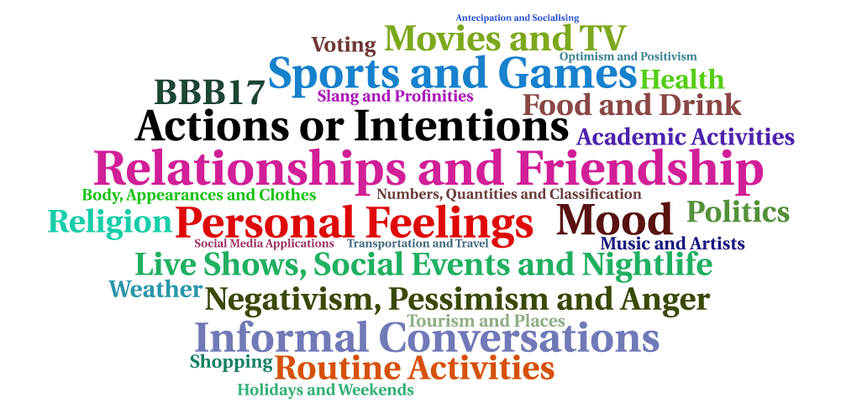
Topic Modelling in Brazil

Slide 27
Travel-related Classification
Falar aqui do treino dos word embeddings

Slide 28
Rio de Janeiro and São Paulo

Slide 29
New York City

Slide 30
Conclusions

Slide 31
Contributions
Technical Contributions
  Design and implementation of a framework in Python to collect geo-located tweets;
  The framework allows the monitoring of multiple bounding-boxes (cities and regions).
Applicational Contributions
  First large scale study with respect to topic modelling and geo-located tweets in Brazil;
  Application of word embeddings to text classification tasks in the context of smart cities and ITS.
Scientific Contributions
  Document the results of experiments and approaches in scientific papers;
  Sharing of the gold-standard datasets created in this dissertation.

Slide 32
Publications
Transportation in Social Media: an automatic classifier for travel-related tweets. In Portuguese Conference on Artificial Intelligence (EPIA), 2017. Published.
Classifying Travel-related Tweets Using Word Embeddings. In IEEE 20th International Conference on Intelligent Transportation Systems (IEEE ITSC), 2017. Under review.
Characterizing Geo-located Tweets in Brazilian Megacities. In The Third International Smart Cities Conference (ISC2), 2017. Under review.

Slide 33
Future Work
Evaluate intrinsically the embeddings produced and share the final benchmarks;
Application of a sentiment analysis module to enrich the extracted information;
Training of embeddings with deep learning models;
Produce statistics to the unexplored scenarios, London and Melbourne;
Creation of more complex documents to retrain the model responsible for identification of latent topics.
Cross the results from travel-related classification with official data of the transportation services.

Slide 34
References

Slide 35
Thank you
Special thanks to Pedro Saleiro, Rosaldo Rossetti and Arian Pasquali.

