Slide 1


Social Media Text Processing and Semantic Analysis for Smart Cities
MSc Dissertation Viva
João Pereira
Supervision:
Rosaldo Rossetti
Pedro Saleiro
July 14, 2017

Slide 2
Agenda
Scope
Problem Statement
Goals
State of the Art
Framework
Exploratory Data Analysis
Text Analytics Experiments
Conclusions

Slide 3
Scope
Instant connectivity 24/7;
Sharing of events, opinions and activities;
Many research areas have tried to exploit social media data;
Smart Cities and Intelligent Transportation Systems are also obvious candidates
Information derived from such exploration may bring benefits to the cities’ governance, traffic-flow management, etc.

Slide 4
Problem Statement
Mining Twitter data is a laborious and time-consuming process.
  Social have its own specificities;
  The volume of data retrieved is overwhelming;
  Tweets are text messages with several restrictions;

Slide 5
Goals
Design and development of a framework for continuous collection of tweets from multiple bounding-boxes;
Discovering of latent topics in the Twitter data;
Travel-related classification of tweets using supervised learning;
Aggregation and visualization of results.

Slide 6
State of the Art

Slide 7
Framework
The framework may contemplate the following requirements:
  Collection of multiple bounding-boxes (cities, regions or countries);
  Flexibility in each module;
  Scalability;
  Results must be shown on-time to the final user.

Slide 8
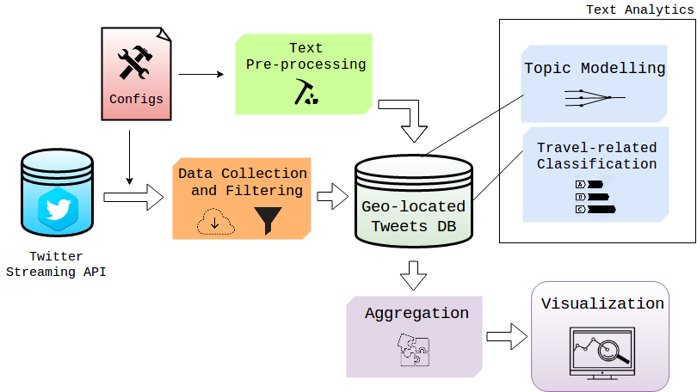
Architecture Overview

Slide 9

Data Collection
Twitter Streaming API allows three different collection heuristics:
  Term-based search;
  Follow users activity;
  Locations through bounding-box system.
Tweepy, a open-source Python library to acess the Twitter APIs.
Preliminary test performed on Tweepy to verify limits of the API.
A module to support parallelization for collecting geo-located tweets in several bounding-boxes .

Slide 10
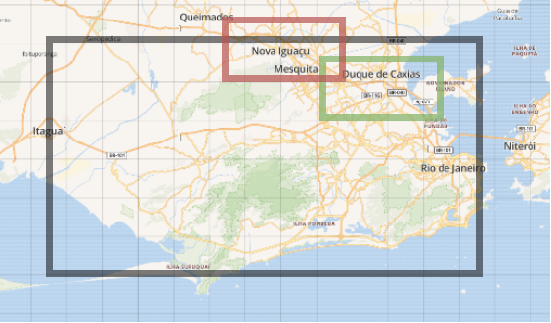
Data Filtering
The data retrieved has two inconsisitencies:
  A large amount of tweets in different idioms comparative to the one spoken in the target city;
  Tweets from outside the searching bounding-box are retrieved by the API.
“The black square represents the searching bounding-box, while the red square represents a tweet with place_id “Nova Iguaçu” and the green one a tweet with place_id “Duque de Caxias”. The tweet associated to the red square is filtered out of the final dataset.”

Slide 11

Database
Tweets are retrieved in JSON-like format;
MongoDB is a NoSQL software to store collections/schemas of this data format;
The overwhelming amount of tweets makes conventional querying operations to perform poorly;
On the contrary, MongoDB has high performance regarding the querying system.
Nonetheless, this software allows easier and quickly deployment and scalability.

Slide 12
Text Pre-processing
We apply a considerable group of text pre-processing operations to the messages.
  Lower casing;
  Lemmatization;
  Tokenization;
  Transformation of repeated characters;
  Punctuation removal;
  Cleaning of metadata and numerical symbols in the text;
  Stop and short words removal.

Slide 13
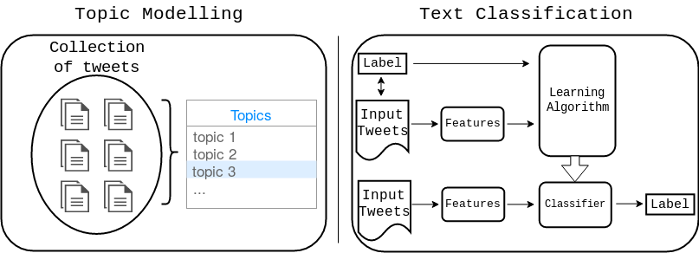
Text Analytics
Two different approaches in the implementation of the text analytics modules:
  Unsupervised approach – Topic Modelling;
  Supervised approach – Text Classification.

Slide 14
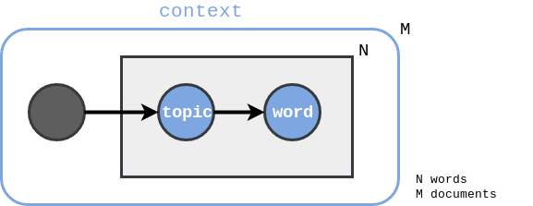
Topic Modelling
Latent Dirichlet Allocation (LDA) - Blei et al. [1]
  Generative probabilistic model;
  Aims to find the latent topics present in a collection of documents;
  Two distinct distributions:
    Distribution of words over topics;
    Distribution of topics over documents.
  We use the Python’s LDA library to implement this text analytics module.

Slide 15
Topic Modelling - Example
Topic 1:
20 most frequent words
paulo, vai, hoje, dia, jogo, ser, melhor, time, vamo, brazil, todo, santo, brasil, gol, cara, aqui, agora, corinthiam, ano, palmeiro, vem
Documents:
382,479 tweets in Rio de Janeiro
“Sports and Games” is distributed over

Slide 16
Travel-related Classification
What is a travel-related tweet?
  “estou ficando acostumada ver o nascer do sol de dentro de um ônibus ou estação de trem”
  “train is quicker they said , get the train they said”
We opt for using a supervised learning approach.
This approach required two important tasks:
  Features extraction;
  Construction of gold-standard datasets due to the lack of it in open-source repositories.

Slide 17
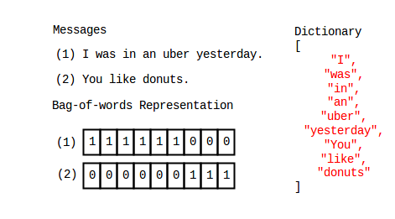
Travel-related Classification
Bag-of-words (BoW)
Majority of studies focus on conventional techniques
Dictionary size and words belonging to documents can be limited

Slide 18
Travel-related Classification
Word Embeddings
  Set of features in which words or phrases are mapped to vectors of real numbers;
  Model are generated using neural network and the context in which the word appears.
Notes:
Recent advances in word embeddings

Slide 19
Travel-related Classification
Word Embeddings
We explore the recent advances in word embeddings.
Word Embeddings
  Set of features in which words or phrases are mapped to vectors of real numbers;
  Model are generated using neural network and the context in which the word appears.

Slide 20

Travel-related Classification
Word Embeddings - The Fake Task
The network is going to learn the statistics from the number of times each pairing shows up.

Slide 21

Travel-related Classification
Paragraph2vec, a.k.a. doc2vec – Mikolov et al. [3]
  Similar to word2vec
  Each document has a label passed into the embeddings matrix
  Labels -> tweets ids
  A collection of pre-processed tweets is used as input to train the word embeedings models with support of the Gensim library for Python.

Slide 22
Aggregation and Visualization
Aggregation
  MongoDB provides inner frameworks that allow aggregation of data;
  These aggregation operations are easier and quickly because they are performed using a map-reduce paradigm
  Aggregation of results are made periodically.
Visualization
  Plotly is a Python library to produce graphical visualizations of data;
  The library allows local storage of these visualizations in HTML files;
  By exploring the embedding functionality of HTML5 we can demonstrate on-time visualizations.

Slide 23
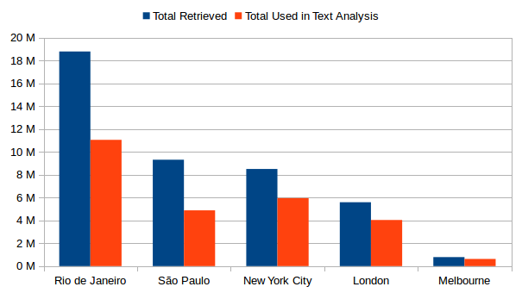
Exploratory Data Analysis
We decide to test our framework in 5 cities over the world: Rio de Janeiro, São Paulo, New York City, London and Melbourne.
We collect a total 43 million tweets over 3 months from March 12 to June 12, 2017.
Total volume of tweets collected in each city

Slide 24
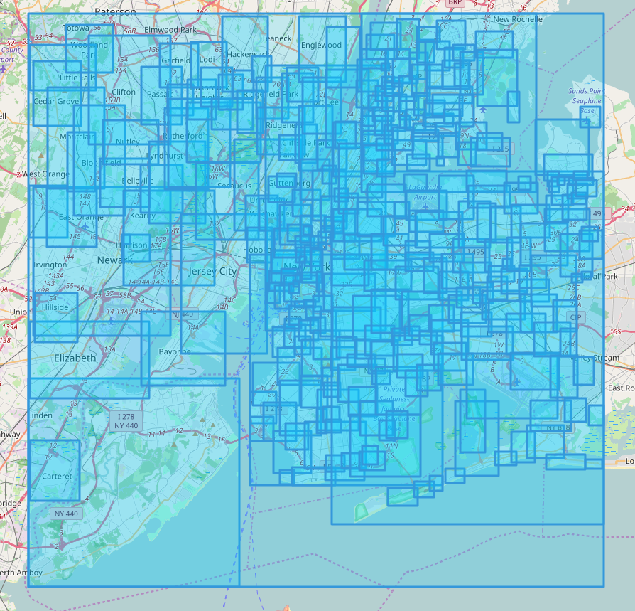
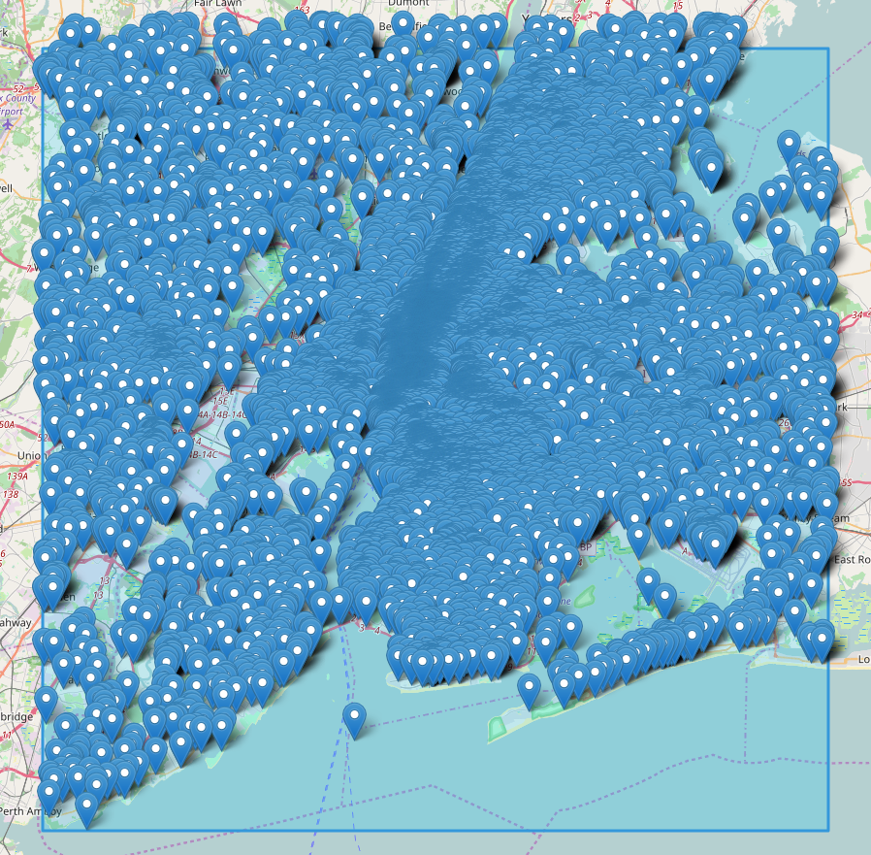
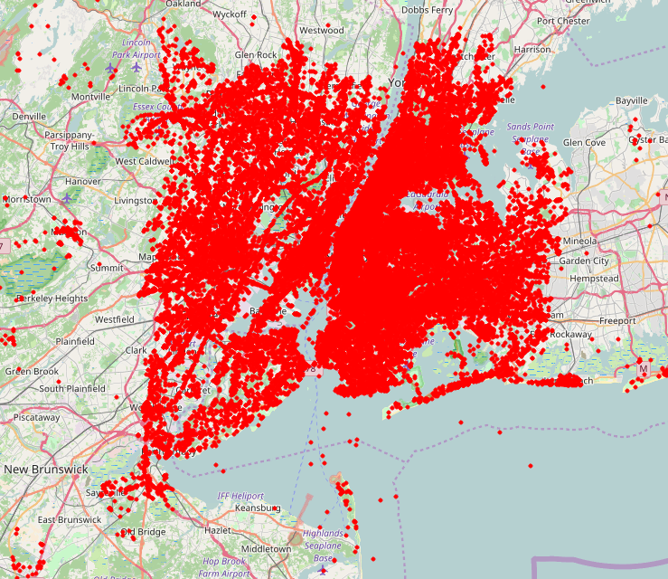
Geographical Statistics
  > 70% of geo-located tweets correspond to areas/regions
  Many studies do not report this fact
Bounding-boxes of variable size
Fixed places
Precise coordinates

Slide 25
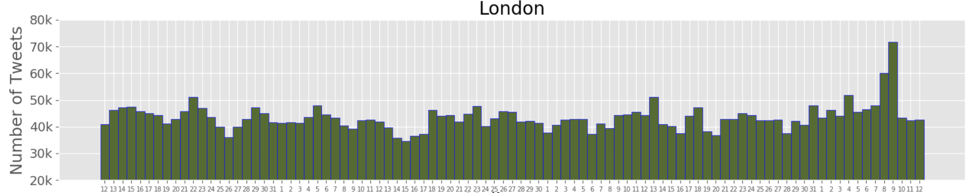
Temporal Frequencies
  Daily and hourly distributions of geo-located tweets allow the identification of potential remarkable events;
  The figure below shows a pike of the Twitter activity in London which is associated with United Kingdom General Elections 2017.
red – Westminster attack and London Bridge attack
blue – UK General Elections 2017

Slide 26
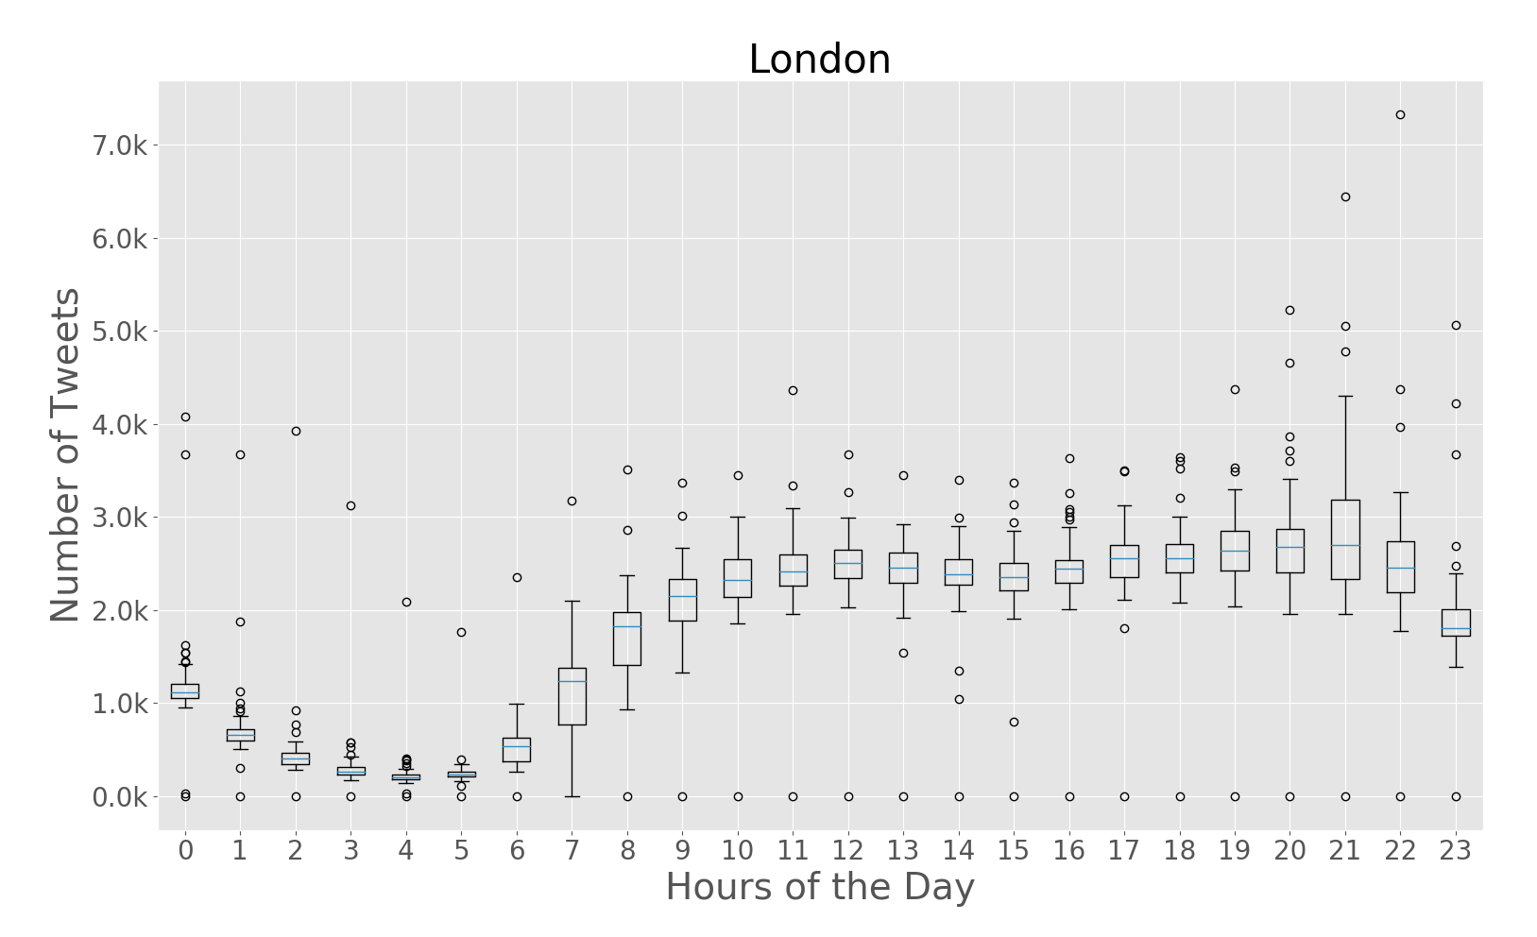
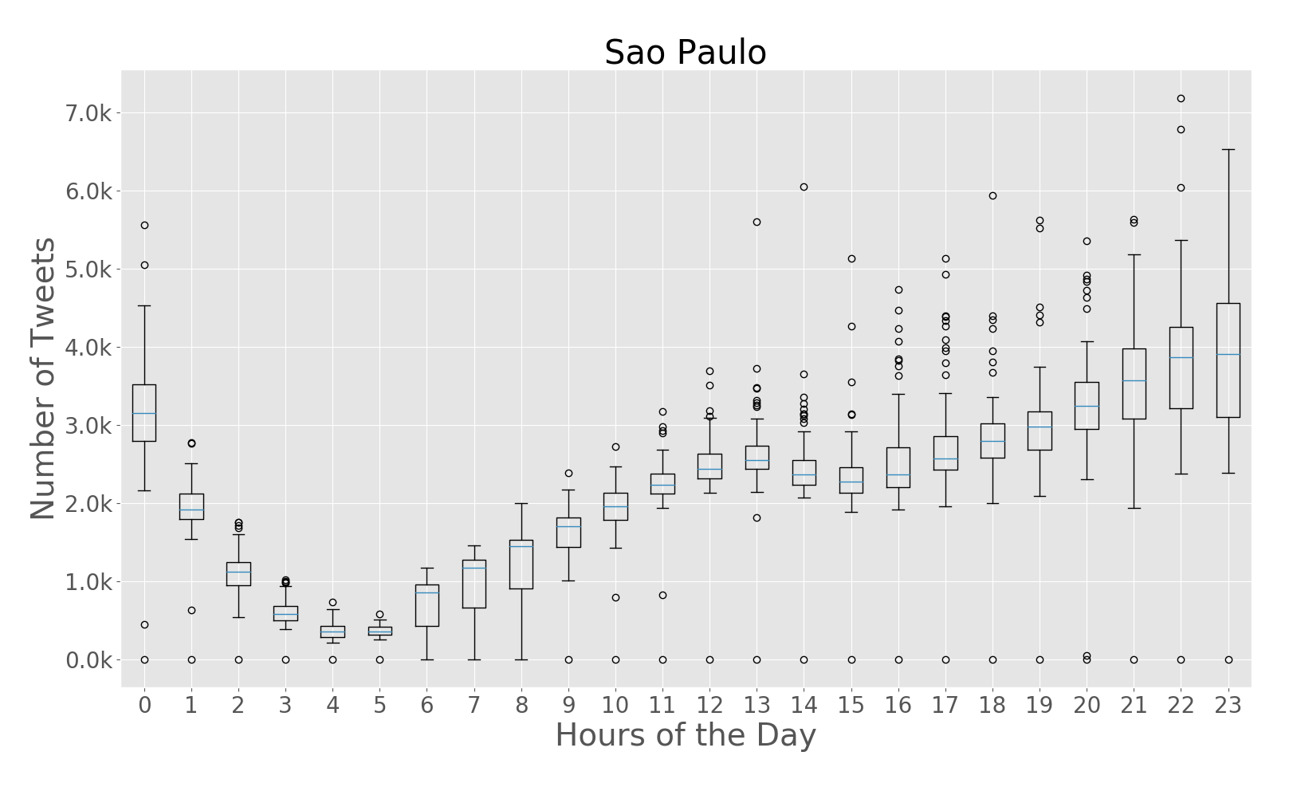
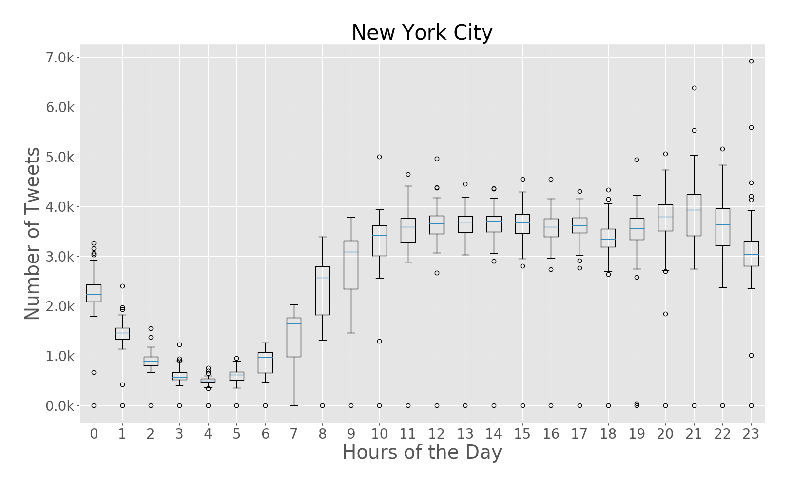
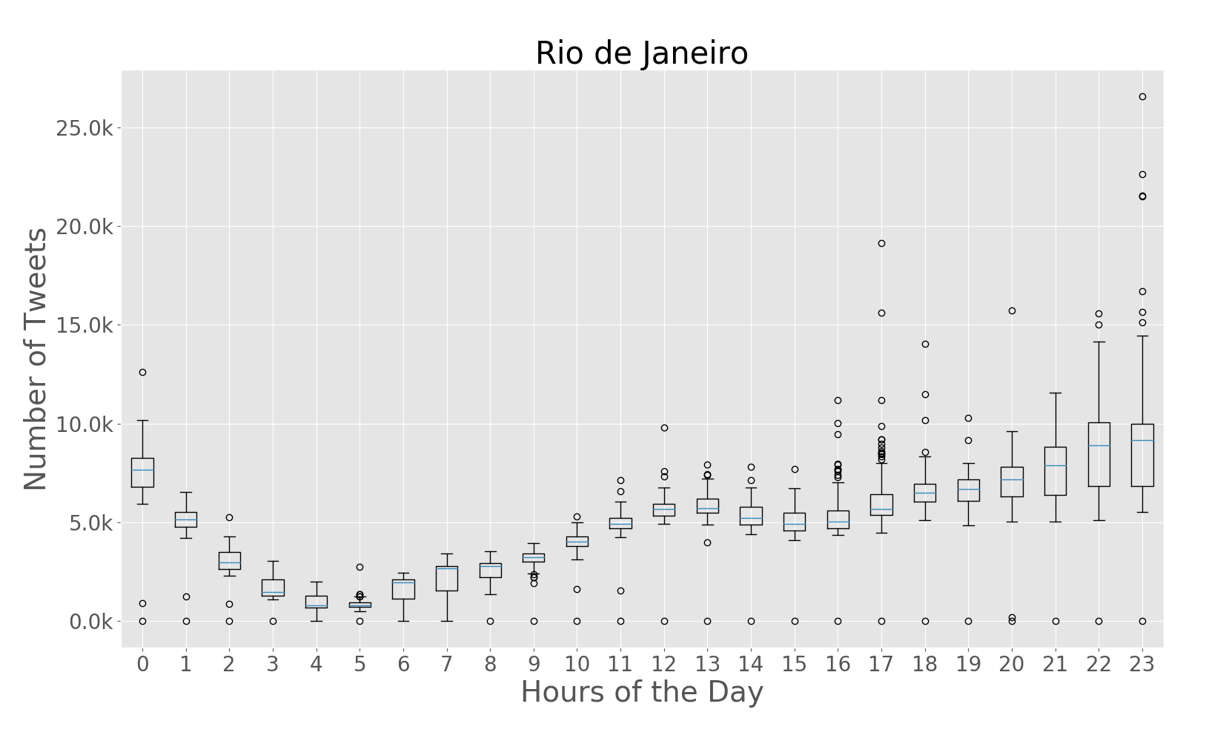
Temporal Frequencies
Hourly Frequencies

Slide 27
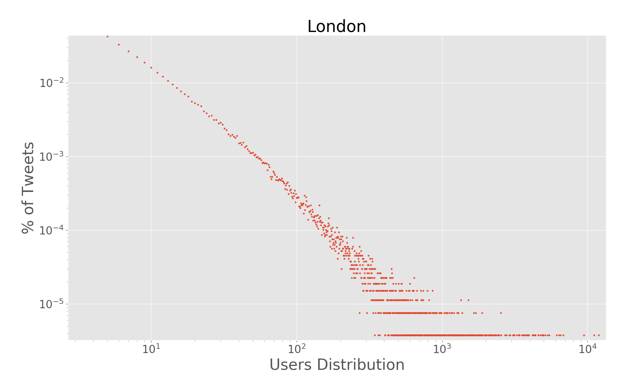
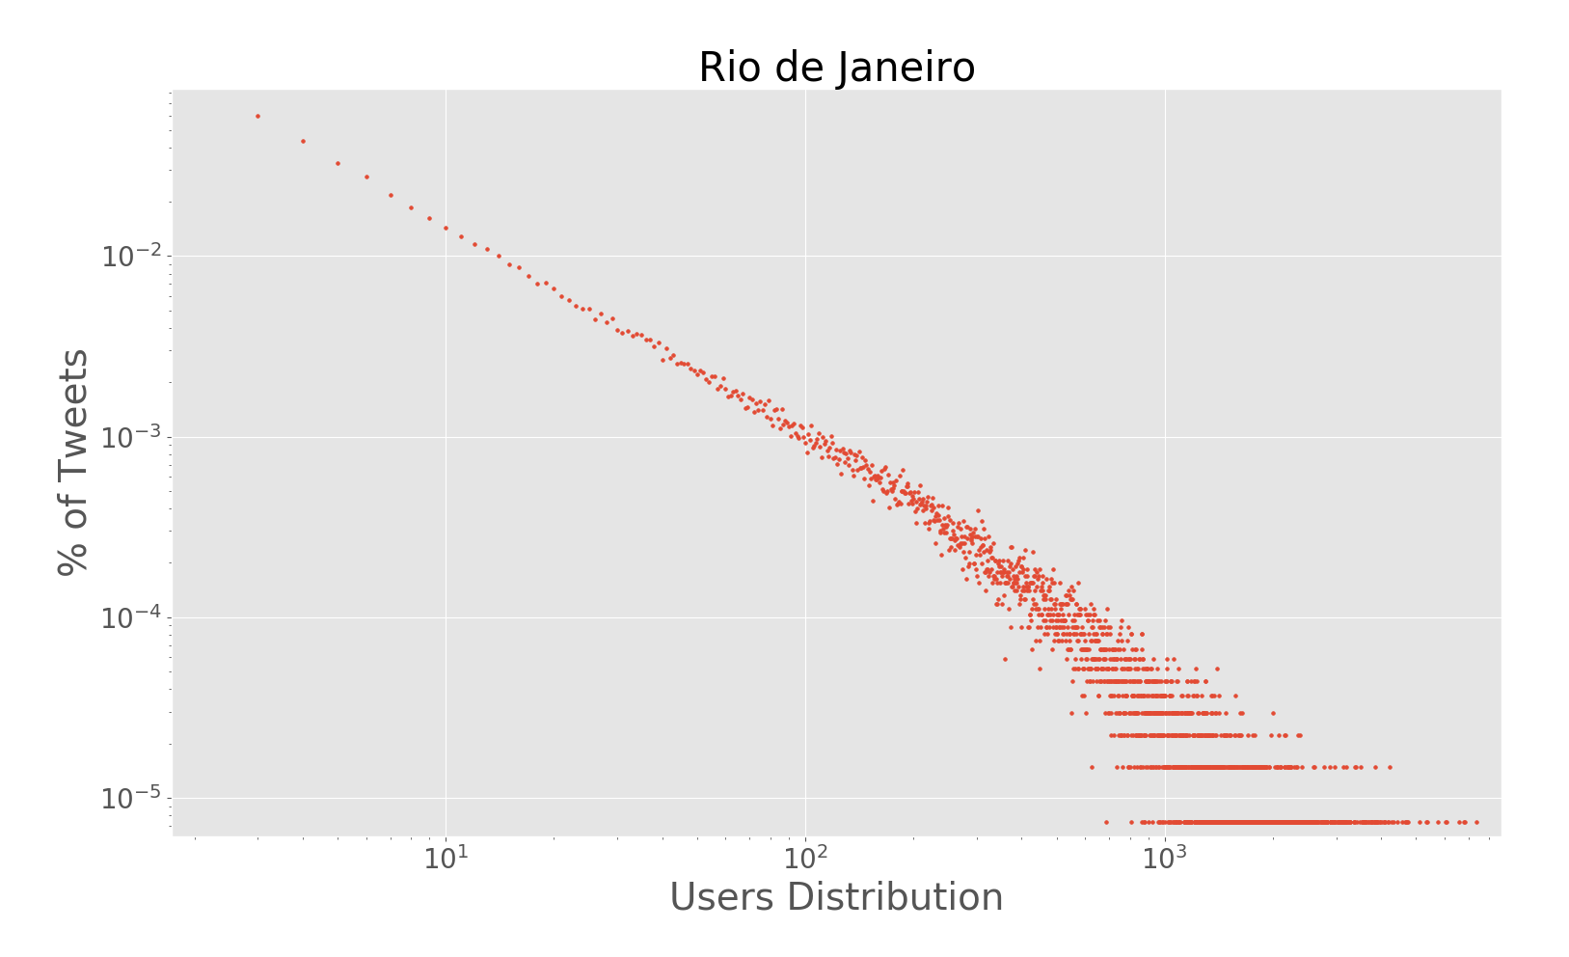
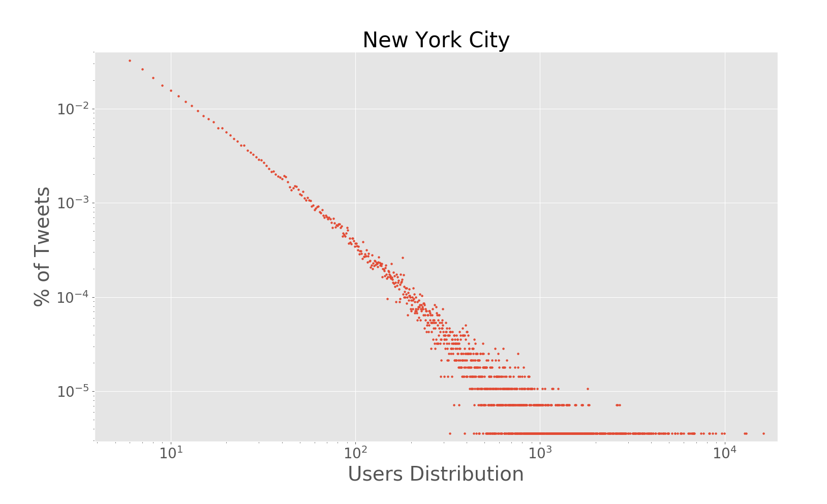
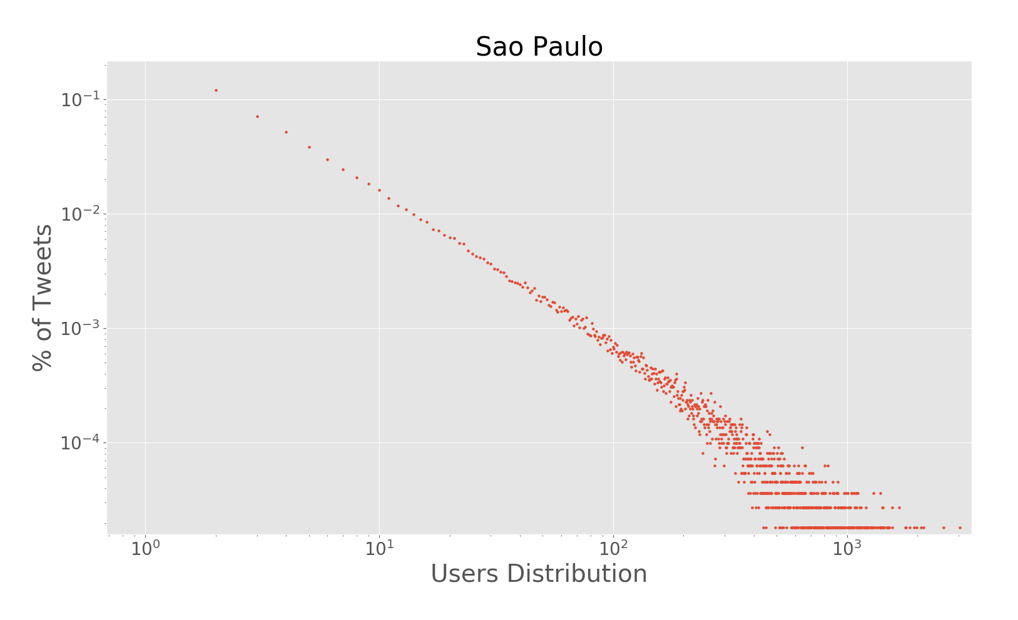
Users Distribution
  All cities presented similar user-tweets distributions
  Similar to a power-law

Slide 28
Text Analytics Experiments
Three experiments to text analysis
  Topic Modelling over Rio de Janeiro and São Paulo;
  Travel-related classification over Rio de Janeiro and São Paulo;
  Travel-related classification over New York City.

Slide 29
Topic Modelling in Brazil
6.6M geo-located tweets for Rio de Janeiro and 2.7M geo-located tweets for São Paulo
Text pre-processing operations – all previous mentioned
Features and Model parametrization:
  Train over 20 iterations (Lansley et al. [4])
  5, 10, 20, 25, 50 latent topics
  Bag-of-words:
    Dictionary limited to 10,000 words
    Words beloging to a maximum of 40% of documents
    Word minimal frequency - 10

Slide 30
Topic Modelling in Brazil
High number of overlap terms between topics – 5, 10, 20 and 25.
Final experiment model - 50 latent topics
Results:
  Topics labelling using a pre-defined taxonomy (Lansley et al. [4])
  Such topics were impossible to label according to the taxonomy
    For instance, “Academic Activities”, “BBB17”, “Relationships and Friendship”
  Overlapping of words between topics -> Topics Aggregation
    For instance, “European Football vs Brazilian Football”
  29 different topics, in which 2 are unique in each city

Slide 31
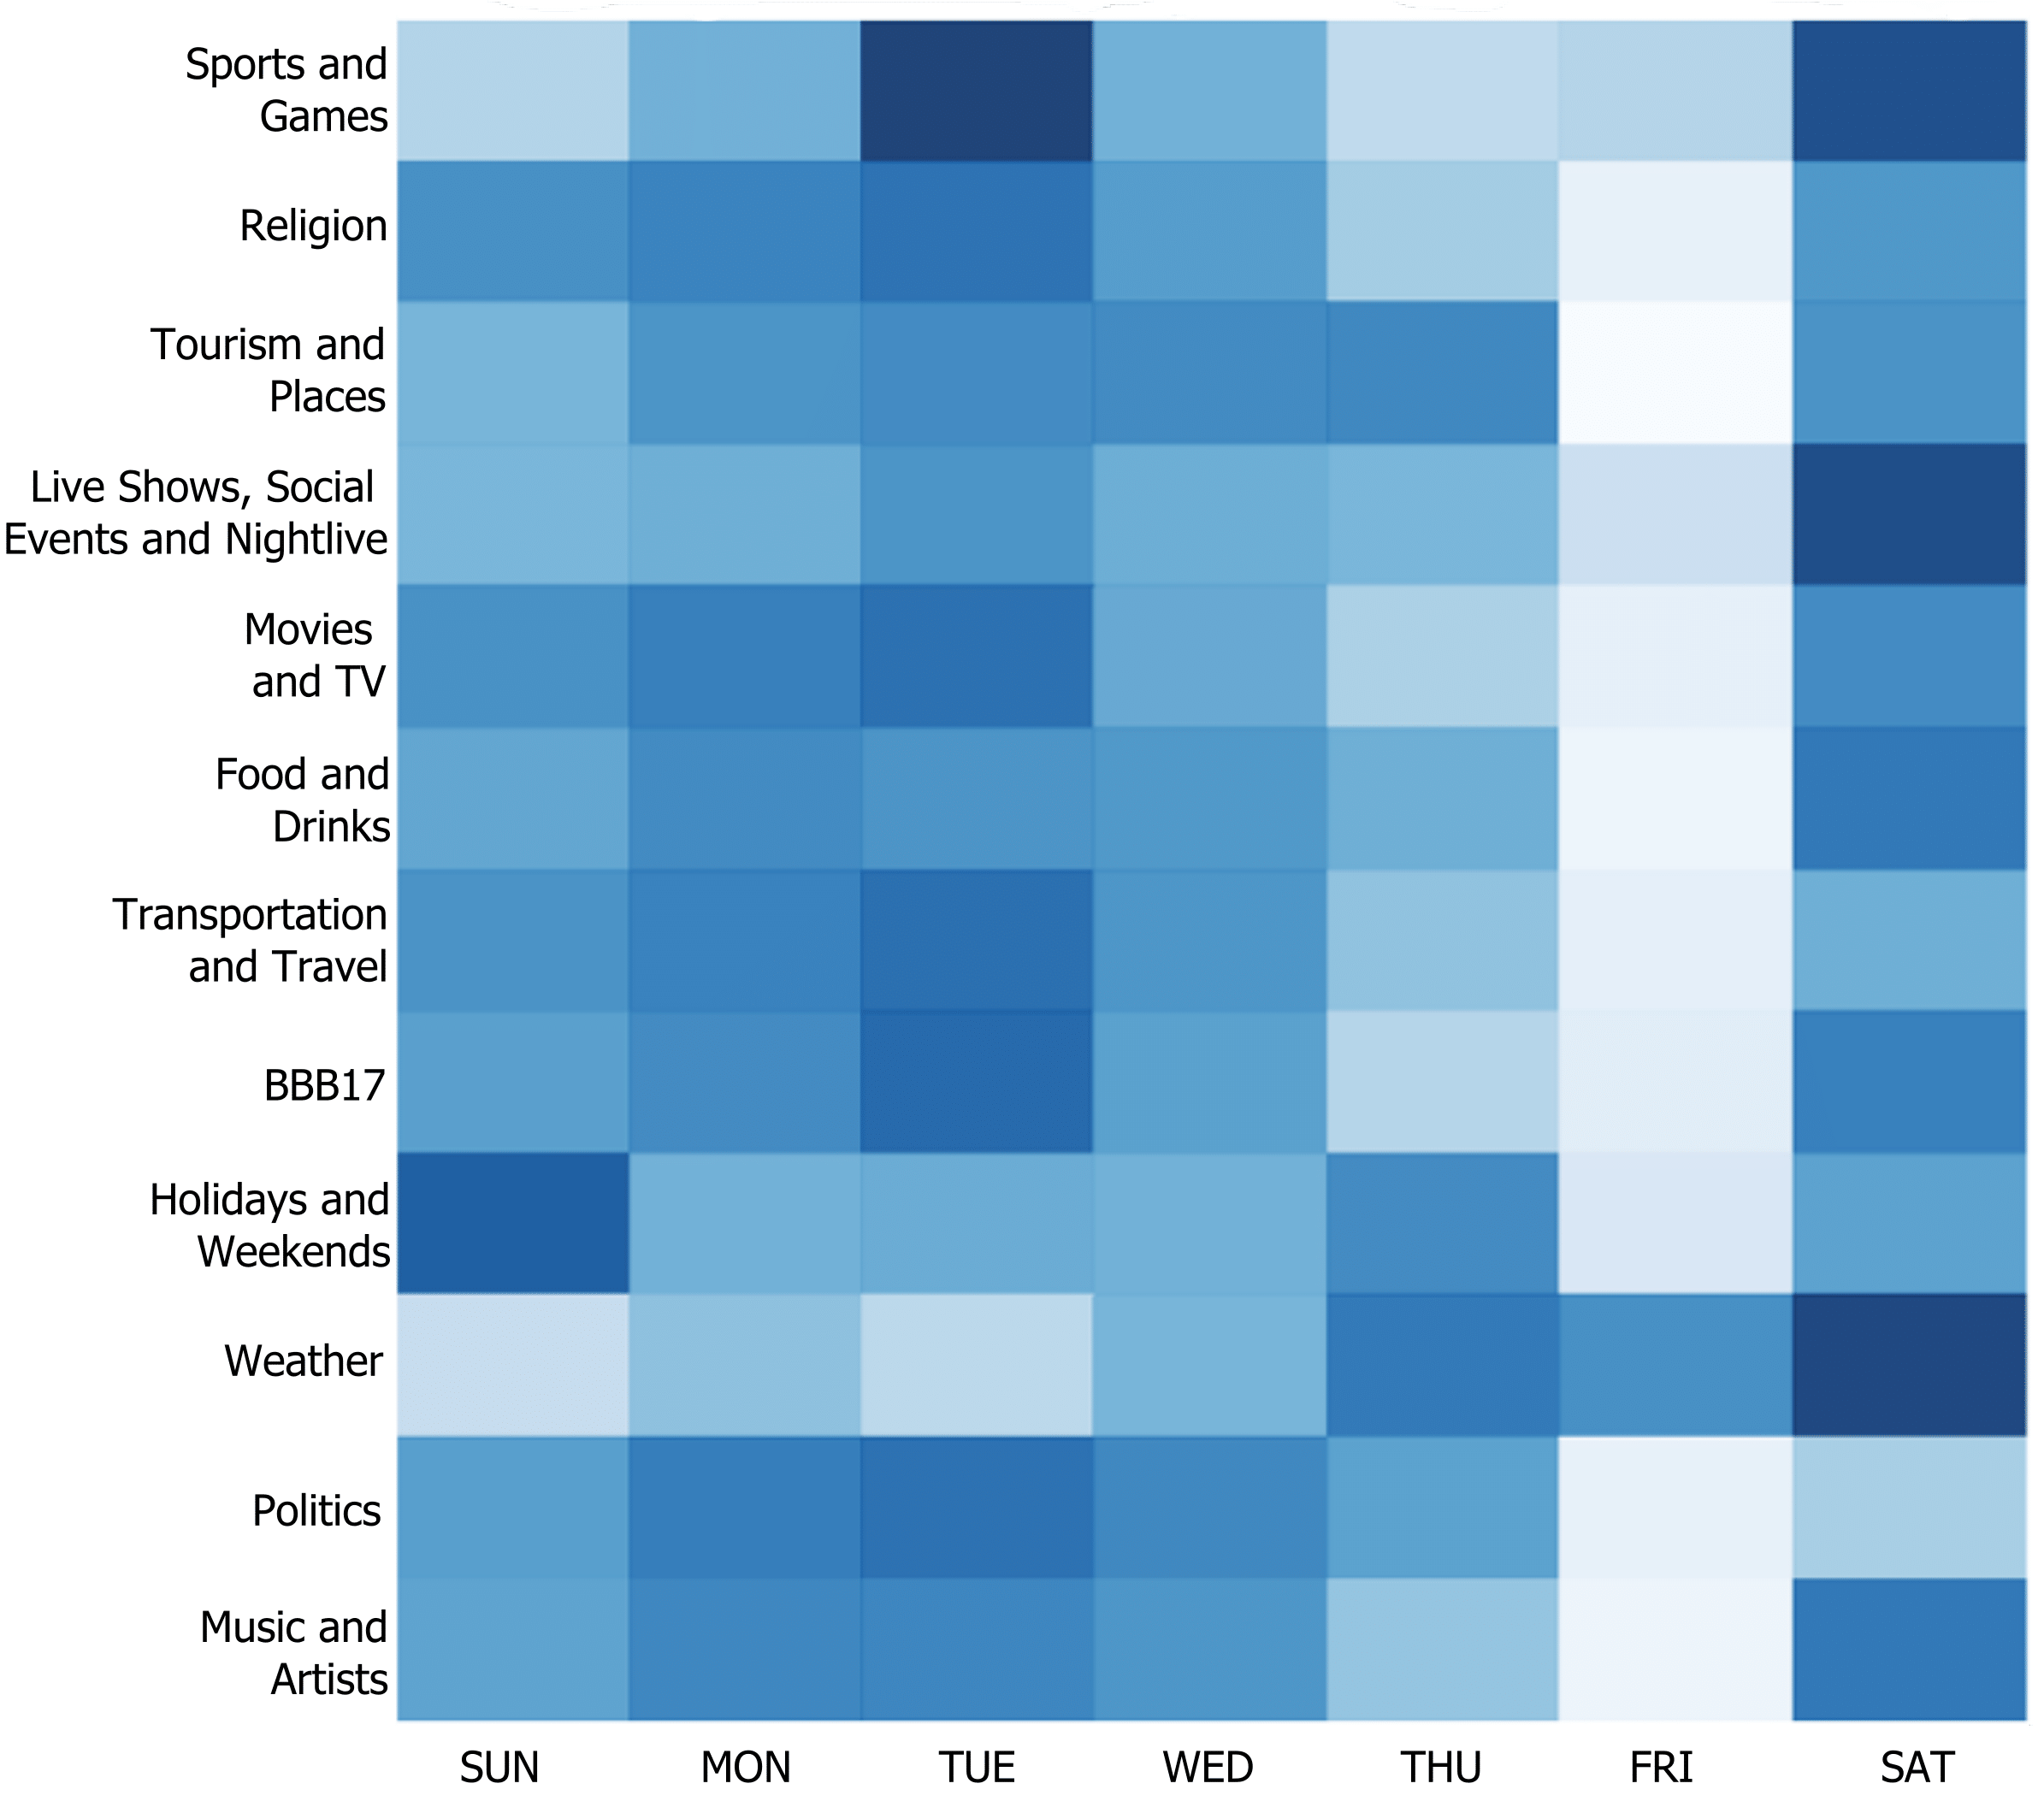
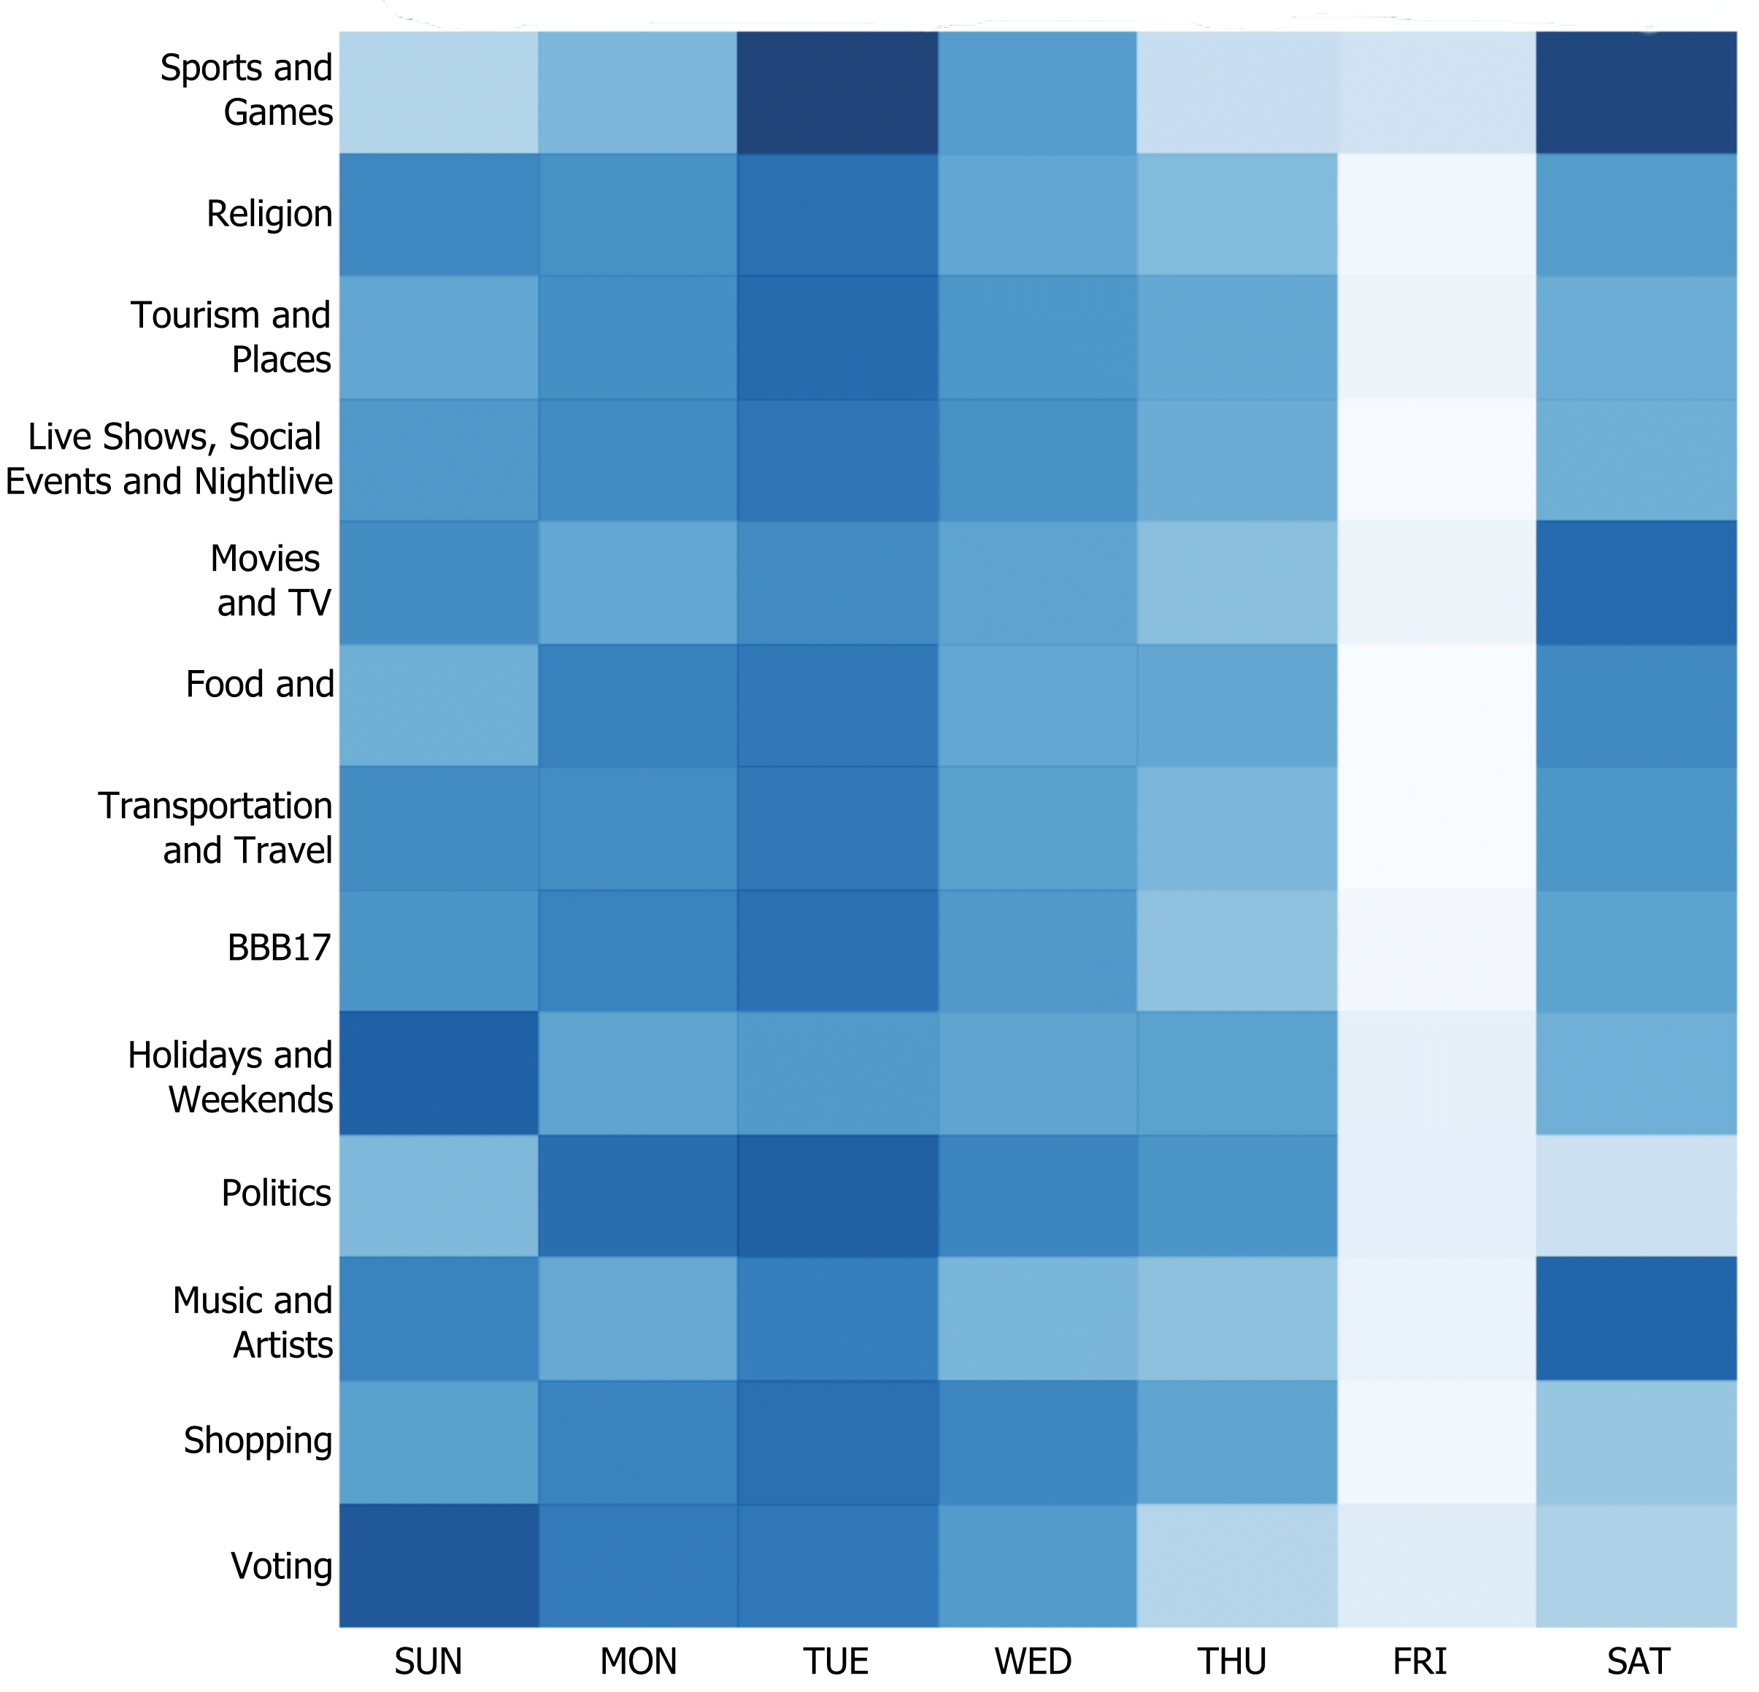
Topic Modelling in Brazil
Temporal Distribution of the Latent Topics
Rio de Janeiro
São Paulo

Slide 32
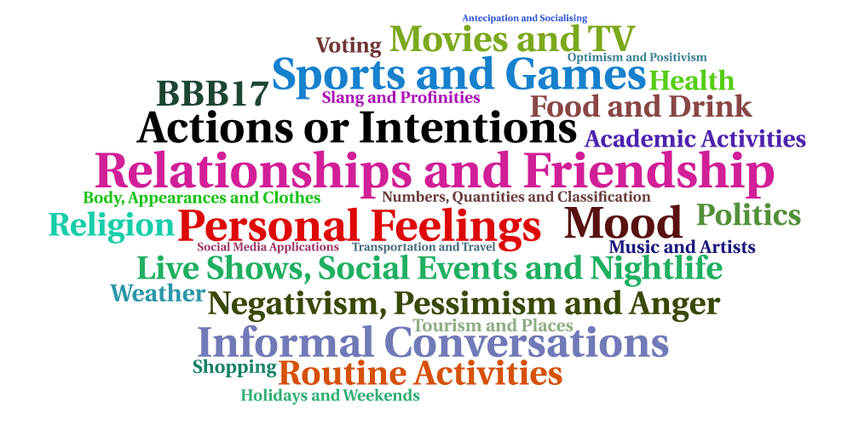
Topic Modelling in Brazil
Latent Topics Word Cloud

Slide 33
Travel-related Classification
Linear SVM, Logistic Regression and Random Forest
Text pre-processing operations:
  Lower casing
  Transformation of repeated characters
  Cleaning of metadata (user mentions and URLs)
  Removal of NLTK stop words
Evaluation Metrics:
  Precision, recall and F1-score
  ROC and AUC in Travel-related classification in Brazil

Slide 34
Travel-related Classification
Features and Models parametrization:
  Bag-of-embeddings:
    Context window of 2;
    Embeddings of 50, 100 and 200 dimensions
  Bag-of-words:
    Dictionary limited to 3,000 words
    Words beloging to a maximum of 60% of documents
    Word minimal frequency – 10
  Combination of both group of features.

Slide 35
Travel-related Classification in Brazil
7.7M geo-located tweets, during a period of 1 month, from March 12 to April 12, 2017
Training and Test datasets:
  Semi-automatic labeling approach
  Queries using terms of Maghrebi et al. [5]
    For instance, “carro”, “trem”, “ônibus”
  Balanced training set composed by 2,000 positive and 2,000 negative examples
  Existence of unknown terms in the test dataset
    For instance, “Busão” and “Uber”
  Test dataset - 71 travel-related tweets and 929 non-related.

Slide 36
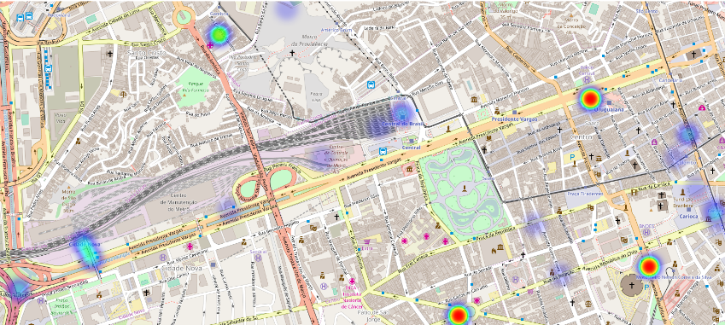
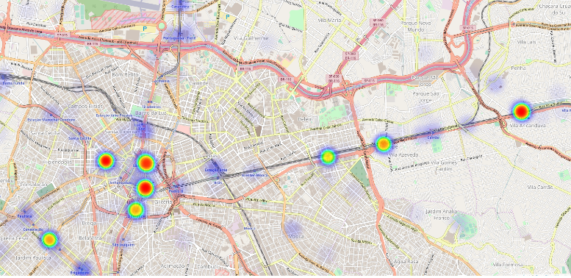
Travel-related Classification in Brazil
Results:
Best model – Linear SVM
F1-score - 0,8548
Group of features - BoW + BoE
AUC - 0,97
37,300 travel-related tweets
Rio de Janeiro – Central do Brasil
São Paulo – Metro line

Slide 37
Travel-related Classification in NYC
4M geo-located tweets in New York City, during a period of 2 months, from March 12 to May 12, 2017
Training and Test datasets:
  Two-phase approach - polysemy of English terms
    For instance, “walk” and “train”
  Balanced training set composed by 1,686 positive and 1,686 negative examples
  Balanced travel-mode classes in the positive examples
  Inclusion of ambiguous geo-located tweets in the negative examples set

Slide 38
Travel-related Classification in NYC
Training Strategy:
k-fold cross-validation - 10 iterations
Preliminary Results:
Best Classifier - Logistic Regression with BoE (200) + BoW
F1-score - 0,98324
Classifier | Features | F1-score
Linear SVM | BoE (200) | 0,87089
 | BoW | 0,96962
 | BoE (200) + BoW | 0,98170
Logistic Regression | BoE (100) | 0,87447
 | BoW | 0,97222
 | BoE (200) + BoW | 0,98324
Random Forests | BoE (100) | 0,82394
 | BoW | 0,97764
 | BoE (50) + BoW | 0,96701
Bag-of-words
dependency???
Notes:
In fact, all models performed incredibly well, arising questions about the robustness of the training features.

Slide 39
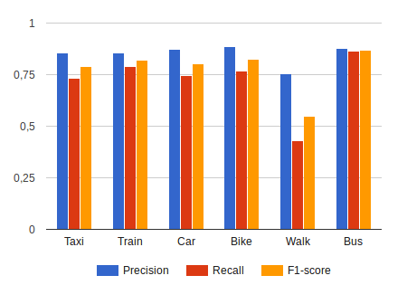
Travel-related Classification in NYC
Leave-one-group-out strategy:
  Hiding one travel-mode class at a time from the training
  Compare models using BoW and BoE features separately
  10-fold cross-validation
Classifier | Features | Mean F1-score
Random Forests | BoW | 0,12629
 | BoE (50) | 0,78447
Logistic Regression | BoW | 0,12629
 | BoE (50) | 0,80219
Linear SVM | BoW | 0,12203
 | BoE (200) | 0,81289
The x-axis are the hidden classes.
Notes:
In a real-world scenario new transportation modes emerges unexpectedly
10-fold cross-validation is maintain and final results are calculated through the mean of each model performance.

Slide 40
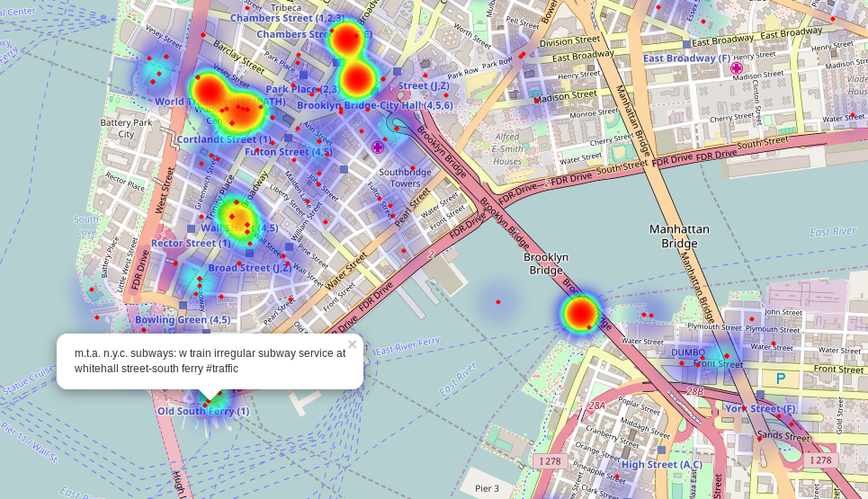
Travel-related Classification in NYC
Final model
  BoE with 200 dimensions
  Trained with all travel-mode classes together
  Dataset prediction, 300,000 travel-related tweets
South of Manhattan and over look at the Brooklyn Bridge.

Slide 41
Conclusions

Slide 42
Main Results
Continuous collection of geo-located tweets from multiple bounding-boxes in parallel and in compliance with Twitter API usage limits;
Tackling Twitter Streaming API inconsistencies and filtering noisy tweets;
Implement standard text pre-processing methods for social media texts;
Content analysis using topic modeling and comparative characterization among different bounding boxes (e.g. cities);
Travel-related classification of tweets using supervised learning;
Train word embeddings from geo-located tweets;
Study the impact of word embeddings in travel-related classification;
Creation of gold-standard data for travel-related supervised learning;
Aggregation and visualization of results.

Slide 43
Contributions
Technical Contributions
  Design and implementation of a framework in Python to collect geo-located tweets;
  The framework allows the monitoring of multiple bounding-boxes (cities and regions).
Applicational Contributions
  First large scale study with respect to topic modelling and geo-located tweets in Brazil;
  Application of word embeddings to text classification tasks in the context of smart cities and ITS.
Scientific Contributions
  Document the results of experiments and approaches in scientific papers;
  Sharing of the gold-standard datasets created in this dissertation.

Slide 44
Publications
Transportation in Social Media: an automatic classifier for travel-related tweets. In Portuguese Conference on Artificial Intelligence (EPIA), 2017. Published.
Classifying Travel-related Tweets Using Word Embeddings. In IEEE 20th International Conference on Intelligent Transportation Systems (IEEE ITSC), 2017. Under review.
Characterizing Geo-located Tweets in Brazilian Megacities. In The Third International Smart Cities Conference (ISC2), 2017. Under review.

Slide 45
Future Work
Evaluate intrinsically the embeddings produced and share the final benchmarks;
Application of a sentiment analysis module to enrich the extracted information;
Training of embeddings with deep learning models;
Produce statistics to the unexplored scenarios, London and Melbourne;
Creation of more complex documents to retrain the model responsible for identification of latent topics.
Cross the results from travel-related classification with official data of the transportation services.

Slide 46
References

Slide 47
Social Media Text Processing and Semantic Analysis for Smart Cities
Thank you
Special thanks to Pedro Saleiro, Rosaldo Rossetti and Arian Pasquali.

