Slide 1


Social Media Text Processing and Semantic Analysis for Smart Cities
MSc Dissertation Viva
João Pereira
Supervision:
Rosaldo Rossetti
Pedro Saleiro
July 14, 2017

Slide 2
Agenda
Scope
Problem Statement
Goals
State of the Art
Framework
Exploratory Data Analysis
Text Analytics Experiments
Conclusions

Slide 3
Scope
Instant connectivity 24/7
Sharing of events, opinions and activities
Many research areas have tried to exploit social media data
Smart Cities and Intelligent Transportation Systems are also obvious candidates
Information derived from such exploration may bring benefits to the cities’ governance, traffic-flow management, etc.
Notes:
Actualmente, as pessoas conseguem estar conectadas à Web num periodo 24 horas por dia em 7 dias da semana. O desenvolvimento tecnologico, como por exemplo os smart phone, possibilita as pessoas partilhem momentos da sua vida nas redes sociais, opiniões, comentarios e partilha eventos, noticias, actividades, desporto que praticam. Várias áreas já demonstraram interesse no tipo de neste informação que as redes sociais fornecem. As smart cities e serviços de transporte não sao exceção, uma vez que a exploração deste tipo de dados pode fornecer informações relevantes para ajudar a controlar o bem-estar de uma cidade, encontrar soluºoes para problemas governamentais e suporte no controlo de trafego rodoviario por exemplo.

Slide 4
Problem Statement
Mining social media data is a laborious and time-consuming process.
  Social media platforms have their own specificities
  The volume of data retrieved is overwhelming
  Social media texts have several restrictions
Notes:
Porém extrair informação util de dados das redes sociais apresenta alguns desafios.
a) Primeiro, as plataformas destas redes, como as APIs, possuem as suas proprias especifidades relativamente à recolha dos dados, formato dos dados devolvidos.
b) volume gigantestco torna dificil a extração automatica de info util e o filtro de ruido.
c) por fim, as mensagens das redes sociais apresentam desafios quanto Às tarefas de processamento necessarios para chegarmos à informação desejada. O curto cumprimento e informalidade nas mensagens sã alguns destes problemas.

Slide 5
Goals
Design and development of a framework for continuous collection of tweets from multiple bounding-boxes
Discovering of latent topics in the Twitter data
Travel-related classification of tweets using supervised learning
Aggregation and visualization of results
Notes:
2) a descoberta de topicos nas cidades permite a characterização de regioes a nivel geografico e temporal
3) A classificação de travel-related tweets permite a soluçao para o filtro das mensagens com informaão util do ruido
4) agregação e demonstração dos resultados finais

Slide 6
State of the Art
Lansley et al. (2016) depicted topic modelling over geo-located tweets in London and cross the results with geographic maps to identify land-use patterns
Maghrebi et al. (2016) classified travel-mode geo-located tweets using term-based search in Melbourne
Kuflik et al. (2017) performed multi-class transport classification over geo-located tweets from Liverpool
Notes:
O trabalho produzido nesta dissertação teve como principal inspiração este 3 papers cientificos.
Maghrebi utilizou termos relacionados com modos de transporte para filtrar tweets relacionados com cada modo na cidade de Melbourne
Kuflik classificou diferentes modos de transport usando geo-located tweets na cidade de Liverpool recorrendo a tecnicas de aprendizagem supervionada.

Slide 7
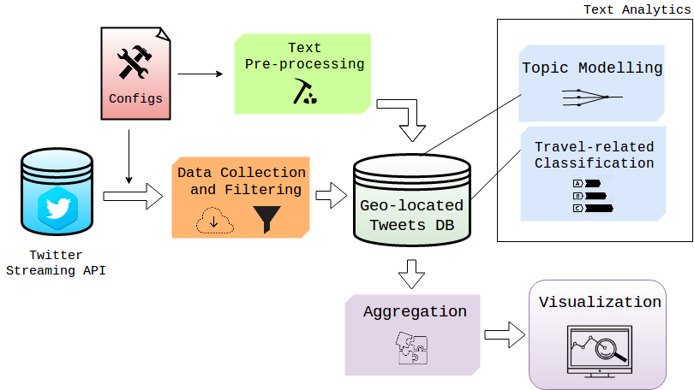
Architecture Overview

Slide 8

Data Collection
Twitter Streaming API allows three different collection heuristics:
  Term-based search
  Users’ activity
  Locations through bounding-box system
Tweepy is an open-source Python library to acess the Twitter APIs
Notes:
Este modulo foi implemntado recorrendo a uma biblioteca de Python, com nome Tweepy. Esta biblioteca permite acesso às APIs do Twitter nomeadamente a Streaming API.

Slide 9
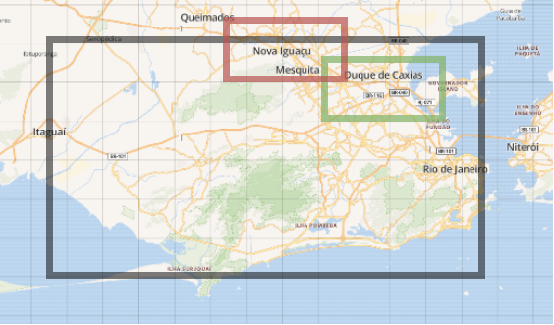
Data Filtering
The data retrieved has two inconsisitencies:
  A large amount of tweets in different languages comparative to the one spoken in the target city
  Tweets from the outside of the searching bounding-box are retrieved by the API
Notes:
“The black square represents the searching bounding-box, while the red square represents a tweet with place_id “Nova Iguaçu” and the green one a tweet with place_id “Duque de Caxias”. The tweet associated to the red square is filtered out of the final dataset.”

Slide 10
Text Pre-processing
We apply a considerable group of text pre-processing operations to the messages
  Lowercasing
  Lemmatization
  Tokenization
  Transformation of repeated characters
  Punctuation removal
  Cleaning of metadata and numerical symbols in the text
  Stop and short words removal

Slide 11
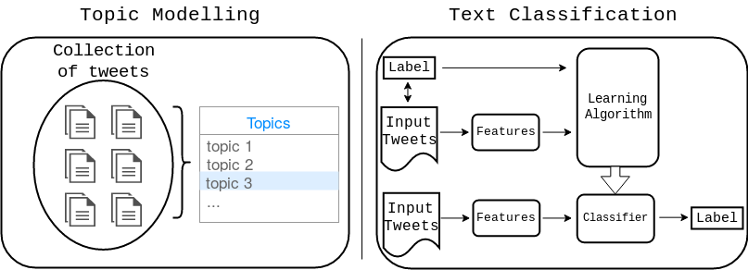
Text Analytics
Two different approaches in the implementation of the text analytics modules:
  Unsupervised approach – Topic Modelling
  Supervised approach – Text Classification

Slide 12
Topic Modelling - Example
Topic 1:
20 most frequent words
paulo, vai, hoje, dia, jogo, ser, melhor, time, vamo, brazil, todo, santo, brasil, gol, cara, aqui, agora, corinthiam, ano, palmeiro, vem
Documents:
382,479 tweets in São Paulo
Topic 1 has the label “Sports and Games”
Topic 2:
20 most frequent words
paulo, brazil, sao, santo, vila, just, parque, posted, photo, shopping, paulista, centro, bernardo, jardim, cidade, avenido, praia, santa, campo, academia
Documents:
86,519 tweets in São Paulo
Topic 2 has the label “Tourism and Places”

Slide 13
Travel-related Classification
What is a travel-related tweet?
  “estou ficando acostumada ver o nascer do sol de dentro de um ônibus ou estação de trem”
  “train is quicker they said , get the train they said”
We opt for using a supervised learning approach using a combination of word-embeddings and bag-of-words
This approach required two important tasks:
  Features extraction
  Construction of gold-standard datasets due to the lack of travel-related datasets in open-source repositories

Slide 14
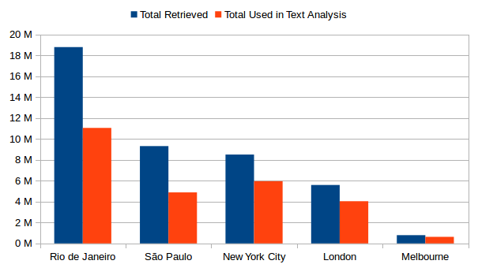
Exploratory Data Analysis
We decided to test our framework in 5 cities over the world: Rio de Janeiro, São Paulo, New York City, London and Melbourne
We collected a total 43 million tweets over 3 months from March 12 to June 12, 2017
Total volume of tweets collected in each city

Slide 15
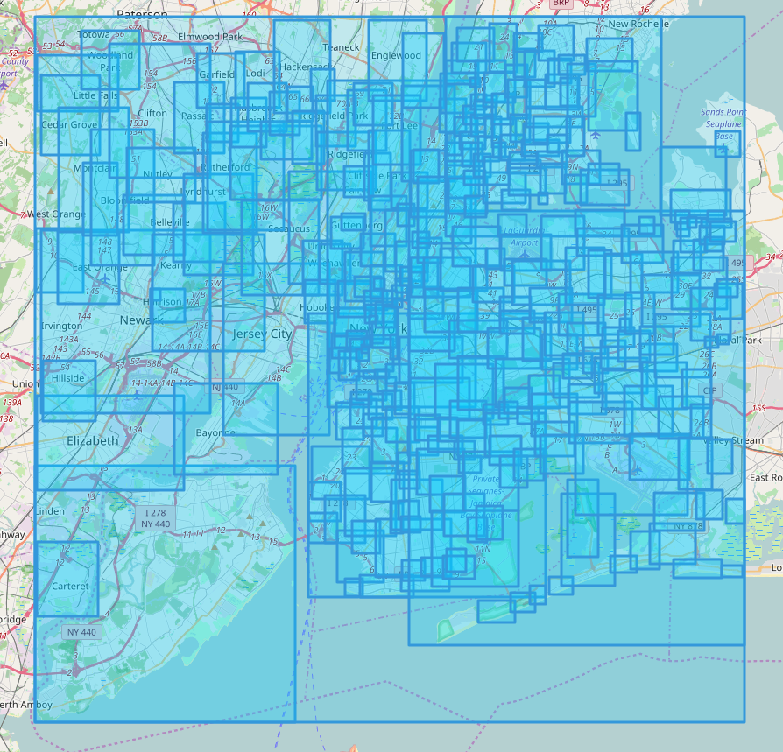
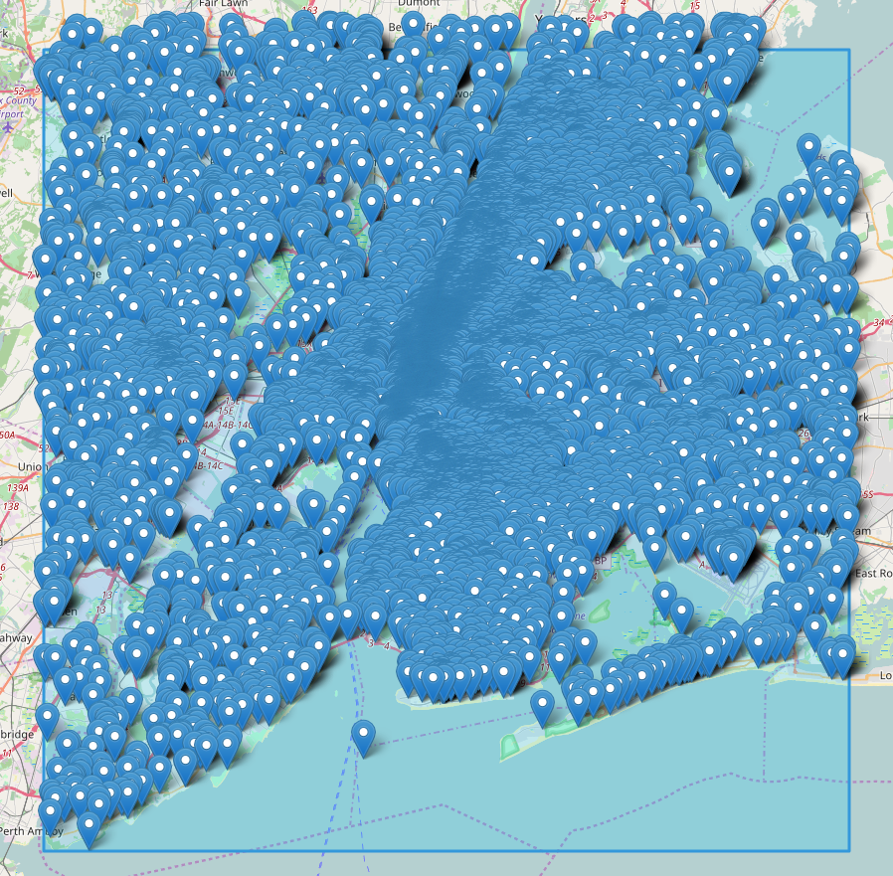
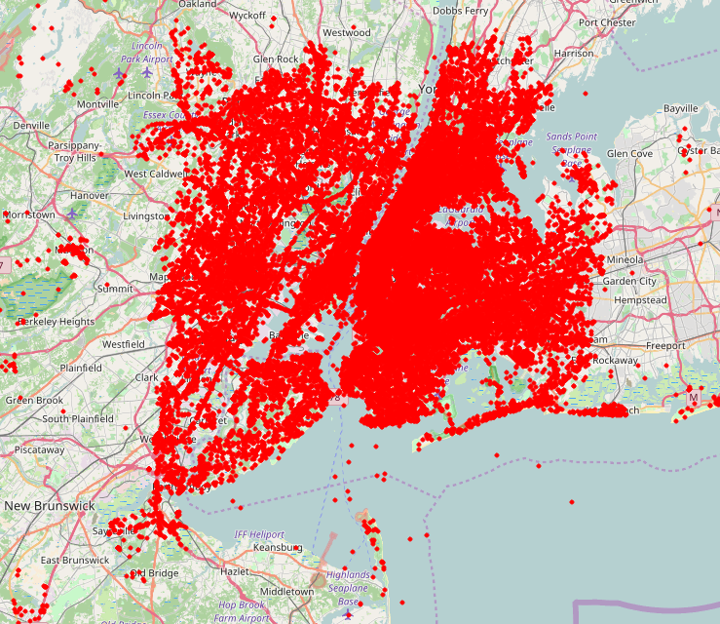
Geographical Statistics
  > 70% of geo-located tweets correspond to areas/regions
  Many studies do not report this fact
Bounding-boxes of variable size
Fixed places
Precise coordinates

Slide 16
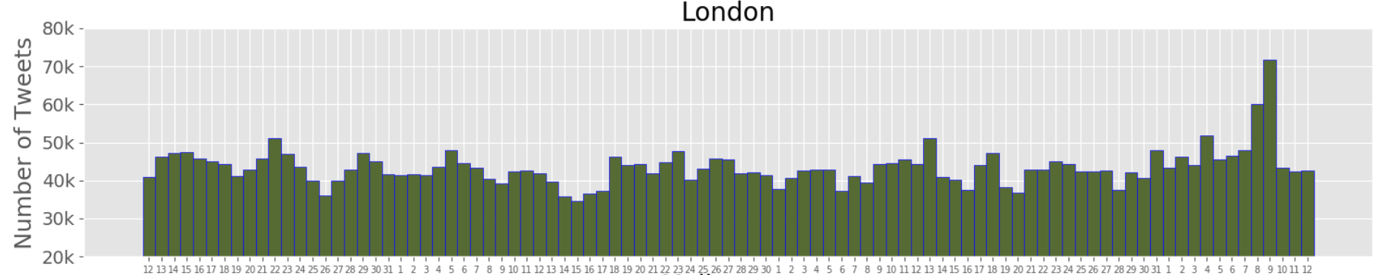
Temporal Frequencies
  Daily and hourly distributions of geo-located tweets allow the identification of potential remarkable events
red – Westminster attack and London Bridge attack
blue – UK General Elections 2017

Slide 17
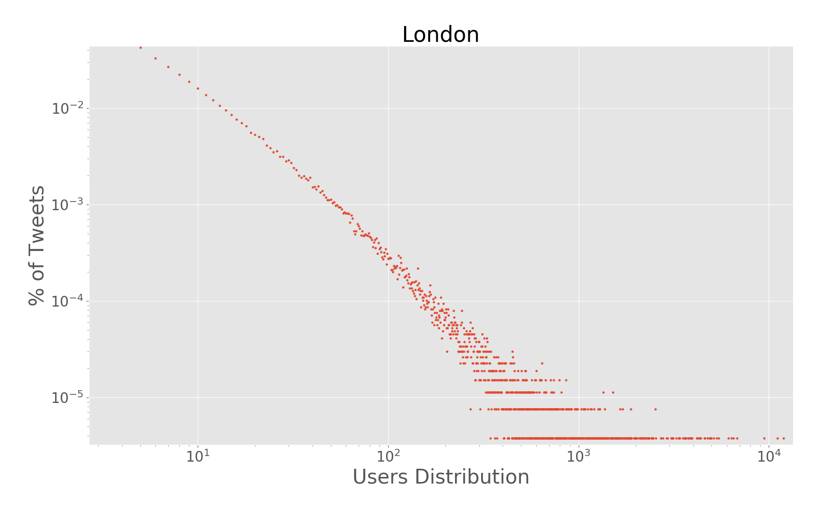
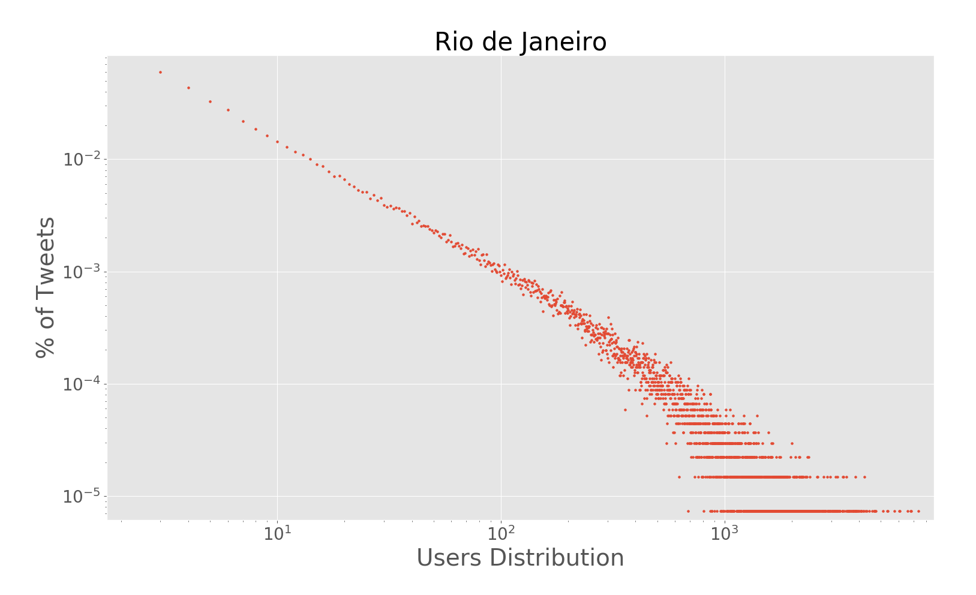
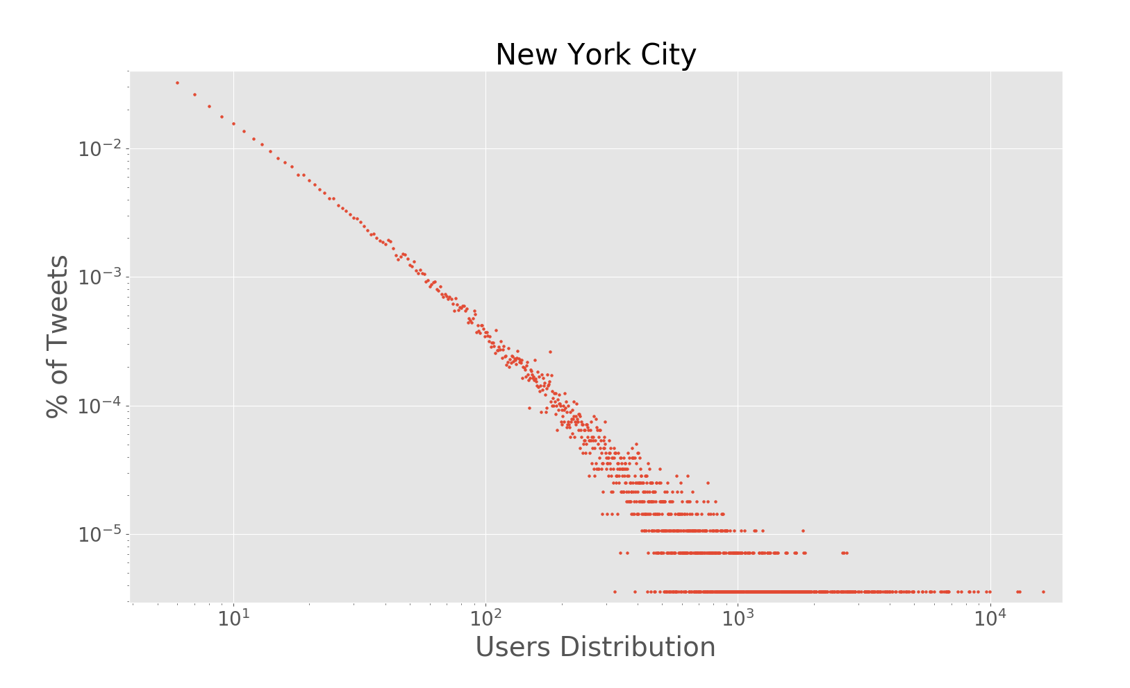
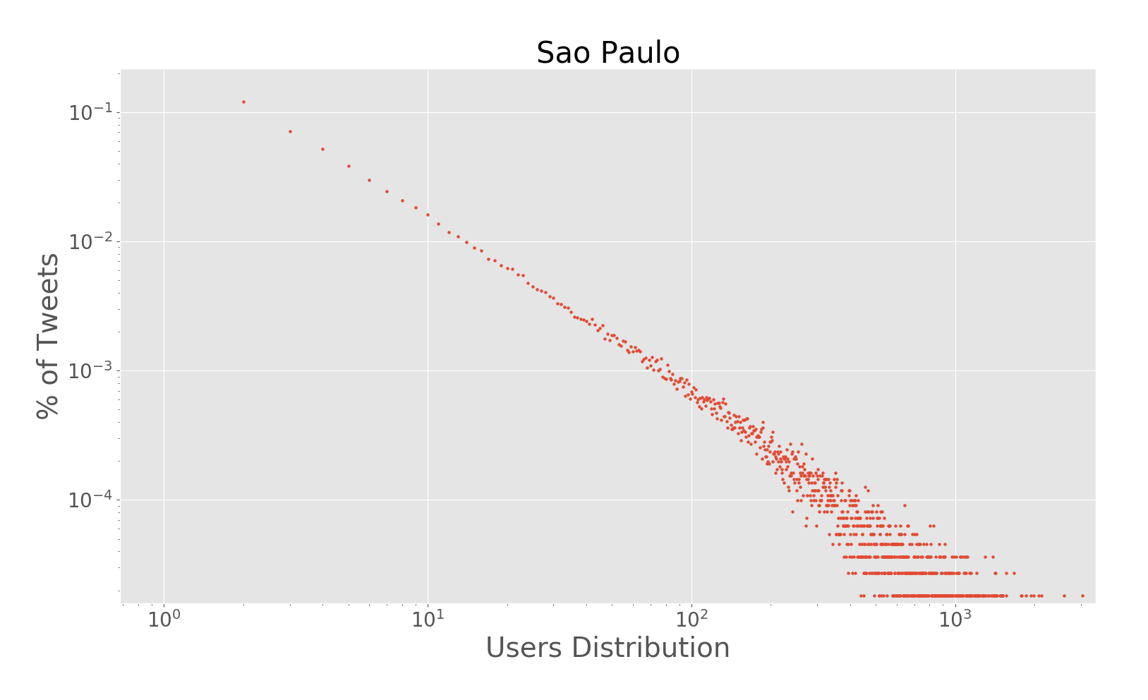
Users Distribution
  User-tweets distributions are similar to a power-law distributions

Slide 18
Topic Modelling in Brazil
6.6M geo-located tweets for Rio de Janeiro and 2.7M geo-located tweets for São Paulo
Text pre-processing operations – all previous mentioned
Features and Model parametrization:
  Train over 20 iterations - Lansley et al. (2016)
  5, 10, 20, 25, 50 latent topics
  Bag-of-words:
    Dictionary limited to the 10,000 most frequent words
    Words beloging to a maximum of 40% of documents
    Word minimal frequency - 10

Slide 19
Topic Modelling in Brazil
High number of overlap terms between topics – 5, 10, 20 and 25.
Final experiment model - 50 latent topics
Results:
  Topics labelling using a pre-defined taxonomy - Lansley et al. (2016)
  Such topics were impossible to label according to the taxonomy
    For instance, “Academic Activities”, “BBB17”, “Relationships and Friendship”
  Overlapping of words between topics -> Topics Aggregation
    For instance, “European Football vs Brazilian Football”
  29 different topics, in which 2 are unique in each city

Slide 20
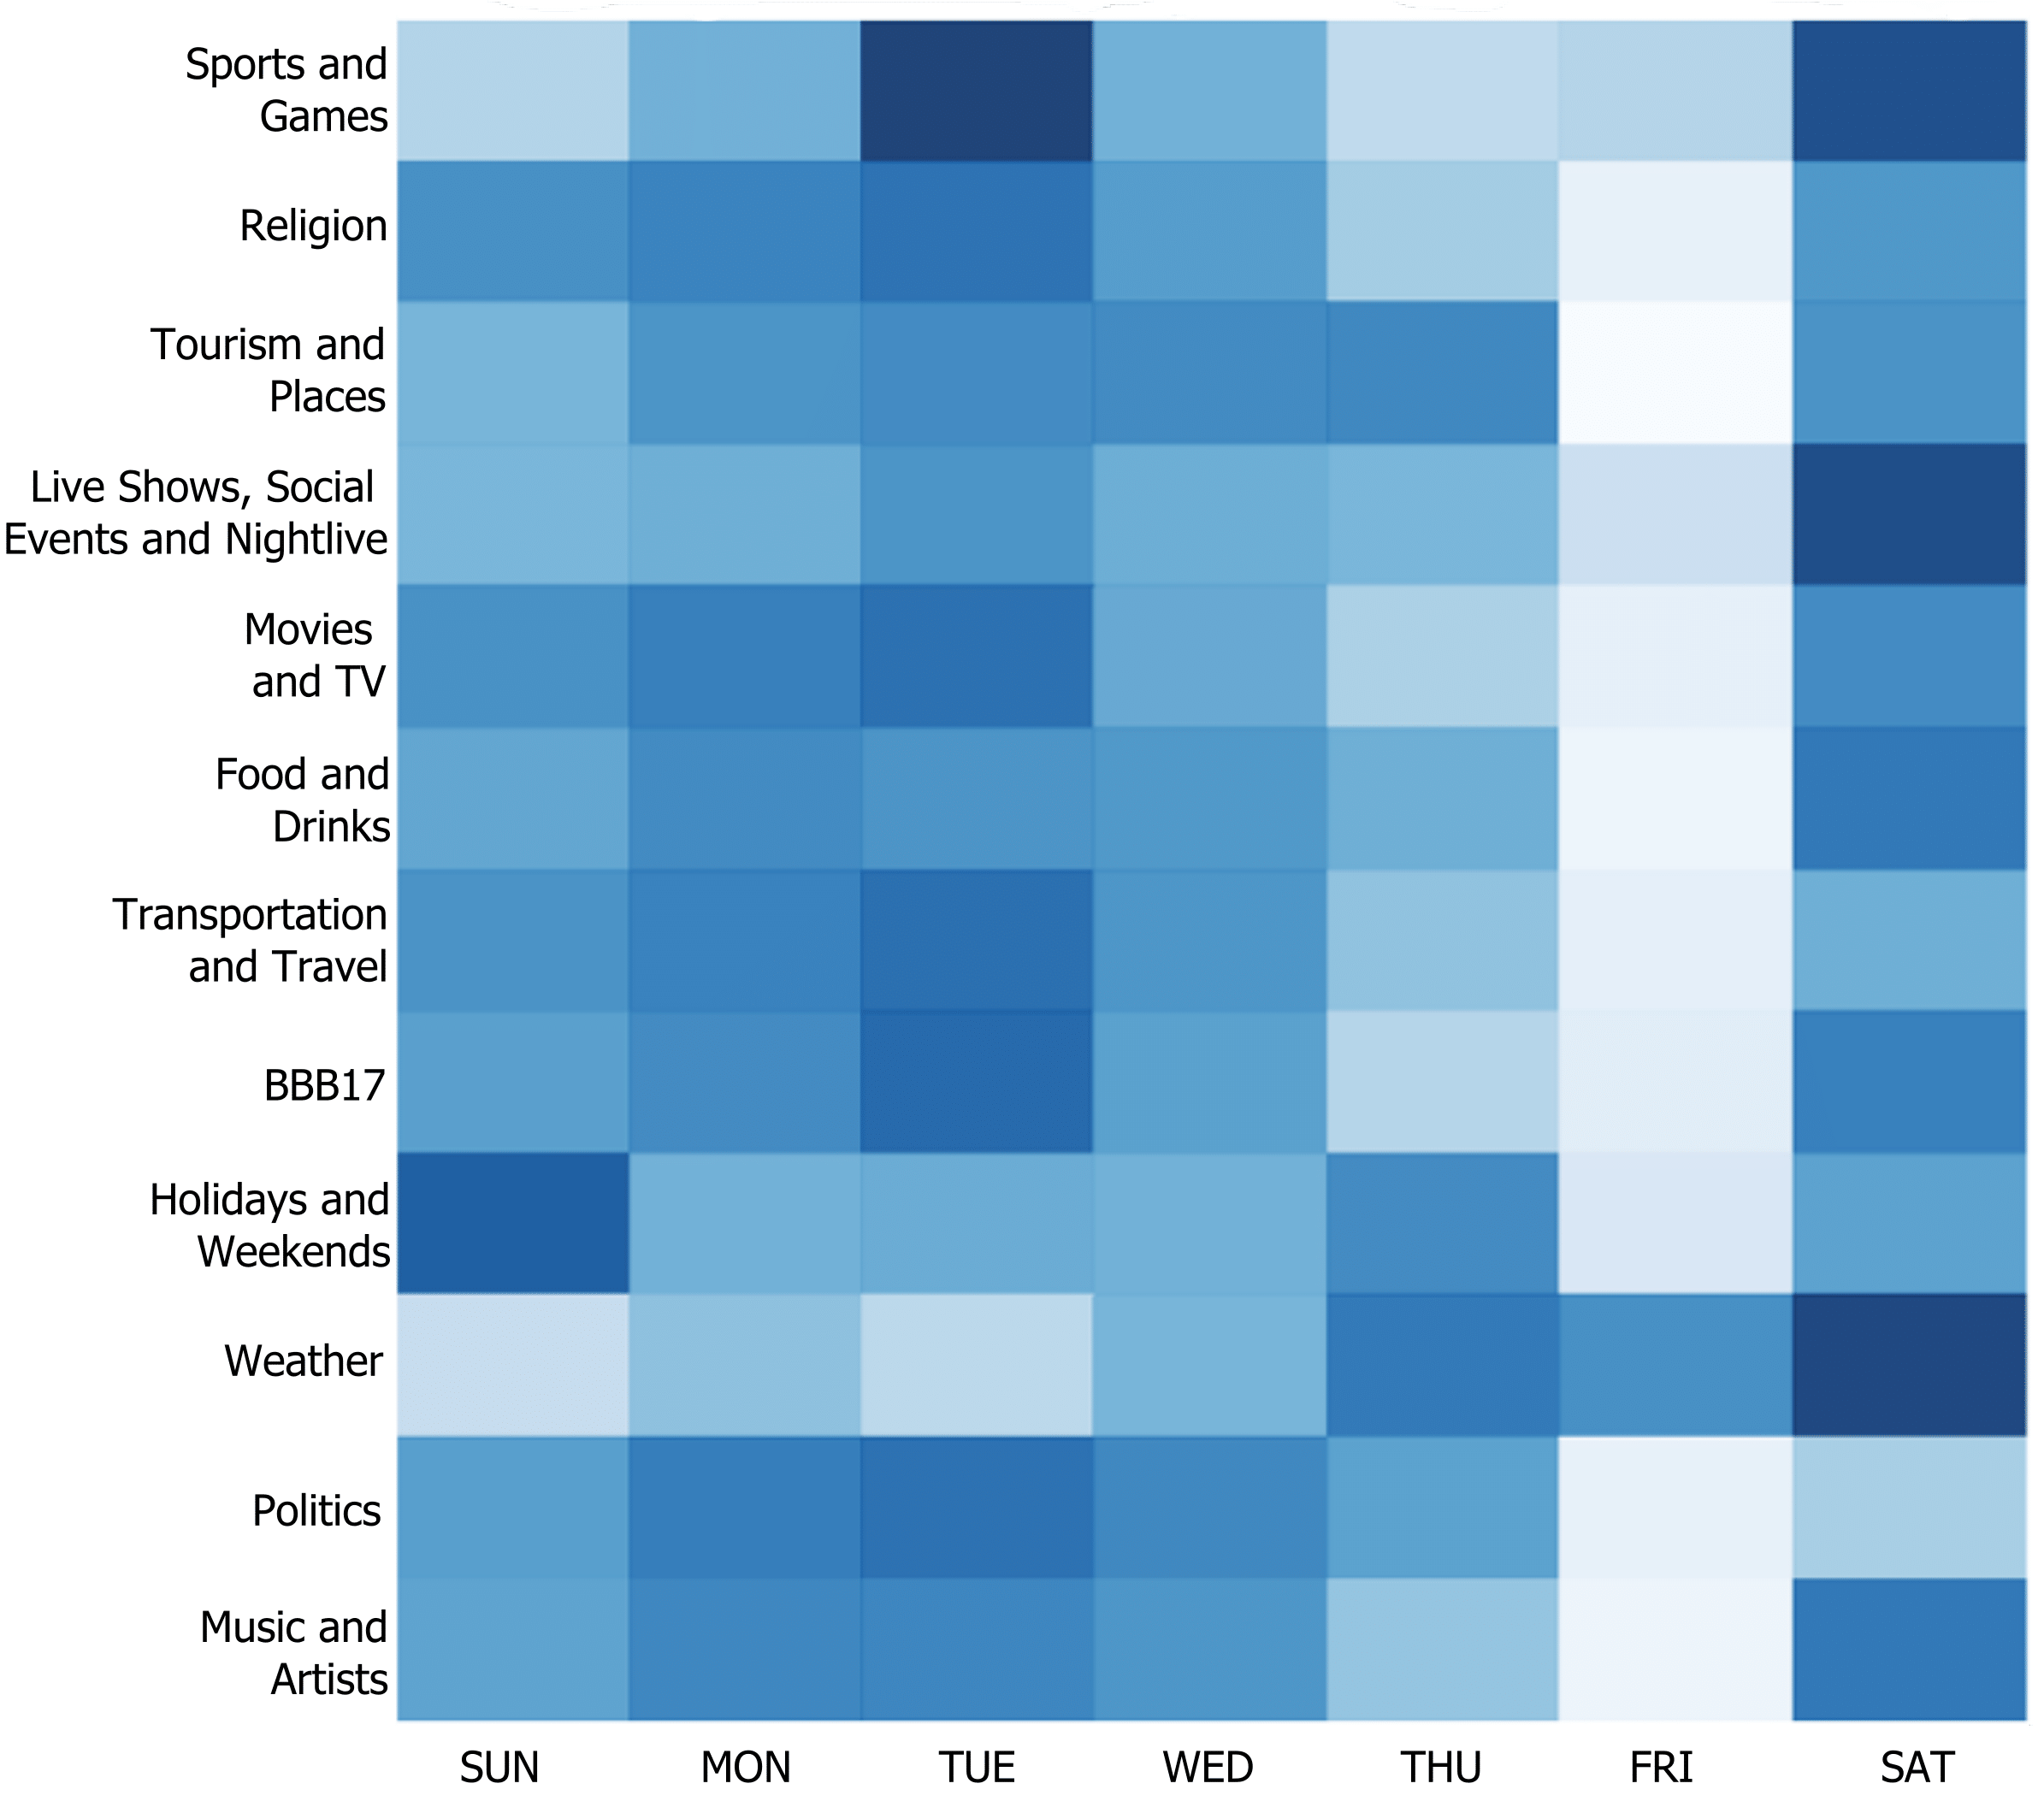
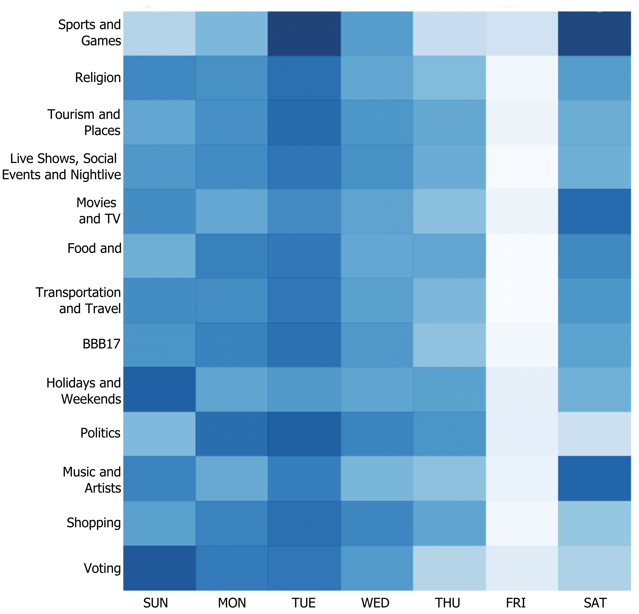
Topic Modelling in Brazil
Temporal Distribution of the Latent Topics
Rio de Janeiro
São Paulo

Slide 21
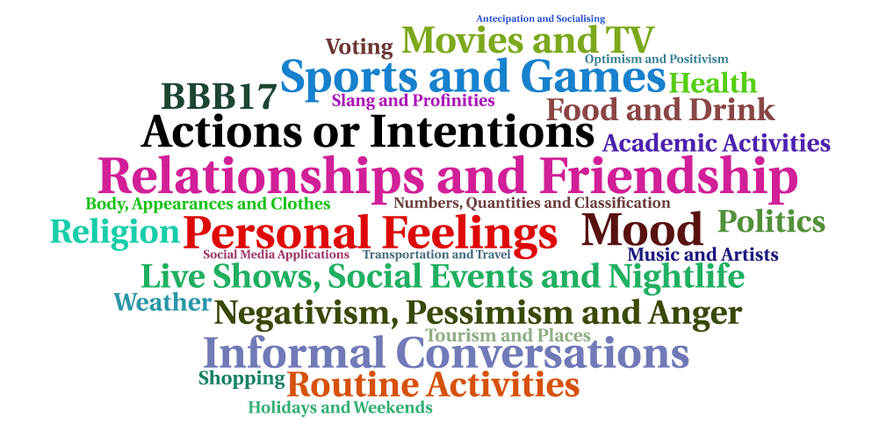
Topic Modelling in Brazil
Latent Topics Word Cloud

Slide 22
Travel-related Classification
Features and Models parametrization:
  Bag-of-embeddings:
    Context window of 2
    Embeddings of 50, 100 and 200 dimensions
  Bag-of-words:
    Dictionary limited to the 3,000 most frequent words
    Words beloging to a maximum of 60% of documents
    Word minimal frequency – 10
  Combination of both group of features.

Slide 23
Travel-related Classification in Brazil
7.7M geo-located tweets, during a period of 1 month, from March 12 to April 12, 2017
Training and Test datasets:
  Semi-automatic labeling approach
  Queries using terms of Maghrebi et al. (2016)
    For instance, “carro”, “trem”, “ônibus”
  Balanced training set composed by 2,000 positive and 2,000 negative examples
  Existence of unknown terms in the test dataset
    For instance, “Busão” and “Uber”
  Test dataset - 71 travel-related tweets and 929 non-related.

Slide 24
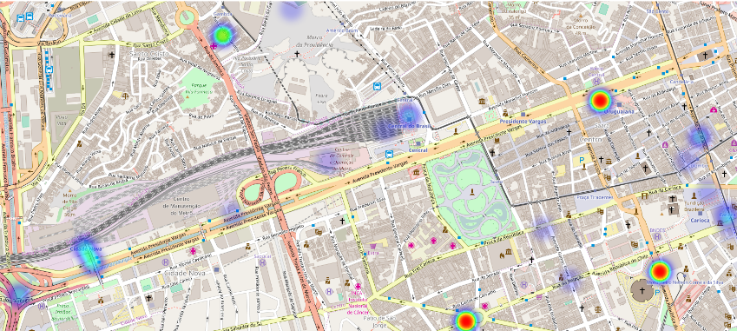
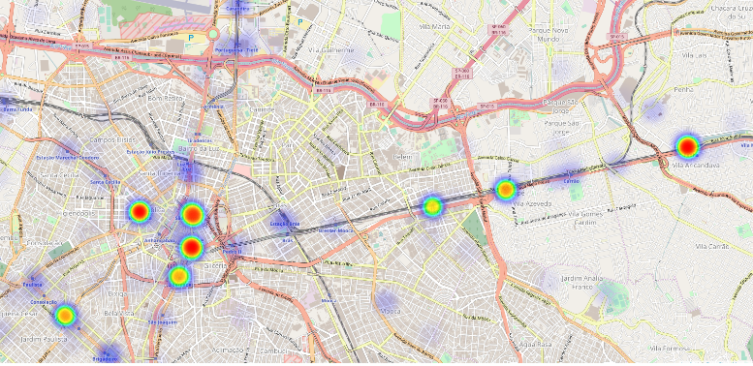
Travel-related Classification in Brazil
Results:
Best model – Linear SVM
F1-score – 0,8548
AUC - 0,97
Group of features - BoW + BoE (100)
37,300 travel-related tweets
Rio de Janeiro – Central do Brasil
São Paulo – Metro line

Slide 25
Travel-related Classification in NYC
4M geo-located tweets in New York City, during a period of 2 months, from March 12 to May 12, 2017
Training and Test datasets:
  Two-phase approach - polysemy of English terms
    For instance, “walk” and “train”
  Balanced training set composed by 1,686 positive and 1,686 negative examples
  Balanced travel-mode classes in the positive examples
  Inclusion of ambiguous geo-located tweets in the set of negative examples

Slide 26
Travel-related Classification in NYC
Training Strategy:
k-fold cross-validation - 10 iterations
Preliminary Results:
Best Classifier - Logistic Regression with BoE (200) + BoW
Classifier | Features | F1-score
Linear SVM | BoE (200) | 0,87089
 | BoW | 0,96962
 | BoE (200) + BoW | 0,98170
Logistic Regression | BoE (100) | 0,87447
 | BoW | 0,97222
 | BoE (200) + BoW | 0,98324
Random Forests | BoE (100) | 0,82394
 | BoW | 0,97764
 | BoE (50) + BoW | 0,96701
Bag-of-embeddings do not have the desired impact on this classification
Notes:
In fact, all models performed incredibly well, arising questions about the robustness of the training features.

Slide 27
Travel-related Classification in NYC
Leave-one-group-out strategy:
  Hiding one travel-mode class at a time from the training
  Compare classifiers using BoW and BoE features separately
  10-fold cross-validation
Classifier | Features | Mean F1-score
Random Forests | BoW | 0,12629
 | BoE (50) | 0,78447
Logistic Regression | BoW | 0,12629
 | BoE (50) | 0,80219
Linear SVM | BoW | 0,12203
 | BoE (200) | 0,81289
Notes:
In a real-world scenario new transportation modes emerges unexpectedly
10-fold cross-validation is maintain and final results are calculated through the mean of each model performance.

Slide 28
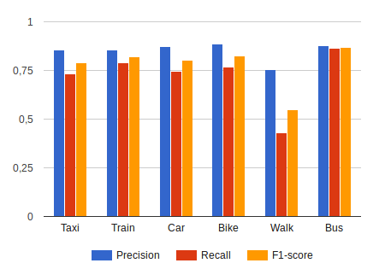
Travel-related Classification in NYC
Leave-one-group-out strategy:
  Results of the classifier for each of the hidden classes using embeddings of 200 dimensions

Slide 29
Conclusions

Slide 30
Main Results
Continuous collection of geo-located tweets from multiple bounding-boxes in parallel and in compliance with Twitter API usage limits
Tackling of the Twitter Streaming API inconsistencies and filtering noisy tweets
Implementation standard text pre-processing methods for social media texts
Content analysis using topic modeling and comparative characterization among different bounding boxes (e.g. cities)
Travel-related classification of tweets using supervised learning
Word embeddings from geo-located tweets
Study the impact of word embeddings in travel-related classification
Creation of gold-standard data for travel-related supervised learning
Aggregation and visualization of results

Slide 31
Contributions
Technical Contributions
  Design and implementation of a framework in Python to collect geo-located tweets
  The framework allows the monitoring of multiple bounding-boxes (cities and regions)
Applicational Contributions
  First large scale study with respect to topic modelling and geo-located tweets in Brazil
  Application of word embeddings to text classification tasks in the context of smart cities and ITS
Scientific Contributions
  Empirical studies on the applicability of word embeddings in travel-related text classification
  Creation of novel resources for the research community on Smart Cities and ITS

Slide 32
Publications
Transportation in Social Media: an automatic classifier for travel-related tweets. In Portuguese Conference on Artificial Intelligence (EPIA), 2017. Published.
Classifying Travel-related Tweets Using Word Embeddings. In IEEE 20th International Conference on Intelligent Transportation Systems (IEEE ITSC), 2017. Under review.
Characterizing Geo-located Tweets in Brazilian Megacities. In IEEE Third International Smart Cities Conference (IEEE ISC2), 2017. Under review.

Slide 33
Future Work
Extend text analytics experiments to all cities
Intrinsic evaluation of word embeddings trained from geo-located tweets
Aspect-based sentiment analysis
Train travel-related classifier with deep neural networks
Multi-class classification of travel modes
Correlation analysis of social-media-based activities and official traffic data

Slide 34
References
David M Blei, Andrew Y Ng, and Michael I Jordan. Latent dirichlet allocation. Journal of machine Learning research, 3(Jan):993–1022, 2003.
Tomas Mikolov, Wen-tau Yih, and Geoffrey Zweig. Linguistic regularities in continuous space word representations. In Hlt-naacl, volume 13, 2013.
Quoc Le and Tomas Mikolov. Distributed representations of sentences and documents. In Proceedings of the 31st International Conference on Machine Learning (ICML-14), pages 1188–1196, 2014.
Guy Lansley and Paul A Longley. The geography of twitter topics in London. Computers, Environment and Urban Systems, 58:85–96, 2016.
Tsvi Kuflik, Einat Minkov, Silvio Nocera, Susan Grant-Muller, Ayelet Gal-Tzur, and Itay Shoor. Automating a framework to extract and analyse transport related social media content: The potential and the challenges. Transportation Research Part C: Emerging Technologies, 77:275–291, 2017.
Mojtaba Maghrebi, Alireza Abbasi, and S Travis Waller. Transportation application of social media: Travel mode extraction. In Intelligent Transportation Systems (ITSC), 2016 IEEE 19th International Conference on, pages 1648–1653. IEEE, 2016.

Slide 35
Social Media Text Processing and Semantic Analysis for Smart Cities
Thank you

Slide 36
Framework
The framework may contemplate the following requirements:
  Collection of multiple bounding-boxes (cities, regions or countries)
  Flexibility
  Scalability
  Almost real time
Notes:
Flexibilidade de forma a extender os modulos existentes ou adicionar novos.
Escalavel porque deve ser capaz de processsar um volume elevado de mensagens.
Apresentar visualizaçºoes dos resultados quase que instantaneamente

Slide 37

Database
Tweets are retrieved in JSON-like format;
MongoDB is a NoSQL software to store collections/schemas of this data format;
The overwhelming amount of tweets makes conventional querying operations to perform poorly;
On the contrary, MongoDB has high performance regarding the querying system.
Nonetheless, this software allows easier and quickly deployment and scalability.
Notes:
MongoDB é um software de base de dados NoSQL que permite o armazenamento de coleções de documentos em formato JSON.
Como os tweets são devolvidos pela API neste formato nós escolhemos este software e também tiramos proveito da alta performance das suas operações de pesquisa.

Slide 38
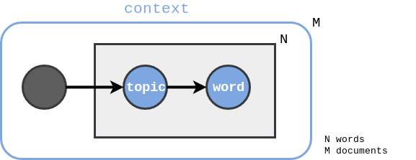
Topic Modelling
Latent Dirichlet Allocation (LDA) - Blei et al. [1]
  Generative probabilistic model;
  Aims to find the latent topics present in a collection of documents;
  Two distinct distributions:
    Distribution of words over topics;
    Distribution of topics over documents.
  We use the Python’s LDA library to implement this text analytics module.

Slide 39
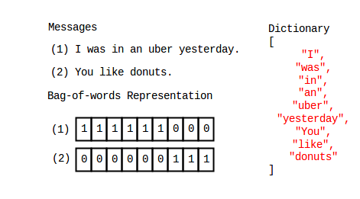
Bag-of-words
Bag-of-words (BoW)
Majority of studies focus on conventional techniques
Frequency-term based text representation
Dictionary size and words belonging to documents can be limited

Slide 40
Word Embeddings
Word Embeddings
  Continuous representation of text into multi-dimensional vectors
    Words or phrases are mapped to vectors of real numbers;
  Model uses:
    Neural network
    Context in which the word appears (surronding words, i.e. words behind and ahead)
Notes:
We explore recent advances in word embeddings

Slide 41

Word Embeddings
Word Embeddings - The Fake Task
Learning of statistics from the number of times each pairing shows up.

Slide 42

Word Embeddings Libraries
Word2vec – Mikolov et al. (2013)
  Input of a collection of pre-processed tweets
  Training of word embeddings is automatic
  The model outputs the matrix of weights for each word in the dictionary
Paragraph2vec, a.k.a. doc2vec – Le and Mikolov (2014)
  Similar to word2vec
  Each document has a label passed into the embeddings matrix
  Labels -> tweets ids
Gensim is a Python library which has both embeddings’ models

Slide 43
Aggregation and Visualization
Aggregation
  MongoDB provides inner frameworks that allow aggregation of data
  These aggregation operations are easier and quickly because they are performed using a map-reduce paradigm
  Aggregation of results are made periodically
Visualization
  Plotly is a Python library to produce graphical visualizations of data
  The library allows local storage of these visualizations in HTML files
  By exploring the embedding functionality of HTML5 we can demonstrate on-time visualizations

Slide 44
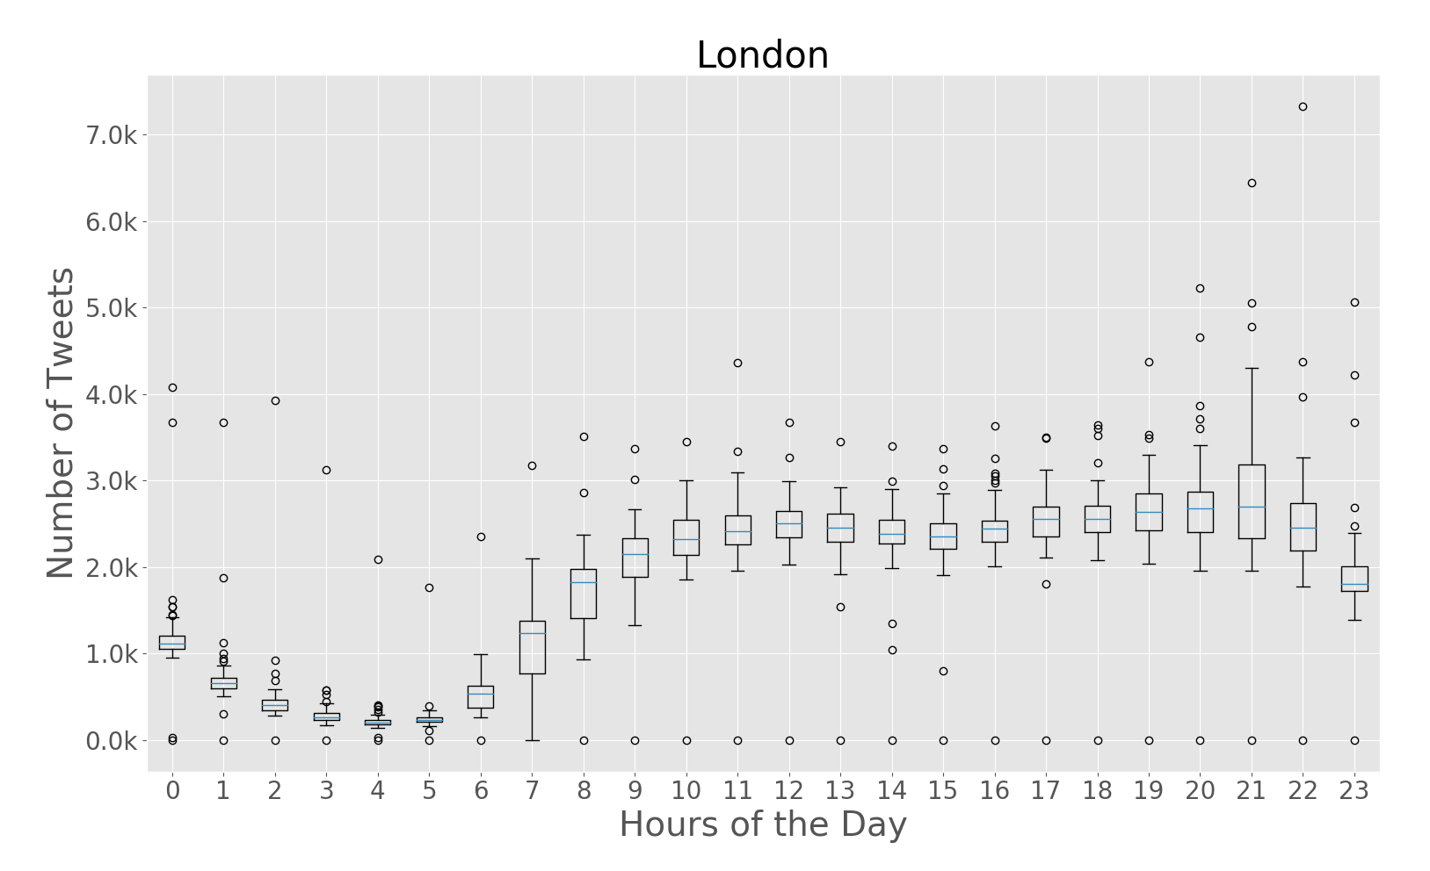
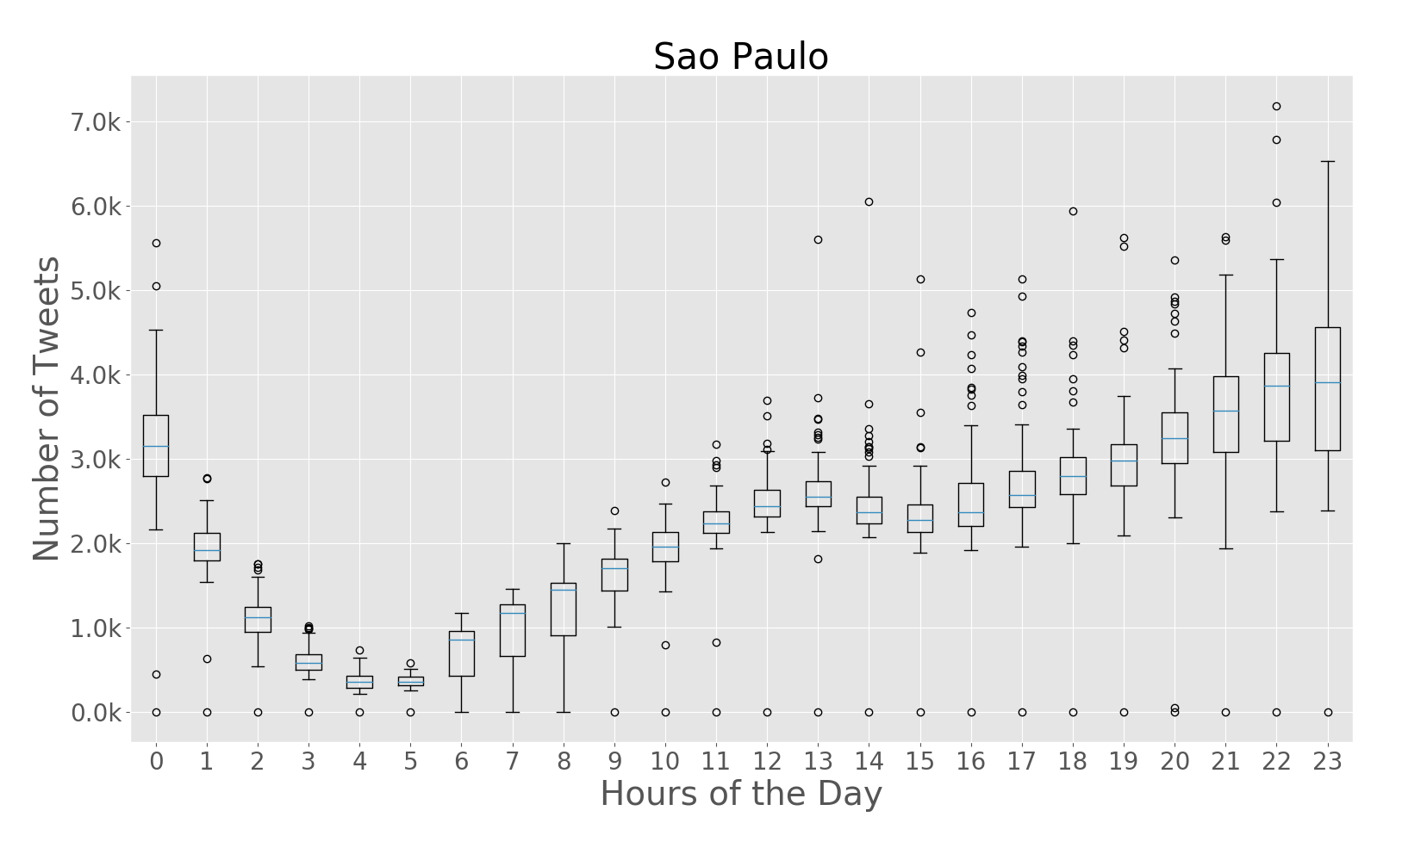
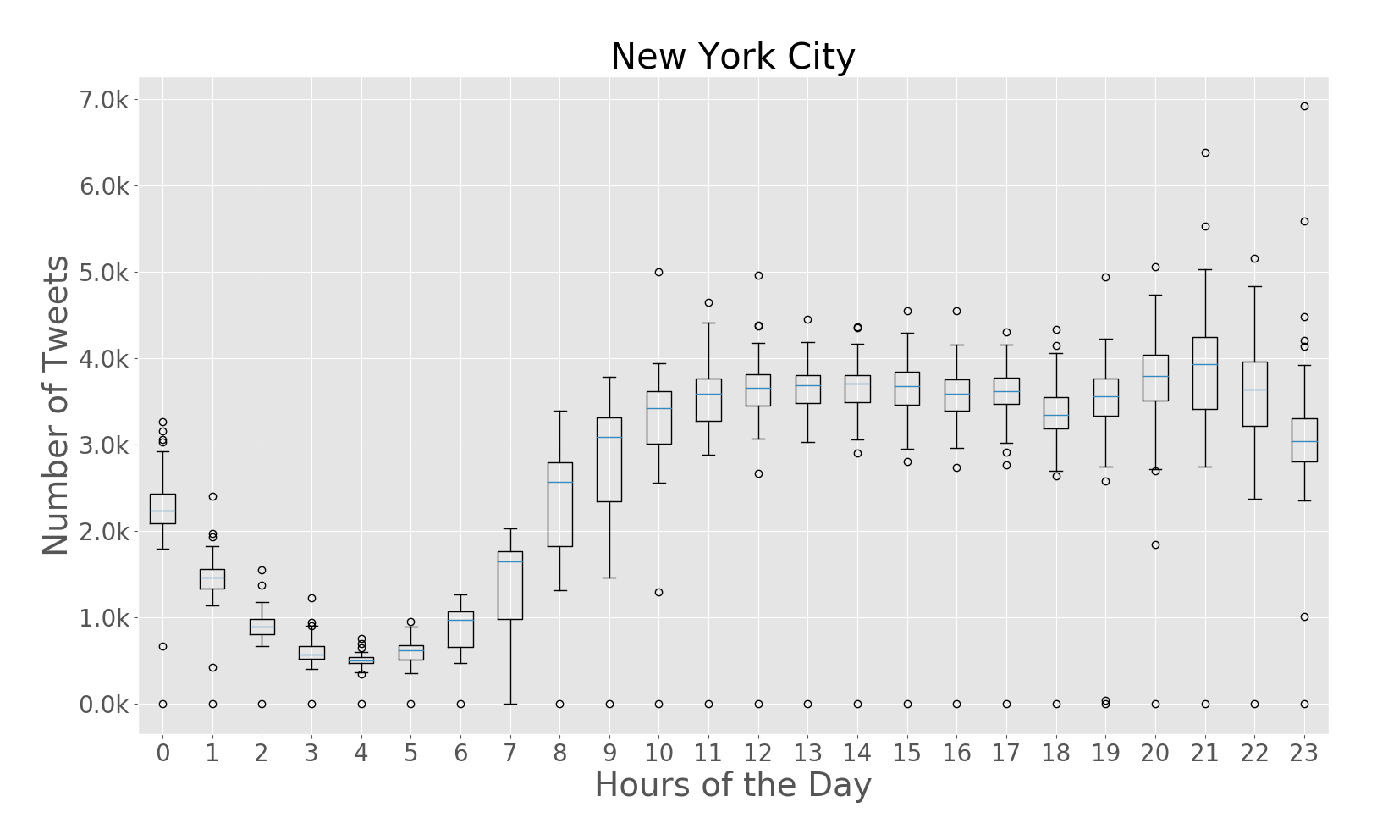
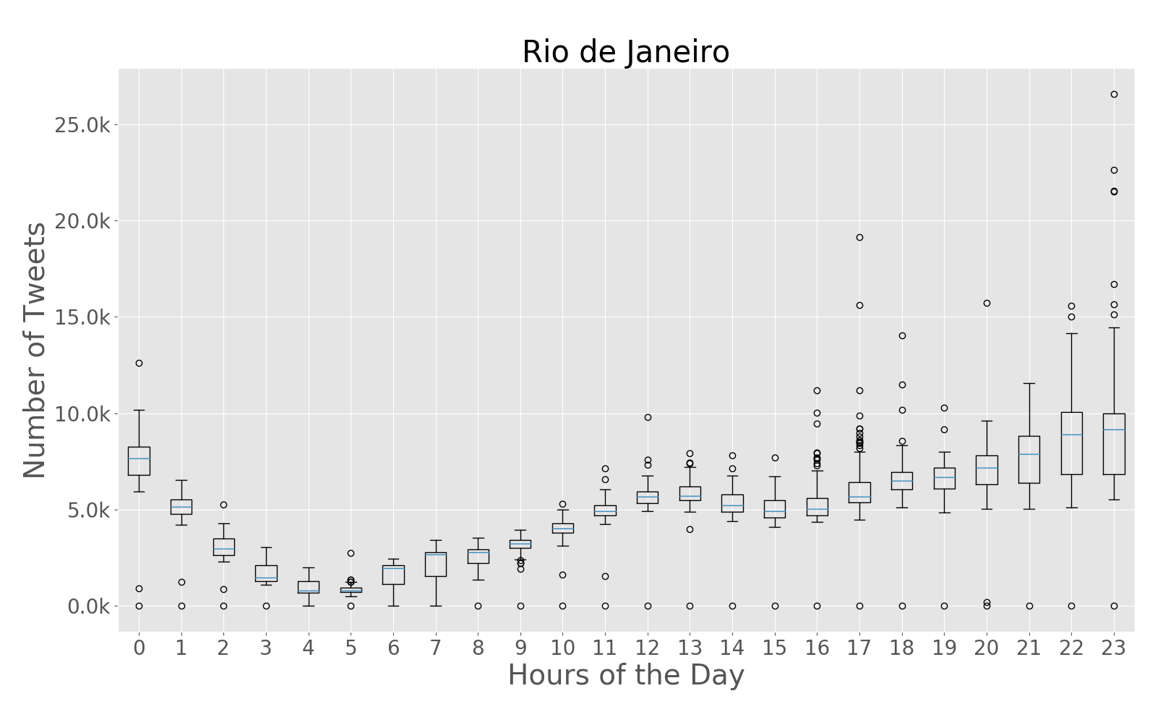
Temporal Frequencies
Hourly Frequencies

Slide 45
Text Analytics Experiments
Three experiments to text analysis
  Topic Modelling over Rio de Janeiro and São Paulo;
  Travel-related classification over Rio de Janeiro and São Paulo;
  Travel-related classification over New York City.

Slide 46
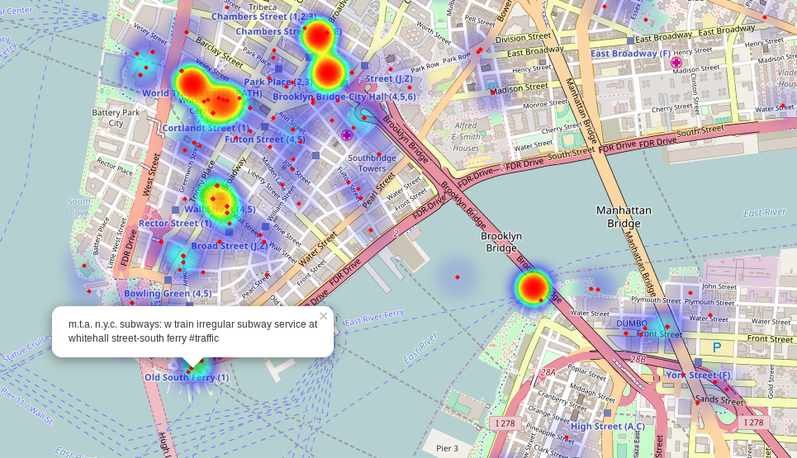
Travel-related Classification in NYC
Final model
  BoE with 200 dimensions
  Trained with all travel-mode classes together
  Dataset prediction, 300,000 travel-related tweets
South of Manhattan and over look at the Brooklyn Bridge.

