Slide 1
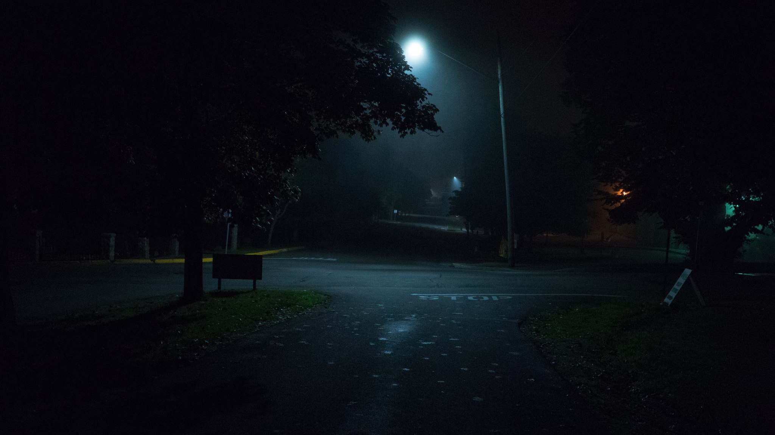
Dark Night
João Gaspar, 107708
Introduction to Computer Graphics – 2023/2024
1

Slide 2
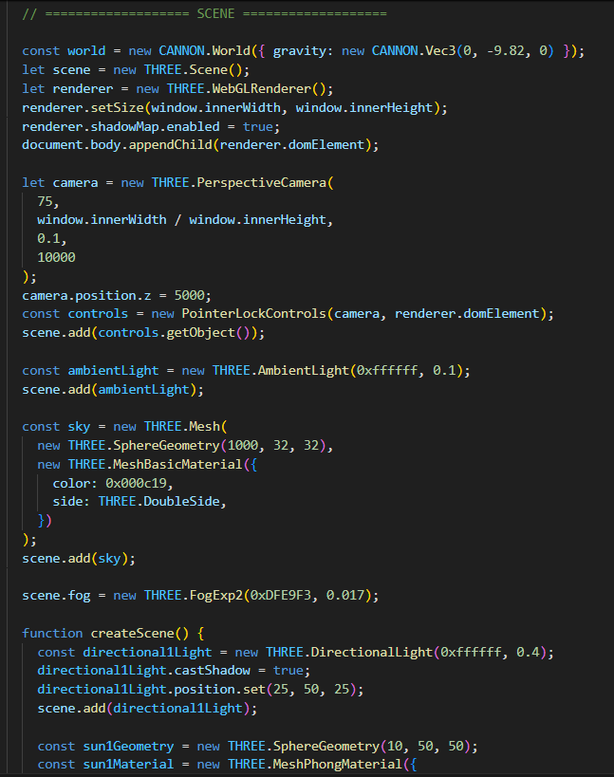
Main Idea
Create a medieval environment and allow the user to explore it and fight against an enemy withing the setting.
It uses three.js and some Blender modules.
The demo is available at joaogasparp.github.io and the code at https://github.com/joaogasparp/joaogasparp.github.io

Slide 3
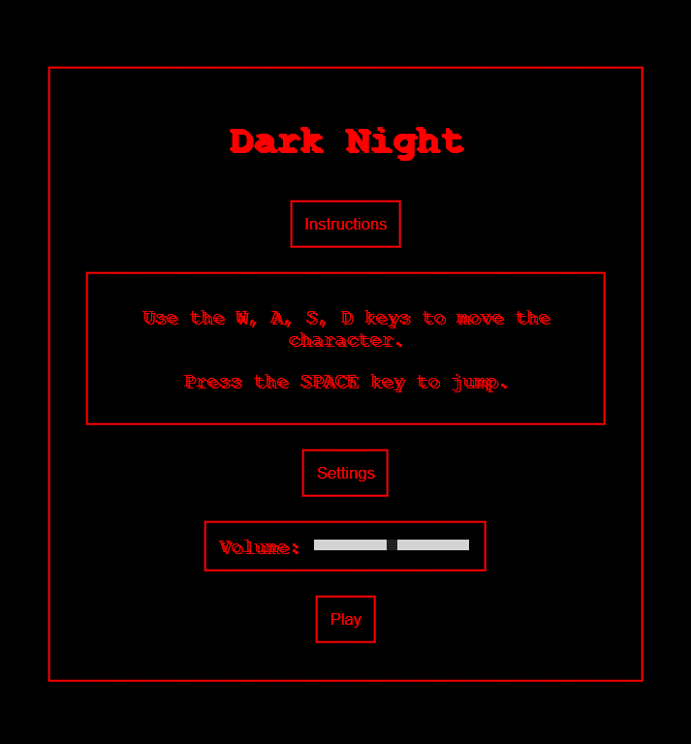
Initial Menu and End Game
j

Slide 4
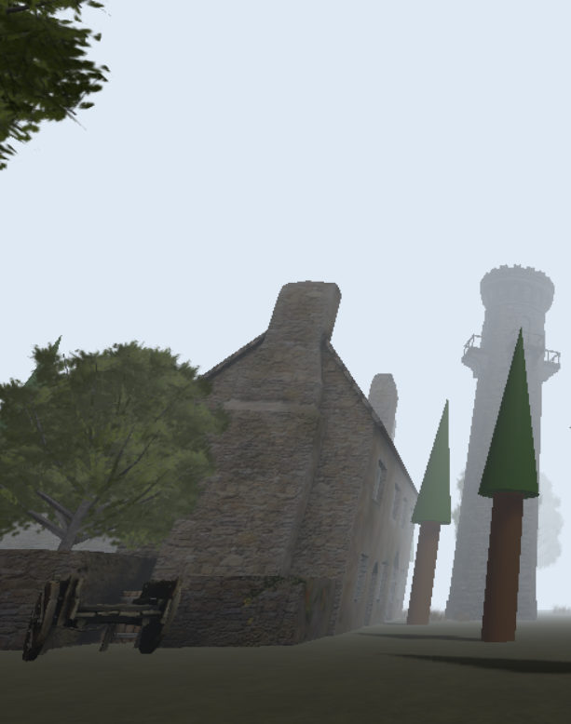
Models and the scene graph
There are various models, made both using three.js (by me) and Blender, such as:
Fog (three.js)
Moon (three.js)
Bullets (three.js)
Trees (three.js and blender)
Grass (Blender)
House (Blender)
Gun (Blender)
Ghost (Blender)
Tower (Blender)

Slide 5
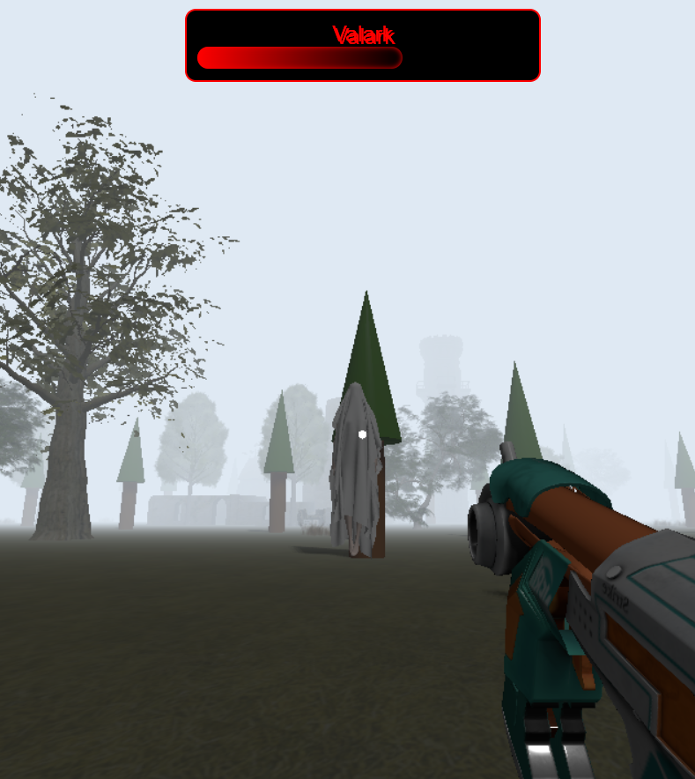
Animation
Player Movement.
Ghost Movement.
Bullet Shooting.
Collisions and Life Update.
Notes:
Animação da Floresta e Objetos 3D:
Árvores, casa, torre e outros objetos 3D são carregados e posicionados na cena sem animação contínua, mas estão presentes no cenário.
Movimento do Jogador:
O movimento do jogador é atualizado a cada frame para refletir a posição e rotação do corpo físico (CANNON.js) e a câmera (THREE.js).
Movimento do Fantasma (Ghost):
O fantasma se move continuamente em direção ao jogador, ajustando sua posição e rotação.
Disparo de Balas:
As balas são disparadas da posição do jogador e se movem na direção em que a câmera está apontada.
Colisões e Atualização de Vida:
As colisões entre o jogador, fantasma e balas são detetadas e geridas, atualizando as vidas e estados dos objetos.

Slide 6
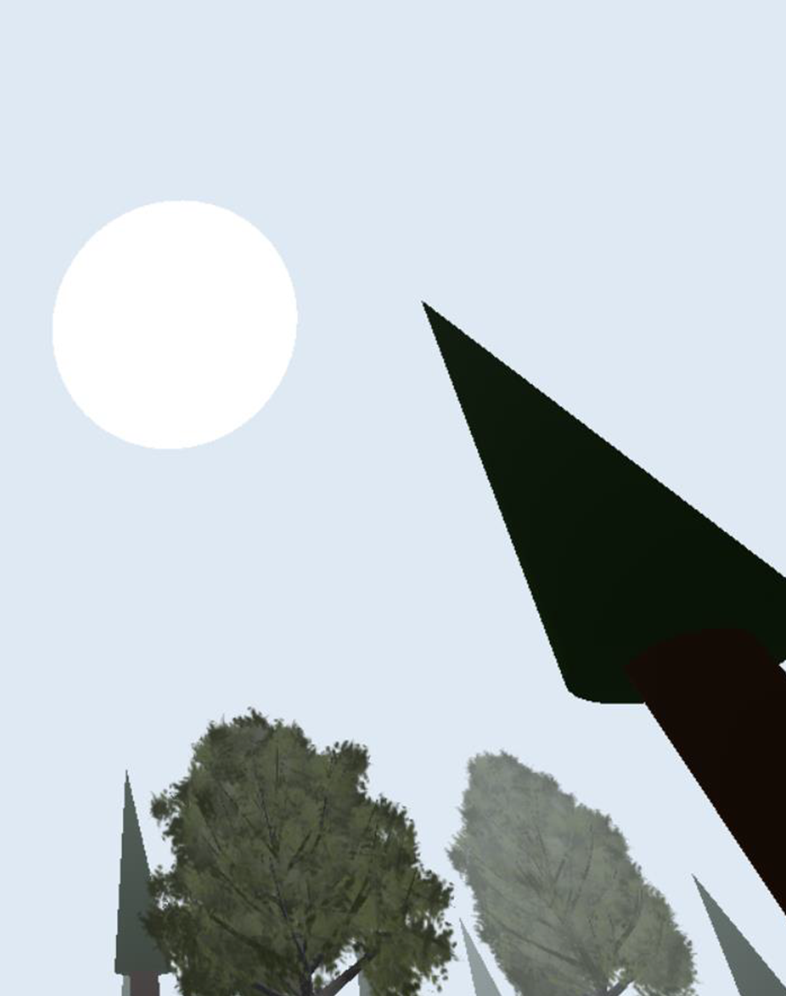
Illumination
Directional Light (represented by the moon):
Color: White.
Intensity: 1.
Position: (0, 10, 0).
Ambient Light:
Color: White.
Intensity: 0,2.

Slide 7

Shadows and Sounds
The Direction Light produces shadows.
Ambient sound produced by the ghost and related to its distance to the player.
Sound from the gunshots.

Slide 8

User Interaction
With the mouse the user can shot bullets at the Ghost.
Using the WASD keys in the keyboard and the SPACE bar the user can move around the map.

Slide 9

Development
The code is organized into different sections to facilitate understanding and maintenance.
Collisions and Event Detection.
Position and Rotation Update.
Difficulties:
Collision Management
Performance Optimization

Slide 10

Conclusions
In conclusion, all goals were successfully achieved, albeit with some challenges encountered along the way and various project ideas considered throughout the development process.

Slide 11
References
Sketchfab. (n.d.-b). Sketchfab. https://sketchfab.com/search?features=downloadable&type=models
“Make a Grass in 45 Seconds-Blender 2024.” Www.youtube.com, www.youtube.com/watch?v=xX72ZuCOVVE&ab_channel=BlenderTips. Accessed 10 Apr. 2024.
Fog – three.js docs. https://threejs.org/docs/#api/en/scenes/Fog
Loading 3D models – three.js docs. https://threejs.org/docs/#manual/en/introduction/Loading-3D-models

