Slide 1

HCI - Assignment n.2
Design and prototyping of an application using a human-centered approach
Deliverable n. 1: Requirement Analysis
Project Title: Key Vault Games
Group: Guilherme Santos (107961), João Gaspar (107708) & Nuno Carvalho (97783)
Lab Class: P5
HCI 2023-2024

Slide 2

Introduction
Key Vault Games
Online game key platform with interactive functionalities, like detailed search, discounts, quizzes, rewards or livestreams.
We like videogames, so we wanted to create a new game key shop with some innovative aspects that help the user know better which games/keys to purchase.
HCI 2023-2024
2

Slide 3

Project Objectives
Key Vault Games
The goal is to have a platform for both casual players and hardcore gamers to use and decide which games to buy or not.
We expect people to use our platform more than the others available, since it offers the opportunity to play any kind of game, with a much more interactive experience.
Good offers and discounts, interactive quizzes and missions to get rewards, detailed descriptions and even game livestreams are some of the benefits that differentiate our app from any other.
HCI 2023-2024
3

Slide 4

Personas - 1
Key Vault Games
Name: André Gonçalves.
Age: 24 years old.
Occupation: Nutritionist.
Story:
André has always harbored a dual interest: nutrition and video games;
He is a dedicated gamer along with his younger brother, Rúben.
Motivation:
His main goal when buying games is to find the best quality-price ratio.
He prefers adventure games, puzzles and RPGs, and seeks titles that fit within his budget.
HCI 2023-2024
4

Slide 5

Personas - 2
Key Vault Games
Name: Filipa Soares.
Age: 30 years old.
Occupation: Game Developer.
Story:
Filipa Soares is passionate about technology and innovation and uses her free time to explore new games;
She considers herself a "hardcore gamer" and is always seeking challenges and immersive experiences.
Motivation:
Filipa seeks games that offer high graphic quality, complex gameplay, and engaging stories.
When purchasing a game, Filipa invests time in researching the title, reading reviews, and watching gameplay before making a purchase.
HCI 2023-2024
5

Slide 6
Scenarios
Key Vault Games
Discount Hunter (André)
André is looking for a new game to enjoy with his younger brother, Rúben, at Key Vault Games. He participates in an interactive quiz about games to get personalized recommendations and receives a 30% discount code as a reward. Using the price filter, he looks for games under 30€ with multiplayer options. After reading player reviews, he decides to purchase an adventure game. Using discount code, he makes the purchase with his credit card and receives the game key via email.
Games Analyst (Filipa)
Filipa, curious but indecisive about whether to purchase a new game recommended by her friends, visits KeyVault Games to gather more information. After reading the game's description to better understand its features, she remains undecided. Opting for a more hands-on approach, she watches a livestream of the game available in the interactive user area to further evaluate it. After some analysis, Filipa decides to buy the game.
HCI 2023-2024
6

Slide 7
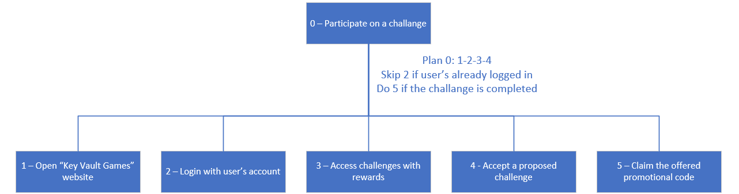
Tasks - Discount Hunter (André)
Key Vault Games
HCI 2023-2024
7

Slide 8
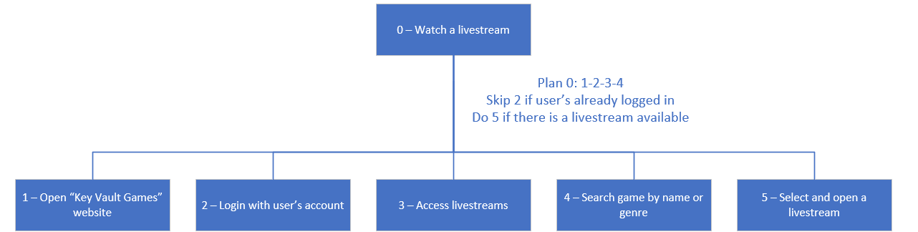
Tasks - Games Analyst (Filipa)
Key Vault Games
HCI 2023-2024
8

Slide 9
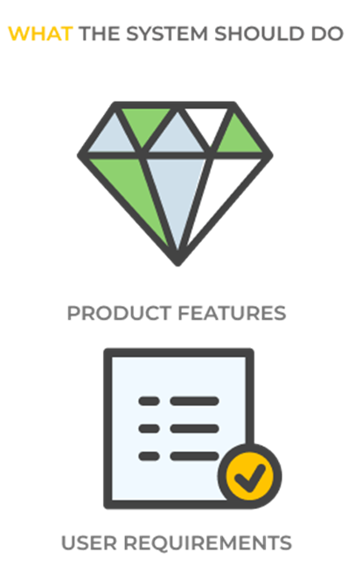
Functional Requirements
Key Vault Games
Searching for games in the catalog by title;
Filtering games by genre and price;
Each game should have a description;
Creating a user account;
Deleting a user account;
Accessing and completing quizzes and/or missions;
Accessing livestreams;
Offering promotional codes to users based on the completion of quizzes and missions;
Purchases should accept promotional codes;
Returning a game key at the end of a successful purchase.
HCI 2023-2024
9

Slide 10
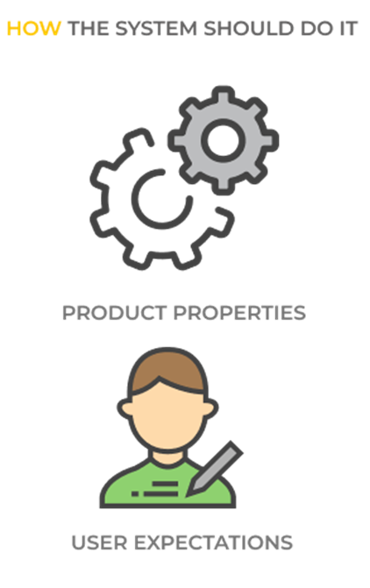
Non-functional Requirements
Key Vault Games
The page loading time should be short;
Encrypt game keys and user passwords in the database;
It should be accessible regardless of the browser and operating system used;
The interface should be easy to understand, even for users with different levels of technology experience;
Game payment should be secure;
The user must authenticate the account before it can be used.
HCI 2023-2024
10

Slide 11

Next steps
Key Vault Games
For the next steps we considered doing a paper prototype.
We're going to ask people to use the platform and make a usability evaluation.
HCI 2023-2024
11

