Slide 1
RadarID
TEAM 5
FRANCISCO GONÇALVES
GUILHERME SANTOS
HUGO RODRIGUES
JOÃO GASPAR
RICARDO DIAS
SÉRGIO CORREIA
PECI – 2023/2024

Slide 2
CONTEXT
In the digital age, technology permeates every aspect of our lives. With this omnipresence comes the need to reinvent interaction, making it seamless, intuitive, and personalized.

Slide 3
PROBLEM
Achieving individual identification in intelligent environments is highly complex.
How can we ensure a personalized experience when the diversity of user movements and habits challenges our identification capabilities? This is the central challenge we face.

Slide 4
GOAL
Explore the revolutionary potential of radars in human identification in intelligent environments.
We seek to go beyond the conventional to identify individuals based on movement patterns.

Slide 5
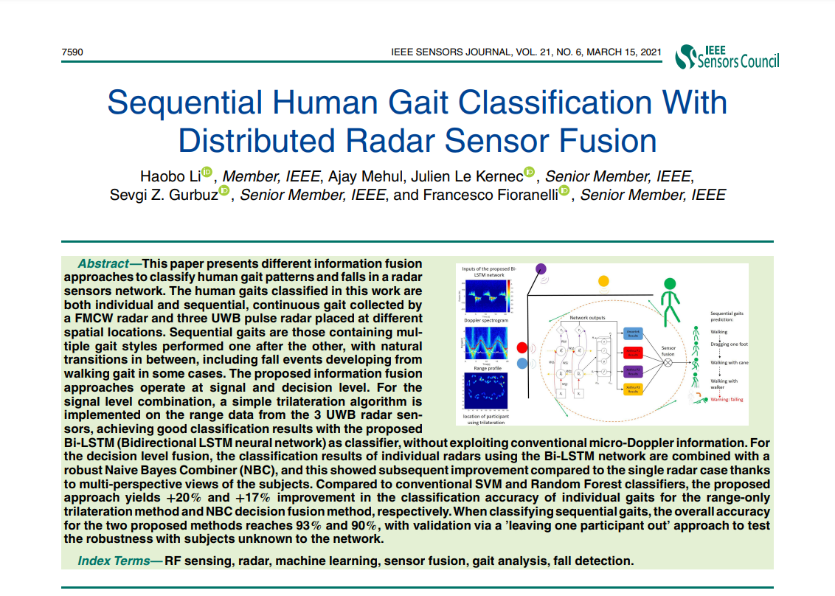
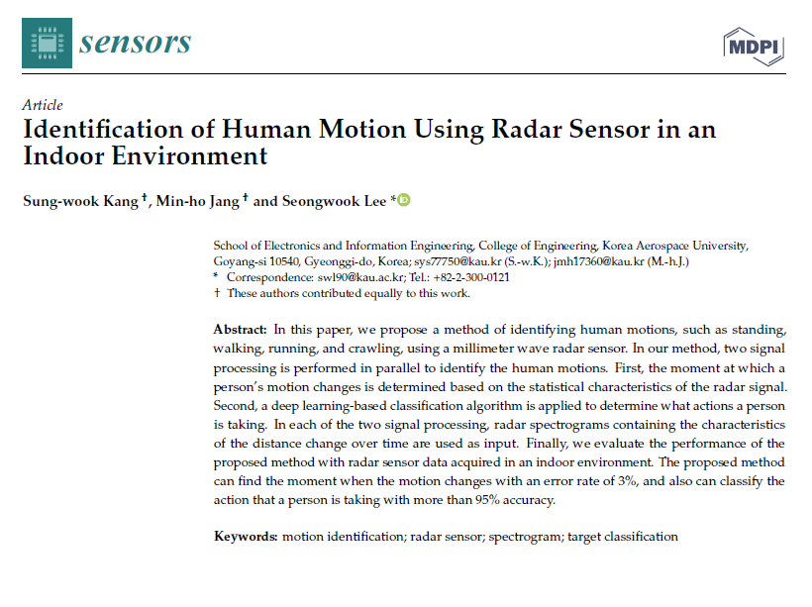
Scope AND RELATED WORK
H. Li; A. Mehul; J. Le Kernec; S. Z. Gurbuz; F. Fioranelli
(2021) Sequential Human Gait Classification With Distributed Radar Sensor Fusion
S. Kang; M. Jang; S. Lee
(2021) Identification of Human Motion Using Radar Sensor in an Indoor Environment

Slide 6
PROJECT PLANNING
​ | SEP | OCT | NOV | DEC | JAN | FEB | MAR | APR | MAY
STATE OF THE ART
REQUIREMENTS
ARCHITECTURE
DEVELOPMENT
DEMONSTRATOR
MANAGEMENT
DOCUMENTATION AND DISSEMINATION
M1
M2
FINAL PRESENTATION
REPORT
DEMO

Slide 7
TASKS
STATE OF THE ART
REQUIREMENTS
ARCHITECTURE
DEVELOPMENT
DEMONSTRATOR
MANAGEMENT
DOCUMENTATION
AND DISSEMINATION
Overview related work and work plan;
Write report’s related section.
Disseminate standardized metrics
Define architecture;
Write report’s related section.
Manage group and task execution.
M1;
M2;
M3;
Final.

Slide 8
EXPECTED RESULTS
Our project aims to contribute to human identification in smart environments by exploring valuable insights through radar technology.
Developing a proof-of-concept to showcase tangible interactions, our gesture-based identification system seeks to validate feasibility and drive advancements in human-machine interaction within smart environments.

Slide 9
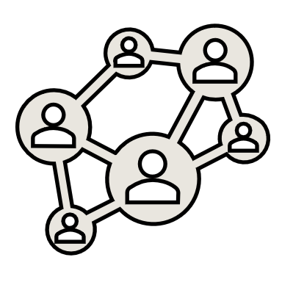



COMMUNICATION PLAN
SCRUM
(flexible teamwork and iterative progress)
GITHUB
(git repository for the team’s work)
JIRA
(software for project management)
ONE DRIVE
(cloud storage and collaboration platform)

Slide 10
THANKS!
Do you have any questions?

