Slide 1


Combinação de classificadores homogêneos
(Homogeneous ensembles classifiers)
Aprendizagem de máquina
João Luiz e Vandeyberg

Slide 2
Agenda
Introduction
Homogeneous ensembles methods
Application
Conclusions
References

Slide 3
Introduction

Slide 4
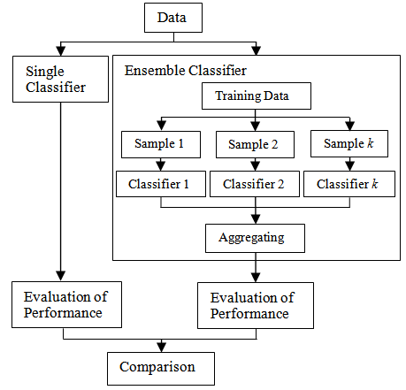
Single classifier vs Ensemble classifier
Trade-off
Computer cost
Interpretation
Precision

Slide 5
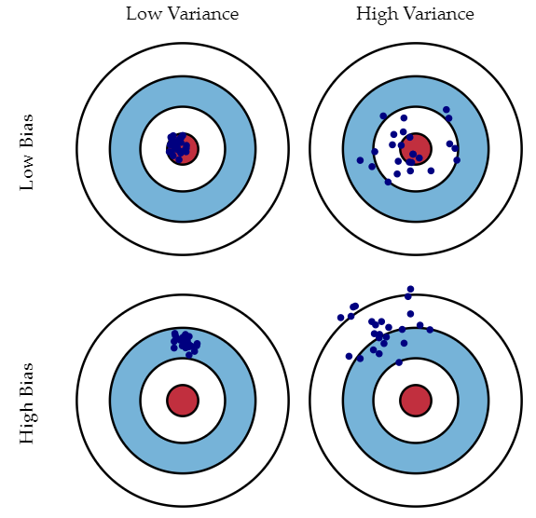
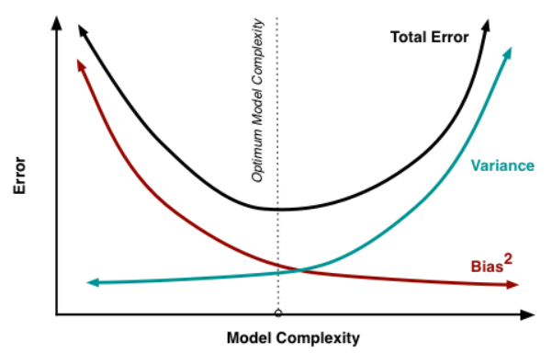
Bias and Variance
Notes:
Viés significa ‘o quanto em média os valores previstos são diferentes dos valores reais’. Variância significa ‘o quão diferentes serão as previsões do modelo num mesmo ponto se diferentes amostras forem tomadas da mesma população’.
Normalmente, à medida que você aumenta a complexidade de seu modelo, você verá uma redução no erro de previsão devido ao viés mais baixo no modelo. À medida que você continuar tornando o modelo mais complexo ele começará a sofrer com a variância.

Slide 6
Bias and Variance
Hot
Temperature
Mild
Cool
Overcast
Outlook
Sunny
Yes
Normal
Humidity
High
Yes
No
Yes
Outlook
Rain
Overcast
Yes
Weak
Wind
Strong
Yes
No
Notes:
Viés significa ‘o quanto em média os valores previstos são diferentes dos valores reais’. Variância significa ‘o quão diferentes serão as previsões do modelo num mesmo ponto se diferentes amostras forem tomadas da mesma população’.
Normalmente, à medida que você aumenta a complexidade de seu modelo, você verá uma redução no erro de previsão devido ao viés mais baixo no modelo. À medida que você continuar tornando o modelo mais complexo ele começará a sofrer com a variância.

Slide 7
Stable and Unstable Classifiers
Stable classifiers
Low variance and High bias
Ex: Linear regression and Naive Bayes
Unstable classifiers
Low bias and High variance
Ex: Decision Trees and NN
Notes:
flexible model is said to have high variance because the learned parameters (such as the structure of the decision tree) will vary considerably with the training data.
On the other hand, an inflexible model is said to have high bias because it makes assumptions about the training data (it’s biased towards pre-conceived ideas of the data.) For example, a linear classifier makes the assumption that the data is linear and does not have the flexibility to fit non-linear relationships. An inflexible model may not have the capacity to fit even the training data and in both cases — high variance and high bias — the model is not able to generalize well to new data.
The reason the decision tree is prone to overfitting when we don’t limit the maximum depth is because it has unlimited flexibility, meaning that it can keep growing until it has exactly one leaf node for every single observation, perfectly classifying all of them. If you go back to the image of the decision tree and limit the maximum depth to 2 (making only a single split), the classifications are no longer 100% correct. We have reduced the variance of the decision tree but at the cost of increasing the bias.

Slide 8
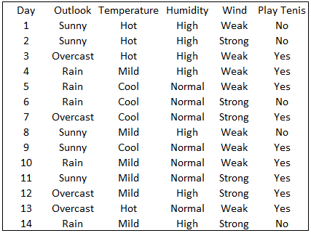
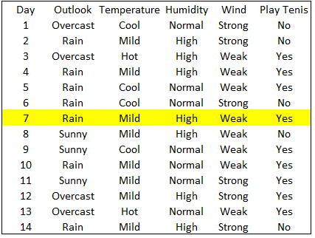
Stable and Unstable Classifiers

Slide 9
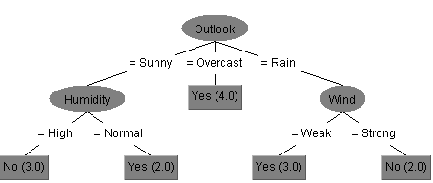
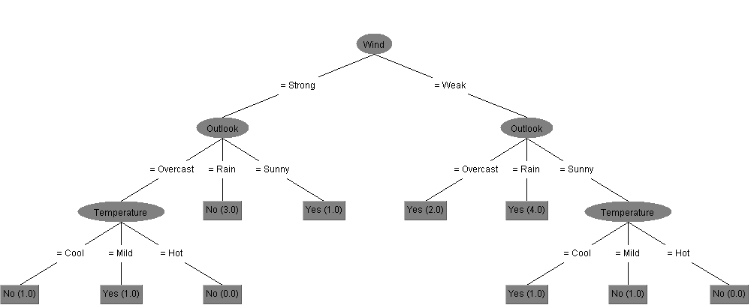
Stable and Unstable Classifiers

Slide 10
2. Homogeneous ensembles methods

Slide 11
Boosting
Associate weights for each object
Generate a new classifier
Adjust the weights* according to objects performances
Repeat steps 1, 2 and 3
Conjugate classifiers by voting its weights**
* objects weight ** classifiers weight

Slide 12
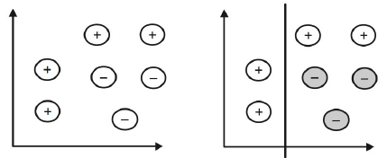
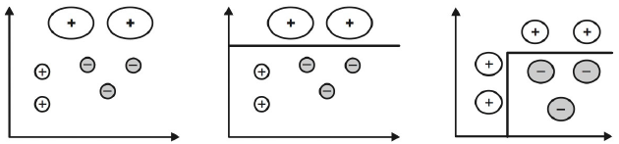
Boosting
1
2
3
4
5

Slide 13
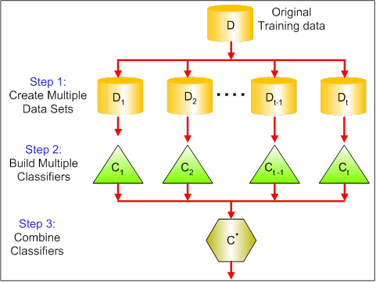
Bagging
Create n random samples (drawn with replacement - bootstrapping)
About 1/3 of examples are not included in the bootstrap (out-of-bag)
Apply the same algorithm to all samples
Aggregating Classifiers
mean, median or mode

Slide 14
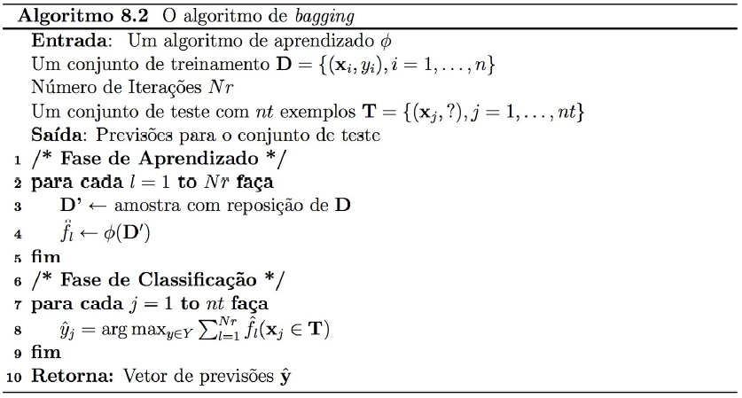
Bagging

Slide 15
Random Forest
Step 1: Create random samples
Original data

Slide 16
Random Forest
Step 1: Create random samples
Original data
Sample with replacement

Slide 17
Random Forest
Step 1: Create random samples
Sample with replacement
5 examples out-of-bag:
5, 6, 8, 9 e 10

Slide 18

Random Forest
Step 2: Create tree
Choose a subset of features randomly
than apply ID3 or C4.5
$$Nº of features = \sqrt{n_features}$$
Outlook
Temperature
Humidity
Wind

Slide 19
Random Forest
Step 2: Create tree
Choose a subset of features randomly
than apply ID3 or C4.5
$$Nº of features = \sqrt{n_features}$$
Outlook
Temperature
Humidity
Wind
Features
Wind
Temperature

Slide 20
Random Forest
Step 2: Create tree
Choose a subset of features randomly
than apply ID3 or C4.5
$$Nº of features = \sqrt{n_features}$$
Outlook
Temperature
Humidity
Wind
Features
Wind
Temperature
Gain
0.02
0.01

Slide 21
Random Forest
Step 2: Create tree
Choose a subset of features randomly
than apply ID3 or C4.5
Temperature
$$Nº of features = \sqrt{n_features}$$
Hot
Cool
Mild
Outlook
Temperature
Humidity
Wind
?
Yes
?
Features
Wind
Temperature
Gain
0.02
0.01

Slide 22
Random Forest
Hot
Temperature
Mild
Step 2: Create tree
Cool
Overcast
Outlook
Sunny
Yes
?
Yes
No
Outlook
Humidity
Wind
Features | Gain
Outlook | 0.985
Wind | 0.23
hot

Slide 23
Random Forest
Hot
Temperature
Mild
Cool
Overcast
Outlook
Sunny
Yes
Normal
Humidity
High
Yes
No
Yes
Overcast
Outlook
Rain
Yes
Weak
Wind
Strong
Yes
No

Slide 24
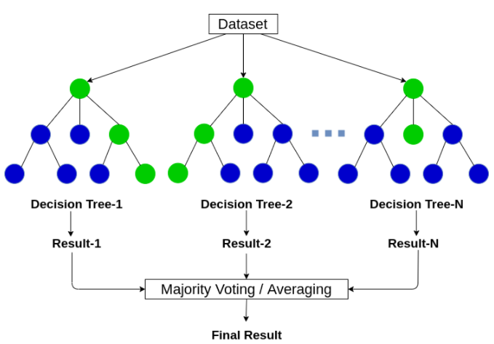
Random Forest
Step 2: Predict

Slide 25
Random Forest
Example
Tree | Results
1 | Yes
2 | Yes
3 | No
4 | Yes
... | ...
n | Yes

Slide 26
Other methods of ensemble
Methods based on:
Manipulating the Input Features
Injecting randomness
Manipulating the Output Targets

Slide 27
3. Application

Slide 28
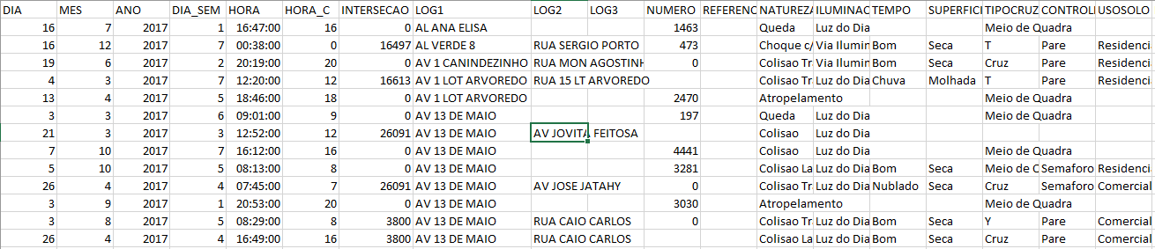
Data overview
Dataset of Traffic accidents in Fortaleza in 2017
Recorded by SIAT (Sistema de Informação em Acidentes de Trânsito de Fortaleza)
16.789 Instances
36 Features
Objective: predict accident severity

Slide 29
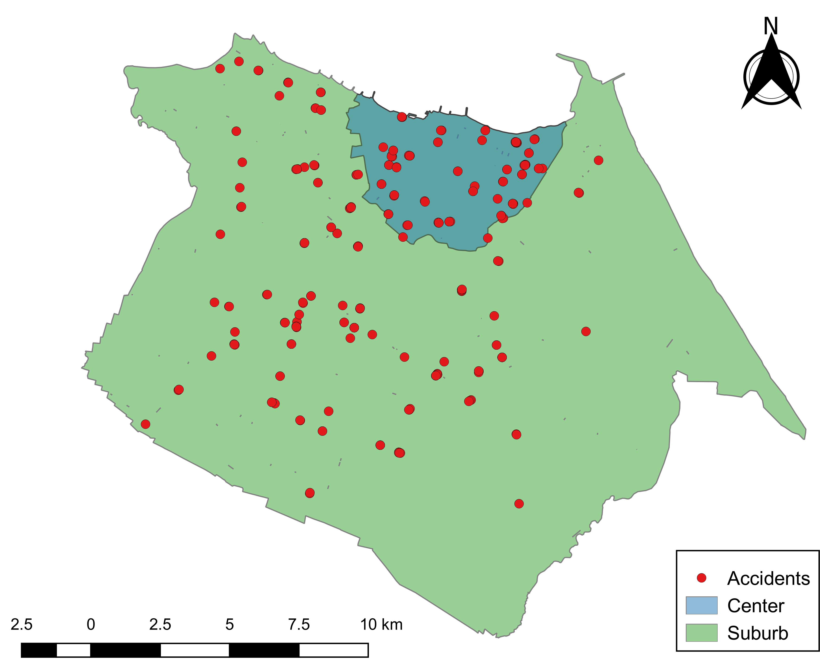
Pre-processing
Select and transform features
time → period (peak/off-peak)
Day → period (weekday/weekend)
geografic coordinates → zone (central/suburb)
Remove empty cells

Slide 30
Pre-processing
7 features and 8814 instances
3115 injuried and 5699 unjuried
60/40 split
6170 instances for training and 2644 for test

Slide 31
Code
Notebook

Slide 32
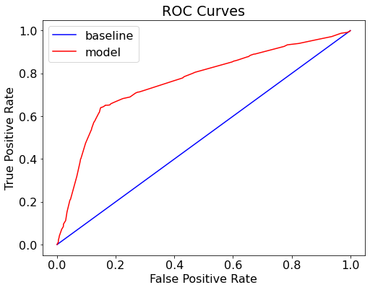



Results
Decision Tree (0:1821, 1:823)
Random Forest (0:1806, 1:838)
$$Recall= \frac{TP}{TP+FN}$$
Metric | Baseline | Train | Test
Recall | 1 | 0,66 | 0,62
Precision | 0,35 | 0,71 | 0,7
ROC | 0,5 | 0,8 | 0,76
Metric | Baseline | Train | Test
Recall | 1 | 0,66 | 0,63
Precision | 0,35 | 0,71 | 0,7
ROC | 0,5 | 0,8 | 0,77
$$Precision= \frac{TP}{TP+FP}$$

Slide 33
Results
Decision Tree (0:1821, 1:823)
Random Forest (0:1806, 1:838)
Feature | Importance
Motorcycles | 0,93
Zone | 0,02
Intersection | 0,01
Large vehicles | 0,01
Peak | 0,01
Feature | Importance
Motorcycles | 0,88
Large vehicles | 0,03
Zone | 0,02
Weekend | 0,02
Intersection | 0,02

Slide 34
Results
Problem: Differents classes for same features

Slide 35
Titanic data set
Dataset of survivors on titanic (Kaggle)
715 Instances
6 Features
Objective: predict survivors
Data
Correlation matrix

Slide 36
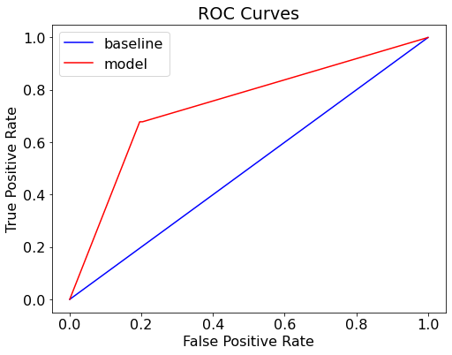
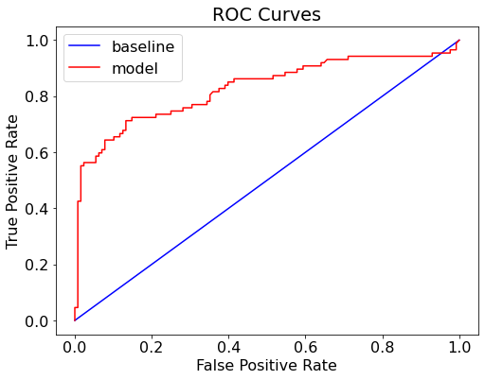


Titanic dataset
Decision Tree (0:131, 1:84)
Random Forest (0:135, 1:80)
$$Recall= \frac{TP}{TP+FN}$$
Metric | Baseline | Train | Test
Recall | 1 | 0,99 | 0,68
Precision | 0,4 | 1,0 | 0,70
ROC | 0,5 | 1,0 | 0,74
Metric | Baseline | Train | Test
Recall | 1 | 0,99 | 0,71
Precision | 0,4 | 1,0 | 0,78
ROC | 0,5 | 1,0 | 0,83
$$Precision= \frac{TP}{TP+FP}$$

Slide 37
Titanic dataset
Decision Tree
Random Forest
Feature | Importance
Female | 0,30
Age | 0,25
Fare | 0,25
Pclass | 0,09
SibSp | 0,06
Feature | Importance
Fare | 0,29
Age | 0,28
Female | 0,25
Pclass | 0,09
SibSp | 0,05

Slide 38
4. Conclusions

Slide 39
Ensemble is a good option to improve predictions
It is necessary to take into account the trade-off between precision and interpretability
Exploring the data is an important step
There are several types of ensembles methods, so it is important to know how they work and for what kind of data they are useful.

Slide 40
References

