Slide 1
Practical Application Development with Spring BOOT
Module 5: CRUD Student
Notes:
Duration: 1 hour, 30 minutes
Content: N/A
Notes to Instructor:
This module introduces Spring MVC Module. Complete coverage of this module is highly recommended. However in case there is not sufficient time to complete case study activities the module may be skipped.

Slide 2

Agenda
Revisão do Spring Essentials
Spring BooT - Overview
Spring BooT – Introduction;
Spring BooT – Components;
Spring BooT – Features;
Funcionamento;
Construção de aplicação;
Notes:
Topic Duration: 10 minutes
Content: N/A
Notes to Instructor:
This is just a brief reminder of where you are in the module. It will help the participants to know what is coming up.
The Appendix includes reference topics that complement the module content. Faculty may use this supplementary content to answer participant questions.
J2EE Presentation Layer Technologies
Spring Web Application Development Stack
Struts MVC Vs. Spring MVC

Slide 3

Module Objectives
Ao final deste modulo você saberá:
O que é Spring Boot 2.0.
Instalar o STS.
Desenvolver uma pequena aplicação web para CRUD de Student.
Notes:
Content: N/A
Notes to Instructor:
Briefly review the module objectives with the participants.
Take note of the learning objectives that are covered by content in the Appendix of this module presentation.

Slide 4
Spring Boot
Aplicação
CRUD Students
Notes:
Aqui abrir uma aplicação juntamente com os alunos;

Slide 5
Projeto CRUD Student
CRUD (acrónimo do inglês Create, Read, Update e Delete) são as quatro operações básicas (criação, consulta, atualização e destruição de dados) utilizadas em bases de dados relacionais (RDBMS) fornecidas aos utilizadores do sistema;
Notes:
Content: N/A
Notes to Instructor:

Slide 6
Projeto CRUD Student
Iremos criar uma página de CRUD, para listar a tabela de students;
Utilizaremos o SpringInitializer;
Criaremos um banco de dados H2 (free);
Iremos utilizar o Hibernate para persistência dos dados;
Vamos configurar o Maven para criar o projeto no STS;
Criar o código;
Notes:
Content: N/A
Notes to Instructor:

Slide 7
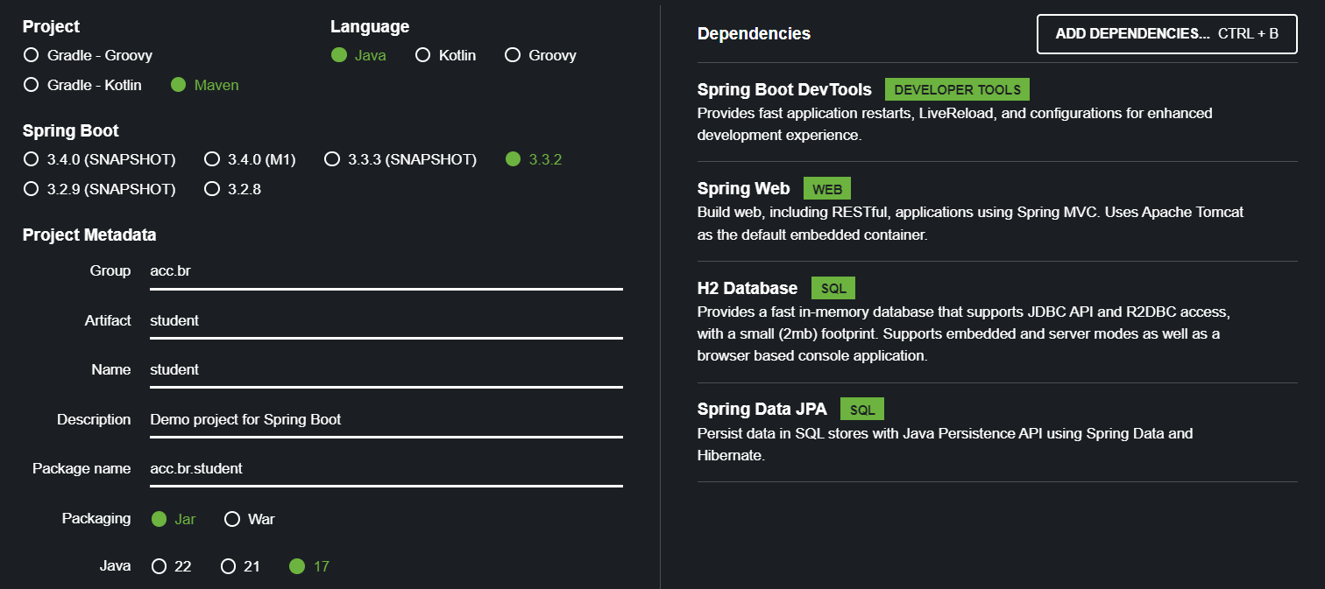
Projeto CRUD Student
Notes:
<?xml version="1.0" encoding="UTF-8"?>
<project xmlns="http://maven.apache.org/POM/4.0.0" xmlns:xsi="http://www.w3.org/2001/XMLSchema-instance"
xsi:schemaLocation="http://maven.apache.org/POM/4.0.0 https://maven.apache.org/xsd/maven-4.0.0.xsd">
<modelVersion>4.0.0</modelVersion>
<parent>
<groupId>org.springframework.boot</groupId>
<artifactId>spring-boot-starter-parent</artifactId>
<version>2.3.0.M1</version>
<relativePath/> <!-- lookup parent from repository -->
</parent>
<groupId>com.javatpoint</groupId>
<artifactId>spring-boot-h2-database-example</artifactId>
<version>0.0.1-SNAPSHOT</version>
<name>spring-boot-h2-database-example</name>
<description>Demo project for Spring Boot</description>
<properties>
<java.version>1.8</java.version>
</properties>
<dependencies>
<dependency>
<groupId>org.springframework.boot</groupId>
<artifactId>spring-boot-starter-data-jpa</artifactId>
</dependency>
<dependency>
<groupId>org.springframework.boot</groupId>
<artifactId>spring-boot-starter-web</artifactId>
</dependency>
<dependency>
<groupId>com.h2database</groupId>
<artifactId>h2</artifactId>
<scope>runtime</scope>
</dependency>
<dependency>
<groupId>org.springframework.boot</groupId>
<artifactId>spring-boot-starter-test</artifactId>
<scope>test</scope>
<exclusions>
<exclusion>
<groupId>org.junit.vintage</groupId>
<artifactId>junit-vintage-engine</artifactId>
</exclusion>
</exclusions>
</dependency>
</dependencies>
<build>
<plugins>
<plugin>
<groupId>org.springframework.boot</groupId>
<artifactId>spring-boot-maven-plugin</artifactId>
</plugin>
</plugins>
</build>
<repositories>
<repository>
<id>spring-milestones</id>
<name>Spring Milestones</name>
<url>https://repo.spring.io/milestone</url>
</repository>
</repositories>
<pluginRepositories>
<pluginRepository>
<id>spring-milestones</id>
<name>Spring Milestones</name>
<url>https://repo.spring.io/milestone</url>
</pluginRepository>
</pluginRepositories>
</project>

Slide 8
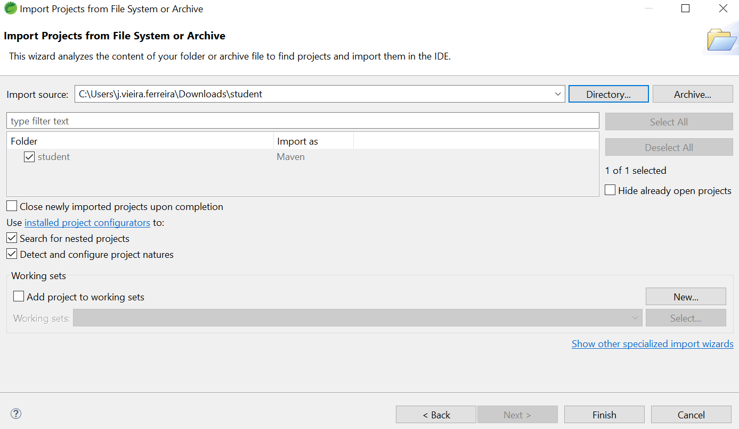
Projeto CRUD Student
FILE ... IMPORT....PROJECTS FROM FOLDER OR...
Notes:
<?xml version="1.0" encoding="UTF-8"?>
<project xmlns="http://maven.apache.org/POM/4.0.0" xmlns:xsi="http://www.w3.org/2001/XMLSchema-instance"
xsi:schemaLocation="http://maven.apache.org/POM/4.0.0 https://maven.apache.org/xsd/maven-4.0.0.xsd">
<modelVersion>4.0.0</modelVersion>
<parent>
<groupId>org.springframework.boot</groupId>
<artifactId>spring-boot-starter-parent</artifactId>
<version>2.3.0.M1</version>
<relativePath/> <!-- lookup parent from repository -->
</parent>
<groupId>com.javatpoint</groupId>
<artifactId>spring-boot-h2-database-example</artifactId>
<version>0.0.1-SNAPSHOT</version>
<name>spring-boot-h2-database-example</name>
<description>Demo project for Spring Boot</description>
<properties>
<java.version>1.8</java.version>
</properties>
<dependencies>
<dependency>
<groupId>org.springframework.boot</groupId>
<artifactId>spring-boot-starter-data-jpa</artifactId>
</dependency>
<dependency>
<groupId>org.springframework.boot</groupId>
<artifactId>spring-boot-starter-web</artifactId>
</dependency>
<dependency>
<groupId>com.h2database</groupId>
<artifactId>h2</artifactId>
<scope>runtime</scope>
</dependency>
<dependency>
<groupId>org.springframework.boot</groupId>
<artifactId>spring-boot-starter-test</artifactId>
<scope>test</scope>
<exclusions>
<exclusion>
<groupId>org.junit.vintage</groupId>
<artifactId>junit-vintage-engine</artifactId>
</exclusion>
</exclusions>
</dependency>
</dependencies>
<build>
<plugins>
<plugin>
<groupId>org.springframework.boot</groupId>
<artifactId>spring-boot-maven-plugin</artifactId>
</plugin>
</plugins>
</build>
<repositories>
<repository>
<id>spring-milestones</id>
<name>Spring Milestones</name>
<url>https://repo.spring.io/milestone</url>
</repository>
</repositories>
<pluginRepositories>
<pluginRepository>
<id>spring-milestones</id>
<name>Spring Milestones</name>
<url>https://repo.spring.io/milestone</url>
</pluginRepository>
</pluginRepositories>
</project>

Slide 9
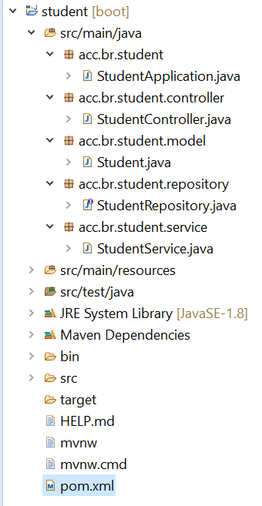
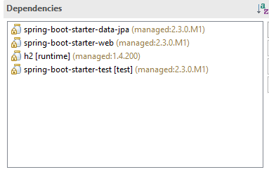
Projeto CRUD Student
Estrutura dos pacotes e dependências;
Notes:
<?xml version="1.0" encoding="UTF-8"?>
<project xmlns="http://maven.apache.org/POM/4.0.0" xmlns:xsi="http://www.w3.org/2001/XMLSchema-instance"
xsi:schemaLocation="http://maven.apache.org/POM/4.0.0 https://maven.apache.org/xsd/maven-4.0.0.xsd">
<modelVersion>4.0.0</modelVersion>
<parent>
<groupId>org.springframework.boot</groupId>
<artifactId>spring-boot-starter-parent</artifactId>
<version>2.3.0.M1</version>
<relativePath/> <!-- lookup parent from repository -->
</parent>
<groupId>com.javatpoint</groupId>
<artifactId>spring-boot-h2-database-example</artifactId>
<version>0.0.1-SNAPSHOT</version>
<name>spring-boot-h2-database-example</name>
<description>Demo project for Spring Boot</description>
<properties>
<java.version>1.8</java.version>
</properties>
<dependencies>
<dependency>
<groupId>org.springframework.boot</groupId>
<artifactId>spring-boot-starter-data-jpa</artifactId>
</dependency>
<dependency>
<groupId>org.springframework.boot</groupId>
<artifactId>spring-boot-starter-web</artifactId>
</dependency>
<dependency>
<groupId>com.h2database</groupId>
<artifactId>h2</artifactId>
<scope>runtime</scope>
</dependency>
<dependency>
<groupId>org.springframework.boot</groupId>
<artifactId>spring-boot-starter-test</artifactId>
<scope>test</scope>
<exclusions>
<exclusion>
<groupId>org.junit.vintage</groupId>
<artifactId>junit-vintage-engine</artifactId>
</exclusion>
</exclusions>
</dependency>
</dependencies>
<build>
<plugins>
<plugin>
<groupId>org.springframework.boot</groupId>
<artifactId>spring-boot-maven-plugin</artifactId>
</plugin>
</plugins>
</build>
<repositories>
<repository>
<id>spring-milestones</id>
<name>Spring Milestones</name>
<url>https://repo.spring.io/milestone</url>
</repository>
</repositories>
<pluginRepositories>
<pluginRepository>
<id>spring-milestones</id>
<name>Spring Milestones</name>
<url>https://repo.spring.io/milestone</url>
</pluginRepository>
</pluginRepositories>
</project>

Slide 10
Projeto CRUD de Produtos
Starters
O spring-boot-starter-web permite aplicativos da web, clássicos e RESTFul.
O spring-boot-starter-data-jpa é um iniciador para usar Spring Data JPA com Hibernate
O H2 (runtime) fornece conectividade para o H2 database.
O spring-boot-starter-test é a principal dependência do teste, ele contém os elementos necessários para nossos testes.
Notes:
Content: N/A
Notes to Instructor:

Slide 11
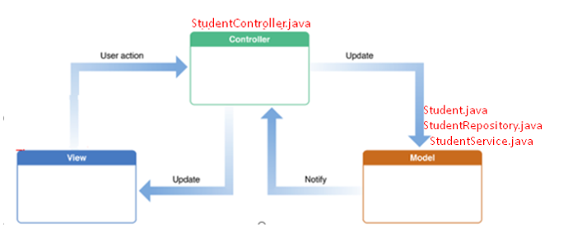
Projeto CRUD Student
Estrutura

Slide 12
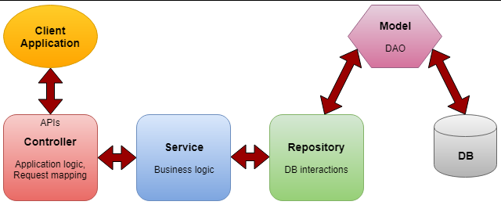
Projeto CRUD Student
Estrutura:
@controller @service @repository
Notes:
Controlador- A camada do controlador contém a * lógica do aplicativo, mapeando a solicitação do usuário para funções específicas e passando a entrada do usuário para a camada de serviço para aplicar a lógica de negócios.
Serviço- Esta é a camada entre o controlador e o repositório que executa a * lógica de negócios e a lógica de validação. O controlador passa a entrada do usuário para a camada de serviço e, após aplicar a lógica de negócios, é passada para a camada de repositório.
Repositório- A camada que interage com as operações CRUD do banco de dados por meio dos DAOs (objetos de acesso a dados).
Modelo - São as classes POJO simples que atuam como DTO (Interagir com a transferência de dados no nível do aplicativo) ou DAO (Interação com operações de banco de dados)

Slide 13
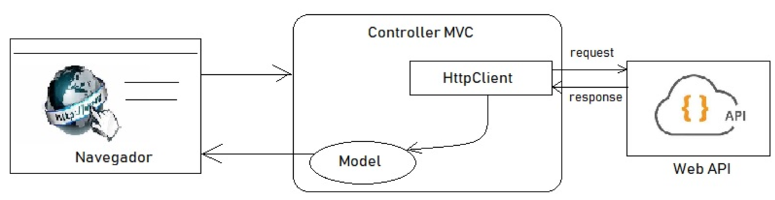
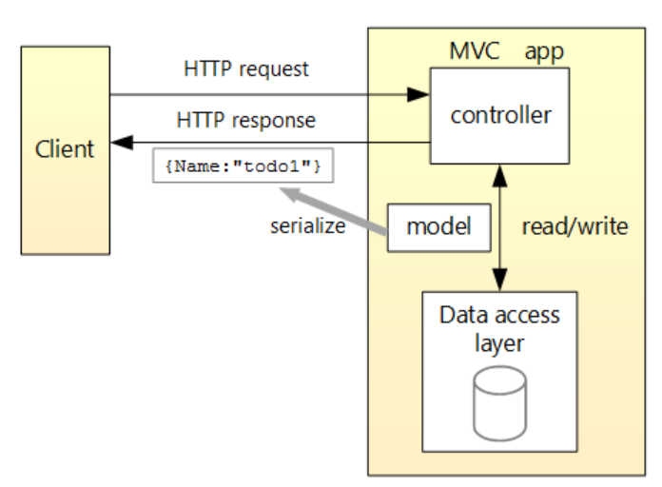
Projeto CRUD Student
Estrutura;
Notes:
Controlador- A camada do controlador contém a * lógica do aplicativo, mapeando a solicitação do usuário para funções específicas e passando a entrada do usuário para a camada de serviço para aplicar a lógica de negócios.
Serviço- Esta é a camada entre o controlador e o repositório que executa a * lógica de negócios e a lógica de validação. O controlador passa a entrada do usuário para a camada de serviço e, após aplicar a lógica de negócios, é passada para a camada de repositório.
Repositório- A camada que interage com as operações CRUD do banco de dados por meio dos DAOs (objetos de acesso a dados).
Modelo - São as classes POJO simples que atuam como DTO (Interagir com a transferência de dados no nível do aplicativo) ou DAO (Interação com operações de banco de dados)

Slide 14
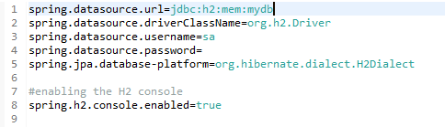

Projeto CRUD Student
Application Properties
http://localhost:8080/h2-console/
Notes:
spring.datasource.url=jdbc:h2:mem:mydb
spring.datasource.driverClassName=org.h2.Driver
spring.datasource.username=sa
spring.datasource.password=
spring.jpa.database-platform=org.hibernate.dialect.H2Dialect
#enabling the H2 console
spring.h2.console.enabled=true
#persist the data
#spring.datasource.url=jdbc:h2:file:/data/sampledata
#spring.datasource.url=jdbc:h2:C:/data/sampledata

Slide 15
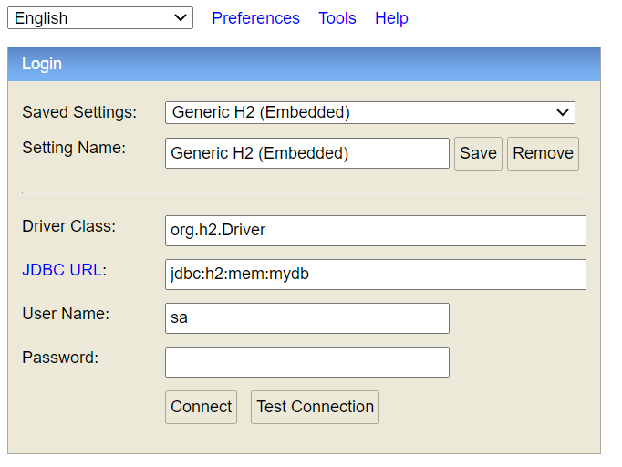
Projeto CRUD Student
H2;
Notes:
Content: N/A
Notes to Instructor:

Slide 16
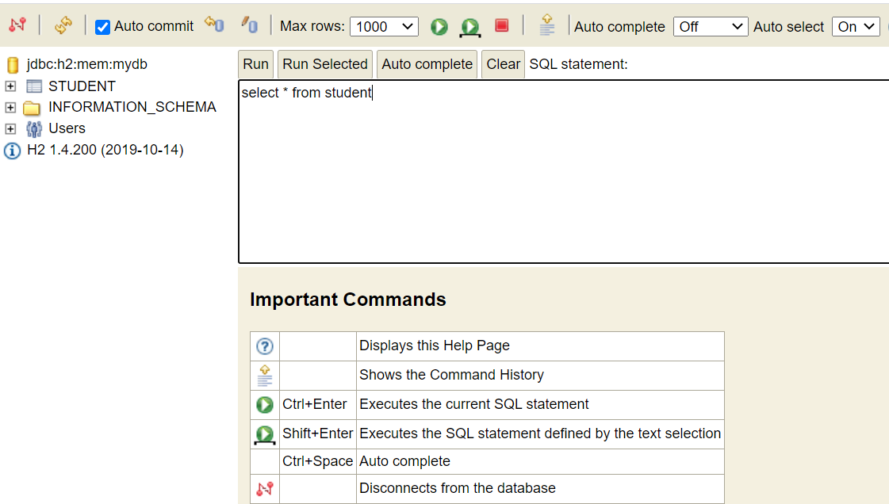
Projeto CRUD Student
H2;
Notes:
Content: N/A
Notes to Instructor:

Slide 17
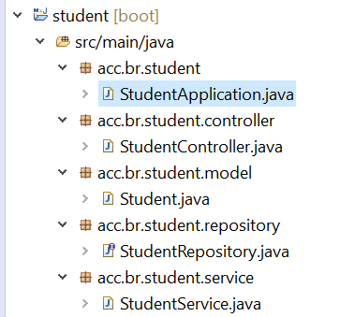
Projeto CRUD Student
Criar a classe principal
StudentApplication no pacote acc.br.student
Notes:
package acc.br.student;
import org.springframework.boot.SpringApplication;
import org.springframework.boot.autoconfigure.SpringBootApplication;
@SpringBootApplication
public class StudentApplication {
public static void main(String[] args) {
SpringApplication.run(StudentApplication.class, args);
}
}

Slide 18
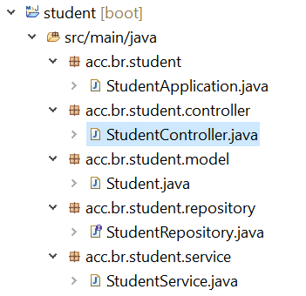
Projeto CRUD Student
Criar a classe controller
Vamos definir o repositório StudentController.java no pacote acc.br.student.controller
Notes:
package acc.br.student.controller;
import java.util.List;
import org.springframework.beans.factory.annotation.Autowired;
import org.springframework.web.bind.annotation.DeleteMapping;
import org.springframework.web.bind.annotation.GetMapping;
import org.springframework.web.bind.annotation.PathVariable;
import org.springframework.web.bind.annotation.PostMapping;
import org.springframework.web.bind.annotation.RequestBody;
import org.springframework.web.bind.annotation.RestController;
import acc.br.student.model.Student;
import acc.br.student.service.StudentService;
//creating RestController
@RestController
public class StudentController
{
//autowired the StudentService class
@Autowired
StudentService studentService;
//creating a get mapping that retrieves all the students detail from the database
@GetMapping("/student")
private List<Student> getAllStudent()
{
return studentService.getAllStudent();
}
//creating a get mapping that retrieves the detail of a specific student
@GetMapping("/student/{id}")
private Student getStudent(@PathVariable("id") int id)
{
return studentService.getStudentById(id);
}
//creating a delete mapping that deletes a specific student
@DeleteMapping("/student/{id}")
private void deleteStudent(@PathVariable("id") int id)
{
studentService.delete(id);
}
//creating post mapping that post the student detail in the database
@PostMapping("/student")
private int saveStudent(@RequestBody Student student)
{
studentService.saveOrUpdate(student);
return student.getId();
}
}

Slide 19
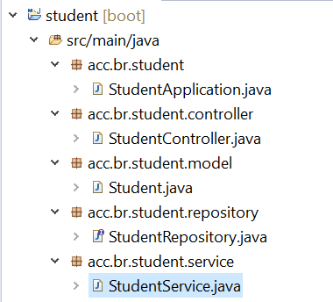
Projeto CRUD Student
Criar a classe service
Vamos definir o repositório StudentService.java no pacote acc.br.student.service
Notes:
package acc.br.student.service;
import java.util.ArrayList;
import java.util.List;
import org.springframework.beans.factory.annotation.Autowired;
import org.springframework.stereotype.Service;
import acc.br.student.model.Student;
import acc.br.student.repository.StudentRepository;
//defining the business logic
@Service
public class StudentService
{
@Autowired
StudentRepository studentRepository;
//getting all student records
public List<Student> getAllStudent()
{
List<Student> students = new ArrayList<Student>();
studentRepository.findAll().forEach(student -> students.add(student));
return students;
}
//getting a specific record
public Student getStudentById(int id)
{
return studentRepository.findById(id).get();
}
public void saveOrUpdate(Student student)
{
studentRepository.save(student);
}
//deleting a specific record
public void delete(int id)
{
studentRepository.deleteById(id);
}
}

Slide 20
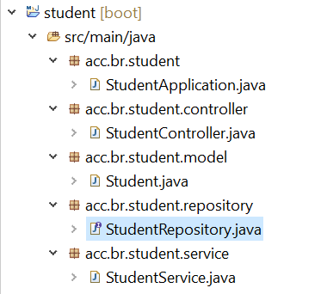
Projeto CRUD Student
Criar a classe repository
Vamos definir o repositório StudentRepository.java no pacote acc.br.student.repository
Notes:
package acc.br.student.repository;
import org.springframework.data.repository.CrudRepository;
import acc.br.student.model.Student;
public interface StudentRepository extends CrudRepository<Student, Integer>
{
}

Slide 21
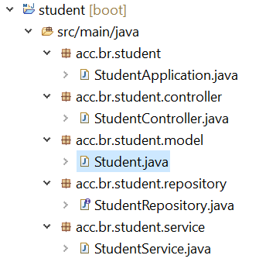
Projeto CRUD Student
Criar a classe model
Vamos definir o repositório Student.java no pacote acc.br.student.model
Notes:
package acc.br.student.model;
import jakarta.persistence.Column;
import jakarta.persistence.Entity;
import jakarta.persistence.Id;
import jakarta.persistence.Table;
//mark class as an Entity
@Entity
//defining class name as Table name
@Table
public class Student
{
//mark id as primary key
@Id
//defining id as column name
@Column
private int id;
//defining name as column name
@Column
private String name;
//defining age as column name
@Column
private int age;
//defining email as column name
@Column
private String email;
public int getId()
{
return id;
}
public void setId(int id)
{
this.id = id;
}
public String getName()
{
return name;
}
public void setName(String name)
{
this.name = name;
}
public int getAge()
{
return age;
}
public void setAge(int age)
{
this.age = age;
}
public String getEmail()
{
return email;
}
public void setEmail(String email)
{
this.email = email;
}
}

Slide 22
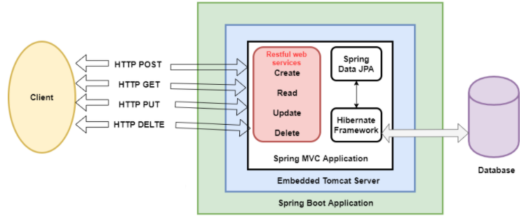
Projeto CRUD Student
POSTMAN
Notes:
Content: N/A
Notes to Instructor:
{
"id": "001",
"age": "23",
"name": "Amit",
"email": "amit@yahoo.co.in"
}

Slide 23
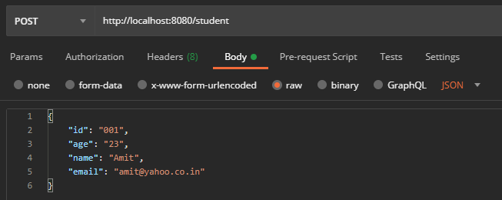
Projeto CRUD Student
POST
Para testar os endpoints, vamos utilizar o Postman:
Notes:
Content: N/A
Notes to Instructor:
{
"id": "001",
"age": "23",
"name": "Amit",
"email": "amit@yahoo.co.in"
}

Slide 24
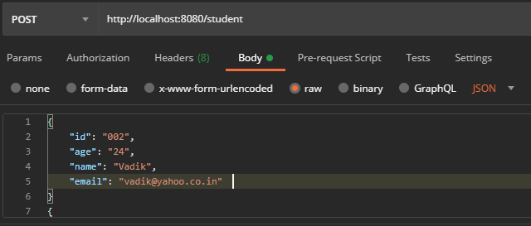
Projeto CRUD Student
POST
Para testar os endpoints, vamos utilizar o Postman:
Notes:
Content: N/A
Notes to Instructor:
{
"id": "002",
"age": "24",
"name": "Vadik",
"email": "vadik@yahoo.co.in"
}
{
"id": "003",
"age": "21",
"name": "Prateek",
"email": "prateek@yahoo.co.in"
}
{
"id": "004",
"age": "25",
"name": "Harsh",
"email": "harsh@yahoo.co.in"
}
{
"id": "005",
"age": "24",
"name": "Swarit",
"email": "Swarit@yahoo.co.in"
}

Slide 25
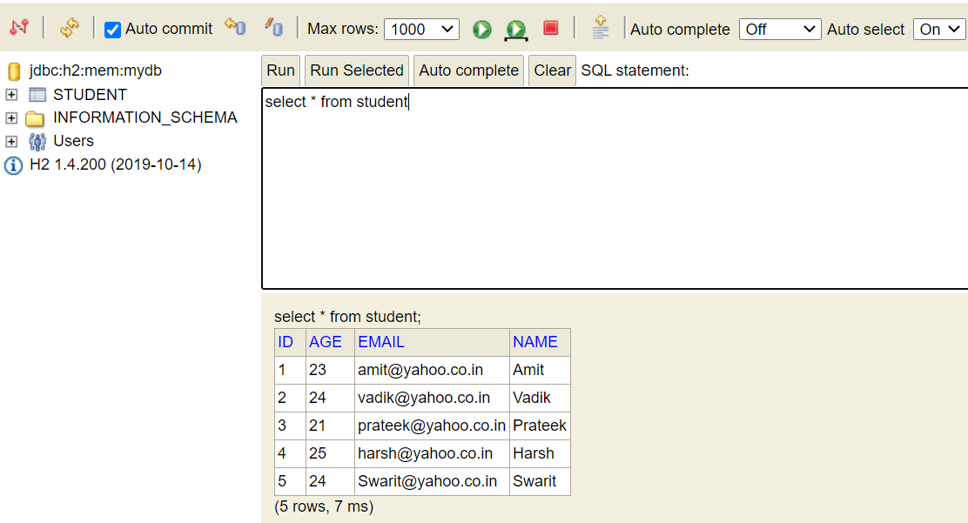
Projeto CRUD Student
Notes:
Content: N/A
Notes to Instructor:

Slide 26
Projeto CRUD Student
Para testar os endpoints,
GET id
DELETE
PUT
Notes:
Content: N/A
Notes to Instructor:

Slide 27
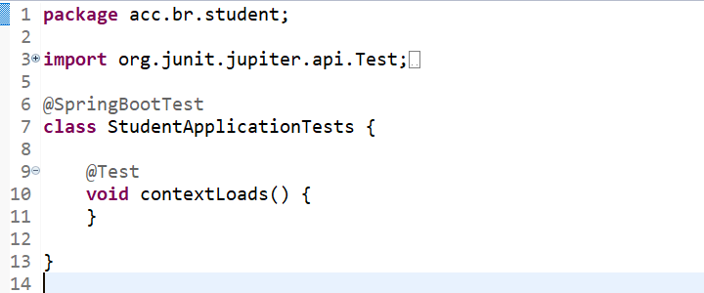
Projeto CRUD de Produtos
Anotation
@SpringBootTest faz a varredura e carrega todo o contexto do aplicativo e todas as configurações automáticas relacionadas ao Spring Boot.
Notes:
package acc.br.student;
import org.junit.jupiter.api.Test;
import org.springframework.boot.test.context.SpringBootTest;
@SpringBootTest
class StudentApplicationTests {
@Test
void contextLoads() {
}
}

Slide 28


Questions and Comments
What questions or comments do you have?

