Slide 1
Practical Application Development with Spring BOOT
Module 6: Lista Contatos

Slide 2

Agenda
Revisão do Spring Essentials
Spring BooT - Overview
Spring BooT – Introduction;
Spring BooT – Components;
Spring BooT – Features;
Funcionamento;
Construção de aplicação;

Slide 3

Module Objectives
Ao final deste modulo você saberá:
O que é Spring Boot 2.0.
Instalar o STS.
Desenvolver uma pequena aplicação web para listagem de contatos.

Slide 4
Spring Boot
Aplicação
Lista Contatos

Slide 5
Projeto Listar Contatos
Iremos criar uma página para listar a tabela de contatos;
Utilizaremos o SpringInitializer;
Criaremos um banco de dados H2 (free) que irá guardar os dados do login;
Iremos utilizar o Hibernate para persistência dos dados;
Vamos configurar o Maven para criar o projeto no STS;
Configurar o Hibernate;
Criar o código;

Slide 6
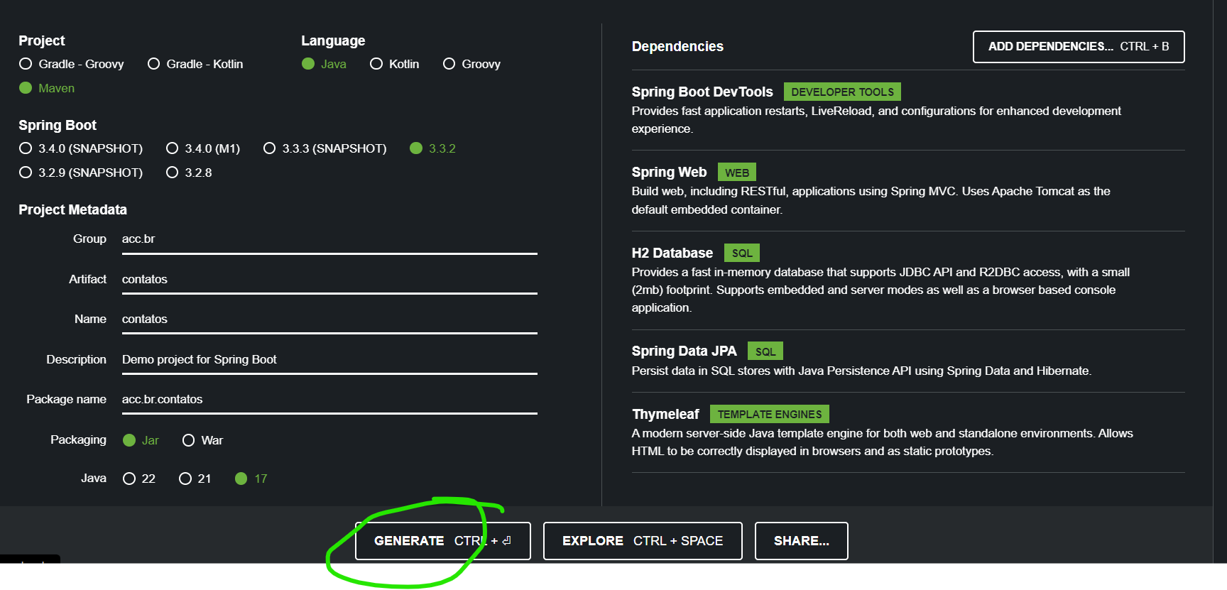
Projeto Listar Contatos
FILE ->Import;

Slide 7
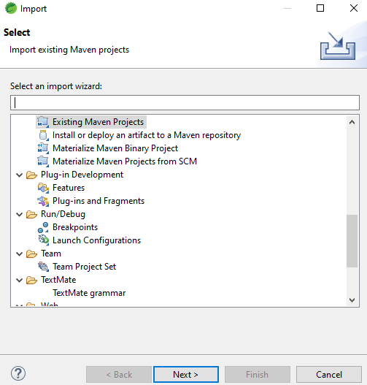
Projeto Listar Contatos
FILE ->Import;

Slide 8
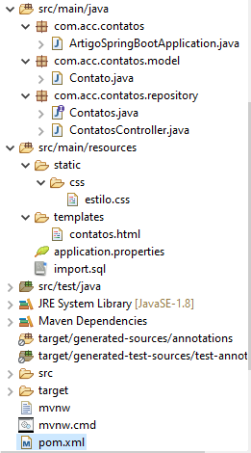
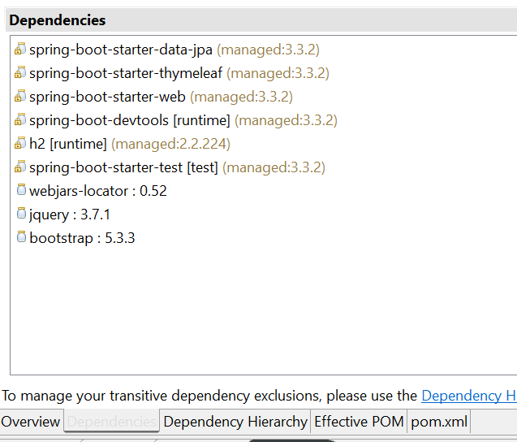
Projeto Listar Contatos
Estrutura dos pacotes e dependências;
Notes:
<?xml version="1.0" encoding="UTF-8"?>
<project xmlns="http://maven.apache.org/POM/4.0.0" xmlns:xsi="http://www.w3.org/2001/XMLSchema-instance"
xsi:schemaLocation="http://maven.apache.org/POM/4.0.0 https://maven.apache.org/xsd/maven-4.0.0.xsd">
<modelVersion>4.0.0</modelVersion>
<parent>
<groupId>org.springframework.boot</groupId>
<artifactId>spring-boot-starter-parent</artifactId>
<version>3.3.2</version>
<relativePath/> <!-- lookup parent from repository -->
</parent>
<groupId>acc.br</groupId>
<artifactId>contatos</artifactId>
<version>0.0.1-SNAPSHOT</version>
<name>contatos</name>
<description>Demo project for Spring Boot</description>
<url/>
<licenses>
<license/>
</licenses>
<developers>
<developer/>
</developers>
<scm>
<connection/>
<developerConnection/>
<tag/>
<url/>
</scm>
<properties>
<java.version>17</java.version>
</properties>
<dependencies>
<dependency>
<groupId>org.springframework.boot</groupId>
<artifactId>spring-boot-starter-data-jpa</artifactId>
</dependency>
<dependency>
<groupId>org.springframework.boot</groupId>
<artifactId>spring-boot-starter-thymeleaf</artifactId>
</dependency>
<dependency>
<groupId>org.springframework.boot</groupId>
<artifactId>spring-boot-starter-web</artifactId>
</dependency>
<dependency>
<groupId>org.springframework.boot</groupId>
<artifactId>spring-boot-devtools</artifactId>
<scope>runtime</scope>
<optional>true</optional>
</dependency>
<dependency>
<groupId>com.h2database</groupId>
<artifactId>h2</artifactId>
<scope>runtime</scope>
</dependency>
<dependency>
<groupId>org.springframework.boot</groupId>
<artifactId>spring-boot-starter-test</artifactId>
<scope>test</scope>
</dependency>
</dependencies>
<build>
<plugins>
<plugin>
<groupId>org.springframework.boot</groupId>
<artifactId>spring-boot-maven-plugin</artifactId>
</plugin>
</plugins>
</build>
</project>

Slide 9
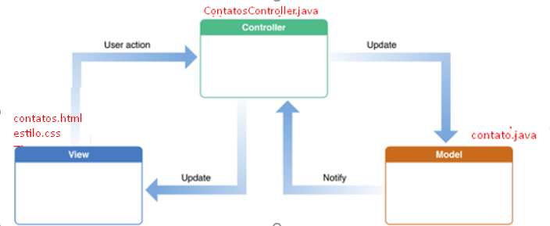
Projeto Listar Contatos
Estrutura

Slide 10
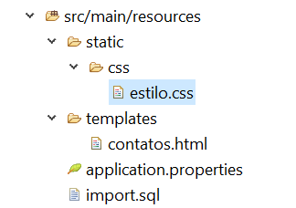
Projeto Listar Contatos
Resources
estilo.css
contatos.html
import.sql
Notes:
body {
margin-top: 50px;
}
footer {
color: #AAA
}

Slide 11
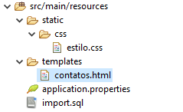
Projeto Listar Contatos
Resources
estilo.css
contatos.html
import.sql
Notes:
<!DOCTYPE html>
<html xmlns:th="http://www.thymeleaf.org">
<head>
<title>Listagem de contatos utilizando o Spring Boot</title>
<link th:href="@{/webjars/bootstrap/css/bootstrap.min.css}" rel="stylesheet" />
<link th:href="@{/webjars/bootstrap/css/bootstrap-theme.min.css}" rel="stylesheet" />
<link th:href="@{/webjars/font-awesome/css/font-awesome.min.css}" rel="stylesheet" />
<link th:href="@{/css/estilo.css}" rel="stylesheet" />
</head>
<body>
<nav class="navbar navbar-default navbar-fixed-top">
<div class="container">
<div class="navbar-header">
<button type="button" class="navbar-toggle collapsed"
data-toggle="collapse" data-target="#navbar" aria-expanded="false"
aria-controls="navbar">
<span class="sr-only">Toggle navigation</span> <span
class="icon-bar"></span> <span class="icon-bar"></span> <span
class="icon-bar"></span>
</button>
<a class="navbar-brand" th:href="@{/contatos}">Contatos</a>
</div>
<div id="navbar" class="collapse navbar-collapse">
<ul class="nav navbar-nav navbar-right">
<li class="dropdown">
<a href="#" class="dropdown-toggle"
data-toggle="dropdown" role="button" aria-haspopup="true"
aria-expanded="false">
Menu
<span class="caret"></span>
</a>
<ul class="dropdown-menu">
<li><a href="http://www.google.com" target="_blank">Site</a></li>
<li><a href="http://www.facebook.com" target="_blank">Facebook</a></li>
<li><a href="http://www.youtube.com" target="_blank">YouTube</a></li>
<li><a href="http://github.com" target="_blank">Github</a></li>
</ul>
</li>
</ul>
</div>
</div>
</nav>
<div class="container">
<div class="page-header">
<h1>Lista de contatos</h1>
</div>
<table class="table table-striped table-bordered">
<thead>
<tr>
<th>#</th>
<th>Nome</th>
<th>E-mail</th>
</tr>
</thead>
<tbody>
<tr th:each="contato: ${contatos}">
<td th:text="${contato.id}"></td>
<td th:text="${contato.nome}"></td>
<td th:text="${contato.email}"></td>
</tr>
</tbody>
</table>
</div>
<script th:src="@{/webjars/jquery/jquery.min.js}"></script>
<script th:src="@{/webjars/bootstrap/js/bootstrap.min.js}"></script>
</body>
</html>

Slide 12
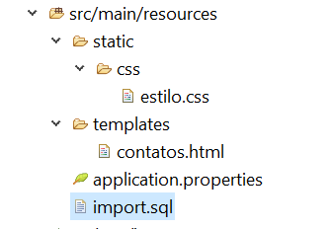
Projeto Listar Contatos
Resources
estilo.css
contatos.html
import.sql
Notes:
insert into Contato (id, nome, email) values (1, 'William Douglas', 'williamdouglas@gmail.com');
insert into Contato (id, nome, email) values (2, 'Al Ries', 'alries@hotmail.com');
insert into Contato (id, nome, email) values (3, 'Mortimer J. Adler', 'mortimeradler@gmail.com');
insert into Contato (id, nome, email) values (4, 'Christian Barbosa', 'christianbarbosa@gmail.com');

Slide 13

Projeto Listar Contatos
Application Properties
http://localhost:8080/h2-console/
Notes:
# Enabling H2 Console
spring.h2.console.enabled=true
spring.datasource.url=jdbc:h2:mem:testdb
spring.data.jpa.repositories.bootstrap-mode=default

Slide 14
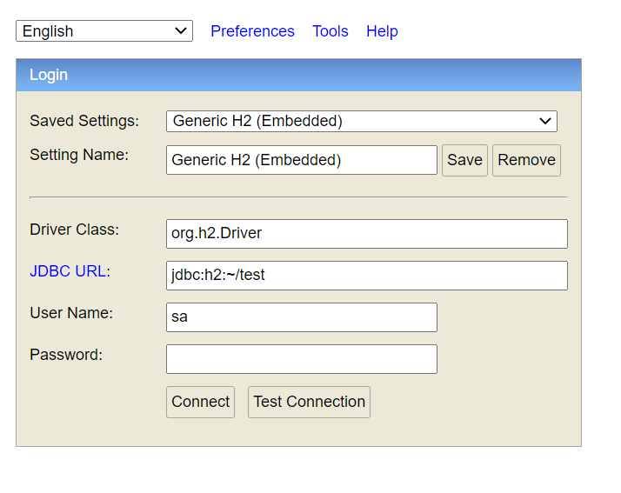
Projeto Listar Contatos
Principais Classes;

Slide 15
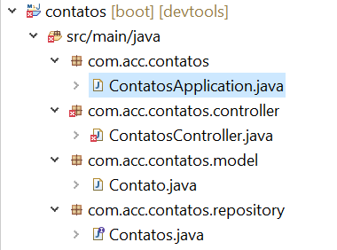
Projeto Listar Contatos
Criar a classe principal
Vamos definir a classe ContatosAppilcation.java no pacote com.acc.contatos
Notes:
package com.acc.contatos;
import org.springframework.boot.SpringApplication;
import org.springframework.boot.autoconfigure.SpringBootApplication;
@SpringBootApplication
public class ContatosApplication {
public static void main(String[] args) {
SpringApplication.run(ContatosApplication.class, args);
}
}

Slide 16
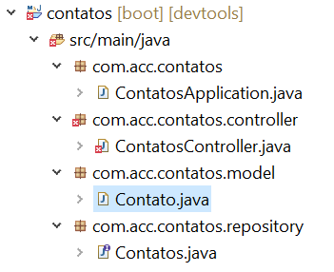
Projeto Listar Contatos
Criar a classe model
Vamos definir a classe Contato.java no pacote com.acc.contatos.model
Notes:
package acc.br.contatos.model;
import java.io.Serializable;
import jakarta.persistence.Entity;
import jakarta.persistence.GeneratedValue;
import jakarta.persistence.GenerationType;
import jakarta.persistence.Id;
@Entity
public class Contato implements Serializable {
private static final long serialVersionUID = 1L;
@Id
@GeneratedValue(strategy = GenerationType.IDENTITY)
private Long id;
private String nome;
private String email;
public Long getId() {
return id;
}
public void setId(Long id) {
this.id = id;
}
public String getNome() {
return nome;
}
public void setNome(String nome) {
this.nome = nome;
}
public String getEmail() {
return email;
}
public void setEmail(String email) {
this.email = email;
}
@Override
public int hashCode() {
final int prime = 31;
int result = 1;
result = prime * result + ((id == null) ? 0 : id.hashCode());
return result;
}
@Override
public boolean equals(Object obj) {
if (this == obj)
return true;
if (obj == null)
return false;
if (getClass() != obj.getClass())
return false;
Contato other = (Contato) obj;
if (id == null) {
if (other.id != null)
return false;
} else if (!id.equals(other.id))
return false;
return true;
}
}

Slide 17
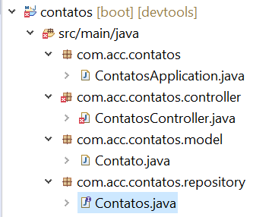
Projeto Listar Contatos
Criar a classe o repositório
Vamos definir a interface Contatos.java no pacote com.acc.contatos.repository
Notes:
package acc.br.contatos.repository;
import org.springframework.data.jpa.repository.JpaRepository;
import com.acc.contatos.model.Contato;
public interface Contatos extends JpaRepository<Contato, Long> {
}

Slide 18
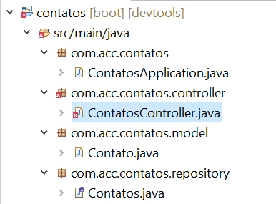
Projeto Listar Contatos
Criar a classe controller
Vamos definir a classe ContatosController.java no pacote com.acc.contatos.controller
Notes:
package acc.br.contatos.controller;
import java.util.List;
import org.springframework.beans.factory.annotation.Autowired;
import org.springframework.stereotype.Controller;
import org.springframework.web.bind.annotation.GetMapping;
import org.springframework.web.bind.annotation.RequestMapping;
import org.springframework.web.servlet.ModelAndView;
import com.acc.contatos.model.Contato;
import com.acc.contatos.repository.Contatos;
@Controller
@RequestMapping("/contatos")
public class ContatosController {
@Autowired
private Contatos contatos;
@GetMapping
public ModelAndView listar() {
List<Contato> lista = contatos.findAll();
ModelAndView modelAndView = new ModelAndView("contatos");
modelAndView.addObject("contatos", lista);
return modelAndView;
}
}

Slide 19

Projeto Listar Contatos
Criar a classe model
Definição da chave primária
Notes:
package acc.br.contatos.model;
import java.io.Serializable;
import jakarta.persistence.Entity;
import jakarta.persistence.GeneratedValue;
import jakarta.persistence.GenerationType;
import jakarta.persistence.Id;
@Entity
public class Contato implements Serializable {
private static final long serialVersionUID = 1L;
@Id
@GeneratedValue(strategy = GenerationType.IDENTITY)
private Long id;
private String nome;
private String email;
public Long getId() {
return id;
}
public void setId(Long id) {
this.id = id;
}
public String getNome() {
return nome;
}
public void setNome(String nome) {
this.nome = nome;
}
public String getEmail() {
return email;
}
public void setEmail(String email) {
this.email = email;
}
@Override
public int hashCode() {
final int prime = 31;
int result = 1;
result = prime * result + ((id == null) ? 0 : id.hashCode());
return result;
}
@Override
public boolean equals(Object obj) {
if (this == obj)
return true;
if (obj == null)
return false;
if (getClass() != obj.getClass())
return false;
Contato other = (Contato) obj;
if (id == null) {
if (other.id != null)
return false;
} else if (!id.equals(other.id))
return false;
return true;
}
}

Slide 20
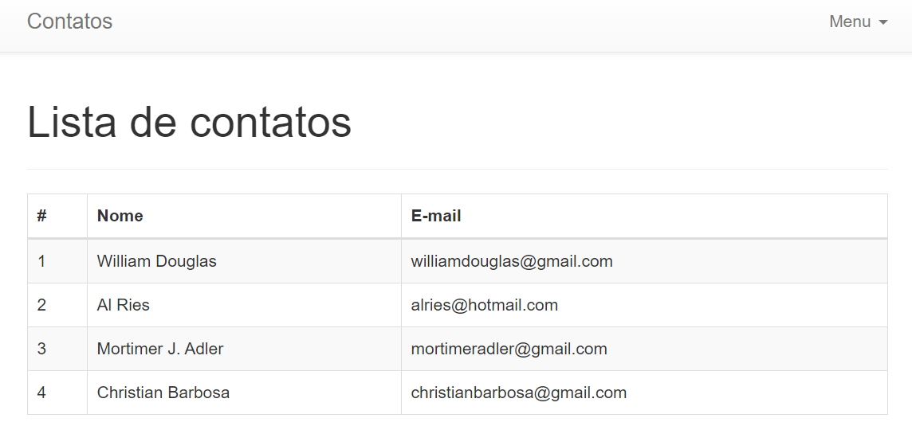
Projeto Listar Contatos
Página da Listagem
http://localhost:8080/contatos

Slide 21


Questions and Comments
What questions or comments do you have?

