Slide 1
Practical Application Development with Spring c/LomBok
Module 11: LOMBOK

Slide 2
Spring c/LomBok
Instalar o LomBok no Eclipse

Slide 3
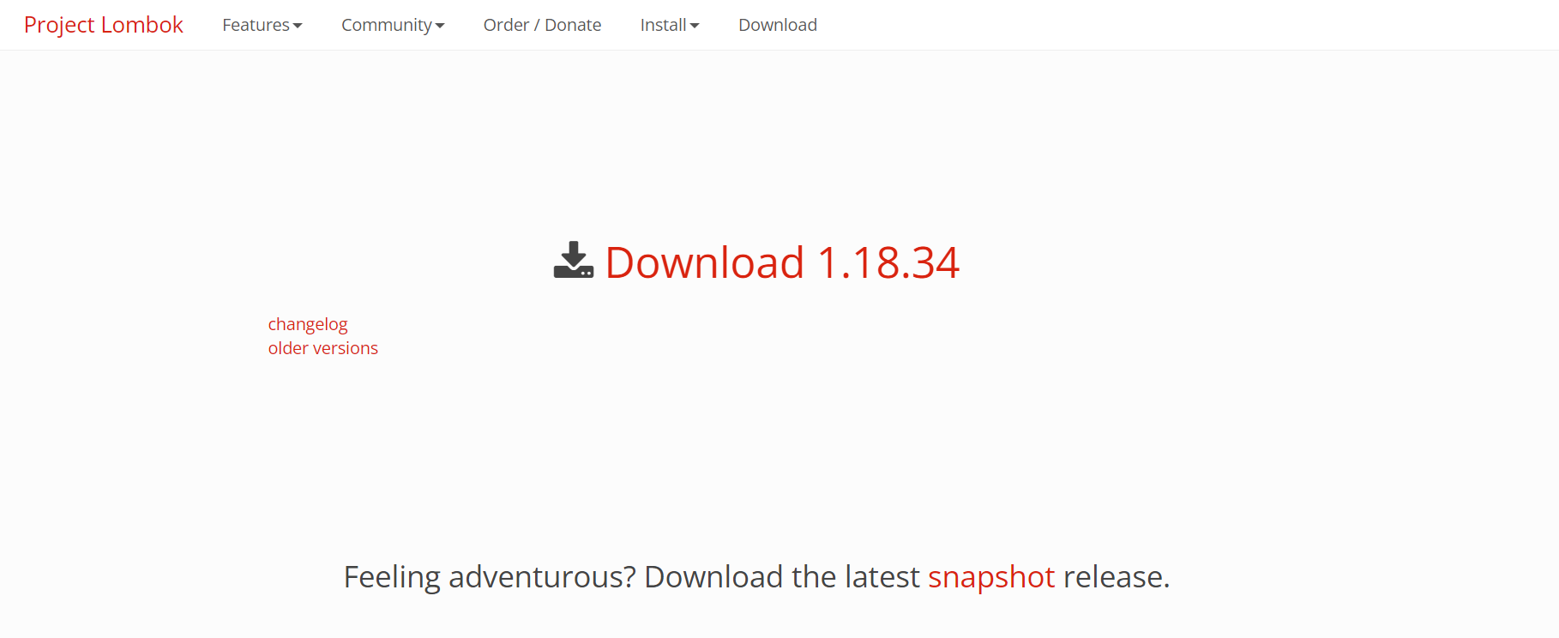
Spring c/LomBok
https://projectlombok.org/download

Slide 4
Spring c/LomBok
Executar lombok

Slide 5
Spring c/LomBok
Instalar lombok

Slide 6
Spring c/LomBok
Aplicação
Spring c/LomBok

Slide 7
Spring c/LomBok
CRUD (acrónimo do inglês Create, Read, Update e Delete) são as quatro operações básicas (criação, consulta, atualização e destruição de dados) utilizadas em bases de dados relacionais (RDBMS) fornecidas aos utilizadores do sistema;

Slide 8
Spring c/LomBok
Criaremos um banco de dados MYSQL (free);
Iremos utilizar o JPA para persistência dos dados;
Vamos configurar o intialzr para criar o projeto no STS;
Criar o código;

Slide 9
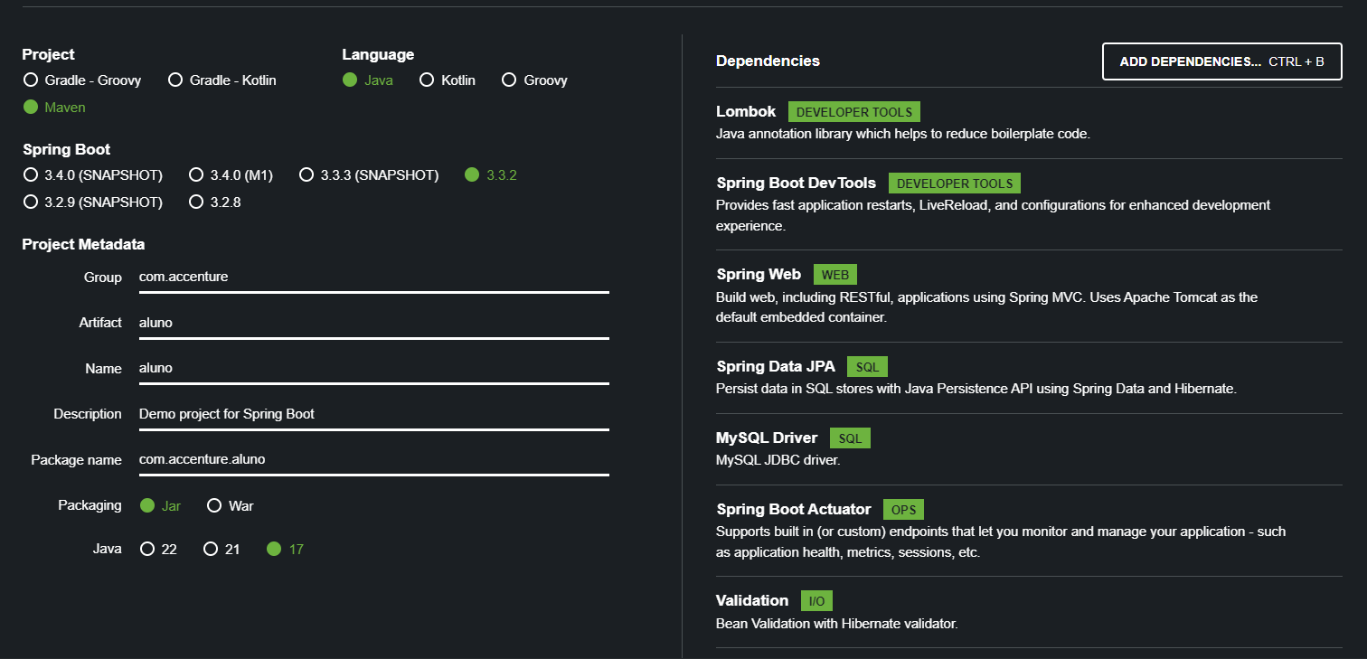
Spring c/LomBok
Starters;

Slide 10
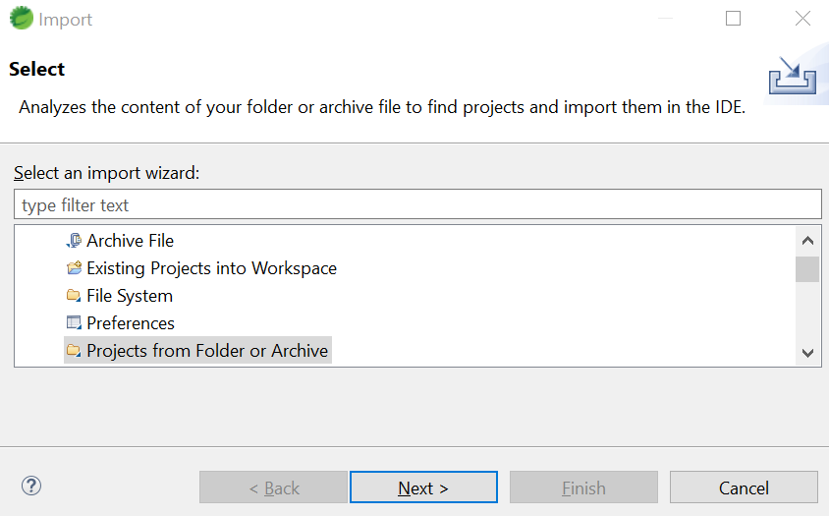
Spring c/LomBok
FILE ->Import → GENERAL → Project from folder or archive;

Slide 11
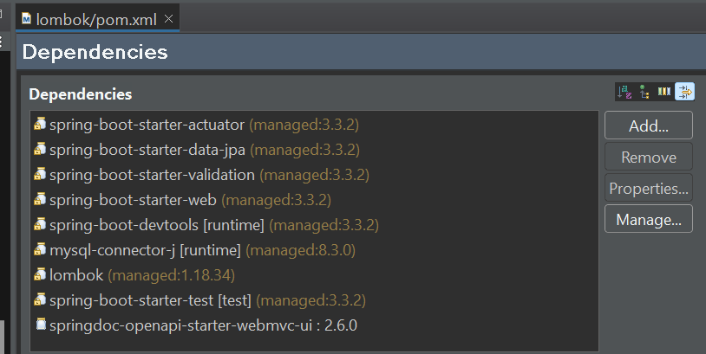
Spring c/LomBok
Estrutura dos pacotes e dependências;
Notes:
<?xml version="1.0" encoding="UTF-8"?>
<project xmlns="http://maven.apache.org/POM/4.0.0" xmlns:xsi="http://www.w3.org/2001/XMLSchema-instance"
xsi:schemaLocation="http://maven.apache.org/POM/4.0.0 https://maven.apache.org/xsd/maven-4.0.0.xsd">
<modelVersion>4.0.0</modelVersion>
<parent>
<groupId>org.springframework.boot</groupId>
<artifactId>spring-boot-starter-parent</artifactId>
<version>3.3.2</version>
<relativePath/> <!-- lookup parent from repository -->
</parent>
<groupId>acc.br</groupId>
<artifactId>lombok</artifactId>
<version>0.0.1-SNAPSHOT</version>
<name>lombok</name>
<description>Demo project for Spring Boot</description>
<url/>
<licenses>
<license/>
</licenses>
<developers>
<developer/>
</developers>
<scm>
<connection/>
<developerConnection/>
<tag/>
<url/>
</scm>
<properties>
<java.version>17</java.version>
</properties>
<dependencies>
<dependency>
<groupId>org.springframework.boot</groupId>
<artifactId>spring-boot-starter-actuator</artifactId>
</dependency>
<dependency>
<groupId>org.springframework.boot</groupId>
<artifactId>spring-boot-starter-data-jpa</artifactId>
</dependency>
<dependency>
<groupId>org.springframework.boot</groupId>
<artifactId>spring-boot-starter-validation</artifactId>
</dependency>
<dependency>
<groupId>org.springframework.boot</groupId>
<artifactId>spring-boot-starter-web</artifactId>
</dependency>
<dependency>
<groupId>org.springframework.boot</groupId>
<artifactId>spring-boot-devtools</artifactId>
<scope>runtime</scope>
<optional>true</optional>
</dependency>
<dependency>
<groupId>com.mysql</groupId>
<artifactId>mysql-connector-j</artifactId>
<scope>runtime</scope>
</dependency>
<dependency>
<groupId>org.projectlombok</groupId>
<artifactId>lombok</artifactId>
<optional>true</optional>
</dependency>
<dependency>
<groupId>org.springframework.boot</groupId>
<artifactId>spring-boot-starter-test</artifactId>
<scope>test</scope>
</dependency>
<!-- https://mvnrepository.com/artifact/org.springdoc/springdoc-openapi-starter-webmvc-ui -->
<dependency>
<groupId>org.springdoc</groupId>
<artifactId>springdoc-openapi-starter-webmvc-ui</artifactId>
<version>2.6.0</version>
</dependency>
</dependencies>
<build>
<plugins>
<plugin>
<groupId>org.springframework.boot</groupId>
<artifactId>spring-boot-maven-plugin</artifactId>
<configuration>
<excludes>
<exclude>
<groupId>org.projectlombok</groupId>
<artifactId>lombok</artifactId>
</exclude>
</excludes>
</configuration>
</plugin>
</plugins>
</build>
</project>

Slide 12
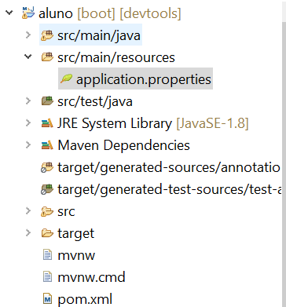
Spring c/LomBok
application.properties
Notes:
## Database Properties
spring.datasource.url=jdbc:mysql://localhost:3306/mydb?allowPublicKeyRetrieval=true&useSSL=false
spring.datasource.username=root
spring.datasource.password=root
spring.jpa.hibernate.ddl-auto=update
spring.jpa.show-sql=true

Slide 13
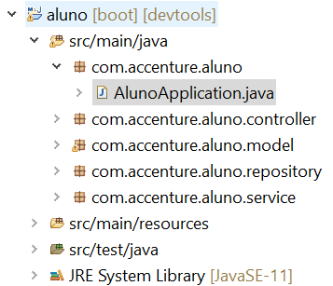
Spring c/LomBok
Criar a classe principal
AlunoApplication.java no pacote com.accenture.aluno
Notes:
package com.accenture.aluno;
import org.springframework.boot.SpringApplication;
import org.springframework.boot.autoconfigure.SpringBootApplication;
@SpringBootApplication
public class AlunoApplication {
public static void main(String[] args) {
SpringApplication.run(AlunoApplication.class, args);
}
}

Slide 14
Spring c/LomBok
LOMBOK
O Lombok é um framework para Java que permite escrever código eliminando a verbosidade. Seu uso permite gerar em tempo de compilação os métodos getters e setters, métodos construtores, padrão builder e muito mais

Slide 15
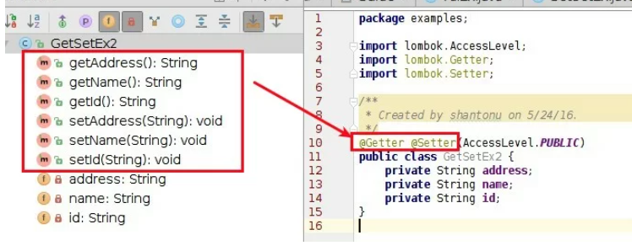
Spring c/LomBok
LOMBOK
@Getter @Setter: Ajuda a fazer getters e setters
Parâmetro: Enum AccessLevel
PUBLIC = Acessível ao público
MODULE, PACKAGE = mesmo que o padrão (sem usar nenhum modificador)
PROTECTED = mesmo que protegido
PRIVATE = mesmo que privado
NONE = não haverá implementação

Slide 16
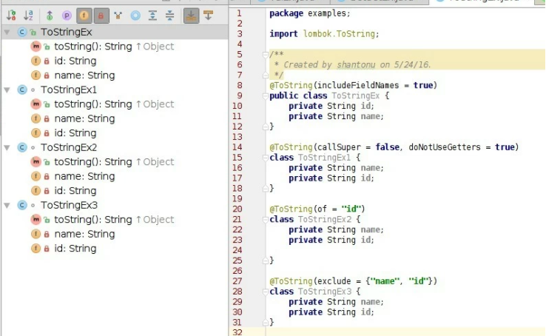
Spring c/LomBok
LOMBOK
@ToString: Esta é a implementação de toString (), podemos usar apenas para o nível de classe.
Parâmetros:
includeFieldNames (): tipo booleano => definir todas as inclusões de campos
callSuper (): tipo booleano => chamando super
doNotUseGetters (): tipo booleano => evite usar getters dos campos.
exclude (): array de strings de nomes de campo => definir exclusão de campo
of (): array de strings de nomes de campos => define quais devem ser adicionados

Slide 17
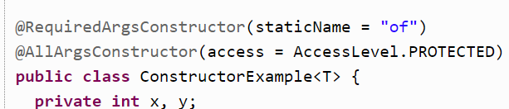
Spring c/LomBok
LOMBOK
@NoArgsConstructor: irá gerar um construtor sem parâmetros.
@RequiredArgsConstructor: gera um construtor com 1 parâmetro para cada campo que requer tratamento especial.
@AllArgsConstructor: gera um construtor com 1 parâmetro para cada campo em sua classe;

Slide 18
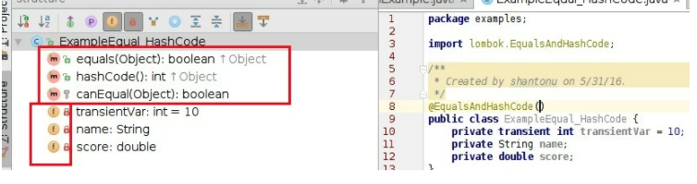
Spring c/LomBok
LOMBOK
@EqualsAndHashCode: É simplesmente adiciona equals (Object other) e hashCode () à classe.
Possui os mesmo parâmetros do @ToString;

Slide 19
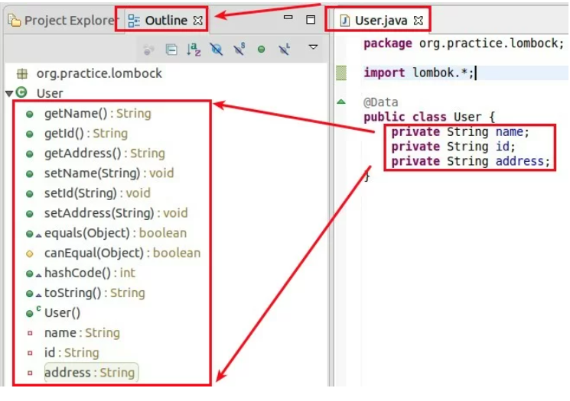
Spring c/LomBok
LOMBOK
@Data é uma combinação de múltiplas anotações
1. @Getter, 2. @Setter. 3. @RequiredArgsConstructor 4. @Tostring 5. @EqualsAndHashCode

Slide 20
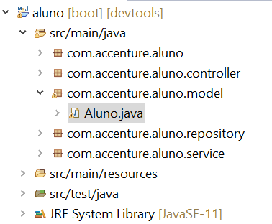
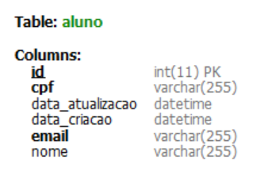
Spring c/LomBok
Criar a classe entidade com lombok
Aluno.java no pacote com.accenture.aluno.model
Notes:
package com.accenture.aluno.model;
import java.io.Serializable;
import java.util.Date;
import jakarta.persistence.Column;
import jakarta.persistence.Entity;
import jakarta.persistence.GeneratedValue;
import jakarta.persistence.GenerationType;
import jakarta.persistence.Id;
import jakarta.persistence.PrePersist;
import jakarta.persistence.PreUpdate;
import jakarta.persistence.Table;
import lombok.AccessLevel;
import lombok.AllArgsConstructor;
import lombok.Builder;
import lombok.Data;
import lombok.NoArgsConstructor;
import lombok.ToString;
@Data
@NoArgsConstructor
@AllArgsConstructor(access = AccessLevel.PRIVATE)
@Entity
@Table(name = "aluno")
public class Aluno implements Serializable {
private static final long serialVersionUID = 1L;
@Id
@GeneratedValue(strategy = GenerationType.AUTO)
private int id;
@Column(name="nome", nullable=false)
private String nome;
@Column(name="email", unique=true)
private String email;
@Column(name="cpf", unique=true)
private String cpf;
@Column(name = "data_criacao", nullable = false)
private Date dataCriacao;
@Column(name = "data_atualizacao", nullable = false)
private Date dataAtualizacao;
@PreUpdate
public void preUpdate() {
dataAtualizacao = new Date();
}
@PrePersist
public void prePersist() {
final Date atual = new Date();
dataCriacao = atual;
dataAtualizacao = atual;
}
}

Slide 21
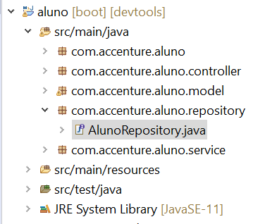
Spring c/LomBok
Criar a classe repositório
AlunoRepository.java no pacote com.accenture.aluno.repository
Notes:
package com.accenture.aluno.repository;
import org.springframework.data.repository.CrudRepository;
import com.accenture.aluno.model.Aluno;
public interface AlunoRepository extends CrudRepository<Aluno, Integer>{
}

Slide 22
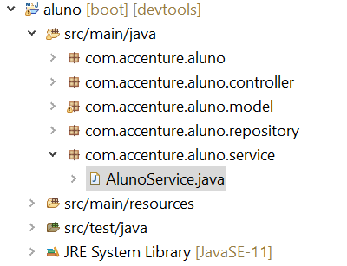
Spring c/LomBok
Criar a classe serviço
AlunoService.java no pacote com.accenture.aluno.service
Notes:
package com.accenture.aluno.service;
import java.util.ArrayList;
import java.util.List;
import org.springframework.beans.factory.annotation.Autowired;
import org.springframework.stereotype.Service;
import com.accenture.aluno.model.Aluno;
import com.accenture.aluno.repository.AlunoRepository;
//defining the business logic
@Service
public class AlunoService {
@Autowired
AlunoRepository alunoRepository;
//getting all student records
public List<Aluno> getAllAluno()
{
List<Aluno> alunos = new ArrayList<Aluno>();
alunoRepository.findAll().forEach(aluno -> alunos.add(aluno));
return alunos;
}
//getting a specific record
public Aluno getAlunoById(int id)
{
return alunoRepository.findById(id).get();
}
public void saveOrUpdate(Aluno aluno)
{
alunoRepository.save(aluno);
}
//deleting a specific record
public void delete(int id)
{
alunoRepository.deleteById(id);
}
}

Slide 23
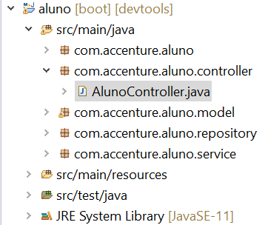
Spring c/LomBok
Criar a classe repository
AlunoController.java no pacote com.accenture.aluno.controller
Notes:
package com.acenture.alunocontroller;
import java.util.List;
import org.springframework.beans.factory.annotation.Autowired;
import org.springframework.web.bind.annotation.DeleteMapping;
import org.springframework.web.bind.annotation.GetMapping;
import org.springframework.web.bind.annotation.PathVariable;
import org.springframework.web.bind.annotation.PostMapping;
import org.springframework.web.bind.annotation.RequestBody;
import org.springframework.web.bind.annotation.RestController;
import com.accenture.aluno.model.Aluno;
import com.accenture.aluno.service.AlunoService;
//creating RestController
@RestController
public class AlunoController {
//autowired the StudentService class
@Autowired
AlunoService alunoService;
//creating a get mapping that retrieves all the alunos detail from the database
@GetMapping("/aluno")
private List<Aluno> getAllAluno()
{
return alunoService.getAllAluno();
}
//creating a get mapping that retrieves the detail of a specific aluno
@GetMapping("/aluno/{id}")
private Aluno getAluno(@PathVariable("id") int id)
{
return alunoService.getAlunoById(id);
}
//creating a delete mapping that deletes a specific aluno
@DeleteMapping("/aluno/{id}")
private void deleteAluno(@PathVariable("id") int id)
{
alunoService.delete(id);
}
//creating post mapping that post the aluno detail in the database
@PostMapping("/aluno")
private int saveAluno(@RequestBody Aluno aluno)
{
alunoService.saveOrUpdate(aluno);
return aluno.getId();
}
}

Slide 24
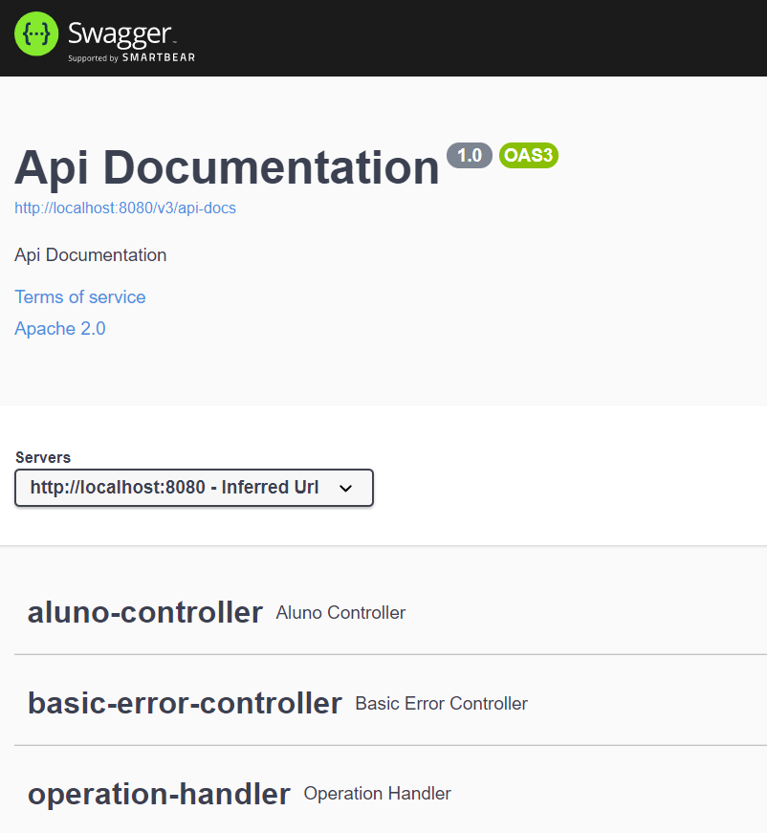
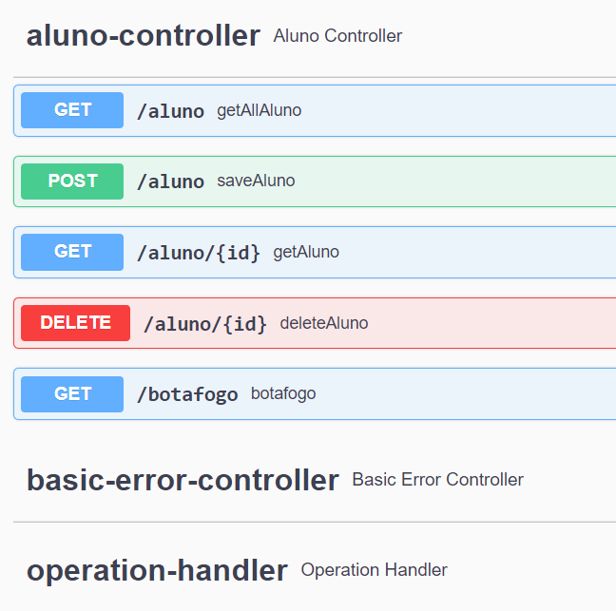
Spring c/LomBok
Testando POST
http://localhost:8080/swagger-ui/index.html#/
Notes:
package com.example.jpa.exception;
import org.springframework.http.HttpStatus;
import org.springframework.web.bind.annotation.ResponseStatus;
@ResponseStatus(HttpStatus.NOT_FOUND)
public class ResourceNotFoundException extends RuntimeException {
public ResourceNotFoundException() {
super();
}
public ResourceNotFoundException(String message) {
super(message);
}
public ResourceNotFoundException(String message, Throwable cause) {
super(message, cause);
}
}

Slide 25
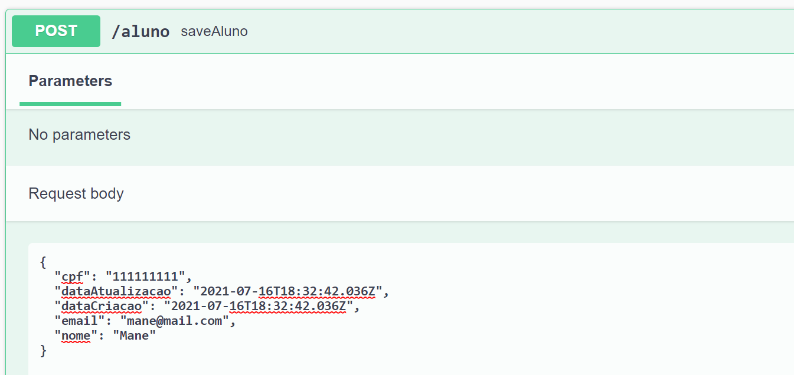
Spring c/LomBok
Testando POST

Slide 26
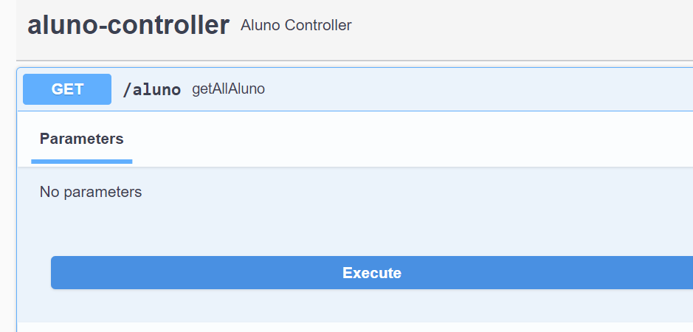
Spring c/LomBok
Testando GET

Slide 27
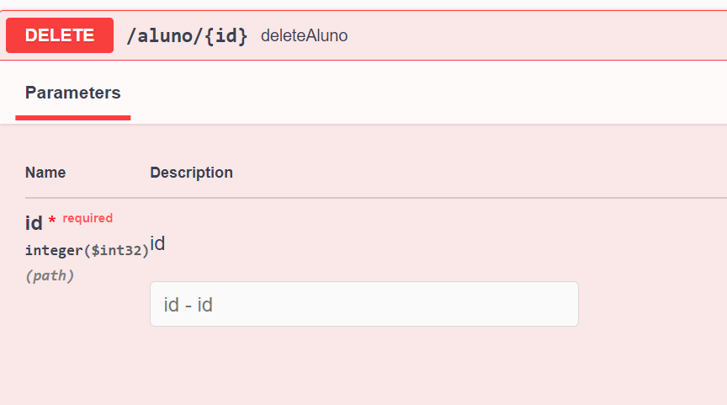
Spring c/LomBok
Testando DELETE

Slide 28


Questions and Comments
What questions or comments do you have?

