Slide 1

QUARKUS
Quarkus #5

Slide 2
Agenda
#1
Code.quakus.io
#2
Model + Service + Controller
#3
Testar a aplicação
#4
Desafio

Slide 3

ATIVIDADE
Aplicação
Primeira API

Slide 4
ATIVIDADE
Iremos criar uma API;
Utilizaremos o https://code.quarkus.io/;
Iremos utilizar o H2, Hibernate com Panache para criar a api;
Vamos configurar o Maven para criar o projeto no Eclipse;
Criar o código;

Slide 5
QUARKUS
code.quarkus.io

Slide 6
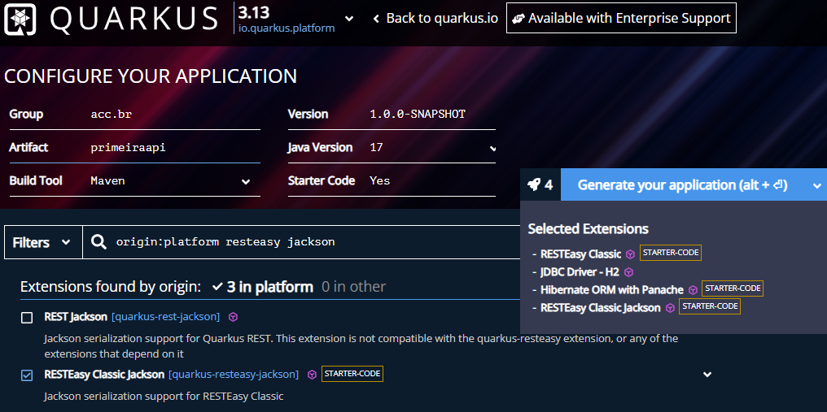
PASSO 1

Slide 7
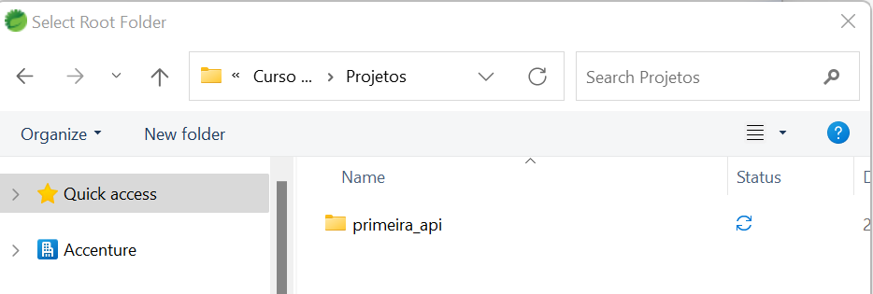
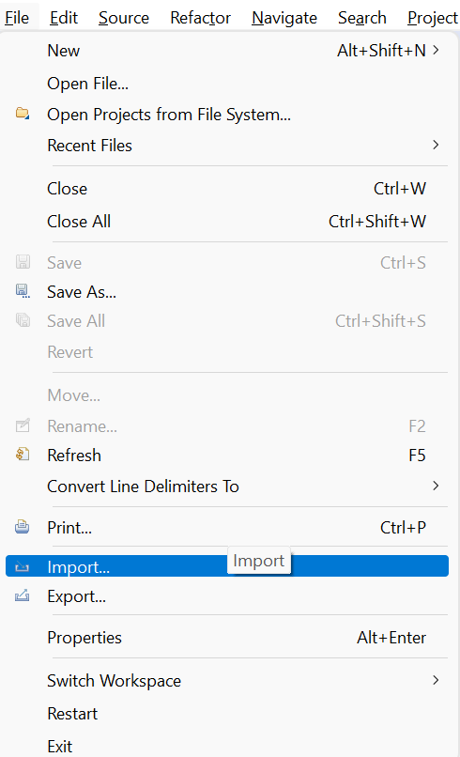
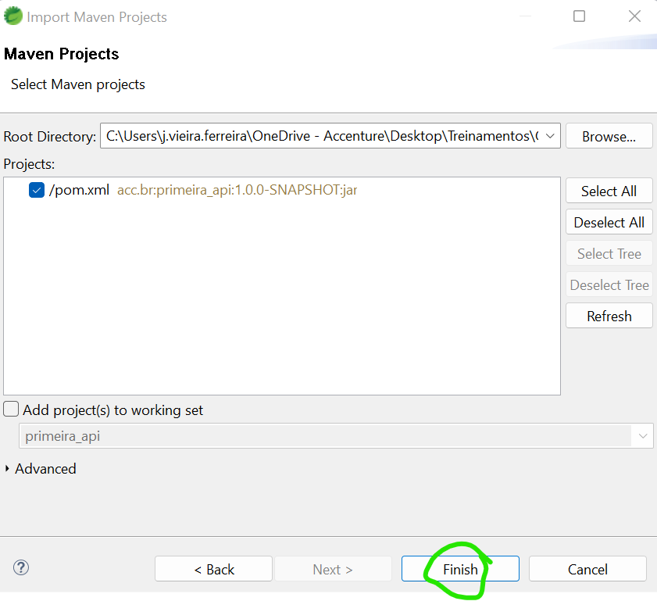
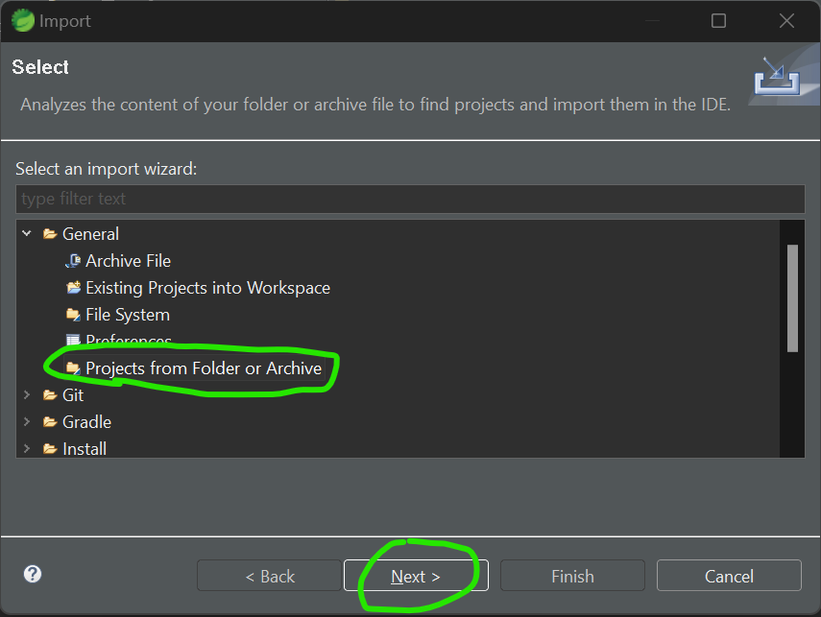
PASSO 2
Baixe e descompacte o arquivo.
Importe o projeto no Eclipse;

Slide 8
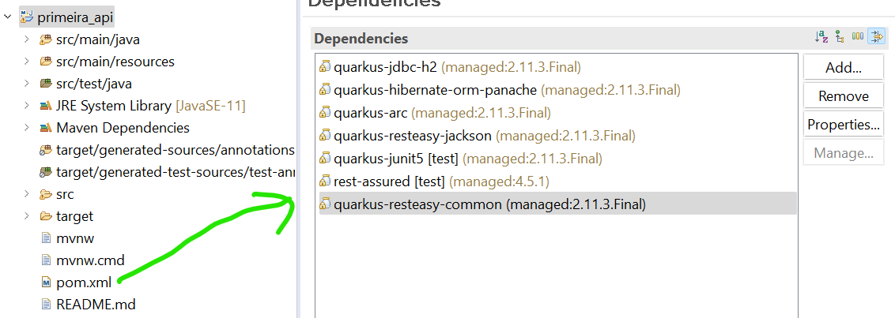
PASSO 3
Explorar o projeto:
POM.XML (Código no slide)
Notes:
<?xml version="1.0"?>
<project xsi:schemaLocation="http://maven.apache.org/POM/4.0.0 https://maven.apache.org/xsd/maven-4.0.0.xsd" xmlns="http://maven.apache.org/POM/4.0.0"
xmlns:xsi="http://www.w3.org/2001/XMLSchema-instance">
<modelVersion>4.0.0</modelVersion>
<groupId>acc.br</groupId>
<artifactId>primeira_api</artifactId>
<version>1.0.0-SNAPSHOT</version>
<properties>
<compiler-plugin.version>3.8.1</compiler-plugin.version>
<maven.compiler.release>11</maven.compiler.release>
<project.build.sourceEncoding>UTF-8</project.build.sourceEncoding>
<project.reporting.outputEncoding>UTF-8</project.reporting.outputEncoding>
<quarkus.platform.artifact-id>quarkus-bom</quarkus.platform.artifact-id>
<quarkus.platform.group-id>io.quarkus.platform</quarkus.platform.group-id>
<quarkus.platform.version>2.11.3.Final</quarkus.platform.version>
<skipITs>true</skipITs>
<surefire-plugin.version>3.0.0-M7</surefire-plugin.version>
</properties>
<dependencyManagement>
<dependencies>
<dependency>
<groupId>${quarkus.platform.group-id}</groupId>
<artifactId>${quarkus.platform.artifact-id}</artifactId>
<version>${quarkus.platform.version}</version>
<type>pom</type>
<scope>import</scope>
</dependency>
</dependencies>
</dependencyManagement>
<dependencies>
<dependency>
<groupId>io.quarkus</groupId>
<artifactId>quarkus-jdbc-h2</artifactId>
</dependency>
<dependency>
<groupId>io.quarkus</groupId>
<artifactId>quarkus-hibernate-orm-panache</artifactId>
</dependency>
<dependency>
<groupId>io.quarkus</groupId>
<artifactId>quarkus-arc</artifactId>
</dependency>
<dependency>
<groupId>io.quarkus</groupId>
<artifactId>quarkus-resteasy-jackson</artifactId>
</dependency>
<dependency>
<groupId>io.quarkus</groupId>
<artifactId>quarkus-junit5</artifactId>
<scope>test</scope>
</dependency>
<dependency>
<groupId>io.rest-assured</groupId>
<artifactId>rest-assured</artifactId>
<scope>test</scope>
</dependency>
<dependency>
<groupId>io.quarkus</groupId>
<artifactId>quarkus-resteasy-common</artifactId>
</dependency>
</dependencies>
<build>
<plugins>
<plugin>
<groupId>${quarkus.platform.group-id}</groupId>
<artifactId>quarkus-maven-plugin</artifactId>
<version>${quarkus.platform.version}</version>
<extensions>true</extensions>
<executions>
<execution>
<goals>
<goal>build</goal>
<goal>generate-code</goal>
<goal>generate-code-tests</goal>
</goals>
</execution>
</executions>
</plugin>
<plugin>
<artifactId>maven-compiler-plugin</artifactId>
<version>${compiler-plugin.version}</version>
<configuration>
<compilerArgs>
<arg>-parameters</arg>
</compilerArgs>
</configuration>
</plugin>
<plugin>
<artifactId>maven-surefire-plugin</artifactId>
<version>${surefire-plugin.version}</version>
<configuration>
<systemPropertyVariables>
<java.util.logging.manager>org.jboss.logmanager.LogManager</java.util.logging.manager>
<maven.home>${maven.home}</maven.home>
</systemPropertyVariables>
</configuration>
</plugin>
<plugin>
<artifactId>maven-failsafe-plugin</artifactId>
<version>${surefire-plugin.version}</version>
<executions>
<execution>
<goals>
<goal>integration-test</goal>
<goal>verify</goal>
</goals>
<configuration>
<systemPropertyVariables>
<native.image.path>${project.build.directory}/${project.build.finalName}-runner</native.image.path>
<java.util.logging.manager>org.jboss.logmanager.LogManager</java.util.logging.manager>
<maven.home>${maven.home}</maven.home>
</systemPropertyVariables>
</configuration>
</execution>
</executions>
</plugin>
</plugins>
</build>
<profiles>
<profile>
<id>native</id>
<activation>
<property>
<name>native</name>
</property>
</activation>
<properties>
<skipITs>false</skipITs>
<quarkus.package.type>native</quarkus.package.type>
</properties>
</profile>
</profiles>
</project>

Slide 9
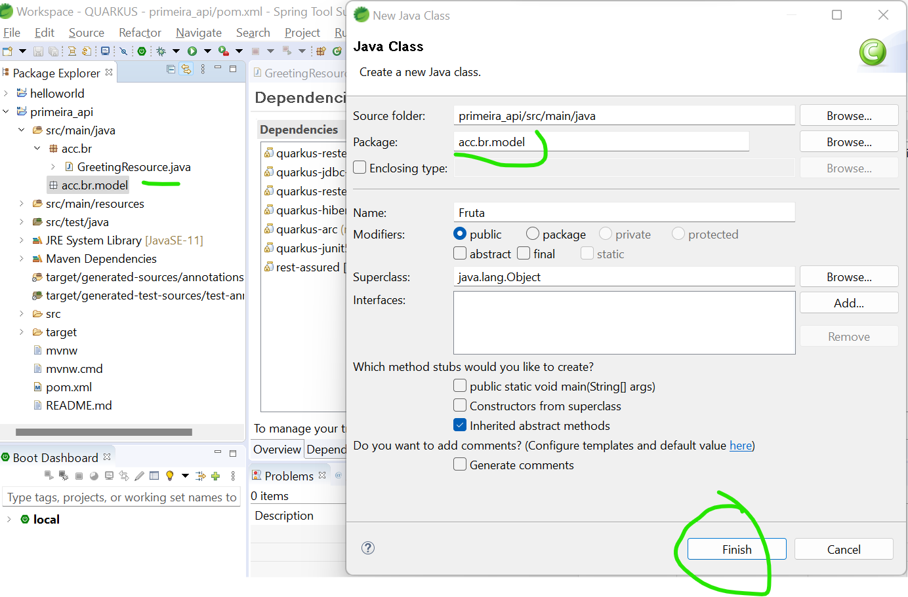
PASSO 4
Na pasta model crie à classe Fruta.java:
Notes:
package acc.br.model;
import jakarta.persistence.Entity;
import io.quarkus.hibernate.orm.panache.PanacheEntity;
@Entity
public class Fruta extends PanacheEntity {
public String nome;
public int qtd;
}

Slide 10
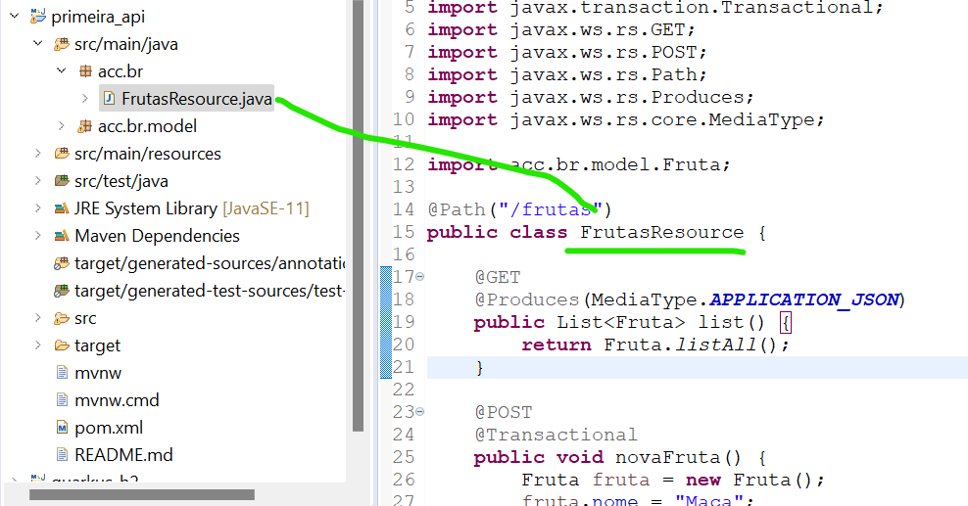
PASSO 5
Na pasta principal renomeie à classe para FrutasResource.java:
Código no slide
Notes:
package acc.br;
import java.util.List;
import jakarta.transaction.Transactional;
import jakarta.ws.rs.GET;
import jakarta.ws.rs.POST;
import jakarta.ws.rs.Path;
import jakarta.ws.rs.Produces;
import jakarta.ws.rs.core.MediaType;
import acc.br.model.Fruta;
@Path("/frutas")
public class GereetingsResource {
@GET
@Produces(MediaType.APPLICATION_JSON)
public List<Fruta> list() {
return Fruta.listAll();
}
@POST
@Transactional
public void novaFruta() {
Fruta fruta = new Fruta();
fruta.nome = "Maça";
fruta.qtd = 6;
fruta.persist();
}
}

Slide 11
PASSO ??
Application.properties
Código no slide
Notes:
quarkus.datasource.db-kind=h2
quarkus.datasource.jdbc.url=jdbc:h2:file:../src/main/resources/data/database;AUTO_SERVER=true;DB_CLOSE_DELAY=-1
#quarkus.datasource.url=jdbc:h2:mem:mydb;AUTO_SERVER=true;DB_CLOSE_DELAY=-1
#quarkus.datasource.url=jdbc:h2:mem:mydb
#quarkus.datasource.driver=org.h2.Driver
#quarkus.datasource.username=sa
#quarkus.datasource.password=
quarkus.hibernate-orm.dialect=org.hibernate.dialect.H2Dialect
quarkus.hibernate-orm.database.generation=drop-and-create
quarkus.hibernate-orm.log.sql=true
#enabling the H2 console
quarkus.h2.console.enabled=true

Slide 12
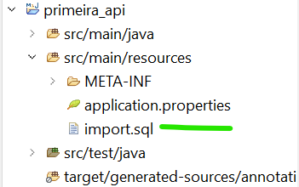
PASSO 7
Crie o arquivo import.sql;
Código no slide
Notes:
INSERT INTO Fruta (Id, nome, qtd) VALUES (nextval('hibernate_sequence'), 'Uva', 5);
INSERT INTO Fruta (Id, nome, qtd) VALUES (nextval('hibernate_sequence'), 'Pera', 4);
INSERT INTO Fruta (Id, nome, qtd) VALUES (nextval('hibernate_sequence'), 'Banana', 3);
INSERT INTO Fruta (Id, nome, qtd) VALUES (nextval('hibernate_sequence'), 'Jaca', 2);

Slide 13
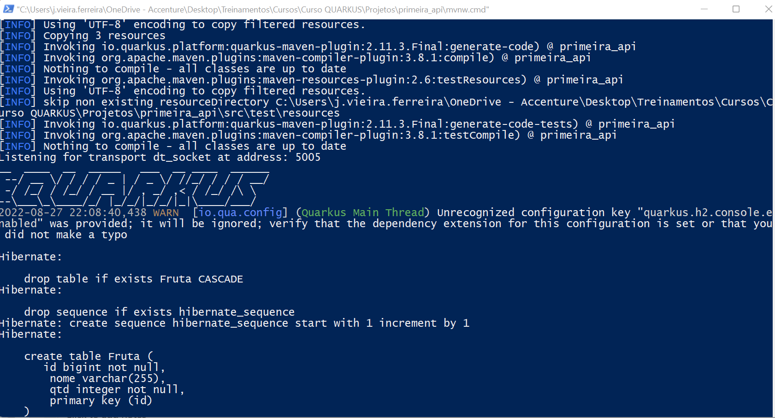
PASSO 8
Execute a aplicação;
Abra o Windows powerShell na pasta onde esta o projeto.
Digite: .\mvnw quarkus:dev

Slide 14
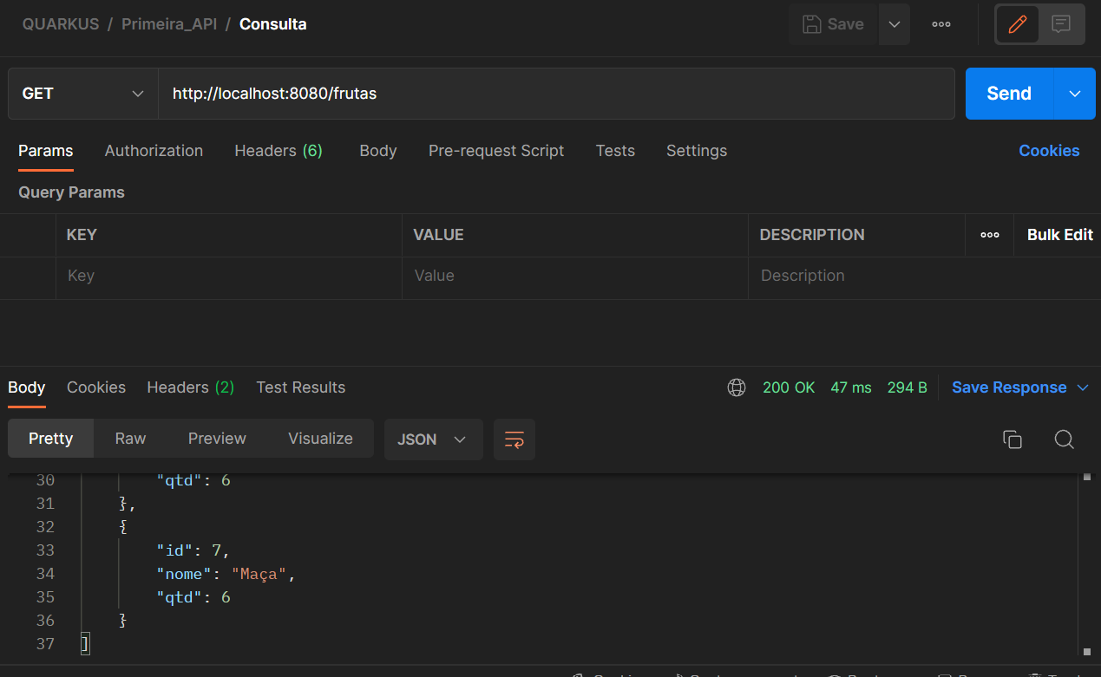
PASSO 9
Teste o GET

Slide 15
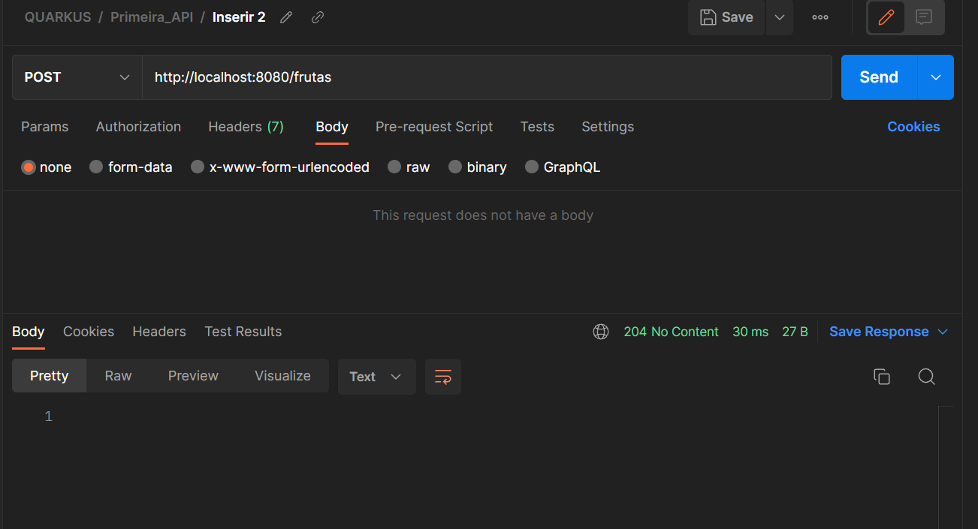
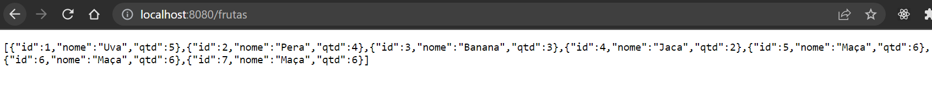
PASSO 10
Teste o POST

Slide 16
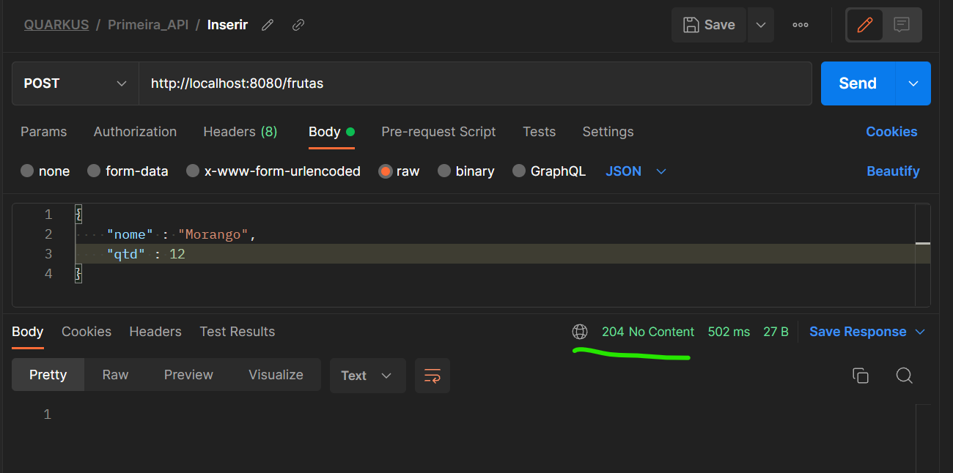
Desafio
Altere a aplicação para que seja possível fazer este post;
Implente o endPoint DELETE;
Adicionar o DEBUG;

Slide 17
Panache Documentação
https://javadoc.io/doc/io.quarkus/quarkus-hibernate-orm-panache/0.19.0/io/quarkus/hibernate/orm/panache/PanacheRepositoryBase.html

