Slide 1

QUARKUS
Quarkus #6

Slide 2

CDI
terceira API

Slide 3


PROJETO
Iremos criar uma API;
Utilizaremos o code.quarkus.io;
Iremos utilizar o QUARKUS JAVA + REST + Panache +mySQL para criar a api;
Vamos configurar o Maven para criar o projeto no STS;
Criar o código;
A aplicação consiste em realizar Cadastro e consultas Personalizadas e entre outras funcionalidades do Panache para gerenciar os produtos cadastrados no banco de dados.
Notes:
docker run --name postgres-car -e "POSTGRES_PASSWORD=postgres" -p 5433:5432 -v ~/developer/PostgreSQL:/var/lib/postgresql/data -d postgres

Slide 4
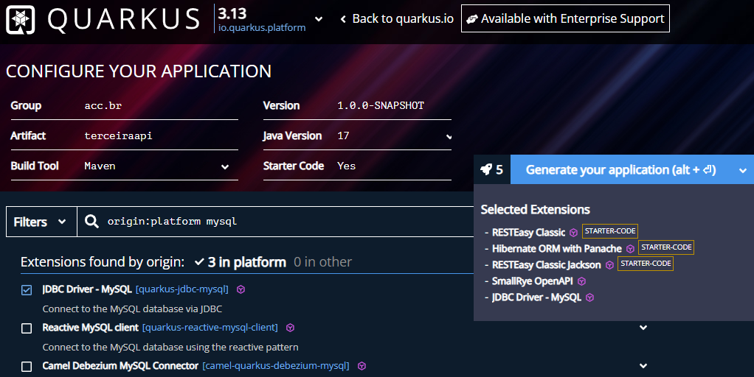
PASSO 1

Slide 5
PASSO 2
Gere, baixe e descompacte o arquivo.
Importe o projeto no Eclipse;

Slide 6
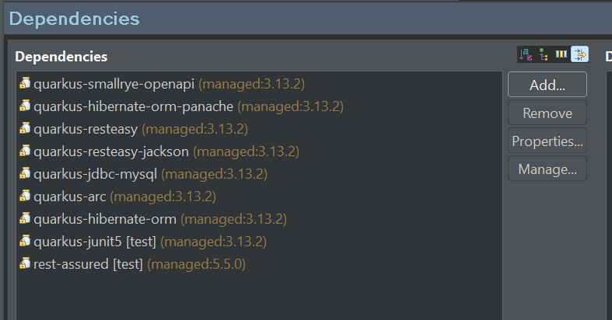
PASSO 3
Explorar o projeto:
POM.XML (Código no slide)
Notes:
<?xml version="1.0" encoding="UTF-8"?>
<project xmlns="http://maven.apache.org/POM/4.0.0" xmlns:xsi="http://www.w3.org/2001/XMLSchema-instance" xsi:schemaLocation="http://maven.apache.org/POM/4.0.0 https://maven.apache.org/xsd/maven-4.0.0.xsd">
<modelVersion>4.0.0</modelVersion>
<groupId>acc.br</groupId>
<artifactId>terceiraapi</artifactId>
<version>1.0.0-SNAPSHOT</version>
<properties>
<compiler-plugin.version>3.13.0</compiler-plugin.version>
<maven.compiler.release>17</maven.compiler.release>
<project.build.sourceEncoding>UTF-8</project.build.sourceEncoding>
<project.reporting.outputEncoding>UTF-8</project.reporting.outputEncoding>
<quarkus.platform.artifact-id>quarkus-bom</quarkus.platform.artifact-id>
<quarkus.platform.group-id>io.quarkus.platform</quarkus.platform.group-id>
<quarkus.platform.version>3.13.2</quarkus.platform.version>
<skipITs>true</skipITs>
<surefire-plugin.version>3.2.5</surefire-plugin.version>
</properties>
<dependencyManagement>
<dependencies>
<dependency>
<groupId>${quarkus.platform.group-id}</groupId>
<artifactId>${quarkus.platform.artifact-id}</artifactId>
<version>${quarkus.platform.version}</version>
<type>pom</type>
<scope>import</scope>
</dependency>
</dependencies>
</dependencyManagement>
<dependencies>
<dependency>
<groupId>io.quarkus</groupId>
<artifactId>quarkus-smallrye-openapi</artifactId>
</dependency>
<dependency>
<groupId>io.quarkus</groupId>
<artifactId>quarkus-hibernate-orm-panache</artifactId>
</dependency>
<dependency>
<groupId>io.quarkus</groupId>
<artifactId>quarkus-resteasy</artifactId>
</dependency>
<dependency>
<groupId>io.quarkus</groupId>
<artifactId>quarkus-resteasy-jackson</artifactId>
</dependency>
<dependency>
<groupId>io.quarkus</groupId>
<artifactId>quarkus-jdbc-mysql</artifactId>
</dependency>
<dependency>
<groupId>io.quarkus</groupId>
<artifactId>quarkus-arc</artifactId>
</dependency>
<dependency>
<groupId>io.quarkus</groupId>
<artifactId>quarkus-hibernate-orm</artifactId>
</dependency>
<dependency>
<groupId>io.quarkus</groupId>
<artifactId>quarkus-junit5</artifactId>
<scope>test</scope>
</dependency>
<dependency>
<groupId>io.rest-assured</groupId>
<artifactId>rest-assured</artifactId>
<scope>test</scope>
</dependency>
</dependencies>
<build>
<plugins>
<plugin>
<groupId>${quarkus.platform.group-id}</groupId>
<artifactId>quarkus-maven-plugin</artifactId>
<version>${quarkus.platform.version}</version>
<extensions>true</extensions>
<executions>
<execution>
<goals>
<goal>build</goal>
<goal>generate-code</goal>
<goal>generate-code-tests</goal>
<goal>native-image-agent</goal>
</goals>
</execution>
</executions>
</plugin>
<plugin>
<artifactId>maven-compiler-plugin</artifactId>
<version>${compiler-plugin.version}</version>
<configuration>
<compilerArgs>
<arg>-parameters</arg>
</compilerArgs>
</configuration>
</plugin>
<plugin>
<artifactId>maven-surefire-plugin</artifactId>
<version>${surefire-plugin.version}</version>
<configuration>
<systemPropertyVariables>
<java.util.logging.manager>org.jboss.logmanager.LogManager</java.util.logging.manager>
<maven.home>${maven.home}</maven.home>
</systemPropertyVariables>
</configuration>
</plugin>
<plugin>
<artifactId>maven-failsafe-plugin</artifactId>
<version>${surefire-plugin.version}</version>
<executions>
<execution>
<goals>
<goal>integration-test</goal>
<goal>verify</goal>
</goals>
</execution>
</executions>
<configuration>
<systemPropertyVariables>
<native.image.path>${project.build.directory}/${project.build.finalName}-runner</native.image.path>
<java.util.logging.manager>org.jboss.logmanager.LogManager</java.util.logging.manager>
<maven.home>${maven.home}</maven.home>
</systemPropertyVariables>
</configuration>
</plugin>
</plugins>
</build>
<profiles>
<profile>
<id>native</id>
<activation>
<property>
<name>native</name>
</property>
</activation>
<properties>
<skipITs>false</skipITs>
<quarkus.native.enabled>true</quarkus.native.enabled>
</properties>
</profile>
</profiles>
</project>

Slide 7
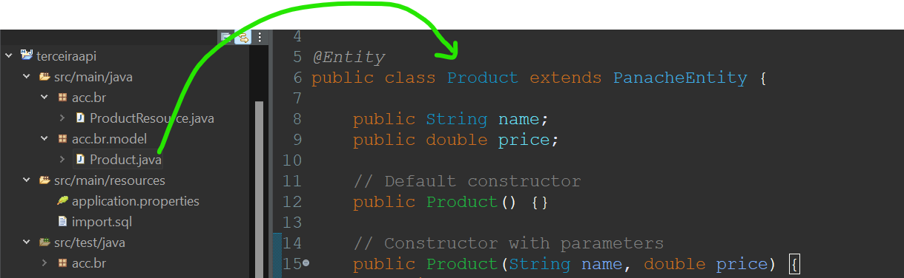
PASSO 4
Na pasta da imagem crie à classe product.java:
Código no slide
Notes:
package acc.br.model;
import io.quarkus.hibernate.orm.panache.PanacheEntity;
import jakarta.persistence.Entity;
@Entity
public class Product extends PanacheEntity {
public String name;
public double price;
// Default constructor
public Product() {}
// Constructor with parameters
public Product(String name, double price) {
this.name = name;
this.price = price;
}
}

Slide 8
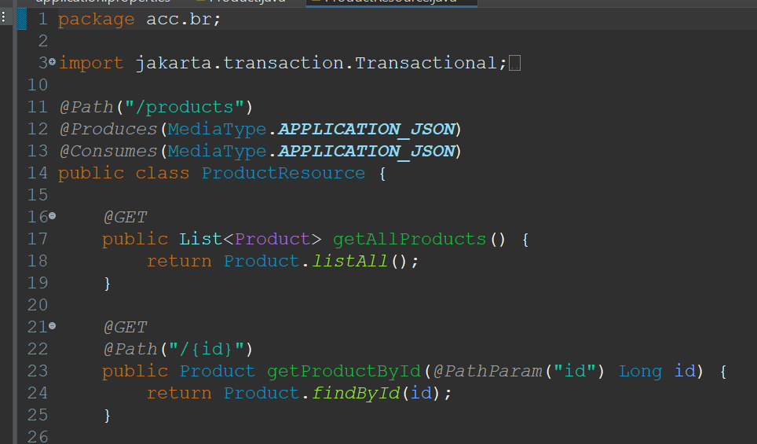
PASSO 5
ProductResource.java:
Código no slide
Notes:
package acc.br;
import jakarta.transaction.Transactional;
import jakarta.ws.rs.*;
import jakarta.ws.rs.core.MediaType;
import jakarta.ws.rs.core.Response;
import java.util.List;
import acc.br.model.Product;
@Path("/products")
@Produces(MediaType.APPLICATION_JSON)
@Consumes(MediaType.APPLICATION_JSON)
public class ProductResource {
@GET
public List<Product> getAllProducts() {
return Product.listAll();
}
@GET
@Path("/{id}")
public Product getProductById(@PathParam("id") Long id) {
return Product.findById(id);
}
@POST
@Transactional
public Response createProduct(Product product) {
product.persist();
return Response.status(Response.Status.CREATED).entity(product).build();
}
@PUT
@Path("/{id}")
@Transactional
public Response updateProduct(@PathParam("id") Long id, Product product) {
Product existingProduct = Product.findById(id);
if (existingProduct == null) {
return Response.status(Response.Status.NOT_FOUND).build();
}
existingProduct.name = product.name;
existingProduct.price = product.price;
return Response.ok(existingProduct).build();
}
@DELETE
@Path("/{id}")
@Transactional
public Response deleteProduct(@PathParam("id") Long id) {
Product product = Product.findById(id);
if (product == null) {
return Response.status(Response.Status.NOT_FOUND).build();
}
product.delete();
return Response.noContent().build();
}
}

Slide 9
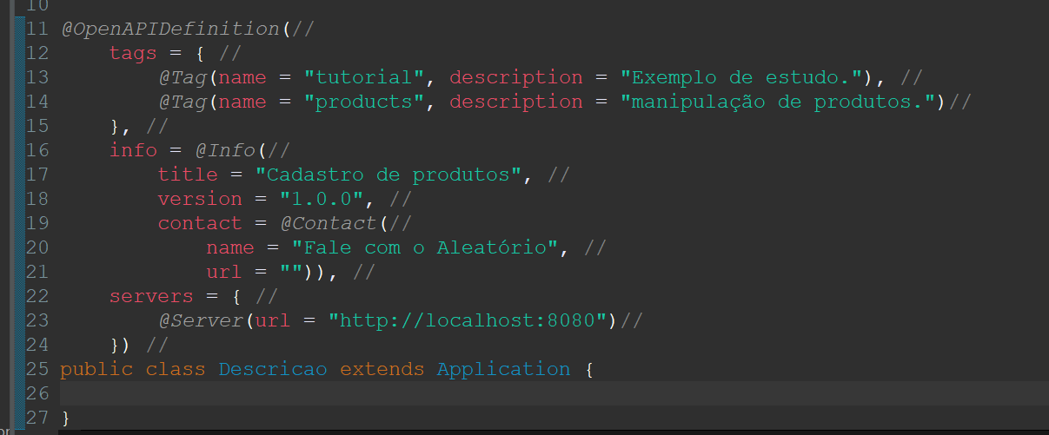
PASSO 6
Descricao.java:
Código no slide
Notes:
package acc.br;
import org.eclipse.microprofile.openapi.annotations.OpenAPIDefinition;
import org.eclipse.microprofile.openapi.annotations.info.Contact;
import org.eclipse.microprofile.openapi.annotations.info.Info;
import org.eclipse.microprofile.openapi.annotations.servers.Server;
import org.eclipse.microprofile.openapi.annotations.tags.Tag;
import jakarta.ws.rs.core.Application;
@OpenAPIDefinition(//
tags = { //
@Tag(name = "tutorial", description = "Exemplo de estudo."), //
@Tag(name = "products", description = "manipulação de produtos.")//
}, //
info = @Info(//
title = "Cadastro de produtos", //
version = "1.0.0", //
contact = @Contact(//
name = "Fale com o Aleatório", //
url = "")), //
servers = { //
@Server(url = "http://localhost:8080")//
}) //
public class Descricao extends Application {
}

Slide 10
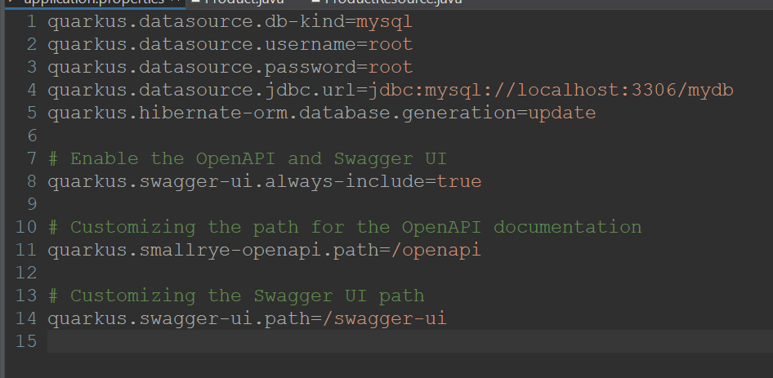
PASSO 7
Application.properties:
Código no slide
Notes:
quarkus.datasource.db-kind=mysql
quarkus.datasource.username=root
quarkus.datasource.password=root
quarkus.datasource.jdbc.url=jdbc:mysql://localhost:3306/mydb
quarkus.hibernate-orm.database.generation=update
# Enable the OpenAPI and Swagger UI
quarkus.swagger-ui.always-include=true
# Customizing the path for the OpenAPI documentation
quarkus.smallrye-openapi.path=/openapi
# Customizing the Swagger UI path
quarkus.swagger-ui.path=/swagger-ui

Slide 11
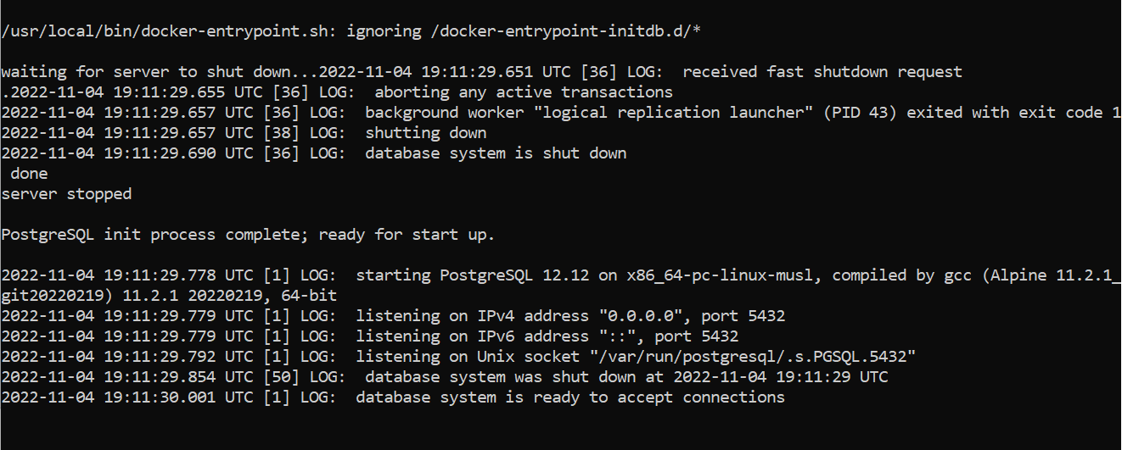
PASSO 8
Execute a aplicação;
Digite: mvn quarkus:dev

Slide 12
QUARKUS
Anotações Importantes:
@Path: Especifica o URI base para a classe de recurso.
@Produces(MediaType.APPLICATION_JSON): Indica que os métodos nesta classe produzem respostas em formato JSON.
@Consumes(MediaType.APPLICATION_JSON): Indica que os métodos nesta classe consomem requisições em formato JSON.
@GET, @POST, @PUT, @DELETE: Mapeiam métodos HTTP para métodos específicos na classe de recurso.
@Transactional: Garante que as operações no banco de dados sejam encapsuladas em uma transação.

Slide 13
QUARKUS
DESÁFIO:
Teste a API no SWAGGER.
Crie as requisições para inserir, consultar e deletar bolos
http://localhost:8080/swagger-ui/

