Slide 1
APPLIED DATA SCIENCE CAPSTONE
Predicting Falcon 9
first-stage landing success
An end-to-end analysis of SpaceX launch data
IBM Skills Network course dataset | 90 labeled launches
IBM Applied Data Science Capstone
2026
Notes:
Course project on the SpaceX Falcon 9 first-stage landing-success problem. Data sources and methods are documented in the repository README and SOURCES.md.

Slide 2
EXECUTIVE SUMMARY
Executive summary
The course sample supports a reproducible comparison of four classifiers. Landing outcomes vary across sites and mission profiles, while the small labeled sample limits how strongly any pattern can generalize.
90
60 / 30
83.3%
88.0%
labeled launches
successful / failed landings
best holdout accuracy
best holdout F1
Decision-useful takeaway
A decision tree ranked first in cross-validation and achieved 15 correct classifications out of 18 holdout launches. Treat this as a course-scale result, not an operational forecast.
The analysis combines API collection, historical scraping, SQL and visual EDA, Folium, Dash, and supervised classification.
GitHub: github.com/joaoltrevisan/spacex-falcon9-capstone
02
Notes:
Results from the verified 90-row course dataset and outputs/analysis_results.json. The test set contains 18 records; model metrics are unstable at this sample size.

Slide 3
INTRODUCTION
Problem and project question
SpaceX advertises Falcon 9 launches at a substantially lower cost when it can recover and reuse the first stage. The analysis asks which mission and vehicle attributes are associated with a successful landing in the course dataset.
TARGET
PREDICTORS
Class = 1
80 encoded features
First-stage landing succeeded
Payload, orbit, launch site, booster version, and mission indicators
SCOPE
Descriptive analysis and a held-out classification exercise. Observed differences do not establish causal effects.
GitHub: github.com/joaoltrevisan/spacex-falcon9-capstone
03
Notes:
Course scenario describes the Falcon 9 first-stage recovery problem. The labeled modeling sample is the official IBM course data, dataset_part_2.csv plus the provided encoded feature matrix.

Slide 4
API DATA COLLECTION
API collection: retrieve and normalize launch records
Request archived SpaceX launch JSON supplied by IBM Skills Network; retain raw response for reproducibility.
Parse each launch and its first-stage core; extract date, flight, rocket, payload, launchpad and landing fields.
Normalize nested JSON to a 107-row, 18-column CSV; preserve raw payload and failure JSON for traceability.
FLOW: IBM course archive → parse JSON + nested core → normalize selected fields → CSV (107 × 18)
GitHub: github.com/joaoltrevisan/spacex-falcon9-capstone
04
Notes:
Data source: IBM Skills Network archived API response at data/raw/API_call_spacex_api.json. Reproduction script: src/collect_api.py. The script reads the archived course response first and downloads it from the course URL if absent.

Slide 5
WEB SCRAPING
Web scraping: extract dated launch-history tables
Use a fixed Wikipedia revision (987426997, 6 Nov 2020) so the source is stable and auditable.
Read page tables, identify flight-number and date columns, remove citation marks, then parse dates as UTC.
Keep numbered launches from 4 Jun 2010 through 5 Nov 2020; drop invalid dates and duplicate flight numbers.
Result: 97 historical launch rows, saved with the source-revision label in the output CSV.
SCRAPE FLOW
Pinned revision → pandas.read_html → identify + parse → date filter + deduplicate → CSV
GitHub: github.com/joaoltrevisan/spacex-falcon9-capstone
05
Notes:
Implementation: src/scrape_wikipedia.py; archived HTML: data/raw/wikipedia_falcon_launch_history_2020.html; output: data/raw/wikipedia_launch_history.csv.

Slide 6
DATA WRANGLING METHODOLOGY
Wrangling aligns features, labels and launch context
Validate the supplied 90 × 80 one-hot feature matrix against the matching IBM labeled course table by FlightNumber.
Decode Orbit, LaunchSite, LandingPad and Serial; confirm every decoded category matches the source row.
Use the source table Class as target (60 successful, 30 failed); fill missing landing-pad labels as Unknown.
Keep API history, scrape history and the fixed 90-row model sample separate because their schemas and coverage differ.
QUALITY CHECKS
Row count + flight order • one-hot sums • decoded category equality • target class counts
GitHub: github.com/joaoltrevisan/spacex-falcon9-capstone
06
Notes:
Validation is implemented in make_dataset() in src/analyze_model.py. The supplied dataset_part_3.csv contains features only; Class is retrieved from the matching IBM dataset_part_2.csv after flight-number and category-alignment checks.

Slide 7
EDA METHODOLOGY
EDA and interactive analytics methods
Pandas + Matplotlib
Compare outcome patterns by flight number, year, payload, launch site, and orbit.
SQLite
Aggregate counts, success rates, and mean payload by site, orbit, and outcome.
Folium
Place launch sites on an interactive geographic map with outcome summaries.
Plotly Dash
Filter the labeled sample by launch site and orbit; inspect rates and payload distributions.
GitHub: github.com/joaoltrevisan/spacex-falcon9-capstone
07
Notes:
Methods and implementation are in notebooks/04_EDA_and_Feature_Engineering.ipynb, notebooks/05_SQL_EDA_and_Folium_Map.ipynb, notebooks/06_Plotly_Dash_Dashboard.ipynb, outputs/sql/capstone_queries.sql, outputs/launch_sites_folium.html, and src/dash_app.py. The GitHub URL is in the slide footer.

Slide 8
PREDICTIVE METHODOLOGY
Classification design
Data split | 72 train / 18 test | Stratified, random_state = 2
Model selection | 5-fold stratified CV | Training set only
Algorithms | Logistic, SVM, KNN, tree | Grid search per model
Scaling | Pipeline for logistic, SVM, KNN | Tree uses raw encoded features
Selection metric | Mean CV accuracy | Final metrics reported on holdout
The holdout remains untouched during model selection. This separation reduces optimistic test estimates.
GitHub: github.com/joaoltrevisan/spacex-falcon9-capstone
08
Notes:
Model configuration and split are documented in src/analyze_model.py and outputs/analysis_results.json.

Slide 9
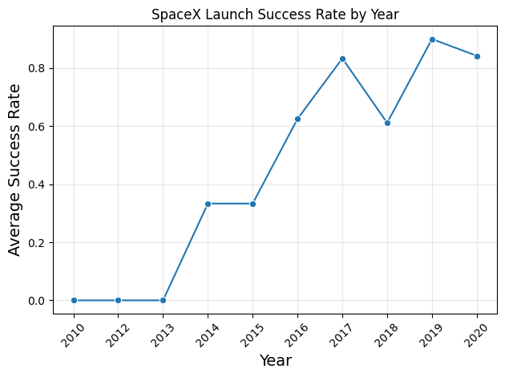
EDA WITH VISUALIZATION
Landing outcomes improved across the observed years
Observed pattern
The course sample moves from no recorded successes in its early years to rates above 80% in 2017 and 2019–2020.
Interpretation
The year trend also reflects fleet maturity, mission mix, and changes in operations. It does not isolate the effect of time alone.
Sample: 90 labeled launches | yearly denominator varies
GitHub: github.com/joaoltrevisan/spacex-falcon9-capstone
09
Notes:
Figure from the completed EDA notebook. Success rate is the mean of Class within each year. Small per-year counts make the early and late estimates noisy.

Slide 10
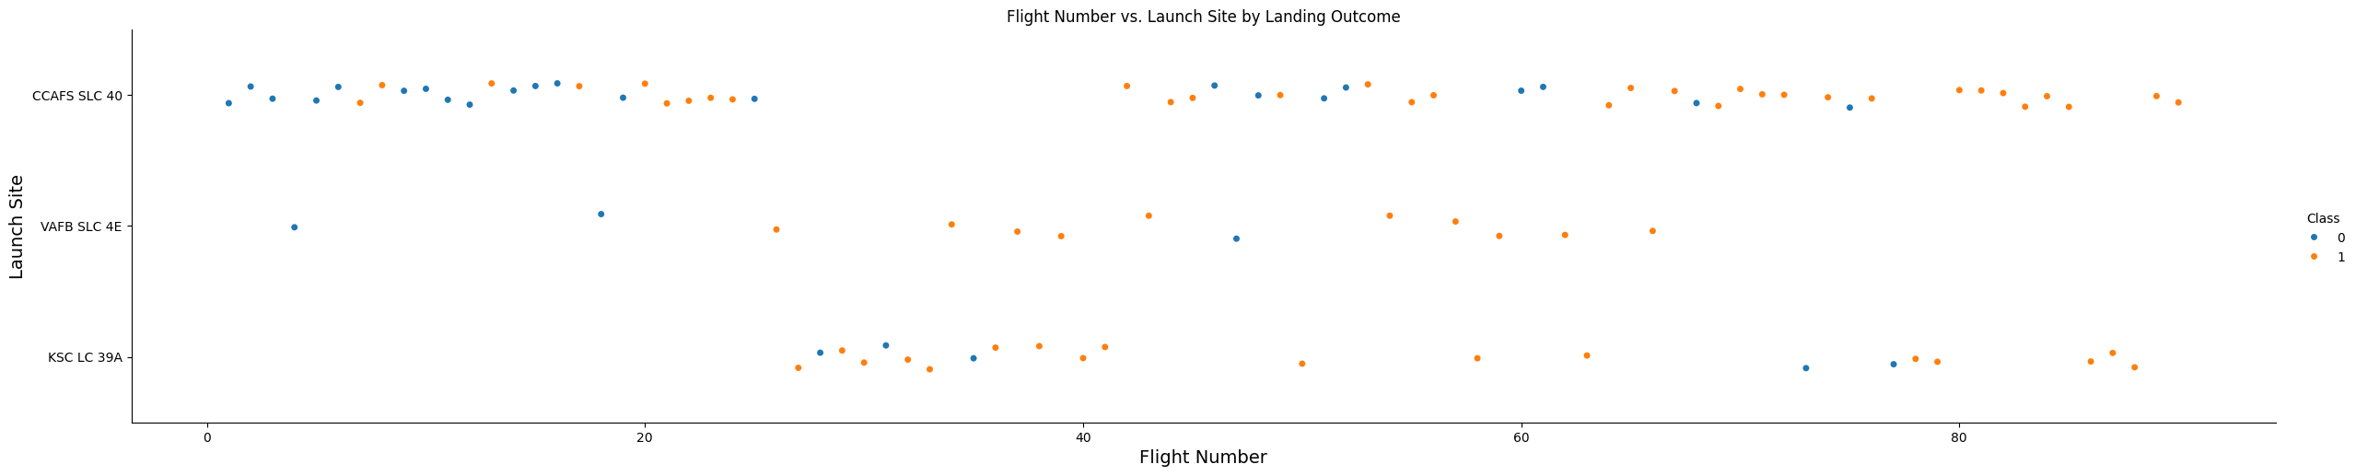
EDA WITH VISUALIZATION
Launch-site outcomes appear in different flight-number ranges
Each point is one launch. Failures and successes occupy different parts of the flight sequence at each site, but site, year, booster version, and mission type change together.
Source: 90 labeled launches
GitHub: github.com/joaoltrevisan/spacex-falcon9-capstone
10
Notes:
Figure from notebooks/04_EDA_and_Feature_Engineering.ipynb. The outcome colors follow Class: 0=failure, 1=success.

Slide 11
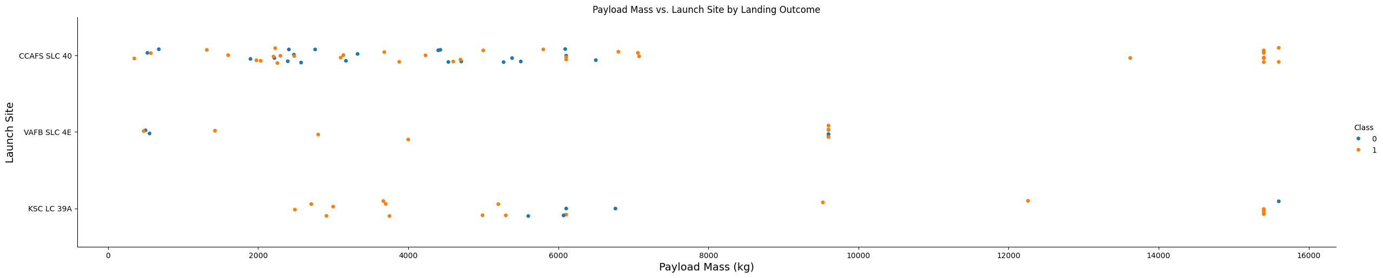
EDA WITH VISUALIZATION
Payload mass alone does not separate outcomes by site
Both outcomes occur across a wide payload range. Several high-mass launches succeeded, so payload weight alone does not separate outcomes.
The mean payload is higher among successes, but this comparison does not adjust for orbit or year.
GitHub: github.com/joaoltrevisan/spacex-falcon9-capstone
11
Notes:
Figure from the completed EDA notebook. Means by class are reported separately on the SQL results slide. The pattern is observational.

Slide 12
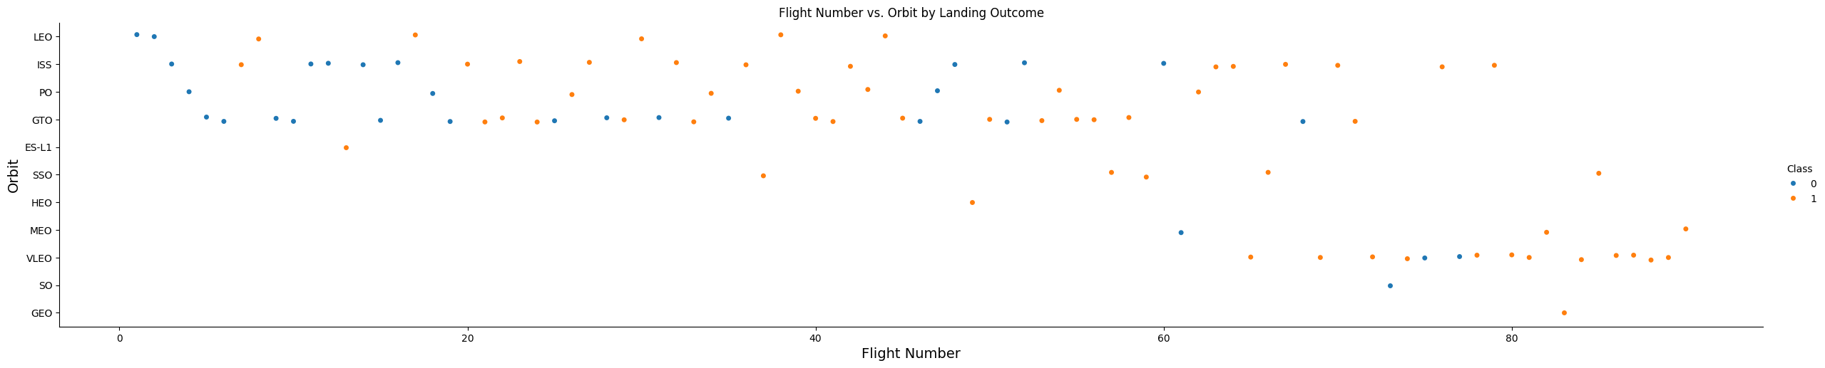
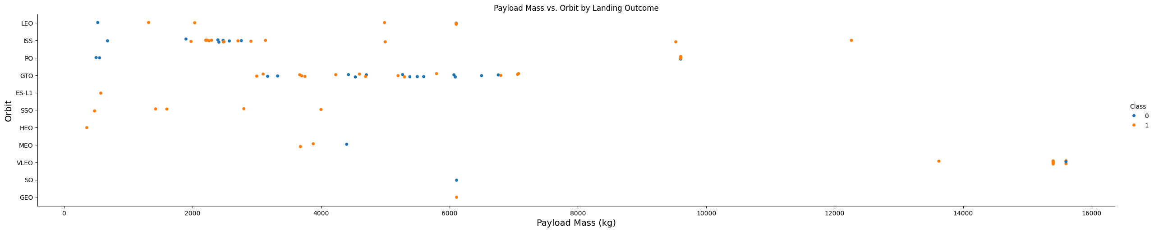
EDA WITH VISUALIZATION
Orbit and payload patterns depend on sample size
Some orbit categories have very few launches. A 100% observed rate with one launch does not imply a stable high-success profile.
The larger groups, such as GTO and ISS, show both outcomes and support more informative comparisons.
GitHub: github.com/joaoltrevisan/spacex-falcon9-capstone
12
Notes:
Figures from the completed EDA notebook. Orbit-specific denominators are shown in the SQL output files; the smallest groups have only one launch.

Slide 13
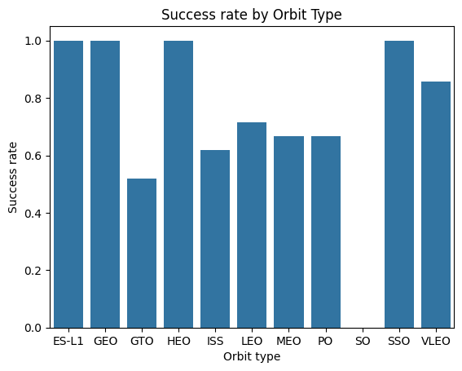
EDA WITH VISUALIZATION
Bar charts compare observed success rates across categories
Why this chart
The bars make orbit-level outcome differences easy to compare at a glance.
Read with counts
Rare orbits can show 100% success with only one launch. SQL tables report denominators alongside the rates.
Additional EDA visuals: flight-versus-site and payload-versus-site scatter plots; annual success-rate trend.
GitHub: github.com/joaoltrevisan/spacex-falcon9-capstone
13
Notes:
Figure eda_cell_33.png is the course EDA bar chart of landing success rate by orbit. Related scatter plots and annual trends are on adjacent EDA slides.

Slide 14
EDA WITH SQL
SQL analysis makes group sizes explicit
SQLite queries were run against the same 90-row labeled course sample. Each result reports group size beside the rate so rare categories remain visible.
Launch-site rates: GROUP BY LaunchSite, with COUNT(*) and AVG(Class).
Orbit rates: GROUP BY Orbit, ordered by observed success rate.
Payload comparison: AVG(PayloadMass) grouped by Class.
Rates are descriptive; denominators and mission mix differ across groups.
Reproducible query file: outputs/sql/capstone_queries.sql
GitHub: github.com/joaoltrevisan/spacex-falcon9-capstone
14
Notes:
SQL statements are in outputs/sql/capstone_queries.sql. The corresponding result tables are outputs/sql/site_success.csv, orbit_success.csv and payload_by_success.csv.

Slide 15
EDA WITH SQL
KSC LC 39A and VAFB SLC 4E lead CCAFS SLC 40 in this sample
Launch site | Launches | Successful | Observed rate
KSC LC 39A | 22 | 17 | 77.3%
VAFB SLC 4E | 13 | 10 | 76.9%
CCAFS SLC 40 | 55 | 33 | 60.0%
The 17.3-point gap between the highest and lowest site rates is an unadjusted sample difference. Site, era, booster, orbit, and payload overlap.
GitHub: github.com/joaoltrevisan/spacex-falcon9-capstone
15
Notes:
Calculated from outputs/sql/site_success.csv and verified course model dataset. Counts inferred from the 90 labeled rows: 22 launches/17 successes at KSC, 13/10 at VAFB, 55/33 at CCAFS.

Slide 16
EDA WITH SQL
Orbit rates need their denominators
Orbit | Launches | Success rate
GTO | 27 | 51.9%
ISS | 21 | 61.9%
VLEO | 14 | 85.7%
LEO | 7 | 71.4%
PO | 9 | 66.7%
MEO | 3 | 66.7%
SSO | 5 | 100.0%
GEO | 1 | 100.0%
HEO | 1 | 100.0%
ES-L1 | 1 | 100.0%
SO | 1 | 0.0%
Payload mean by observed outcome
Failure 4,784.6 kg
Success 6,765.2 kg
The difference is not causal evidence. Orbit and payload distributions vary, and successful launches include heavy payloads.
GitHub: github.com/joaoltrevisan/spacex-falcon9-capstone
16
Notes:
Orbit counts/rates and mean payload by class from outputs/analysis_results.json and outputs/sql/*.csv. The 100% groups with one launch are especially uncertain.

Slide 17
EDA WITH SQL
Temporal SQL analysis tracks volume and landing success by year
The query extracts the UTC year from each launch date, then reports launch count, successful launches and the observed success rate.
The time pattern shows a marked increase after the early Falcon 9 years.
SQL result: outputs/sql/year_success.csv
Interpret with the yearly launch counts: small denominators make annual rates volatile.
GitHub: github.com/joaoltrevisan/spacex-falcon9-capstone
17
Notes:
Query: SELECT CAST(strftime('%Y', Date) AS INTEGER) AS year, COUNT(*) AS launches, SUM(Class) AS successful_launches, ROUND(AVG(Class), 3) AS success_rate FROM launches GROUP BY year ORDER BY year. The chart and table are generated from the same 90-row labeled course dataset.

Slide 18
INTERACTIVE VISUAL ANALYTICS
Folium maps the three sampled launch sites
The project generates an interactive HTML map with one marker per launch site. Marker popups report launch counts and observed landing rates.
Site | Sample launches | Observed success
CCAFS SLC 40 | 55 | 60.0%
KSC LC 39A | 22 | 77.3%
VAFB SLC 4E | 13 | 76.9%
Interactive artifact
outputs/launch_sites_folium.html
Open the HTML file in a browser to zoom and inspect site markers.
Proximity analysis: KSC LC 39A and CCAFS SLC 40 are about 5.6 km apart; VAFB SLC 4E is about 3,720 km from the nearest Florida site.
Each popup reports site, launch records, successful launches, rate and nearest sampled site distance.
GitHub: github.com/joaoltrevisan/spacex-falcon9-capstone
18
Notes:
Interactive map output created by src/build_folium_map.py. Pairwise distances use the haversine great-circle calculation on the site coordinates in the course dataset. Florida sites are approximately 5.6 km apart; VAFB is approximately 3,720 km from KSC LC 39A.

Slide 19
INTERACTIVE VISUAL ANALYTICS
Dash exposes the sample through interactive filters
The Plotly Dash app contains launch-site and orbit filters with two linked views.
Filter
Launch-site and orbit dropdowns restrict the displayed sample.
View 1
Pie chart shows the share of successful and failed launches in the filtered sample.
View 2
Scatter plot compares payload mass with binary landing outcome; hover reveals flight, site and orbit.
Run
python src/dash_app.py, then open http://127.0.0.1:8050
The app layout, route, and filtered callback were exercised with the Flask test client.
GitHub: github.com/joaoltrevisan/spacex-falcon9-capstone
19
Notes:
Implementation: src/dash_app.py and notebooks/06_Plotly_Dash_Dashboard.ipynb. The project test client verified the route and callback.

Slide 20
PREDICTIVE RESULTS
Decision tree ranked first in training cross-validation
Model | CV accuracy | Test accuracy | Precision | Recall | F1
Logistic regression | 83.7% | 77.8% | 78.6% | 91.7% | 84.6%
SVM | 82.3% | 77.8% | 78.6% | 91.7% | 84.6%
KNN | 69.4% | 66.7% | 66.7% | 100.0% | 80.0%
Decision tree | 87.7% | 83.3% | 84.6% | 91.7% | 88.0%
CV selects the tree. Its holdout result is 15 / 18 correct, with 12 / 12 successes detected and 4 / 6 failures detected.
GitHub: github.com/joaoltrevisan/spacex-falcon9-capstone
20
Notes:
All metrics use the 18-record stratified holdout except CV accuracy, which is averaged over five stratified folds of the 72-row training partition. Values from outputs/analysis_results.json.

Slide 21
PREDICTIVE RESULTS
The holdout contains only six failed landings
Actual \ Predicted | Failure (0) | Success (1)
Failure (0) | 4 | 2
Success (1) | 1 | 11
Model
Decision tree
Gini, max depth 5
Recall: 91.7%
Precision: 84.6%
F1: 88.0%
One additional error among six failures changes failure-class metrics sharply. Treat the model as a learning exercise, not a launch decision system.
GitHub: github.com/joaoltrevisan/spacex-falcon9-capstone
21
Notes:
Confusion matrix rows are actual classes and columns are predicted classes. Counts and model settings from outputs/analysis_results.json.

Slide 22
CONCLUSION
Conclusion: mission context matters alongside payload
What the sample supports
Model result
Landing success becomes more common in later years in this dataset. Site and orbit rates differ, but their group sizes and mission mix also differ.
A tuned decision tree led the four-model comparison on five-fold CV accuracy and the 18-row holdout.
Innovative insight
The apparent payload pattern reverses a simple “lighter is easier” story: average payload was higher among successes, while success still varied by orbit and launch site. Mission context and vehicle maturity deserve joint analysis.
Next analysis: validate on a larger, time-aware sample and measure uncertainty within site-orbit groups.
GitHub: github.com/joaoltrevisan/spacex-falcon9-capstone
22
Notes:
The payload observation is computed from the 90-row labeled sample: 6,765.2 kg mean among successes and 4,784.6 kg among failures. This is an exploratory association, not a causal claim.

Slide 23
PROJECT FILES
Reproducibility and submission files
Seven notebooks document collection, wrangling, EDA, SQL, Folium, Dash, and modeling.
Python scripts, SQL queries, source datasets, output tables, visualizations, and the interactive map are organized in the project folder.
The presentation PDF is the file to upload to the Mark question.
Repository URL
https://github.com/joaoltrevisan/spacex-falcon9-capstone
The repository contains the completed notebooks, source code, data, SQL outputs, and presentation.
Sources: IBM Skills Network course datasets; SpaceX API archive; Wikipedia revision 987426997 (2020-11-06).
GitHub: github.com/joaoltrevisan/spacex-falcon9-capstone
23
Notes:
This slide reflects the actual repository status at creation time. Supporting notebooks and scripts are in the accompanying project bundle; sources are documented in SOURCES.md.

