Slide 1
Quick Start on FluentMigrator
And other Open Source libraries

Slide 2
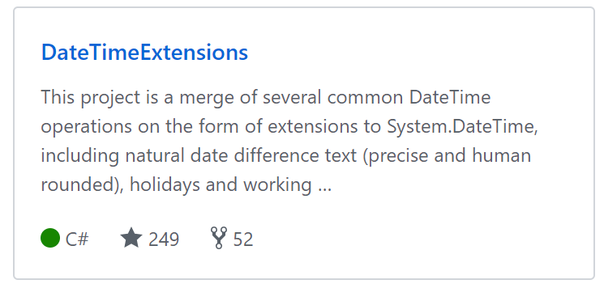

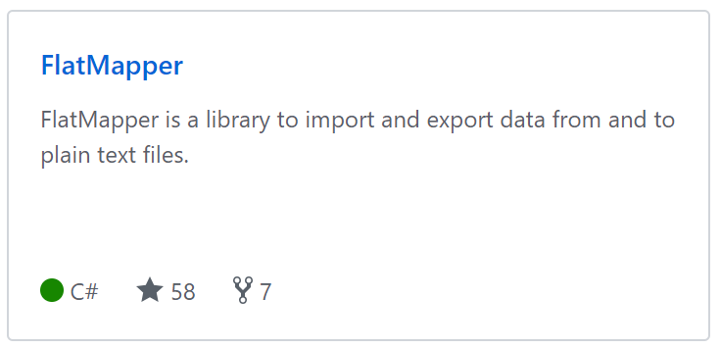



João Matos Silva
github.com/joaomatossilva
kspace.pt
@kappyzor

Slide 3
Demo
Let’s build stuff!!!!

Slide 4
TL DR
FluentMigrator – for database migrations
EntityFramework – a Db ORM
Dapper – a Db Micro-ORM
DateTimeExtensions – for WorkingDays Calculations / Holidays
Formo – a configuration Mapper
Flatmapper – Import and export flat files
Nuke.build – A script builder
Others…
FluentValidator
AutoMapper
MediatR

Slide 5
Thank you!

