Slide 1
Innovation Networks Analysis
An ecological point of view over social phenomena

Slide 2
Outline
Data Science (Math, Statistics)
Network Theory
Ecology (polinizator-plant bipartite networks)
Economics

Slide 3
Motivation
Complex network relationships between VC-VC and accelerators-VC (co-investiment)
Limited application of network theory to VC-VC and VC-accelerator relationships

Slide 4
Macro RQ
How do network structures emerge between venture capitalists and accelerators, and what patterns govern their investment relationships?

Slide 5
Relevant Topics
Data Science (Math, Statistics)
Network Theory
Ecology (polinizator-plant bipartite networks)
Economics

Slide 6
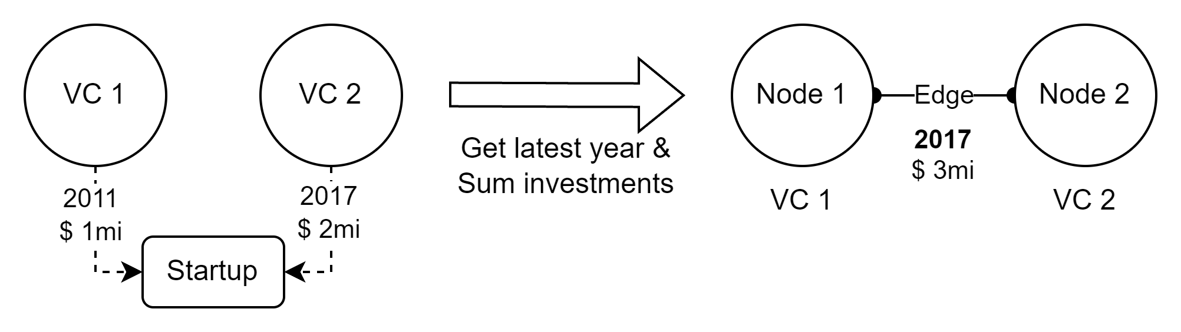
Methodology
Number of edges
Number of nodes
Connectance / density
Modularity / components
Nestedness (bipartite case)
Get data from Crunchbase
Clean data (Matthijs and Theo methods)
Build network (Acc-VC and VC-VC) and get metrics
Analyze results through economics and ecology lenses

Slide 7
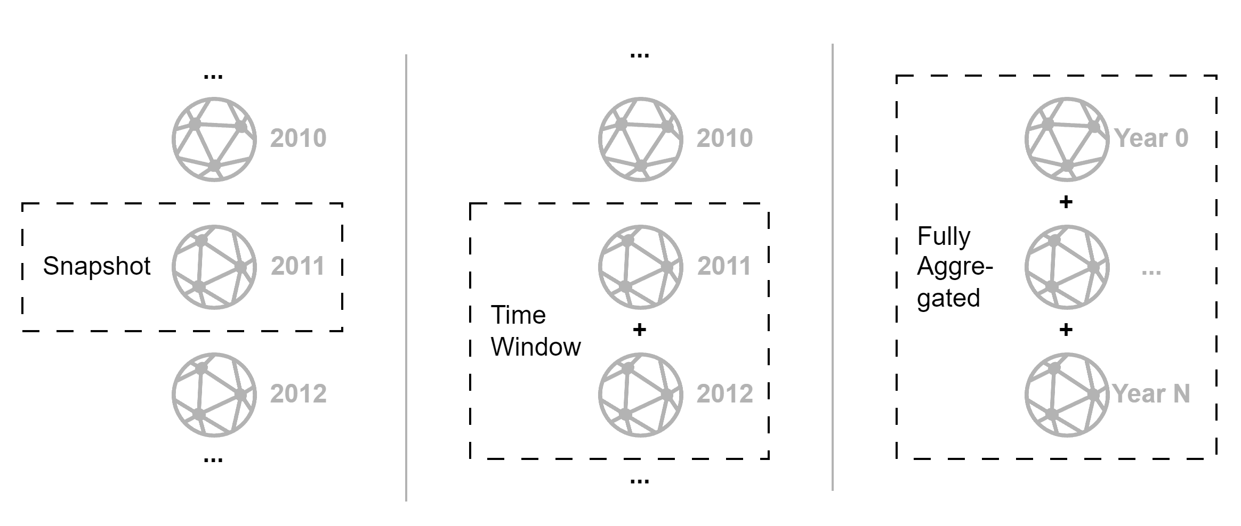
Metodology
3 distinct approaches…

Slide 8
Results – ACC-VC Network

Slide 9
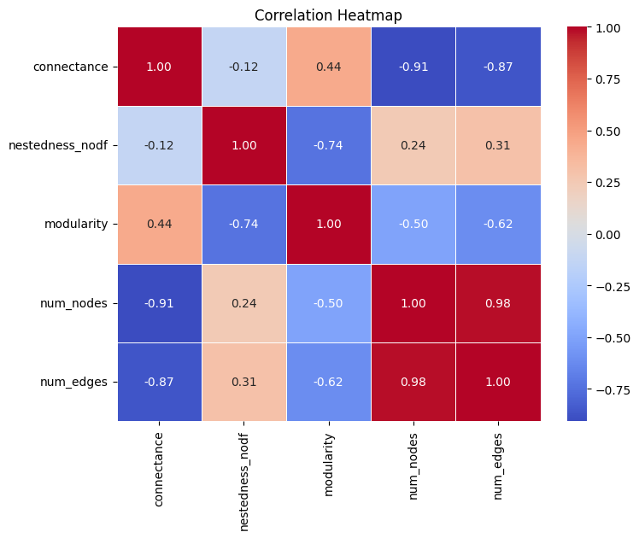
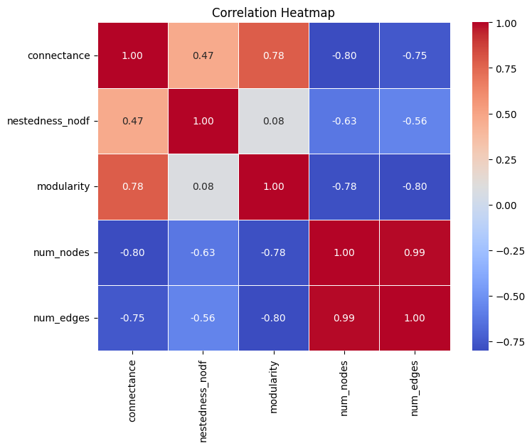


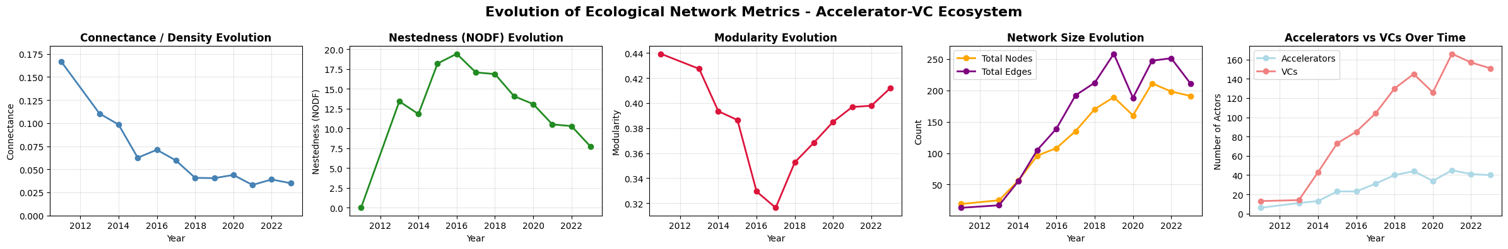
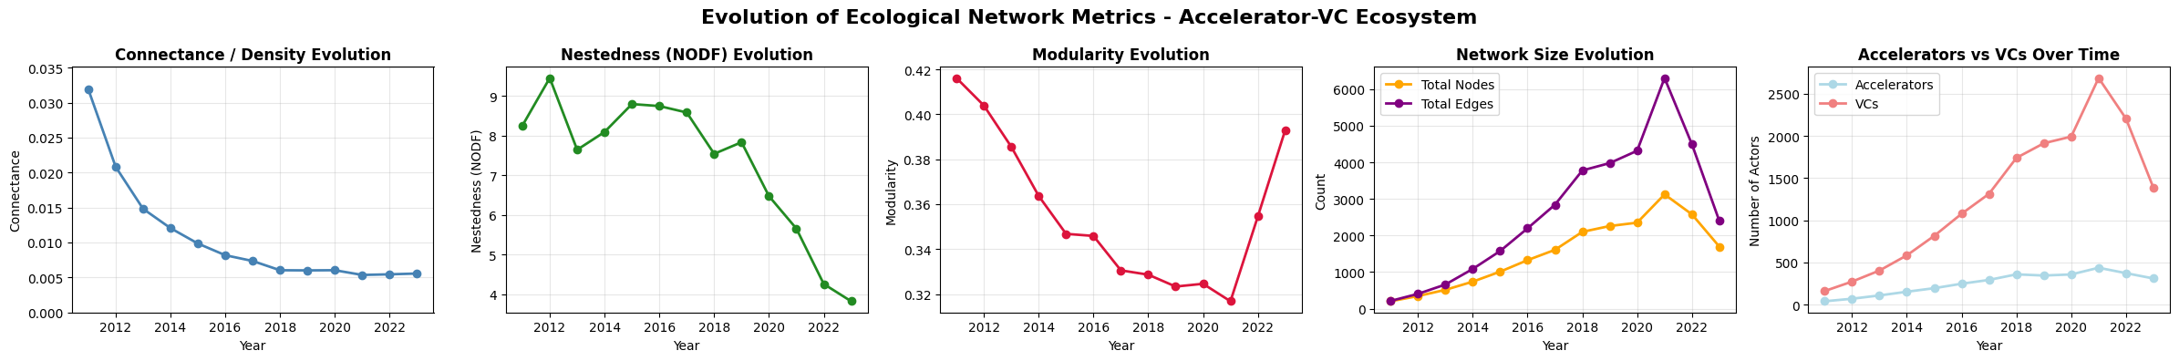
ACC-VC - Snapshots
Notes:
Connectance decreasing in both US and France, but overral values in France are at least 5 times greater than US
Nestedness decreasing in both US and France, France from 20 to 10 (half) in 8 years, US from 9 to 4 (half) in same period
Modularity in U format, decreasing in France until 2017, then increasing, and in US dreseasing until 2021 then increasing. Interesting that modularity have similar amplitudes in both countries (0.4 to 0.3)
Network nodes and edges were increasing until 2021, then decreasing, for both US and France, but US is way bigger (6000 edges and 3000 nodes in the highest volume year in US vs. 250 egdes and 200 nodes in france
Number of ACCs and VCs increasing until 2021, then decreasing. Quantities equamy different in countries

Slide 10
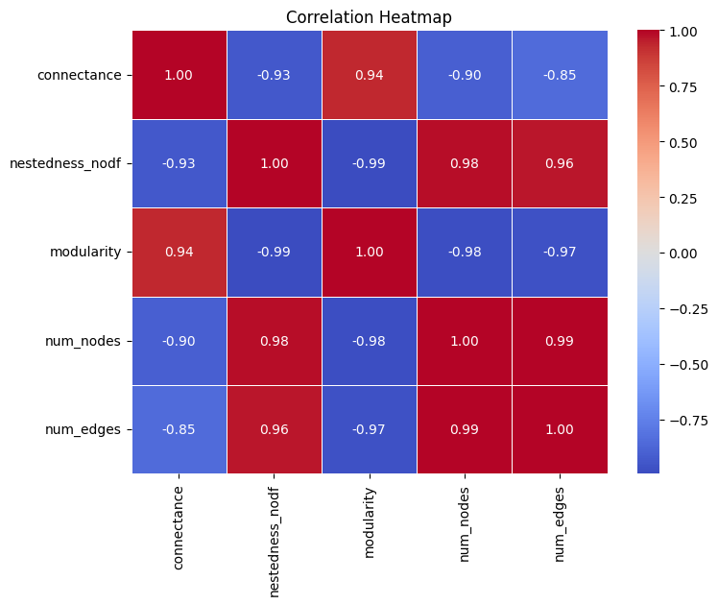
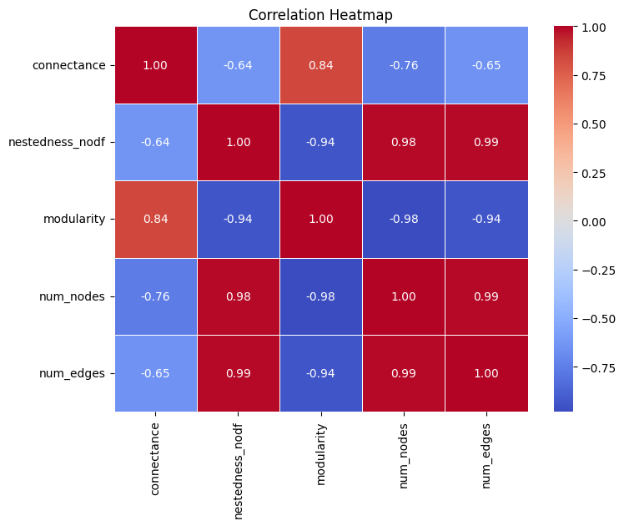
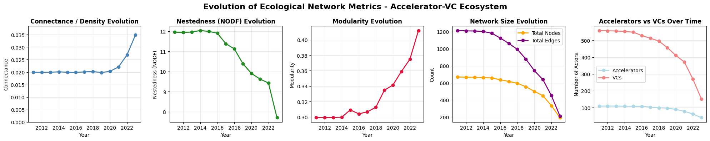
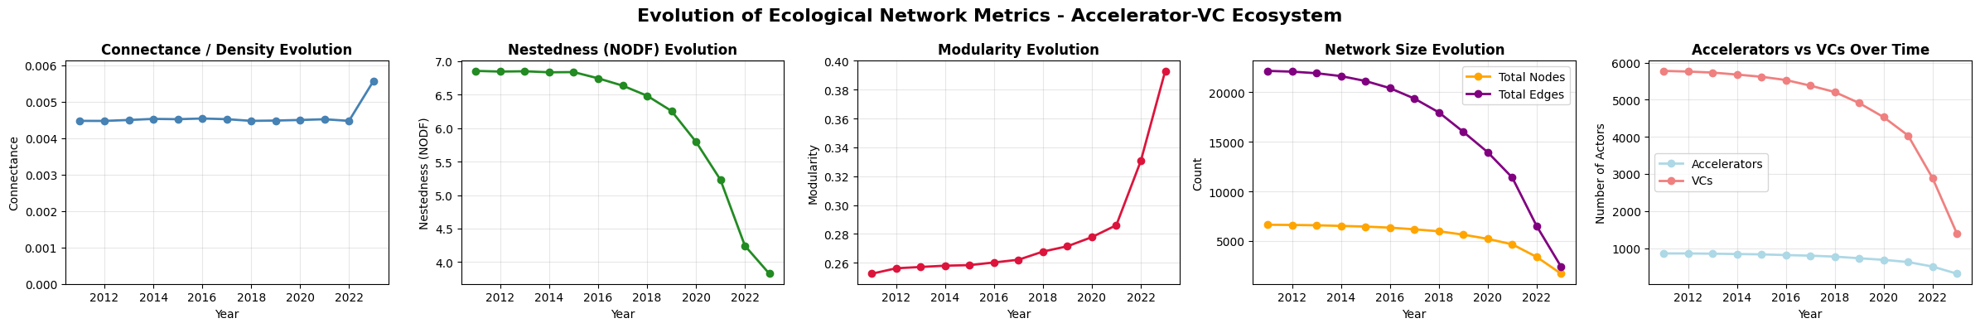
ACC-VC – Time Window (5 years)
Notes:
Stable connectance over year in both countries, then it starts incresing from 2020 on. France is at least 4 or 5 times more connected (0.02 to 0.03 in France vc 0.0045 to 0.0055 in US)
Nestedness decreasing in both countries, in France from 12 to 8, in US frol 7 to 4
Modularity increasing in both countries in similar order of values (0.25 to 0.4)
Network size decreasing in both countries, as well as number of ACCs and VCs

Slide 11
ACC-VC – Fully Aggregated
Nodes: 744 (117 acc + 627 VCs)
Edges: 1352
Density: 0.018
Components: 12
Connectance: 0.018
Nestedness (NODF): 11.0
Modularity: 0.302
Nodes: 6936 (889 acc + 6047 VCs)
Edges: 23295
Density: 0.004
Components: 35
Connectance: 0.004
Nestedness (NODF): 6.6
Modularity: 0.246

Slide 12
Results – VC-VC Network

Slide 13
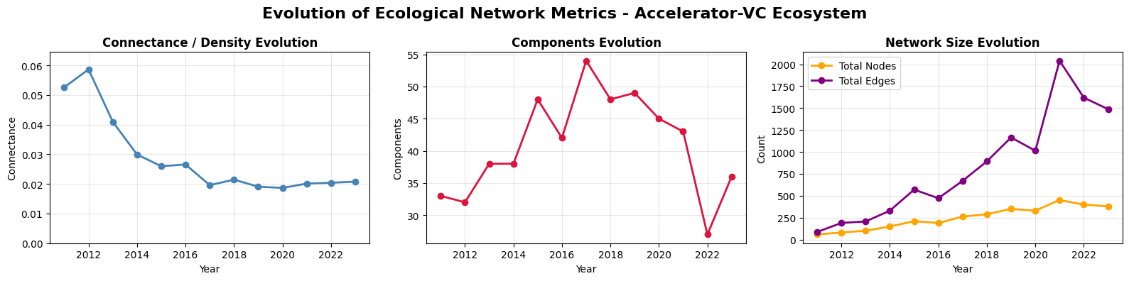
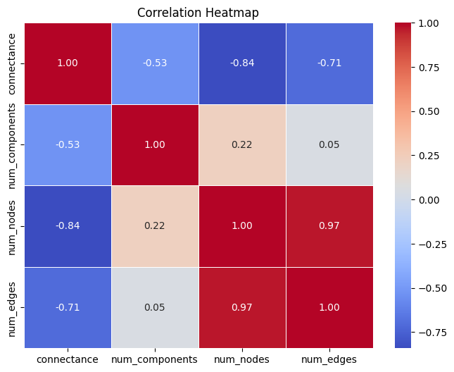
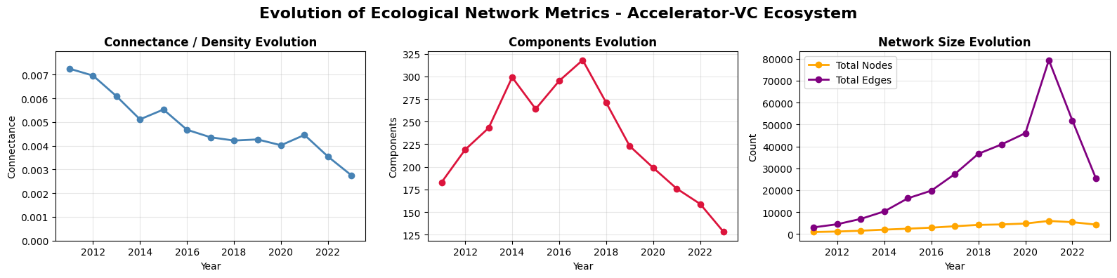
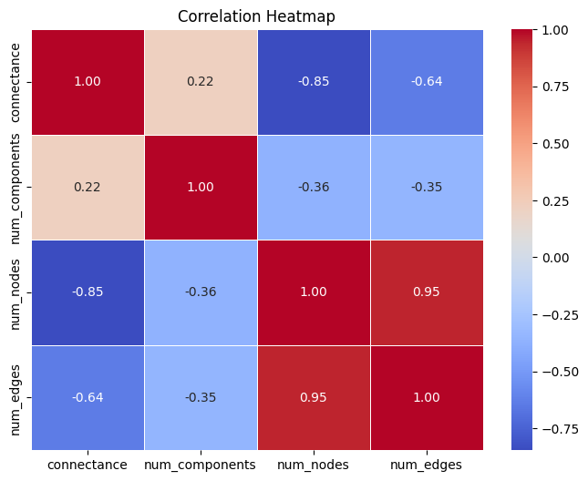
VC-VC - Snapshots

Slide 14
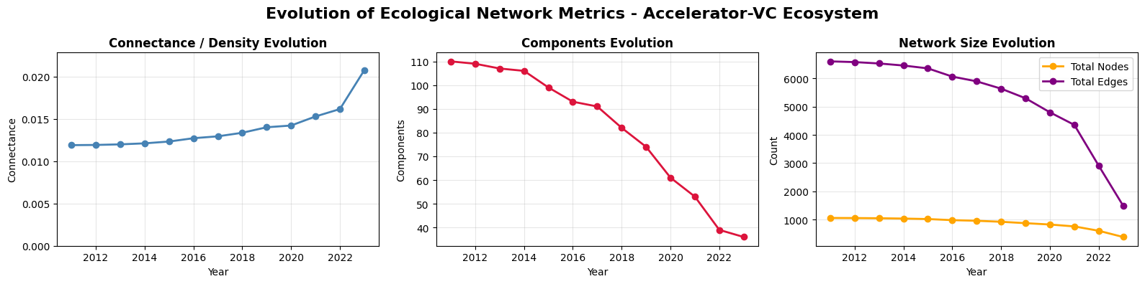
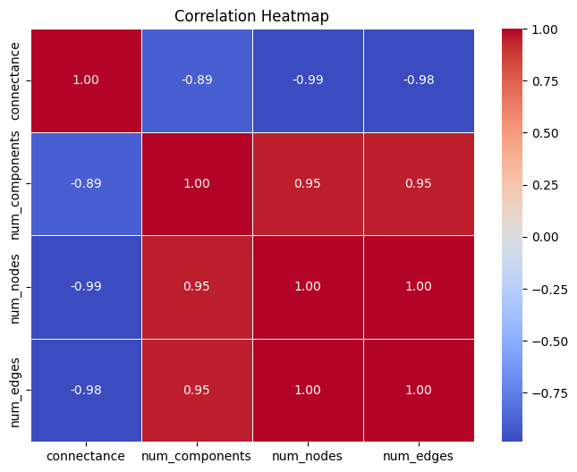
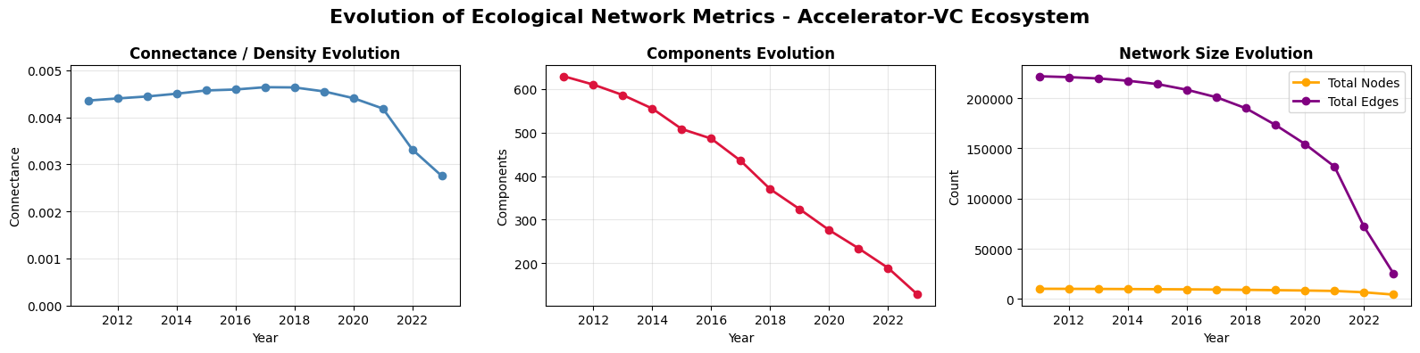
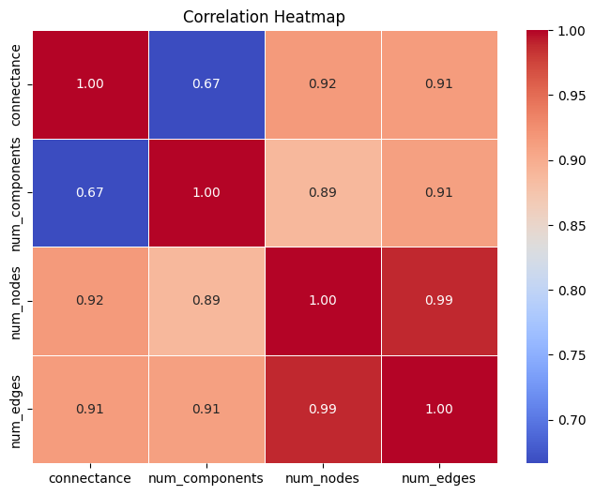
VC-VC – Time Window (5 years)

Slide 15
VC-VC – Fully Aggregated
Unique VCs: 1,180
Partnership edges: 7,360
Connected components: 125
Density: 0.0105
Unique VCs: 11,095
Partnership edges: 238,737
Connected components: 750
Density: 0.0038

Slide 16
ACC-VC x VC-VC Networks
Notes:
Modularity in ACC-VC between countries is similar, but in VC-VC this is not true, US is more modular (separate cluster) than France in this network

